Slide 1


QXF requirements relevant to optimization and selection of conductor and cable parameters
GianLuca Sabbi, Ezio Todesco
Internal review of conductor for HL-LHC IR Quadrupoles
October 16, 2013

Slide 2
Acknowledgement
Information for this talk was derived by design, fabrication, test and analysis
results from many colleagues
CERN:
  H. Bajas, M. Bajko, L. Bottura, R. DeMaria, S. Fartoukh, P. Ferracin, M. Juchno
BNL
  M. Anerella, A. Ghosh, J. Schmalzle, P. Wanderer
FNAL
  G. Ambrosio, R. Bossert, G. Chlachidze, J. DiMarco, M. Yu
INFN/LASA
  G. Manfreda, V. Marinozzi, M. Sorbi
LBNL:
  F. Borgnolutti, D. Dietderich, A. Godeke, H. Felice, M. Martchevsky, X. Wang
SLAC
  Y. Cai, Y. Nosochkov

Slide 3
Introduction
Formal requirements for the IR quadrupole performance and each of the sub-components will be established through the HiLumi design study, with support from model magnet R&D (esp. HQ/LHQ) and the first results from QXF models (depending on target dates for TDR vs. QXF test schedule)
At this stage, we have a good degree of understanding of performance goals, key priorities, constraints and trade-offs
  Purpose of this presentation is to review the impact of these factors on the conductor/cable design choices, provide guidelines for optimization and specifications, and formulate some questions for discussion
Feedback from this meeting and future ones covering individual areas of the QXF design (mechanics, quench protection etc.) will be used to determine if present QXF targets should be maintained, or if changes are necessary to reach an optimal and balanced performance

Slide 4
Magnetic Performance
Target operating condition is 140 T/m in 150 mm aperture (1.9 K)
  Chosen maximum (practical) cable width to help reach high field
Nevertheless, with current assumptions, design cannot meet target operational point at 80% on the load line (we are at 82%)
  In addition, some of the assumptions made seem too optimistic
Higher critical current density at high field would be very beneficial to:
  Restore 80% operating point on the load line; account for degradation during coil fabrication, assembly, pre-load and excitation; allow an increase of Cu/non-Cu fraction for quench protection
Mains parameters of the QXF_v1 magnet
 | unit | Real iron yoke
% of Iss | % | 100 | 82
Current | kA | 21.25 | 17.46
Gradient | T/m | 168 | 140
Peak field | T | 14.51 | 12.06
F. Borgnolutti et al,
MT23

Slide 5
Magnetic performance assumptions
Critical current density assumed for calculations:
  2450 A/mm² at 12 T, 1400 A/mm² at 15 T (4.2 K)
  3100 A/mm² at 12 T, 1900 A/mm² at 15 T (1.9 K)
Can this be increased? (do not focus on contractual issues relevant to the specification for procurement, but rather on technical expectations for different design choices)
1.2 Cu/non-Cu ratio. This parameter could be adjusted to redistribute margins (if available) on magnetic performance or quench protection
5% degradation (attributed to cabling, no additional degradation during coil fabrication, pre-load and excitation)

Slide 6
Specs and Parameterizations (A. Godeke)
https://plone.uslarp.org/MagnetRD/DesignStudies/QX-CD/ShortSample/LARP-MQXF-Wire-Specification_and_Short-Sample-Limit-130625.xlsm

Slide 7
Mechanical Performance
QXF mechanical design is very challenging: another step in aperture and field
  Chosen maximum practical cable width to help decrease coil stresses
Design target: pole compression up to 155 T/m (10% above nominal)
  Coil (pole) stress is 100 MPa during loading (warm) and 180 MPa cold: this should be compared with respective limits for permanent degradation
  Mid-plane stress at excitation is ~150 MPa: this should be compared with limit for reversible degradation (taking into account the available margin)
Preload window is very narrow (or closed):
  Need sufficient pre-load to satisfy acceptance criteria (provisionally, 4 quenches to nominal, 10 quenches to 10% above nominal (155 T/m)
  But stress levels are already in the range where we expect conductor degradation possibly preventing to reach 10% above nominal
Higher critical current would increase pre-load margin, this can come in some combination of high J_{c} and low degradation in particular under transverse stress
If sufficient margins cannot be obtained, we may be forced to decrease the operating gradient, in this case coil stresses can quickly improve

Slide 8
Mechanical design parameters
 |  | Reference |  | Optimization
Keypole | mat | Ti | Al | Ti | G10
Coil | σ_{eqv} (b) | 102 | 111 | 96 | 102
 | σ_{eqv} (k) | 67 | 71 | 70 | 75
 | σ_{eqv} (v) | 82 | 88 | 85 | 90
 | σ_{eqv} (c) | 165 | 179 | 174 | 185
 | σ_{eqv} (g) | 162⁽¹⁾ | 171⁽¹⁾ | 150⁽¹⁾, 133⁽²⁾ | 160⁽¹⁾, 144⁽²⁾
Iron | σ_{eqv} (b) | 181 | 190 | 180 | 188
 | σ_{eqv} (k) | 195 | 194 | 168 | 171
 | σ_{eqv} (v) | 216 | 214 | 190 | 184
 | σ_{I} (c) | 217 | 211 | 185 | 180
 | σ_{I} (g) | 230⁽¹⁾ | 227⁽¹⁾ | 199⁽¹⁾, 197⁽²⁾ | 196⁽¹⁾ ,193⁽²⁾
p_{blad} (gap) |  | 42 (755, 773) | 42 (765,784um) | 40 (683,705um) | 40 (685,706um)
P_{cont} |  | -2,-10⁽¹⁾ | -10, -17⁽¹⁾ | -5, -6⁽¹⁾ -27, -20⁽²⁾ | -12, -12⁽¹⁾ -35, -27⁽²⁾
(1)=(90% I_{ss}, (2)=80% I_{ss}
Mariusz Juchno, CM20
Analysis steps: (b)ladder, (k)ey, (v)essel welding, (c)ooldown, (g)radient

Slide 9
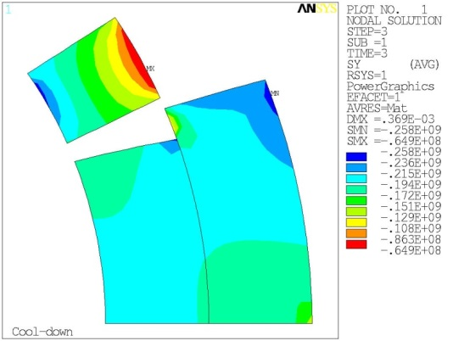
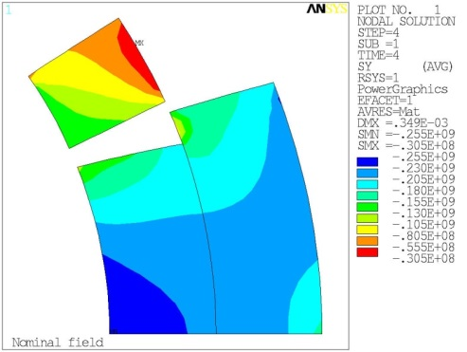
Preload windows in TQS03
As pre-load is increased, training is decreased/eliminated, but max gradient decreases
TQS03a: 120 MPa pole/ave, 156 MPa peak (pre-load), 153 MPa excitation: 93% SSL
TQS03b: 160 MPa pole/ave, 208 MPa peak (pre-load), 204 MPa excitation: 91% SSL
TQS03c: 200 MPa pole/ave, 260 MPa peak (pre-load), 255 MPa excitation: 88% SSL
TQS03c
Analysis
(H. Felice,
P. Ferracin)
260 MPa
@ 4.5K, 0A
TQS03 training
(M. Bajko et al.)
255 MPa
@ 4.5K, SSL

Slide 10
Preload windows in HQ01
HQ01d: pole quenches and strain gauge data indicate insufficient pre-load, mid-plane quenches indicate excessive pre-load
Asymmetric shims in HQ01e: more uniformity, improved training without degradation
Continue and refine these studies in HQ02/03
M. Martchevsky, P. Ferracin, H. Felice

Slide 11
Field quality and dynamic effects
At nominal gradient:
Most critical to machine performance. Main challenge is the control of non allowed harmonics, requiring uniformity of coil geometry and properties
This requires uniform size/properties for strand and cable (and insulation)
During ramp:
HQ has demonstrated good control of eddy currents effects using a core with partial (60%) coverage
Flux-jump effects observed at 4.5 K, need to better understand and cure, but effect is much less pronounced at 1.9 K
At injection:
Expectations for QXF, based on models validated in HQ, are consistent with our target of 20 units at injection for 108/127 and higher stacks
Weak dependence on effective filament size
Smaller filaments also help to decrease variability in magnetization
Effective methods to control magnetization harmonics are available

Slide 12
Field quality targets

Slide 13
Fabrication tolerances and random errors
Simulation of random errors due to coil fabrication tolerances fits HQ01 measured harmonics (n=3 to 7) for a block positioning error of 30 µm
Flat dependance for n>7 attributed to limited probe sensitivity
HQ02 analysis underway
J. DiMarco
X. Wang

Slide 14
Non-allowed harmonics in HQ
Some of the sextupole and octupole components are at the upper limits or beyond the range of variability expected from random error analysis
Both in HQ01 and HQ02, although largest errors are in different harmonics
Longitudinal scan shows smooth dependence, possibly an end effect
HQ03 will provide a much more relevant benchmark, with uniform cable, parts and coil fabrication processes
X. Wang

Slide 15
Persistent current harmonics in HQ
Validation of analysis method using HQ01 (54/61+108/127) and HQ02
HQ01 magnetization harmonics
Magnetization data (OSU)
Skew sextupole,
HQ01 vs HQ02
HQ02 magnetization harmonics
X. Wang

Slide 16
Sub-element size as a function of stack

Slide 17
Persistent current harmonics in QXF
Second up-ramp data
 | TF | b₆ | b₁₀ | b₁₄ | b₁₈
 | T/m/kA | Unit at R_{ref} = 50 mm
108/127 | -0.0368 | -19.3 | 4.9 | -0.8 | 0.0
144/169 | -0.0330 | -16.4 | 4.2 | -0.7 | 0.0
 | 90% | 85% | 86% | 86% | 187%
108/127 | -0.0683 | -32.3 | 3.7 | -0.8 | -0.0
144/169 | -0.0592 | -27.7 | 3.2 | -0.7 | -0.0
 | 87% | 86% | 87% | 87% | 85%
108/127 | -0.0021 | -1.3 | 0.0 | -0.0 | 0.0
144/169 | -0.0018 | -1.1 | 0.0 | -0.0 | 0.0
 | 87% | 87% | 86% | 87% | 87%
1 kA, ~ injection
1.5 kA, negative peak
17.3 kA, nominal level
X. Wang
Given the same J_{c}, harmonics due to magnetization reduce by ~ 14%, consistent with the sub-element size reduction

Slide 18
Quench protection
Protection of QXF is very challenging. We need to improve our understanding of the limits, and explore all possible routes to mitigate this problem
Chosen wide cable to help protection (spread the energy on more material)
  - further increase not practical (cable design, overall size/fringe field)
Limited improvements from individual factor/component, so we will need to combine them in order to obtain a meaningful gain
  - Heater design, enhanced quench-back, detection algorithms...
If sufficient gains are not obtained, we may be forced to decrease the operating gradient, in this case protection margins can quickly improve
From the conductor standpoint, there are two main areas of interest:
Increase of Cu/non-Cu ratio. The “practical” range is limited and in this range we have a relatively small effect, but it can contribute to the solution
Suppress flux jumps that can make quench detection more challenging, possibly requiring higher thresholds and/or longer validation times

Slide 19
Impact of Cu/non-Cu ratio
  Increasing Cu/non-Cu from 1.2 to 1.5 requires 12% more Jc to maintain operating point at 80% of the load line (or we lose 3% on the load line)
  The hot spot temperature decreases by 30 K and the reaction time increases by 3.5 ms
  For comparison, improvement is similar to lowering the gradient by 5 T/m

Slide 20
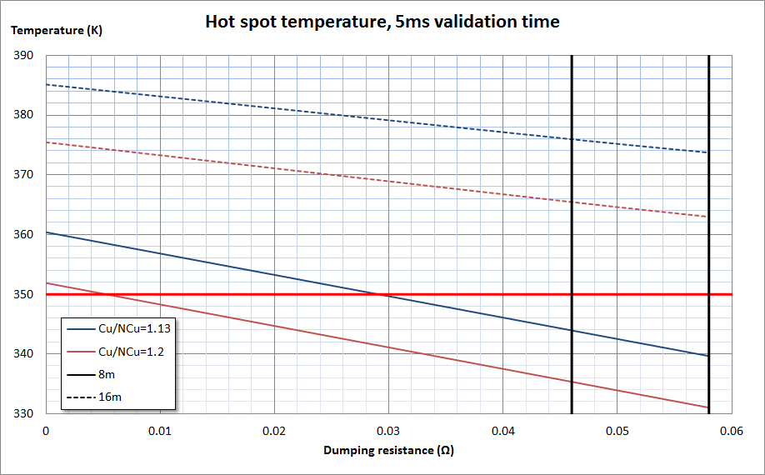
Hot spot temperature vs. Cu/non-Cu ratio
V. Marinozzi, QXF meeting presentation 5/22/2013

Slide 21
Stability margins
Sufficient stability is an essential pre-condition for achieving operating conditions
  Design choices for strand and cable need to ensure stable operation and adequate margins
As a general guideline in LARP we have required a factor of 2 margin from operating current to stability current (I_{s})
  We have discussed increasing it to a factor of 3 for QXF. Is this required? What are the trade-offs with respect to other performance parameters, depending on strand/cable design?
QXF strand diameter was not increased proportionally to cable width in part due to stability considerations
  This could change based on assessment of stability margin for larger diameter strands of various designs, but at this point we would also need to demonstrate strong benefits to justify its impact on schedule

Slide 22
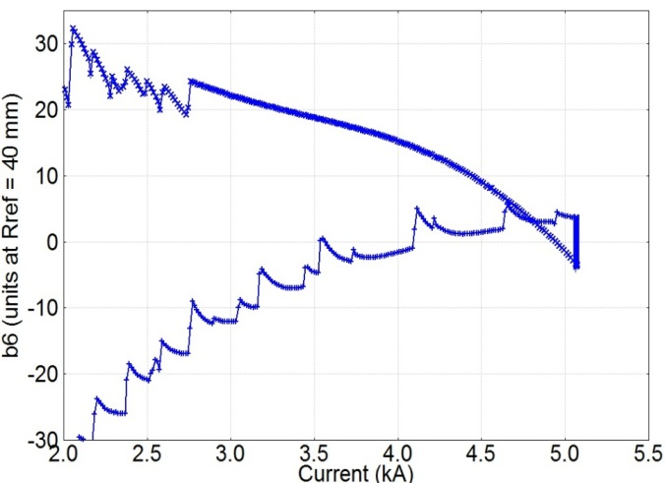
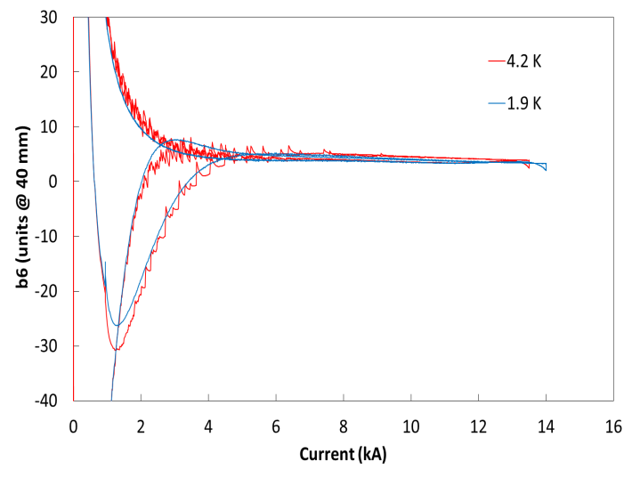
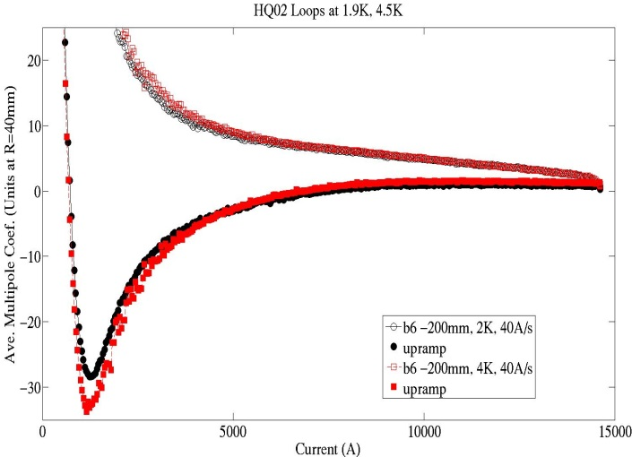
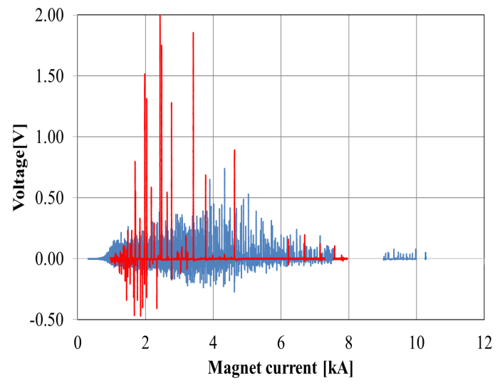
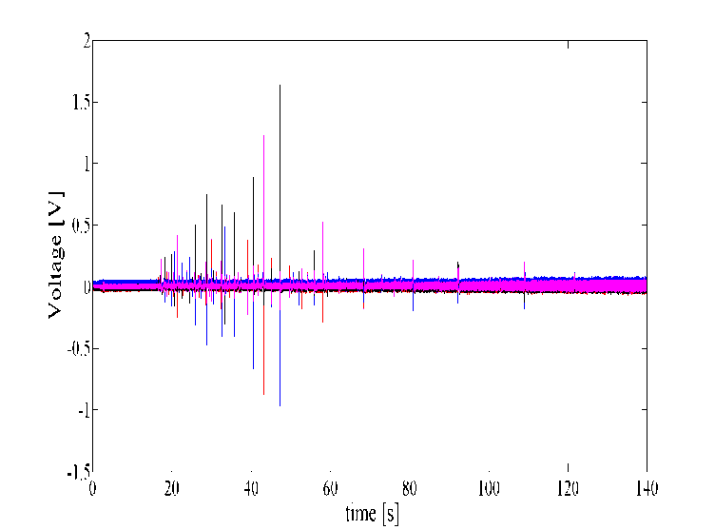
Flux-jump effects
At 4.5K, HQ02a @FNAL has much smaller spikes than HQ01@LBNL, CERN
Significant decrease from 4.5K to 1.9K (observed both at CERN and FNAL)
HQ02@FNAL,
J. DiMarco
HQ01@LBNL,
X. Wang
HQ01@CERN,
H. Bajas
Smaller amplitude and higher frequency at 1.9K
FJ amplitude not much larger for 54/61 then 108/127
HQ01@CERN,
H. Bajas
HQ01@CERN,
H. Bajas

Slide 23
Cable design considerations
Wide cable is required from magnetic, mechanical and quench protection considerations
The strand diameter was not increased proportionally mainly due to stability considerations, leading to higher aspect ratio
  For review: assess based on benefits to cable performance, stability margin for larger diameter strands of various designs, keeping in mind impact on schedule (see QXF plan presentation)
Low degradation/damage is required by magnetic, mechanical and stability considerations
Cable mechanical stability has been given a lower priority, as long as it can be mitigated by improved winding techniques and end part design
HQ02 demonstrated the benefits of the core in suppressing eddy current harmonics and ramp rate dependence, but core size/location for QXF needs to be further optimized

Slide 24
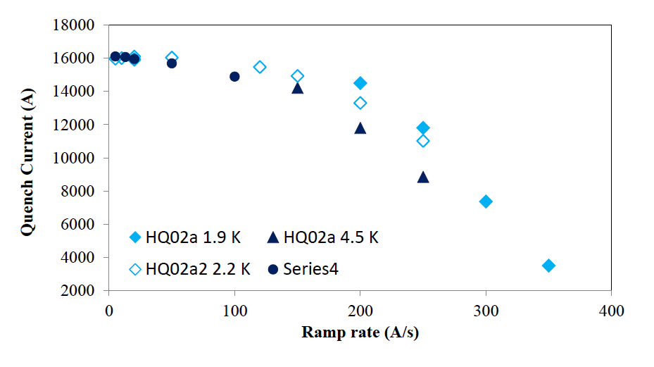
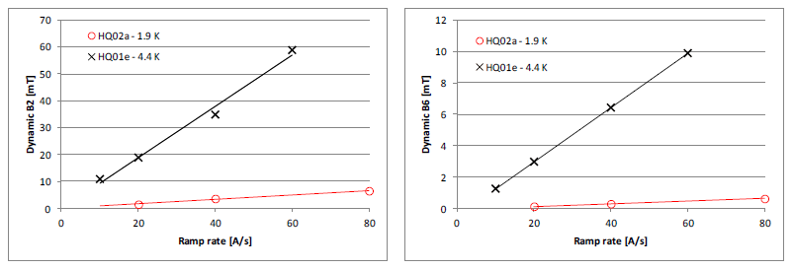
Control of dynamic effects with core
HQ01
HQ02
M. Martchevsky,
G. Chlachidze,
J. DiMarco,
X. Wang

Slide 25
Core size and position optimization
Issue | Implications on core design
Cable mechanical stability | No core or core biased to thick edge
Dynamic field quality | Partial core
Fast down-ramp | Wide core (high R_{c})
Quench back (driven by losses) | Narrow or no core (low R_{c})
Stability (current sharing among cable layers) | Narrow or no core (low R_{c})
Quench propagation velocity | TBD
Core in both layers
Core in inner layer only
X. Wang

Slide 26
Production issues
Piece length:
At this stage, we don’t need to discuss the contractual issues related to negotiating a minimum piece length
Rather, focus on our analysis/understanding of the distributions that manufacturers will be able to achieve and how the design or future process optimization can influence them
Establish a reasonable target for wire losses due to piece length. Example: For <10% loss we need typical piece lengths of ~5 times with respect to what is needed for one cable UL
  Cable length for Q1/Q3: 430 m + 50 m to account for various factors
  Cable length for Q2a/b 710 m + 60 m to account for various factors
With the above assumptions, need “typical” pieces of 2-2.5 km for Q1/Q3 and 3.5-4 km for Q2
Uniformity of conductor properties:
This will be key to field quality. Past history has shown slow improvements and periodic deteriorations. Need consistent production and detailed QA.

Slide 27
Summary
Higher GxA is the main reason we seek to use Nb3Sn in HL-LHC IR
QXF performance targets present considerable challenges from the magnetic, mechanical and quench protection standpoint
Improvements in conductor and cable performance can help to mitigate some of these challenges
  Increase of critical current density at high field will benefit magnetic, mechanical and quench protection design
  Increase the Cu/Sc ratio would give some benefit on quench protection, but requires that sufficient margin on the load line is available
  Persistent current harmonics are acceptable and differences are small in the practical range of effective filament size being considered
Impact of a modest variation of the effective filament diameter on magnetization and field quality, the size of FJ stability thresholds, stability and quench validation windows should be assessed as part of this review
Uniformity of strand/cable properties will be critical

