Slide 1

Past and Present
Manufacture and Performance of
PIT and RRP®132/169
Hi-Lumi LHC/LARP Conductor and Cable Internal Review
A. Ballarino, CERN
A. Ballarino, L. Oberli, B. Bordini, D. Richter and L. Bottura

Slide 2
Conductor specification and procurement
Double sourcing
  Procurement of PIT and RRP® Nb₃Sn wire
→ Qualification of PIT and RRP® Nb₃Sn wire
→ Development and qualification of PIT and RRP® cables
FRESCA 2. Diameter of strand =1 mm. Procurement started in Marc 2010 it will be completed in Dec 2013
(∼ 170 km tot)
11 T Dipole. Diameter of strand =0.7 mm. Procurement started in May 2010
MQXF Quadrupole. Diameter of strand =0.85 mm
Procurement started in August 2012

Slide 3
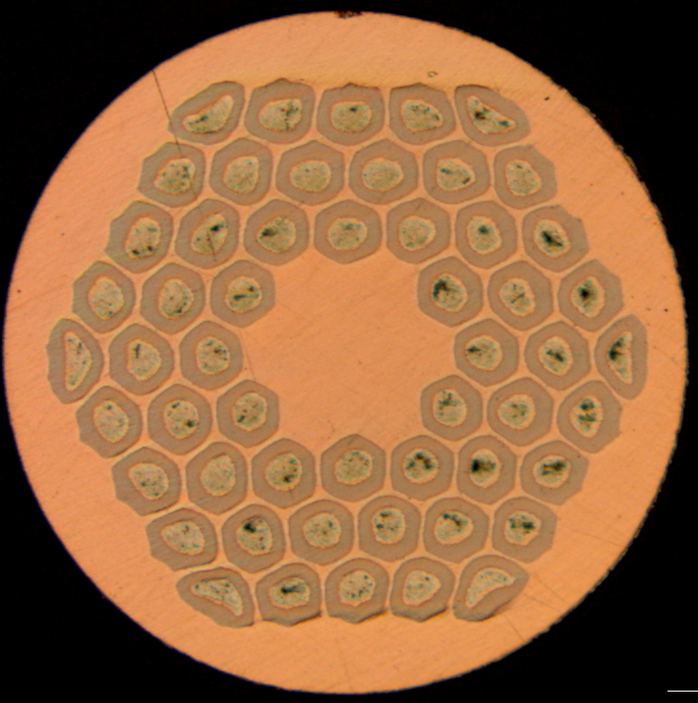
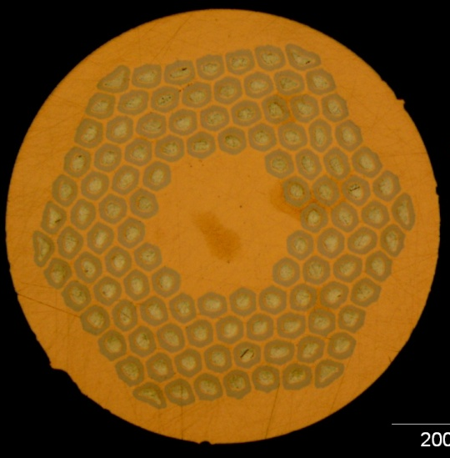
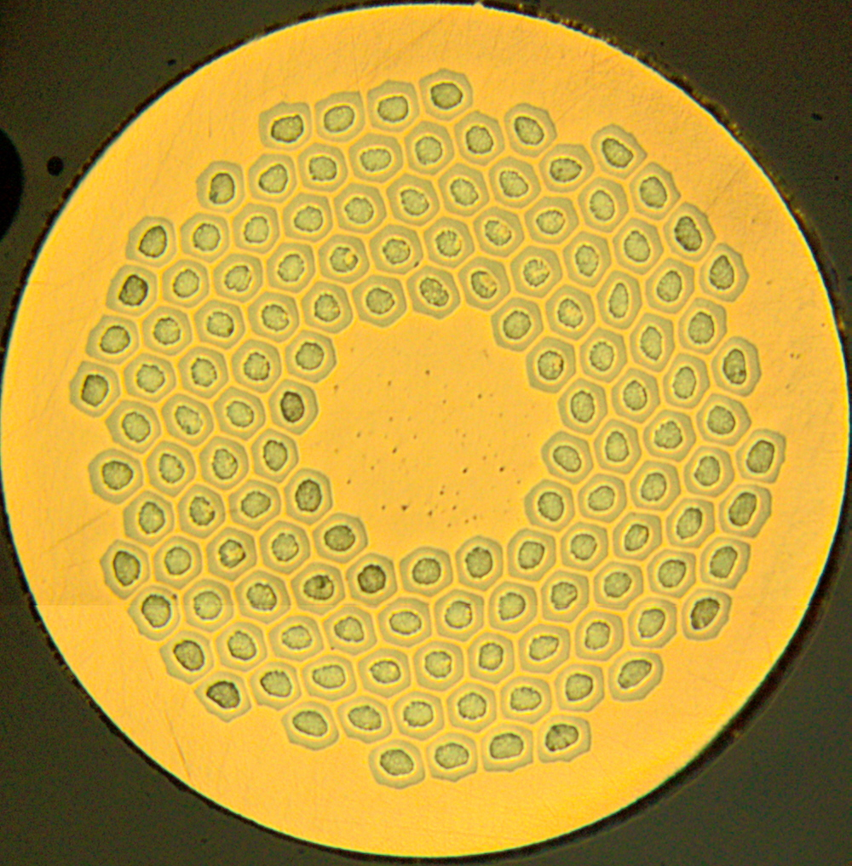
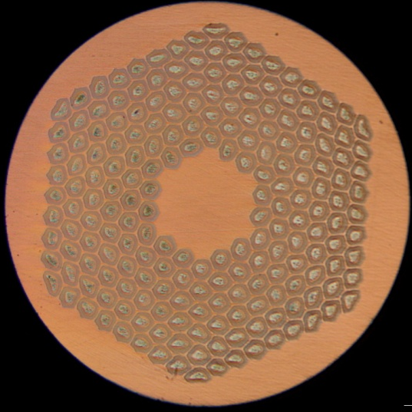
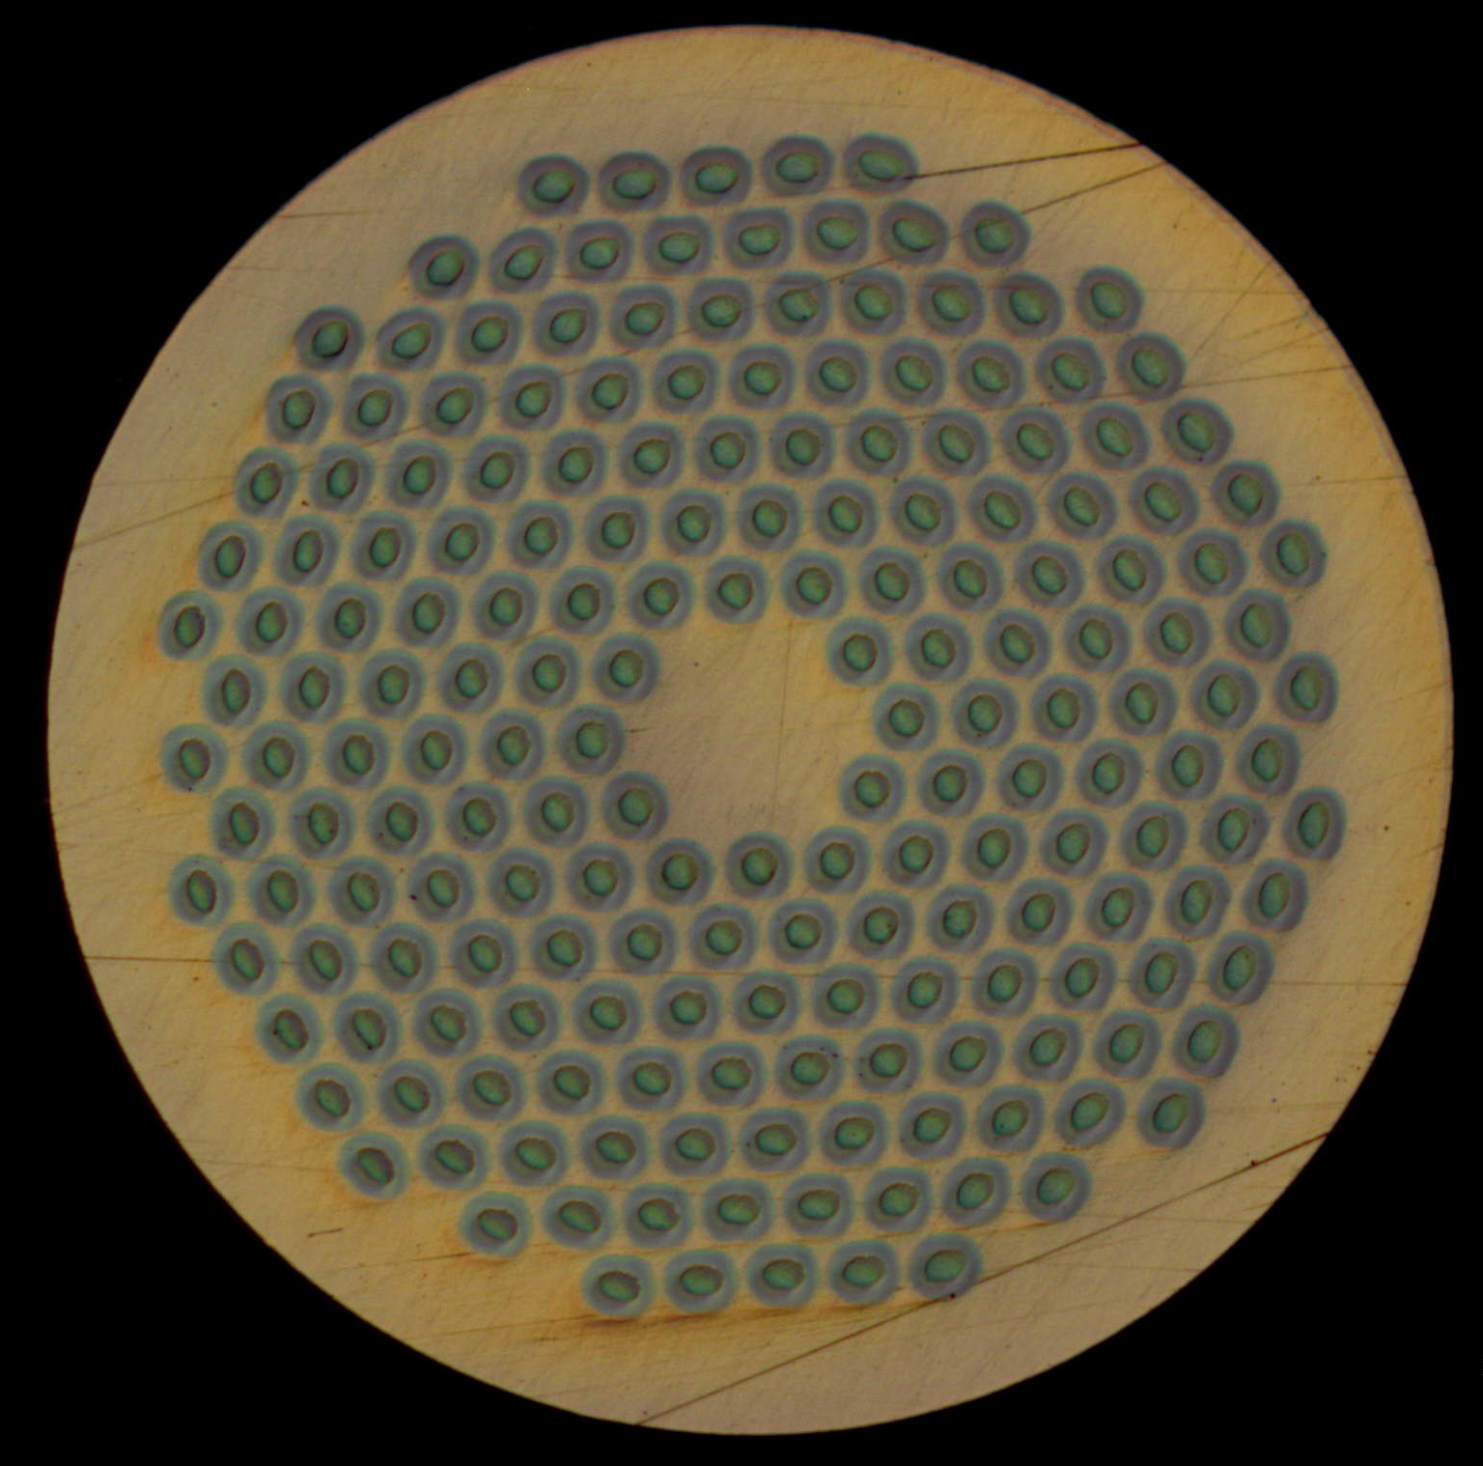
Conductor procured for CERN projects
 | Sub-element size (μm)
 | Wire Φ (mm) | RRP® 108/127 | RRP® 132/169 | RRP® 192/217 | PIT 114 | PIT 192
FRESCA 2* | 1 | - | 58 | - | - | 48
Hi-Lumi Quad | 0.85 | - | 48 | - | - | 41
11 T | 0.7 | 46 | 41 | 32 | 44 | -
Smaller sub-element size
RRP
PIT
54/61
108/127
132/169
198/217
114
192
*Fresca 2 conductor: procurement by CERN and CEA – FP7 European Project

Slide 4
Conductor procured: RRP 132/169 and PIT
 | Quantity Procured (km)
 | Wire Φ (mm) | RRP® 132/169 | PIT 114 | PIT 192
FRESCA 2 | 1 | 10+15+18+45 | - | 1+9+15+15+45
Hi-Lumi Quad | 0.85 | 5 + 35 | - | 5 + 35
11 T | 0.7 | 30 + 150 | 3 + 22.4*+ 50 | -
* Additional length of 12.2 km of PIT 192, 0.778 mm diameter, procured by CERN for LARP – shipped by CERN to LBNL in June 2013
Delivered
In production at OST - on track (38 km Febr. 2014, total quantity by Aug. 2014)
In production at Bruker – on track. Conductor to be delivered in 2013
In production - on track (delivery completed in first trimester 2014)

Slide 5
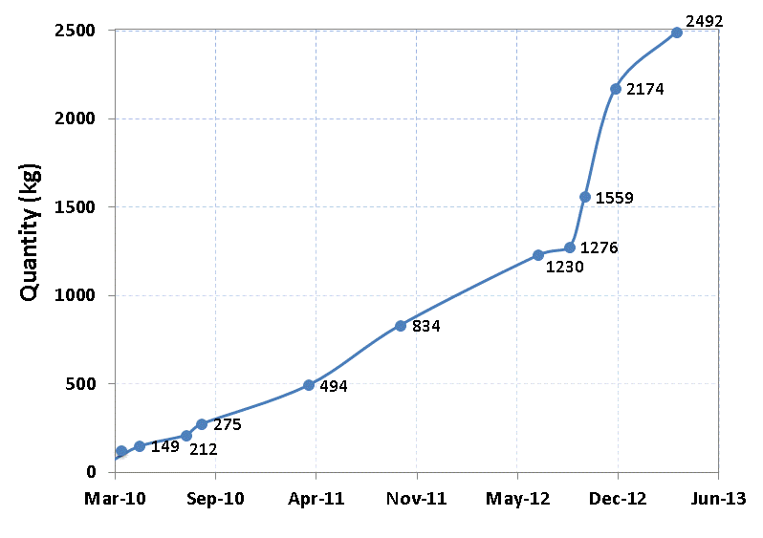
Quantity of Nb₃Sn conductor procured
Fresca 2
11 T
Hi-Lumi Quadrupole
PIT (43 %) and RRP® (57 %)
1.29 tons RRP® 132/169

Slide 6
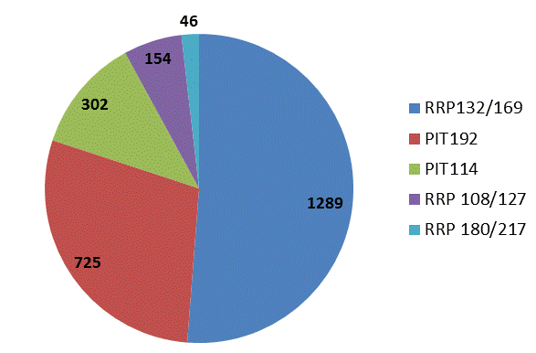
Quantity of Nb₃Sn conductor procured
2.5 tons

Slide 7
RRP 132/169, PIT 114 and PIT 192
 |  | Quantity Procured (km)
 | Wire Φ (mm) | RRP® 132/169 | PIT 114 | PIT 192
FRESCA 2 | 1 | 10+15+18+45 | - | 1+9+15+15+45
Hi-Lumi Quad | 0.85 | 5 + 35 | - | 5 + 35
11 T | 0.7 | 30 + 150 | 3 + 22.4*+ 50 | -
Total length |  | 308 | 75.4 | 125

Slide 8
Specification – Procured conductor
 |  | FRESCA 2 | 11 T Dipole | Hi-Lumi Quadrupole
Wire Φ | mm | 1 ± 0.003 | 0.7 ± 0.003 | 0.85 ± 0.003
Sub-element Φ | μm | < 50 | < 45 | < 50
Cu/non-Cu |  | 1.25 ± 0.1 | 1.15 ± 0.1 | 1.1 ± 0.1
Twist pitch | mm | 24 ± 2 | 14 ± 2 | 19 ± 2
Ic(4.2 K) | A | > 873 @12 T | > 438 @ 12 T | > 361 A @ 15 T
Jc(4.2 K) | A/mm² | > 2500 @ 12 T | > 2450 @ 12 T | > 1340 @ 15 T
n-nalue (4.2 K, 15 T) |  | > 15 | > 15 | > 15
RRR |  | > 150 | > 100 | >150
Unit length | m | > 800 | > 700 | > 400
Quantity of conductor procured
45 km
150 km
35 km

Slide 9
Fresca 2 RRP® strand (Φ = 1 mm)
Specified values
RRP 132/169
> 2500 A/mm²
> 150
Billet ID 1.0 mm 132/169 | Jc (4.2 K,15T) A/mm² OST | Jc (4.2 K,12T) A/mm² OST | Jc (4.2 K,12T) A/mm² CERN | RRR CERN
14310 | 1569/1627/1627 | 3020/3047/3026 | 2751/2810/2780 | 296/311/317
14311 | 1698/1624/1627 | 3119/3098/3071 | 2843/2781/2897 | 311/318/304
14312 | 1562/1557/1595 | 2967/2983/3040 | 2738/2739/2799 | 329/335
14108 | 1612/1599/1644 | 3102/3028/3090 | 2749 | 297
14393 | 1609/1641/1655 | 3006/3057/3102 | 2808/2940 | 281/267
14839 | 1540/1579/1599 | 2947/2943/3016 | 2746/2794/2793 | 201/241/218
14840 | 1646/1641/1604 | 3040/3051/3013 | 2743/2833/2800 | 222/250/288
14842 | 1617/1644/1594 | 3025/3058/3026 | 2656/2785/2664 | 222/263/230
Average value | 1613 A/mm² | 3036 A/mm² | 2783 A/mm² | 280
Cu/non Cu values: 1.23 -1.32
50 hours at 650 °C

Slide 10
Fresca 2 RRP® strand (Φ = 1 mm)
RRP 132/169
800 m
80 % of Ltot = 35 km delivered in Uls > 800 m

Slide 11
Hi-Lumi quadrupole RRP® strand (Φ=0.85 mm)
Verificare
RRP 132/169
Specified values
> 1340
> 150
Billet ID 0.85 mm 132/169 | Jc (4.2 K,15T) A/mm² OST | Jc (4.2 K,12T) A/mm² OST | Jc (4.2 K,12T) A/mm² CERN | RRR CERN
14842 | 1512/1498 | 2888/2900 | 2830/2752 | 160/212
14393 | 1440/1451 | 2881/2877 | 2808/2744 2776/2666 | 232/186 201/196
14310 | 1510/1598 | 2966/3023 | 2757/2820 | 210/215
14839 | 1463/1425 | 2842/2835 | 2800 | 189
Average value | 1490 A/mm² | 2900 A/mm² | 2770 A/mm² | 180
Cu/non Cu ratio: 1.21 -1.35
50 hours at 640 °C

Slide 12
11 T Dipole RRP® strand (Φ=0.7 mm)
RRP 132/169
Specified values
> 2450 A/mm²
> 100
Billet ID 0.7 mm 132/169 | Jc (15T) A/mm² OST | Jc (12T) A/mm² OST | Jc (12T) A/mm² CERN | RRR
14799 | 1335/1182/1253 | 2669/2456/2530 | 2490/2380/2490 | 175/159 204
14833 | 1226/1244/1218 | 2540/2575/2485 | 2295/2449/2457 | 97/90/101
14841 | 1314/1300/1267 | 2647/2612/2588 | 2402/2470/24322472 | 134/139 121/117
Average value | 1260 A/mm² | 2567 A/mm² | 2434 A/mm² | 134
Cu/non Cu ratio: 1.17 - 1.33
50 hours at 640 °C

Slide 13
RRP® 132/169
4.2 K, 15 T
RRR
41
48
58
Sub-element geometrical size (μm)

Slide 14
RRP® 132/169
4.2 K, 12 T
41
48
58
Sub-element geometrical size (μm)

Slide 15
Fresca 2 PIT strand (Φ = 1 mm)
PIT 192
Billet ID 1.0 mm | Jc (15T) A/mm² Bruker | Jc (12T) A/mm² CERN | RRR CERN
10503 | 1399 | 2508/2528 | 153/155
11201 | 1410 | 2451/2453/2616 | 160/172/175
10402 | 1353 | 2462/2477/2634 | 103/96/105/135
11302 | 1337 | 2519/2415 | 165
11403 | 1463/1507 | 2512/2507 | 154/173/179/201
23448 | 1403/1433 | 2442/2412 | 225/226/241/201
23258 | 1406/1382 | 2480/2447/24792391/2372/2446 | 159/161/201/209
23728 | 1518/1523 | 2548/2621 | 180/184/154/147
Average values | 1423 A/mm² | 2478 A/mm² | 176
Cu/non Cu ratio: 1.23 - 1.32

Slide 16
Fresca 2 PIT strand (Φ = 1 mm)
800 m

Slide 17
Hi-Lumi quadrupole PIT strand (Φ=0.85 mm)
PIT 192
Production of 5 km
> 1340
> 150
Billet ID 0.85 mm 192 | Jc (4.2 K,15T) A/mm² Bruker | Jc (4.2 K,12T) A/mm² Bruker | RRR Bruker
29992 | 1349/1343 | 2395/2412 | 183/193
26279 | 1521 | 2648 | 230
Average value | 1404 A/mm² | 2485 A/mm² | 205
Standard Sn content
Cu/non Cu ratio: 1.33 - 1.34

Slide 18
RRP® 132/169 and PIT 192
12 T
15 T
Comparable performance at 15 T

Slide 19
RRP® 132/169 and PIT 192
12 T
15 T

Slide 20
Conclusions (1/2)
Main experience at CERN with RRP® 132/169 (∼ 1.3 tons tot) is today based on procurement of conductor for FRESCA 2
A large procurement (150 km) of RRP® 132/169 for the 11 T Dipole has been launched – production on track, deliveries expected from Feb. 2014 until Aug. 2014
Experience with the 5 km production of RRP® 132/169 for the Hi-lumi Quadrupoles indicates that this conductor meets specification in terms of both Jc and RRR. The RRR measured on the 0.85 mm diameter wire with standard, i.e. not reduced, Sn content is above 180

Slide 21
Conclusions (2/2)
The - today limited - experience at CERN with RRP® 192/217 indicates that RRP® 192/217 is still an R&D conductor
In parallel with qualification and procurement of PIT 192, development of Nb₃Sn wires of 0.7 mm diameter with smaller (30 μm) filaments size and high Jc and RRR is being performed in the framework of a CERN/Bruker EAS R&D Contract

