Slide 1

CERN Cabling Experience
FRESCA 2, 11 T Dipole and MQXF
A. Ballarino
Hi-Lumi LHC/LARP Conductor and Cable Internal Review
A. Ballarino, L. Oberli and B. Bordini
17/10/2013

Slide 2
Outline
Fresca 2 and 11 T cables : short overview of geometry and performance
Status of development of MQXF cable
Development of RRP cable
Development of PIT cables
“First generation” cable
Short term planned activity and conclusions
Cable developed at CERN by L. Oberli and A. Bonasia

Slide 3
Nb₃Sn cabling experience at CERN
Fresca 2 cable: 40 strands
Φ of strand = 1 mm
RRP® 132/169
PIT 192
11 T Dipole cable 40 strands
Φ of strand = 0.7 mm
RRP® 54/61, RRP® 108/127, RRP® 132/169
PIT 114
MQXF Quadrupole 40 strands
Φ of strand = 0.85 mm
RRP® 132/169
PIT 192

Slide 4
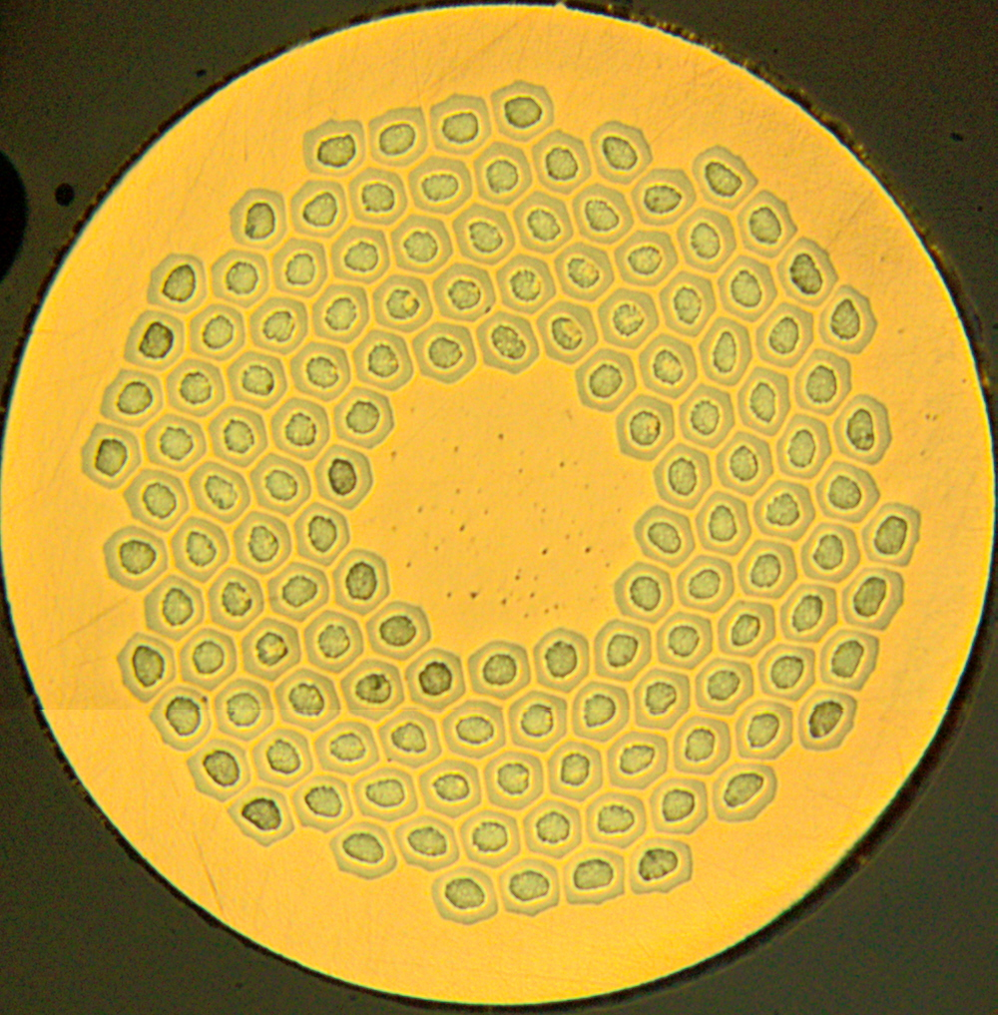
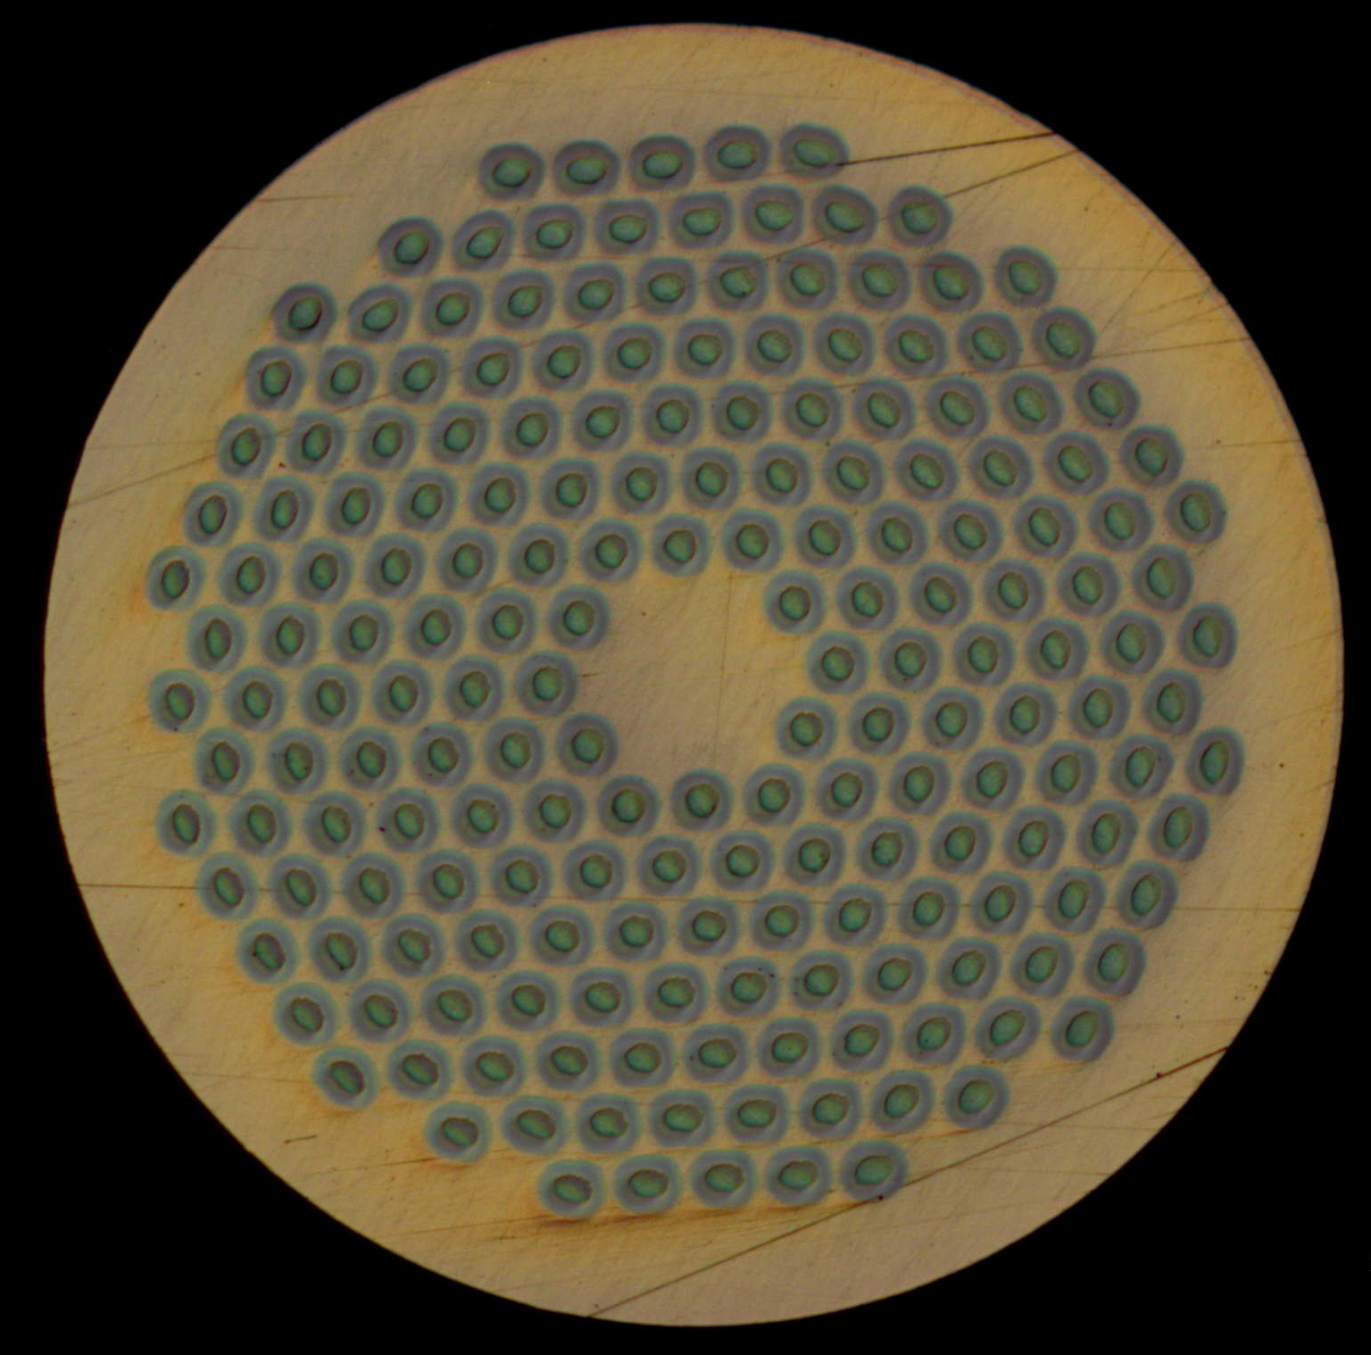
Cable for FRESCA 2
Ic(4.2 K,12 T) | A | 31420
Ic(4.2 K, 15 T) | A | 15170
Iop(1.9 K, Bpeak=13.4 T) | A | 10900 A
n-value(4.2 K, 15 T) | - | > 20
RRR | - | > 100
RRP 132/169
PIT 192

Slide 5
Cable for FRESCA 2
Strand diameter | mm | 1
Number of strands | - | 40
Cable width | mm | 20.9
Cable mid thickness (50 MPa) | mm | 1.82
Keystone angle | deg | 0
Cable transposition pitch | mm | 120
Aspect ratio | - | 11.48
Packing factor | % | 87.4
Unit length | m | 260
Measured Ic degradation < 5.5 % for cables, with same geometry, made
with PIT and RRP strands. Cables mechanically stables
Without core

Slide 6
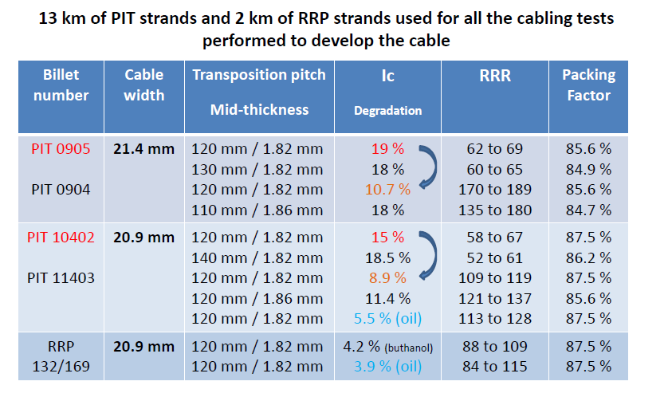
Cable for FRESCA 2
Ic degradation < 5.5 % for cables, with same geometry, made
with PIT 192 or RRP132/169 strands. Cables mechanically stable

Slide 7
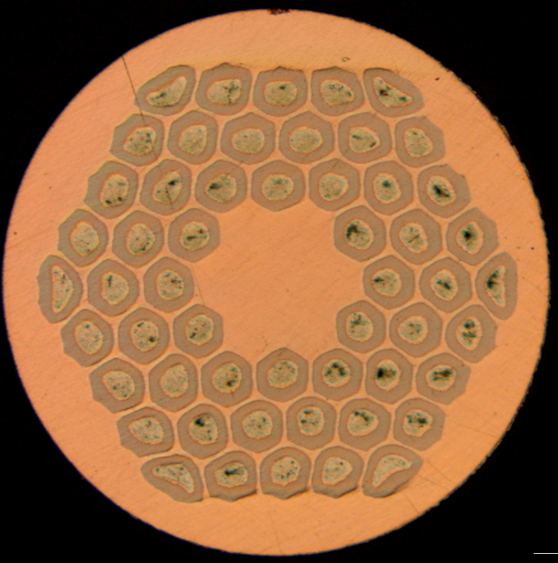
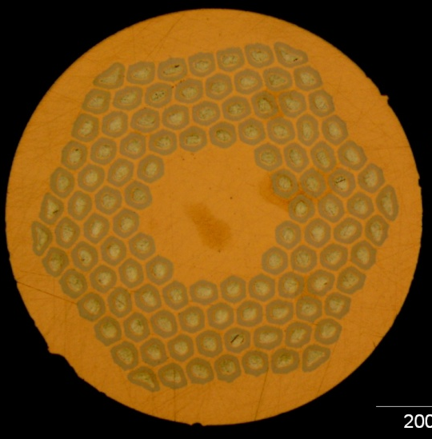

Cable for 11 T dipole
Iop(1.9 K, Bp=11.2 T) | A | 11850
n-value(4.2 K, 15 T) | - | > 20
RRR | - | > 100
RRP 54/61
RRP 108/132
RRP 132/169
PIT 114

Slide 8
Cable development for 11 T dipole
Strand diameter | mm | 1
Number of strands | - | 40
Cable width | mm | 14.7
Cable mid thickness | mm | 1.25
Keystone angle | deg | 0.78
Cable transposition pitch | mm | 100
Aspect ratio | - | 11.76
Thin edge | mm | 1.149
Thick edge | mm | 1.351
t/2d thin edge | % | 82.5
t/2d thick edge | % | 96.5
Packing factor | % | 87.3
With stainless steel (316 L) core - 12 mm width and 25 μm thickness

Slide 9
Cable for 11 T dipole
RRP 108/127 Cables
Cable ID | Run ID | Length | Width | Mid-thickness at 50 MPa | Keystone angle
H15OC0127A | 86A | 237 m | 14.715 mm | 1.2498 mm | 0.78º
H15OC0127B | 86A | 235 m | 14.717 mm | 1.2491 mm | 0.78º
H15OC0137A | 96A | 218 m | 14.706 mm | 1.2499 mm | 0.78º
Three unit lengths produced for the first 3 CERN 11 T Short Model Coils
In the last two months, development started with cables made from PIT 192 and RRP® 132/169 strands:
Degradation < 1.3 % for cables made with RRP® 132/169 strands
Same degradation (< 1.3 %) degradation measured on cables made with PIT 114 strands when keystone angle reduced to 0.61º – mid thickness = 1.263

Slide 10
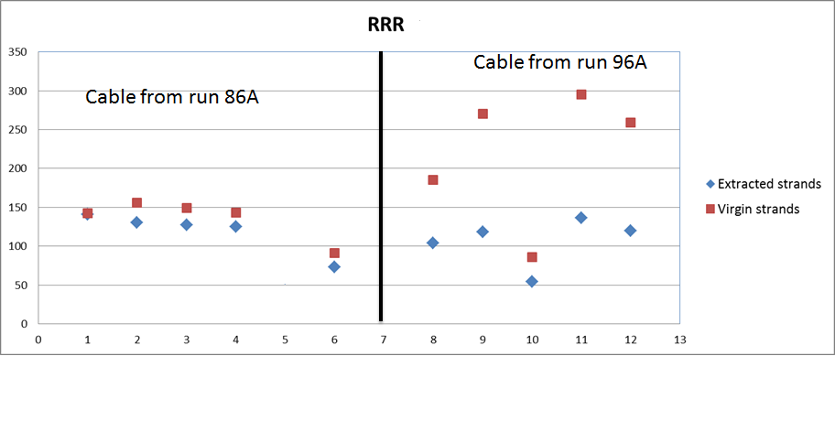
Cable development for 11 T dipole
Degradation of RRR in 11 T cables made from RRP® 198/127 strands
RRP 208/127 Cables with same geometry and same heat treatment
48h/210°C + 48h/400°C + 50h/640°C

Slide 11
Cable development for MQXF quadrupole
Iop(1.9 K, Bp=11.2 T) | A | 17460
n-value(4.2 K, 15 T) | - | > 20
RRR | - | > 100
RRP 132/169
PIT 192
Stainless steel (316 L) core - 14 mm width and 25 μm thickness

Slide 12
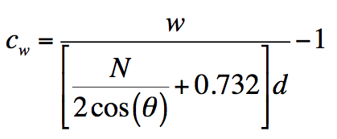
Cable development for MQXF quadrupole
Width : 17.8 mm
Width compaction C_{w} = - 3.5
Mid-thickness : 1.50 and 1.53 mm
Keystone angle : 0.65 degree
Pitch length : 113 mm (17.5º) and 125 mm (16º)
Cw larger than its value for the FRESCA2 cable (- 4.6) but smaller than its value for the cable for the dipole DS 11 T (- 2.6).

Slide 13
Cable development for MQXF quadrupole
Production of PIT and RRP cables with identical geometries: width ∼ 17.8 mm and ∼ 18.1 mm and mid-thickness of ∼ 1.5 mm
Variation of keystone angle and twist pitch
Verification of critical current degradation - critical current measurements, optical and SEM analysis – and of winding behaviour – cable mechanical stability

Slide 14
Mechanical stability
Summary
P. Ferracin and S. Izquierdo Bermudez

Slide 15
Cable development for MQXF quadrupole
RRP® 132/169
Sample | Cable ID | Cable width | Mid-thickness | Pitch length | Keystone angle
1 | H16OC0123BA | 17.8 mm | 1.551 mm | 109 mm | 0.66 degree
2 | H16OC0123BB | 17.8 mm | 1.534 mm | 109 mm | 0.67 degree
3 | H16OC0123BC | 17.8 mm | 1.509 mm | 109 mm | 0.65 degree
4 | H16OC0139A* | 17.8 mm | 1.530 mm | 113 mm | 0.50 degree
5 | H16OC0139A* | 17.8 mm | 1.518 mm | 113 mm | 0.54 degree
6 | H16OC0132CA | 18.1 mm | 1.512 mm | 109 mm | 0.62 degree
7 | H16OC0132C | 18.12 mm | 1.512 mm | 95 mm | 0.60 degree
8 | H16OC0132C | 18.08 mm | 1.517 mm | 120 mm | 0.56 degree
During winding tests, all cables were NOT sufficiently mechanically stable
(* better behaviour because of smaller keystone angle – increased compaction
of the thick edge)

Slide 16
Cable development for MQXF quadrupole
RRP® 132/169
17.8 mm wide cable with a keystone angle of 0.65º
Pitch length 113 mm, mid-thick. 1.50 mm: degradation 1.8 % ( - 1.6% to 4.5% ) oil RRR=137
Pitch length 109 mm, mid- thick. 1.534 mm: degradation 0.75 % ( 0% to 3.3% ) oil RRR=112
Pitch length 109 mm, mid-thick. 1.50 mm: degradation 4.1 % ( 2.1% to 6.5% ) oil RRR=122
Pitch length 125 mm, mid-thick 1.50 mm: degradation 2.6 % ( 1.5% to 4% ) no oil RRR=126
17.8 mm wide cable with a keystone angle of 0.58º
Pitch length 125 mm, thickness 1.479 mm: degradation 0.9 % ( -0.3% to 2.8% ) no oil RRR=97
18.1 mm wide cable with a keystone angle of 0.62º
Pitch length 109 mm, thickness 1.512 mm: degradation 1.1% ( - 1.7% to 3.6% ) oil RRR=115
Low-critical current degradation
The larger width does not impact on the degradation
RRR of extracted strands above 100 – RRR of virgin strands > 180

Slide 17
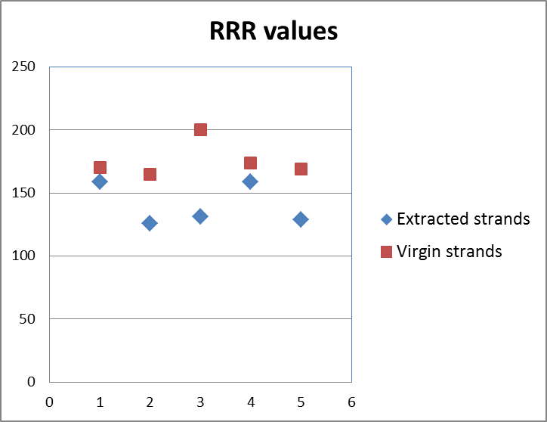
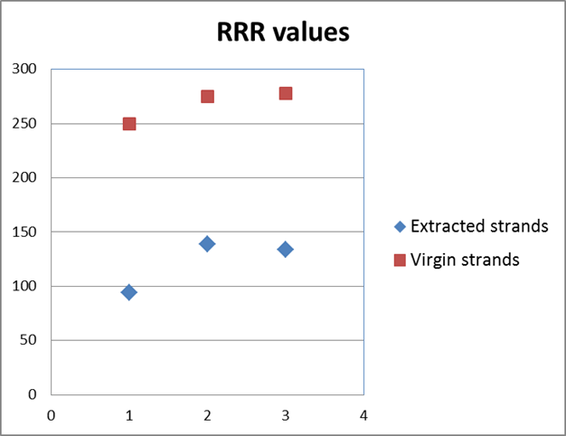
Cable development for MQXF quadrupole
RRP® 132/169
Cable run 82 fabricated without a core :
Keystone angle 0.64º
Pitch Length of 113 mm,
Mid-thickness of 1.50 mm
Width = 17.8 mm
Use of oil as lubricant
48h/210C + 48h/400C + 50h/640C
Cable run 90 fabricated with a core:
Keystone angle 0.65º
Pitch Length of 109 mm,
Mid-thickness of 1.50 mm

Slide 18
Cable development for MQXF quadrupole
PIT 192
Sample | Cable ID | Cable width | Mid-thickness | Pitch length | Keystone angle | Winding test
1 | H16EC0131AA | 17.8 mm | 1.5418 mm | 109 mm | 0.65 degree | OK
2 | H16EC0131AB | 17.8 mm | 1.523 mm | 117 mm | 0.64 degree | Not OK
3 | H16EC0131AC | 17.8 mm | 1.507 mm | 117 mm | 0.63 degree | Not OK
4 | H16EC0138A | 17.8 mm | 1.531 mm | 109 mm | 0.52 degree | Not OK
5 | H16EC0143AA | 17.8 mm | 1.520 mm | 117 mm | 0.52 degree | Not OK
6 | HE16E0132AA | 18.1 mm | 1.525 mm | 109 mm | 0.57 degree | Not OK
7 | HE16E0132AB | 18.1 mm | 1.540 mm | 95 mm | 0.55 degree | OK
8 | HE16E0132AD | 18.1 mm | 1.520 mm | 117 mm | 0.57 degree | OK
During winding tests, three cable geometries – in red in the table - were
mechanically stable – winding of bare cable with no use of winding tools
and/or binder

Slide 19
Cable development for MQXF quadrupole
PIT 192
17.8 mm wide cable with a keystone angle of 0.65º
Pitch length 109 mm, thickness 1.507 mm: degradation 6.9 % ( 5.1% to 7.8% ) oil
Pitch length 109 mm, thickness 1.507 mm: degradation 7.5 % ( 6% to 8.8% ) no oil
Pitch length 109 mm, thickness 1.543 mm: degradation 8.9 % ( 7.8% to 10% ) no oil
Pitch length 117 mm, thickness 1.523 mm: degradation 6.8 % ( 5.4% to 8.6 % ) no oil
18.1 mm wide cable with a keystone angle of 0.57º
Pitch length 109 mm, thickness 1.52 mm: degradation 7.8 % ( 6% to 8.6% ) oil
17.8 mm wide cable with a keystone angle of 0.52º
Pitch length 117 mm, thickness 1.520 mm: degradation 4.9 % ( 2.6% to 7.1% ) oil
Pitch length 125 mm, thickness 1.520 mm: degradation 5.8 % ( 4.6% to 7.1% ) oil
PL=117 mm
Critical current degradation ∼ 4.9 % -8.9 % for 17.8 mm wide cable
The larger width does not impact significantly on the degradation
RRR of extracted strands above 100

Slide 20
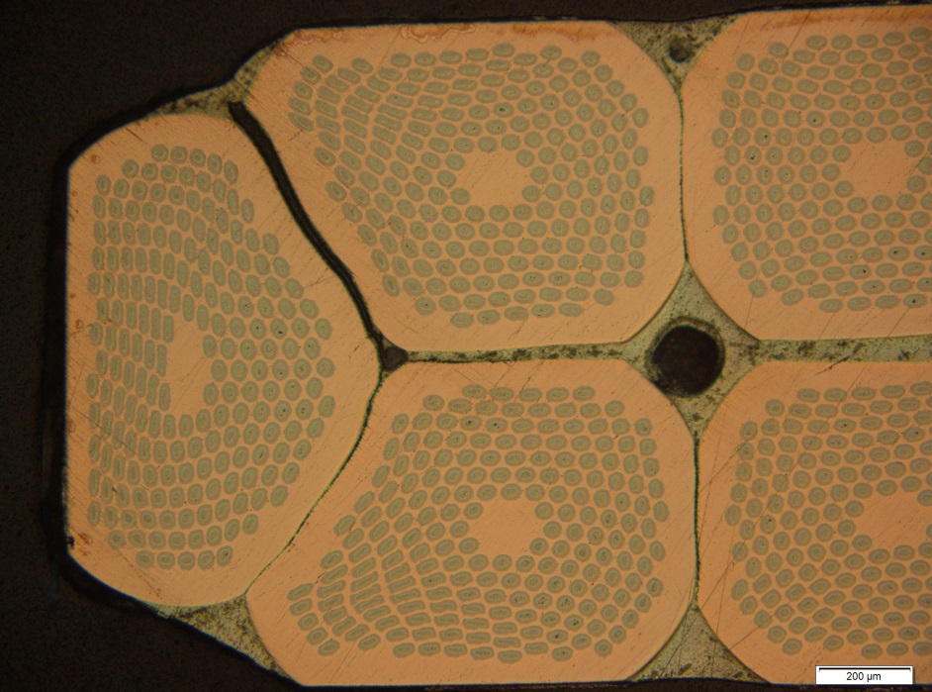
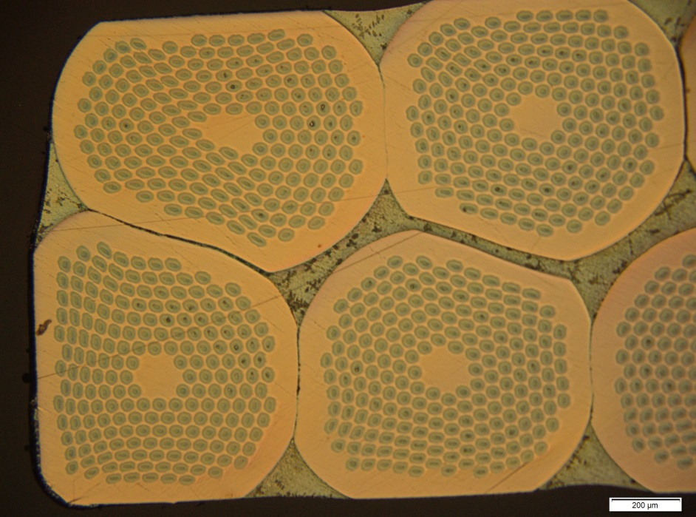
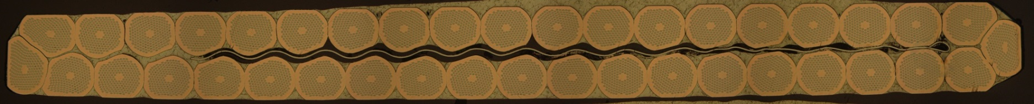
Cable development for MQXF quadrupole
Cross-section of the PIT 192 cored cables
(17.8 mm, PL = 109 mm, 1.50 mm, 0.65 degree)
H16EC0131AE
Limited shearing seen through the sub-elements of the PIT cable.

Slide 21
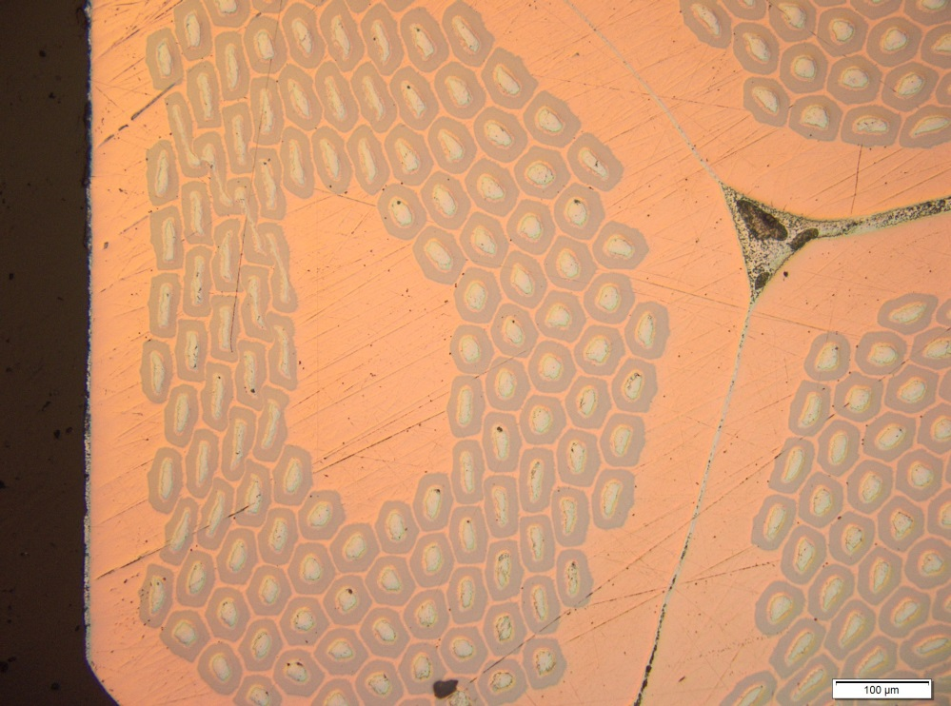
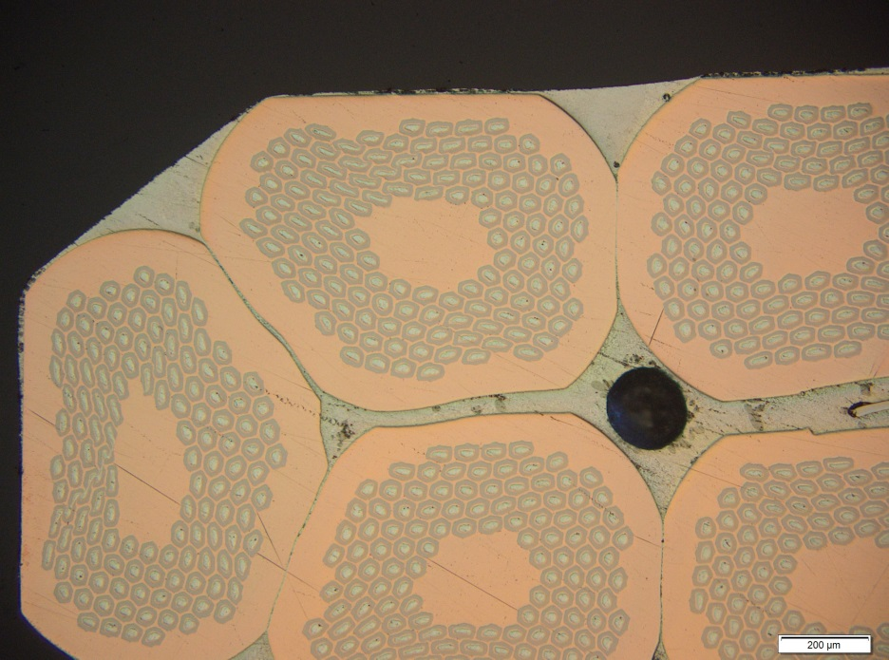
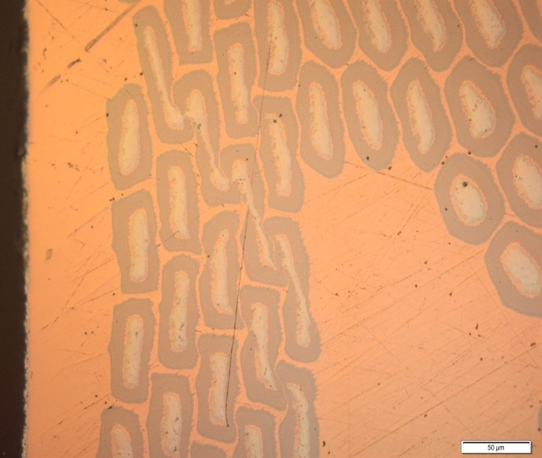
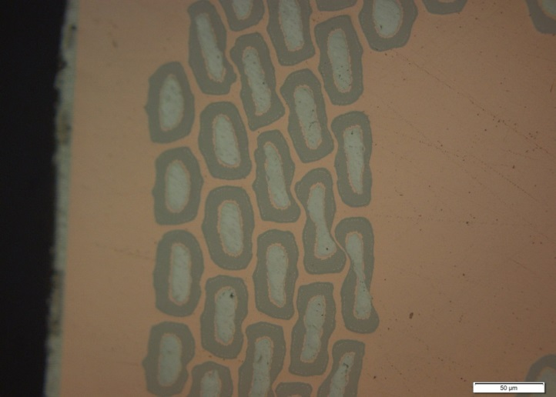
Cable development for MQXF quadrupole
Cross-section of the RRP® 132/169 cored cables (w=17.8 mm)
(PL = 113 mm, 1.50 mm, 0.65^{O})
(PL = 113 mm, 1.52 mm, 0.54^{O})
Significant shear of
sub-elements

Slide 22
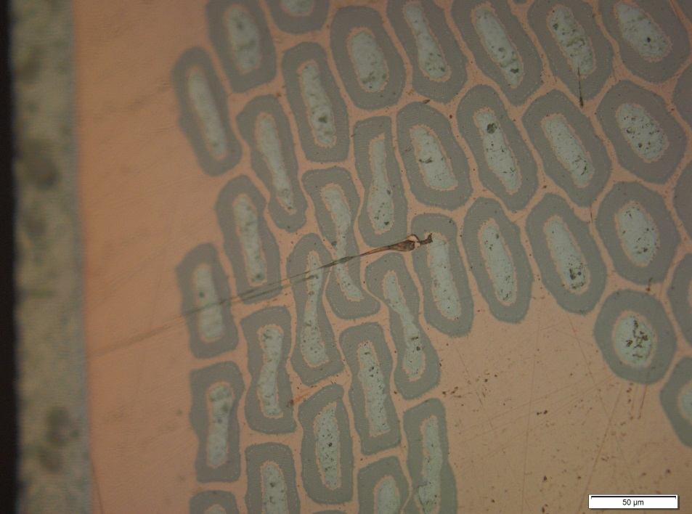
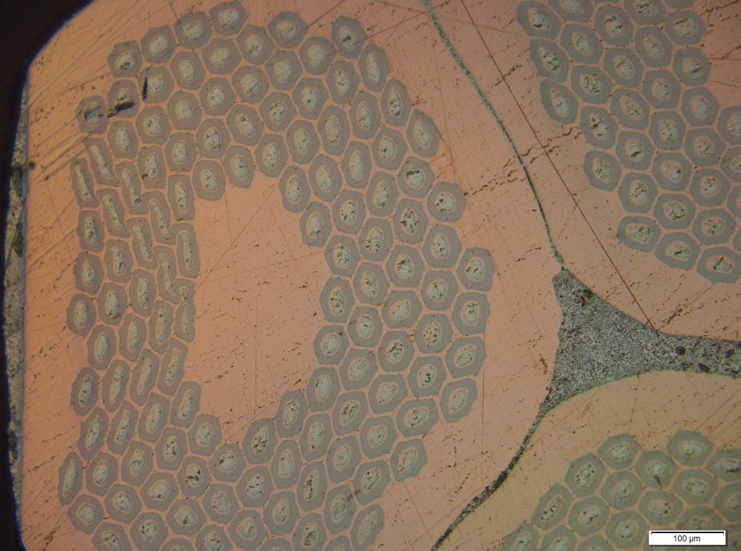
Cable development for MQXF quadrupole
Cross-section of the RRP® 132/169 cored cables (w=18.1 mm)
Thin edge
Thin edge

Slide 23
Cable development for MQXF quadrupole
PIT 192
Qualification at CERN in FRESCA of two PIT MQXF cables (17.8/18.1 mm width, 117/109 mm twist pitch, 0.63°/0.57° keystone angle).
Reached Ic calculated from Ic measured on extracted strands - see next presentation of B. Bordini

Slide 24
“First iteration” cable geometry
selected for first Short Model Coils
Cable width = 18.15 mm
Cable mid-thickness = 1.55
Keystone angle = 0.55°
From previous tables:
PIT 192 cable mechanically stable (average degradation of 7.8 % measured at CERN on strands extracted from cable with 0.57 ° keystone angle);
RRP® 132/169 cable mechanically unstable (average
degradation of 0.9 % measured at CERN on strands extracted from cable with 0.62 ° keystone angle)

Slide 25
Remarks/Conclusions (1/3)
The geometry of the “first iteration” cable ended up to be better optimized for PIT – reached acceptable Ic degradation and complete mechanical stability – than for RRP® – mechanical unstable cable
The performance of the “first iteration” cable is considered acceptable by magnet designers for the winding of the first short model coils
There are not sufficient results/sufficient understanding today to conclude that mechanical stability of RRP® cable cannot be improved – at the benefit of reduced risk during winding of series of coils

Slide 26
Remarks/Conclusions (2/3)
An activity has started at CERN in order to answer to the following points:
  RRP® and PIT are different conductors with different mechanical characteristics. Can we reasonably converge to/adopt an identical cable geometry with acceptable electrical and mechanical performance ?
  Local RRR measurements are needed on extracted strands. How can we correlate the local RRR values, with the stability of the strand/cable and the results of the SEM images (number/quality of sheared sub-elements) ?
  Can we improve the mechanical stability of the RRP® cable with a new geometry ? Would that geometry be acceptable for PIT ?

Slide 27
Remarks/Conclusions (3/3)
Strand (PIT and RRP) for MQXF will be delivered to CERN by end of November 2013. Cabling, heat treatments of extracted strands and cables and various measurements need to be performed
Final deadline set by magnet program (June 2014, see presentation of Paolo and Giorgio) for the definition of the geometry of the “second/last generation” MQXF cable

Slide 28
Thanks for your attention !

