Slide 1
Magnet Feedback:
LARP Long Quadrupole
G. Ambrosio
with contributions by many LARP members
October, 17 2013
QXF Conductor Review

Slide 2
Outline
Long Quadrupole (LQ) features and conductors
LQS02 conductor related issue
LQS03 conductor related issue
➔ lessons learnt about conductor

Slide 3
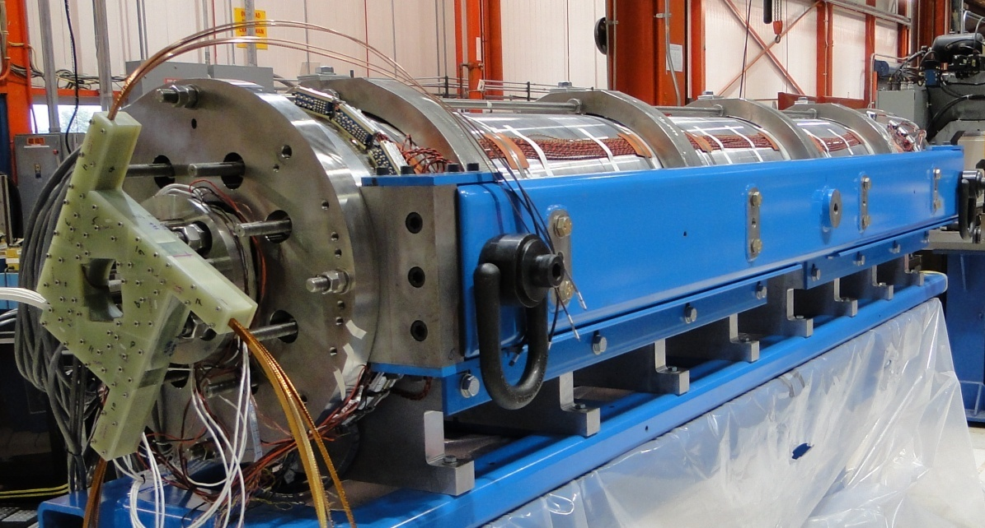
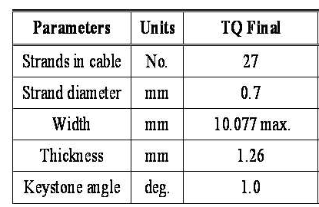
Long Nb₃Sn Quadrupole†
Main Features:
Aperture: 90 mm
Magnet length: 3.7 m
Target:
Gradient: 200 T/m
Goal: Demonstrate Nb₃Sn magnet scale up
Parameter at SSL |  | LQS01/02 | LQS03
Strand type |  | RRP 54/61 | RRP 108/127
Jc at 4.2K 12T | A/mm² | 2670 | 2660
Copper | % | 46% | 55%
Copper RRR in coils |  | > 200 | 70-130
SSL Current 4.6K/1.9K | kA | 13.7/15.2 | 12.9/14.4
SSL Gradient 4.6K/1.9K | T/m | 239/263 | 227/250
† LQ Design Report available online at:
https://plone4.fnal.gov/P1/USLARP/MagnetRD/longquad/LQ_DR.pdf

Slide 4
LQS02 Conductor related issue

Slide 5
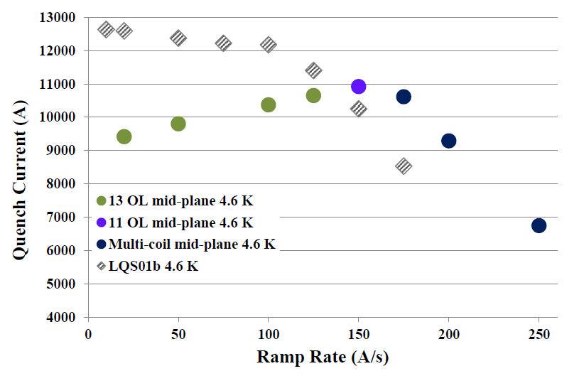
Ramp Rate Dependence: LQS01b vs. LQS02
LQS01 and LQS02 magnets with the same conductor and coil design show very different ramp rate dependence

Slide 6
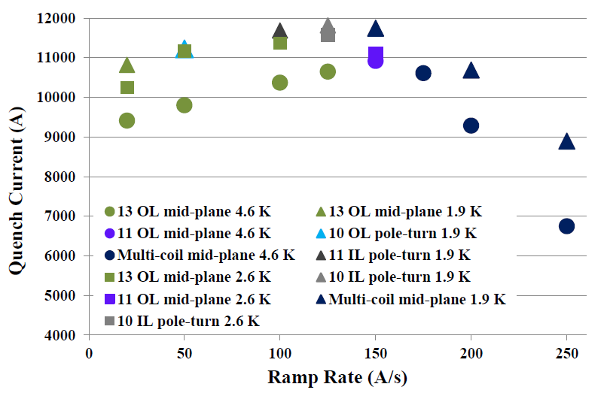
LQS02 “Reverse” Ramp Rate Dependence
Ramp rate dependence was studied at 1.9 K, 2.6 K and 4.6 K
Low ramp rate quenches developed in the OL mid-plane block of coil 13
“Reverse ramp-rate dependence”

Slide 7
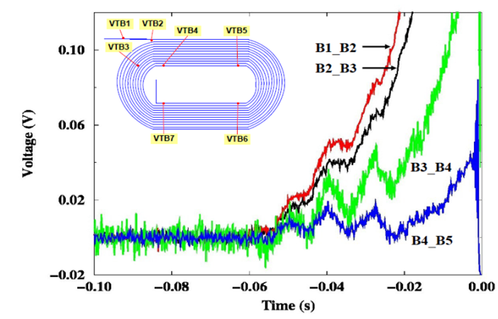
Quenches in Coil 13, OL midplane block
Facts:
Voltage spike at every quench start
Quench started in several segments at the same time
Reverse ramp-rate dependence
Normal temp. dependence
Quenches at lower current during magnetic meas.
Coil 13 OL mid-plane, 10.5 k A
Coil 10 IL pole-turn, at 10.5 k A
G. Ambrosio, et al., “Progress in the Long Quadrupole R&D by LARP”,
IEEE Trans. Appl. Supercond., vol. 22, No. 3, June 2012

Slide 8
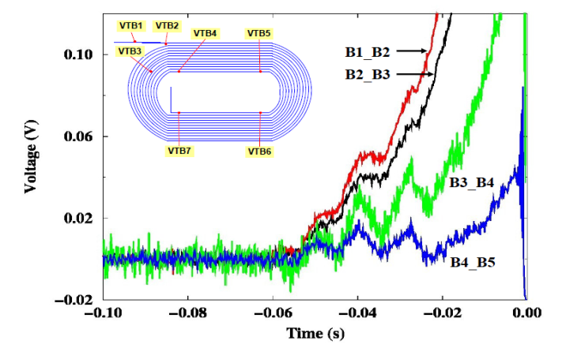
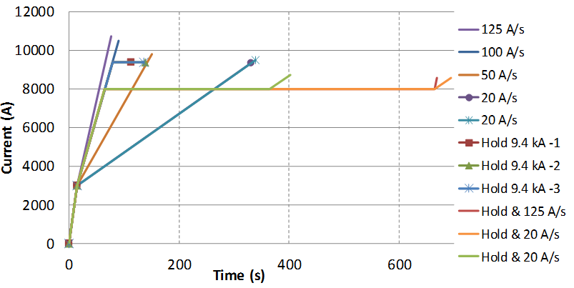
LQS02 Analysis
Holding quenches, Voltage Tap data, Quench Antenna data, and Spike Recording System data confirmed:
The cause is “Enhanced Instability” in one coil
  An unknown “issue” causes a decrease of the stability threshold (I_{s}/2.6) of the conductor in coil 13 OL.
  Possible “issues” are: (i) a local damage or a non-uniform splice forcing more current in a few strands; (ii) a damage of some strands decreasing the local RRR and/or causing filaments merging.

Slide 9
Notes about Coil 13
Lesson learnt:
There are issues that we are not able to detect, which may cause the failure of a coil/magnet
We have unstable conductors
➔ We need MARGIN!
By the time we made LQ Coil 13 the fabrication process was well established with small number of nonconformities
Although on Coil 13 inner surface we used three different materials trying to avoid “bubbles”

Slide 10
LQS03 Conductor related issue

Slide 11
LQS03 Training History
All quenches started in the pole turn of the inner layer
  Always in the straight section

Slide 12
LQS03 Temperature Dependence
200 T/m
After “training”
Holding current at 200 T/m and 4.6 K for 40 minutes w/o quench

Slide 13
LQS03 Analysis
Current limitation independent of temperature
  11.5-11.8 kA
Quench start moving through several segments of 2 coils
No signs of precursors at quench start
One strain gauge showed unloading at 10.6 kA
  Current of quenches #2-#5
➔ 1st possible cause: quenches due to start of unloading
But TQS03 showed more unloading and trained up to 238 T/m
TQS03 RRR > 150; LQS03 RRR > 70
Present understanding: self-field instability with low RRR† triggered by unloading
†E. Takala, et al., “Perturbation Sensitivity of the Magnetothermal Instability”,
IEEE Trans Applied Superc. Vol 22, N. 6, #. 4706106

Slide 14
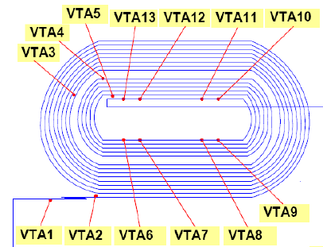
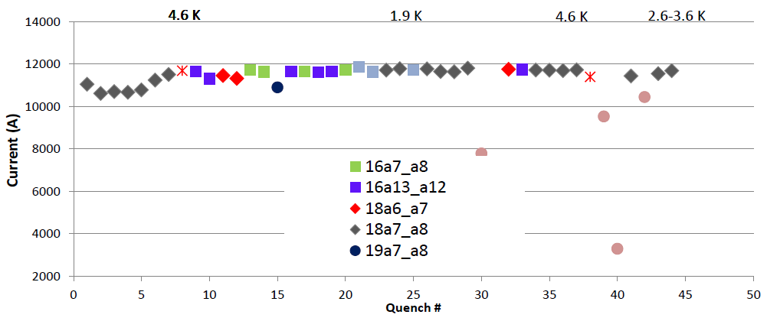
LQS03 quench training
Most quenches in Coil #18
Some quenches in Coil #16
One quench in Coil #19

Slide 15
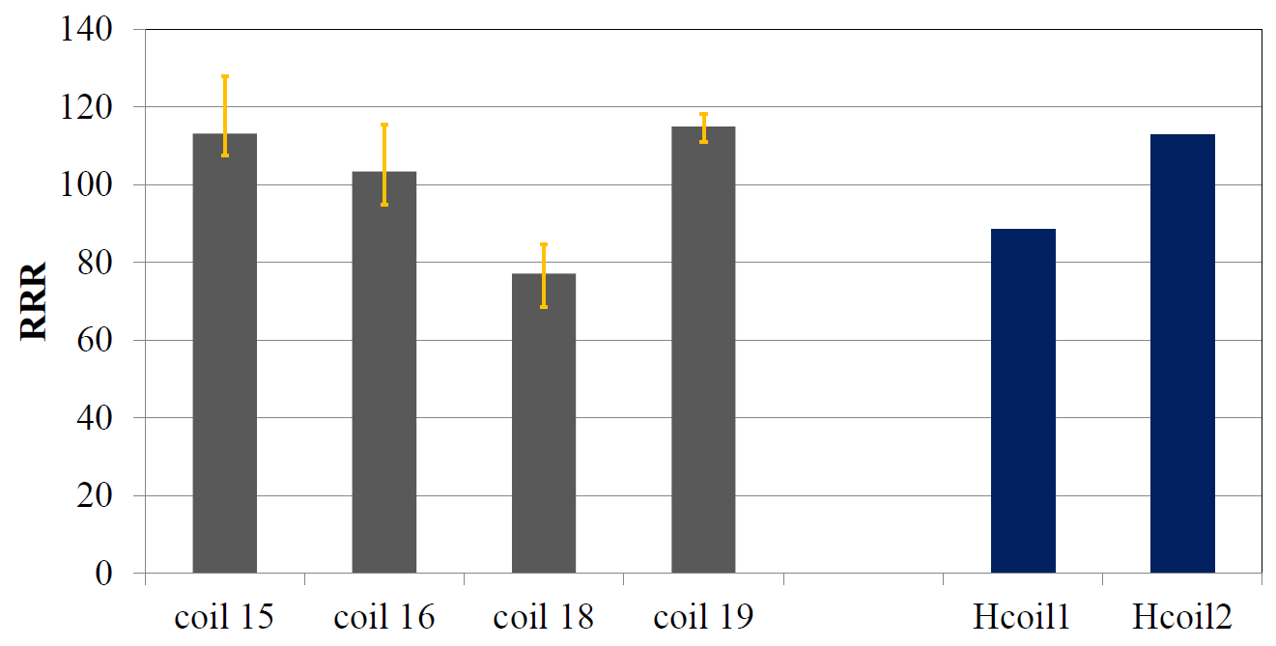
LQS03 RRR measurements
* RRR = 50 in kinks of one LQS03 extracted strand

Slide 16
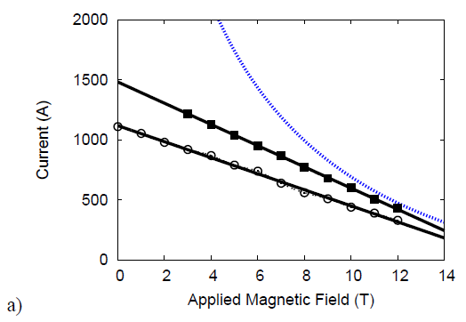
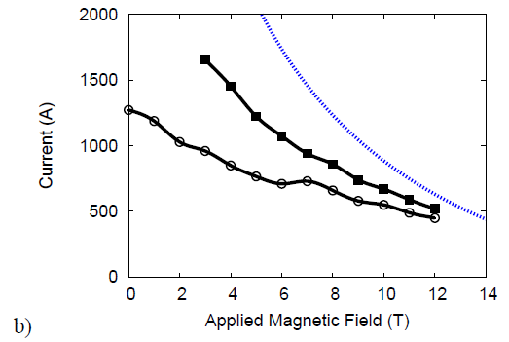
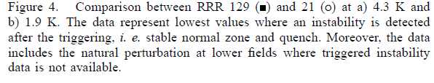
Stability study on RRP 108/127
E. Takala, B. Bordini, L. Rossi, Perturbation Sensitivity of the MagnetoThermal
Instability, IEEE Trans. Appl. Supercond., (2012), Vol 22, No 6, # 4706106
RRR = 50 in kinks of one LQS03 extracted strand

Slide 17
Lessons Learnt
Issues (in conductor, coil fabrication, magnet assembly) are possible and will happen in the MQXFs
The conductor is NOT intrinsically stable
➔ we should try to have as much margin as possible
  Will result in better coil yield
Margin is give by:
Higher RRR in coils (minimum: 100, better: 150)
Smaller subelements
Avoiding excessive strand deformation/shear during cabling

Slide 18
Backup Slides

Slide 19
LQS02 Test at Fermilab
SSL was computed based on extracted witness sample test results
  LQS02 SSL estimate w/o additional strain: 13.8 kA or 240 T/m at 4.6 K
  Compare to 13.75 kA for LQS01 SSL at 4.6 K
Azimuthal compression of the coil’s pole reached ‑133 ± 28 MPa in LQS02, similar to ‑130 ± 30 MPa in LQS01b
LQS02 was tested at Fermilab in July-August 2011
Voltage tap system in LQ

Slide 20
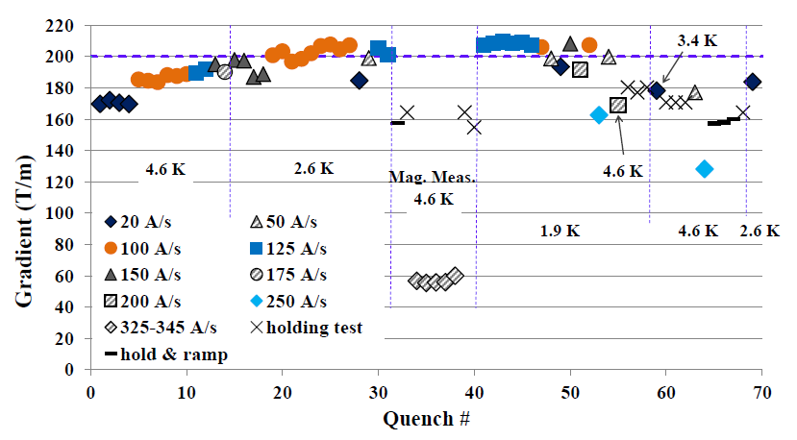
LQS02 Quench History
Exceeded 200 T/m at 1.9 K and 2.6 K (only for ramp rates of 100-150 A/s) but failed to reproduce LQS01b performance

Slide 21
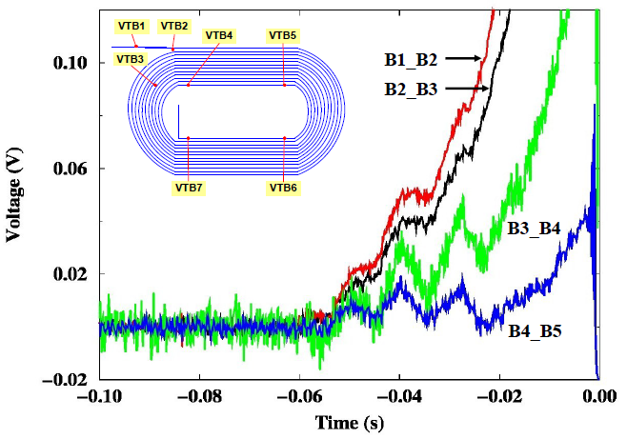
LQS02 quenches in coil 13
All quenches in coil 13 OL mid-plane area showed similar pattern
  Simultaneous start in several segments
  Voltage spikes at the beginning of quench could be indication of decreased conductor stability

Slide 22
LQS02 quench patterns at high currents
Quench patterns in coil 13 OL mid-plane block (left) and coil 10 pole-turn block (right)
Coil 13 OL mid-plane, 10.5 k A
Coil 10 IL pole-turn, Quench at 10.5 k A

Slide 23
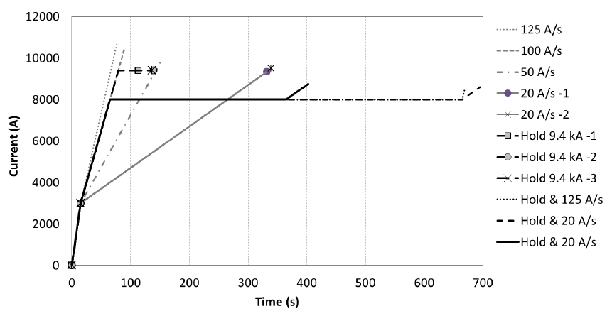
More checks on conductor stability in LQS02
“Unknown conductor damage” could be a reason for enhanced instability
  Forcing current in a fewer number of strands
Holding quenches: the magnet current increased to 9.4 kA and then held till a quench occurred after 34 s, 57 s and 60 s
All segments have RRR larger than 200, resistance of NbTi-Nb₃Sn splices in coil 13 found acceptable 0.8-1 nOhm

Slide 24
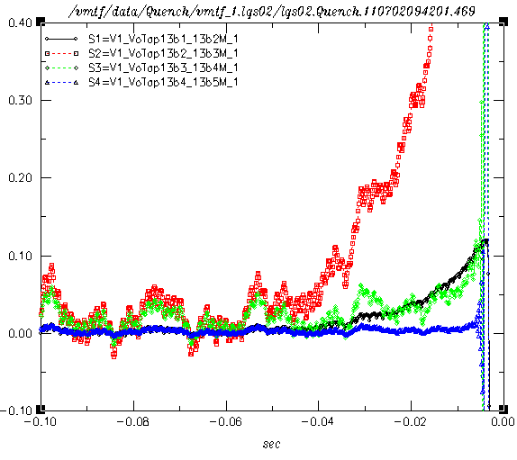
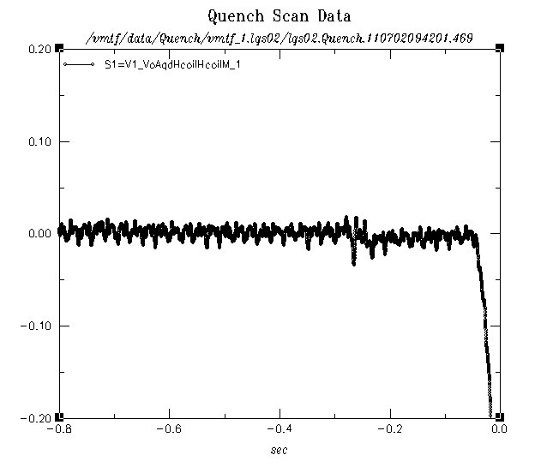
Quench 4
I = 9337 A
(ramp 4)

Slide 25
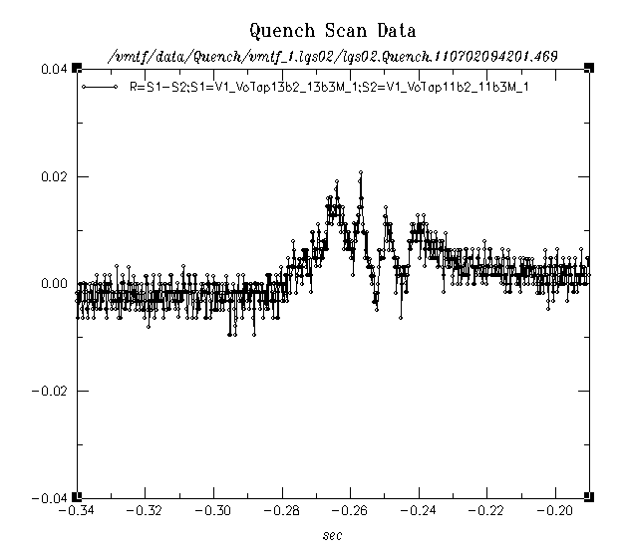
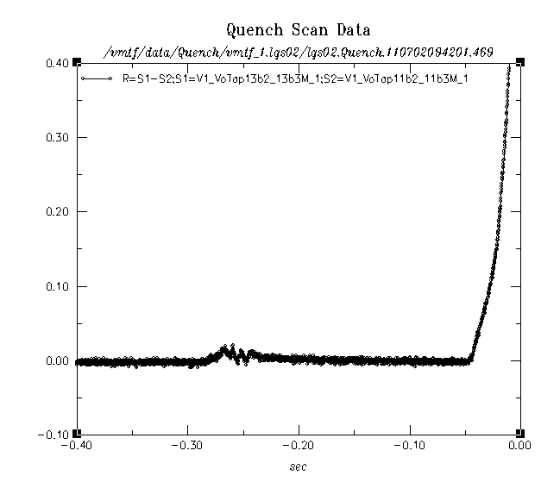
Better signals by bucking segments in opposite coils;
13b2_b3 – 11 b2_b3
50 ms
Voltage spike captured
250 ms before quench,
~ 50 ms activity

Slide 26
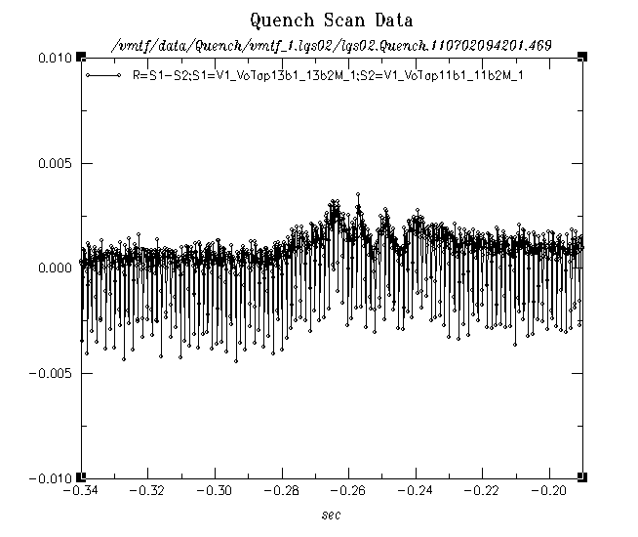
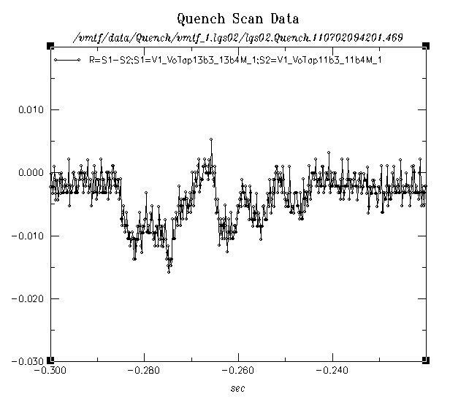
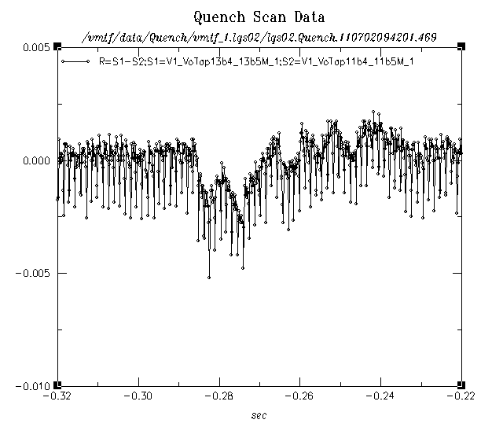
“Same” spike in other segments
250 ms before quench,
~ 50 ms activity

Slide 27
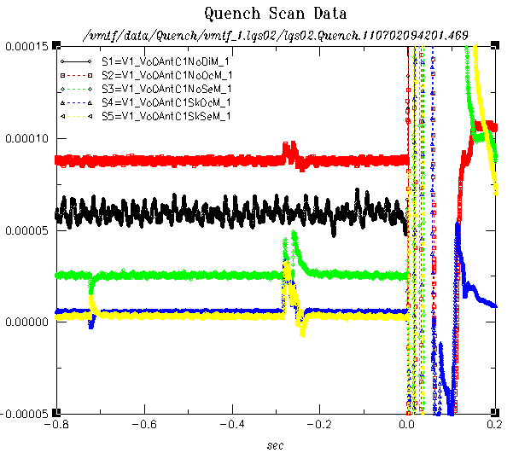
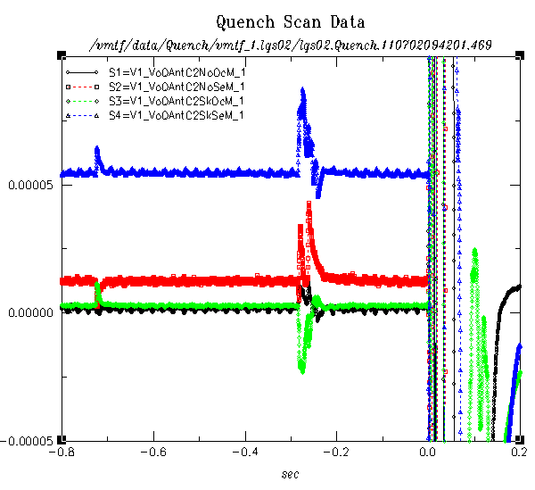
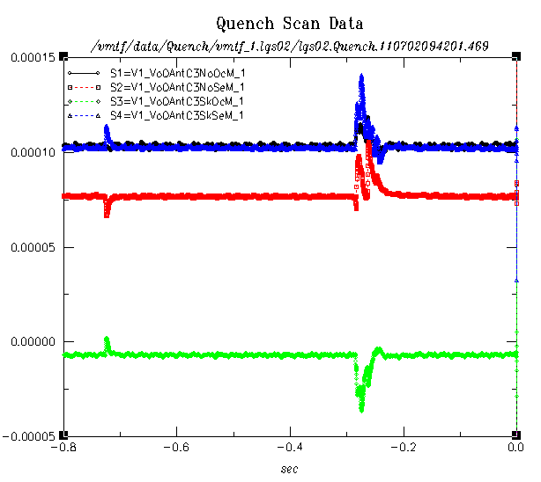
Quench antenna segments:
1
2
3

Slide 28
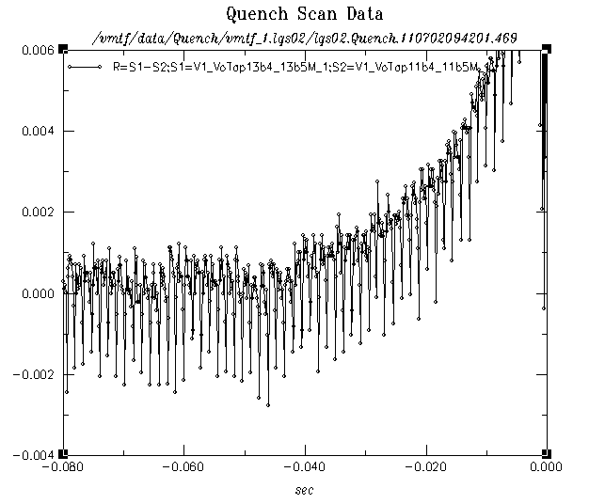
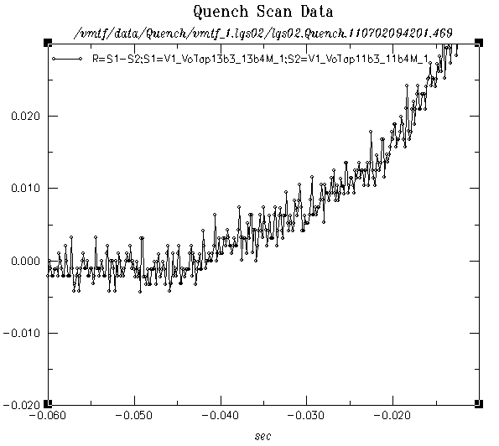
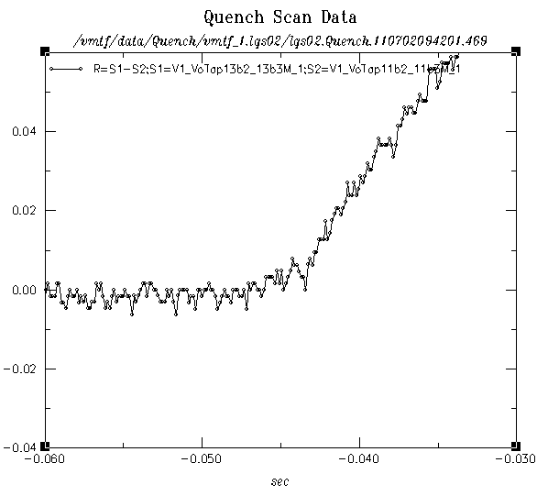
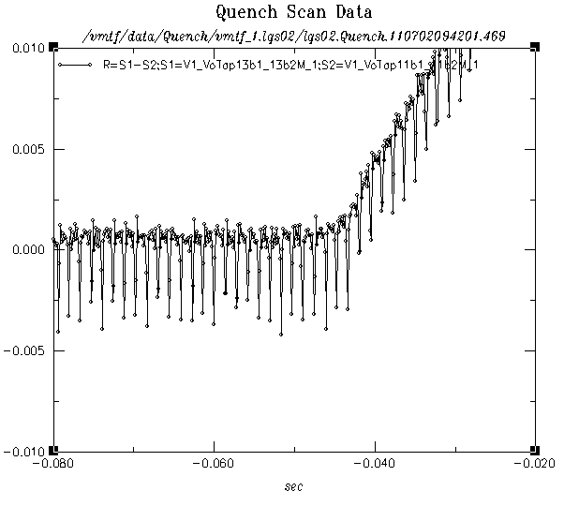
Quench start in Coil 13:
b4_b5
b3_b4
b2_b3
b1_b2
All segments start in 5 msec range

Slide 29
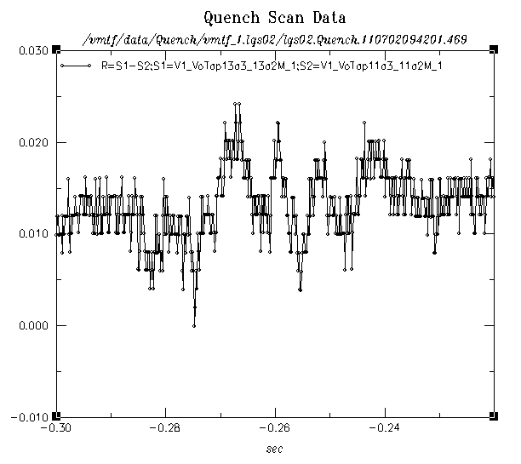
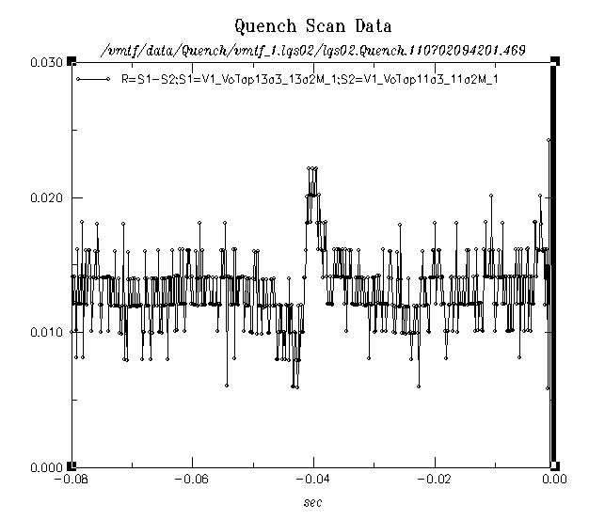
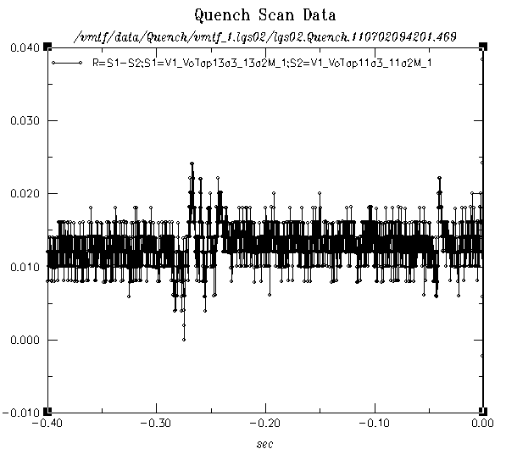
Spikes in 13a2_a3:
The quench start looks like the -270 ms voltage spike ➔ same cause

Slide 30
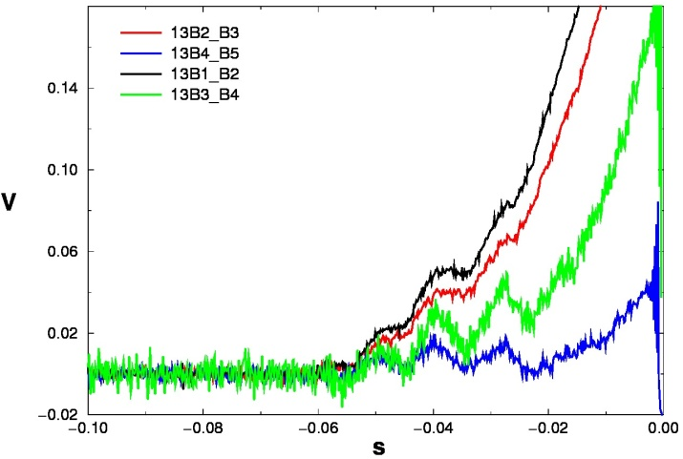
LQS02
“Reverse ramp-rate dependence”
200 T/m
Caused by:
“Enhanced instability”
G. Ambrosio, et al., “Progress in the Long Quadrupole R&D by LARP”,
IEEE Trans. Appl. Supercond., vol. 22, No. 3, June 2012

Slide 31
LQS03
Parameter at ssl |  | LQS01/02 | LQS03 | TQS03
Strand type |  | RRP 54/61 | RRP 108/127 | RRP 108/127
Jc at 4.2K 12T (with SF) | A/mm² | 2670 | 2660 | 2790
Copper | % | 46% | 55% | 54%
RRR of extracted strands* |  | >150 | 70-150 | 150-190
SSL Current 4.6K/1.9K | kA | 13.7/15.2 | 12.9/14.4 | 13/14.5
SSL Gradient 4.6K/1.9K | T/m | 239/263 | 227/250 | 231/254
* RRR = 50 in kinks of one LQS03 extracted strand
Test Highlights:
  1st quench at 4.6 K reached 197 T/m (86% ssl)
  1st quench at 1.9 K exceeded 200 T/m (6th quench overall)
  Temperature margin at 200 T/m ~3 K in peak field area

Slide 32
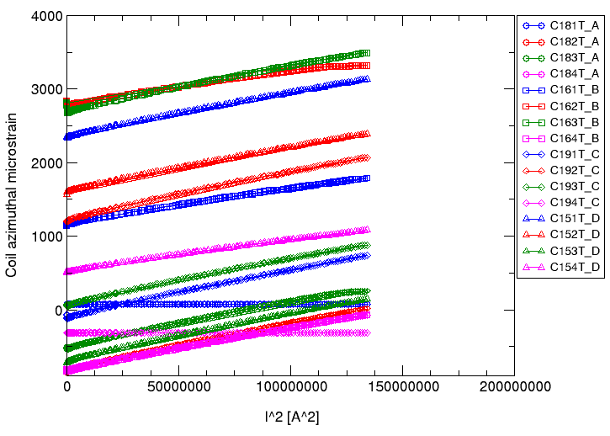
LQS03 Mechanical Behavior
Strain gauges on structure:
  As expected
  Same prestress as LQS02 (target)
Strain gauges on coils:
  2 lost
  1 unloading at 10.6 kA
  large spread of starting points
    Calibration lost during cool down?
    Issues with thermal compensation?

Slide 33
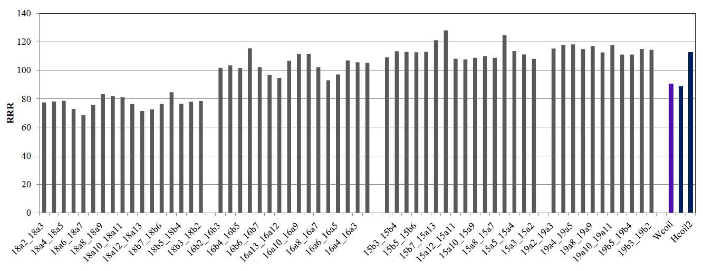
LQS03 RRR measurements
All segments

Slide 34
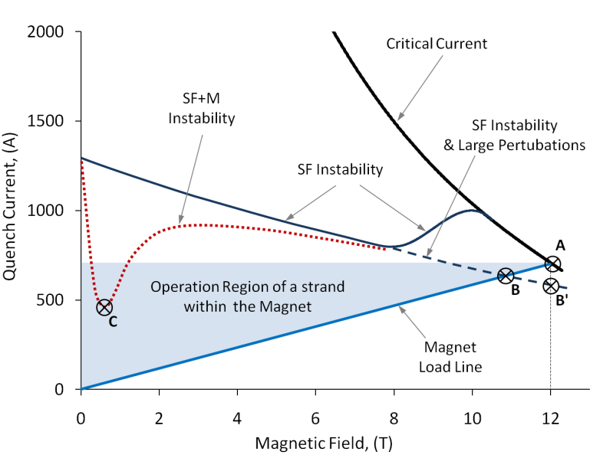
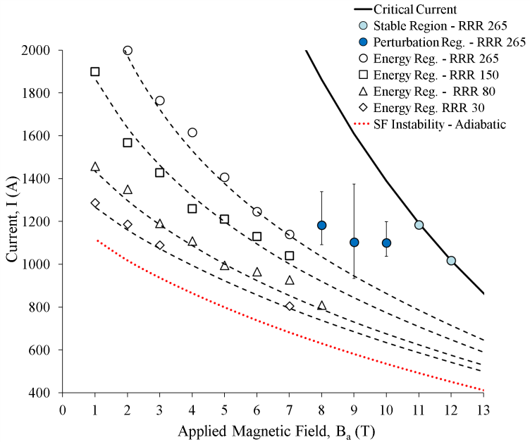
Possible effect of low RRR - II
Impact of the Residual Resistivity Ratio on the Stability of Nb₃Sn Magnets
B. Bordini, L. Bottura, L. Oberli, L. Rossi Senior Member IEEE, and E. Takala
Fig. 1. Sketch representing qualitatively the causes of premature quenches in superconducting magnets affected by magneto-thermal instabilities. In the plot it is reported the current in a strand of the magnet. The acronyms SF and M stand for Self Field and Magnetization respectively.
Fig. 3. Critical current and quench current at 1.9 K. The markers represent the experimental results while the dashed lines are the simulation using the proposed semi-analytical model.

