Slide 1
Monitoring PanDA usage of FAX
Ilija Vukotic
Valeri Fine
Paul Nilsson

Slide 2
FAX usage by PanDA
The first production use case for FAX is so called FAX failover.
In case pilot fails to get stage input files from 2 tries, it will try to get them from FAX.
To failover or not is controlled by a AGIS queue variable “failoverToFAX”. How to set it is described here:
  https://twiki.cern.ch/twiki/bin/view/AtlasComputing/FAXconfigAGIS#Enabling_FAX_failover
As it is always beneficial, we would suggest all the sites and all the queues to have it on.
  Currently all US sites, large part of UK sites and a few continental EU site
  There is no need to contribute to FAX in order to use it.
We need to verify that service runs and what it contributes so comes monitoring

Slide 3
Getting the information
Pilot for each job collects:
  Number of files transferred through FAX
  Number of files transferred in regular way
  Number of bytes transferred through FAX
  Number of bytes transferred in regular way
  Duration of FAX transfers
Information is curl-ed to PandaLogger

Slide 4
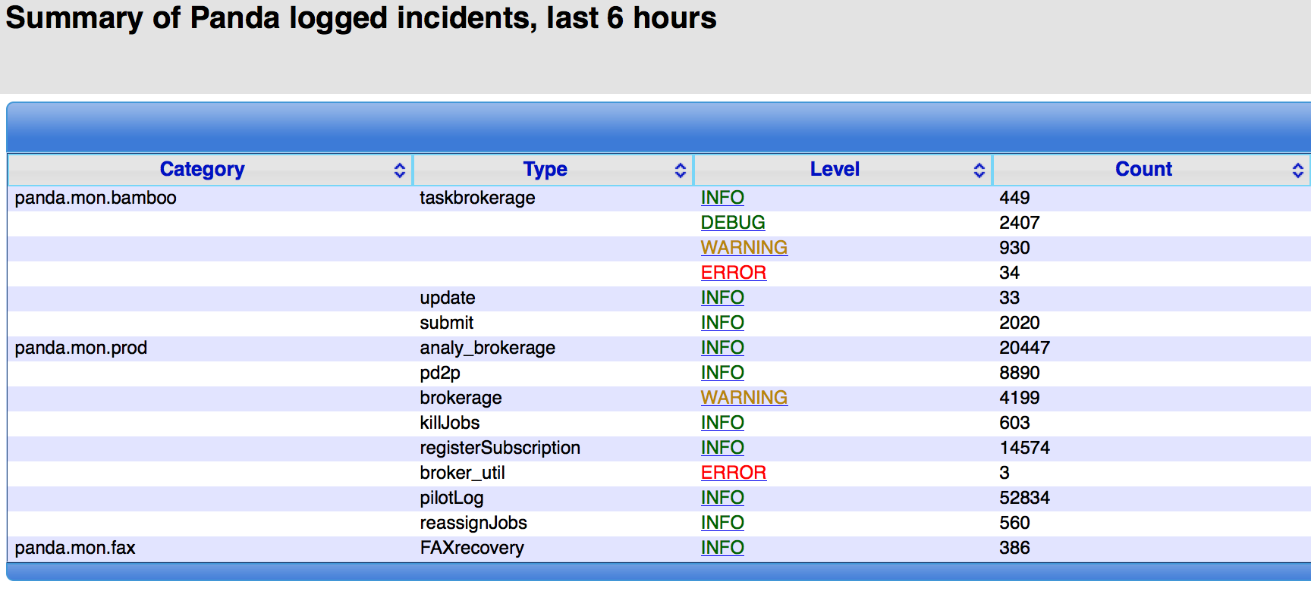
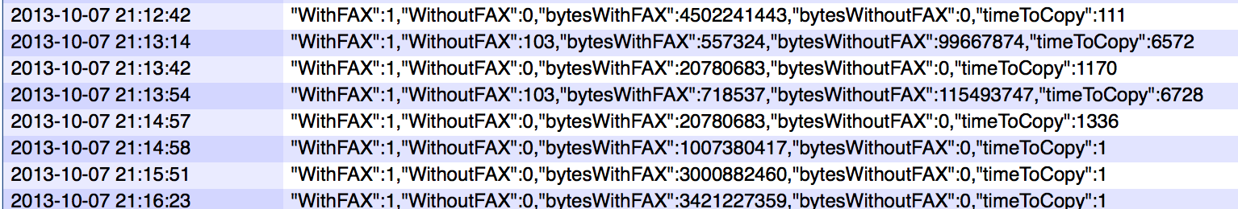
Presenting information
Default way http://pandamon.atlascloud.org/logsummary not exactly human friendly.

Slide 5
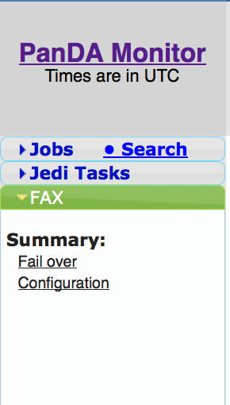
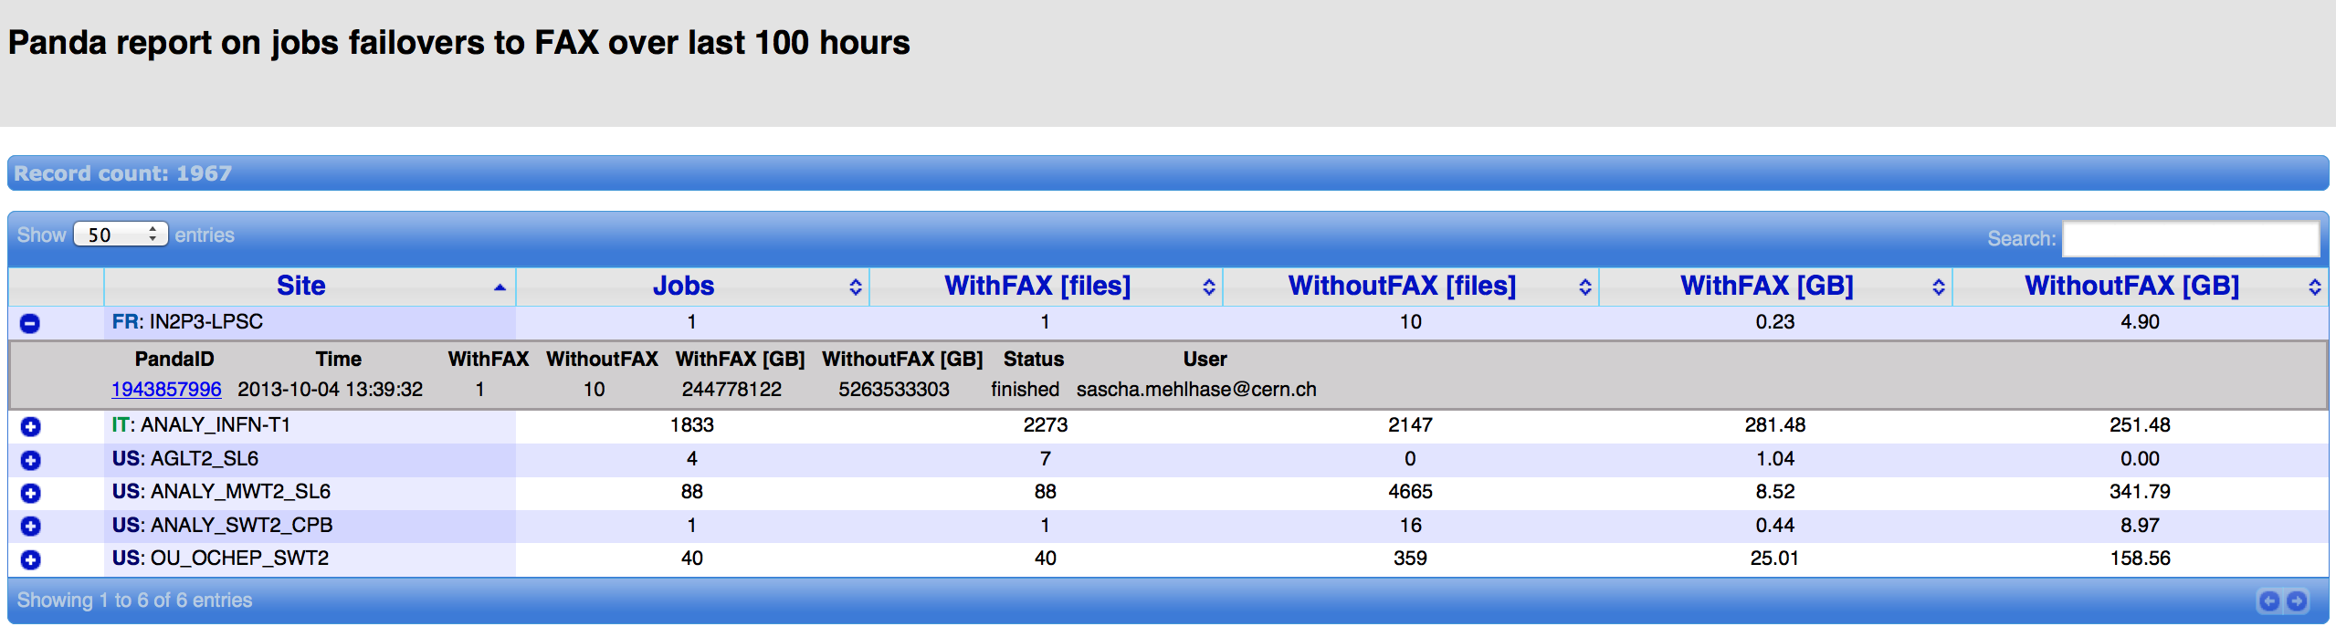
Presenting information
New entry in side menu for all things FAX
Dedicated Panda Monitor pages
Thanks to Valeri

Slide 6
Presenting information – to be done
Currently data older than 3 days are deleted. We want it kept
Have a way to select/filter-out different users – currently HC jobs filtered out in code.
Reorganize code/db to be faster
Add historic plots for total / per site values.

Slide 7
Separating other FAX use cases
overflow - when Panda decides that site is too busy and decides to send job elsewhere while reading from "busy" site via FAX. Should start in roughly one month
user directly gives FAX filenames in input dataset. Already possible using prun jobs.
This requires
Changes in pilot
  In order to separate use cases
  To collect other information
    where the data comes from
    all the data that contributed to making the overflow decission
New Panda Monitor pages

