Slide 1
Higgs - What now ?
Report of the
IPPOG Higgs Panel
Thomas Naumann
DESY

Slide 2
Explaining the Higgs
The basics of the Higgs boson [TED-Ed, D. Barney + S. Goldfarb]
based on many IPPOG discussions…
A new particle is discovered: a Higgs boson!
[made with CERN-EDU]
simple video playing in a loop at the entrance of Microsom + Globe @ CERN, explains very basic concepts, FR + EN
The Higgs Field, explained [TED-Ed, Don Lincoln]
The Higgs Boson Explained [PhD Comics]
The Particle Adventure [ParticleAdventure.org]
IPPOG Meeting, November 2013, Sylvie Brunet for ATLAS Outreach

Slide 3
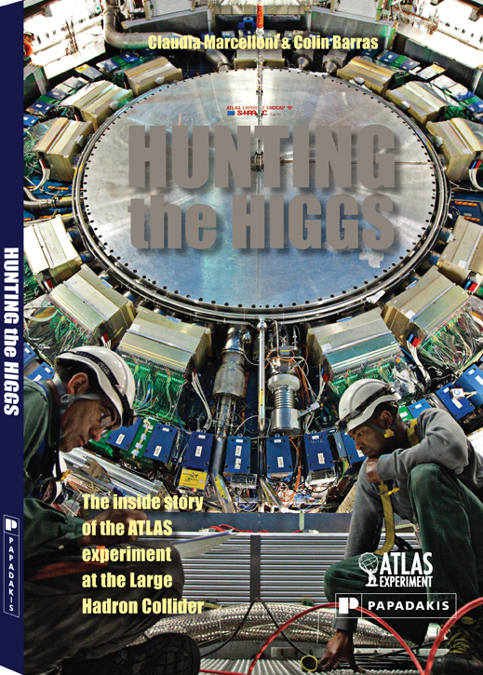
Higgs Resources: ATLAS
www.atlas.ch/HiggsResources
http://cms.web.cern.ch/org/cms-presentations-public
new ATLAS Book:
classify Higgs resources +
put to IPPOG DB:
by format
by target audience

Slide 4

UK: Royal Society summer science exhibition booklet
Contributions from all UK Particle Physics groups
Coordinator Cristina Lazzeroni
Excellent web resource for those not able to visit exhibition
http://understanding-the-higgs-boson.org/exhibit/booklet/

Slide 5
Higgs: messages
announcement of the Nobel Prize:
‚ ... for the theoretical discovery ...‘ ???
Freudian slip to honour CERN ? but G. Ingelman:
‘this is a triumph of the scientific method …
of formulating theoretical predictions …
and testing them in experiments’
LHC to resolve a theory jam of almost 50 years:
Higgs, SUSY, superstrings, extra dim …
Run2 has huge potential to resolve it:
>100x better for heavy objects

Slide 6
Higgs: What now?
Higgs discovery not the end of an era, but
beginning of a New Era:
We enter a new Scalar World !
Cosmic connections:
primordial Big Bang inflation driven by scalar field
today‘s inflation driven by scalar field:
Dark Energy, cosmological constant (Nobel 2010)
Higgs: scalar field
world(s) born from chaos - of fluctuations of scalar field ?

Slide 7


What is Mass?

Slide 8

Higgs - a new field
spin field emergent fundamental
0 scalar temperature, pressure Higgs ! Inflation, Dark Energy
1 vector flow: wind, water forces: electromagnetism
½ fermions building blocks: electron, quarks

Slide 9
Higgs issues
H boson is an excitation of the H field.
H field not H boson creates particle masses.
H field is responsible for
electron mass, atoms, chemistry - and life.
H field is not responsible for
most of our mass + mass in today’s universe.
How do particles get mass -
how is the H mechanism working?
How is the symmetry broken -
in space + time (dynamics) ?
H is not gravity!

Slide 10
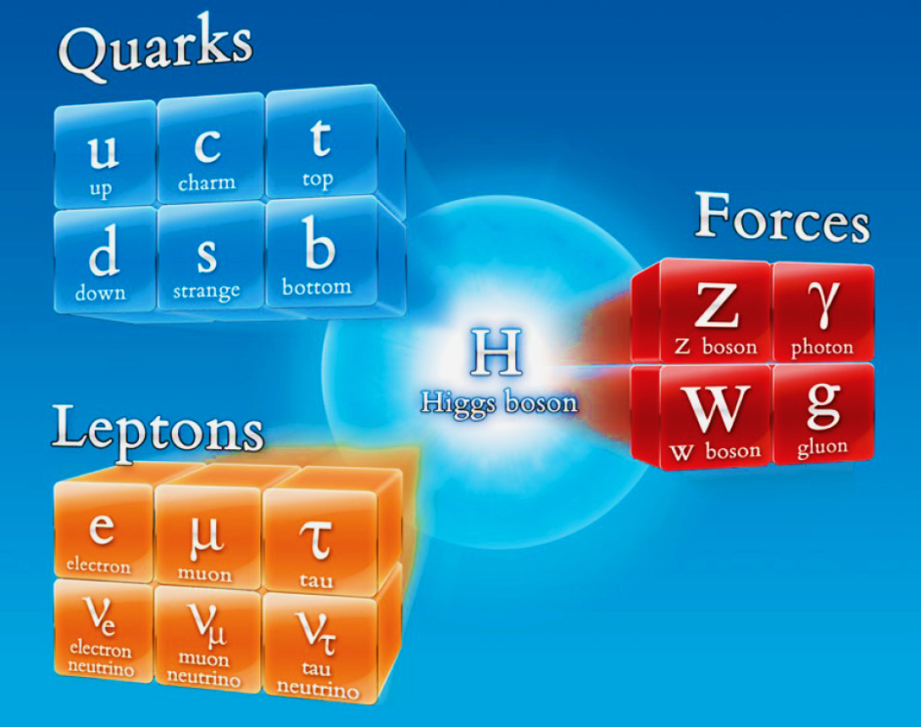
Higgs issues

Slide 11







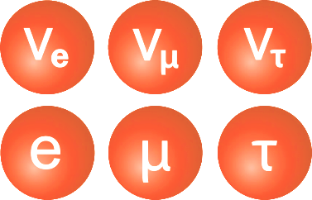
Higgs - the origin of mass
FORCE
BUILDING BLOCKS

Slide 12



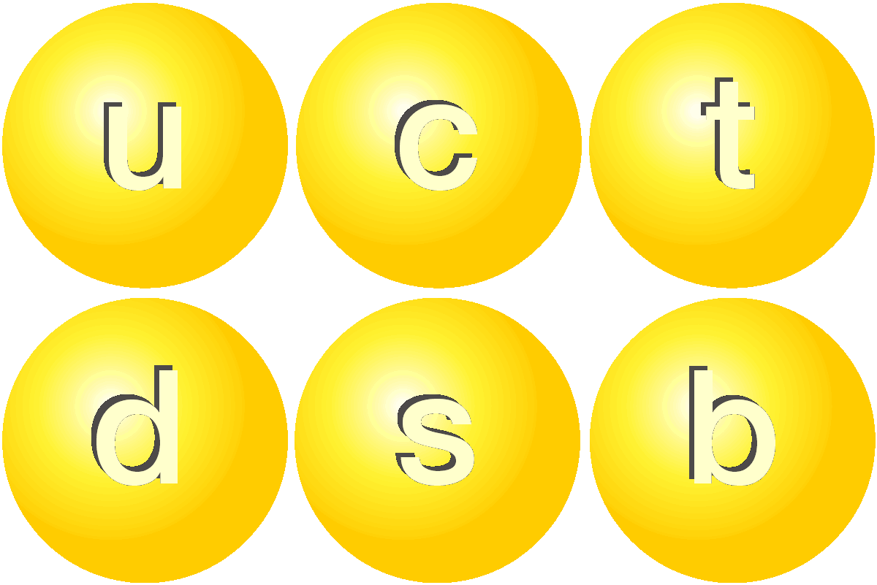
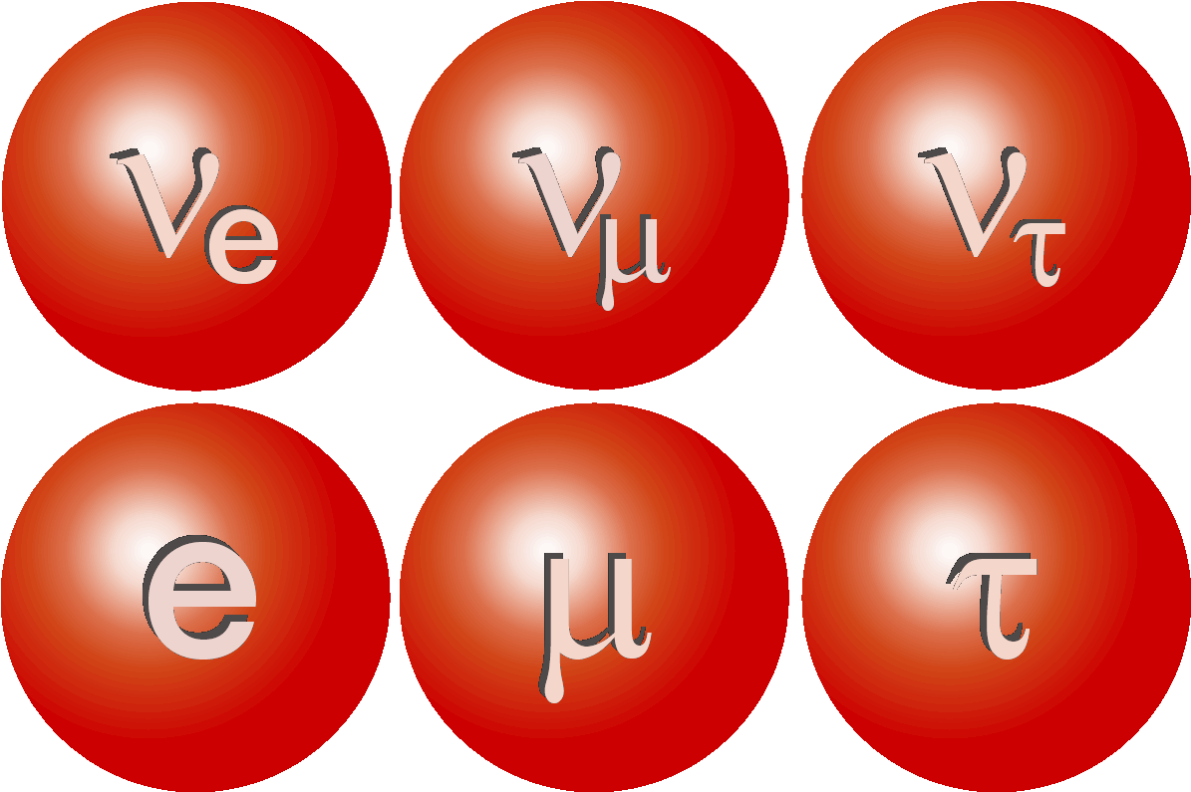
weak bosons
quarks
leptons
HIGGS

Slide 13
IPPOG + EPPCN let‘s stay in contact !

