Slide 2


Slide 3
CERN‘s 60th Anniversary
Sascha Schmeling, CERN
Coordinator

Slide 4
Key Messages
60 years of Science for Peace
Scientific Discoveries and the way ahead
International Cooperation –
Science as a motor for international dialogue
60 years of progress in Science and Technology
Science Education and Training –
Modern Science for Everyone

Slide 5
Events

Slide 6
Central Celebration Events
July 1st
  Celebration of the
  Anniversary of the Signature of the Convention
  at UNESCO in Paris
September 29th
  Celebration of the CERN Anniversary with highest level representatives from the MS, AMS, OBS, …
  at CERN
October 7th
  Celebration of the
  Anniversary of the First Council Session
  at CERN
November
  Meeting „Science for Peace“

Slide 7
Member State Celebrations
CERN invites its Member States to celebrate the Anniversary in their countries
CERN offers to help with a central coordination team and with communications and exhibitions
A coordination with other CERN-related events in the Member States is desirable
Each Member State has nominated at least one national contact by now
Of course the invitation to celebrate
CERN‘s 60th Anniversary includes
Observer States
Associate Member States
Non-Member States

Slide 8









CERN-related Events Abroad
 | A series of exhibitions is planned.
 | CERN Accelerator School
 | CERN Accelerator School
 | ICHEP 2014 with CERN Travelling Exhibition
 | Two confirmed exhibitions, at Athens and Thessaloniki
 | European School of High Energy Physics
 | CERN Travelling Exhibition
 | CERN School of Computing
 | Asia-Europe-Pacific School of High Energy Physics

Slide 9
Celebratory Events
Local Events
Strong relations to the local area around the Laboratory exist
Create a series of neighborhood events together with the local communities
Internal Events
Series of historical, scientific, and technological colloquia
Modest reception for the CERNois

Slide 10
Colloquia
Historical Series
1949-1954
The Founding Years
1954-1964 • The SC and the PS
  Maria and Giuseppe Fidecaro
1964-1974 • ISR Era
  Leslie Camilleri, Pierre Darriulat
1974-1984 • SPS Era
  Carlo Rubbia
1984-1994 • LEP I
  Herwig Schopper
1994-2004 • LEP II
  Steve Myers, Dieter Schlatter
2004-2014 • LHC Era
  Lyn Evans, Peter Jenni
Scientific, Technological,
and Social Series
Accelerator Technologies
Detector Technologies
Information Technology
Medical Applications
Science and Society
The World Wide Web
Arts and Science

Slide 11
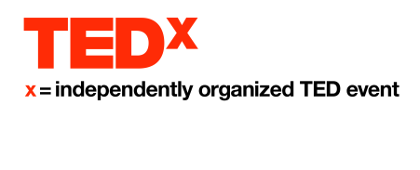

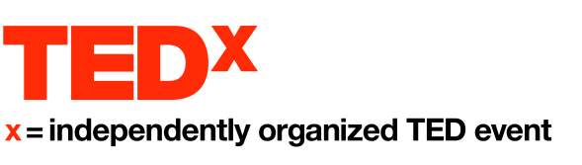
Other Celebration Events and Activities
Events at Geneva
  Several Inaugurations
    Beamline for Schools
    S‘Cool Lab
    Synchrocyclotron Exhibition
  Neighborhood Events
  Colloquia
  CERN-related Films Screenings in Cinemas
Events elsewhere
  Educational Events
  Arts Events
Activities
  CERN Historical Film
  Publications
  Stamps
  Coins

Slide 12
„Disclaimer“
The proposed events have been presented to the CERN Council in September or have arisen from the discussion there.
Please note that only half of the „central events“ are confirmed by now.
The further decisions on the remaining two as well as the available support for all other events depend on budget availability and will be taken in due course.
Events outside CERN and the Central Events need to be financed where they happen. Only limited support can be given from CERN, mainly in terms of communications support.

Slide 13
Relevant Anniversaries in 2014/15
CERN-related Events | 25 y | The World Wide Web
 | 30 y | Nobel Prize for Rubbia and Van der Meer
 | 50 y | ESRO – European Space Research Organisation
 |  | ICTP – The Abdus Salam International Centre for Theoretical Physics
Other Anniversaries for Information | 40 y | J/ψ Discovery
 | 50 y | Initial publications on spontaneous symmetry breaking
 |  | Initial publications about quarks by Gell‐Mann and Zweig
 | 135 y | Albert Einstein
 | 200 y | The Swiss Academy of Sciences
 | 450 y | Galileo Galilei

Slide 14
Organisation

Slide 15
Workload
Organisation of
  Events at CERN
Co-Organisation of
  Events at UNESCO, UNOG, UNHQ, …
Coordination of
  Events in Member States and others
  Events in the local area

Slide 16
Central Coordination
General Coordinator | Sascha Schmeling
Deputy General Coordinator | Markus Nordberg
Project Safety Officer | Yann Lechevin
Assistant | Eva Tolosa
Communication | James Gillies Marie Bugnon
Local Events Support | Iulia Pascu
Steering Committee | Maurizio Bona James Gillies Rolf Landua Markus Nordberg Sascha Schmeling Emmanuel Tsesmelis Rüdiger Voss

Slide 17
Workpackages
UNESCO Event | Angela Göhring-Crinon Yann Lechevin
Anniversary Celebration | Bernard Pellequer N.N.
First Council Session Celebration | Brigitte van der Stichelen
UN Event | N.N. N.N.
Neighbourhood Events | N.N.
Colloquia Series | Michael Doser
Yellow Report | Gian Giudice
Beamline for Schools Inauguration | N.N.
S‘CoolLab Inauguration | Gerfried Wiener
SC Inauguration / EPS Ceremony | Bernard Pellequer Marco Silari
Exhibition Support | Rolf Landua
TEDx | Claudia Marcelloni de Oliveira
FAMELAB | Antonella del Rosso

Slide 18
Communication

Slide 19
How do we proceed?
To relay the key messages and the values of the event in an efficient way, we need to remember the central theme in all our communication tools in order to have a well known identity and a certain unity.
To have an accurate balance between the international and local communication, we need to underline the universal values of CERN, with some degree of cultural adaptation for each country.
One story to tell + a shared graphic design (designed by Fabienne Marcastel)
=
    A consistent and unique identity across the countries

Slide 20
Stakeholders
CERN Internal Comm
Webmaster
Audiovisual Service
CERN Local Comm
CERN Press Office
Graphics Design Office
Social Media
CERN Protocol Office
EPPCN
IPPOG
…
and many more
…
CERN60
Comm

Slide 21











EN / FR SEARCH
Main events
Country
60 years of Science
for Peace
Website
General Message
60 ANNIVERSARY
HISTORY
DISCOVERIES
INTERNATIONAL COOPERATION
SCIENCE &TECHNOLOGY
SCIENCE & EDUCATION
PROGRAM
AUDIOVISUAL TOOLS
EDUCATIONAL TOOLS
MEDIA
FEATURED
HIGHLIGHTS
1st Jul 14
PARIS
29 Sep 2014
CERN
14 Nov 2014
CERN
25 years of the web
Opening Event
Official Ceremony
International Event
EXPLORE
READ >
READ >
READ >

Slide 22



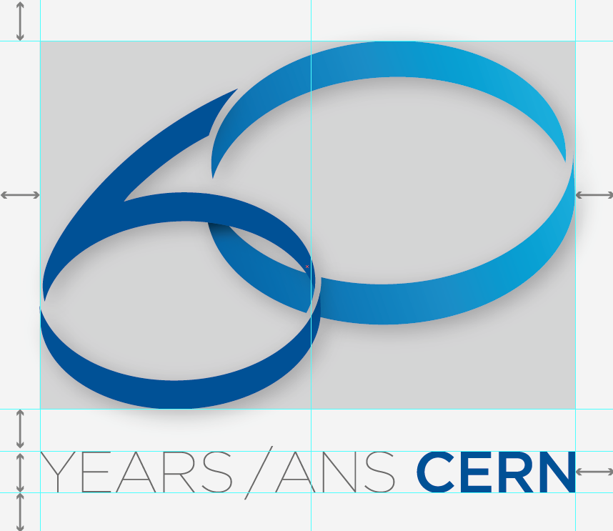

Design Guidelines
The Design Guidelines can be found on http://cern.ch/design-guidelines

Slide 23
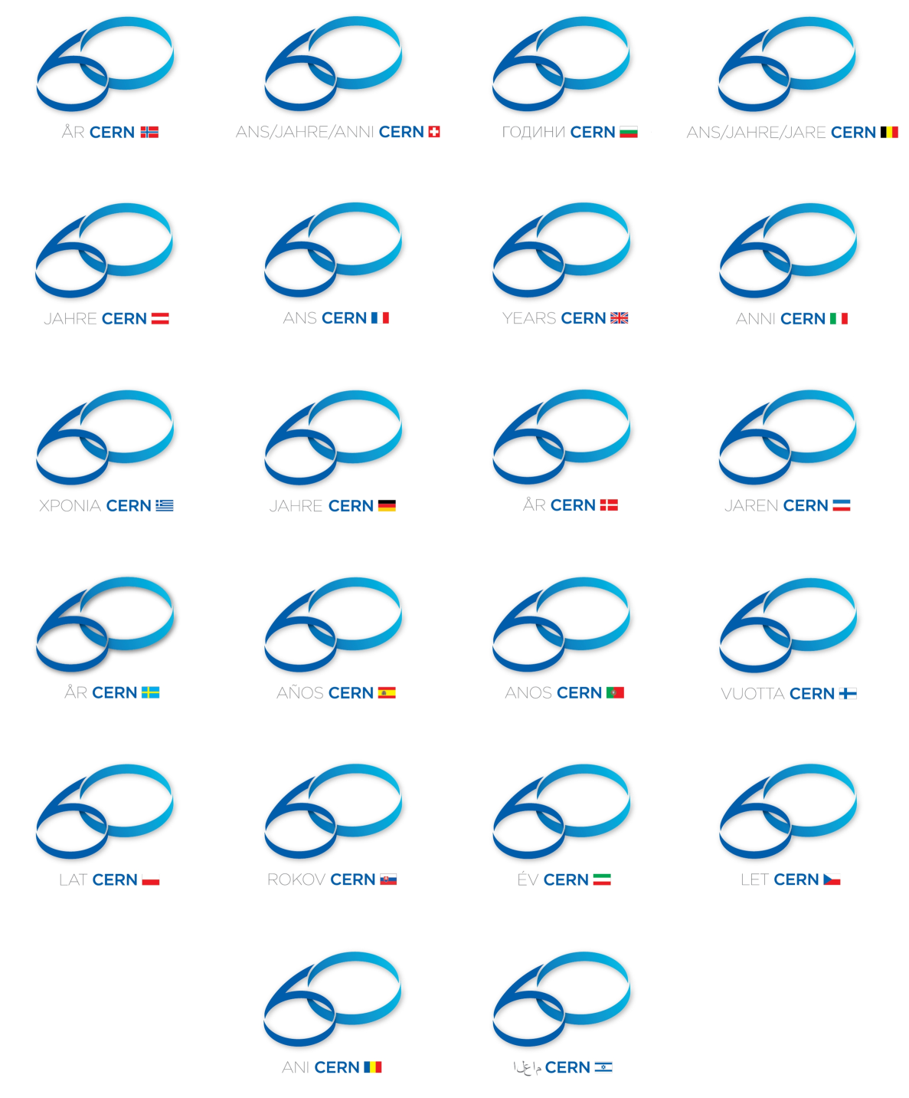
Design Guidelines
Customizations will be done by the Graphics Design Office
Please do not make last-minute requests

Slide 24


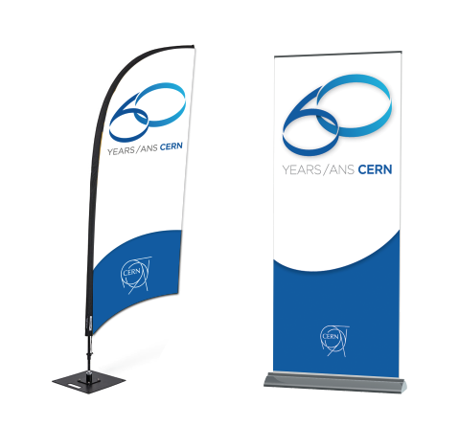
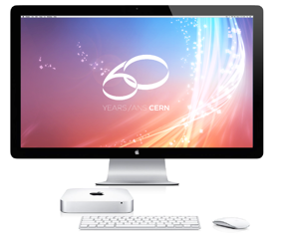
Branded Ideas

Slide 25
Next Steps
Just Being Done
  Invitations to Heads-of-State
  Country Contacts query for planned events
Near Future
  Round-Table on Cultural Events
  Presentation to ECFA (November 21st)
  Timeline of Celebration Events
  Final Presentation to CERN Council (December 12th)
2014
  The Celebrations start

Slide 26
CERN60-Team@CERN.CH
 +41 22 767 6060
 +41 22 766 6060

