Slide 2
CERN media coverage Nobel day

Slide 3
Higgs boson, it was 1 year ago…
Media coverage – keywords: “CERN & LHC”

Slide 4
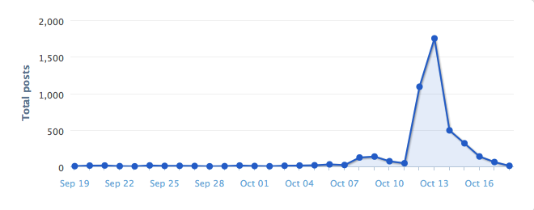
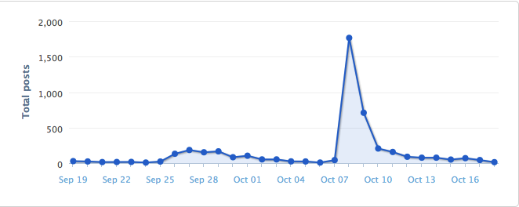
Nobel day: news & social media
Tweetup + Open Days
Media coverage – keywords: “CERN & LHC” (but not with the same tool)

Slide 5
Recent 3 months period to compare
Principe de Asturias Prize
www: 20 years
Englert: “many cosmic mysteries remain”
CERN searches for 1st Web page + ILC report
15-tonne magnet moving from NY to Chicago
Isolde exotic atoms
NeXT first webpage…
Key words: “CERN” & “LHC”- Fermilab

