Slide 1

2013 Nobel Prize
Media Coverage, Germany

Slide 2
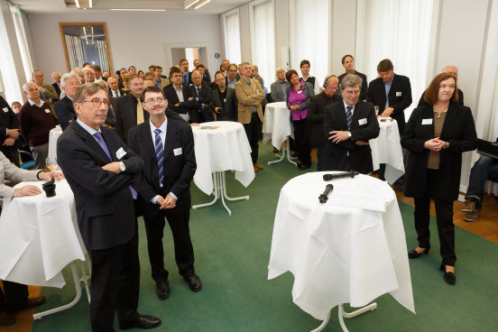

Higgs Nobel Prize in Germany
Central Event in Berlin
German Physical Society holds “Live from Stockholm” Nobel event every year in its Berlin branch
Swedish embassy, a variety of physicists and the Berlin press attend Nobel announcement live
Immediately followed by interviews with experts
→ Most efficient and fast opportunity for press to get statements and reactions

Slide 3
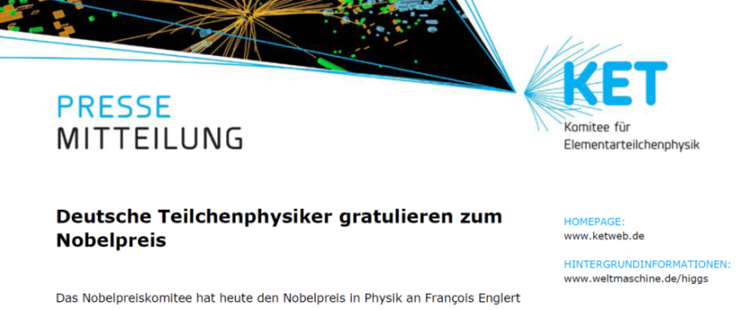
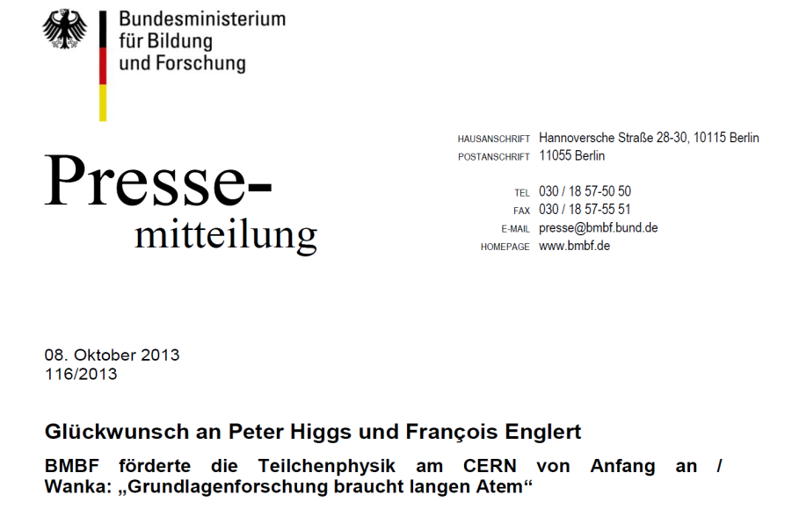
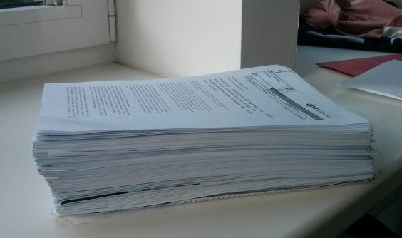
Higgs Nobel Prize in Germany
press releases: German particle physics committee for community; mirrored by Federal Ministry
background information
on www.weltmaschine.de
regional press releases / news on university website
press response: HUGE (Picture below: clippings of one week alone)

Slide 4
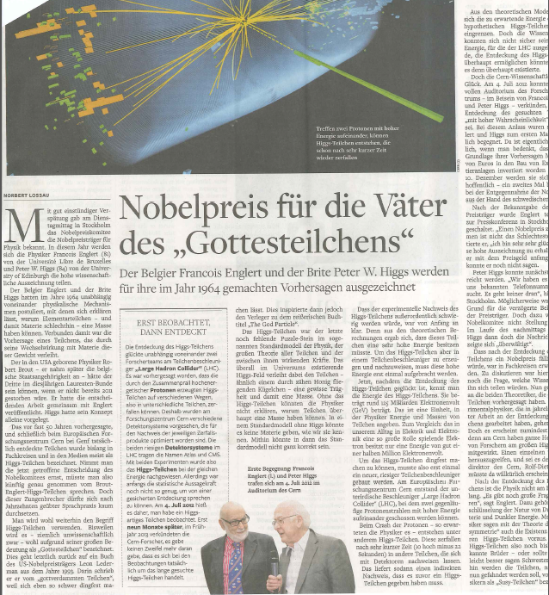
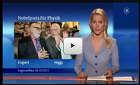
Media coverage
1.10 - 15.10
Number of articles
Print: 275 (254 daily newspaper)
News agencies: 25
TV: 73
Radio: 284
Online: 982
Reaching
more than 13 million people (TV)
more than 11 million people (Radio)
more than 13 million people (daily newspaper)

