Slide 1
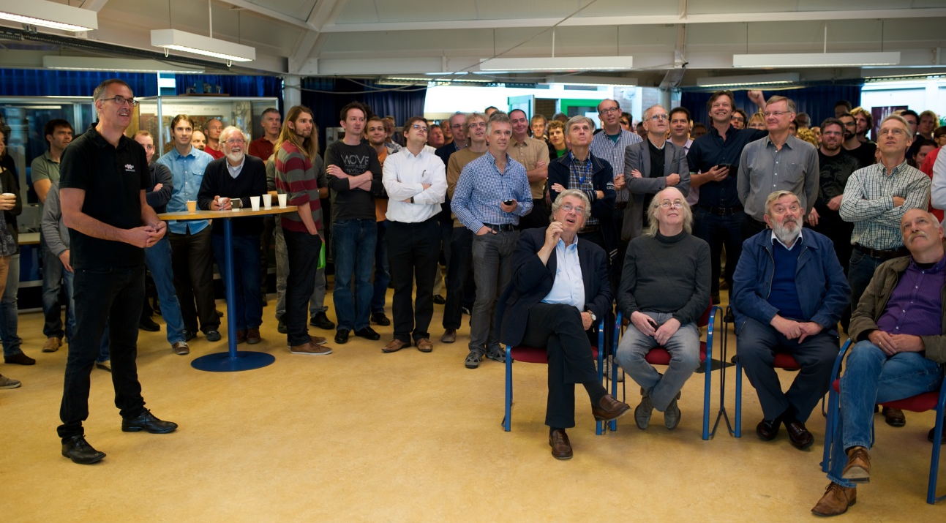
Nikhef on 8 October 2013
Webcast at Nikhef of announcement Nobel prize in Physics
( more than 100 Nikhef people attended, one radio journalist joined in. )
Nikhef press release with quotes (in Dutch)
Nikhef tweets

Slide 2
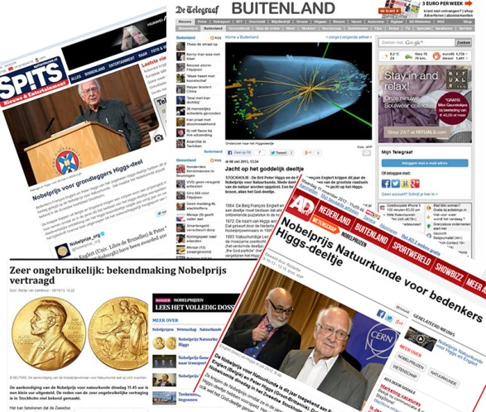
Media Coverage of Nobel Prize
71 articles
in Dutch newspapers
6 of which
with interviews/quotes
from Nikhef-researchers
92 articles online
8 of which
with interviews/quotes
from Nikhef-researchers

Slide 3
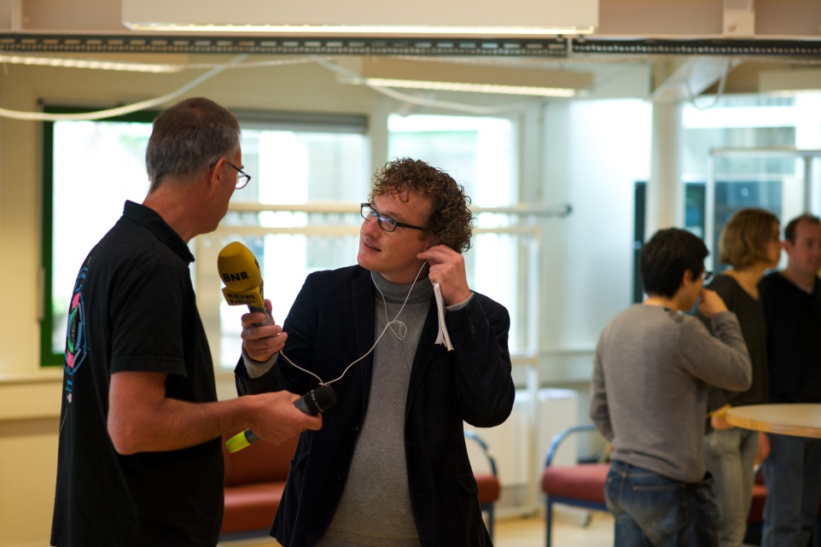
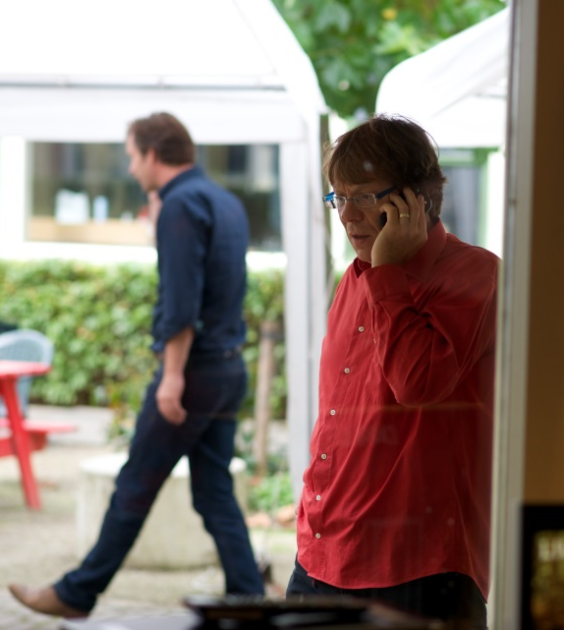
Media Coverage of Nobel prize
2 radio channels had interviews with Nikhef people
TV item in popular evening talk show (with science journalist who consulted us in advance and named Nikhef in the show)
TV items in news programmes (without mentioning Nikhef)

Slide 4
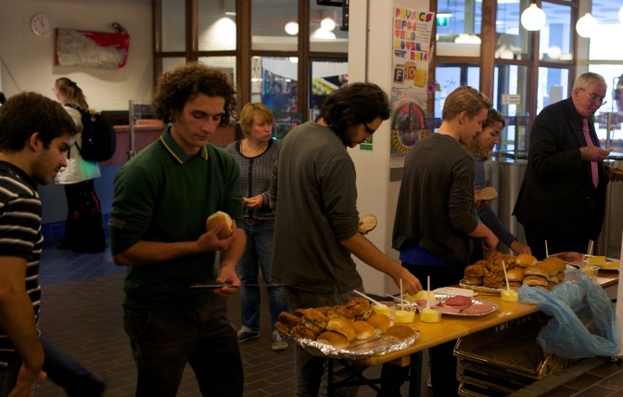
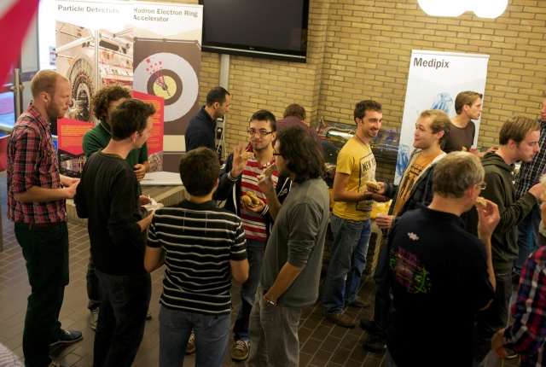
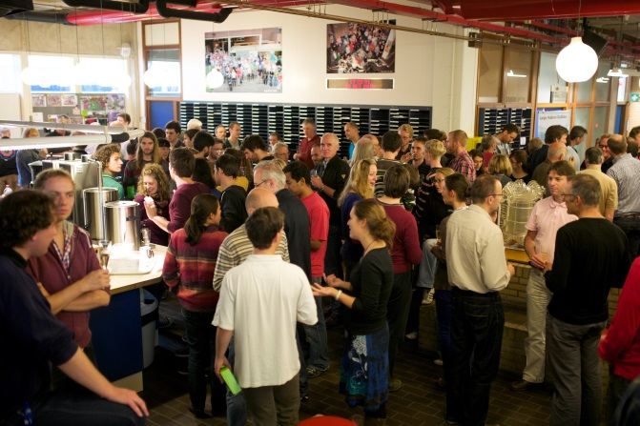
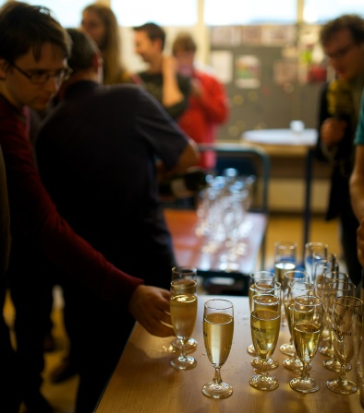

Nobel Prize Celebrations at Nikhef
Lunch for everyone during the long wait
And then champagne

