Slide 2
Basics of Accelerator Science and Technology at CERN
Magnet powering scheme
Jean-Paul Burnet

Slide 3
Definition
What is special for magnet powering?
Power electronics
Converter topologies
Converter association
Nested circuits
Energy management
Discharged converter
Power supply control
What should specify an accelerator physicist?

Slide 4
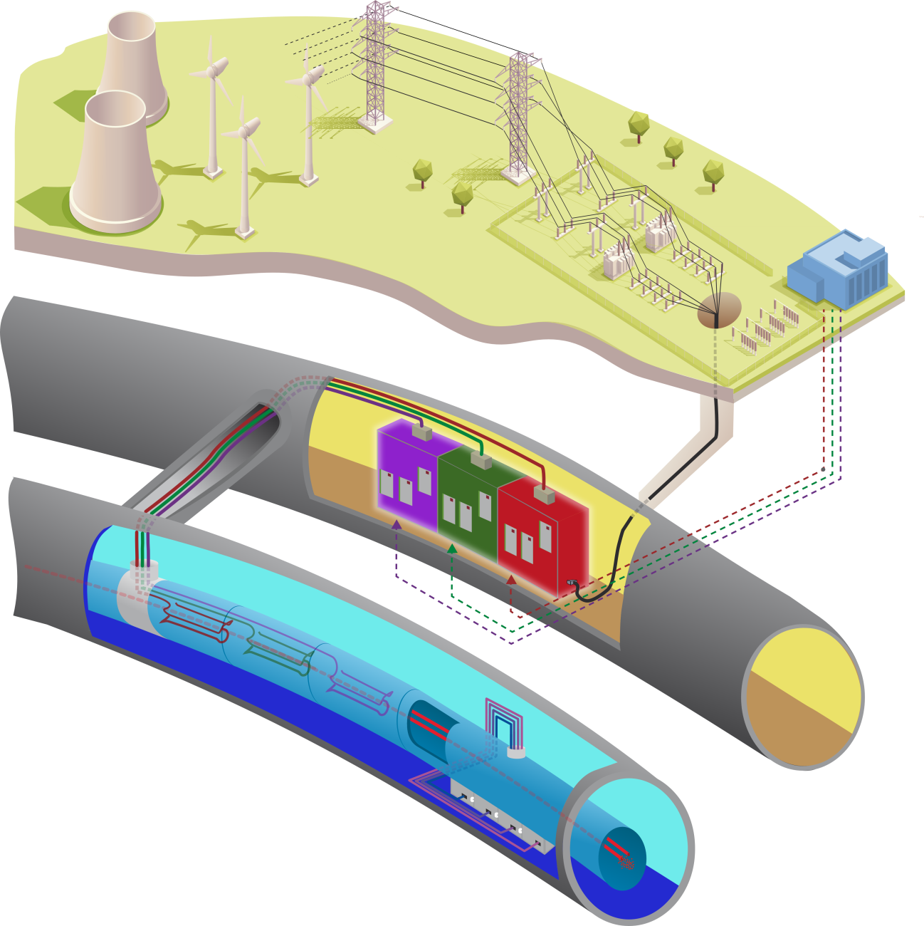
Definition
Wikipedia: A power supply is a device that supplies electric power to an electrical load.
Power supplies are everywhere:
Computer, electronics, motor drives,…
Here, the presentation covers only the very special ones for particles accelerators : Magnet power supplies
Power supply # power converter
US labs uses magnet power supplies
CERN accelerator uses power converter
CERN experiment uses power supply

Slide 5
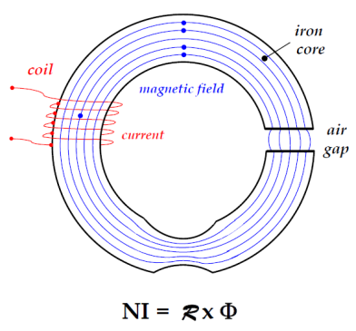
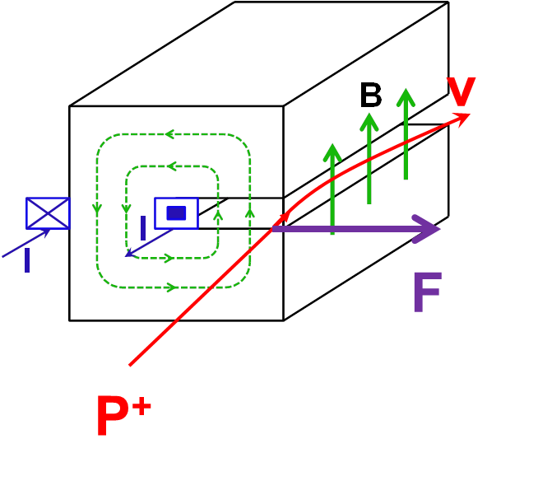
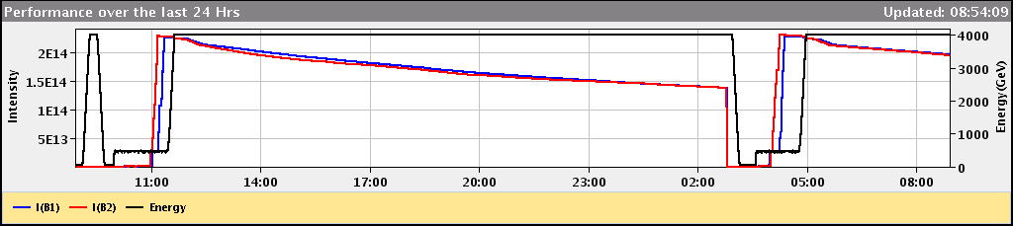
What is special for magnet powering ?
In a synchrotron, the beam energy is proportional to the magnetic field.
The magnet field is generated by the current circulating in the magnet coils.
Magnet current
Magnetic field in the air gap
LHC vistar : Beam Energy = Dipole Current

Slide 6
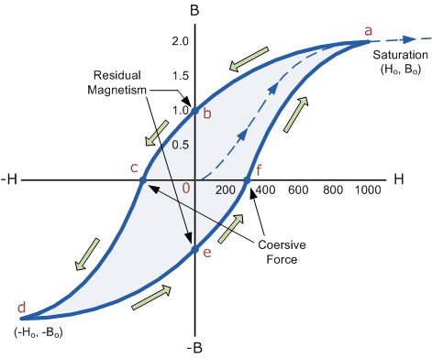
What is special for magnet powering ?
The relation between the current and B-field isn’t linear due to magnetic hysteresis and eddy currents.
In reality, Beam Energy = kf×Dipole field ≠ ki×Dipole Current
Classical iron yoke
Magnet current

Slide 7
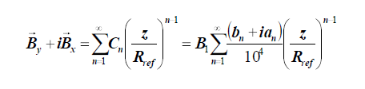
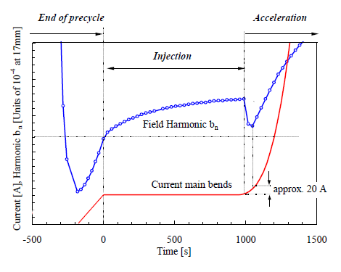
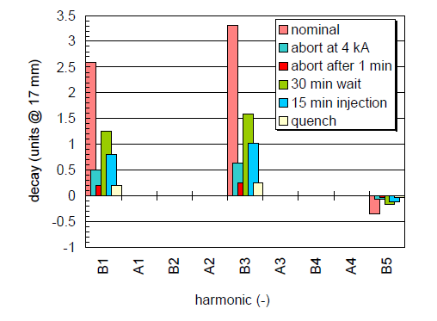
What is special for magnet powering ?
For superconducting magnet, the field errors (due to eddy currents) can have dynamic effects.
Decay Snapback
Decay is characterised by a significant drift of the multipole errors when the current in a magnet is held constant, for example during the injection plateau. When the current in a magnet is increased again (for example, at the start of the energy ramp), the multipole errors bounce back ("snap back") to their pre-decay level following an increase of the operating current by approximately 20 A.
For the energy ramp such as described in [3], the snapback takes 50-80 seconds but this can vary if, for example, the rate of change of current in the magnet is changed.
http://accelconf.web.cern.ch/accelconf/e00/PAPERS/MOP7B03.pdf

Slide 8
What is special for magnet powering ?
To solve this problem of hysteris, the classical degauss technique is used.
For a machine working always at the same beam energy, few cycles at beam energy will degauss the magnets. Example LHC precycle.
For machine or transfer line with different beam energies, the degauss has to take place at each cycle. Solution, always go at full saturation in each cycle.

Slide 9
What is special for magnet powering ?
Measuring the magnetic field is very difficult and need a magnet outside the tunnel.
In most of the synchrotrons, all the magnets (quadrupole, sextupole, orbit correctors,…) are current control and the beam energy is controlled by the dipole magnet current.
For higher performance, the solutions are :
Get a high-precision magnetic field model (10⁻⁴)
Real time orbit feedback system
Real time tune feedback
Real time chromaticity feedback
Or
Real-time magnetic field measurement and control (10⁻⁴)
How an operator change the beam energy with a synchrotron?
To ramp up, the operator increases the dipole magnetic field.
The radiofrequency is giving the energy to the beam, but the RF is automatically adjusted to follow the magnetic field increase (Bdot control).

Slide 10
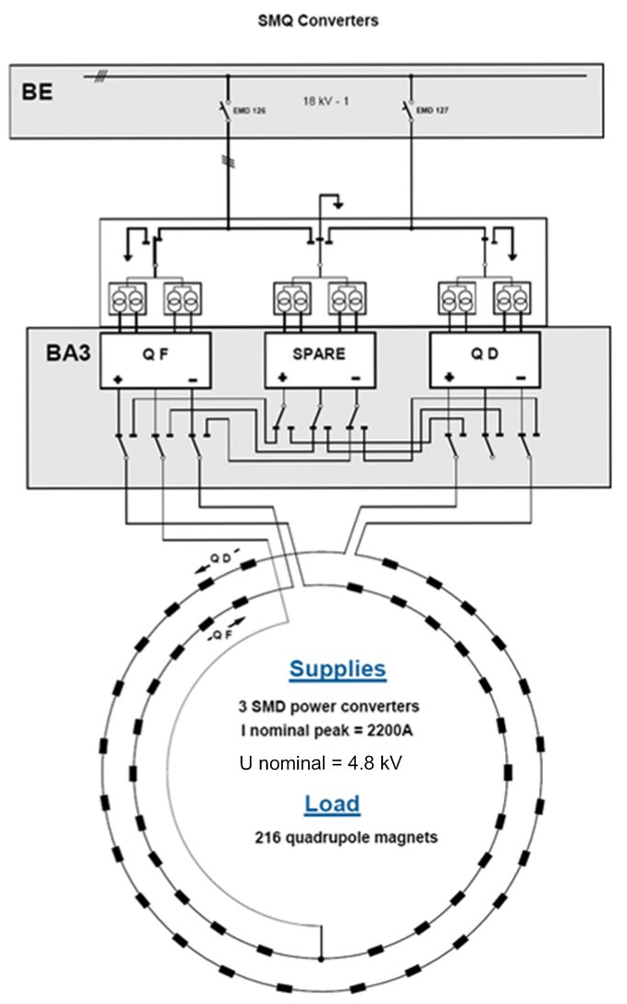
Magnet powering scheme
To get the same B-field in all the magnets, the classical solution is to put all the magnets in series.
Generally done with dipole and quadrupole.
Example of SPS quadrupole
Lead to high power system for Dipole and quadrupole.

Slide 11

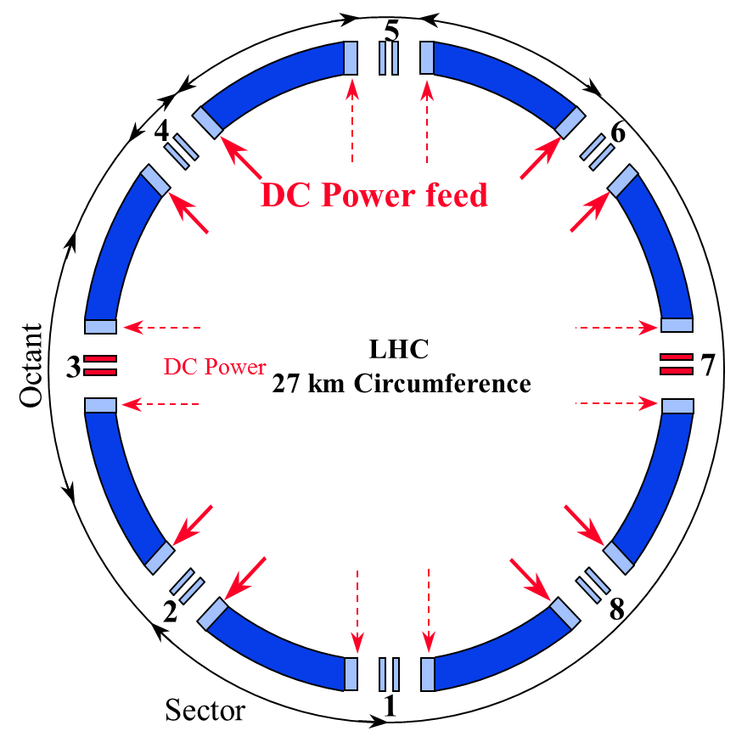
Magnet powering scheme
But when the power is becoming too high, the circuit can be split.
First time with LHC in 8 sectors.
Tracking between sector !
Powering Sector:
154 dipole magnets
total length of 2.9 km

Slide 12
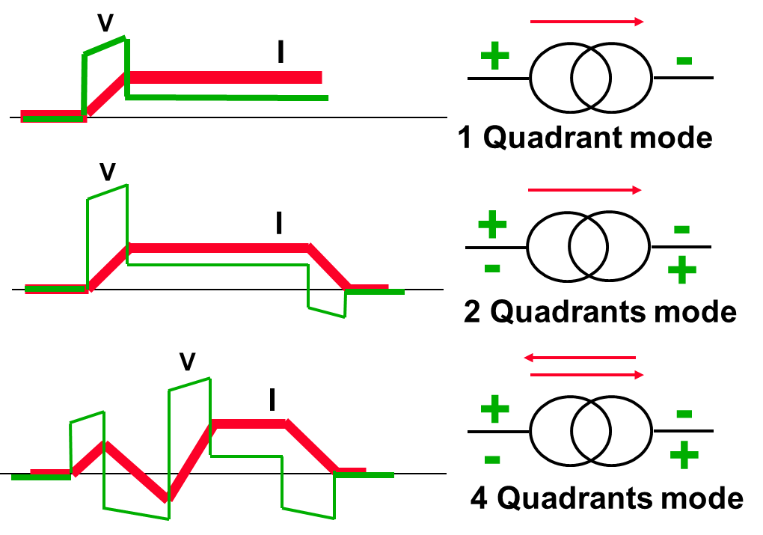
Magnet powering scheme
Vmagnet
Magnet current operation Power supply type
1
Imagnet
Vmagnet
1
Imagnet
2
Vmagnet
4
1
Imagnet
3
2
In quadrant 2 and 4, the magnet stored energy is returning to the power supply.
E_{magnet} = 0.5 * L_{magnet} * I²

Slide 13
What is special for magnet powering ?
The magnet power supplies are high-precision current control.
To build it, the technical solutions are out the industrial standard:
Need very low ripple
Need current and voltage control over large range
Operation in 1-2-4 quadrant
Need high-precision measurement
Need high-performance electronics
Need sophisticated control and algorithm
Powering a magnet isn’t classical, and few one the shelf product can be used
always custom power supplies
What is power electronics?
Special topologies
Special electronics and control

Slide 14
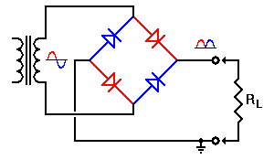
Power electronics
Power electronics is the application of solid-state electronics for the control and conversion of electric power.
Power electronics started with the development of mercury arc rectifier. Invented by Peter Cooper Hewitt in 1902, the mercury arc rectifier was used to convert alternating current (AC) into direct current (DC).
The power conversion systems can be classified according to the type of the input and output power
AC to DC (rectifier)
DC to AC (inverter)
DC to DC (DC-to-DC converter)
AC to AC (AC-to-AC converter)

Slide 15
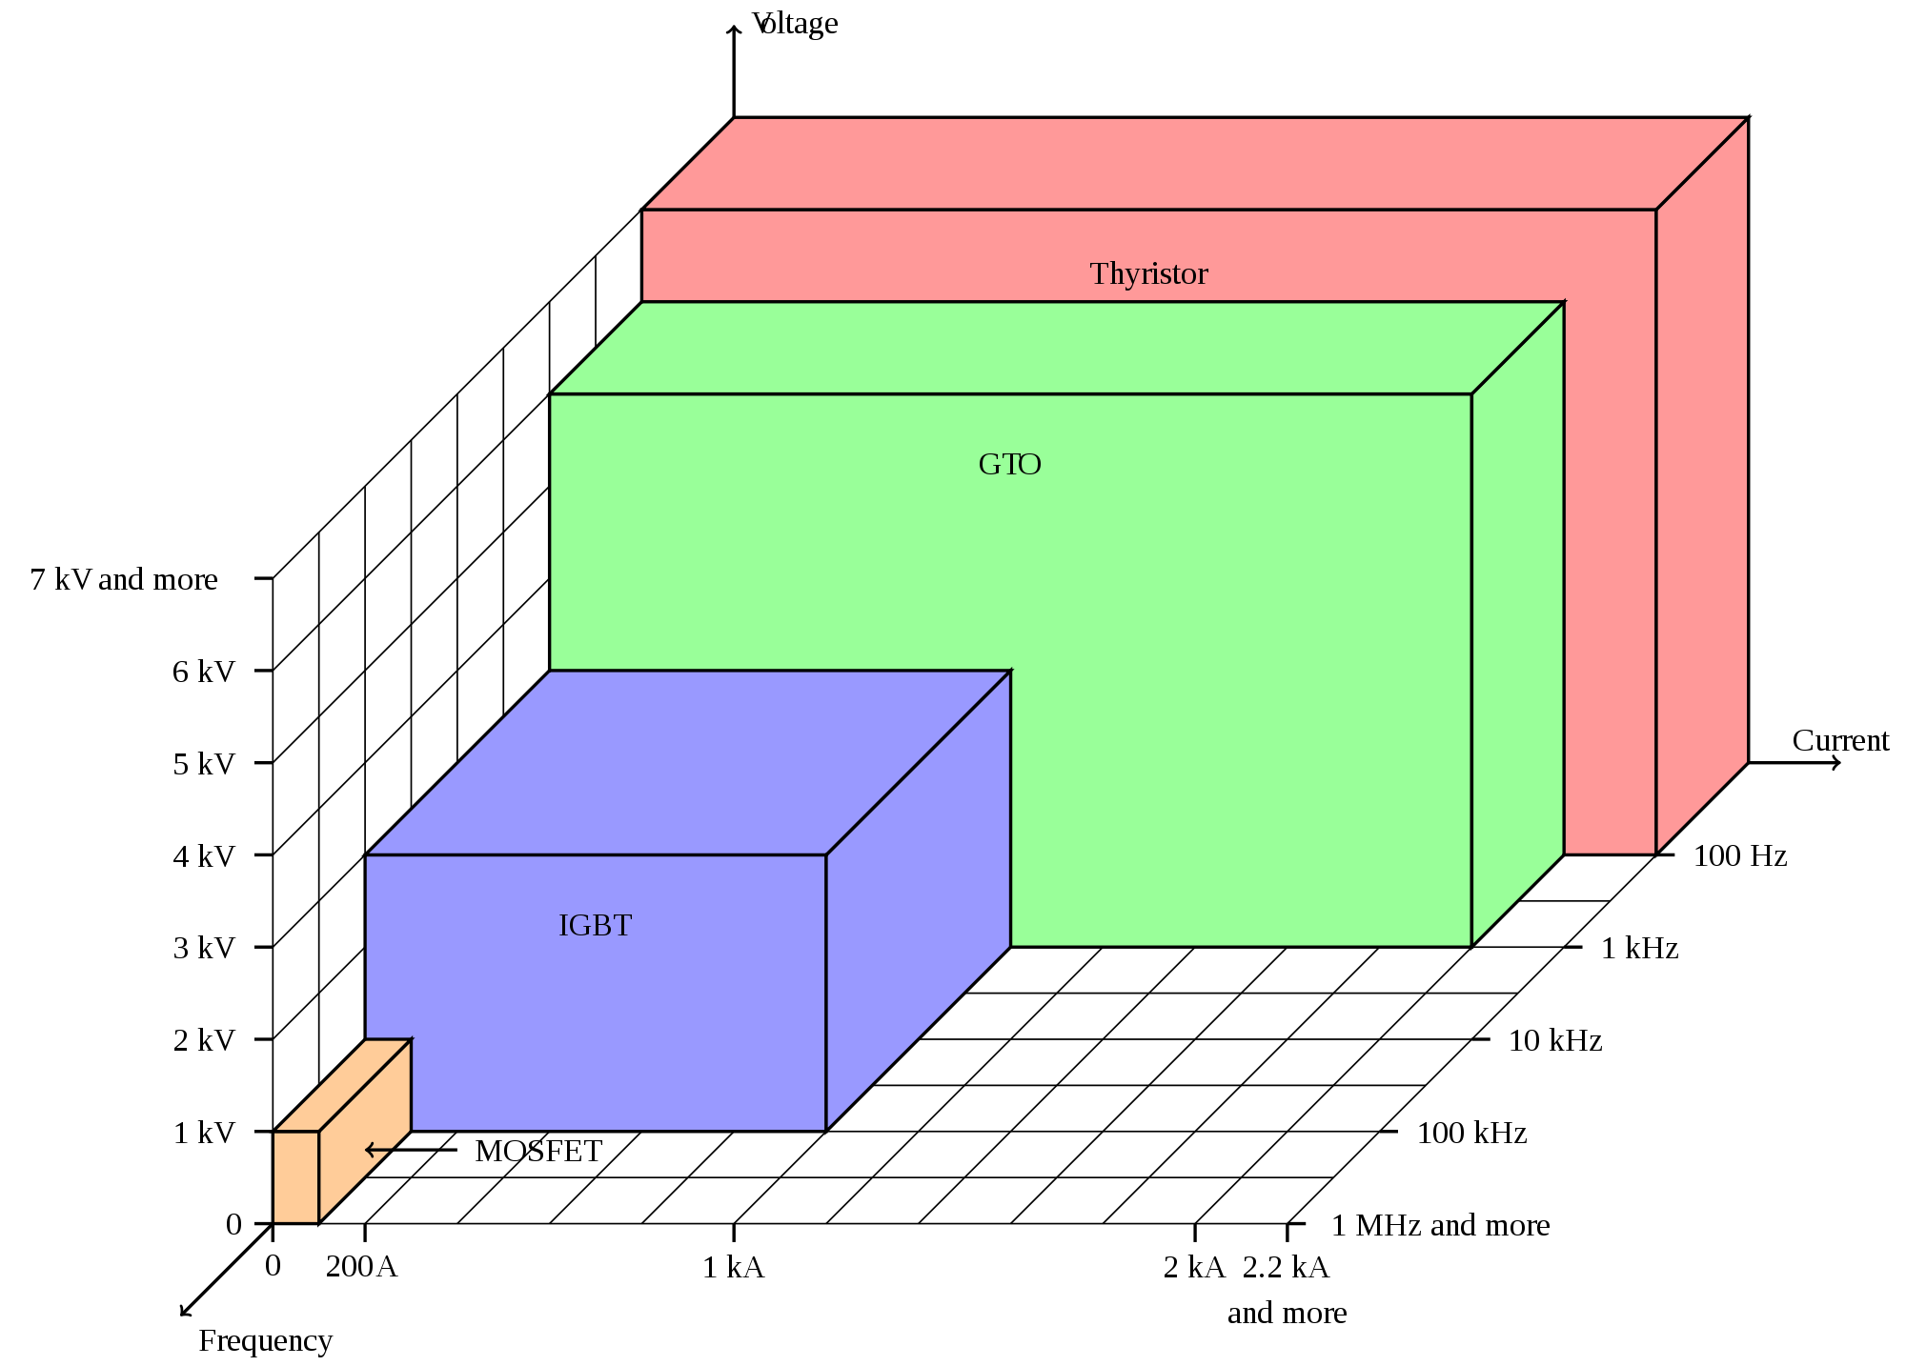
Switching devices
Nowadays, the main power semiconductors are:
Diode
MOSFET
IGBT
Thyristor
The most popular is the IGBT
GTO
IGBT
IGBT

Slide 16
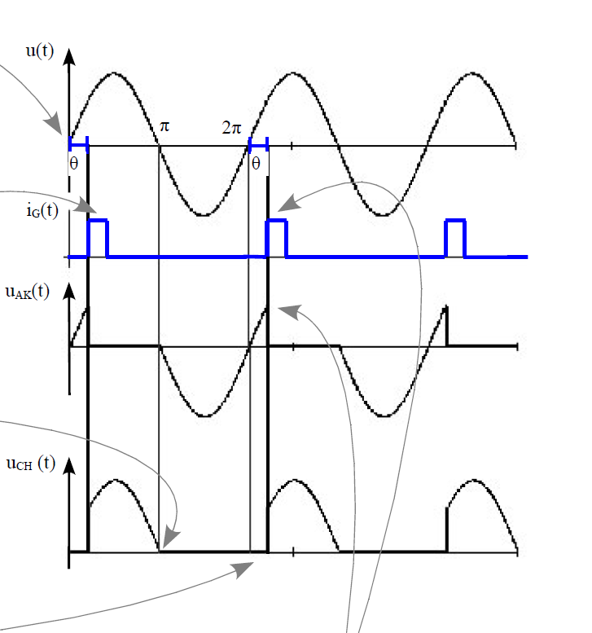
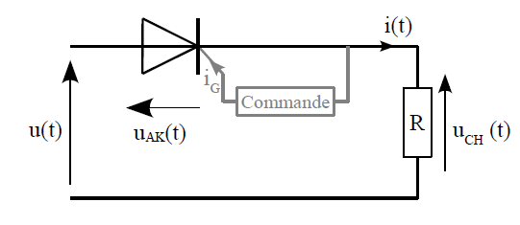
Thyristor principle
Thyristor (1956): once it has been switched on by the gate terminal, the device remains latched in the on-state (i.e. does not need a continuous supply of gate current to remain in the on state), providing the anode current has exceeded the latching current (I_{L}). As long as the anode remains positively biased, it cannot be switched off until the anode current falls below the holding current (I_{H}).
Thyristor Blocked
Thyristor turn ON
Thyristor turn OFF
At zero current
Turn ON possible when positive voltage

Slide 17
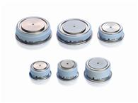
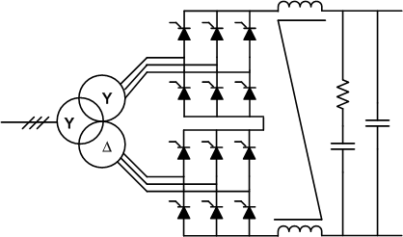
Topologies based on thyristor
The magnets need DC current.
The magnet power supplies are AC/DC.
The magnets need a galvanic isolation from the mains: 50Hz transformer
The thyristor bridge rectifier is well adapted to power magnets.
AC
AC mains
Magnets
DC
Thyristor advantages
Very robust
Cheap
Low losses
Thyristor drawbacks
Sensible to mains transients
Low losses
Low power density

Slide 18
Diode bridge rectifier
3 phases diode bridge voltage rectification
  Bridge output voltage is fixed, 1.35 * U _{line to line}

Slide 19
Thyristor bridge rectifier
3 phases Thyristor bridge voltage rectification
  Can control the bridge output voltage by changing the firing angle α
  Vout = Umax * cos α
    α = 15°, Vout = 0.96 * Umax
    α = 70°, Vout = 0.34 * Umax
    α = 150°, Vout = -0.86 * Umax
α
α
α

Slide 20
Thyristor bridge rectifier
Maximum voltage, α = 15°
α

Slide 21
Thyristor bridge rectifier
Transformer line current at maximum voltage, α = 15°
  The diode bridge current is in phase with the voltage
  For the thyristor rectifier, the AC line current is shifted with the angle α
α

Slide 22
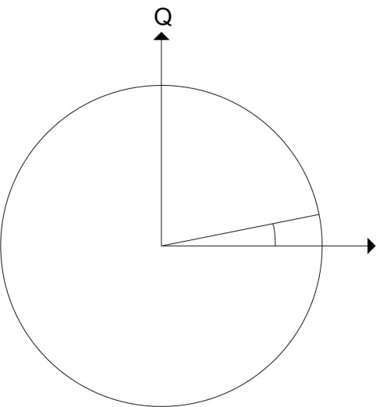
Thyristor bridge rectifier
Power analysis
  Power: P(t) = V_{r}(t) * I_{r}(t) + V_{s}(t) * I_{s}(t) + V_{T}(t) * I_{T}(t)
  Active power: P = 3 * V_{r} * I_{Line rms} * cos α
  Reactive power: Q = 3 * V_{r} * I_{Line rms} * sin α
  Apparent power:
  Power factor: P/S = cos α
  α = 15°
    Active power high
    Reactive power low
Q
P

Slide 23
Thyristor bridge rectifier
At flat top, α = 70°
Full current / low DC voltage
α

Slide 24
Thyristor bridge rectifier
Transformer line current at flat top (at α = 70°)
α

Slide 25
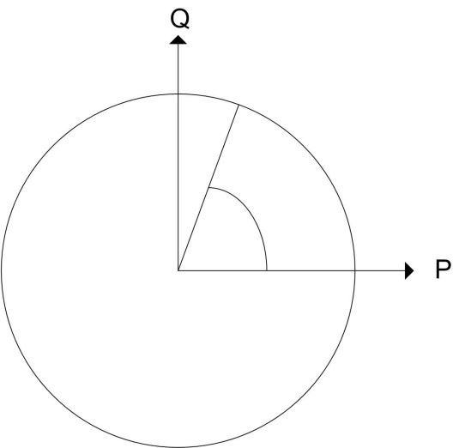
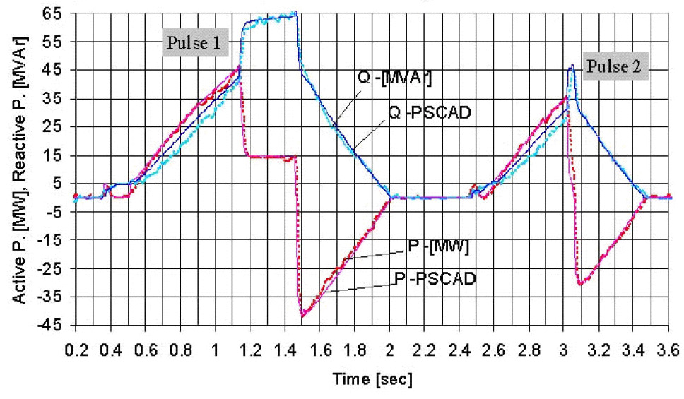
Thyristor bridge rectifier
Power analysis
  Active power: P = 3 * V_{r} * I_{Line rms} * cos α
  Reactive power: Q = 3 * V_{r} * I_{Line rms} * sin α
  Apparent power:
  α = 70°
    Active power low
    Reactive power high
Q
P

Slide 26
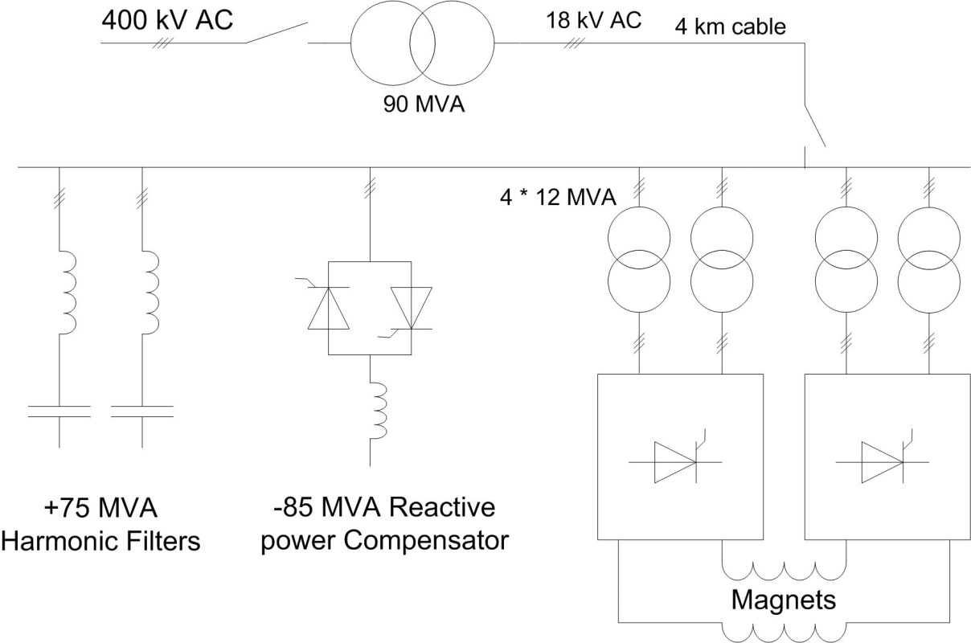
Reactive power compensation
Reactive power must be compensated.
Power factor > 0.93 for EDF.
Affect the mains voltage stability.
Solution :SVC: Static VAR Compensator, Qc
Q
P
Qc
SVC
Thyristor rectifiers

Slide 27
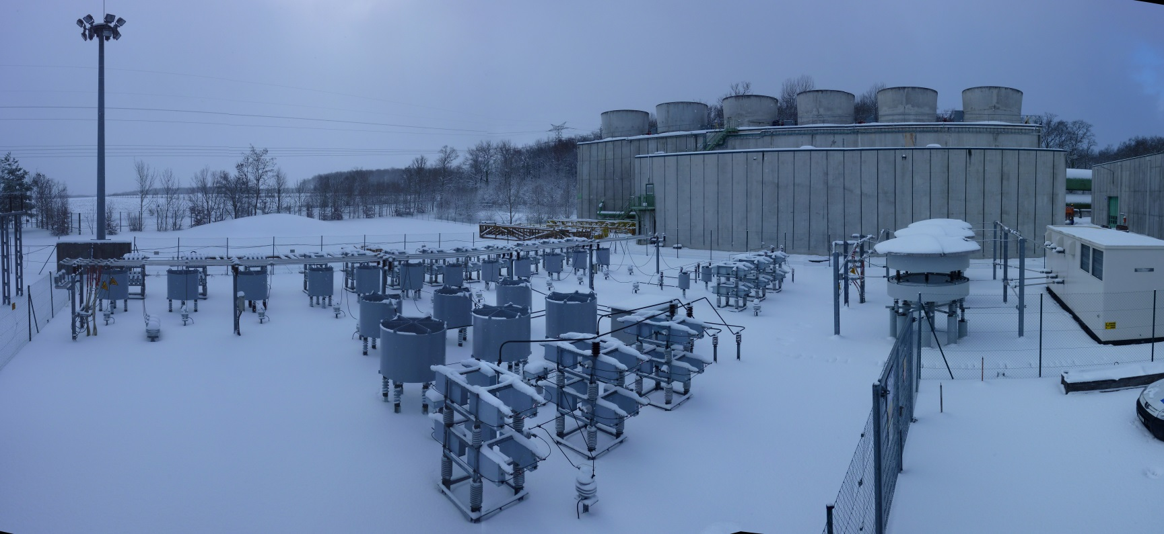
Reactive power compensation
SVC role on the 18kV
  Compensate reactive power (Thyristor Controlled Reactor)
  Clean the network (harmonic filters)
  Stabilize the 18kV network (>±1%)
Harmonic filters
TCR

Slide 28
Thyristor rectifier example
Example: LHC dipole converter 13kA/180V
Magnet: L = 15.7H
R = 0.001Ω
Iultimate = 13kA
Magnet operation:
Iinjection = 860A
dI/dt = ±10A/s
I_{4TeV} = 6.9kA
I_{7TeV} = 11.8kA
Magnet protected by
external dump resistor
I
(A)
pre-injection
(1 min - 1 h)
115 kW
860 A
several hours
11800
-10 A/sec
350 A
2,2 MW
1 min
+10 A/sec
500 W
350 A
860 A
0.1 A/sec
20 min
2 min
t

Slide 29
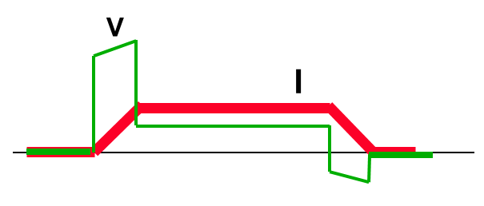
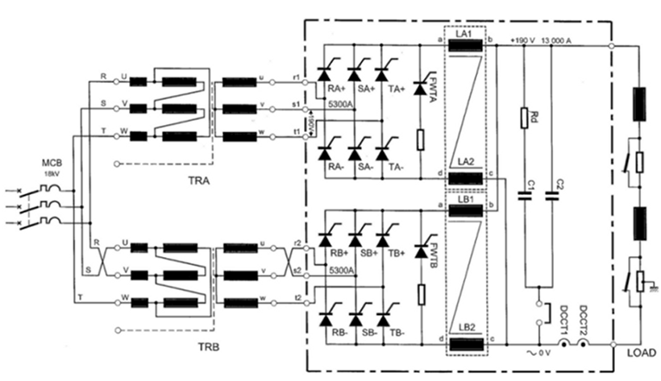
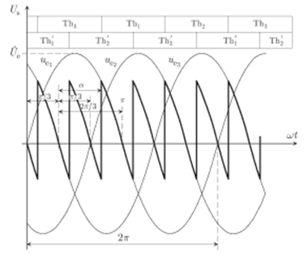
Thyristor rectifier example
Vmagnet
Example: LHC dipole converter 13kA / 180V
1
Imagnet
2
Magnets
18kV AC
50Hz transformer
Output filter
Thyristor rectifier

Slide 30
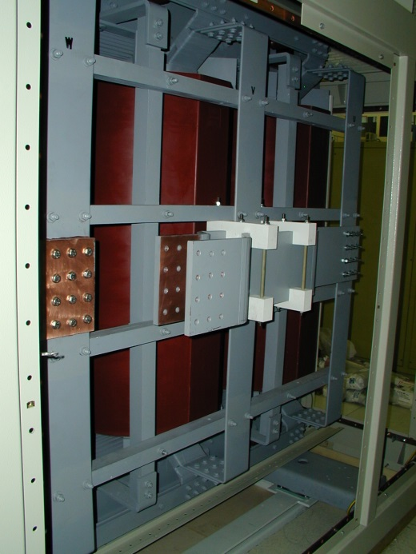
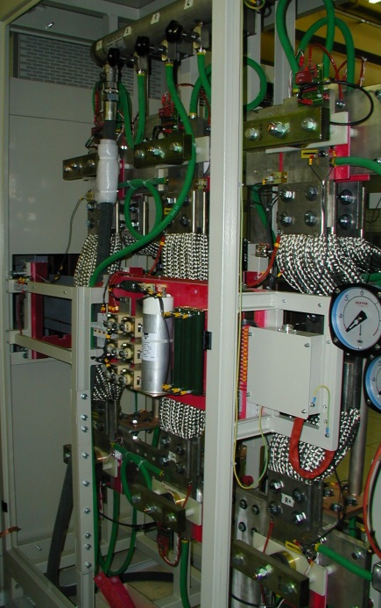
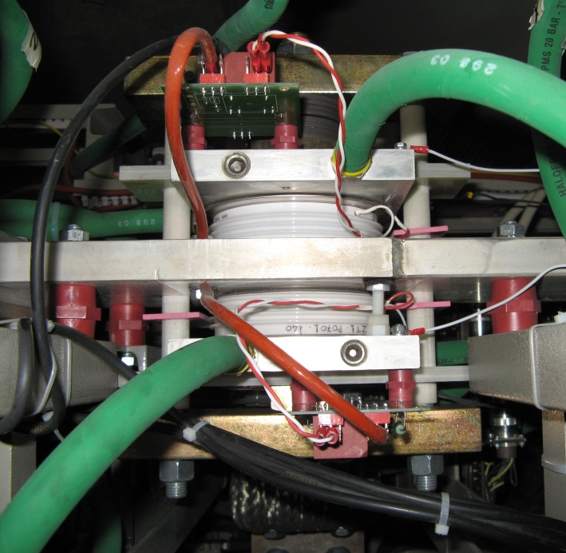
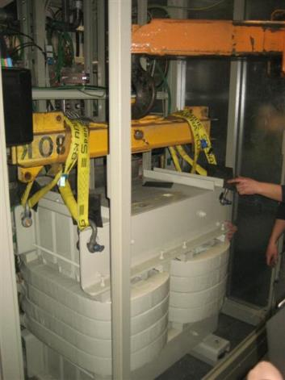
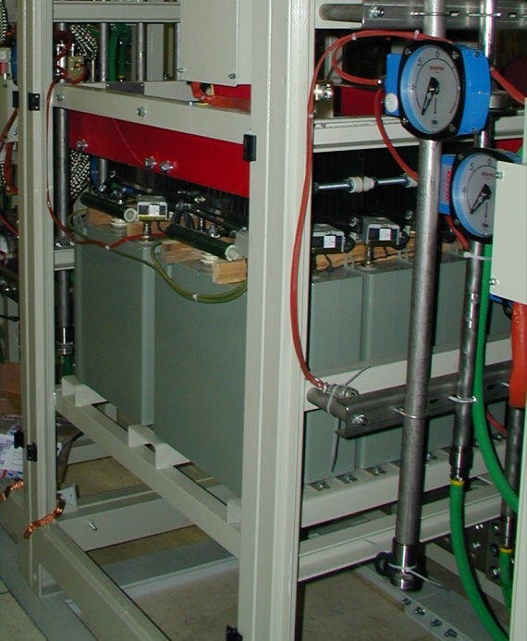
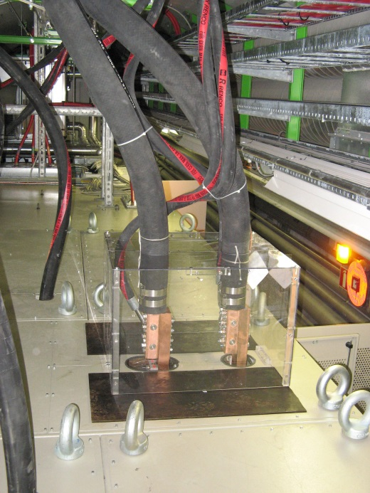
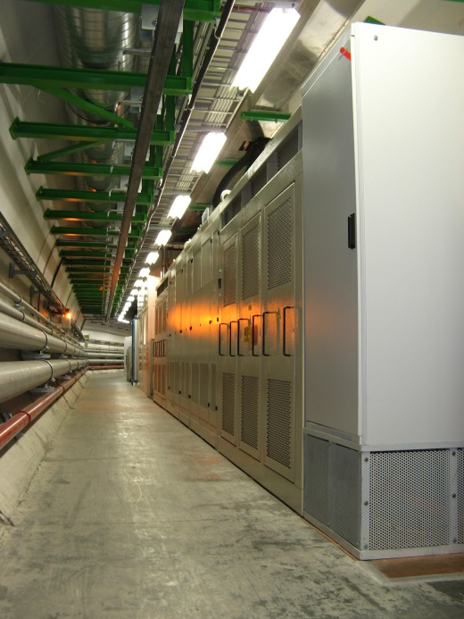

Slide 31
Thyristor rectifier
Limitation a low current due to discontinuity of current
300 Hz
300 Hz
18kV/600V
600 Hz
18kV
300 Hz
MCB
18kV/600V
Firing
300 Hz
Sum of line current
Vfiring
±I
=
2*I
Sum of bridge voltages
=
Minimum current

Slide 32
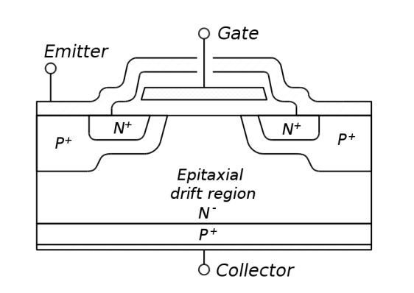
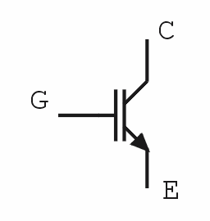
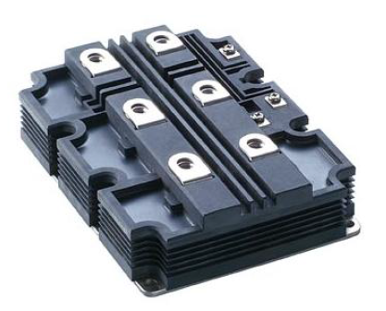
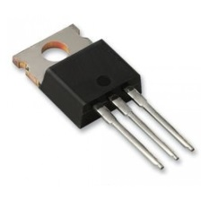
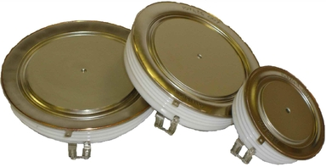
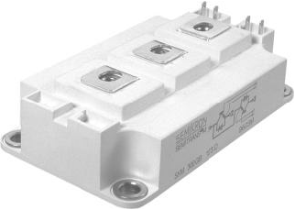
Topologies based on IGBT
What is an IGBT ?
The IGBT combines the simple gate-drive characteristics of the MOSFETs with the high-current and low-saturation-voltage capability of bipolar transistors.
The main different with thyristor is the ability to control its turn ON and turn OFF.
Many topologies can be built using IGBT.
200A 3kA
10A
1kA

Slide 33
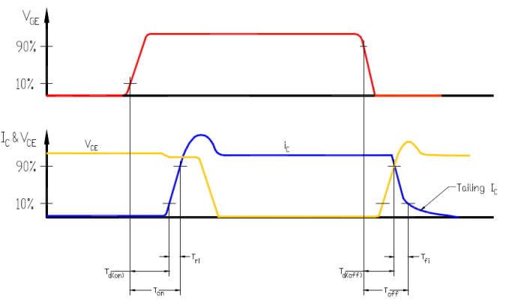
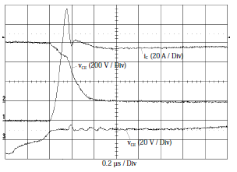
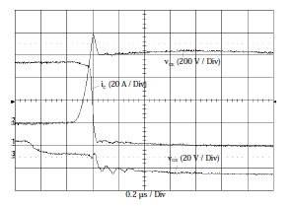
IGBT
Real IGBT turn-on and turn-off:
Very fast di/dt, dv/dt => EMC
Switching losses => thermal limitation

Slide 34
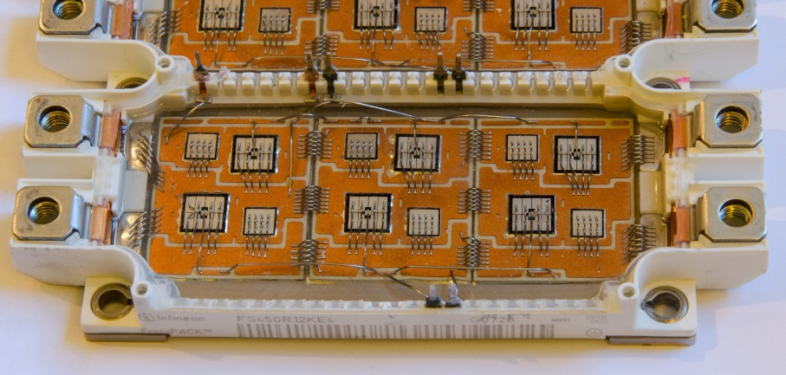
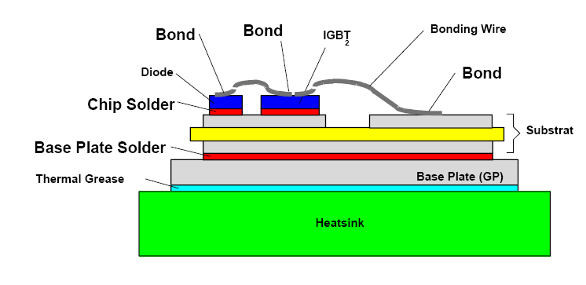
IGBT
Number of cycles
Thermal cycling of the IGBT
IGBT bonding can break after few thousand of thermal cycles

Slide 35
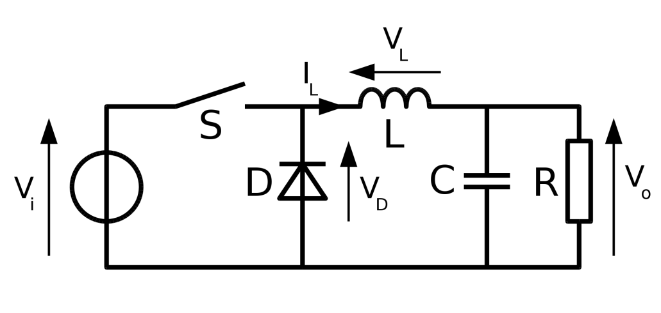
Power electronics basic concept
The basic principle is to command a switch to control the energy transfer to a load.
Example of a BUCK converter:
Constant voltage source
Load
Power switches
Filter

Slide 36

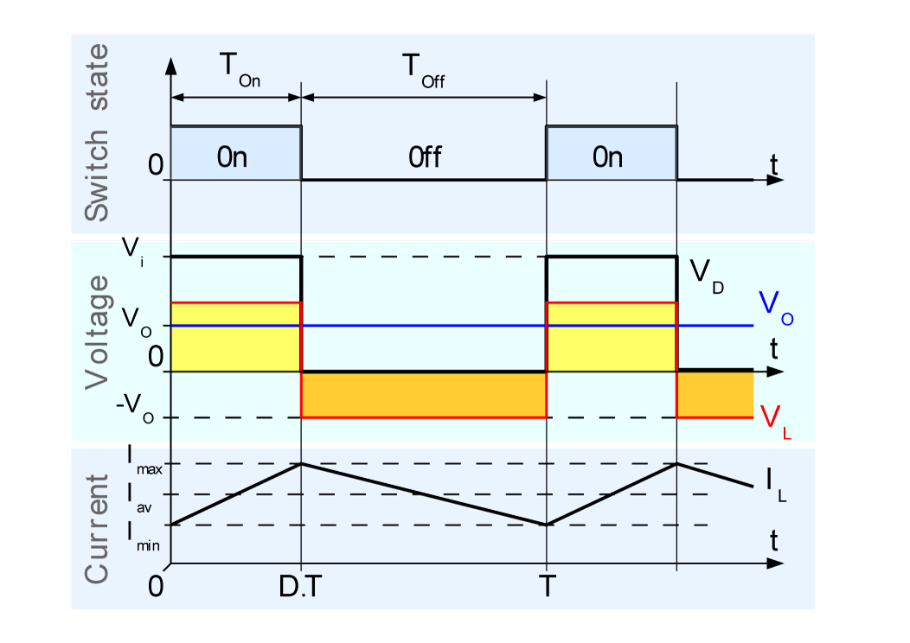
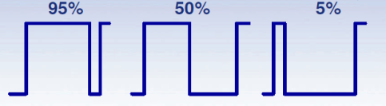
Power electronics basic concept
The switch S is switched ON during a short period which is repeated periodically.
<Vo> = Ton/T × Vi
Vout = α × Vi
The output voltage can be controlled by playing with the duty cycle α.

Slide 37
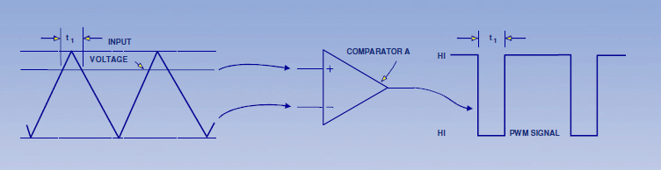
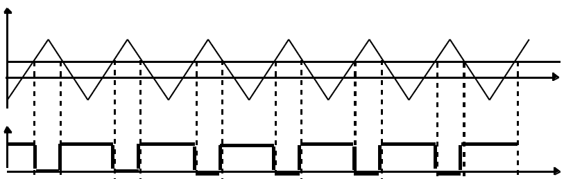
Power electronics basic concept
Most of the time, PWM (Pulsed Width Modulation) technique is used to control the switches. A triangular waveform is compared to a reference signal, which generates the PWM command of the switch.
Triangular waveform
Reference signal
ON
OFF

Slide 38
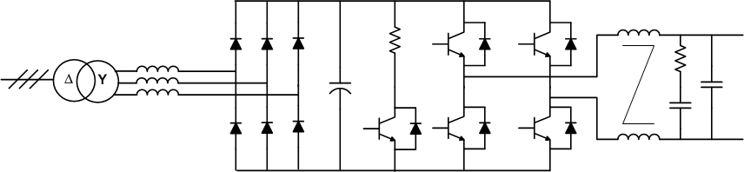
Topologies based on IGBT
The magnets need DC current.
The magnet power supplies are AC/DC.
The topologies are with multi-stages of conversion.
The magnets need a galvanic isolation from the mains: cases with 50Hz transformer
AC mains
AC
DC
Magnets
DC
DC

Slide 39
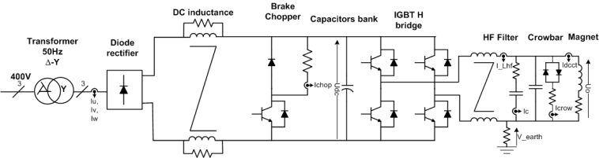
Switch-mode converters
Vmagnet
Example: PS converter: PR.WFNI, ±250A/±600V
4
1
Imagnet
3
2
50Hz AC/DC stage
High-frequency DC/DC stage

Slide 40








Slide 41





Transformer technologies
Two technologies are used for power transformers:
laminated magnetic core (like magnet):
50Hz technology
High field (1.8T)
Limitation due to eddy current
Low power density
High power range
Ferrite core (like kicker):
kHz technology
Low field (0.3T)
Nonconductive magnetic material, very low eddy current
High power density
Low power range (<100kW)

Slide 42


Topologies with HF transformer
In this case, it is multi-stages converter with high-frequency inverters
AC mains
AC
DC
AC
Magnets
DC
AC
DC
50Hz rectifier
HF inverters &
transformer
HF rectifier & filter

Slide 43

Switch-mode converter with HF inverter
Example: LHC orbit corrector, ±120A/±10V
Vmagnet
4
1
Imagnet
3
2

Slide 44





Slide 45
Converter association
When the power demand increases above the rating of the power semiconductor, the only solution is to build a topology with parallel or series connection of sub-system.
AC mains
AC
DC
AC
Magnets
DC
AC
DC
AC mains
AC
DC
AC
DC
AC
DC
AC mains
AC
DC
AC
DC
AC
DC

Slide 46



Parallel connection of sub-converters
Example: Atlas toroid magnet converter 20.5kA/18V
3.25kA/18V sub-converter 8 sub-converters in parallel
3.25kA/18V
Redundancy implementation, n+1 sub-converters
Can work with only n sub-converters
Vmagnet
1
Imagnet

Slide 47






Slide 48


Parallel connection with thyristor rectifier
Example: Alice Dipole, 31kA/150V

Slide 49

Series connection of sub-converters
Example: SPS dipole converter, 6kA/24kV
12 converters in series between magnets.
Each converter gives 6kA/2kV.
1
Imagnet
2

Slide 50







Slide 51

Nested circuits
Nested powering scheme is popular with accelerator physicists and magnet designers.
Allows association of different magnets or to correct local deviation over a long series of magnets.
Main reasons: saving on DC cables, current leads, lower power converter rating,…
Example, LHC inner triplet

Slide 52

Nested circuits
Nested powering scheme is a nightmare for power engineers !!
Very complex control, it is like a car with many drivers having a steering wheel acting on only one wheel.
Coupled circuits

Slide 53

Nested circuits
Very difficult to operate and repair, long MTTR.
All converters have to talk each others.
Need a decoupling control to avoid fight between converters !
Reduce investment but decrease availability!

Slide 54

Nested circuits
Look at the current and voltage of RQX while RTQX2 current is changing!
Nested circuits aren’t RECOMMANDED !
LHC inner triplet works perfectly well but MTTR is very high.
RHIC had many difficulties with nested circuits.

Slide 55


Energy management
Magnets need voltage to move their current:
Vmagnet(t) = Rmg * Img(t) + Lmg * dImg(t)/dt
Example with the PS main magnets
Imagnet_{max}=5.5kA
+35MW
average power = 4MW
2.4s
Vmagnet_{max}=±9kV
-35MW
Blue: Umagnet 1 kV / div
Red: Imagnet 500A / div
Light blue: Power_to_magnet 10 MW / div
Power(t) = I_magnet(t) x V_magnet(t)
The peak power needed for the main magnets is ±40MW with a dynamic of 1MW/ms
The average power is only 4MW !!!
The challenge: Power a machine which needs a peak power 10 times the average power
with a very high dynamic !!!

Slide 56
New concept for energy management
The energy to be transferred to the magnets is stored in capacitors
The capacitor banks are integrated in the power converter
DC/DC converters transfer the power from the storage capacitors to the magnets.
Four flying capacitors banks are not connected directly to the mains. They are charged via the magnets
Only two AC/DC converters (called chargers) are connected to the mains and supply the losses of the system and of the magnets.
Chargers
Magnets
Patent
The global system with dedicated control has been filed as a patent application. European Patent Office, Appl. Nr: 06012385.8 (CERN & EPFL)
DC converters
Flying capacitors

Slide 57
Energy management
Magnets current and voltage
Stored magnetic energy
12MJ
Power to the magnets
Capacitor banks voltage
Power from the mains =
Magnet resistive losses
+50MW peak
5kV to 2kV
10MW
POPS: POwer converter for the PS main magnets.

Slide 58

Energy management
Example: POPS 6kA/±10kV
Control room
Electrical room
Cooling tower
Power transformers
Capacitor banks

Slide 59


Energy management
Capacitor banks
  5kV Dry capacitors
  Polypropylene metalized self healing
  Outdoor containers: 2.5m x 12m, 18 tons
  0.247F per bank, 126 cans
  1 DC fuse
  1 earthing switch
  3 MJ stored per bank
60 tons of capacitors divided in
6 capacitor banks making in total 18.5MJ
Up to 14MJ can be extracted during a cycle!
The capacitors represent 20% of the total system cost.

Slide 60


Energy management
Best optimization : Max power taken on the mains # magnet average power
Resistive losses of the magnets
Power demand on the mains
Magnet average power
POPS energy management

Slide 61
Discharged converter
Synchrotrons
Linac’s and transfer lines
Beam is injected, accelerated and extracted in several turns
Beam is passing through in one shot, with a given time period;
B (T),
I (A)
extraction
B (T),
I (A)
Beam passage
acceleration
t (s)
t (s)
injection
Direct Energy transfer from mains is not possible:
Intermediate storage of energy
Peak power : could be > MW
Average power kW
Rise and fall time < few ms

Slide 62
Discharged converter
Charge
Discharge

Slide 63

Example of LINAC4 Klystron modulator
Specification | symbol | Value | unit
Output voltage | V_{kn} | 110 | kV
Output current | I_{out} | 50 | A
Pulse length | t_{rise}+t_{set}+t_{flat}+t_{fall} | 1.8 | ms
Flat-Top stability | FTS | <1 | 5
Repetition rate | 1/T_{rep} | 2 | Hz
Beam passage
1800µs
Peak power : 5.5MW
Average power: 20kW

Slide 64
Power supply control
Power Part
AC
Supply
Load
Local control
Load characteristics are vital.
Transfer function is a must !
Control
Transducer
Reference

Slide 65

Power supply control
The power supply are controlled by the global control system.
They need to be synchronized => Timing
Locally, a fieldbus (must be deterministic) is used to communicate with a gateway,
WORLDFIP in the LHC
ETHERNET for LINAC4
In each power supply, an electronic box (FGC) manages the communication, the state machine and do the current control.
Real time software is implemented.

Slide 66




Power supply control
Voltage loop
Digital Current loop
I
B
Vref
Iref
e_{I}
+
V
Reg.
DAC
G(s)
-
e_{V}
F(s)
I_{measured}

Slide 67



High-precision definition
Nee calibration to reference
Accuracy
The closeness of agreement between a test result and the accepted reference value. (ISO)
Reproducibility
Uncertainty when returning to a set of previous working values from cycle to cycle of the machine.
Stability
Maximum deviation over a period with no changes in operating conditions.
Trueness

Slide 68

Accuracy characterisation
The term Accuracy is a qualitative concept, used to describe the quality of a measurement. At CERN (and elsewhere) a measurement’s systems capability is often characterized in terms of Gain and Offset errors, Linearity, Repeatability, Reproducibility and Stability.
Linearity:
Difference in the systematic error of a measuring device, throughout its range.
Gain and Offset errors:
They are systematic errors that relate to the trueness of a measurement.
The offset error refers to the systematic error at zero and the gain error to the systematic error at full scale.
Stability:
Measurement of the change in a measurement system’s Systematic errors with time. We can more specifically refer to Gain Stability or Offset Stability.
Noise can also be seen as a measurement of a device’s stability, although normally the term stability is used only for the low frequency range (≤Hz).
http://te-epc-lpc.web.cern.ch/te-epc-lpc/sensors/definitions.stm

Slide 69

Current measurement technologies

Slide 70




High-precision Current measurement chain
Precision amplifier and burden
Signal conditioning and filtering
High-resolution ADC

Slide 71

LHC class specification

Slide 72


LHC class 1 DCCT
13kA DCCT
Magnetic Head
13kA DCCT
Electronics
DCCT specification
Gain drift 1 year | 5 ppm
Offset drift 1 year | 5 ppm

Slide 73
LHC class 1 ADC
The CERN 22 bit Delta Sigma ADC
DS22 specification
Gain drift 1 year | 20 ppm
Offset drift 1 year | 10 ppm

Slide 74

LHC class 1 global accuracy
Converter category | Accuracy Class | 1 year stability
Main Dipoles | Class 1 | 50
LHC specification
50ppm/year
LHC result
< 10ppm/year with annual calibration
Possible improvement
< 2ppm/year with monthly calibration

Slide 75


LHC resolution
Smallest increment that can be induced or discerned.
The resolution is expressed in ppm of maximum DCCT current.
Resolution is directly linked to A/D system.
I*_{ref} ± ΔI*_{ref}
I
B
DAC
V
I*_{meas.} ± ΔI*
I_{meas} + ΔI.
ADC

Slide 76
LHC resolution
Best resolution achieved = 1ppm
80
I₀ = 1019.9 Amps
4
60
3
Current offset in Milliamps
40
Current offset in ppm of 20 kA
2
20
1
Reference
0
Measured
0
0
1
2
3
4
5
6
7
8
Time in Seconds

Slide 77



Current regulation
The performance of the current regulation is critical for a machine. Can be a nightmare for operators!
RST controller provides very powerful features:
Manage the tracking error as well as the regulation.
Iref
Current reference
Imeas
Current measurement

Slide 78

Current regulation
Anti-windup is needed to control the saturation of the loop.
complex control loop
The real controller is shown below:

Slide 79

Current regulation
Tutorial is proposed here on the FGC currant regulation
Here you can find some examples
https://project-cclibs.web.cern.ch/project-cclibs/download_tutorial.htm
https://project-cclibs.web.cern.ch/project-cclibs/plots/tests/

Slide 80
ripples
V
I
B
Load
H(s)
Magnet
F(s)
Power converter
V = R . I + L . dI/dt
=> H(s) = 1/ (L/R . s + 1)
Control
Voltage ripple is defined by the power supply
Current ripple : load transfer function (cables & magnet)
B-Field ripple : magnet transfer function (vacuum chamber,…)
Current ripple
Depends of the load

Slide 81




Grounding
Particles accelerators are very sensitive to EMC (conducted and radiated noise).
Need a meshed earth !
http://indico.cern.ch/getFile.py/access?contribId=44&sessionId=9&resId=0&materialId=slides&confId=85851

Slide 82

Grounding
Appling good EMC rules to power supplies:

Slide 83
What do an accelerator physicist should specify ?
If you have already designed the magnets without including power supply engineer, you have already made a mistake!
Powering optimization plays with magnet parameters
The power engineer has to be included in the accelerator design from the beginning!

Slide 84
What do an accelerator physicist should specify ?
Magnet parameters:
Inductance, in mH
Resistance, in mΩ
Maximum current
Voltage rating
DC cable resistance, in mΩ
much better, magnet model including saturation effect
Load Saturation model
Inductance
_{L}
L
L_{m}(I)=f(I).L
_{Rs}
_{Rm}
Load model 3
_{Rp}
L_{sat}
I_{sat_start}
I_{sat_end}
Current

Slide 85

What do an accelerator physicist should specify ?
Magnet operation:
Precision class
Type of control: Current / B-field
Maximum current ripple
Complete cycle
  Injection current
  Maximum dI/dt, ramp-up
  Maximum flat top current
  Maximum dI/dt, ramp-down
  Return current
  Cycle time
Degauss cycle / pre-cycle
Magnet protection system
Power supply functional specification

Slide 86



Power supply delivery
From power supply functional specification
Power supply design
simulation
Component design
3D mechanical integration
Production
Laboratory Tests
On site commissioning
https://edms.cern.ch/document/829344/3
Minimum 18 months

Slide 87


Summary
Power supplies are the main actuators of a particles accelerator.
The performances for particles accelerators are very challenging.
Creativity on many technical fields are required!
More training :
Special CAS on power converters
7 – 14 May 2014
Baden (CH)
WikipediA
The Free Encyclopedia

