Slide 1
Introduction to
Beam Diagnostics
Ulrich Raich
CERN BE - BI
(Beam Instrumentation)

Slide 2
A few depicted examples
Introduction
Beam presence: Scintillating screens (LHC)
Intensity measurement, Faraday Cup and Transformer (Linac-4)
Transverse Profile measurement, wire scanner & wire grids
(PSB & PS)
Emittance measurement
  Slit and Grid (Linac-4, 3 MeV line)
  Emittance measurement line (Linac-2)
  Longitudinal Emittance measurement (Linac-2)
Trajectory measurement (LHC and PS) using Beam Position Monitors (BPMs)
Longitudinal phase space: Tomoscope (PS) using a wall current monitor
Tune measurement (SPS) using BPMs
Losses: Beam Loss Monitors (BLMs) (LHC)

Slide 3
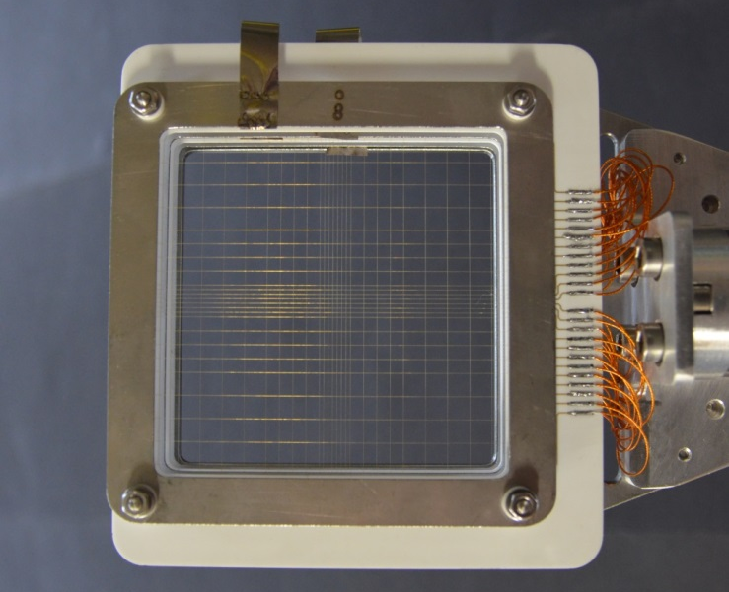
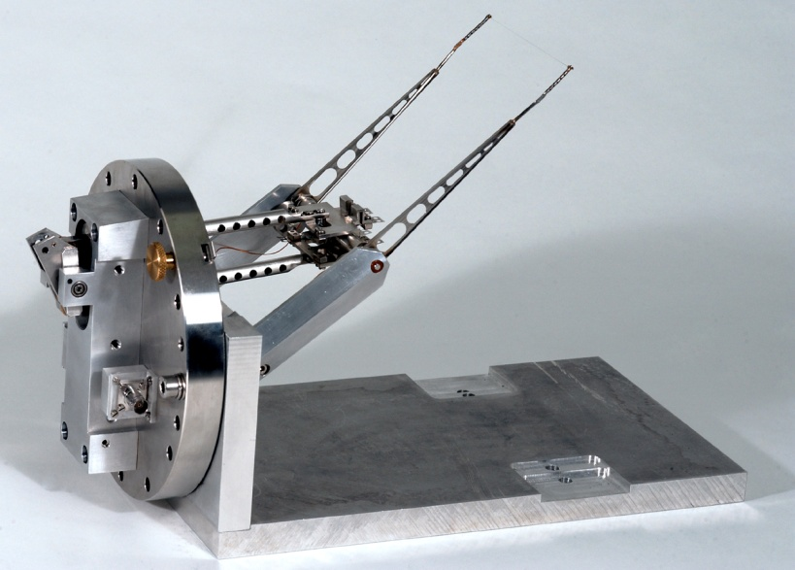
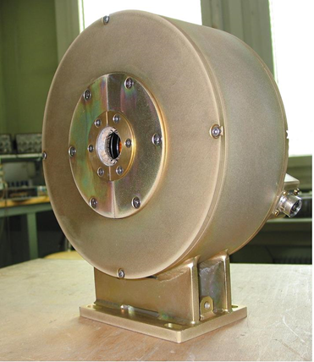
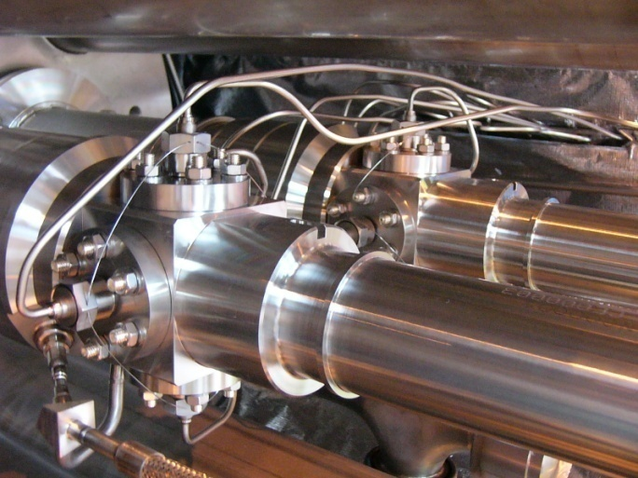
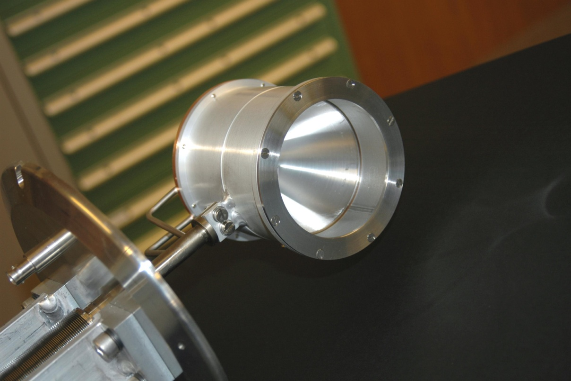
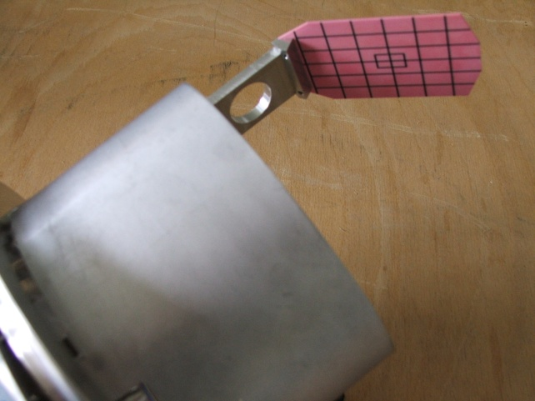
Introduction
An accelerator can never be better than the instruments measuring its performance!

Slide 4
Diagnostic devices and quantity measured
Instrument | Physical Effect | Measured Quantity | Effect on beam
Faraday Cup | Charge collection | Intensity | Destructive
Current Transformer | Magnetic field | Intensity | Non destructive
Wall current monitor | Image Current | Intensity Longitudinal beam shape | Non destructive
Pick-up | Electric/magnetic field | Position, Tune | Non destructive
Secondary emission monitor | Secondary electron emission | Transverse size/shape, emittance | Disturbing, can be destructive at low energies
Wire Scanner | Secondary particle creation | Transverse size/shape | Slightly disturbing
Scintillator screen | Atomic excitation with light emission | Transverse size/shape (position) | Destructive
Residual Gas monitor | Ionization | Transverse size/shape | Non destructive

Slide 5
Different uses of beam diagnostics
Regular crude checks of accelerator performance
  Beam Intensity
  Radiation levels
Standard regular measurements
  Emittance measurement
  Trajectories
  Tune
Sophisticated measurements e.g. during machine development sessions
  May require offline evaluation
  May be less comfortable

Slide 6
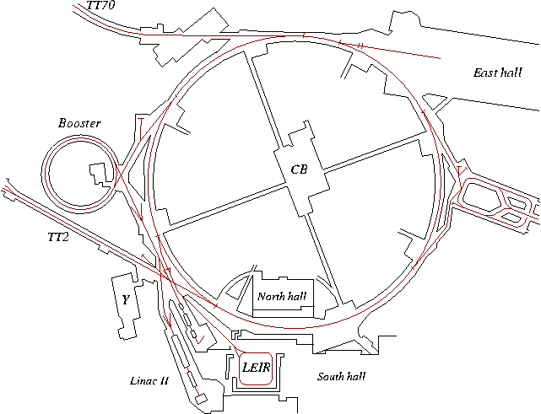
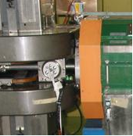
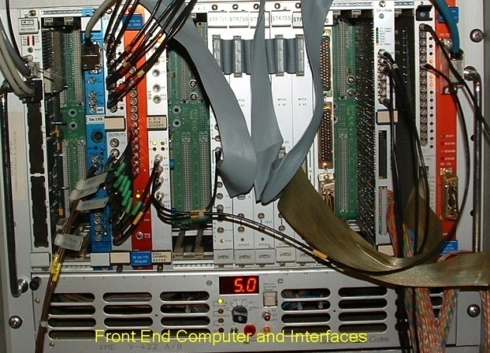
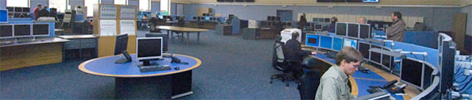
A beam parameter measurement

Slide 7
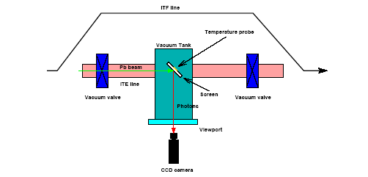
Beam Presence
Scintillating Screens
Method already applied in cosmic ray experiments
Very simple
Very convincing
Needed:
Scintillating Material
TV camera
In/out mechanism
Problems:
Radiation resistance
of TV camera
Heating of screen (absorption of
beam energy)
Evacuation of electric charges

Slide 8

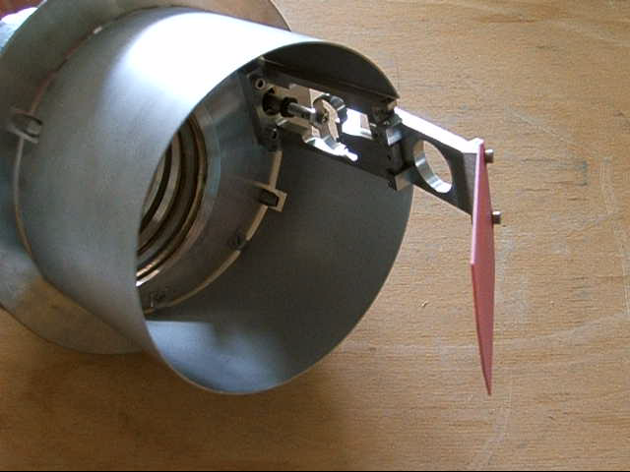

Screen mechanism
Screen with graticule

Slide 9
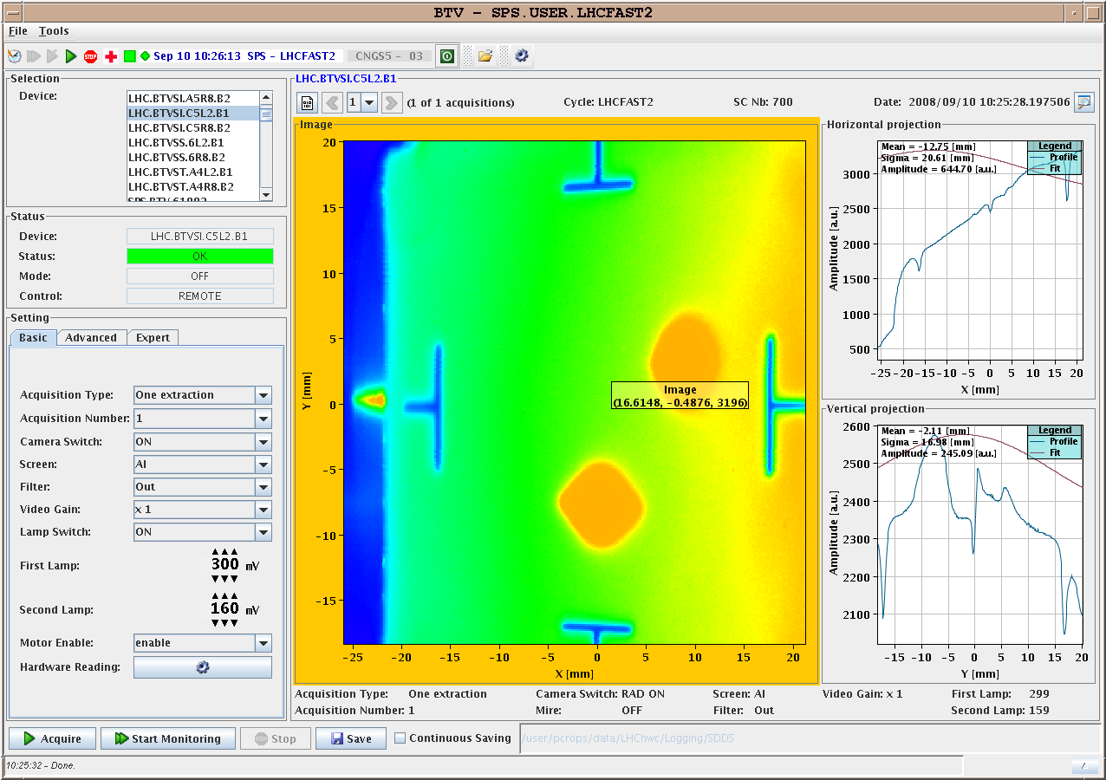
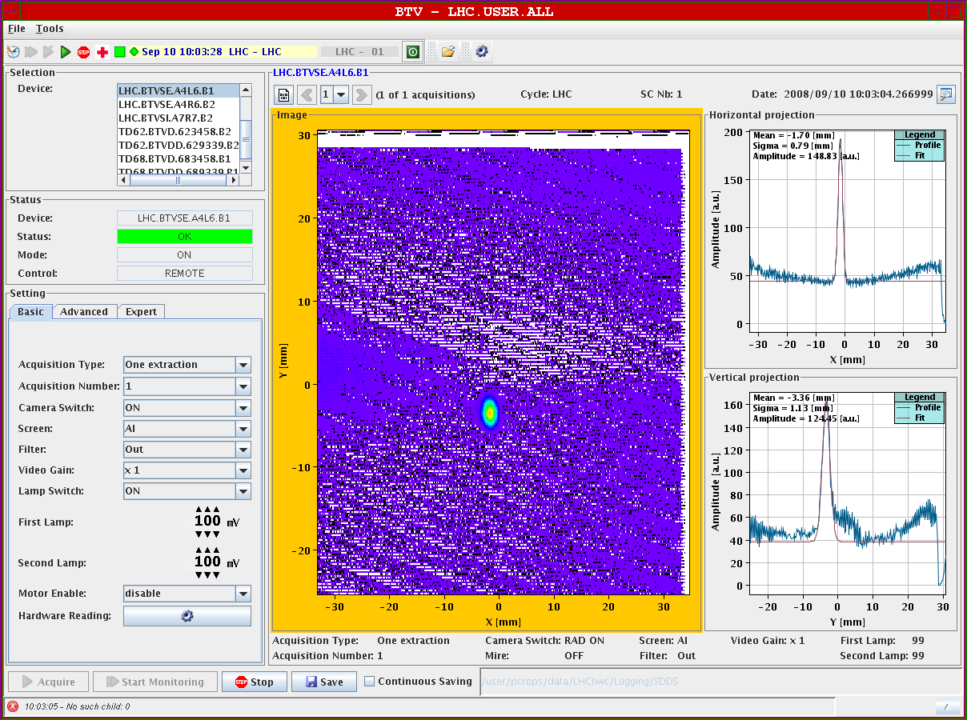
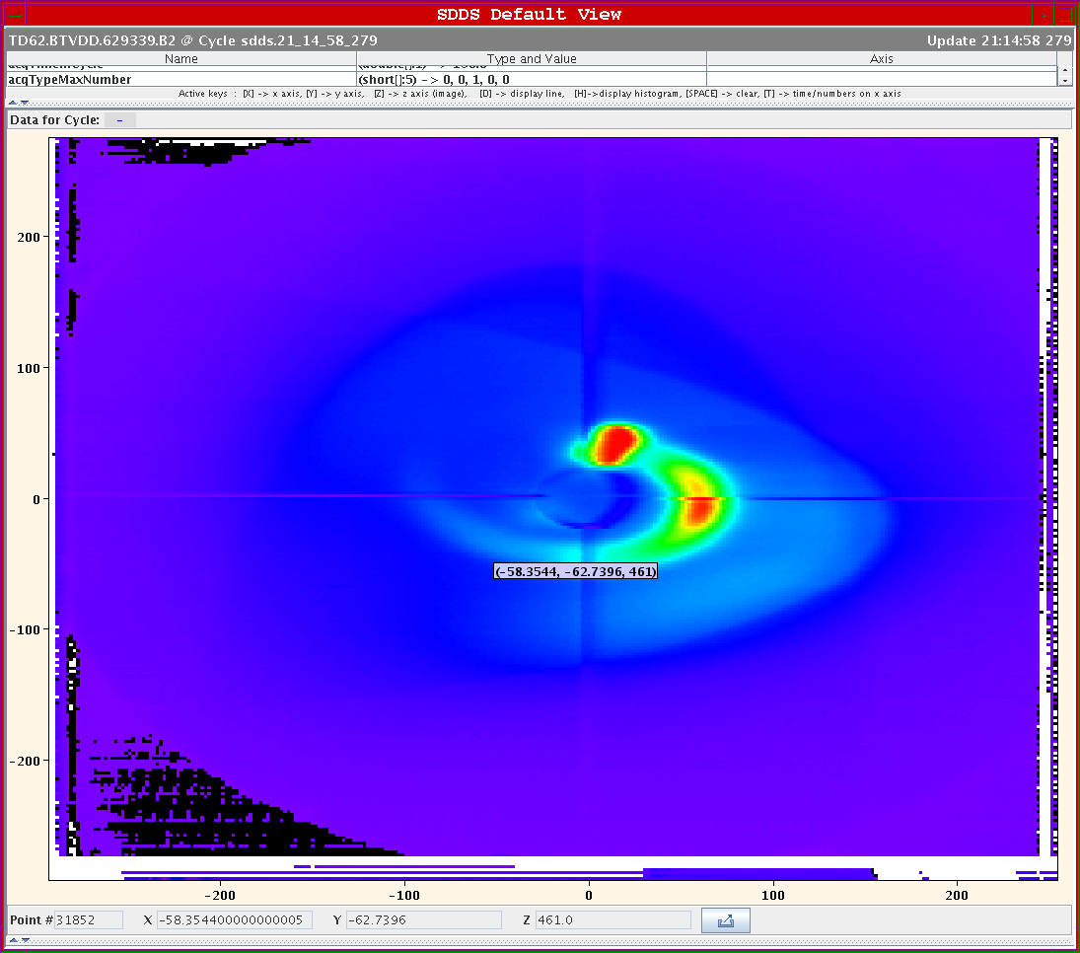
Results from TV Frame grabber
First full turn
as seen by the BTV
10/9/2008
Un-captured beam sweeps through he dump line
For further evaluation the video signal is digitized, read-out and treated by program

Slide 10
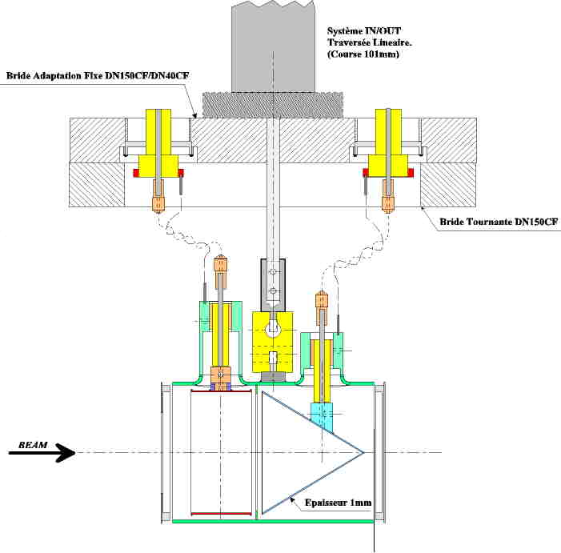
Beam Intensity
Layout of a Faraday Cup
Electrode: 1 mm stainless steel
Only low energy particles can be measured
Very low intensities (down to 1 pA) can be measured
Creation of secondary electrons of low energy (below 20 eV)
Repelling electrode with some 100 V polarisation voltage pushes secondary electrons back onto the electrode

Slide 11
Faraday Cup

Slide 12
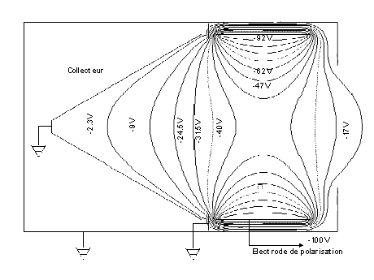
Electro-static Field in Faraday Cup
In order to keep secondary electrons with the cup a repelling voltage is applied to the polarization electrode
Since the electrons have energies of less than 20 eV some 100V repelling voltage is sufficient

Slide 13
Energy of secondary emission electrons
With increasing repelling voltage the electrons do not escape the Faraday Cup any more and the current measured stays stable.
At 40V and above no decrease in the Cup current is observed any more

Slide 14

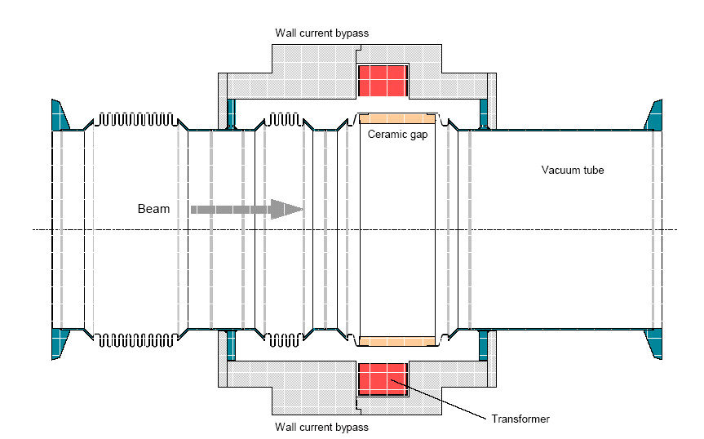
Intensity
Principle of a fast current transformer
500MHz Bandwidth
Low droop (< 0.2%/μs)
Image
Current
Ceramic Gap
BEAM
80nm Ti Coating
20Ω to improve
impedance
Calibration winding
Diagram by H. Jakob

Slide 15
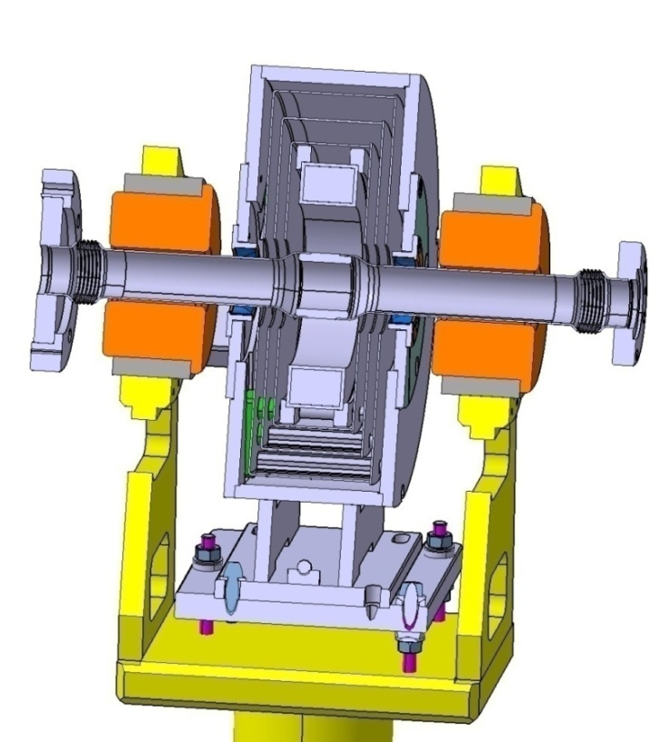
Magnetic shielding
Transformer steel (μ2)
Soft iron (μ1)
Permalloy (μ3)
Shield should extend along the vacuum chamber
length > diameter of opening
Shield should be symmetrical to the beam axis
Air gaps must be avoided especially along the beam axis
Shield should have highest μ possible but should not saturate

Slide 16
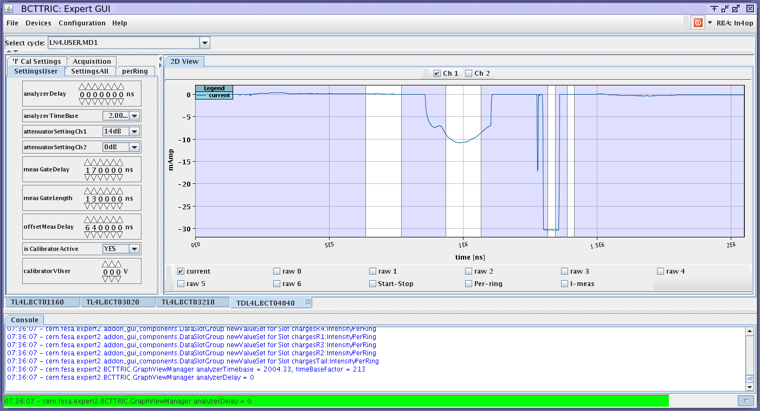
Calibration of AC current transformers
The transformer is calibrated with a very precise current source
The calibration signal is injected into a separate calibration winding
A calibration procedure executed before the running period
A calibration pulse after the beam pulse measured with the beam signal

Slide 17

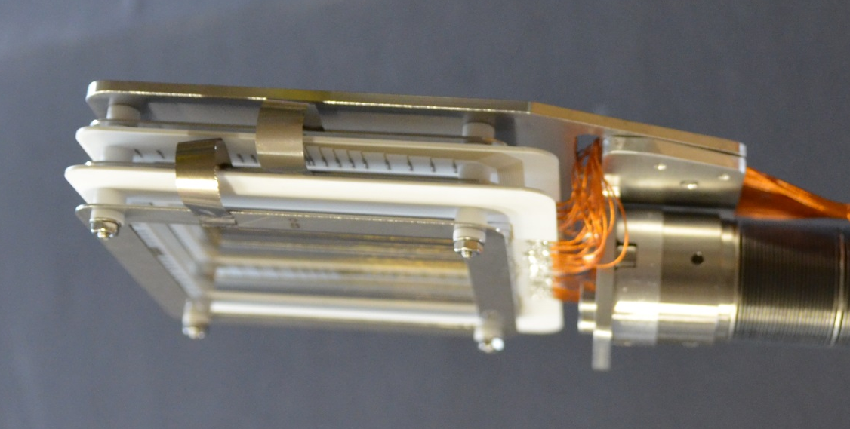
Profile measurements
Secondary emission grids (SEMgrids)
When the beam passes secondary electrons are ejected from the wires
The current flowing back onto the wires is measured
The ejected electrons are taken away by polarization voltage

Slide 18
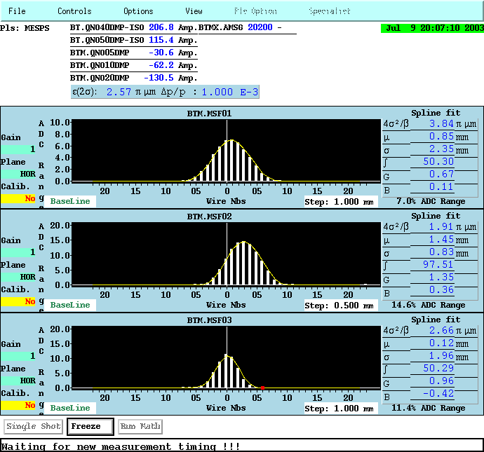
Profiles from SEMgrids
Projection of charge density
projected to x or y axis is
Measured
One amplifier/ADC per wire
Large dynamic range
Resolution is given by wire
distance
Used only in transfer lines

Slide 19

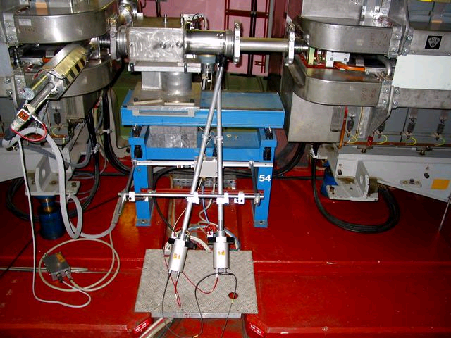
Wire Scanners
A thin wire is quickly moved across the beam
Secondary particle shower is detected outside the vacuum chamber
on a scintillator/photo-multiplier assembly
Position and photo-multiplier signal are recorded simultaneously

Slide 20
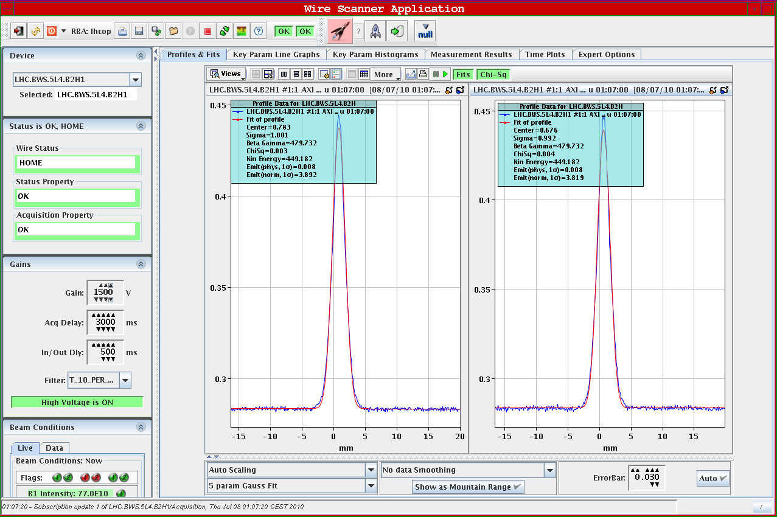
Wire scanner profile
High speed needed
because of heating.
Adiabatic damping
Current increase due to
speed increase
Speeds of up to 20m/s
=> 200g acceleration

Slide 21
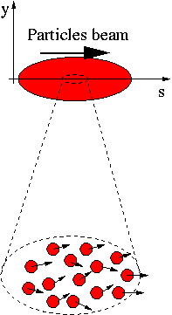
Emittance measurements
A beam is made of many, many particles,
each one of these particles is moving with
a given velocity. Most of the velocity
vector of a single particle is parallel to the
direction of the beam as a whole (s).
There is however a smaller component of
the particles velocity which is
perpendicular to it (x or y).
Design by E. Bravin

Slide 22
Emittance measurements
If for each beam particle we plot its position and its transverse angle we get a particle distribution whose boundary is an usually ellipse.
The projection onto the x axis is the beam size
x’
Beam size
x

Slide 23
The slit and grid method
x’
If we place a slit into the beam we cut out a small vertical slice of phase space
Converting the angles into position through a drift space allows to reconstruct the angular distribution at the position defined by the slit
x
slit

Slide 24
Transforming angular distribution to profile
Influence of a drift space
When moving through a drift space the angles don’t change (horizontal move in phase space)
When moving through a quadrupole the position does not change but the angle does (vertical move in phase space)
x’
x’
x
x
slit
slit
Influence of a quadrupole
x’
x
slit

Slide 25
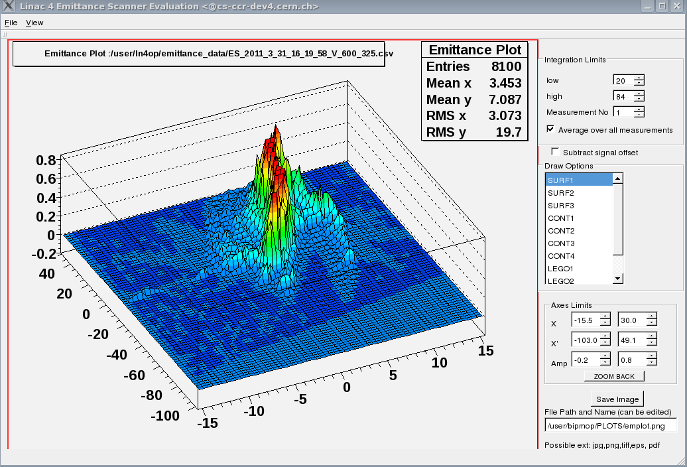
The Slit Method

Slide 26
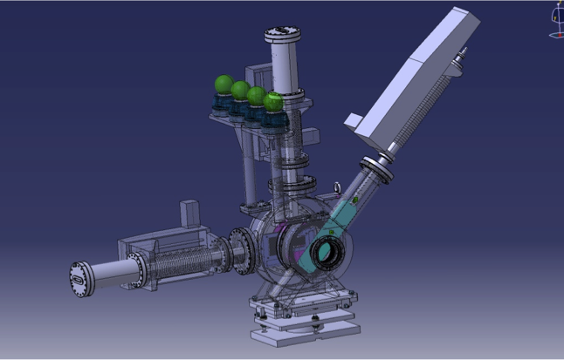
Emittance Meter
SEM grid read-out 250kHz
Stepping motors to allow coarse + fine position tuning

Slide 27
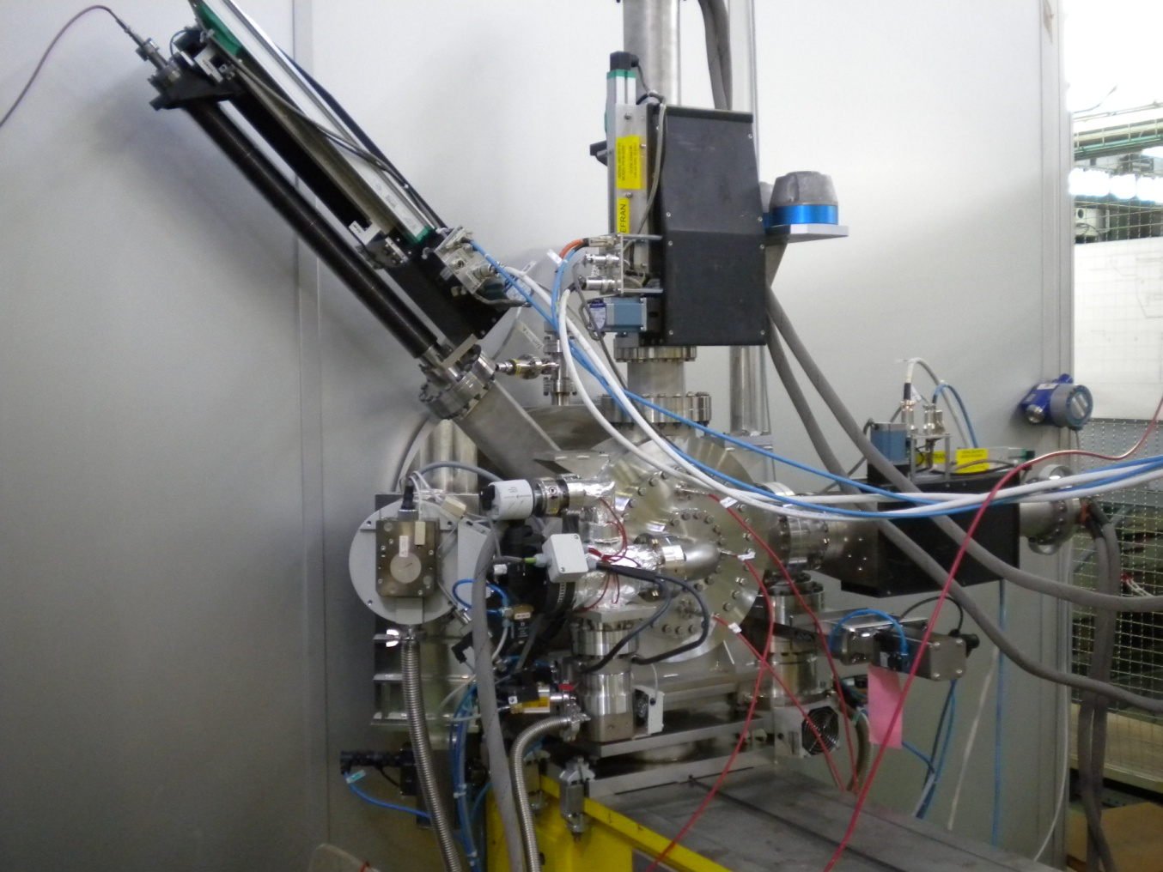
Transverse Emittance Measurement
Slit and grid phase space scanner
L-shaped 0.1mm slit moves under
45 degrees
Slit and grids move independently
Positioning precision: 50 µm
Movement PLC controlled
Slit and grids mounted in
2 independent vacuum boxes which
can be separated
Horizontal and vertical SEMGrid
wire distance .75 mm
30 signal wires
readout with home built 36 channel
250 kHz ADC
time resolved profiles

Slide 28
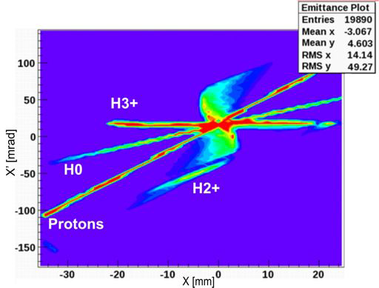
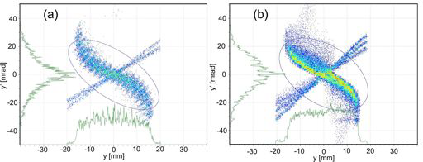
Emittance plot Solenoid

Slide 29
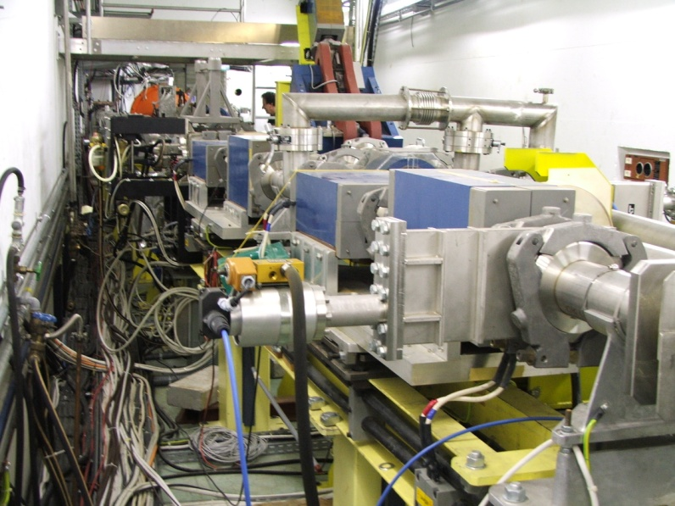
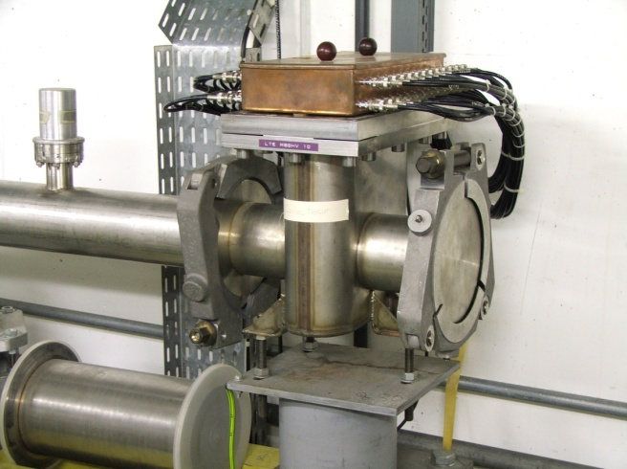
Single pulse emittance measurement
Every 100 ns
a new profile
Quadrupole
Quadrupole
Kickers
slit
SEMgrid

Slide 30
Transformation in Phase Space
Kicker
Kicker
Quadrupole
Quadrupole
SEMGrid
X’
X’
X’
X’
X’
X
X
X
X
X
at slit
first drift space
first quadrupole
second drift space
Second quadrupol

Slide 31
Result of single pulse emittance measurement

Slide 32
Longitudinal Emittance measurement
Kicker
Spectrometer produces image
of slit on second slit
second slit selects energy slice
first kicker sweep phase space
over all energies
buncher rotates energy slice in
phase space
at second spectrometer the
phase distribution is
transformed into an
energy distribution analyzed by
the second spectrometer
second kicker corrects for first
kick
Transformer
SEMGrid
Buncher
Buncher RF
Kicker
Spectrometer magnet
E
E
E
E
φ
φ
φ
φ
at slit
first drift space
buncher
second drift space

Slide 33
Trajectory and Orbit Measurements
Measure the particle position
of each bunch as it travels
around the ring

Slide 34
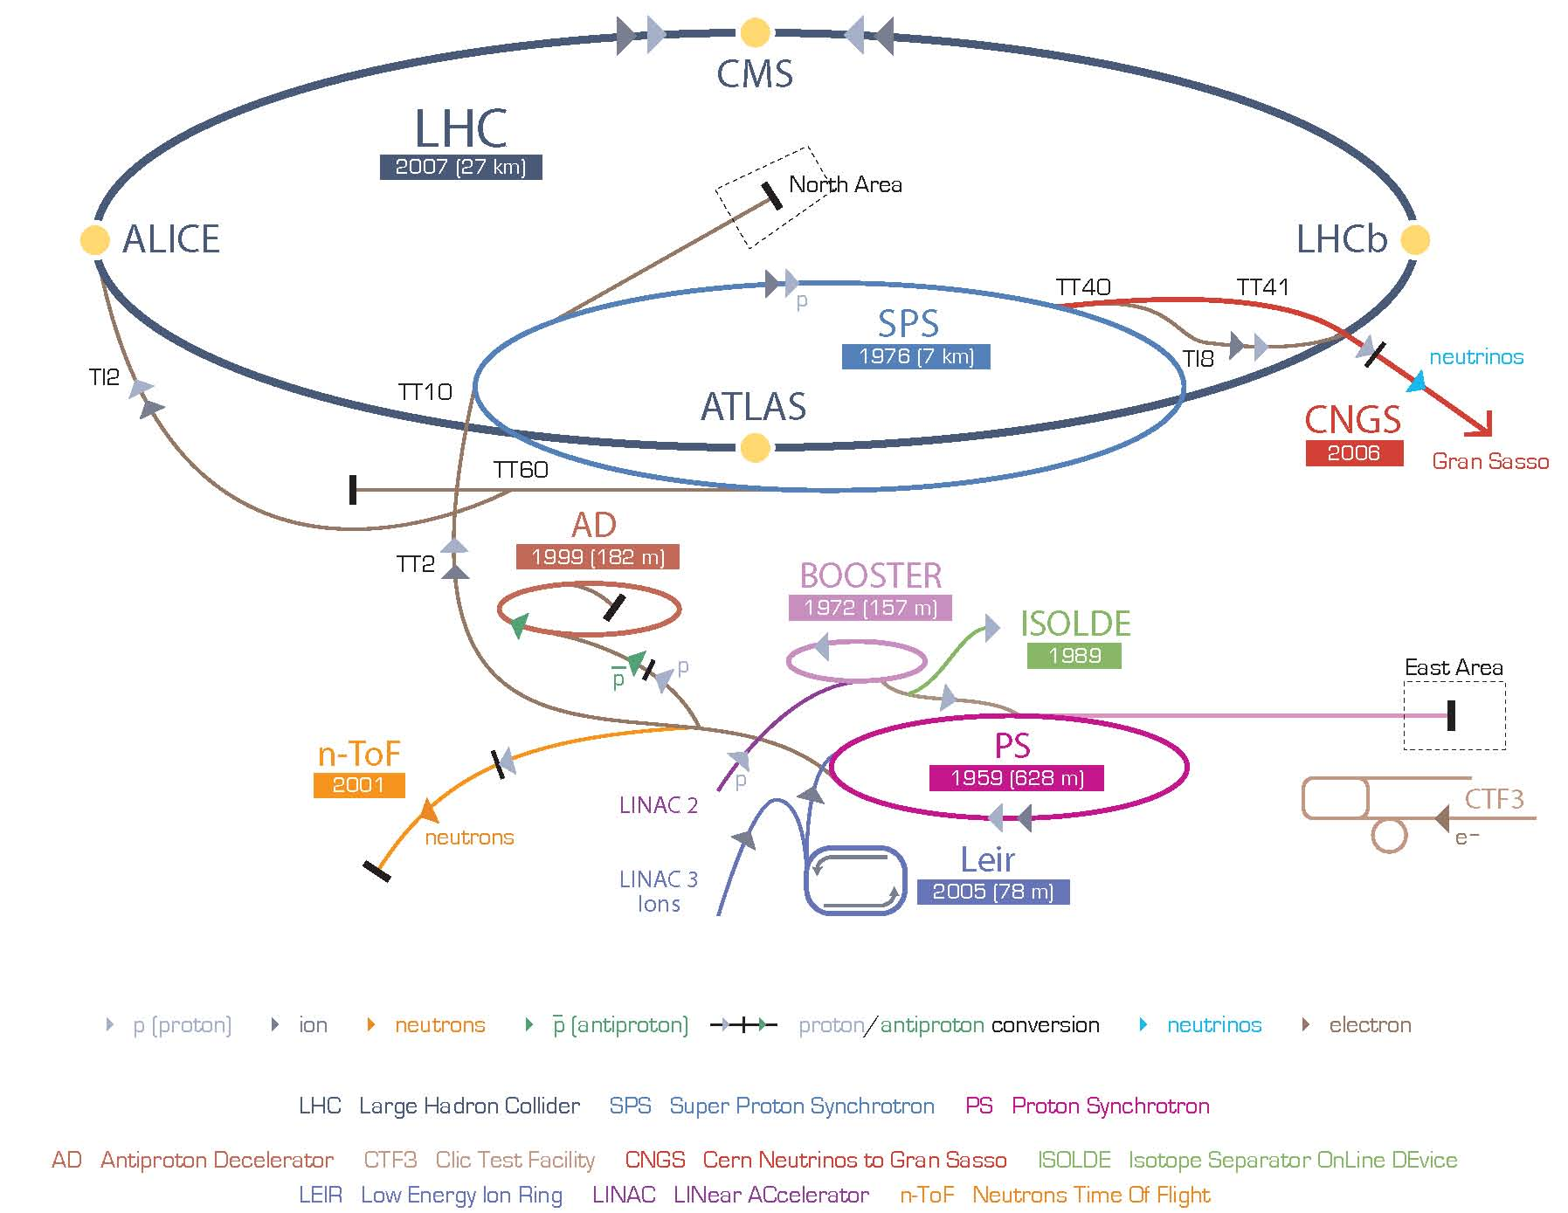
The PS, a universal machine
All beams pass through the PS
Different particle types
Different beam characteristics
Concept of a super cycle

Slide 35
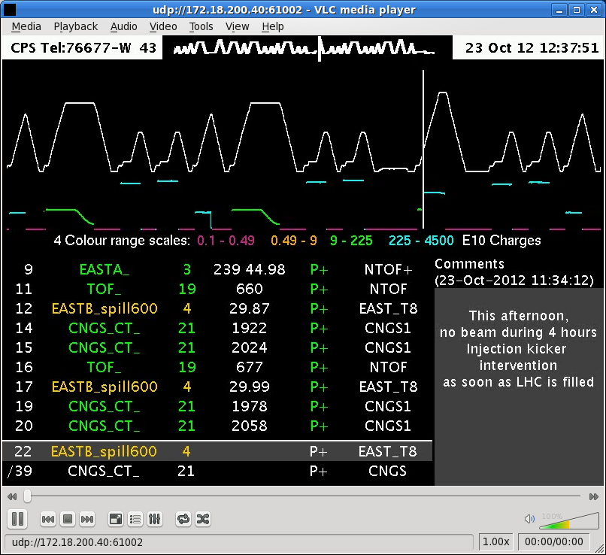
The Supercycle

Slide 36
Position Measurements
BPM signals sampled at 120 MHz
Red: The sum signal
Green: The difference signal
Procedure:
Produce integration gates and
baseline signals
Baseline correct both signals
Integrate sum and difference signals
and store results in memory
Take external timing events into account e.g. harmonic number change, γ-transition etc.

Slide 37
Baseline restoration
Low pass filter the signal to get an estimate of the base line
Add this to the original signal

Slide 38
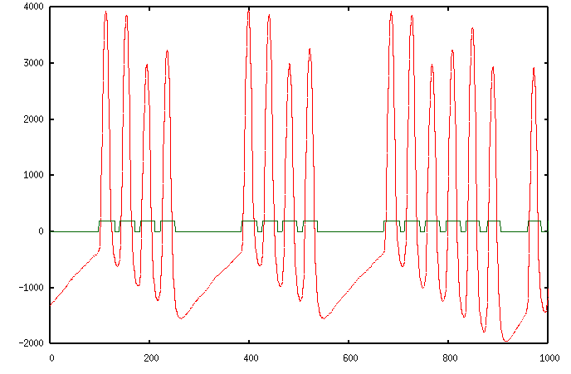
Trajectory measurements in circular machines
Needs integration gate
Can be rather tricky
Distance between bunches
changes with acceleration
Number of bunches
may change

Slide 39
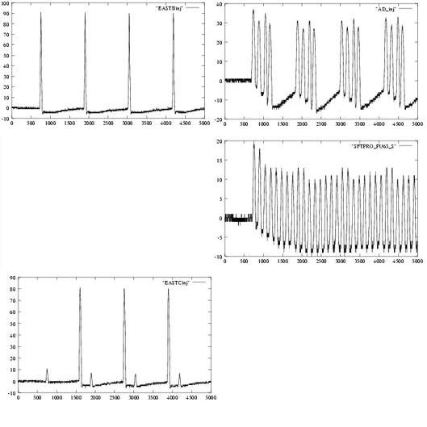
Beams in the PS

Slide 40
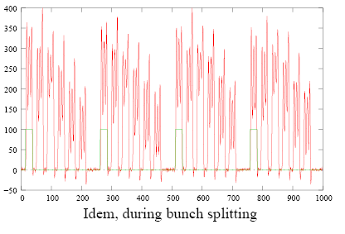
RF Gymnastics
Bunch splitting or recombination
One RF frequency is gradually decreased while the other one
is increased
The gate generator must be synchronized

Slide 41
Trajectory readout electronics

Slide 42
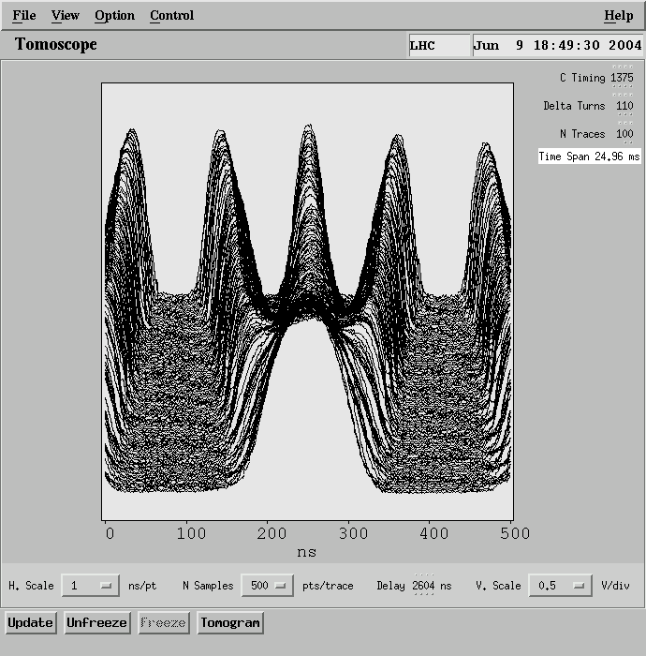
Changing bunch frequency
Bunch splitting or recombination
One RF frequency is gradually
decreased while the other one
is increased
Batch compression
For all these cases the gate generator must be synchronized

Slide 43
Tune measurements
When the beam is displaced (e.g. at injection or with a deliberate kick, it starts to oscillate around its nominal orbit (betatron oscillations)
Measure the trajectory
Fit a sine curve to it
Follow it during one revolution
kicker

Slide 44
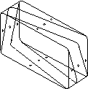
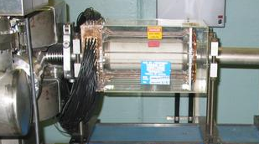
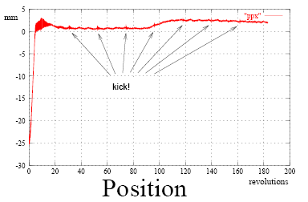
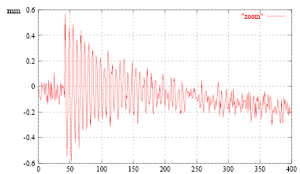
The Sensors
Shoebox pick-up
with linear cut
The kicker

Slide 45
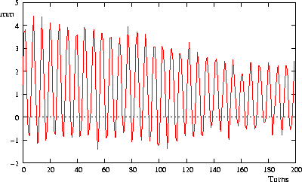
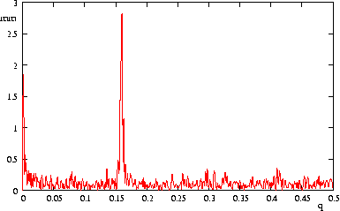
Kicker + 1 pick-up
Measures only non-integral part of Q
Measure a beam position at each revolution
Fourier transform BPM signal
Search peak in Fourier Spectrum
Fourier transform of pick-up signal

Slide 46
Q-Measurement Results

Slide 47
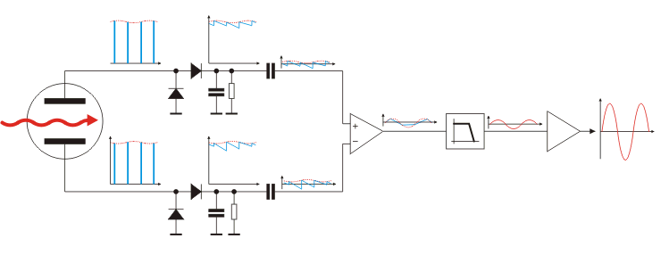
Direct Diode Detection Base Band Q measurement
Diode Detectors convert spikes to saw-tooth waveform
Signal is connected to differential amplifier to cut out DC level
Filter eliminates most of the revolution frequency content
Output amplifier brings the signal level to amplitudes suitable for long distance transmission

Slide 48
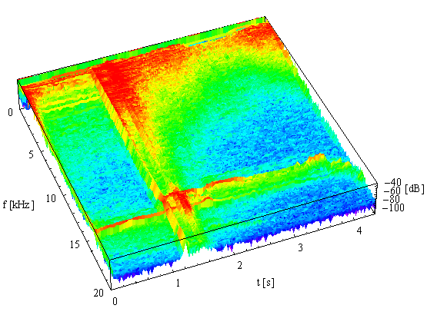
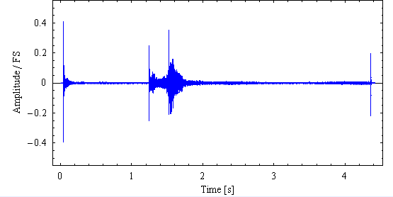
BBQ Results from CERN SPS
Results from Sampling
After Fourier Transform

Slide 49
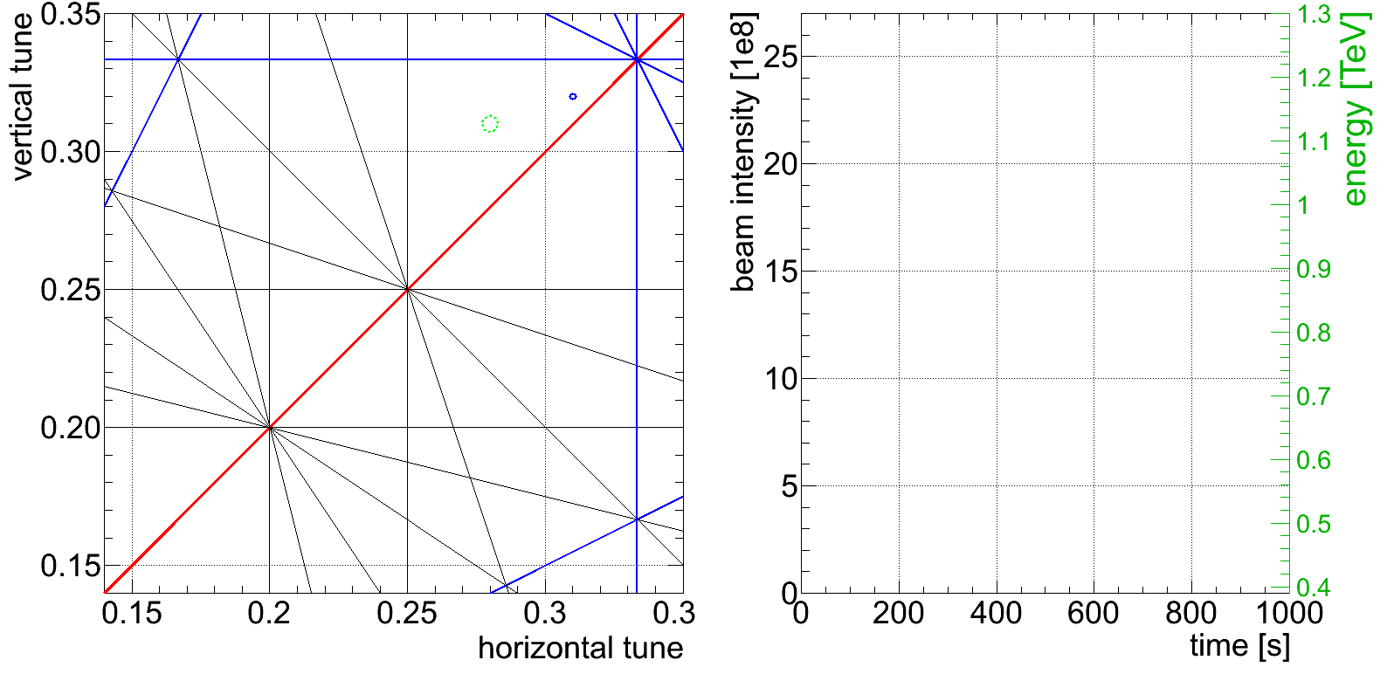
Tune feedback at the LHC

Slide 50
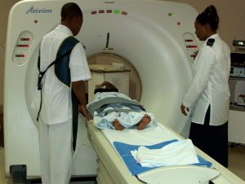
Computed Tomography (CT)
Principle of Tomography:
Take many 2-dimensional Images at
different angles
Reconstruct a 3-dimensional picture
using mathematical techniques
(Algebraic Reconstruction Technique,
ART)

Slide 51
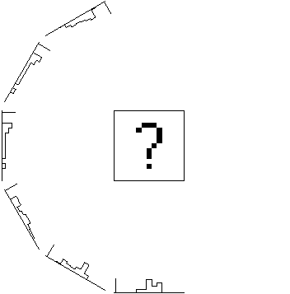



The reconstruction
Produce many projections of the object to be reconstructed
Back project and overlay the “projection rays”
Project the back-projected object and calculate the difference
Iteratively back-project the differences to re-construct the original object

Slide 52


Some CT resuluts

Slide 53
Computed Tomography and Accelerators
RF voltage
Restoring force for non-synchronous particle
Longitudinal phase space
Projection onto Φ axis corresponds to bunch profile

Slide 54


Reconstructed Longitudinal Phase Space
Courtesy S. Hancock

Slide 55


Bunch Splitting

Slide 56
Stored Beam Energies
(Based on graph from R. Schmidt)
Quench Levels | Units | Tevatron | RHIC | HERA | LHC
Instant loss (0.01 - 10 ms) | [J/cm³] | 4.5 10⁻⁰³ | 1.8 10⁻⁰² | 2.1 10⁻⁰³ - 6.6 10⁻⁰³ | 8.7 10⁻⁰⁴
Steady loss (> 100 s) | [W/cm³] | 7.5 10⁻⁰² | 7.5 10⁻⁰² |  | 5.3 10⁻⁰³
Notes:
LHC extrapolation
Energy in beam 7 times Tevatron
Intensity of beam 30 times Tevatron
Number of LHC of moving elements in the LHC about 200
Energy stored in both beams: 0.7 GJoule
heat up from cryogenic temperature and melt
0.1 m3 of Copper

Slide 57

Beam power in the LHC
The Linac beam (160 mA, 200μs, 50 MeV, 1Hz) is enough to burn a hole into
the vacuum chamber
What about the LHC beam: 2808 bunches of 15*10¹¹ particles at 7 TeV?
1 bunch corresponds to a 5 kg bullet at 800 km/h

Slide 58


Beam Loss Monitor Types
Design criteria: Signal speed and robustness
Dynamic range (> 10⁹) limited by leakage current through insulator ceramics (lower) and saturation due to space charge (upper limit).
Secondary Emission Monitor (SEM):
  Length 10 cm
  P < 10⁻⁷ bar
  ~ 30000 times smaller gain
Ionization chamber:
  N₂ gas filling at 100 mbar over-pressure
  Length 50 cm
  Sensitive volume 1.5 l
  Ion collection time 85 μs
Both monitors:
  Parallel electrodes (Al, SEM: Ti) separated by 0.5 cm
  Low pass filter at the HV input
  Voltage 1.5 kV
Notes:
Chamber design considerations: Signal speed and robustness against ageing (and loss of chamber gas)
BLMB: Planned to use standard ACEM detectors (or photo-multipliers), and acquisition systems of LHC BCT. Not part of baseline scenario, for refined beam observation.

Slide 59
Quench levels

Slide 60

Industrial production of chambers
Beam loss must be
measured all around
the ring
=> 4000 sensors!

Slide 61
Conclusions
Beam diagnostics is a very wide field where many different competences are needed
  Machine physics
  Electronics
  Computing
  Mechanics
The instruments are the eyes with which we observe the beam
The beam can never be adjusted with higher precision than what can be measured

