Slide 1



Search
Search Drupal with Apache Solr
with
CERN Web Communications Group – Copyright 2013

Slide 2
What is Solr?
Search Drupal with Apache Solr
Solr Features
- Full-text Search
- Hit Highlighting
- Faceted Search
- Near Real-time Indexing
- Dynamic Clustering
- Database Integration
- Rich Document Handling
- Geospatial Search
CERN Web Communications Group – Copyright 2013
Notes:
Solr is a fast open source enterprise search platform from the Apache Lucene project. It is written in Java and runs as a standalone full-text search server within a servlet container such as Jetty and its external configuration allows it to be tailored to almost any type of application without Java coding.
Its major features include powerful full-text search, hit highlighting, faceted search, near real-time indexing, dynamic clustering, database integration, rich document (e.g., Word, PDF) handling, and geospatial search.
It is highly reliable, scalable and fault tolerant, providing distributed indexing, replication and load-balanced querying, automated failover and recovery, centralized configuration and more.

Slide 3
Installing Solr
Drupal Modules
- Entity API
- Search API
- Database Search
- Solr Search
- Search Pages
Install Solr 4.5
- Locally
- Remotely
Search Drupal with Apache Solr
- Search Views
- Facet API
- Search API Autocomplete
- Search Spellcheck
CERN Web Communications Group – Copyright 2013
Notes:
Prior installing Solr you need to install and enable some modules in your Drupal site. These modules are: the Entity API, Search API, Database Search, Solr Search, Search Pages, Search Views, Facet API, Search API Autocomplete and Search Spellcheck.
After you have installed and enabled these modules you must download and install Solr 4.5. You can install Solr either locally on your machine or remotely to a server.

Slide 4
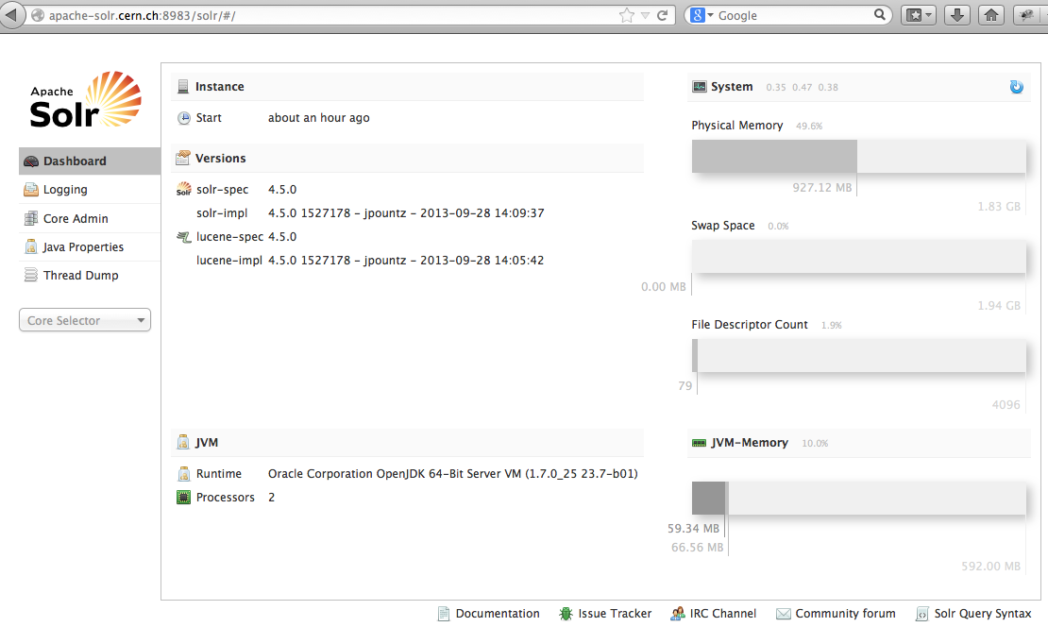
Solr Admin UI
Search Drupal with Apache Solr
CERN Web Communications Group – Copyright 2013
Notes:
After setting up Solr properly you should be able to login to the Admin’s UI from your browser by entering the hostname, where your solr installation resides, followed by the port number 8983, which is the default and the /solr in the URL

Slide 5
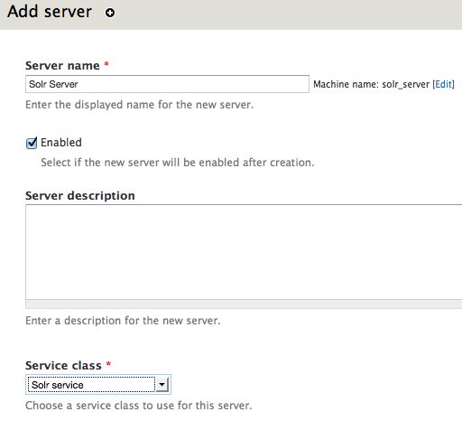
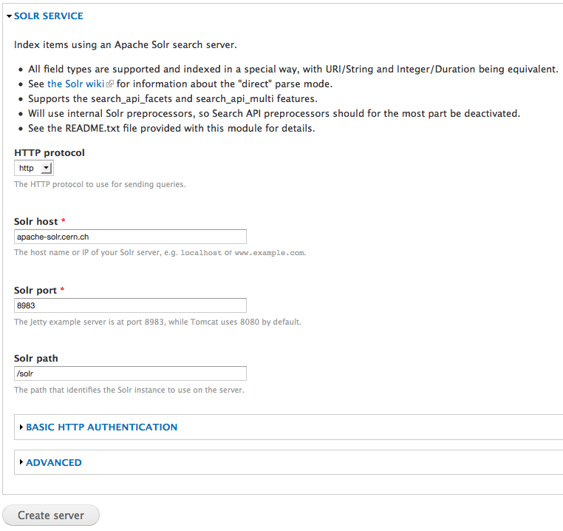
Search API Configuration (Server)
Search Drupal with Apache Solr
CERN Web Communications Group – Copyright 2013
Notes:
In your Drupal site, go to Search API and add a new server. Enter a name for your server, for example Solr Server, tick the enabled checkbox to enable the server after creation and in Service class choose Solr service.
In the solr service window, you must enter the details of your server. In Solr host, enter the hostname of the machine that runs solr. If it is in your local machine type localhost or if it is in a remote machine, type its full
address (hostname and domain). In solr path you have to type the address where your solr core resides. By default is in solr directory, but if you setup a multicore installation you should put the exact path of your site’s
core.

Slide 6
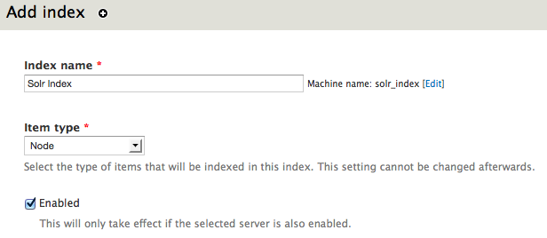
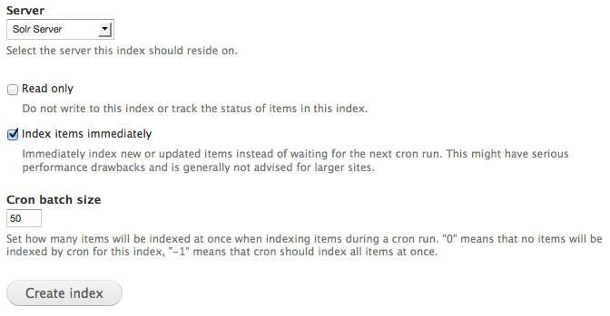
Search API Configuration (Index 1)
Search Drupal with Apache Solr
CERN Web Communications Group – Copyright 2013
Notes:
After you have added your server you must add an index in Search API. In index name you type an name for your index and in Item type you choose the items that will be indexed in this index. Here we choose node.
You tick the enabled option so the index can be enabled immediately after its creation. In Server you choose the Solr Server that we created previously and you tick the Index items immediately, if you want to index immediately
the items of your site instead of waiting for the next cron run and then click on Create Index button.

Slide 7
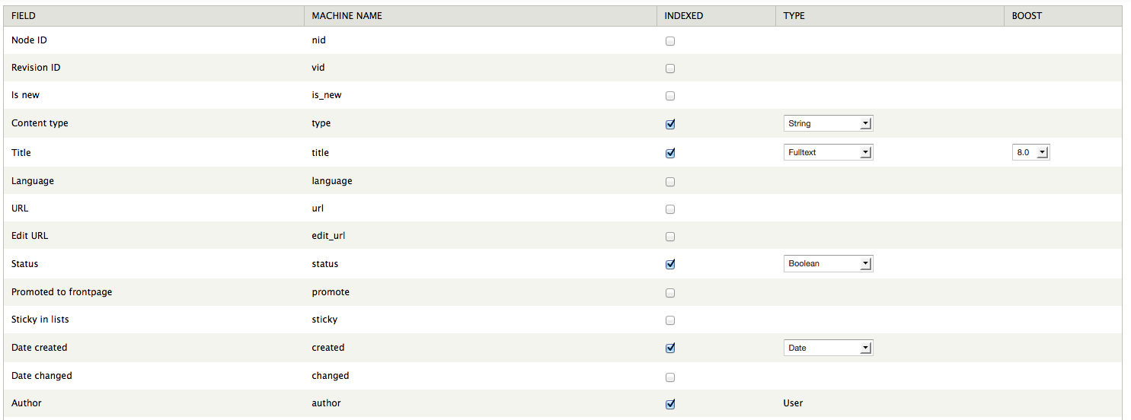
Search API Configuration (Index 2)
Search Drupal with Apache Solr
CERN Web Communications Group – Copyright 2013
Notes:
In fields tab you choose the fields that you want to index. Here we have chosen Content type, Title, Status, Date created and Author. When you finished with your selections click on Save Changes to go to the next tab.

Slide 8
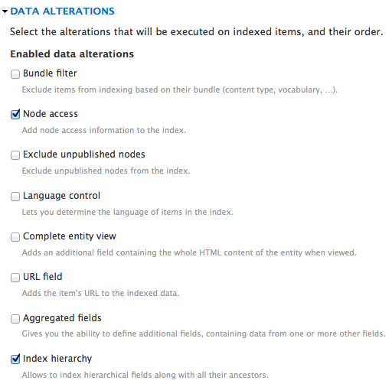
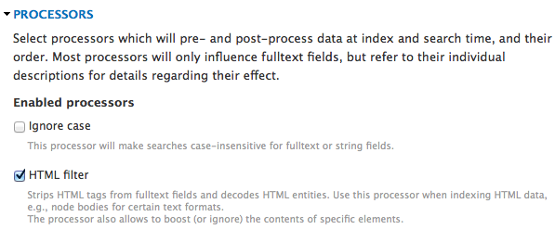
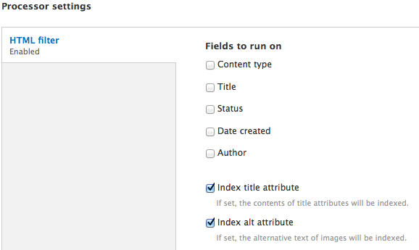
Search API Configuration (Index 3)
Search Drupal with Apache Solr
CERN Web Communications Group – Copyright 2013
Notes:
In Data alterations in Workflow tab, choose node access and index hierarchy in order to add node access information to the index and allow it to index hierarchical fields respectively. In Processors, choose HTML filter so the index can strip the HTML tags form the fulltext fields and to decode HTML entities. Finally, in processor settings, tick Index title attribute and index alt attribute and then click the button Save Configuration.

Slide 9
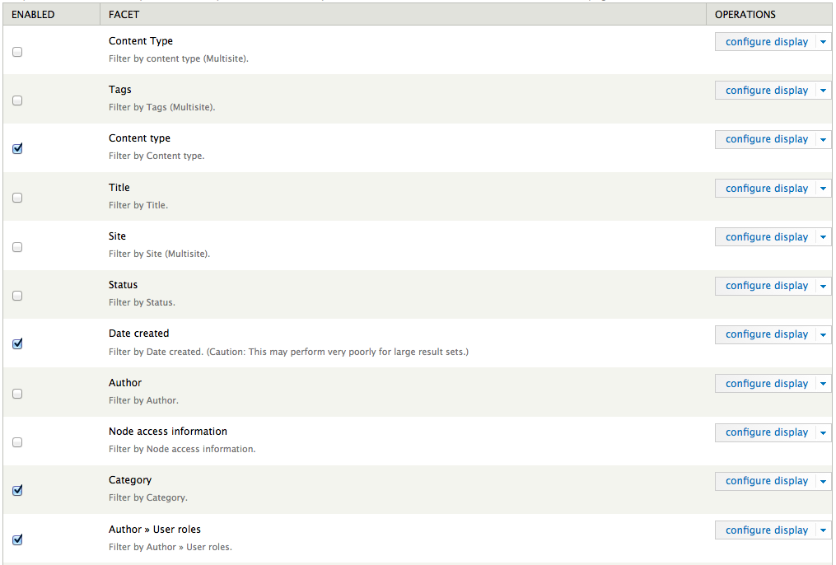
Search Drupal with Apache Solr
Search API Configuration (Index 4)
CERN Web Communications Group – Copyright 2013
Notes:
In Facet tab you choose the facet that you want to enable. Here we have chosen Content type, Date Created, Category and Author >>User roles. Click Save Configuration.

Slide 10
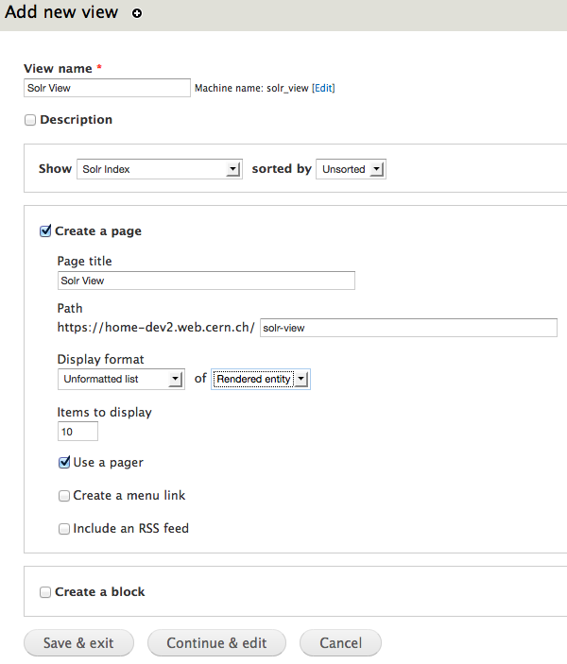
Add a View (1)
Search Drupal with Apache Solr
CERN Web Communications Group – Copyright 2013
Notes:
Now we are ready to add a view to display our indexed items. Give a name to the view (ex. Solr View). In Show choose Solr Index that you have created before.
In Display format choose unformatted list of Rendered entity and click on Continue and Edit.

Slide 11
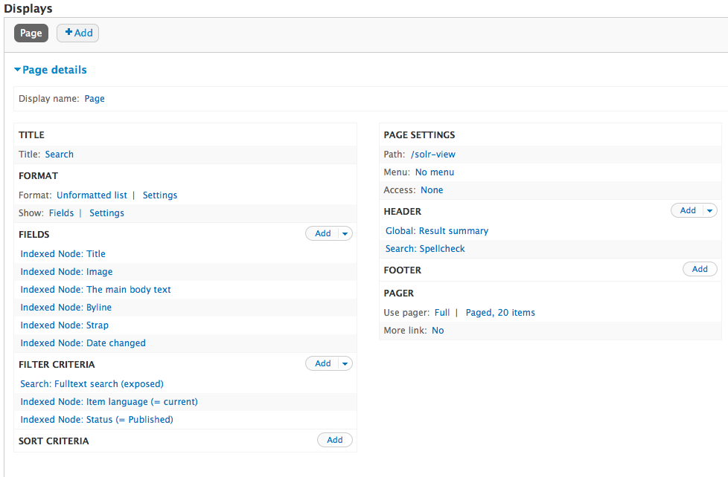
Add a View (2)
Search Drupal with Apache Solr
CERN Web Communications Group – Copyright 2013
Notes:
In Display, add in fields Title, Image, The main body text, Byline, Strap and Date changed. In Filter Criteria add Search: Full text search set to exposed, an Item language indexed node set to current and a status indexed node set to published.
Finally in Header add Global: Result Summary and Search Spellcheck to enable the spellcheck feature, which is provided by the Search Spellcheck module. Save the Changes and the view is ready.

Slide 12
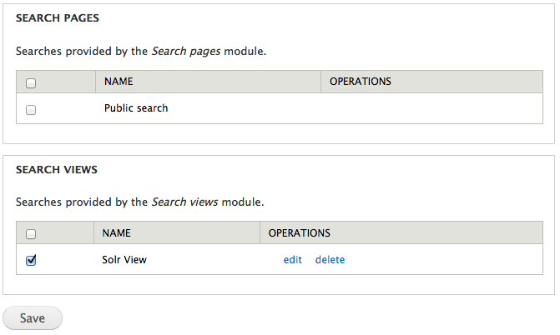
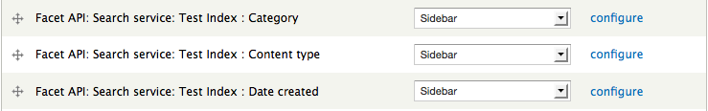
Autocomplete
Search Drupal with Apache Solr
Facets
CERN Web Communications Group – Copyright 2013
Notes:
To enable the autocomplete feature, go to the Search API and click on your Index’s edit and then autocomplete. In Search View in autocomplete tab tick the view that you want to enable the autocomplete feature and then save.
Finally, go to Blocks and add the Facet API blocks for Category, Content type and Date created to the Sidebar.

Slide 13
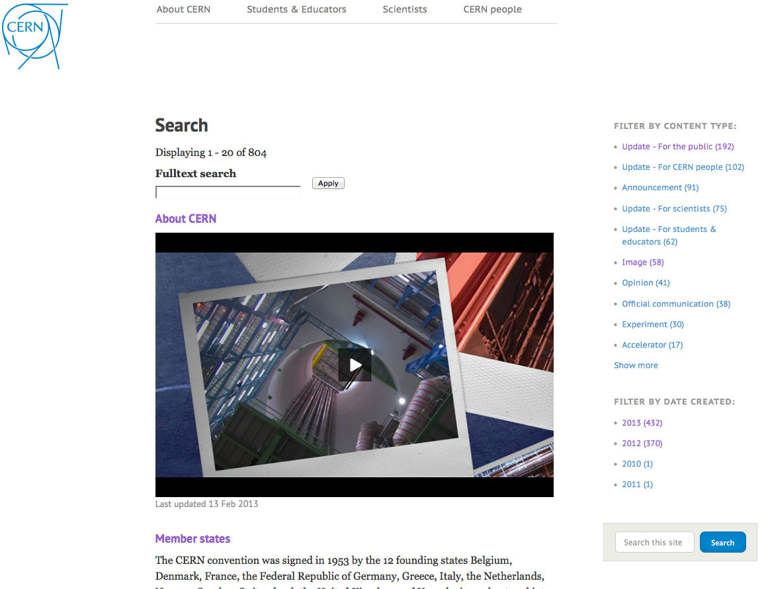
Search View
Search Drupal with Apache Solr
CERN Web Communications Group – Copyright 2013
Notes:
Now go to Solr View. Our new search engine is ready for use!

