Slide 1
PH-DT site migration to Drupal
Nefeli Kousi
(Supervisor: Danilo Piparo)
PH-SFT
Notes:
Only group in the slides

Slide 2
Who am I?
Nefeli
IT student at NKUA Greece
Technical Student at PH-SFT, CERN (July2013-June2014)

Slide 3
PH-DT and PH-SFT cooperation
Cross group project (and student!) in PH.
A cooperation between PH-DT (offering the financial support) and PH-SFT (offering supervision).
It includes the porting into Drupal and update of PH-DT as well as PH-SFT sites (and more if time allows?).

Slide 4
Why this project?
There is a great challenge to communicate the work done by and the identity of the group.
I had the challenge as well as the opportunity to create a web site that represents the work, the unique personality and the contribution of the group in a consistent and clear way, according to the style guidelines adopted by the Organisation.
Help the group to have a greater impact

Slide 5
Our workflow
Drupal is based on a database. So in order to duplicate one site to an other location we just need to clone the database.
Dev
Test
Prod
Dev instance : this is where we try things out. We install new modules create new Content types and Views Tweak code.
Test instance: this is where we move changes when they are ready for testing. The users are invited to test the pages and give feedback.
Prod instance: this is the final product the only one to be visible for the public.
Flexible and fail safe procedure

Slide 6
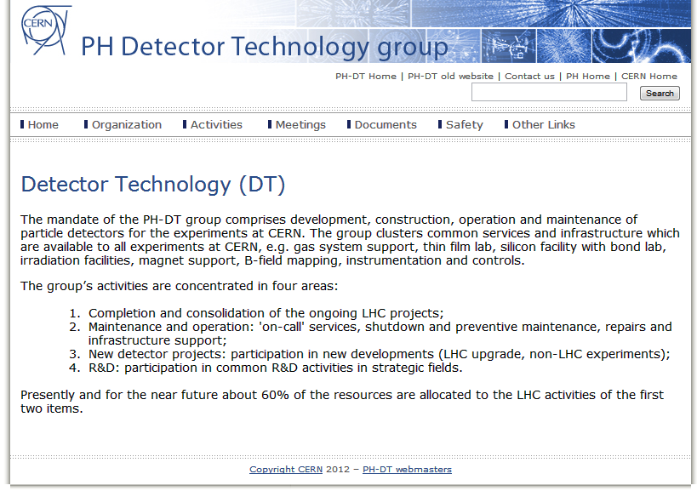
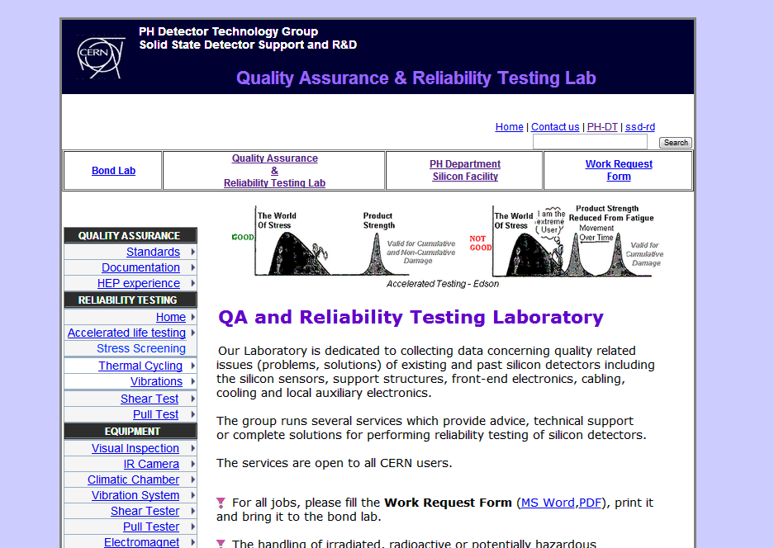
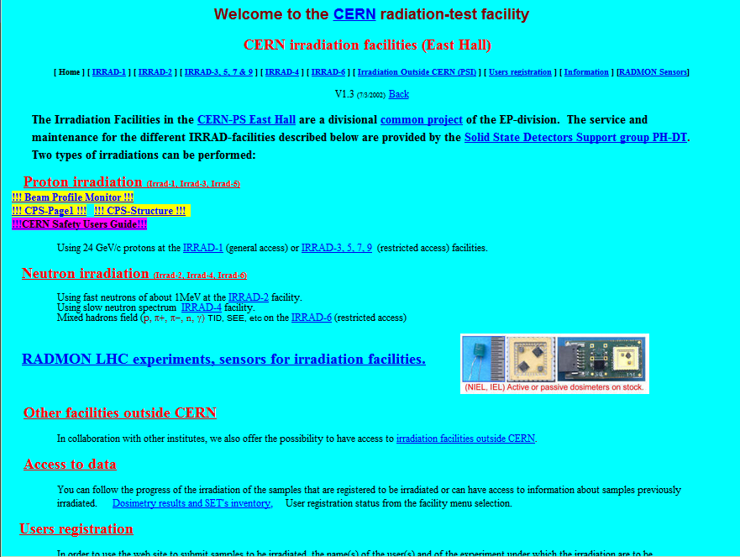
What we began with
A Dreamweaver site.
A lot of broken links and redirections to other pages.
No automatic connection to other CERN sites.
Several scattered non uniform, non CERN branded and old fashioned (although well working!) pages.

Slide 7
What is the strategy
FACTS:
PH-DT is a large Group with many sub-teams and also has a matrix organisation (cross-group activities, O(10²) people, 12 sub-teams).
Every team and activity should be represented in the site.
The site should contribute to the smooth organisation of the Group.
There is a great amount of equipment that the Group has and an infrastructure in order to pin-point and book-keep it is needed.
There is a great amount of spaces (laboratories, assembly halls, offices etc) and they change usage form time to time.
The site should be scalable and sustainable.
Notes:
And demonstrate in the correct word
100 ppl
6 to the deliverables (goal section)

Slide 8
What is the strategy
STEPS:
Get the general specifications from the head of the group.
Meet with a limited amount of diverse teams and get the specifications of their needs.
Create the draft of the main structure(Content Types, Main Pages).
Implement the pages for those teams by adjusting the structure to their needs.
Use those pages as portfolio to help the rest build their pages.

Slide 9
Thinking ahead
FACTS:
As most pages in CERN the main editor and superuser of the site after its completion is going to be the secretariat of the group.
Every team will be editors of their pages.
Drupal 8 is going to be released in 2014. It is reasonable to assume that CERN will migrate at some point.

Slide 10

Stick to CERN
PRECAUTIONS:
We have used mostly CERN supported tools in order to create a site that is sustainable and supported out of the box (no special cases).
For the very few cases that we could not solve only with CERN modules we used only modules that are heavily supported by the Drupal community.
Notes:
Thousand sites use them
WYSIWYG editor

Slide 11


What we used
CERN-Supported Infrastructure
CERN-Supported community
CERN theme
LDAP module
Indico module
CERN – Maps automatic redirection
CERN Profile (!)
Drupal-Supported Modules
Drupal-Supported community
Superfish
Devel generate
Media
Panels
And More
Ensuring Sustainability
Notes:
Drupal support in CERN
Other resources that we leveraged
Kick LDAP off.

Slide 12
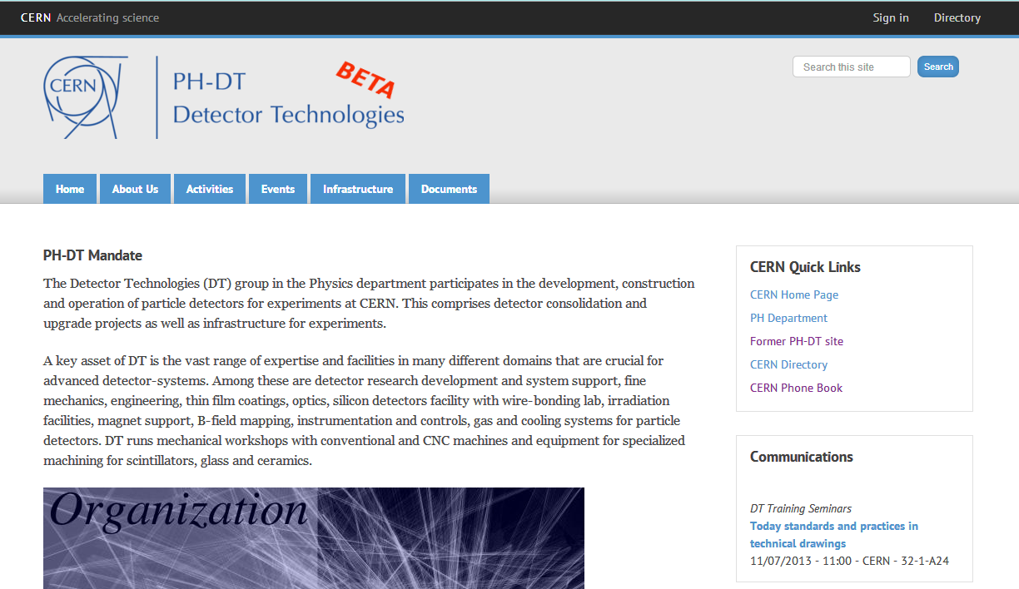
Where we are
http://new-ph-dep-dt-test.web.cern.ch/
The site is almost finished
CERN branded
Automatic connected to Indico and LDAP
Notes:
New Slide:
The role of the administrative assistant. A lot of help the admin assistant is a good source of knowledge, structure and help.

Slide 13
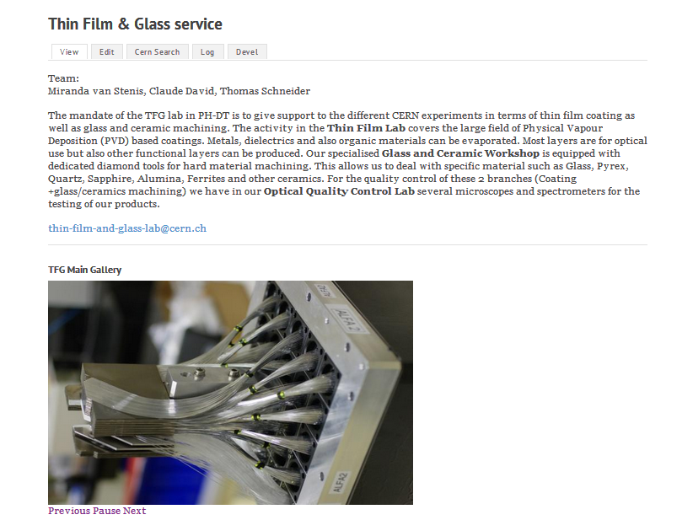
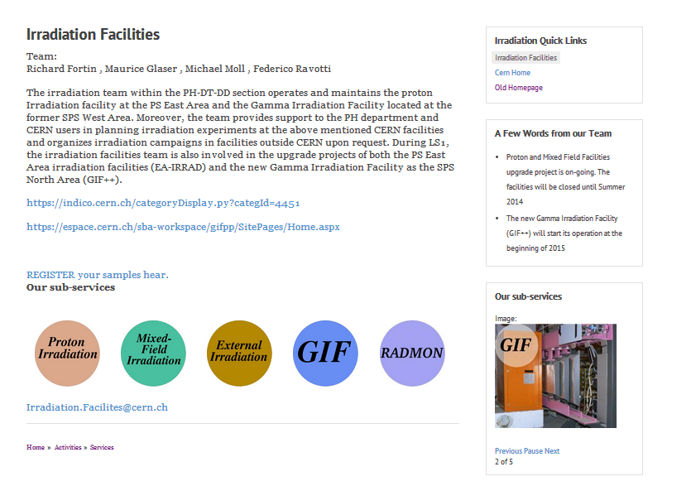
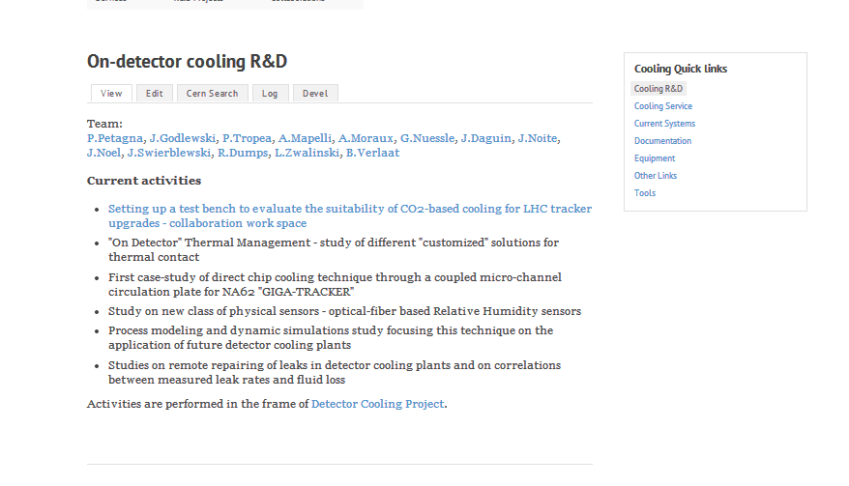
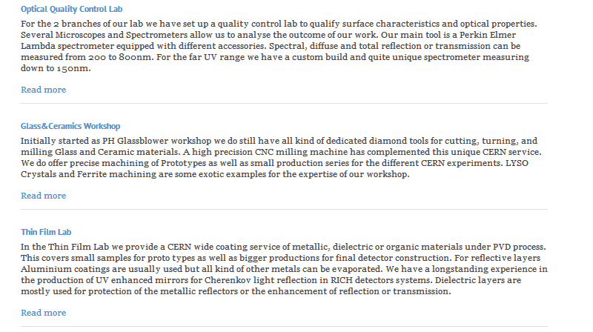
Where we are
Every team has a customised page reflecting the unity of the group as well as the unique character of the team.
12 Teams and 10 Projects Currently in DT

Slide 14
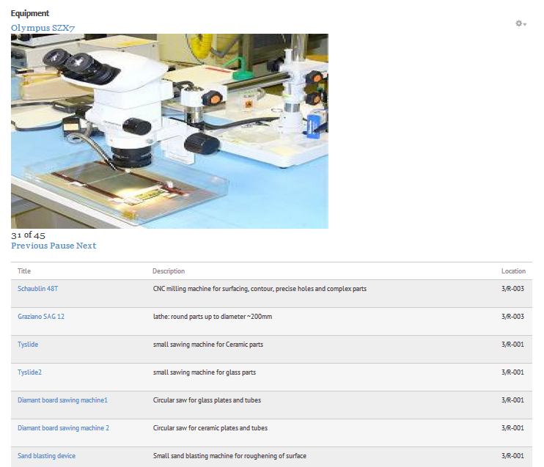
Where we are
Great use of Views for aggregation and Tags for division of content.
Especialy in the Equipment pages.
Tools to ease everyday Group life have been provided

Slide 15
Lessons learned
Drupal experience: manipulation of content, creation of consistent structures, easing the work of the editors.
CERN related Drupal experience: CERN modules, hosting service, ENTICE, troubleshooting.
Group image: how to represent the identity of a CERN group which is supporting experiments and drives innovation of technology.

Slide 16
Next steps
The new SFT web site
SFT Group is smaller than DT but very active
Multiple activities.
  Big HEP software projects.
  Participation and organisation of conferences, workshops, trainings and educational activities.

Slide 17
Challenges we faced
Documentation/usage guides Indico and LDAP.
Way to support more than 2 layers menu.
Profile pages of the members with automatic deletion of previous members (thanks to Eduardo Alvarez Fernandez for his input).
Responsive main content and central support deadlock.
Cars representation and booking (thanks to Silvia Tomanin for her help).

Slide 18
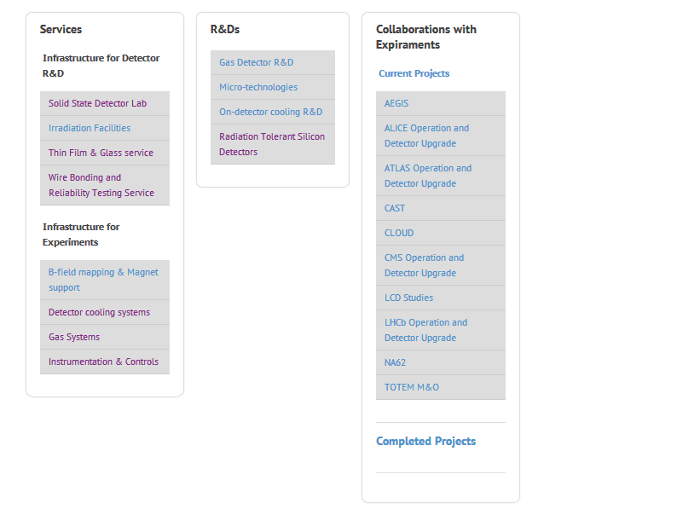
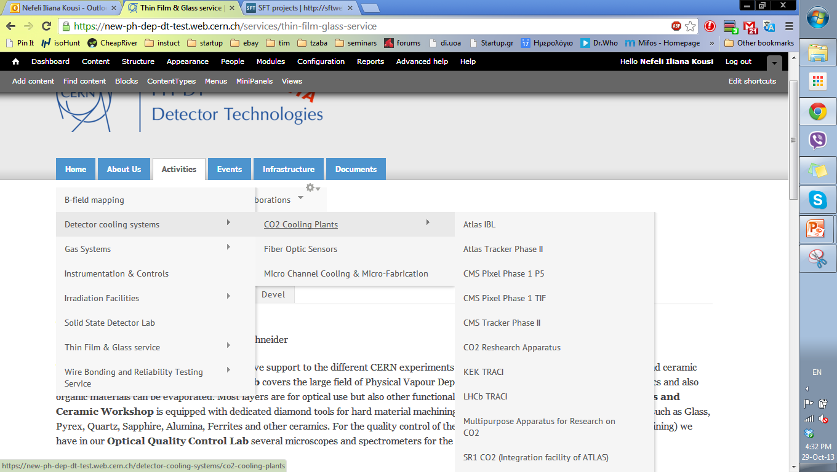

Needs
1
Multi-layer menu
Clear strategy for Browser support
Clear communication lines
Fast and effective (one button) migration from one instance to an other and backup
Panels
Adding a view of contents in a node
2
3
4

Slide 19
Proposals
Support a popular and actively maintained menu module like Superfish.
Support a module that allows us to have a date as a field such as Date.
Support Panels, EVA.
Responsitivity for the main content (images scaling, blocks rearrangement).
Compose a proposition for browser support strategy (what browsers, until what version etc).
Share asap timescale and migration strategies for Drupal8
Clear communication lines (Clear documentation catalogue. Clear way to communicate with every team. CERN Infrastructure “Starting pack” for beginners ).

Slide 20


