Slide 2
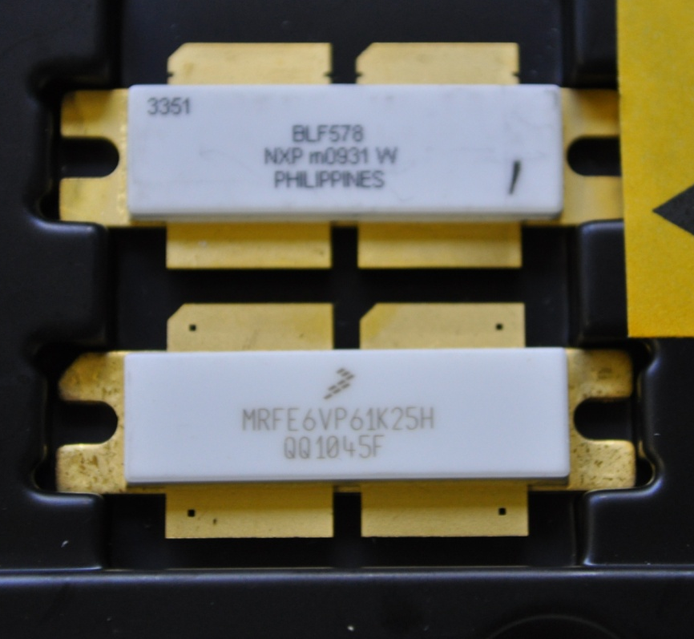
CRISP WP 7
SSA using a cavity combiner
Michel Langlois, Pierre Barbier, Jörn Jacob

Slide 3
CRISP WP 7
The main drawback of SSA for science is the large ratio between specified RF power and modest single module power hence
2 main targets for this development:
Decrease the footprint and volume of solid state amplifiers.
Make them cheaper, i.e. decrease the €/W rating.

Slide 4
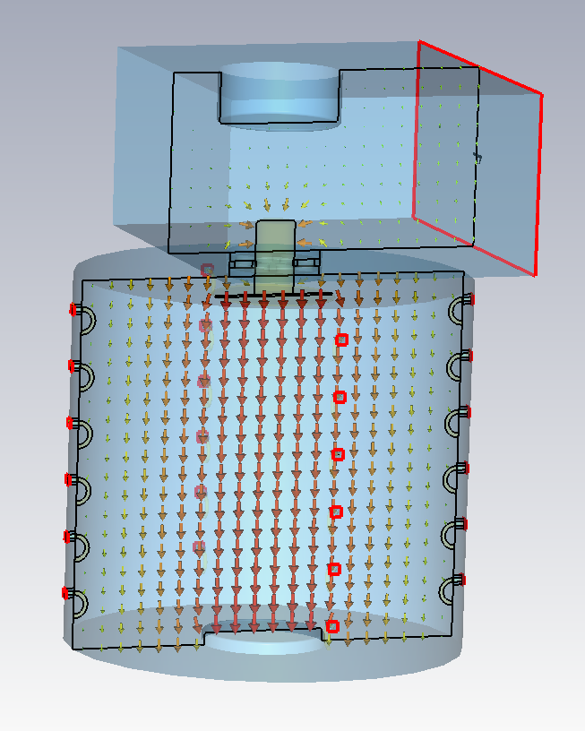
CRISP WP 7
5 ideas could make it happen!
1/ Make use of a cavity combiner to provide compactedness!
The resonator operates in E010 mode.
All modules are coupled to the resonator with fixed loops.
The resonator is capacitively coupled to the waveguide. This coupling can be varied.

Slide 5
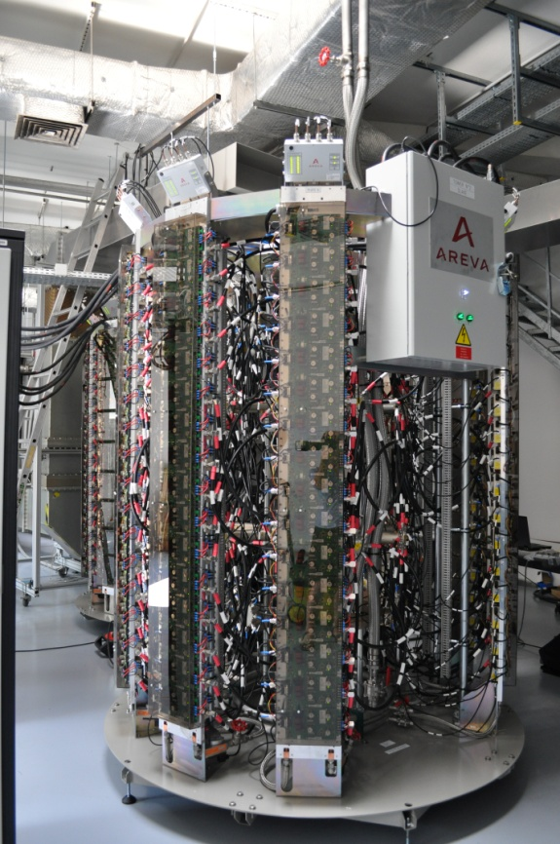
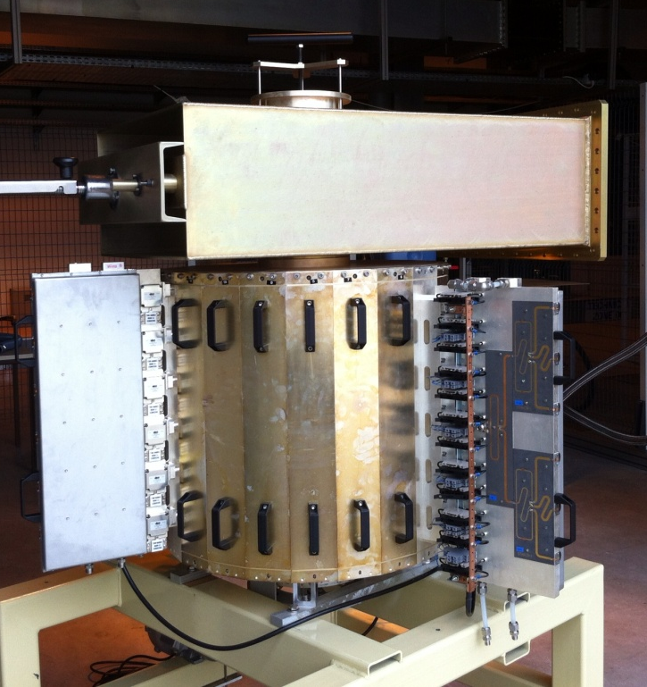
CRISP WP 7
How successful?
75 kW
C.W.
height 1.37m
height 2.7m
diameter 1.32 m
diameter 2.1m
Footprint efficiency=54.8 kW/m2
Volume efficiency =40 kW/m3
Footprint efficiency=21.6 kW/m2
Volume efficiency =8.02 kW/m3

Slide 6
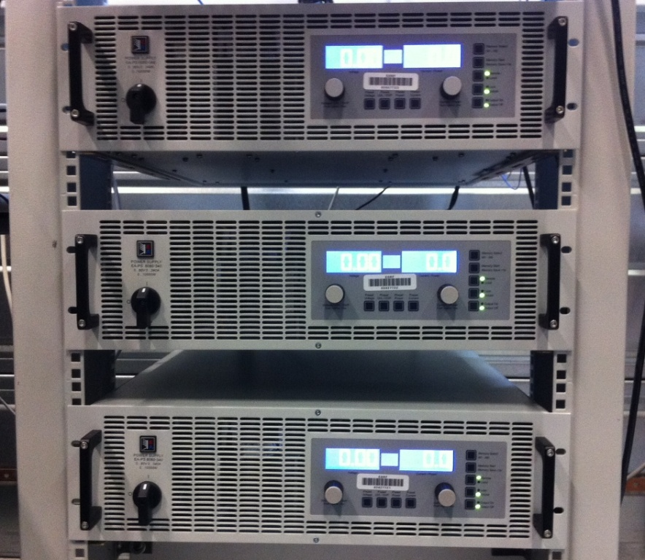
CRISP WP 7
CRISP project WP7
2/ Use off-the-shelf power supplies.
A 50V/10kW supply is chosen. It is available from a European manufacturer. It feeds a wing containing 6 modules. They use the 400V/ 3 phases mains.
The amplifier is still in operation if one supply dies. The power derating, if any, is not known yet.
Configuration for 3 wings=18 modules of 700W each

Slide 7
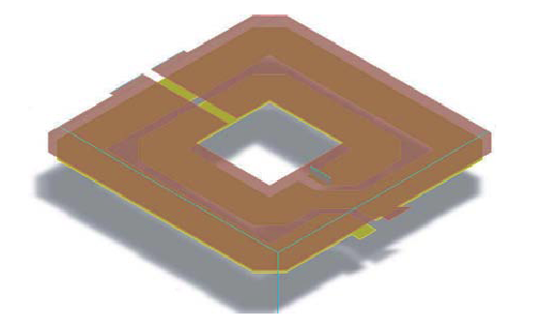
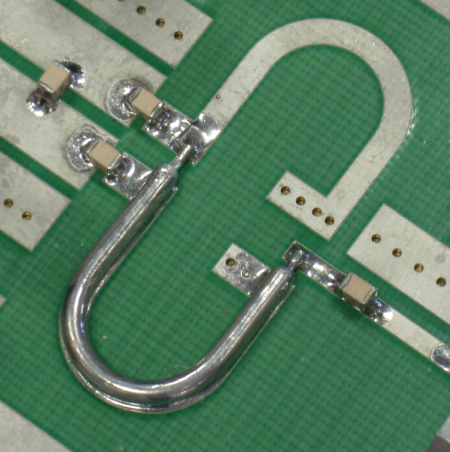
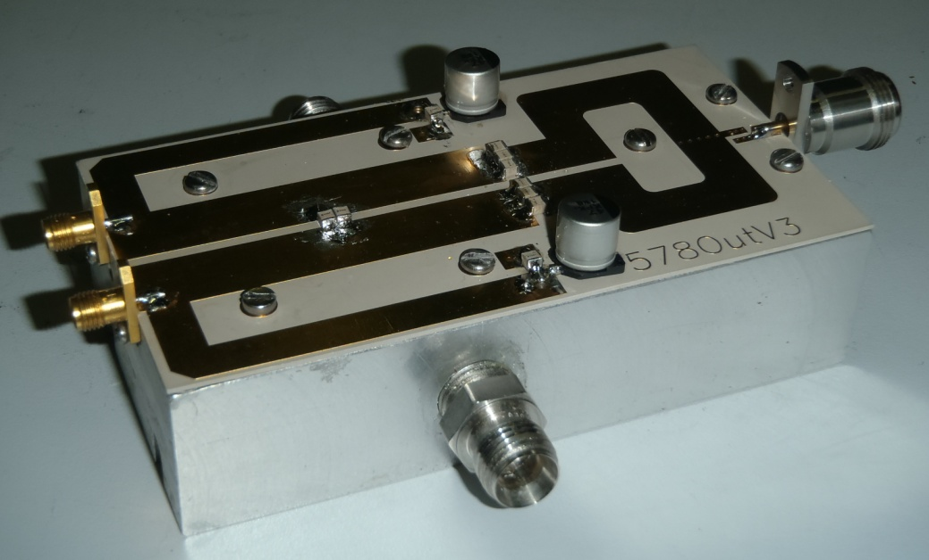
CRISP WP 7
3/ RF modules feature planar baluns, no chokes and no trimming
PCB implementation
Balun coaxial implementation
Involving manpower
Printed baluns, accurate capacitor values and positions make it possible to do away with trimming

Slide 8
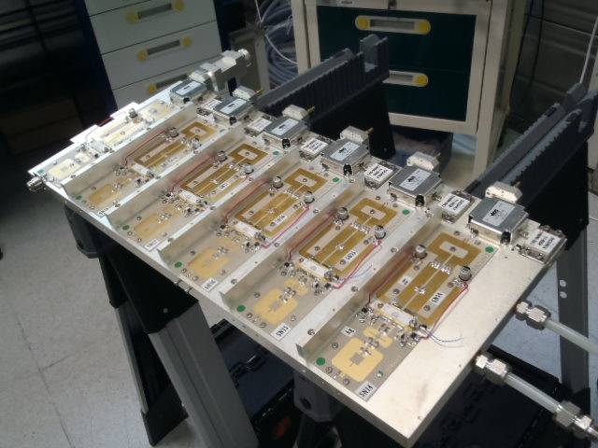
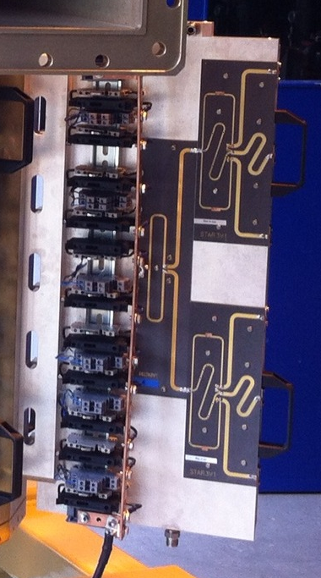
CRISP WP 7
4/ RF and D.C. distribution use the same support as the RF modules.
front side of a wing
Including 6 RF modules + circulators + loads
back side of a wing
Including RF drive splitting and DC distribution
Notes:
Notice the water cooling

Slide 9
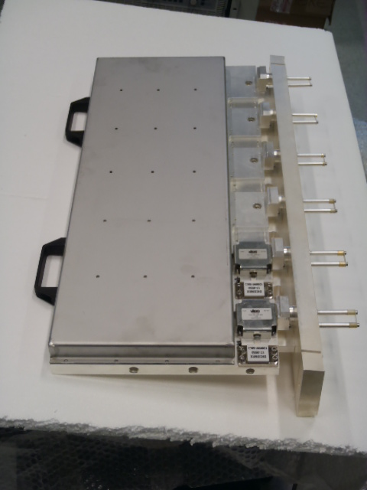
CRISP WP 7
5/ The modules are not individually shielded
+ the sole of the transistor is very close to the cooling channel.
+ much cheaper than individual shielding.
- RF radiation originating from the circulator tabs.

Slide 10

CRISP WP 7
Achievements so far
A cavity combiner equipped with 3 wings of 6 modules has been built and tested on a 50 Ω dummy load.

Slide 11
CRISP WP 7
CRISP project WP7
Gain and phase distributions
The modules were hand made. It caused a poor reproducibility of the matching capacitors positions. The transistors (NXP BLF578) came from different batches ordered at different times.
Will these modules still combine harmoniously?
Notes:
Matching caps tolerance

Slide 12
CRISP WP 7
Amplifier performances
Test conditions: Idq=2*100mA per module (nearly class B)
Vds=50V 15l/min per wing
63%=Prf/(Vds*ΣId)=drain efficiency
The efficiency of a class B amplifier is bad at low output level. If the RF power has been overestimated, the number of wings plugged on the cavity combiner may be decreased to run the amplifier at a decent efficiency. The output coupling has to be adjusted.

Slide 13
CRISP WP 7
Amplifier performances
Test conditions: Idq=2*100mA per module (nearly class B)
Vds=50V
SN12 is a module chosen for its average gain and efficiency. Its performances are compared with that of the whole amplifier. The RF power and drain total current of the whole amplifier have been divided by 18. The plots are quite close.

Slide 14
CRISP WP 7
Amplifier performances
DISCREPANCIES

Slide 15
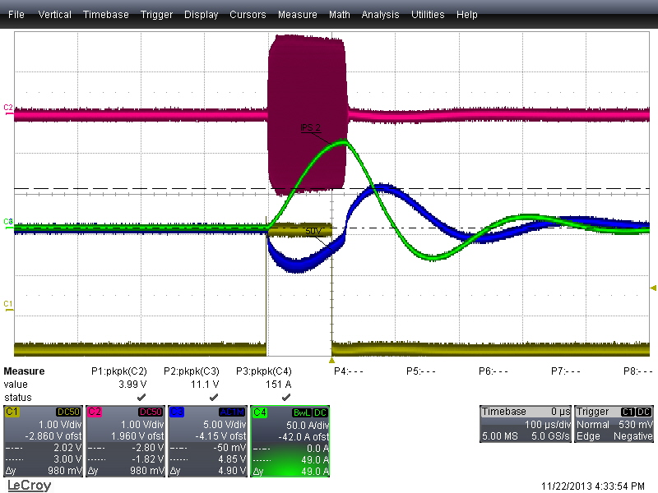
CRISP WP 7
Amplifier performances
Pulsed operation up to 10 kW
RF
Recorded at 5kW
Vds
46V min
100 us

Slide 16
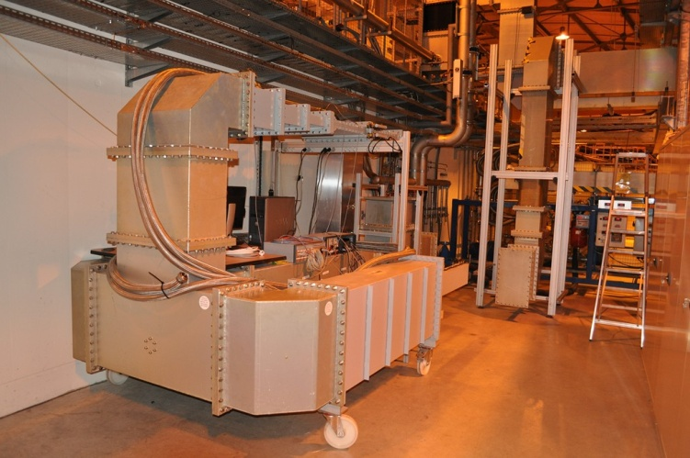
CRISP WP 7
FURTHER TESTS WITH 3 WINGS
Check the operation with new DC distribution boards on 50Ω load and additional cooling circuit.
Test with 3 adjacent wings on 50Ω load.
Test with VSWR using our EH tuner.

Slide 17
CRISP WP 7
What’s next?
We launched the production of 19 (+2 spares) wings to complete the cavity combiner slots.
The extrusion of cooling plates has been ordered to an Italian company.
The machining and electroplating of mechanical parts has been subcontracted in France.
The manufacturing of the modules has been handed over to a French company.
The wings will be put together by ESRF people.

Slide 18
CRISP WP 7
Thanks to my dear colleagues for their very welcomed advices
Thanks to Hans Kartman (NXP) for his help in the module design
You still here? Thank you for that too!

