Slide 1
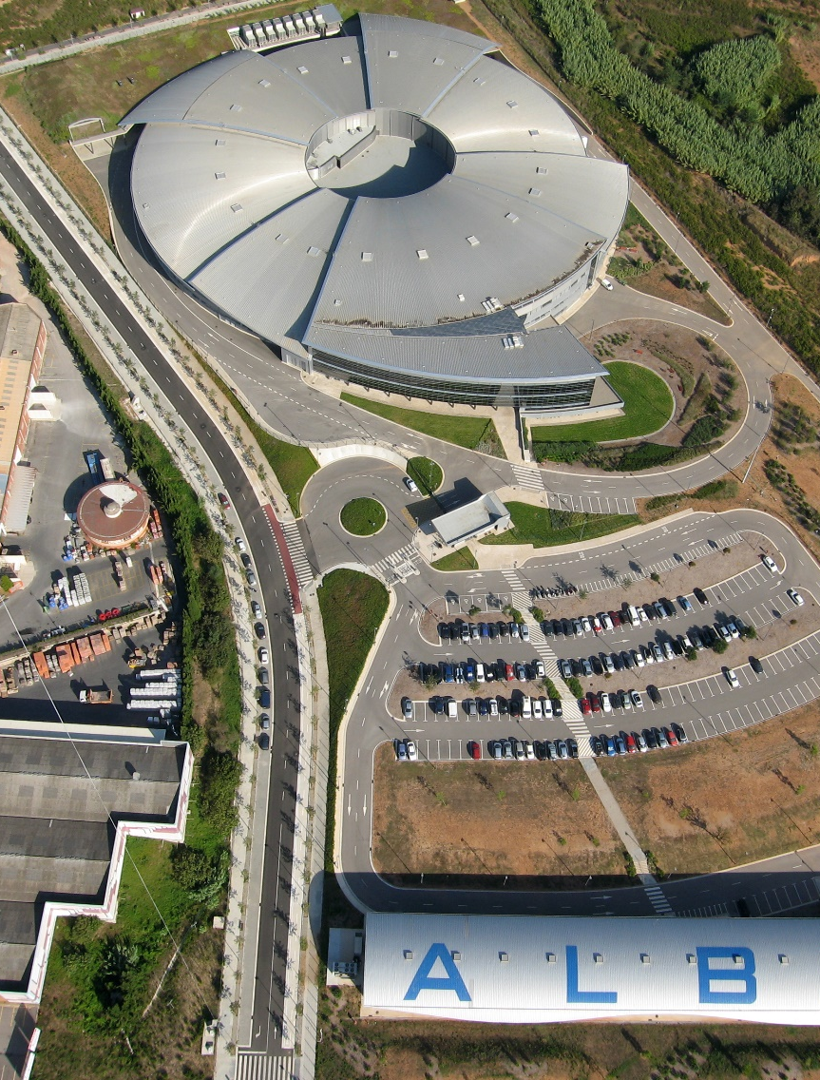
Status and operation of the ALBA RF system
J. Ocampo on behalf of the ALBA RF Group
F. Pérez, A. Salom, B. Bravo
Notes:
Presentarme

Slide 2
Contents
ALBA RF overview
ALBA Operation
Status of the RF system
RF-Lab

Slide 3
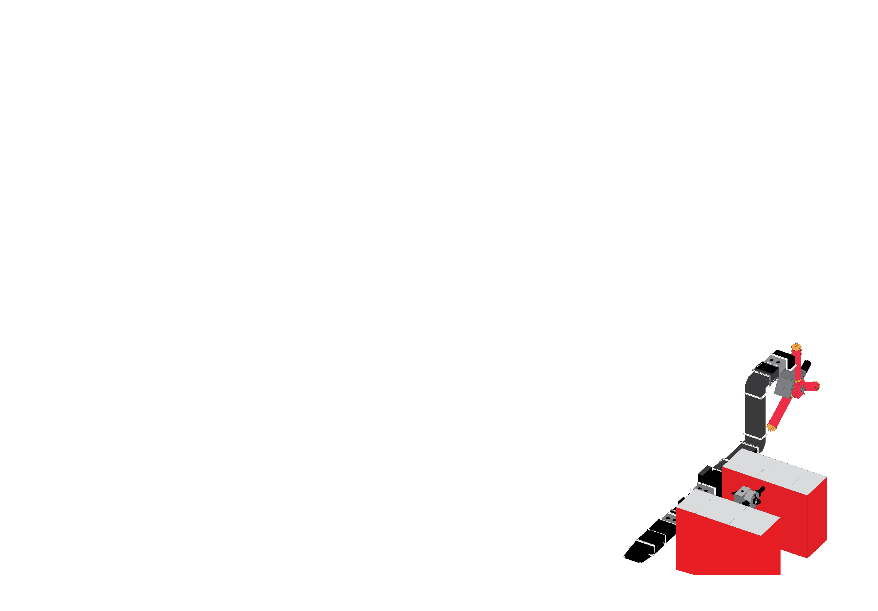
ALBA RF system
General overview of the ALBA RF system for the Booster and Storage Ring

Slide 4
RF Overview
 | STORAGE RING | BOOSTER (@ 3 GeV)
Frequency | 499.654 MHz
RF total Voltage | 3600 kV | 900 kV
Beam Current | 400 mA | 2 mA
Total Beam Power | 540 kW | 1.3 kW
Losses (including IDs) | 1300 keV/turn | 627 keV/turn
Type of cavity | NC EU-Cav (DAMPY) | NC 5-cell
Number of cavities | 6 | 1
RF Voltage per cavity | 600 kV | 1000 kV
RF Power per cavity | 150 kW | 35 kW
RF Transmitter | 2 x 80 kW | 1 x 80 kW
Synchrotron frequency | 9.3 kHz | 8.6 kHz
Notes:
We work at 500MHz
Our SR is designed for 400mA although we work at 120 for users
Top-up operation is under testing and is foreseen for thenear future
We use normal conducting cavities powered by IOT based amplifiers

Slide 5
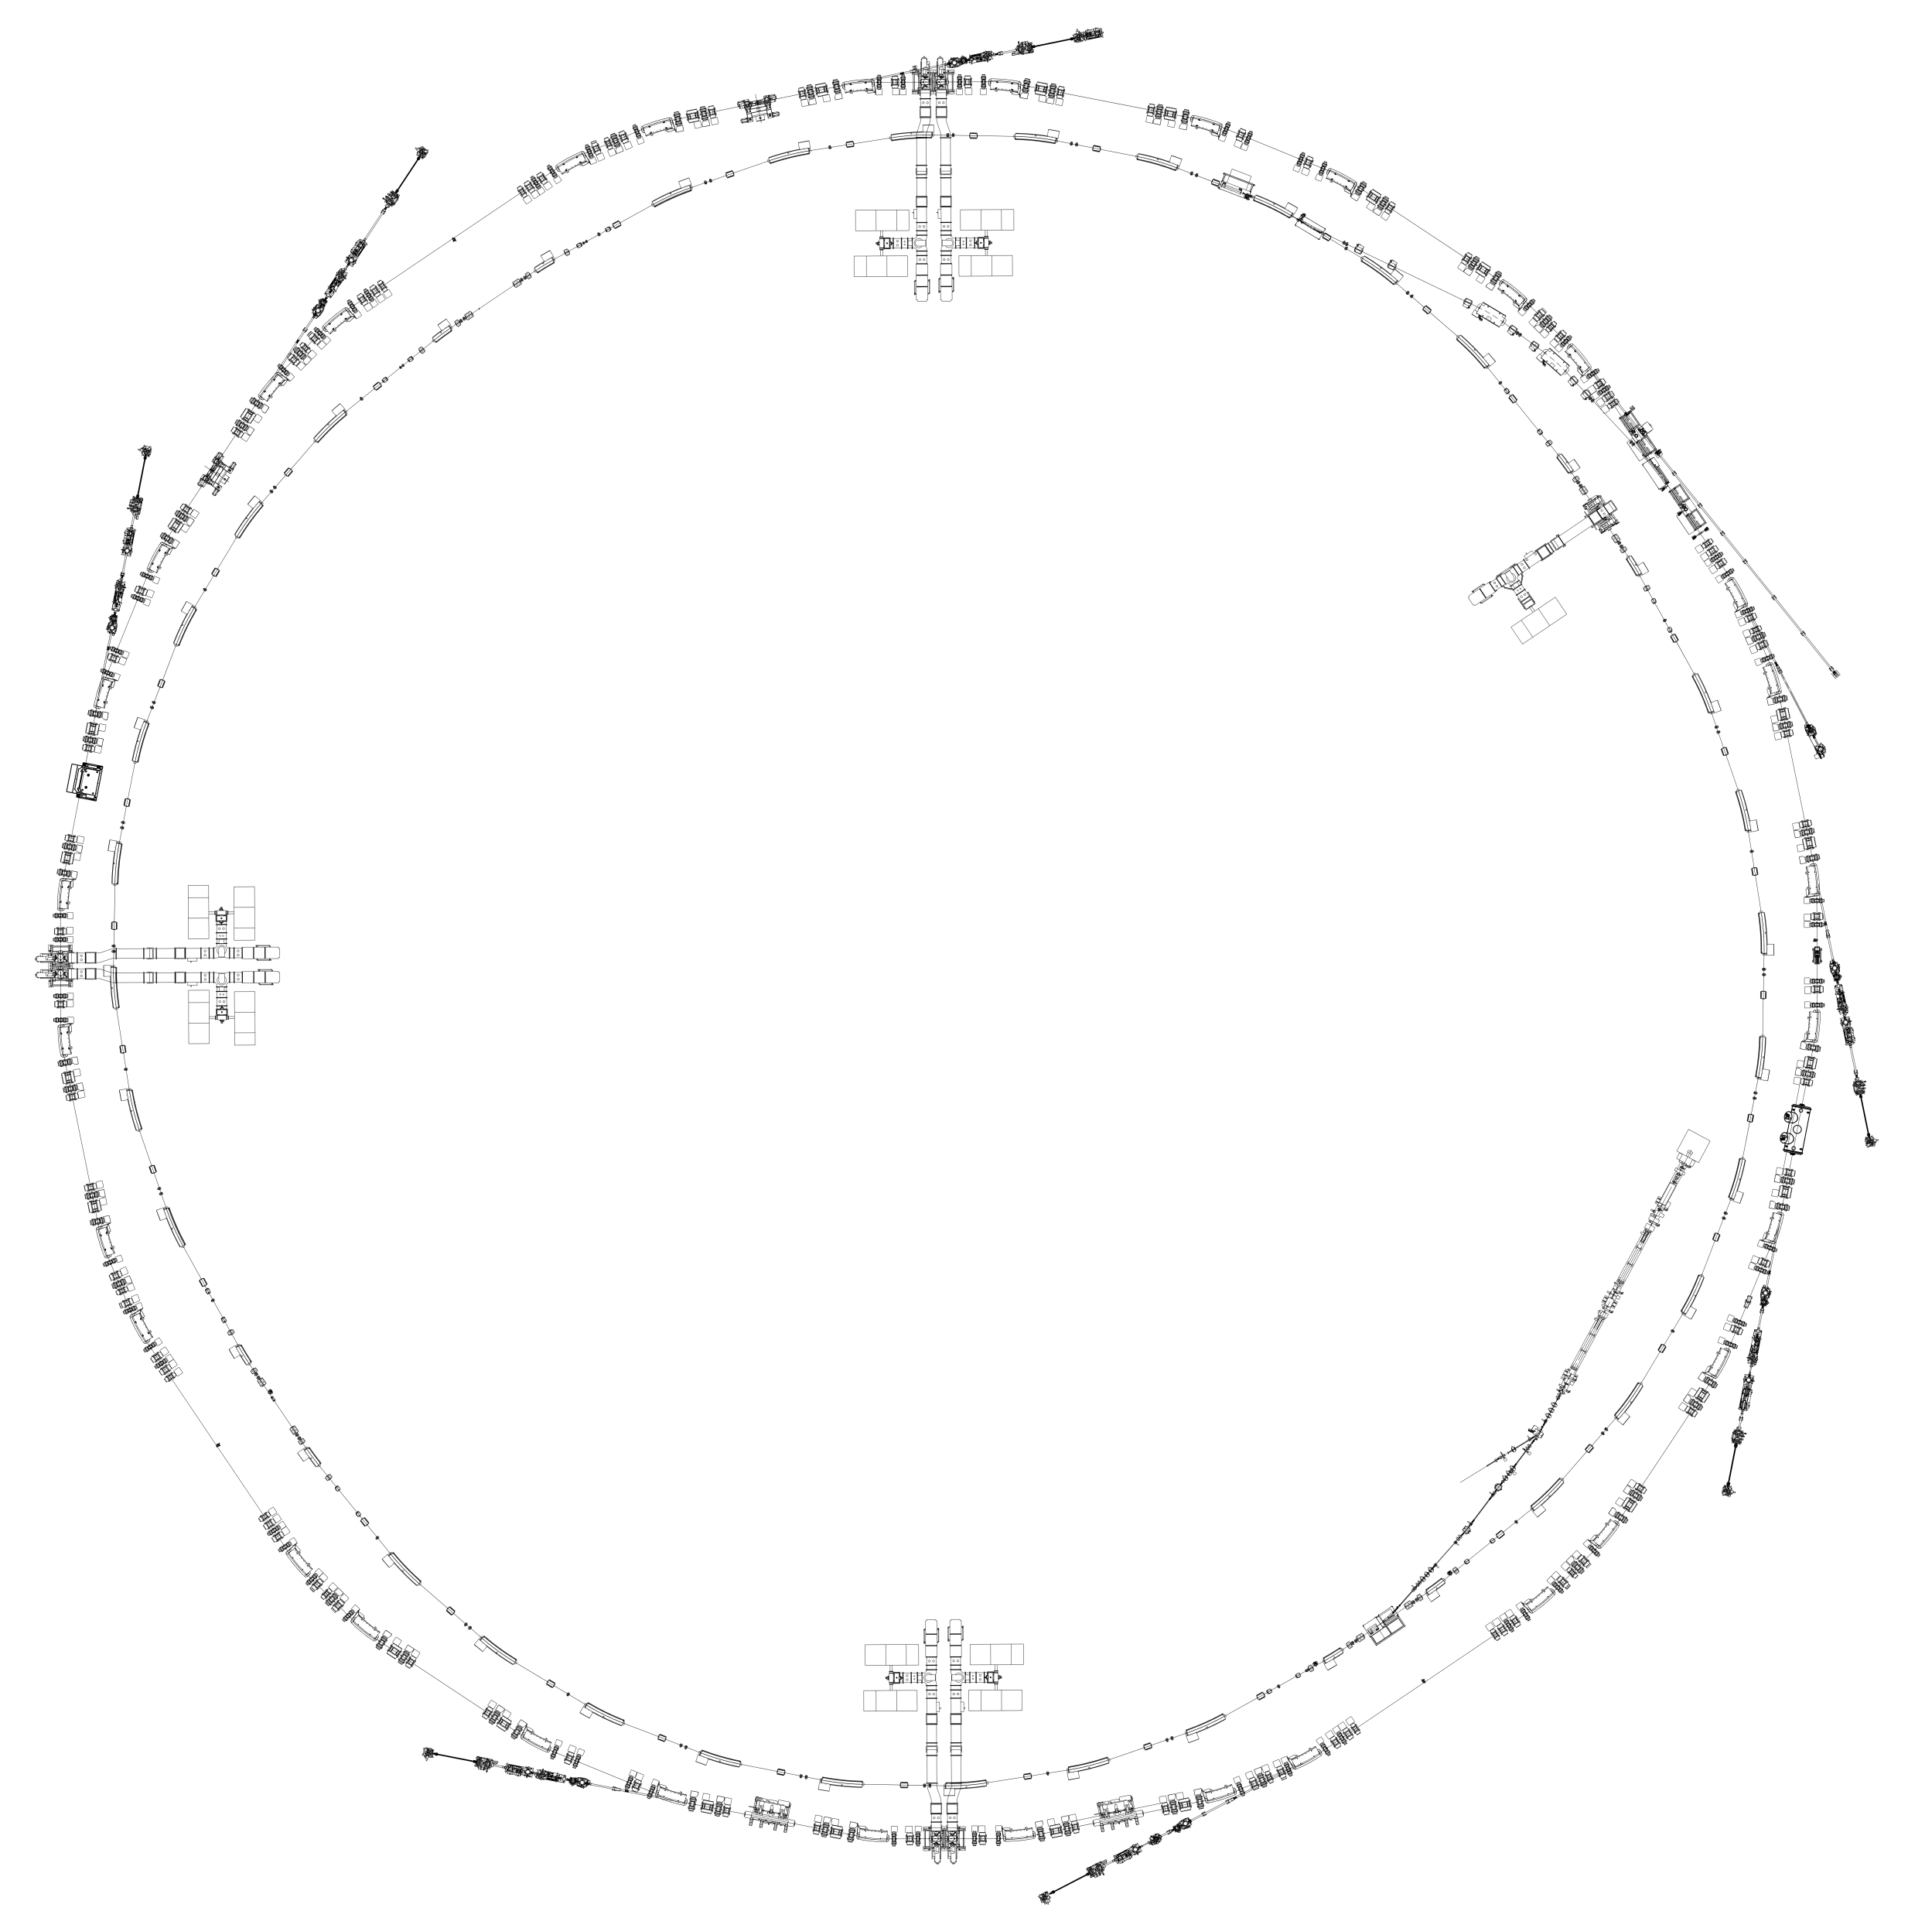
ALBA RF System
SR: 6 cavities
BO: PETRA 5 Cell cavity
13 IOT 80 kW
Notes:
This is the distribution of thecavities in our accelerators
We have six dampy cavities distributed in three straight sections for the SR
For rhe Booster, we have a t cell petra cavity.
All cavities are powered by IOTs. Two for each SR cavity and one for the BO cavity, wich makes a total of 13 IOTs

Slide 6
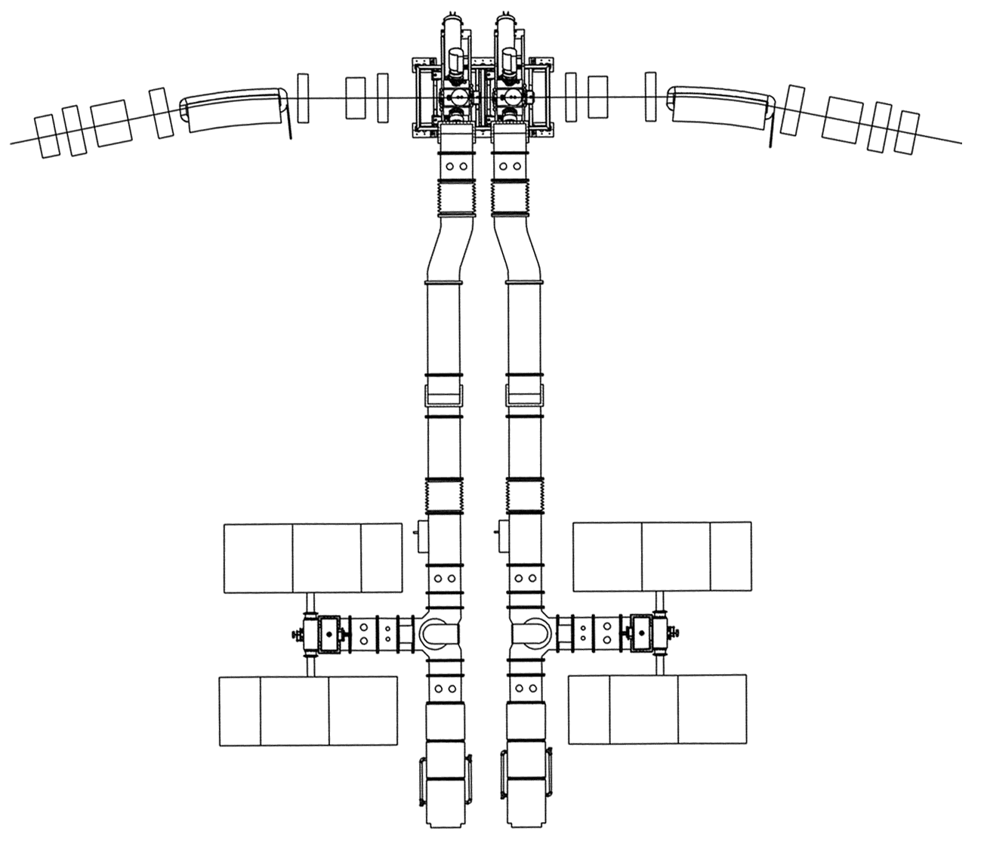
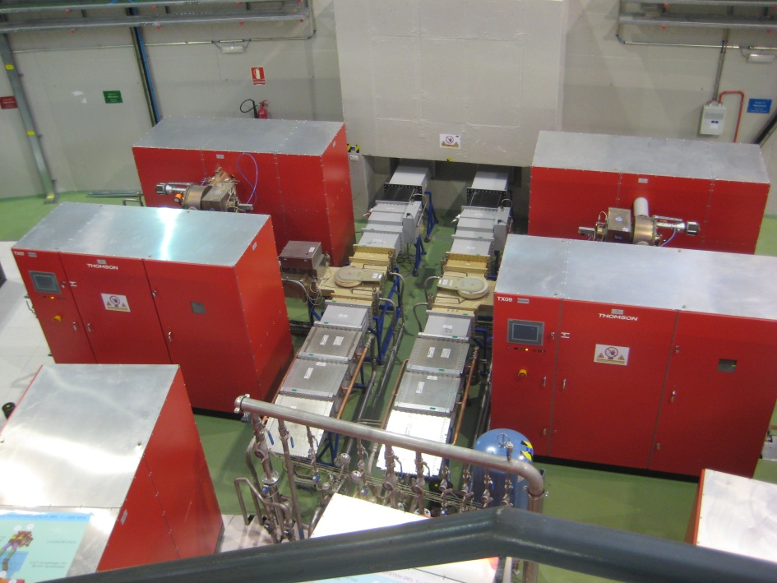
Storage Ring RF
A
B
Notes:
In the SR we have three groups of two cavities. Everything is placed simetrically.

Slide 7
Transmitters
HVPS
  38kV
  4A
  PSM technology
IOT Amplifier
  80kW CW
  TH794 IOT
Notes:
Each cavity is powered by two AMPEGON transmitters, with independent power supplies using psm switching technology. They provide up to 38kV and 4ª
Rhe amplifier uses 80kW TH794 IOTs

Slide 8
TH-794 IOT’s
Operation configurations
 | Conf. 50 kW | Conf. 80 kW
Cathode voltage | -32 kV | -36 kV
DC beam current | 0.15 A | 0.2 A
Gain | 22.9 dB | 23.4 dB
Efficiency | 59,3 % 50 kW | 70,4 % 80 kW
Notes:
We usually operate the IOTs at reduced power, below 50kW, so we have lowered the cathode voltage. The peak efficiency is lower, but at the operation power, it is better. Also the reliability of the system improves at lower voltaje
The gain is roughly the same

Slide 9
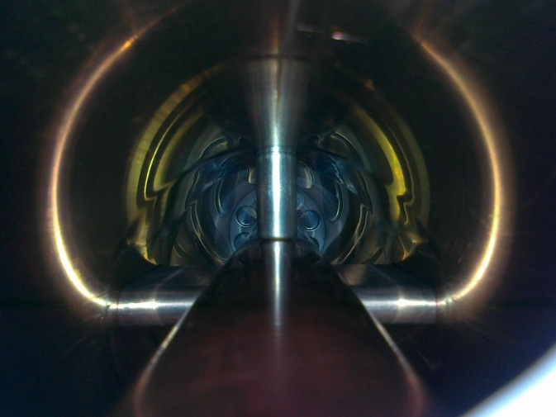
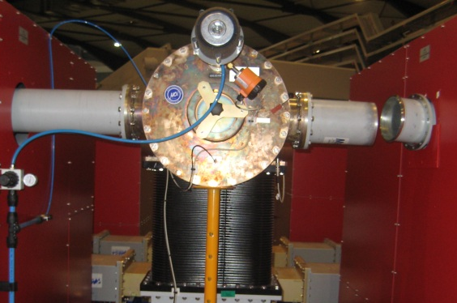
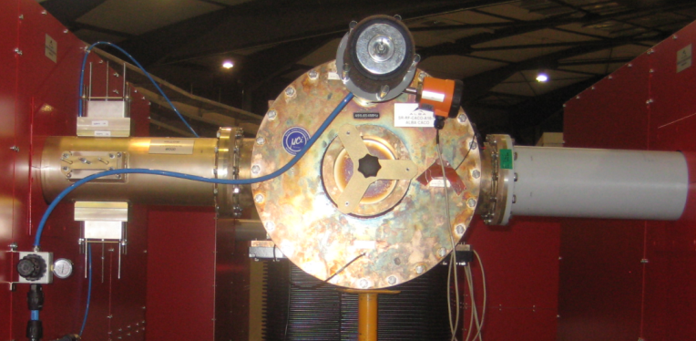
CoStub & CaCo
CaCo: Cavity Combiner
CoStub: Quickly isolate 1 IOT from CaCo
Notes:
We use a cavity combiner CaCo to add the power of both IOTs. In case of a faulty IOT, it has to be isolated. Previously we removed the waveguide and installed a shortcircuit wich takes a lot of time. To avoid this we developed the CoStub
The costub introduces 4 stubs that créate a shortcircuit between both conductors in a 10 minute intervention.
Here you can see the inner part of the waveguide with the stubs doing contact.

Slide 10
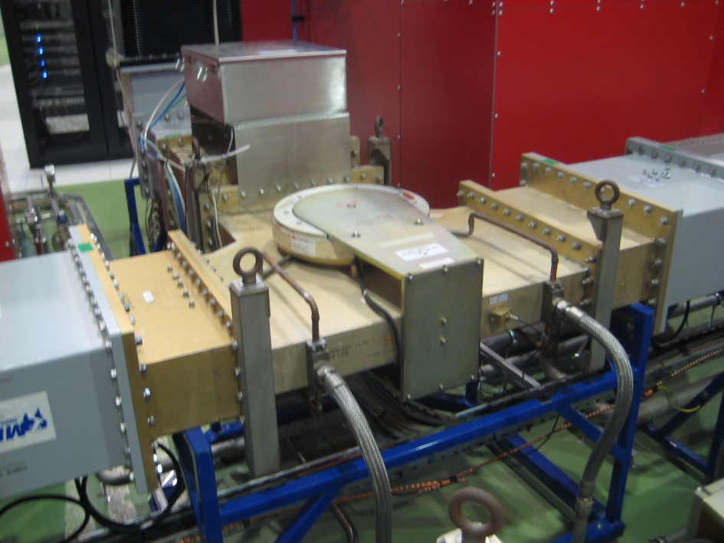
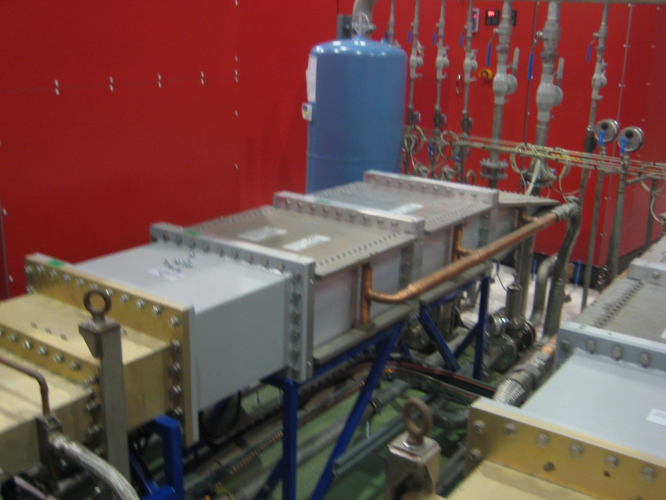
Waveguide system
Circulator
Load
Watrax

Slide 11
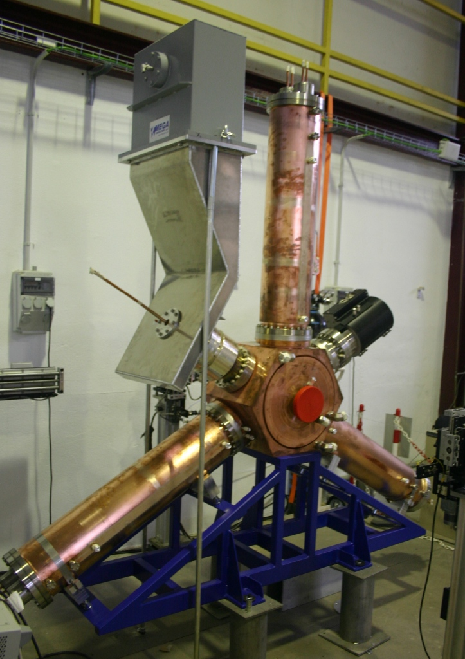
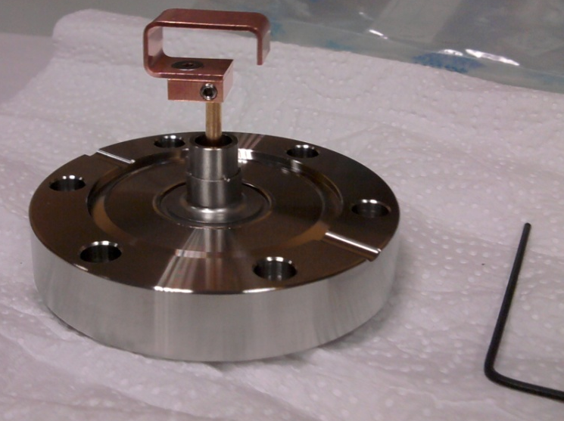
DAMPY cavities
Normal conducting
New pick-up loops
Notes:
We use normal conducting dampy cavities for the sr. We replaced the pick-up-loops for a new model without ceramics. This has improved the vacuum and reliability of the system.

Slide 12
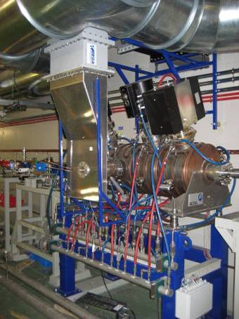
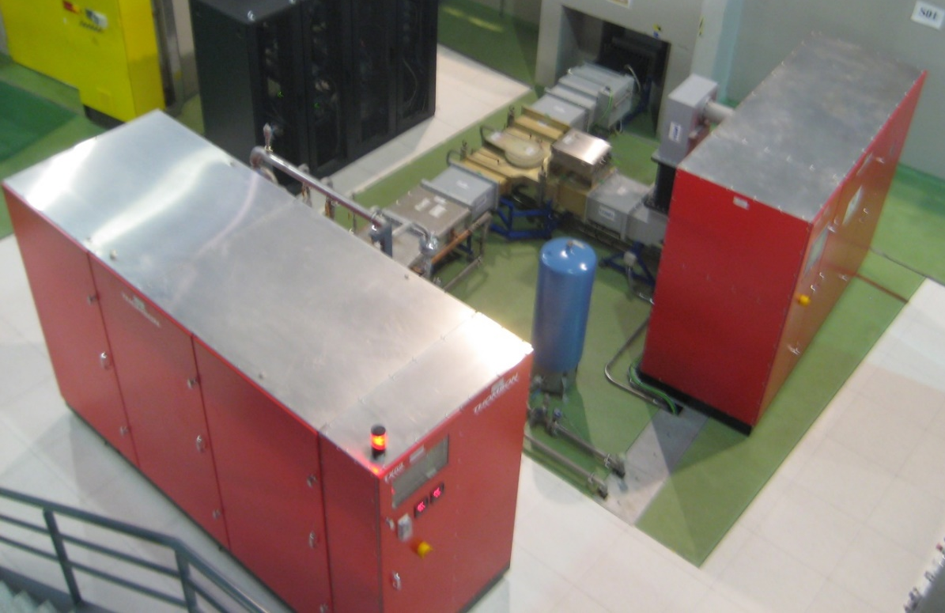
Booster cavity
80kW single IOT
5 Cell PETRA Cavity
Notes:
In the booster we use a 5 cell normal conducting cavity. We work at 35kW peak power, so only one iot is needed. Obviously, the rf layout is a bot simpler so we have no combiner nor costub in there.

Slide 13
Digital LLRF
In-house design
Built with commercial components
 | Resolution | Bandwith | Dynamic range
Amplitude loop | < 0.1% rms | [0.1, 50] kHz | 30 dB
Phase loop | < 0.1º rms | [0.1, 50] kHz | 60º
Tuning | < ±0.5º | 100 Hz | < ±75º
Notes:
The llrf is designed and built in house with commercial components. It has a phase stability of 0,1degrees and an amplitude stability of point one percent

Slide 14
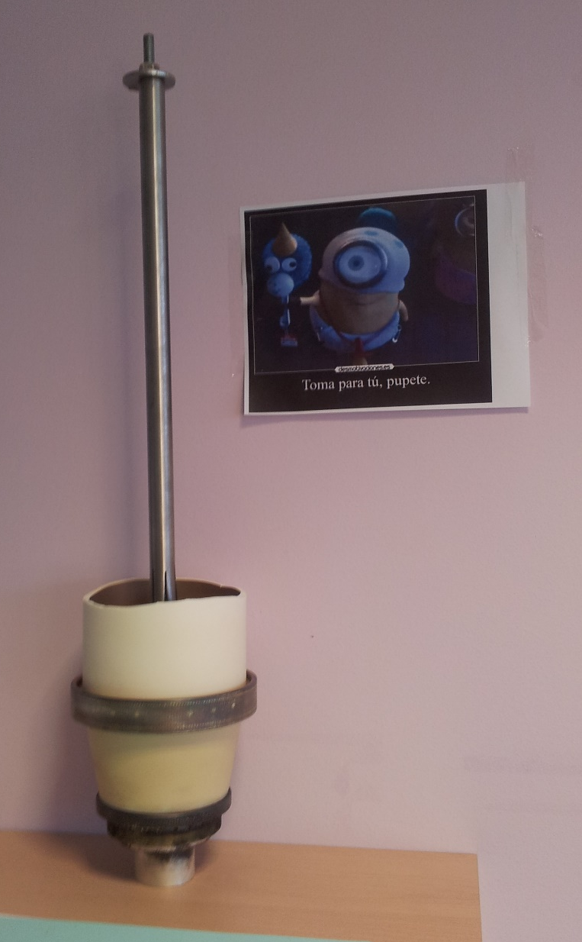
ALBA operation &
Status of the RF
Notes:
So now I will talk a bit about the operation of our accelerators and the RF systems

Slide 15
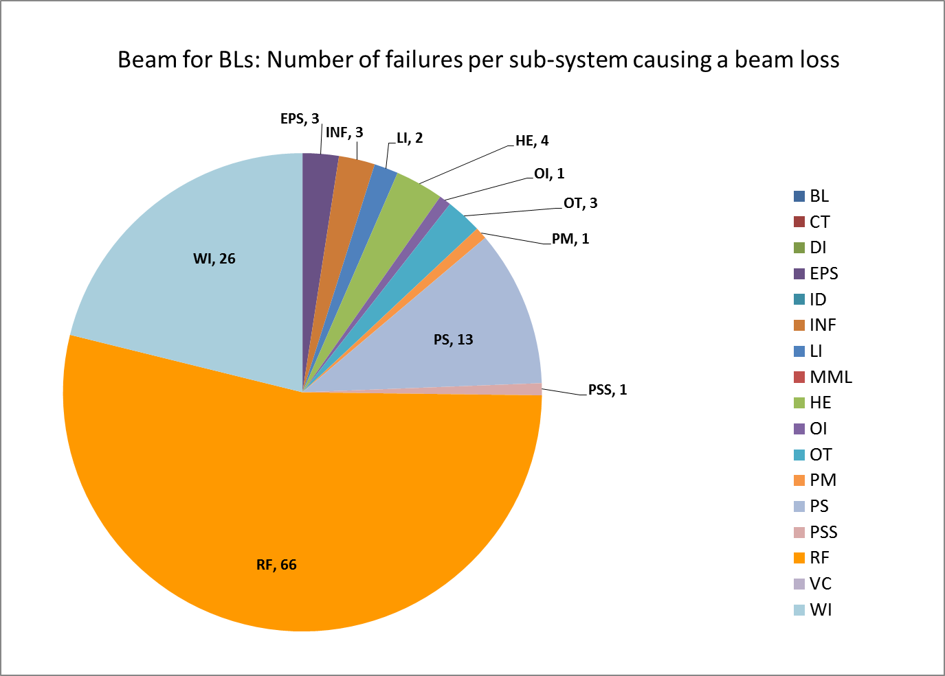
2013 ALBA operation
96,8 beam availability
MTBF 25 hours
MTTR 0.8 hours
123 beam dumps
RF responsable of 53% of beam dumps
Notes:
We have a mean time between failures of 25 hours

Slide 16
2013 RF beam dumps

Slide 17
2014 RF beam dumps

Slide 18
13,5 active IOT’s
Last TX | Fil hours | HV hours | Comment
TX02 | 21.652 | 15.436 | Booster.
TX09 | 19.304 | 14.433 | 10B1. Original
TX08 | 18.864 | 14.282 | 10A2. Original
TX05 | 17.795 | 13.230 | 06B1
TX07 | 16.891 | 13.900 | 10A1
TX03 | 16.622 | 12.006 | 06A1
TX14 | 9.456 | 7.399 | 14B1
TX10 | 7.410 | 5.961 | 10B2
TX04 | 4.875 | 4.071 | 06A2
TX11 | 718 | 695 | 14A1
 | 0 | 0
TX01 | ~300 | ~150 | RF-LAB: 75kW Ok
TX14 | ~48 | ~24
Total |  | Average |  | St. Dev.
Fil | HV | Fil | HV | Fil | HV
133.587 | 101.413 | 13.359 | 10.141 | 7.146 | 5.184

Slide 19
11,5 damaged IOT’s
Last TX | Date | FIL hours | HV hours | Comment
TX01 |  | 1.714 | 1.088 | Damaged during transportation
TX07 | 19/09/2011 | 2.316 | 515 | Damaged after 3 months shutdown
TX01 | 07/10/2011 | 1.639 | 1.101 | Only functional up to 20kW
TX04 | 21/05/2012 | 7.468 | 4.851 | Water leak in IOT carriage
TX06 | 20/08/2012 | 7.828 | 5.080 | Spontaneous arc
TX10 | 08/11/2012 | 10.296 | 6.970 | Arc at 50kW
TX03 | 17/01/2013 | 10.627 | 7.585 | Spontaneous arc
TX04 | 26/01/2013 | 4.221 | 3.324 | Spontaneous arc
TX13 | 25/10/2013 | 15.456 | 12.004 | Spontaneous arc
TX11 | 12/02/2014 | 18.257 | 13.250 | Spontaneous arc
TX13 | 02/03/2014 | 8.203 | 6.501 | Spontaneous arc
TX12 | 24/02/2014 | 17.039 | 12.395 | Impossible to recover after December shutdown
Total |  | Average |  | St. Dev.
FIL | HV | FIL | HV | FIL | HV
105.064 | 74.664 | 8.755 | 6.222 | 5.837 | 4.474
Since 2010

Slide 20
Damaged IOT’s
2 damaged IOT’s in 2014
1 IOT undergoing high voltage conditioning

Slide 21
620408
17.039 hours of operation
External arching
Grid current increase with only DC HV applied

Slide 22
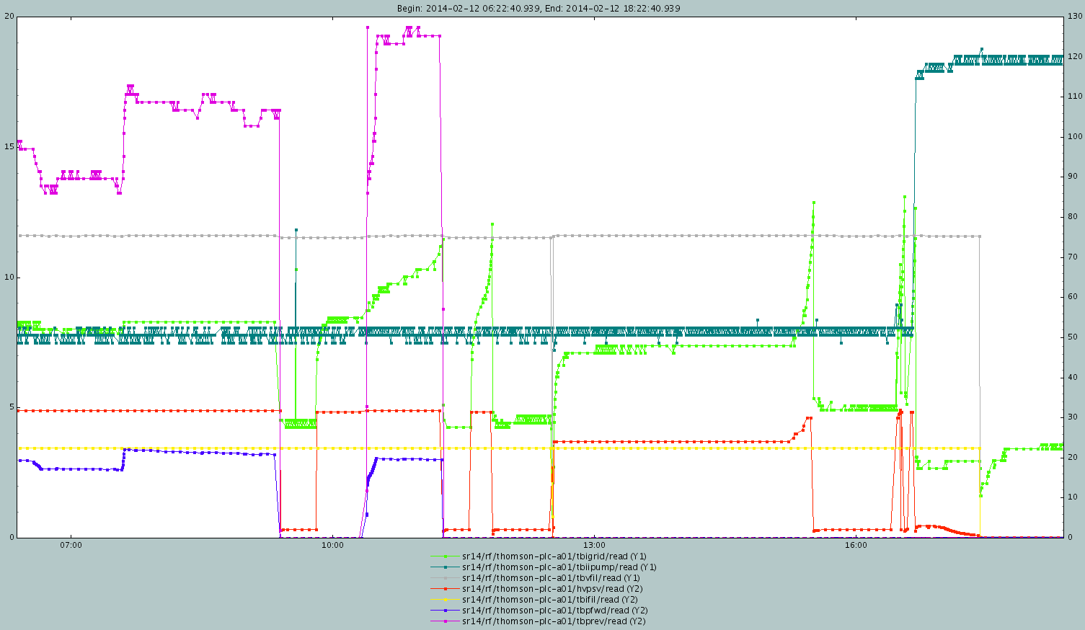
620408
Vacuum
Grid current
Grid current

Slide 23
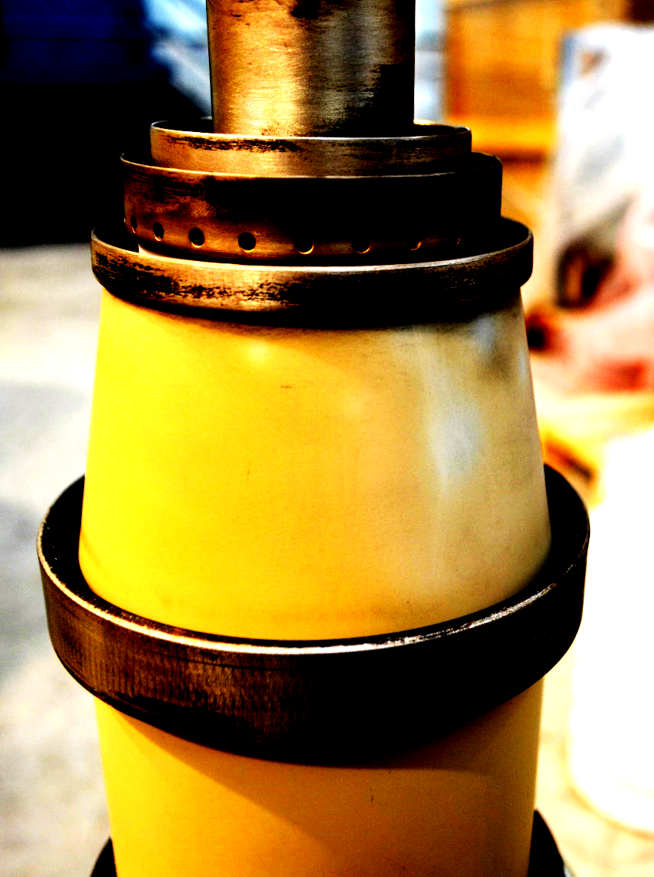
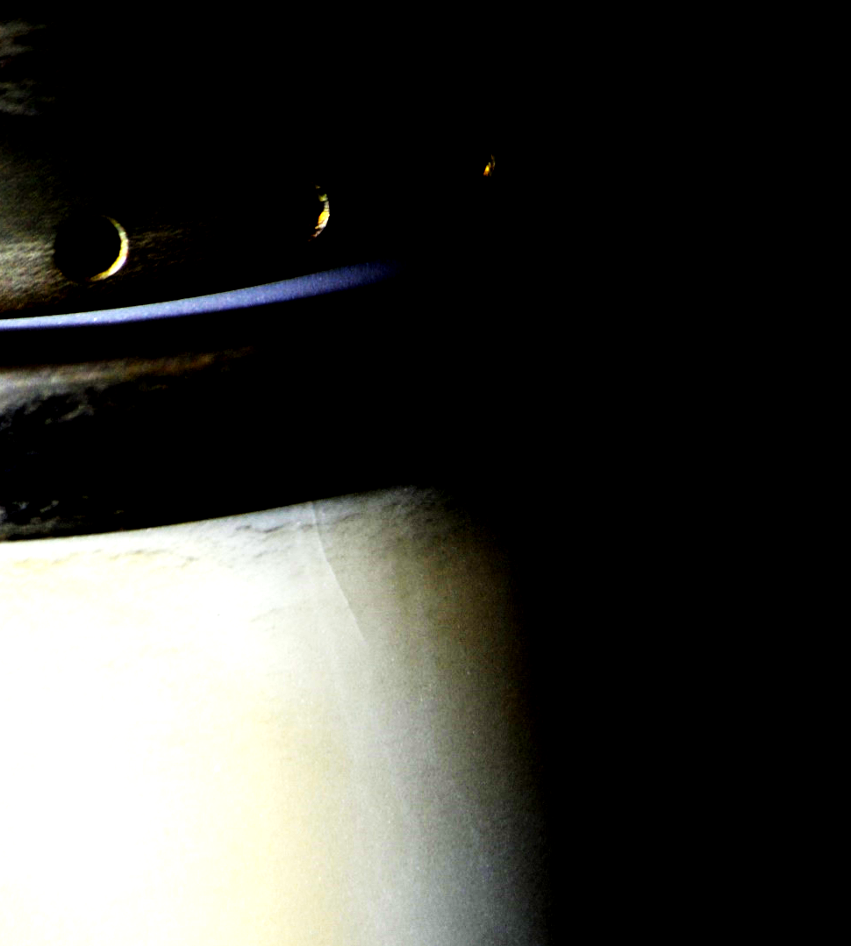
Ceramics detail

Slide 24
Take it easy!
Remove the IOT and look for defects
High voltage conditioning in transmitter up to 40kV
HVON 32kV

Slide 25
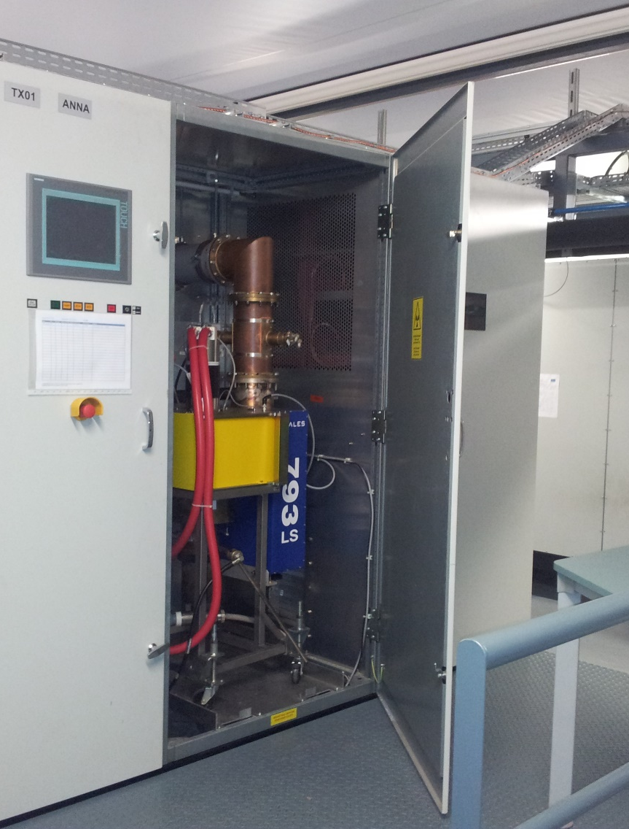
RF-Lab
80kW amplifier
SR & BO cavities
External collaborations

Slide 26
Purpose
IOT testing
Cavity conditioning and testing
Prototype test
Collaboration with other institutions
  CIEMAT: Conditioning of buncher cavities for IFMIF

Slide 27
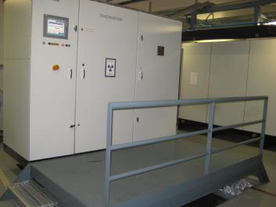
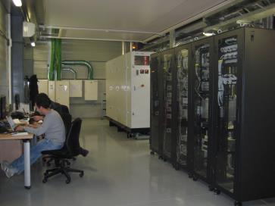
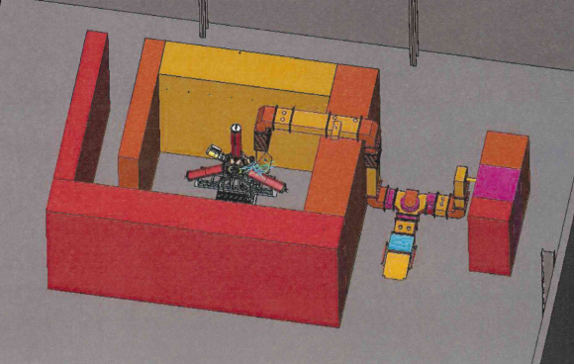
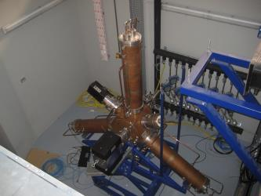
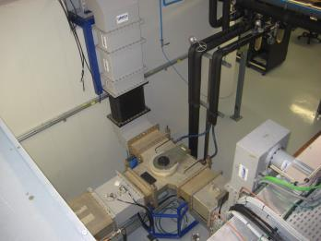
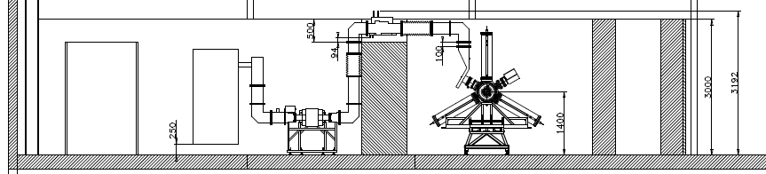
Layout

Slide 28
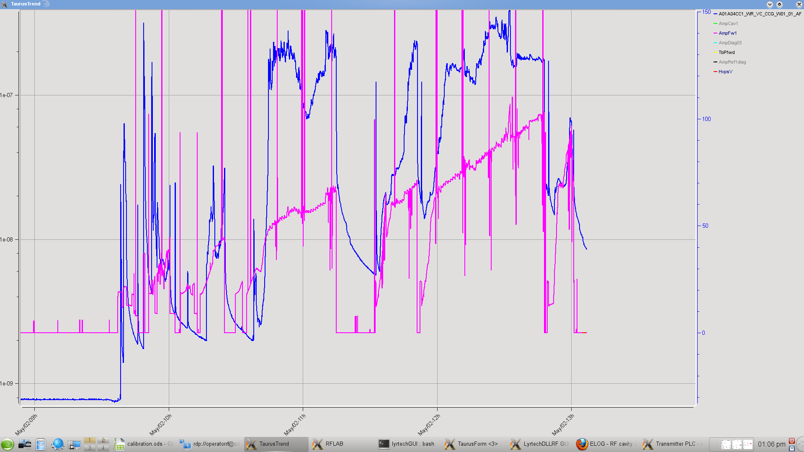
Operation
Amplifier tested up to 75kW CW
Conditioning spare Dampy cavity
  40kW, 20% duty cycle

Slide 29
Status and operation of the ALBA RF system
Thank you for your attention

