Slide 1
Almost 40 years of operation with tetrodes in the CERN-SPS
CWRF workshop 2014, Trieste
Eric Montesinos, CERN-RF, on behalf of RF-SPS team

Slide 2
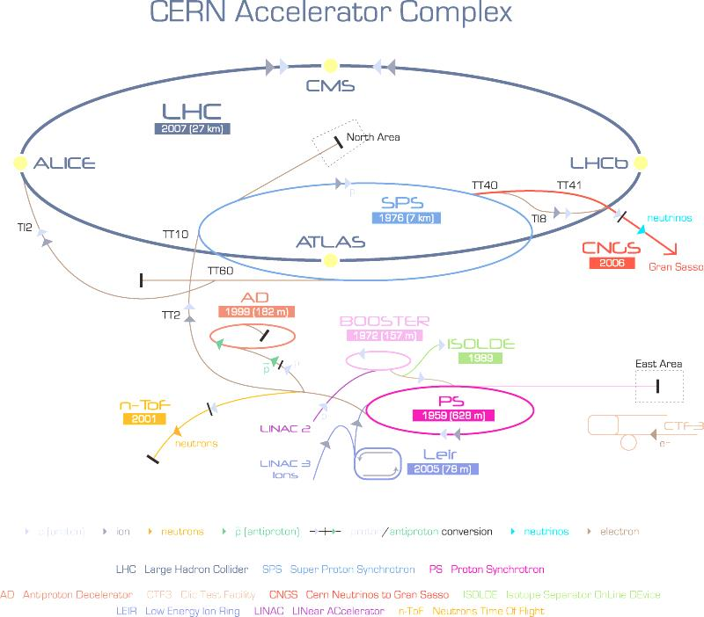
What is the CERN-SPS ?
SPS
1976 (7 km)

Slide 3
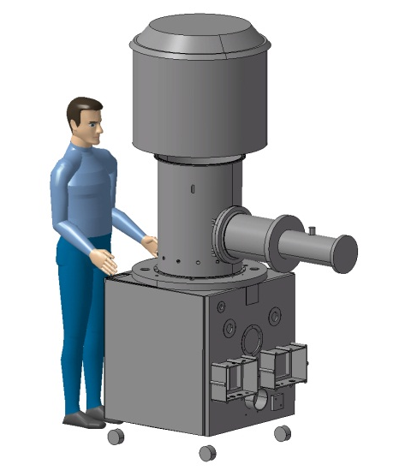
RF in the SPS
1970
1980
1990
2000
2010
2020
1972
prototype Siemens Amplifier
RS2004 tetrode
137.5 kW CW @ 200.2 MHz

Slide 4
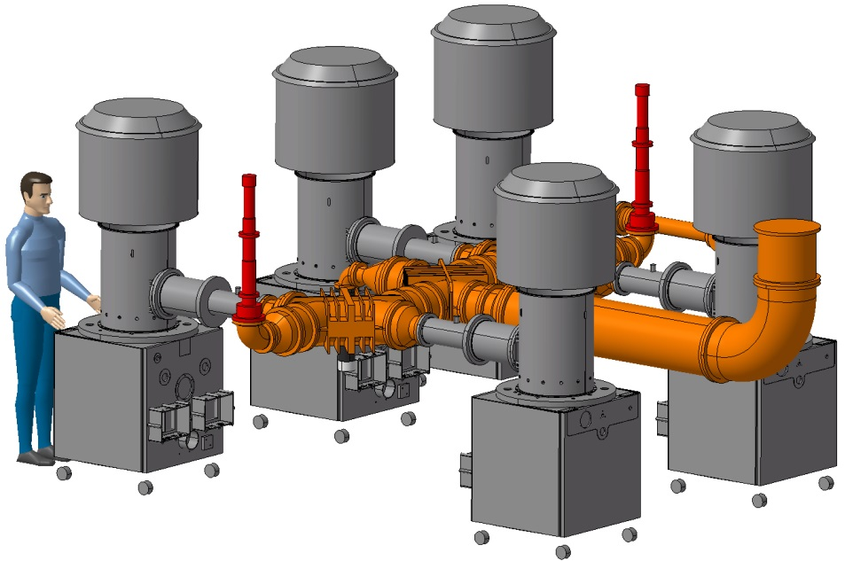
RF in the SPS
1970
1980
1990
2000
2010
2020
1974
First Siemens Transmitter
1 x RS2004 Driver
4 x RS2004 Finals
Total output power = 515 kW CW

Slide 5
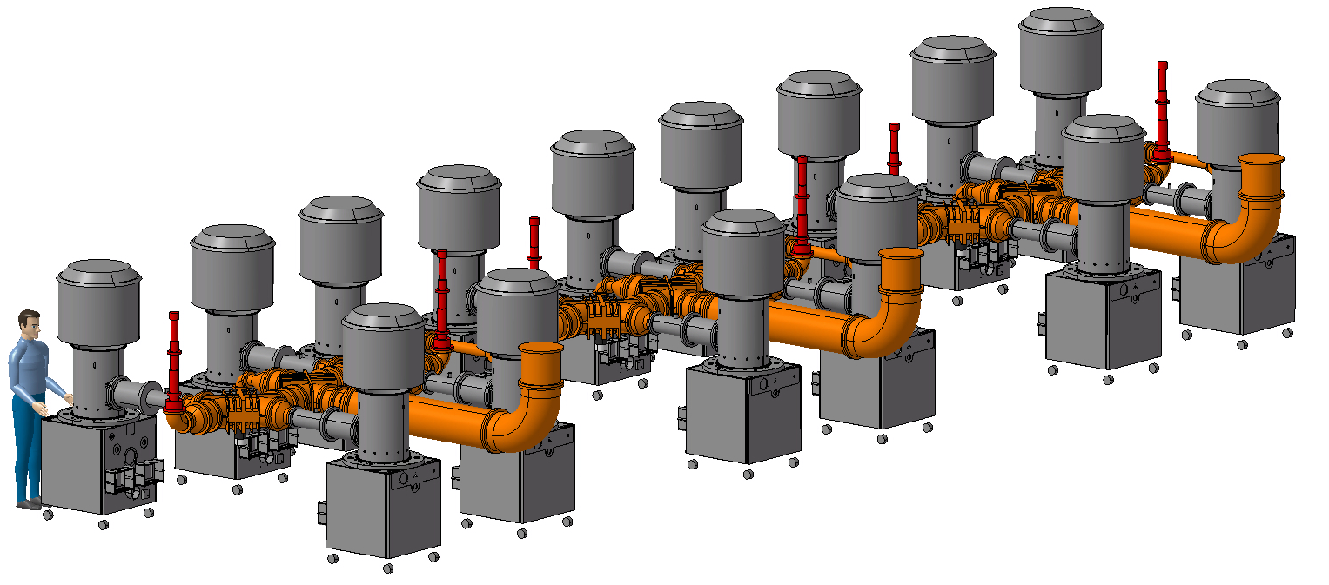
RF in the SPS
1970
1980
1990
2000
2010
2020
1976
Three Siemens Transmitters
3 x 515 kW CW

Slide 6
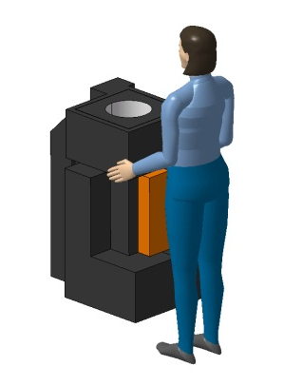
RF in the SPS
1970
1980
1990
2000
2010
2020
1978
prototype Philips Amplifier
YL1530 tetrode
35 kW CW @ 200.2 MHz

Slide 7
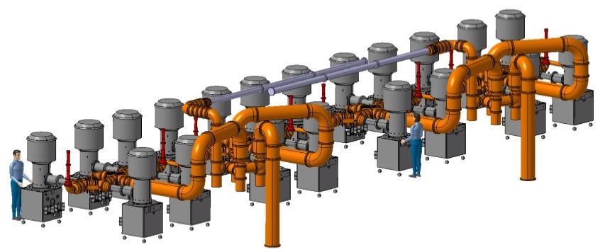
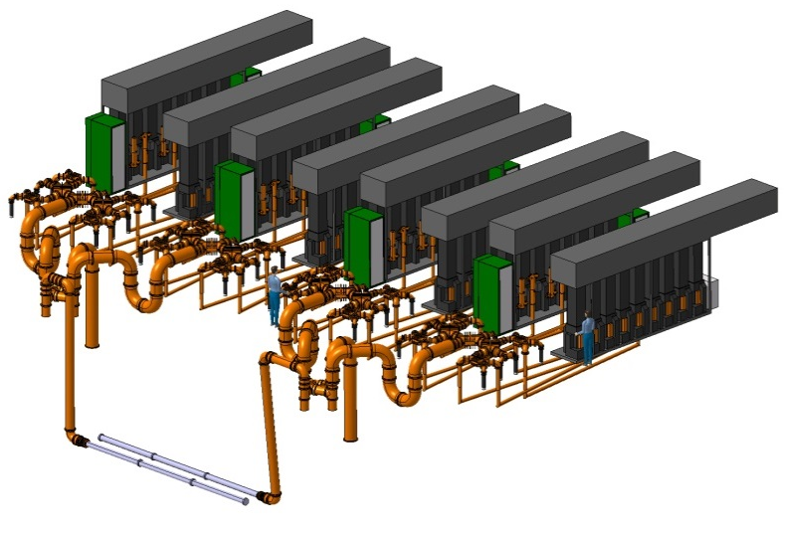
RF in the SPS
1970
1980
1990
2000
2010
2020
1980
2 Siemens Lines
20 x RS2004
2 x 1 MW CW
2 Philips Lines
72 x YL1530
2 x 1 MW CW

Slide 8
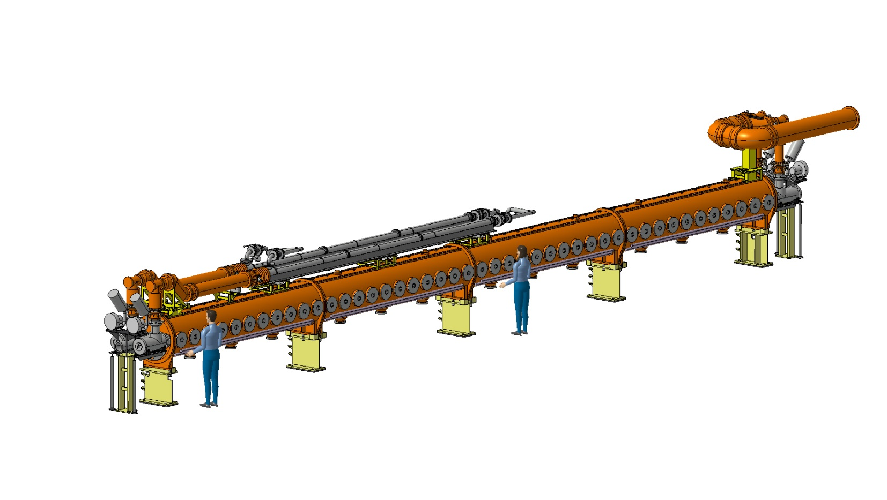
RF in the SPS
1970
1980
1990
2000
2010
2020
2 x 4 sections
2 x 5 sections
Travelling Wave
Cavities
Per TWC:
2 x 2 x 375 kW Fundamental
Power Couplers
2 x 500 kW
Power Loads

Slide 9
First period 1976-1988
1970
1980
1990
2000
2010
2020
Fixed Target & Collider operation
Maximum power 450 kW CW
North Area
SPS
1976 (7 km)
West Area

Slide 10
Second period 1989-2000
1970
1980
1990
2000
2010
2020
1989-2000: FT + leptons injector for LEP
Maximum power 600 kW CW
+ 600 kW 172 kHz (1994-2000)
LEP
1989 (27 km)
North Area
SPS
1976 (7 km)
West Area

Slide 11
Third period 2001-2005
1970
1980
1990
2000
2010
2020
2001-2004: FT operation
Maximum power 600 kW CW
+ 600 kW 172 kHz (2003)
North Area
SPS
1976 (7 km)
West Area

Slide 12
Fourth period 2006-2013
1970
1980
1990
2000
2010
2020
2006-2013: protons & ions operation + CNGS + injector for LHC
Maximum power 600 kW CW
+ 600 kW 43 kHz (2007-2012)
LHC
2008 (27 km)
North Area
SPS
1976 (7 km)
CNGS
2006

Slide 13
Power request 1976-2018
1970
1980
1990
2000
2010
2020

Slide 14
Tubes statistics
Total 1980-2013 : 254 tubes
Average lifetime : 32’000 hours
Tubes with > 28’000 hours : 78 %
(also true for tubes stored 20 years !)

Slide 15
Amplifiers statistics
YL1530 SPS 200 MHz, 2 x 32 tubes in parallel
Reason of fault | # of faults | % of faults
Loss of emission | 99 | 39
Input reflections | 97 | 38
Unknown | 20 | 8
Over Temp | 20 | 8
Arcing | 18 | 7
Unpredictable : 23 %
Graceful degradation : 77 % (possible to monitor and predict)
Graceful operation : 99.5 % (2012)

Slide 16
Operating with
‘OFF Line’ Tubes
Pout _{3dBCombiner} = (A+B)/2 + SQRT(A.B)
In normal operation, one tube delivers 600 kW / 8 = 75 kW
Systems have been designed (1976) to deliver full voltage into the cavity even with 3/4 + 3/4 tubes
In case of two tubes ‘OFF Line’, remaining tubes shall deliver
75 kW x (8/6)^2 = 133 kW
RS2004 tubes are rated 137.5 kW, just ok
P
2P
4P
2P
8P
2P
4P
2P

Slide 17
Operating with
‘OFF Line’ Tubes
Pout _{3dBCombiner} = (A+B)/2 + SQRT(A.B)
In normal operation, one tube delivers 600 kW / 8 = 75 kW
Systems have been designed (1976) to deliver full voltage into the cavity even with 3/4 + 3/4 tubes
In case of two tubes ‘OFF Line’, remaining tubes shall deliver
75 kW x (8/6)^2 = 133 kW
RS2004 tubes are rated 137.5 kW, just ok
P
2P
2.25P
0.5P
4.5P
0.5P
2.25P
2P

Slide 18
Operating with
‘OFF Line’ Tubes
The same philosophy applies to Philips amplifiers, in normal operation, one tube delivers
600 kW / 32 (+ 3 dB combiner losses) = 20 kW
In case of 2 x 4 tubes ‘OFF Line’, remaining tubes shall deliver
20 kW x (32/24)^2 = 36 kW
YL1530 tubes are rated 37 kW
32P
18P

Slide 19
Operating with
‘OFF Line’ Tubes
Along the year we loose
  6 Siemens tubes
  16 Philips tubes
Thanks to the graceful degradation and the OFF line possibility we change these tubes during the ‘one day technical stop’ every 8 weeks
We sometimes operate Philips plant with one ‘OFF line tube’
We rarely need to use it with the Siemens plant, but from time to time it helps us to remain available
Even if we operate with faulty tubes, we still have some margin in power
So, we apply the rule
-5% U_{filament} → +25% lifetime
I cannot say if the rule is true, I can simply say that our tubes have a very long lifetime
Please keep it in mind looking at our tubes statistics

Slide 20
Major events 1970-2010
1970-1980
  Development phase + first operation, no major troubles
1980-1990
  No major troubles
1990-2000
  HVPS 18 KVAC capacitor explosion
  Fundamental Power Coupler failures
  Power Load failures
2000-2010
  Near miss Tunnel ceiling water infiltration
  Crowbar/water pipe failure
  HVPS Transformer failure
Local / Remote Control
Miscellaneous

Slide 21
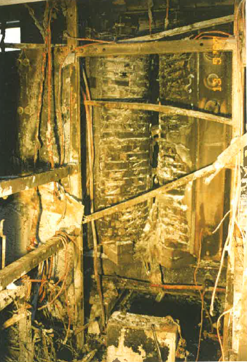
HVPS 18 KV-AC capacitor explosion
1970
1980
1990
2000
2010
2020
Spring 1997, after few weeks of operation, explosion of a HVPS (18 kV-AC capacitor)
Fire in the cubicle
Mercury crowbar system vaporised
SPS stopped for 3 months

Slide 22
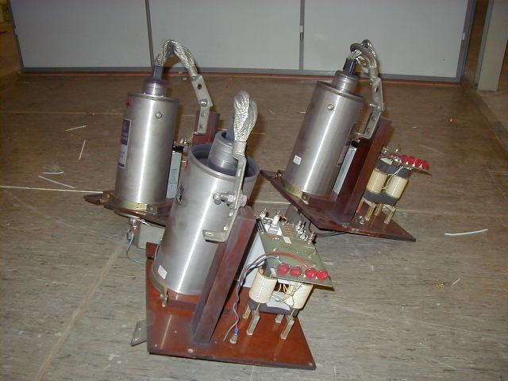
HVPS 18 KVAC capacitor explosion
1970
1980
1990
2000
2010
2020
Spring 1997, after few weeks of operation, explosion of a HVPS (18 kV-AC capacitor)
Fire in the cubicle
Mercury crowbar system vaporised
SPS stopped for 3 months

Slide 23
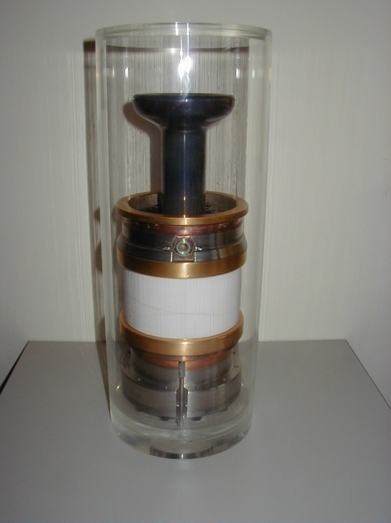
Fundamental Power Couplers
1970
1980
1990
2000
2010
2020
Ceramic failures with the Fundamental Power Couplers
  1994
  1998
  1999
We made a new design, more powerful, based on a Thales klystron disk window, still in operation

Slide 24
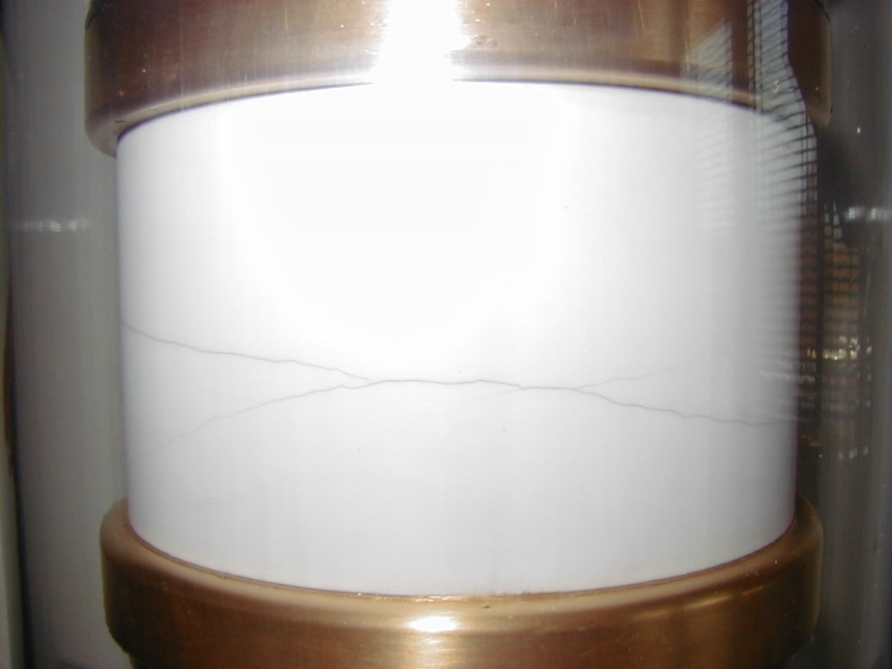
Fundamental Power Couplers
1970
1980
1990
2000
2010
2020
Ceramic failures with the Fundamental Power Couplers
  1994
  1998
  1999
We made a new design, more powerful, based on a Thales klystron disk window, still in operation

Slide 25
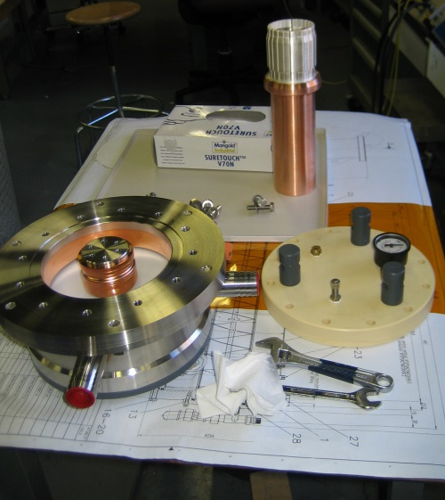
Fundamental Power Couplers
1970
1980
1990
2000
2010
2020
Ceramic failures with the Fundamental Power Couplers
  1994
  1998
  1999
We made a new design, more powerful, based on a Thales klystron disk window, still in operation

Slide 26
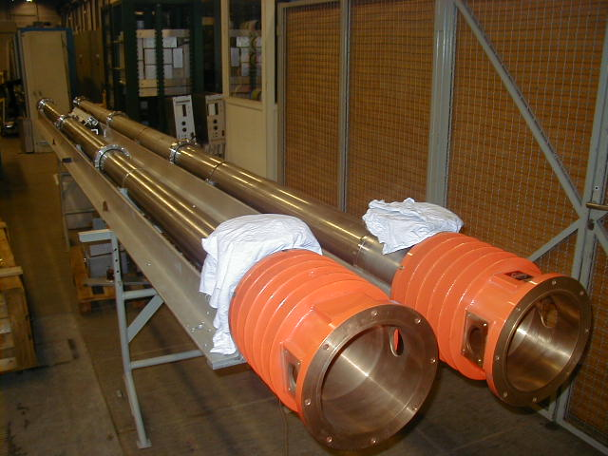
Power load window failure
1970
1980
1990
2000
2010
2020
After 20 years of operation, we had three failures with the window of our power loads
  First one on the Siemens amplifier (1998)
  Two on the cavities (1999)
We made a new design, without a molybdenum junction, thanks to new brazing possibilities

Slide 27
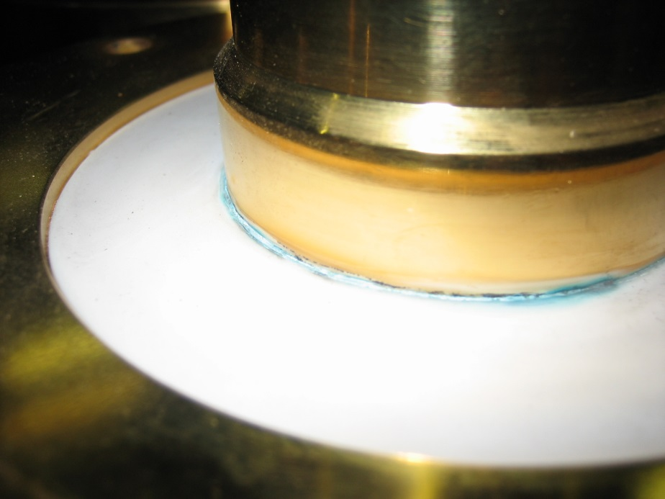
Power load window failure
1970
1980
1990
2000
2010
2020
After 20 years of operation, we had three failures with the window of our power loads
  First one on the Siemens amplifier (1998)
  Two on the cavities (1999)
We made a new design, without a molybdenum junction, thanks to new brazing possibilities

Slide 28
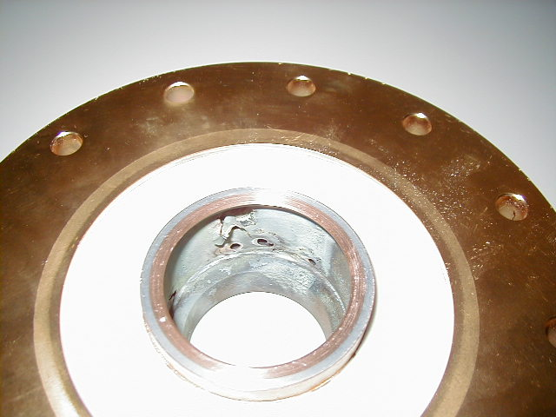
Power load window failure
1970
1980
1990
2000
2010
2020
After 20 years of operation, we had three failures with the window of our power loads
  First one on the Siemens amplifier (1998)
  Two on the cavities (1999)
We made a new design, without a molybdenum junction, thanks to new brazing possibilities

Slide 29
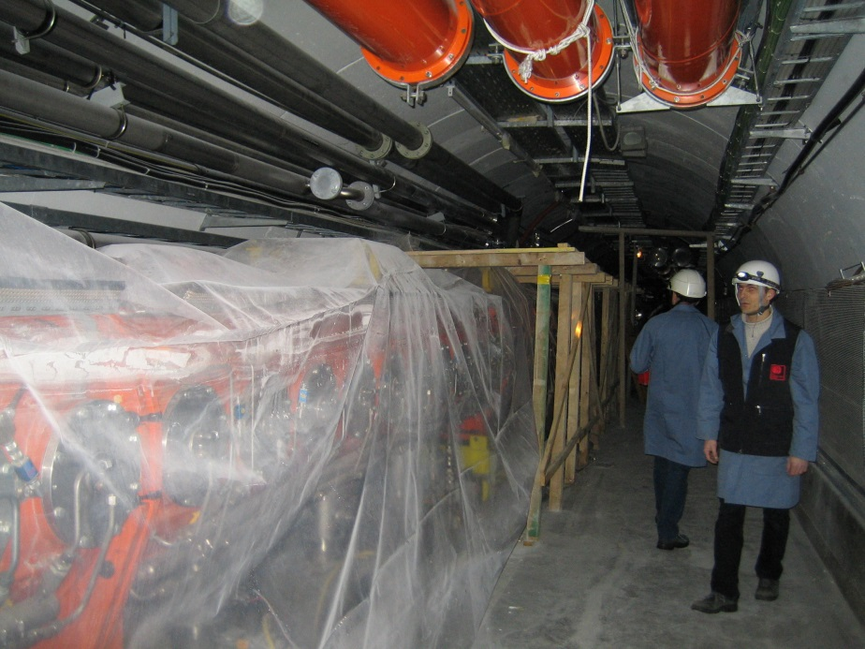
Near miss coaxial lines
1970
1980
1990
2000
2010
2020
During the 2005 one year shutdown, we had to repair the vault above the cavity#2
(water infiltration)
Some of the vacuum seals on the cavity were damaged
The coaxial lines were about to be perforated

Slide 30
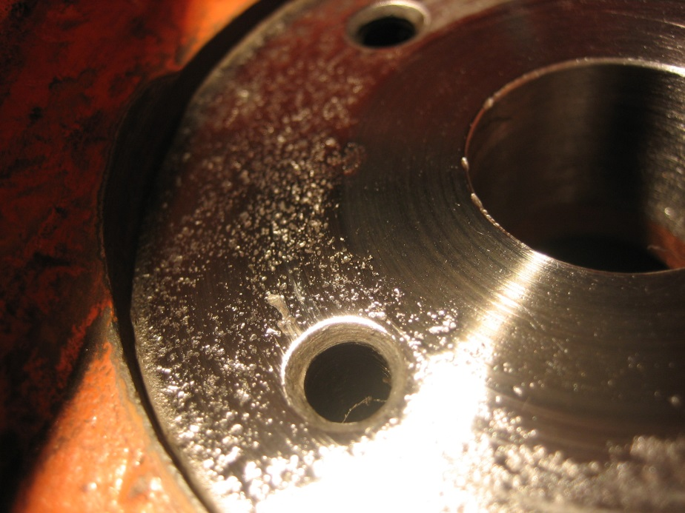
Near miss coaxial lines
1970
1980
1990
2000
2010
2020
During the 2005 one year shutdown, we had to repair the vault above the cavity#2
(water infiltration)
Some of the vacuum seals on the cavity were damaged
The coaxial lines were about to be perforated

Slide 31
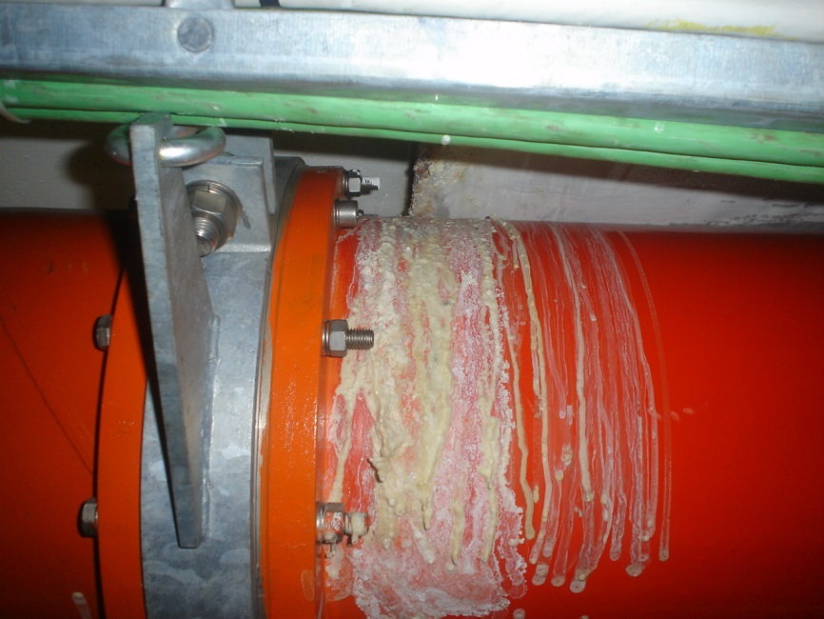
Near miss coaxial lines
1970
1980
1990
2000
2010
2020
During the 2005 one year shutdown, we had to repair the vault above the cavity#2
(water infiltration)
Some of the vacuum seals on the cavity were damaged
The coaxial lines were about to be perforated

Slide 32
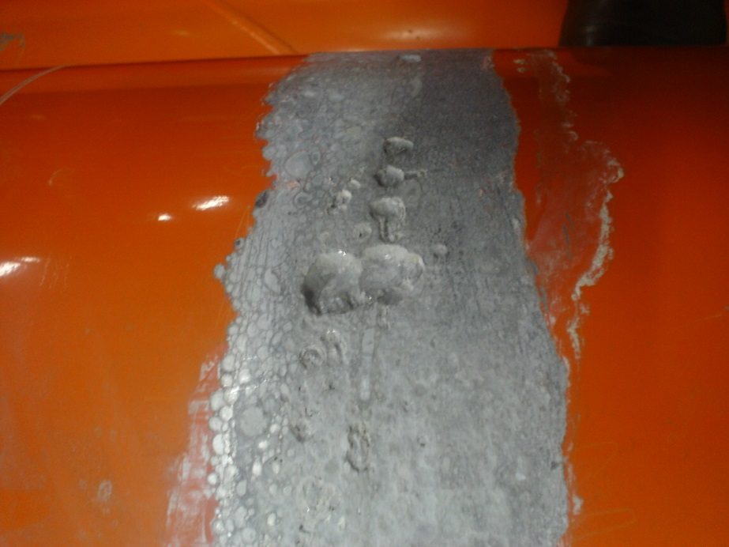
Near miss coaxial lines
1970
1980
1990
2000
2010
2020
During the 2005 one year shutdown, we had to repair the vault above the cavity#2
(water infiltration)
Some of the vacuum seals on the cavity were damaged
The coaxial lines were about to be perforated

Slide 33
Crowbar/water pipe
1970
1980
1990
2000
2010
2020
Two faults with the same symptoms
  New GTO crowbar system unstable (10 kV)
  A water pipe intermittently arcing between HVDC and GND triggering the crowbar
It took us a long time to fix these, explanation for bad statistics during 2008 to 2010
Ug2

Slide 34
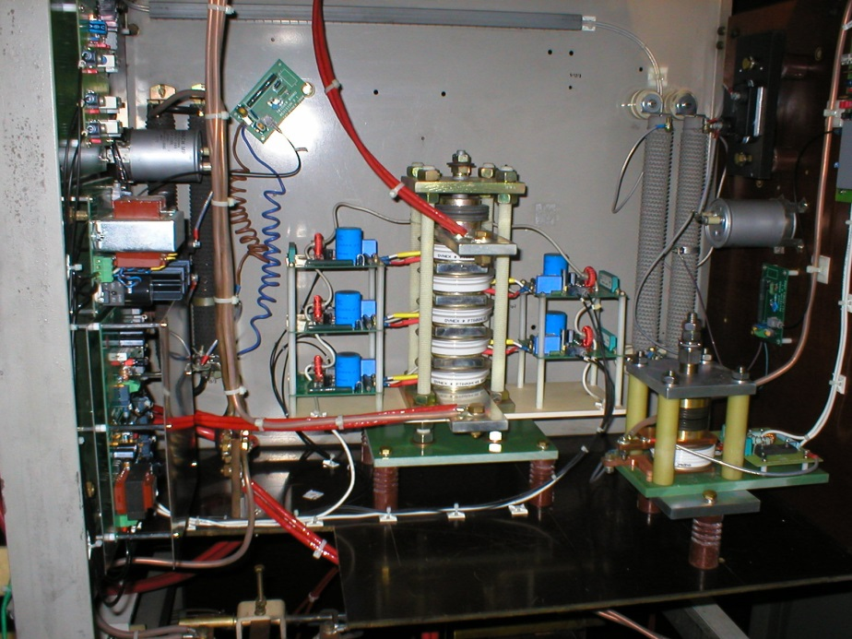
Crowbar/water pipe
1970
1980
1990
2000
2010
2020
Two faults with the same symptoms
  New GTO crowbar system unstable (10 kV)
  A water pipe intermittently arcing between HVDC and GND triggering the crowbar
It took us a long time to fix these, explanation for bad statistics during 2008 to 2010

Slide 35
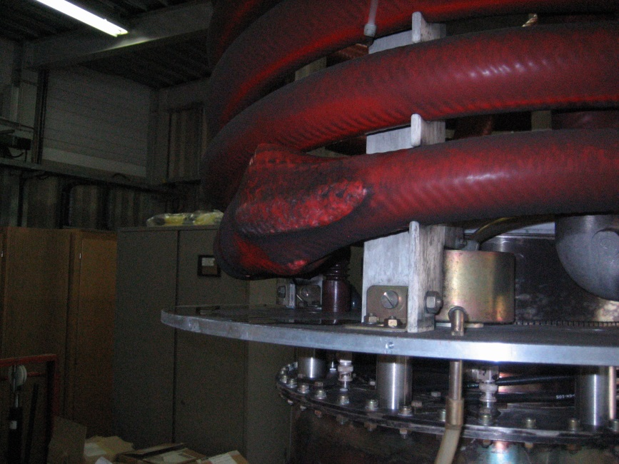
Crowbar/water pipe
1970
1980
1990
2000
2010
2020
Two faults with the same symptoms
  New GTO crowbar system unstable (10 kV)
  A water pipe intermittently arcing between HVDC and GND triggering the crowbar
It took us a long time to fix these, explanation for bad statistics during 2008 to 2010

Slide 36
Crowbar/water pipe
1970
1980
1990
2000
2010
2020
Two faults with the same symptoms
  New GTO crowbar system unstable (10 kV)
  A water pipe intermittently arcing between HVDC and GND triggering the crowbar
It took us a long time to fix these, explanation for bad statistics during 2008 to 2010

Slide 37
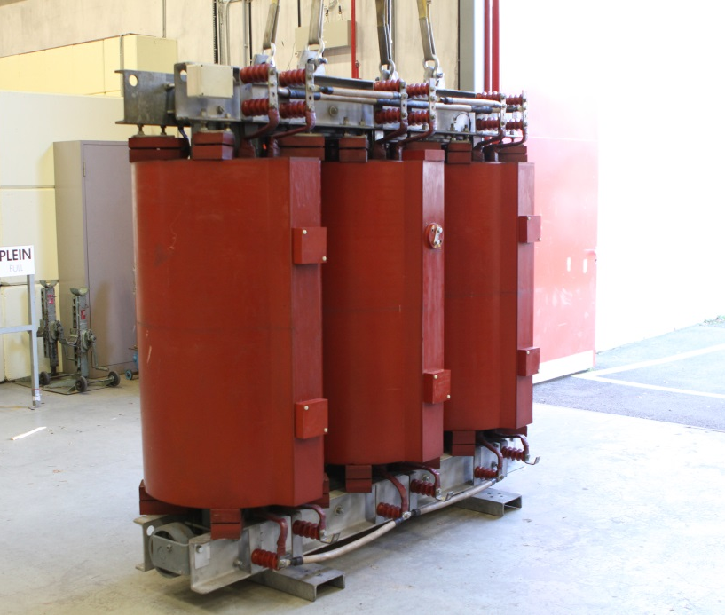
HVPS Transformer failure
1970
1980
1990
2000
2010
2020
We had two majors faults with the HV transformers
2012 near miss
  one connection of the coil started to burn
  We exchange the transformer before any accident
  Transformers have a lifetime and replacement must be correctly scheduled on old machines
2013
  Measuring cable connection broke and 18 kVAC accidentally touched GND

Slide 38
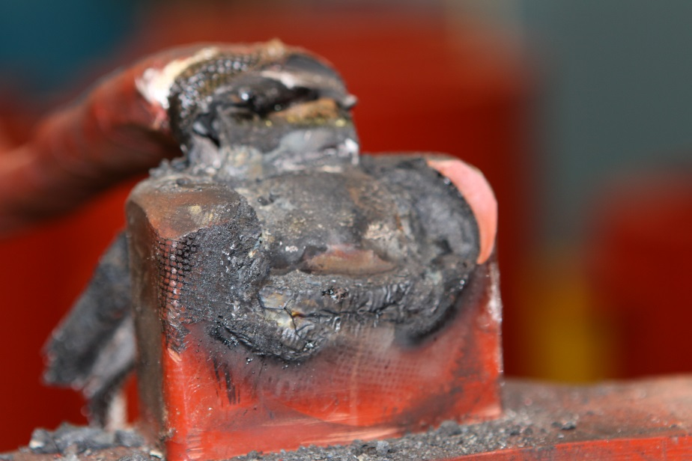
HVPS Transformer failure
1970
1980
1990
2000
2010
2020
We had two majors faults with the HV transformers
2012 near miss
  one connection of the coil started to burn
  We exchange the transformer before any accident
  Transformers have a lifetime and replacement must be correctly scheduled on old machines
2013
  Measuring cable connection broke and 18 kVAC accidentally touched GND

Slide 39
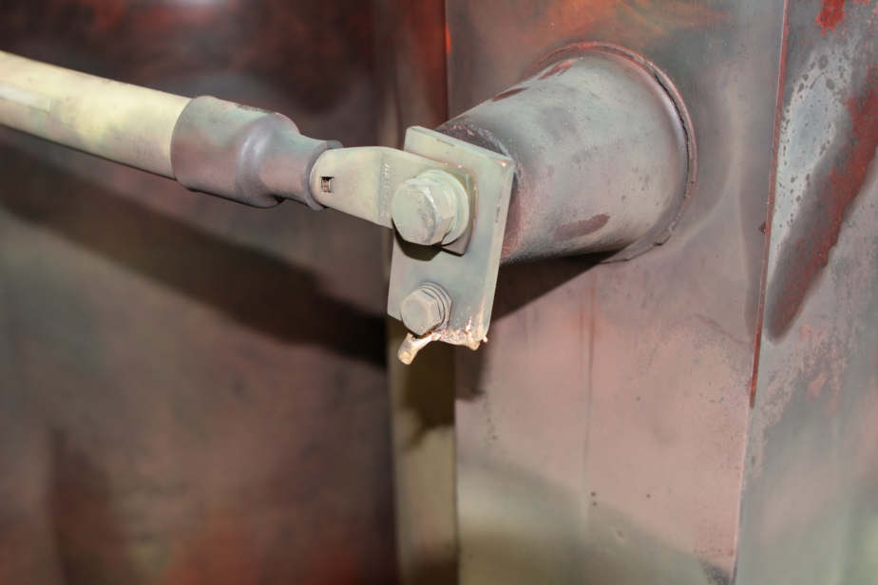
HVPS Transformer failure
1970
1980
1990
2000
2010
2020
We had two majors faults with the HV transformers
2012 near miss
  one connection of the coil started to burn
  We exchange the transformer before any accident
  Transformers have a lifetime and replacement must be correctly scheduled on old machines
2013
  Measuring cable connection broke and 18 kVAC accidentally touched GND

Slide 40
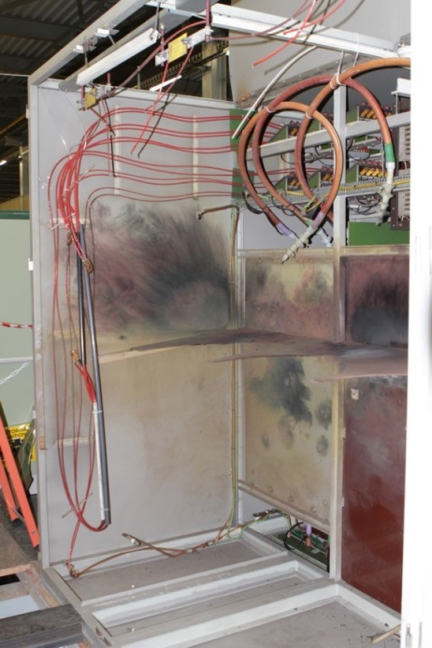
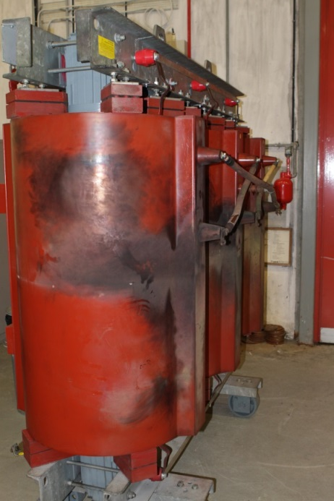
HVPS Transformer failure
1970
1980
1990
2000
2010
2020
We had two majors faults with the HV transformers
2012 near miss
  one connection of the coil started to burn
  We exchange the transformer before any accident
  Transformers have a lifetime and replacement must be correctly scheduled on old machines
2013
  Measuring cable connection broke and 18 kVAC accidentally touched GND

Slide 41
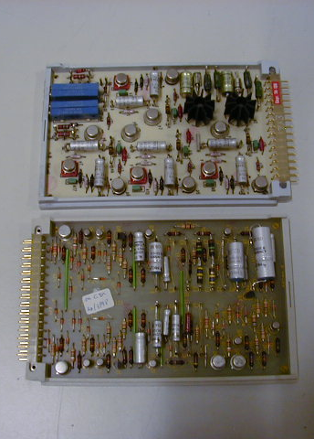
Local/Remote control
1970
1980
1990
2000
2010
2020
Local electronics are still the same since the beginning, faults are very rare (electricians of the team are able to repair it)
Remote systems had to be upgraded as not robust enough (specialists needed)
  1970-1991 Nodal
  1991-2013 Siemens S5
  2014-… Beckoff

Slide 42
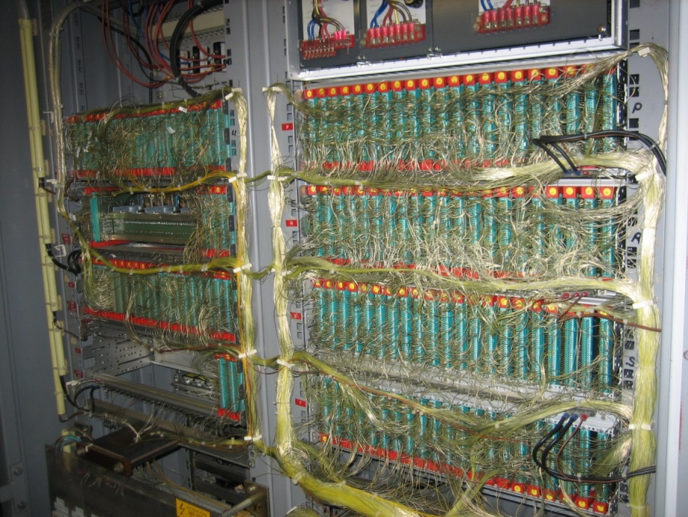
Local/Remote control
1970
1980
1990
2000
2010
2020
Local electronics are still the same since the beginning, faults are very rare (electricians of the team are able to repair it)
Remote systems had to be upgraded as not robust enough (specialists needed)
  1970-1991 Nodal
  1991-2013 Siemens S5
  2014-… Beckoff

Slide 43
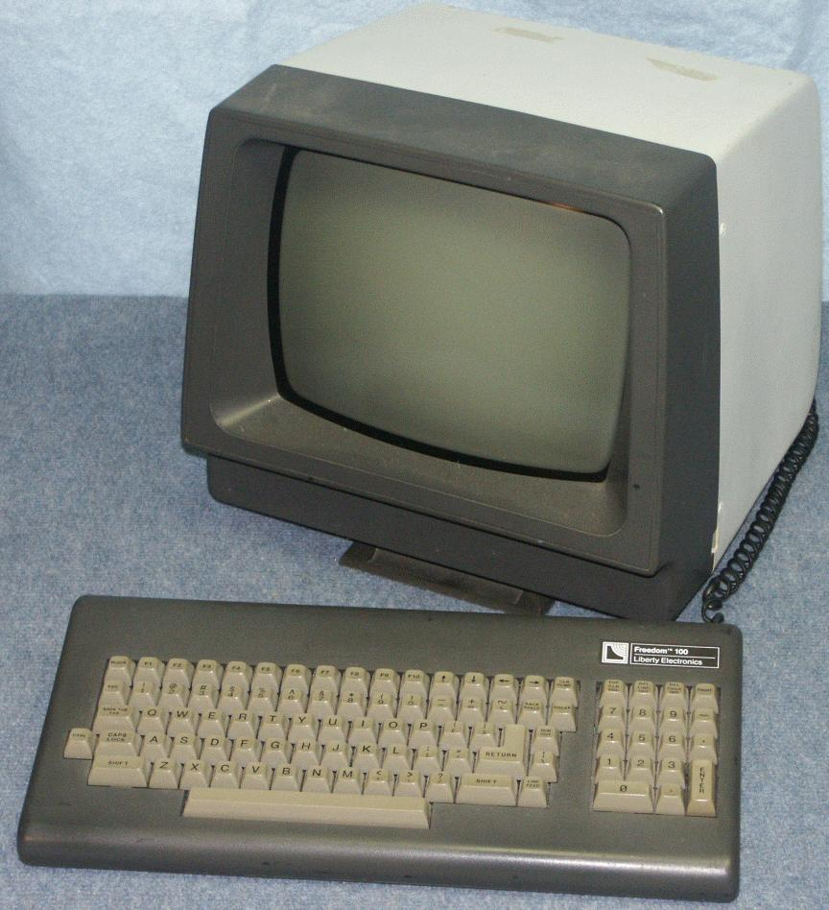
Local/Remote control
1970
1980
1990
2000
2010
2020
Local electronics are still the same since the beginning, faults are very rare (electricians of the team are able to repair it)
Remote systems had to be upgraded as not robust enough (specialists needed)
  1970-1991 Nodal
  1991-2013 Siemens S5
  2014-… Beckoff

Slide 44
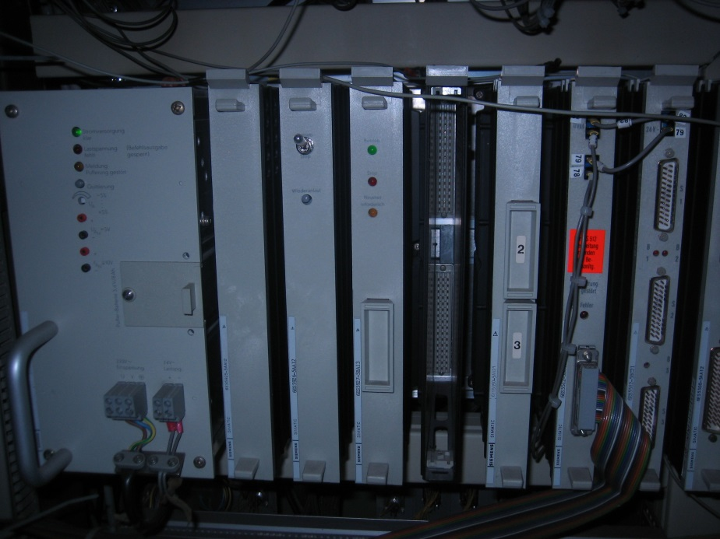
Local/Remote control
1970
1980
1990
2000
2010
2020
Local electronics are still the same since the beginning, faults are very rare (electricians of the team are able to repair it)
Remote systems had to be upgraded as not robust enough (specialists needed)
  1970-1991 Nodal
  1991-2013 Siemens S5
  2014-… Beckoff

Slide 45
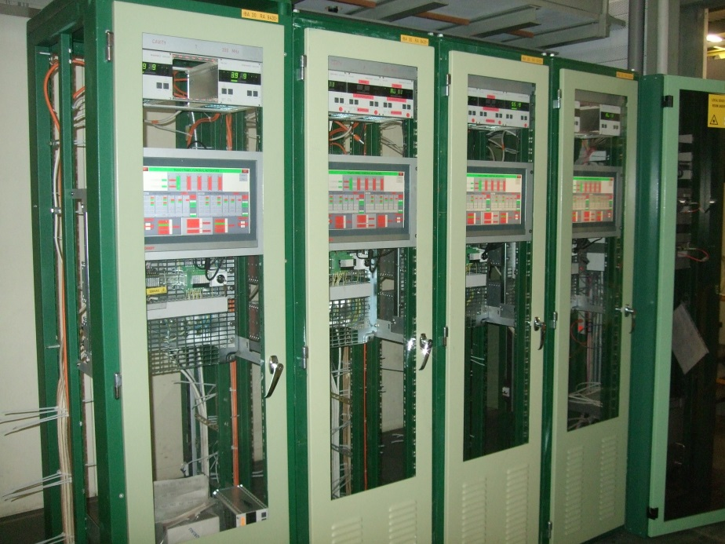
Local/Remote control
1970
1980
1990
2000
2010
2020
Local electronics are still the same since the beginning, faults are very rare (electricians of the team are able to repair it)
Remote systems had to be upgraded as not robust enough (specialists needed)
  1970-1991 Nodal
  1991-2013 Siemens S5
  2014-… Beckoff

Slide 46
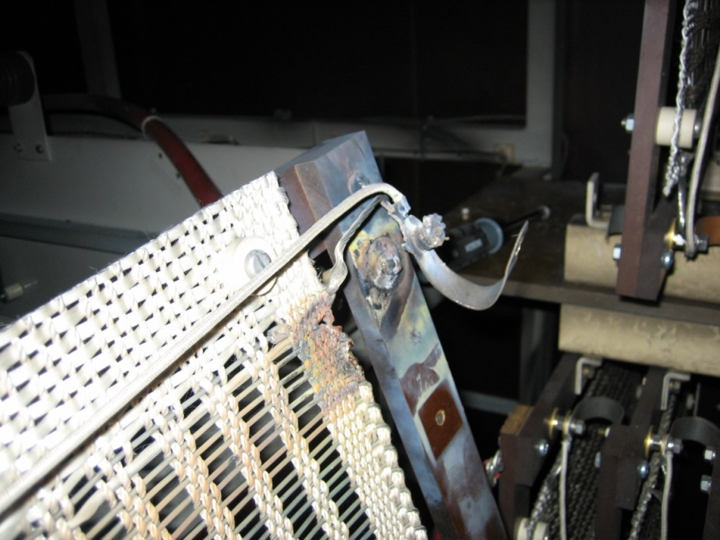
Miscellaneous
1970
1980
1990
2000
2010
2020
We had several troubles with usual suspects
  HV wiring
  High Power transmission line connections

Slide 47
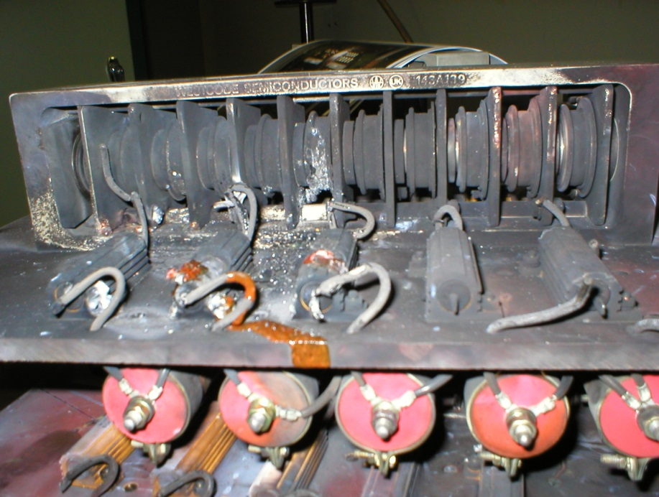
Miscellaneous
1970
1980
1990
2000
2010
2020
We had several troubles with usual suspects
  HV wiring
  High Power transmission line connections

Slide 48
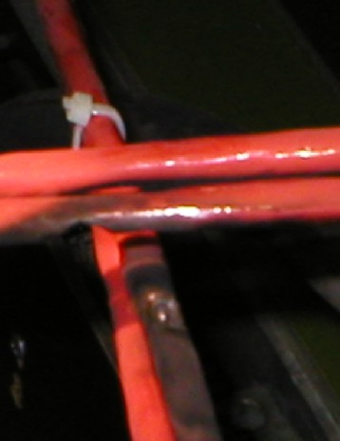
Miscellaneous
1970
1980
1990
2000
2010
2020
We had several troubles with usual suspects
  HV wiring
  High Power transmission line connections

Slide 49
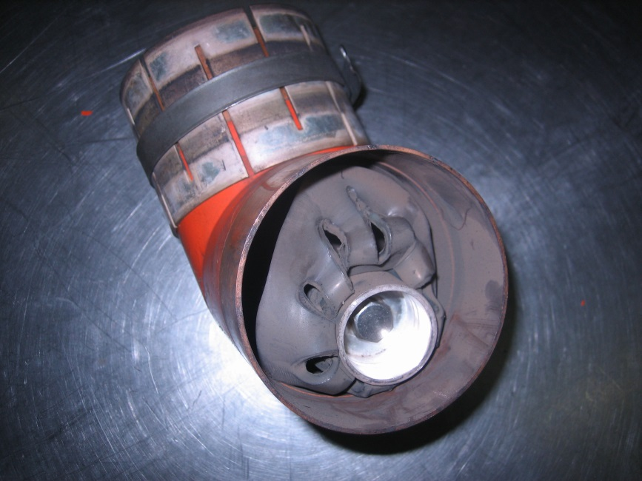
Miscellaneous
1970
1980
1990
2000
2010
2020
We had several troubles with usual suspects
  HV wiring
  High Power transmission line connections

Slide 50
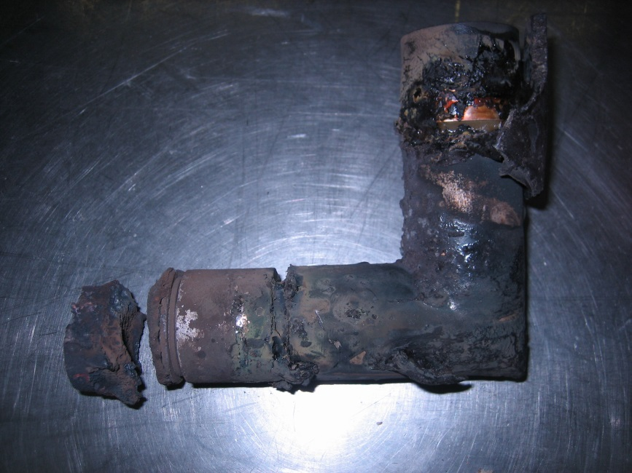
Miscellaneous
1970
1980
1990
2000
2010
2020
We had several troubles with usual suspects
  HV wiring
  High Power transmission line connections

Slide 51
Improvements
1970
1980
1990
2000
2010
2020
All these troubles have been improved case by case and not occurred again
We simply need an experienced team

Slide 52
Manpower strategy
Good Machine = (when my boss does not hear about it) =
(a*efficiency)*(b*reliability)*(c*AVAILABILITY)*(d*Experienced team)*k

Slide 53
Manpower strategy
Availability of an Injector is the key parameter
CERN’s total annual electricity consumption is 1 TWh, for an operation of almost 7000 hours per year, 130 MW average
When SPS is down, almost 40 % of the electrical bill is for nothing (lost money)
  20 % for LHC cryogenics + cooling and ventilation
  10 % for LHC experiments
  7 % for the North Area experiments
  (http://cds.cern.ch/record/1324541?ln=en)
When SPS is down, electrical bill costs 5 000 CHF / hour
SPS RF is down ~ 1 % of the SPS operating time, 70 hours lost per year
Hiring a new colleague with three years overlap before retirement of an experienced colleague would save 1% additional along three years,
210 hours x 5000 CHF/hour = 1 MCHF !
1 % of the SPS operating time costs
~ 350,000 CHF per year (electrical bill only)
Please do hire young persons early enough
to ensure a correct overlap and experience sharing !

Slide 54
Maintenance strategy
From 1970 to 2009, preventive maintenance was systematically done on the whole series of items, regardless the quantity in operation
Nowadays, we are not preparing large series of spares anymore, except few specific items such as trolleys or RF loads, we are ‘only’ having:
‘Two tested spares of everything everywhere’
We successfully modified the balance
preventive maintenance / corrective actions

Slide 55
Conclusion
1970
1980
1990
2000
2010
2020
We had several major failures along this long period of time, mostly ageing of components
  15-20 years for FPC
  20 years HVPS main items
  15 years controls
  30 years infrastructure
  Not any major RF amplifier trouble, tubes are very nice devices
A good balance of preventive maintenance / corrective actions allows good results, if and only if
  Systems have correctly been overdesigned (redundancy)
  Systems are as simple as possible (minimum number of items, of connections, of interlocks, …)
  Team has enough experienced staff

Slide 56
Thank you very much for your attention
I wish you all to never experience that !

