Slide 1
Experimental particle physics in the LHC area and possible implications for development in Africa
Kétévi A. Assamagan, Julia Gray, Jacobo Montano, Esmeralda Yitamben

Slide 2
Outline
African institutes in experiments at CERN
Implications for building scientific networks in Africa in particle and nuclear physics
  The African school of fundamental physics and its applications
Creating a good resume packet
Applying to graduate schools and post-doctoral positions

Slide 3
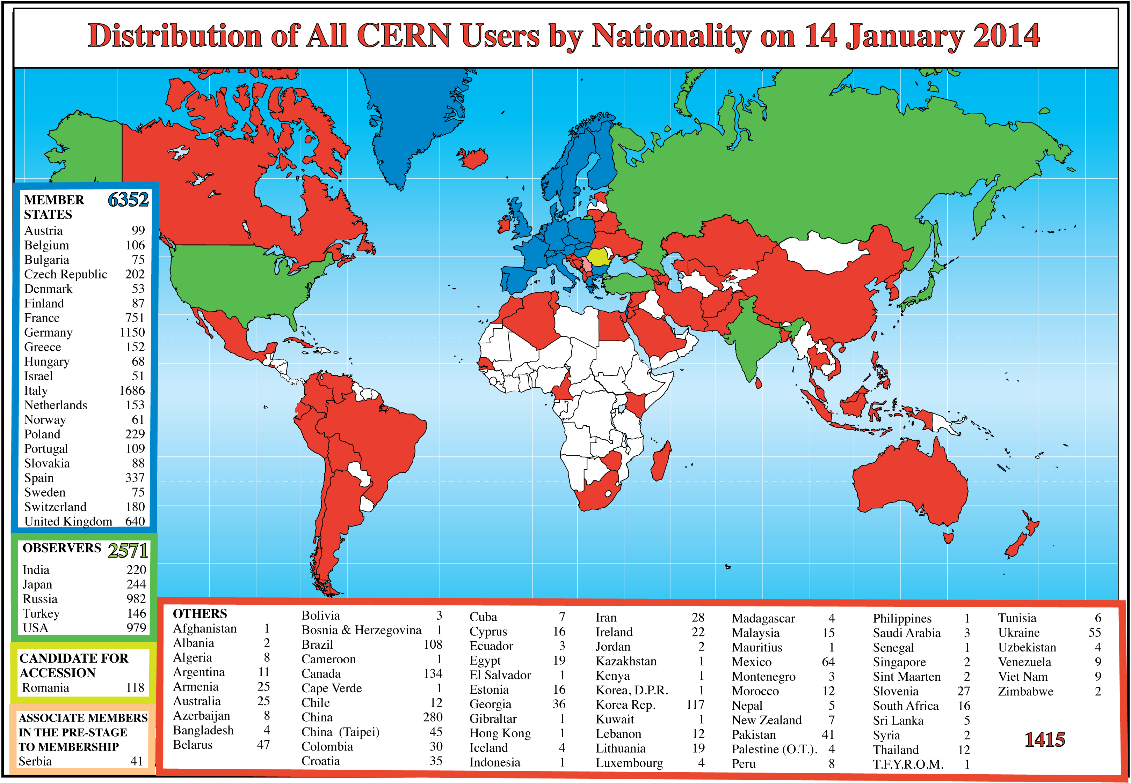
Distribution of CERN Users by Nationality
~10,500 CERN users from all countries. 12 African nations with 72 African participants. CERN has formal agreements or open dialogues with 9 African countries.

Slide 4
CERN Relations with African Nations
Algeria: open talks to join LHC experiments (ATLAS), ISOLDE (University Houari Boumedienne, University of Oran, Center for Development of Advanced Technologies)
Egypt: CMS member
Ghana: digital library techniques, open talks to join ATLAS, CMS (Kwame Nkrumah University of Science and Technology)
Madagascar: open talks to join LHCb (University of Antananarivo)
Morocco: ATLAS member
Mozambique: open talks regarding scientific training (Universidade Eduardo Mondlane)
Rwanda: open talks regarding information technology
South Africa: ALICE, ATLAS, ISOLDE member
Tunisia: previously worked on OPERA. Open talks to join CMS (National Center for Nuclear Sciences and Technologies)

Slide 5
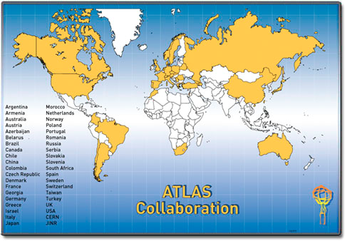
ATLAS Collaboration
“South Africa joins the ATLAS experiment
The ATLAS collaboration has increased its reach across Africa now that South Africa has
joined Morocco as the second member country from that continent. This development
follows a unanimous ballot at the meeting of the ATLAS collaboration board in Copenhagen
on 2 July [2010].”
http://cerncourier.com/cws/article/cern/43506/2

Slide 6
Morocco-ATLAS membership
Thanks to the efforts of a small group of Moroccan academics
  Morocco has been participating in the LHC programme since 1996.
  12 Moroccan physicists are members of the ATLAS collaboration
Moroccan physicists network (RUPHE) from different universities in Morocco http://ruphe.fsac.ac.ma/
  Centre National de l'Energie des Sciences Techniques Nucléaires (CNESTEN), Rabat
  Universite Hassan II, Ain Chock, Casablanca
  Université Cadi Ayyad, Marrakech
  Universite Sidi Med Ben Abdellah, Meknes
  Universite Mohammed Premier Oujda, Oujda
  Université Mohommed V, Rabat

Slide 7
Morocco-ATLAS
With the support of the Ministry of education and (The National Center for Scientific and Technical Research) CNRST
All these universities are linked thanks to MARWAN (the Moroccan National Research and Education Network)
The MaGrid Certificate Authority (At CNRST) provides grid certificates to all Moroccan scientists
15 Ph.D. students currently working on ATLAS-LHC experiment and CALICE-ILC
15 theses defended on ATLAS and over 100 international publications
ATLAS week 2013 held in Marrakech, Morocco
Contribution to ATLAS construction: ATLAS Liquid Argon Calorimeter Electronics
Technical studies: luminosity and beam spot determination, inner detector alignment, calibration of triggers
Physics interests: BSM, B-physics, charged Higgs, top quark

Slide 8


South Africa-ATLAS membership
South Africa
  University of the Witwatersrand, Johannesburg
  University of Johannesburg, Johannesburg
  Small groups at starting at
    University of Kwazulu-Natal, Durban
    University of Cape Town

Slide 9
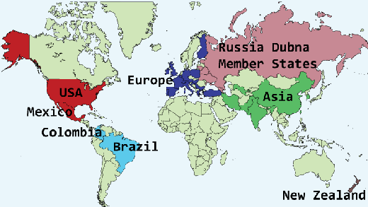
CMS Collaboration
Over 3000 users working for CMS from institutes 172 institutions in 40 countries, spanning Europe, Asia, the Americas, Australasia and Africa.
Egypt and Tunisia are the only African countries in CMS
There are 22 Africans in CMS
Tunisia
Egypt

Slide 10
Africa-CMS
Egypt
  Academy of Scientific Research and Technology of the Arab Republic of Egypt, Egyptian Network of High Energy Physics, Cairo
  Contribution to CMS
    Assembly and testing of Muon Resistive Plate Chambers (RPC)
    Analysis of beam test data
Tunisia
  No current active contribution

Slide 11
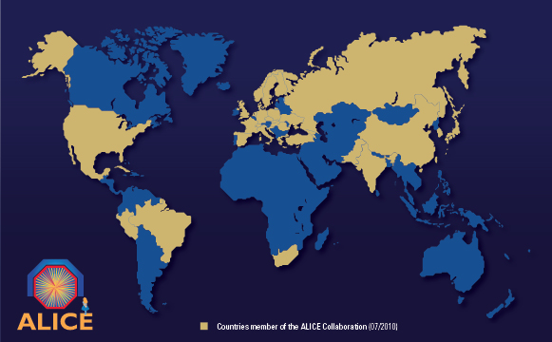
ALICE Collaboration
36 Countries including one African country,
132 Institutes 2 of which are from South Africa, and over 1200 members, 5 are Africans

Slide 12
ALICE African Institutes
South Africa,
  University of Cape Town (UCT), Cape Town
  iThemba Laboratory, Somerset West
Egypt as an associate member
  Academy of Scientific Research and Technology, Cairo

Slide 13
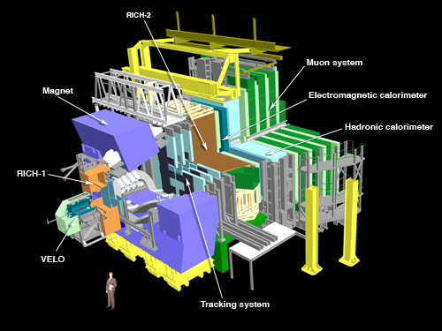
LHCb Collaboration
17 countries, no African country in LHCb
65 institutes, none from Africa
670 members, 1 African
Madagascar in open talks to join collaboration

Slide 14
South Africa-ISOLDE
The On-Line Isotope Mass Separator ISOLDE
  is a facility dedicated to the production of a large variety of radioactive ion beams
  for many different experiments in the fields of nuclear and atomic physics, solid-state physics, materials science and life sciences.
  The facility is located at the Proton-Synchrotron Booster (PSB) of CERN.
South African Institutes in ISOLDE
  University of Kwazulu – Natal, Durban (KZN)
    1 participant, 1 student
  University of the Witwatersrand, Johannesburg
    1 participant, 3 students
    Largest group in the collaboration
International collaborators in Denmark, Germany, Italy, Belgium, Iceland

Slide 15
The SA-CERN Program
“An important step in developing high-energy physics in South Africa was to unify all of the CERN-based activities into one coherent network, known as the SA-CERN Programme (ATLAS, ALICE, ISOLDE and theory). This network worked together on issues of Grid development, student training, schools planning, interaction with government and by applying jointly for support at a national level.”
These institutes that form the SA-CERN program http://www.sa-cern.ac.za
  iThemba LABS, Western Cape /Gauteng (ALICE)
  University of Cape Town, Western Cape (ALICE)
  University of Johannesburg (ATLAS, Theory)
  University of the Witwatersrand (ATLAS, ISOLDE, Theory)
  University of Kwazulu-Natal (ATLAS, ISOLDE)
  Rhodes University, Eastern Cape (Theory)

Slide 16
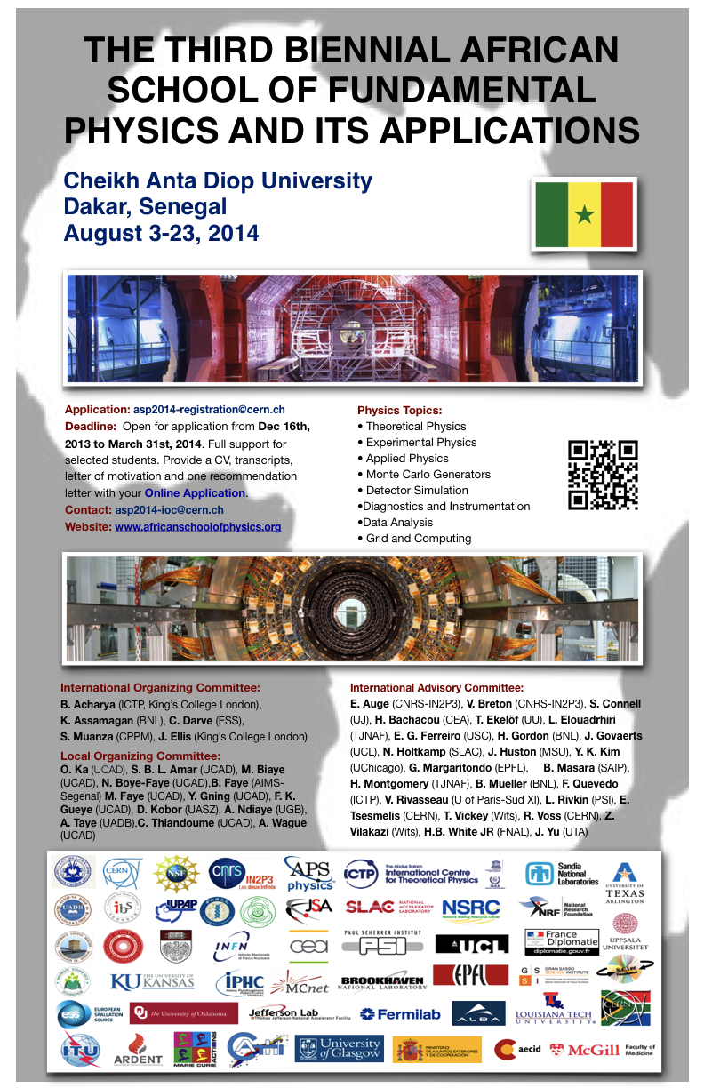
The African School of Fundamental Physics and Its Applications http://www.africanschoolofphysics.org/
Opportunities for networking within and beyond Africa, for graduate and professional opportunities

Slide 17
ASP2014
Motivation
  Contribute to capacity building in Africa
  Instill the capacity to harvest, interpret and exploit results from physics experiments
  Increase proficiency in related applications and technologies
  Use the LHC and its experiments as an example, although the broader objectives are far beyond
  We believe that the knowledge that the students gain will benefit them whichever careers they may pursue
Student Participation
  328 applications received
  69 students selected
  Final participation: 55 students, mainly from Africa, a few from abroad (Iran, USA)
Lectures
  Theoretical Particle Physics (first week)
  Experimental Particle Physics (second week)
  Applications: medical physics, accelerators, technologies (third week)
  Grid computing, Geant-4 simulation, data analysis
Lecturers
  A number of excellent lecturers
Financial support
  From Africa, Europe, US – universities, laboratories, UN, and other organizations

Slide 18
2010 & 2012 Alumni Survey
2010+2012 total students: 113
Survey Respondents: 60
Respondents from:
Nigeria, South Africa, Ghana, Madagascar, Sudan, Kenya, Algeria, Senegal, DRC, Ethiopia, Zambia, Tanzania, Cameroon, Egypt, USA, Iran, Canada

Slide 19
Best Methods of Communication with our Alumni

Slide 20
What do our alumni do?

Slide 21
Where do our alumni go?

Slide 22
When they leave their home country…
Different African country
  Move between different geographical regions of north, central, and south
North America
  United States: 2
Asia
  China: 2, Malaysia, South Korea, Saudi Arabia
Europe
  France: 4, Germany: 2, Belgium, Italy, Turkey

Slide 23
Putting Together a Resume Packet
Cover letter
  Format
  Themes
Curriculum Vitae
  European and American styles
  Academic vs. industrial styles
Letters of Recommendation
  Choosing your letter writers

Slide 24
Cover Letter
Use formal letter writing style
  Your address right-justified
  The recipient’s address left-justified
  Address letter “Dear [Professional Title] [Last Name]” or “To Whom It May Concern”
  Sign with “Sincerely,”
Highlight strengths from your Curriculum Vitae and tie those attributes to the work being done at the institutes
Include a clear motivation for working at institute, but put emphasis on your practical skills and professional goals

Slide 25
European vs. American
European
American
The ideal size is 2-3 pages;
The European CV should always be printed on ISO A4 paper, standard paper size used for different types of business correspondence in most of the world.
It is acceptable, although increasingly optional, to include some personal information on a European CV.
- Marital Status
- Age
- Number of children (ages optional)
- Personal Interests
- Nationality and gender are also commonly mentioned on a European CV.
Always expected to contain some secondary school information, even if the applicant has an advanced college degree.
In some countries, will contain a professional-looking headshot (photo).
US resume ➔ 1 page; US CV ➔ minimum 3 pages;
The U.S. resume and U.S. CV, on the other hand, should always be printed on American “letter size” paper. In the U.S., “letter size” paper is 8.5 × 11 inches.
On the other hand, sharing any type of personal information on a resume, CV, or cover letter is considered very unprofessional in the US.
On the other hand, a U.S. CV does not contain this information.
A U.S. resume or U.S. CV will almost never include a photo. Acting resumes and modeling resumes are exceptions.

Slide 26
Academic vs. Industry
Academic
Industry
Designed for the human eye and keyword searches;
Always highlight research;
Skills and techniques more important;
Describe research with more APPLIED approach.
Designed for the human eye;
Highlight research or teaching;
Grants and proposals more important;
Describe research with more BASIC approach.

Slide 27
Academic vs. Industry
Academic
Industry
Selected publications and presentations (if many);
Send references if requested;
Initial screening by HR or pulled from database;
Submitted online; no hard copy.
Exhaustive list of publications and presentations;
Include references and contact info;
Initial screening by P.I. or search committee;
Hard copy or e-mail attachment.

Slide 28
Letter of Recommendation: Selecting Writers
Usually need 3 letter writers
  For industrial jobs, normally need only to provide contact information of recommenders, no letter required
Choose professional contacts with some standing in field
  Either a full professor or adjunct professor
More important to choose writers who know you well than a writer of standing
  Choose a professor for whom you have done research or one whose class you’ve done particularly well in

