Slide 1
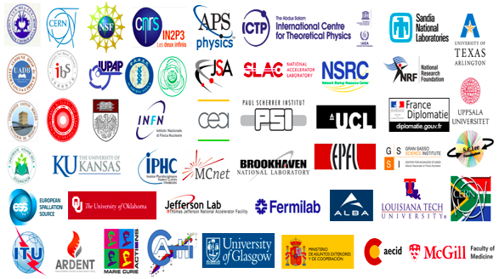
Neutron Sources
Christine Darve
African School of Fundamental Physics and its Applications
www.europeanspallationsource.se
August 20, 2014

Slide 2
Outline
  Neutrons properties and their interactions
How to generate intense neutron beams using high power proton linear accelerator: The example of the ESS
for further reading
Applications using Neutrons

Slide 3
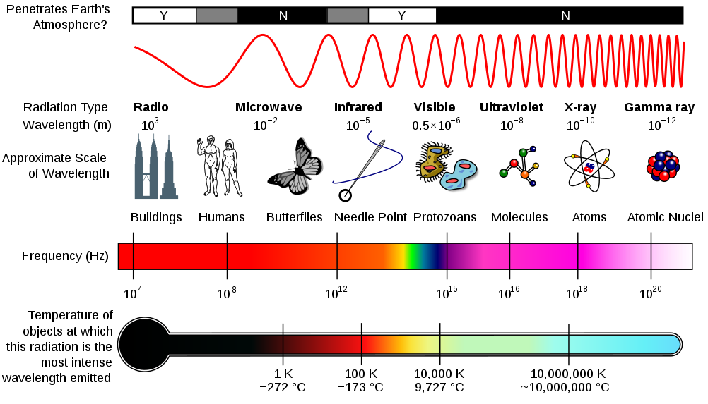
Electro-magnetic Spectrum

Slide 4
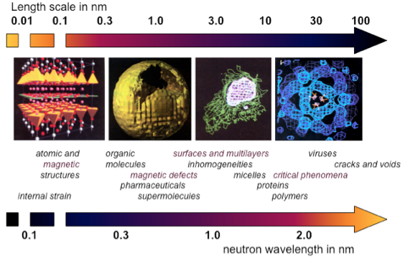
Neutron Microscope – Length scales

Slide 5
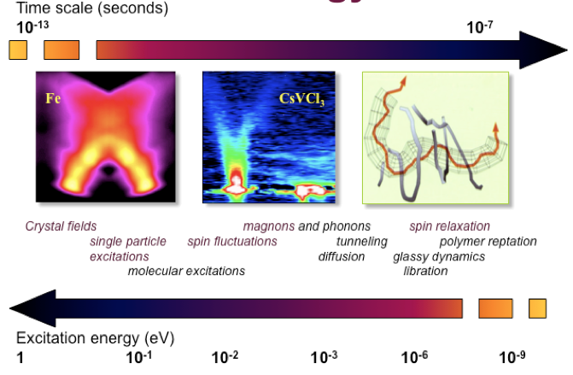
Neutron Microscope – Time & energy scales

Slide 6
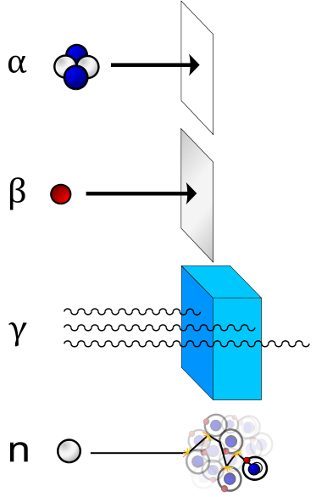
Ionizing Radiation
Ionizing radiation is radiation composed of particles that individually carry enough energy to liberate an electron from an atom or molecule without raising the bulk material to ionization temperature.
When ionizing radiation is emitted by or absorbed by an atom, it can liberate a particle.
Such an event can alter chemical bonds and produce ions, usually in ion-pairs, that are especially chemically reactive.
Note: Neutrons, having zero electrical charge, do not interact electromagnetically with electrons, and so they cannot directly cause ionization by this mechanism.
➔ High precision non-destructive probe … why ?

Slide 7
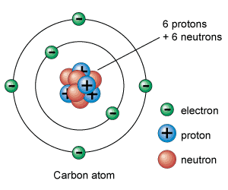
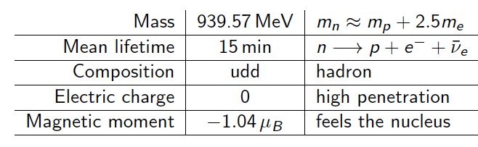
Neutrons Properties
Note: X-rays are emitted by electrons outside the nucleus, while gamma rays are emitted by the nucleus.
Synchrotron X-rays
Neutrons
1.675×10⁻²⁷ kg

Slide 8
Neutron Energy
Boltzmann distribution
De Broglie
Source | Energy | Temperature | Wavelength
cold | 0.1-10 | 1-120 | 30-3
thermal | 5-100 | 60-1000 | 4-1
hot | 100-500 | 1000-6000 | 1-0.4
Notes:
Energy wave lengh - inversion

Slide 9

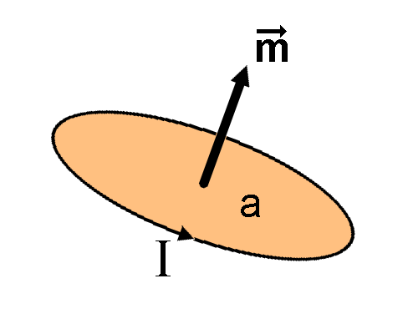
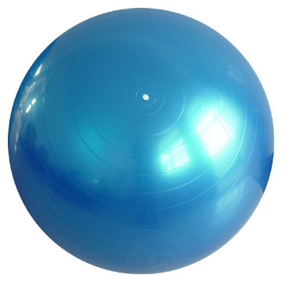
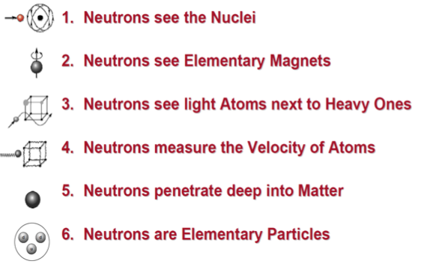
Why neutrons?
Wave Particle Magnetic moment Neutral
Neutron properties are used to understand the nature of the solid and liquid states of matter, as an analytical tool to aid the development of materials and as a tool to examine curiosity-driven research that spans from cosmology, superconductivity to the dynamics of the molecules of life.

Slide 10
Why neutrons?
Electrically Neutral – neutrons are non-destructive and can penetrate deep into matter. This makes them an ideal probe for biological materials and samples under extreme conditions of pressure, temperature, magnetic field or within chemical reaction vessels.
Microscopically Magnetic – they possess a magnetic dipole moment which makes them sensitive to magnetic fields generated by unpaired electrons in materials. Precise information on the magnetic behavior of materials at atomic level can be collected. In addition, the scattering power of a neutron off an atomic nucleus depends on the orientation of the neutron and the spin of the atomic nuclei in a sample. This makes the neutron a powerful instrument for detecting the nuclear spin order.
Ångstrom wavelengths – neutron wavelengths range from 0.1 Å to 1000 Å, making them an ideal probe of atomic and molecular structures, be they single atomic species or complex biopolymers.

Slide 11
Why neutrons?
Energies of millielectronvolts – their energies are of the same magnitude as the diffusive motion in solids and liquids, the coherent waves in single crystals (phonons and magnons), and the vibrational modes in molecules. It is easy to detect any exchange of energy between a sample of between 1microeV (even 1 neV with spin-echo) and 1eV and an incoming neutron.
Randomly sensitive – with neutrons the variation in scattering power from one nucleus to another within a sample varies in a quasi-random manner. This means that lighter atoms are visible despite the presence of heavier atoms, and neighboring atoms may be distinguished from each other. In addition, contrast can be varied in certain samples using isotopic substitution (for example D for H, or one nickel isotope for another); specific structural features can thus be highlighted. The neutron is particularly sensitive to hydrogen atoms; it is therefore a powerful probe of hydrogen storage materials, organic molecular materials, and biomolecular samples or polymers.

Slide 12
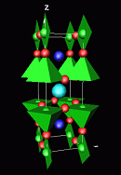
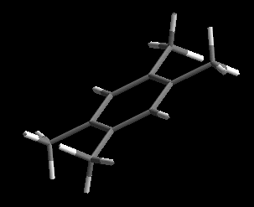
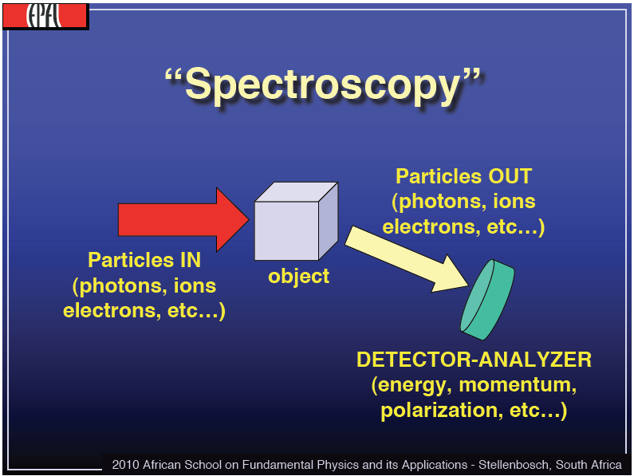
Why neutrons?
In half a century we have developed neutron scattering science enormously with an effective gain in source performance of only a factor of 4 !
Diffractometers - Measure structures
– Where atoms and molecules are
1 - 10 Ångström
→ To analyze the structure of a material from the scattering pattern produced when a beam of radiation or particles (such as X-rays or neutrons) interacts with it
Spectrometers - Measure dynamics
– What atoms and molecules do
1 - 80 meV
→ To measure properties of light over a specific portion of the electromagnetic spectrum

Slide 13
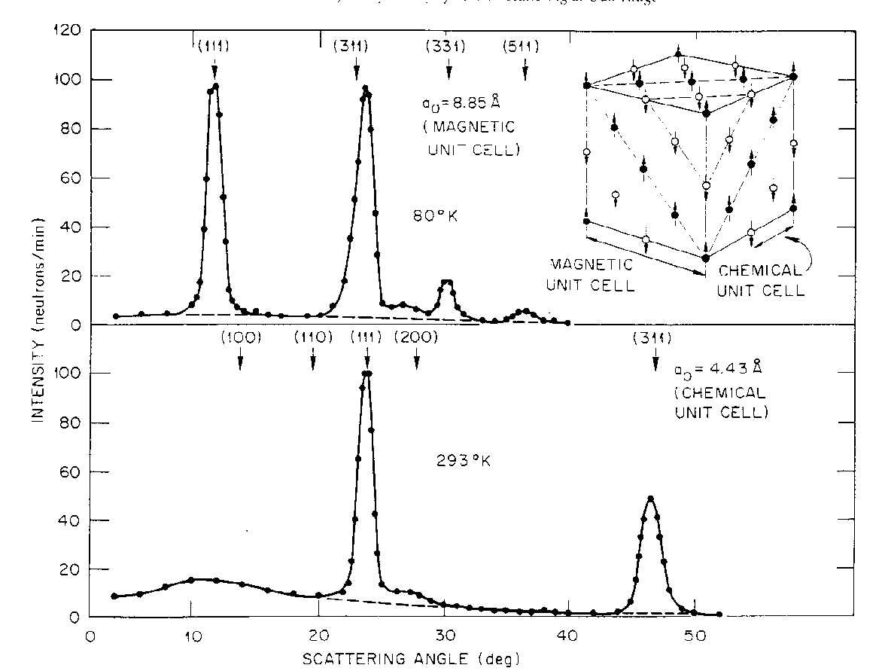
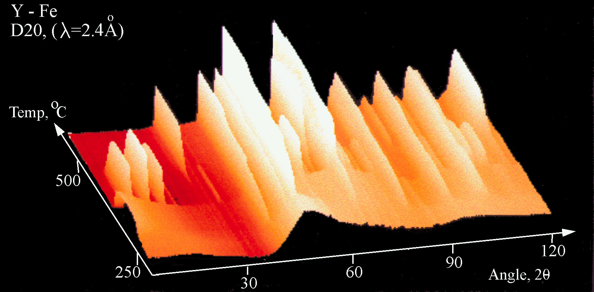
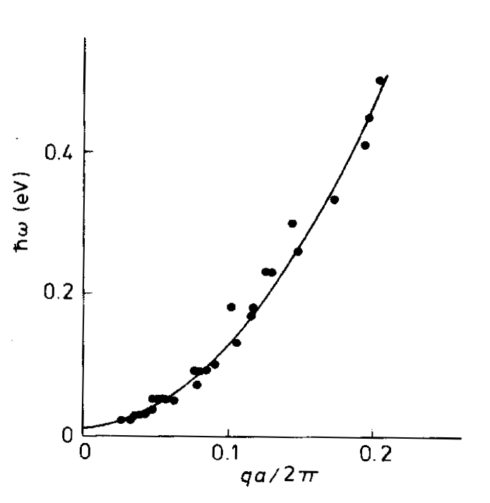
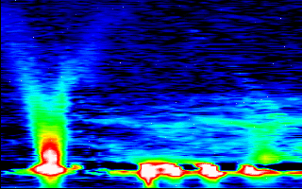
Why neutrons?
Cliff Shull – Neutron diffraction - showing where atoms are:
MnO
Bert Brockhouse – Spectroscopy - showing what atoms do:
CoFe
AS -
Using nowadays technique..

Slide 14
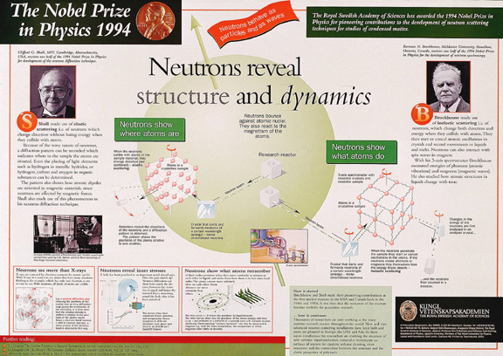
Neutrons show us : where atoms are (left, Bragg scattering) and what they do (right, Spectroscopy).
Energies of neutrons are same scale as excitations. 1 Aneutron 6orders of magnitude less than 1 A Synch.
Notes:
Neutrons show us : where atoms are (left, Bragg scattering) and what they do (right, Spectroscopy). Energies of neutrons are same scale as excitations. 1 angstrom neutron six orders of magnitude less than 1 Angstrom Synchrotrons X-ray.

Slide 15
Scientific challenges
Solid State Physics
Dynamics of superlattices, wires and dots, molecular magnets, quantum phase transitions
Liquids and Glasses
Solvent structures, influence of molecular structures on protein folding
Fundamental Physics
Left and right handedness of the universe, neutron decay, ultracold neutrons
Soft Condensed Matter
Time resolution, molecular rheology, structures and dynamics
Biology and Biotechnology
Hydrogen and water , membranes, biosensors, functions
Materials Science and Engineering
Real time investigations with realistic dimensions under real conditions
Chemical Structure, Kinetics and Dynamics
Thin films, pharmaceuticals, supramolecules - structures and functionality
Earth and Environmental Science, Cultural Heritage
Extreme temperatures and pressures simulating the mantle

Slide 16
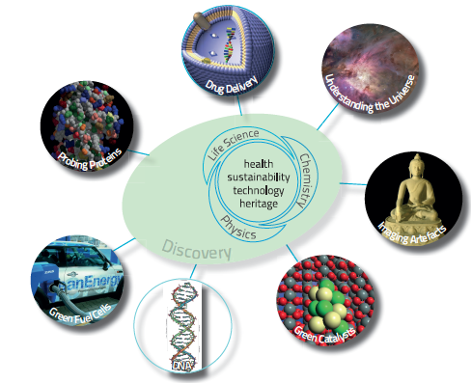
Fields of interest
A wide range of length and timescales.
High sensitivity and selectivity.
Deep penetration.
A probe of fundamental properties.
A precise tool
An ideal probe for magnetism.
16

Slide 17
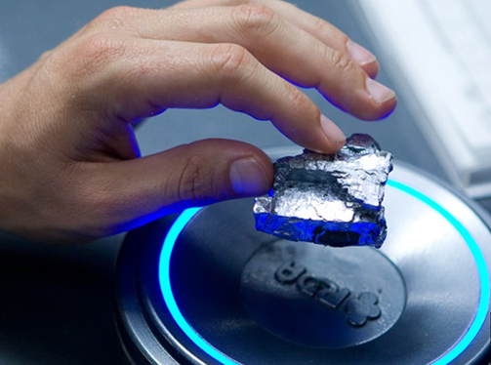
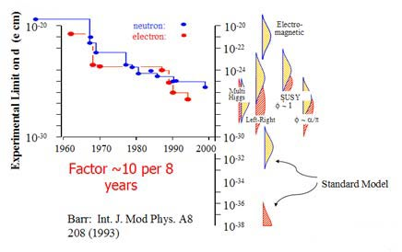
The visions
Room Temperature Super Conductors
Sterile neutrinos
Hydrogen storage substrate
Neutron electric dipole moment
Efficient membrane for fuel cells
Flexible and highly efficient solar cells
Carbone nano-tubes for controlled drug release
Self healing materials – smart materials
Spin-state as a storage of data (10²³ gain in capacity)
CO₂ sequestration
Unobtainium
Avatar

Slide 18
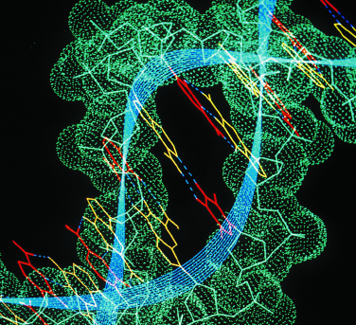
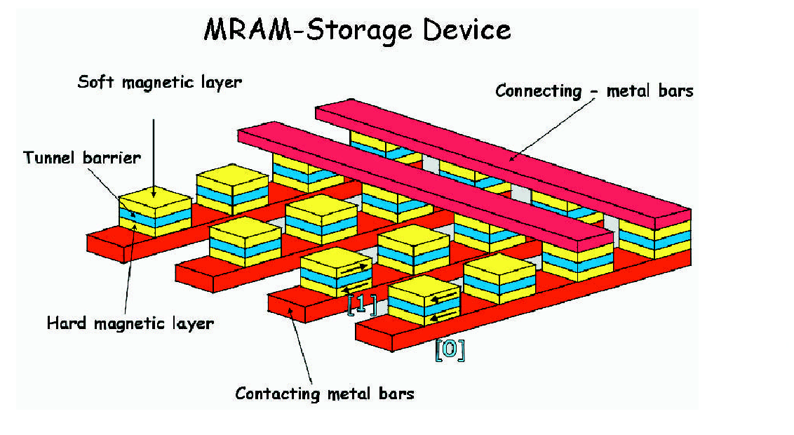
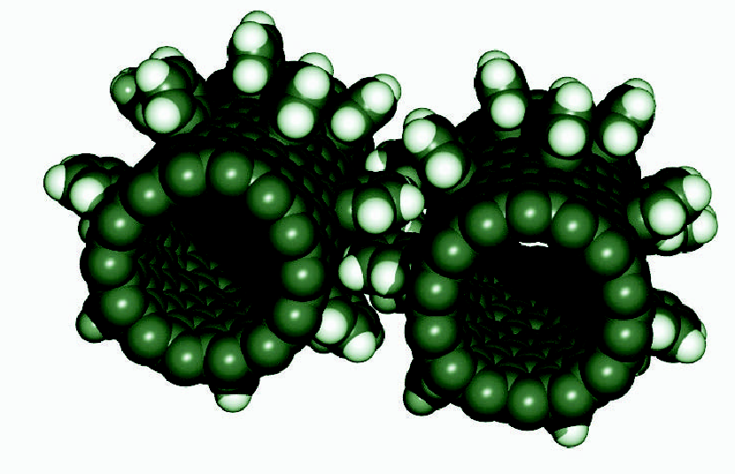
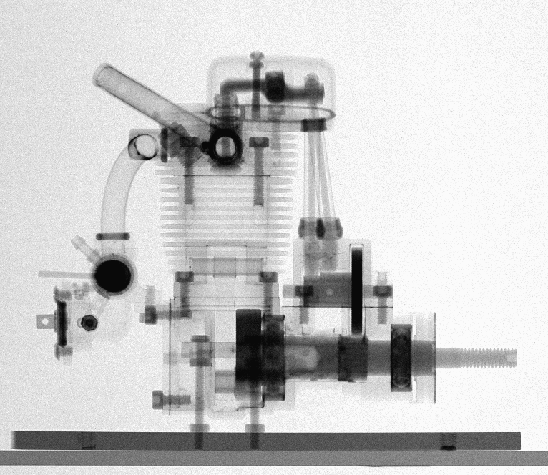
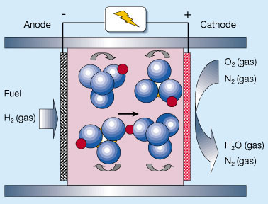

Multi-science with neutrons
Materials science Bio-technology Nano science
Energy Technology Hardware for IT Engineering science
Neutrons can provide unique and
information on almost all materials.
Information on both structure and
dynamics simulaneously. ”Where are
the atoms and what are they doing?”
6000 primary users in Europe today and 6000 secondary users.
Access based on peer review.
- Science with neutrons is limited
by the intensity of today’s sources
Notes:
The development of neutron scattering over the past 40 years has been from the initial studies of basic solid state physics in model systems, to detailed studies of complex systems with applications. Similar development can be expected in the next 40 years.

Slide 19
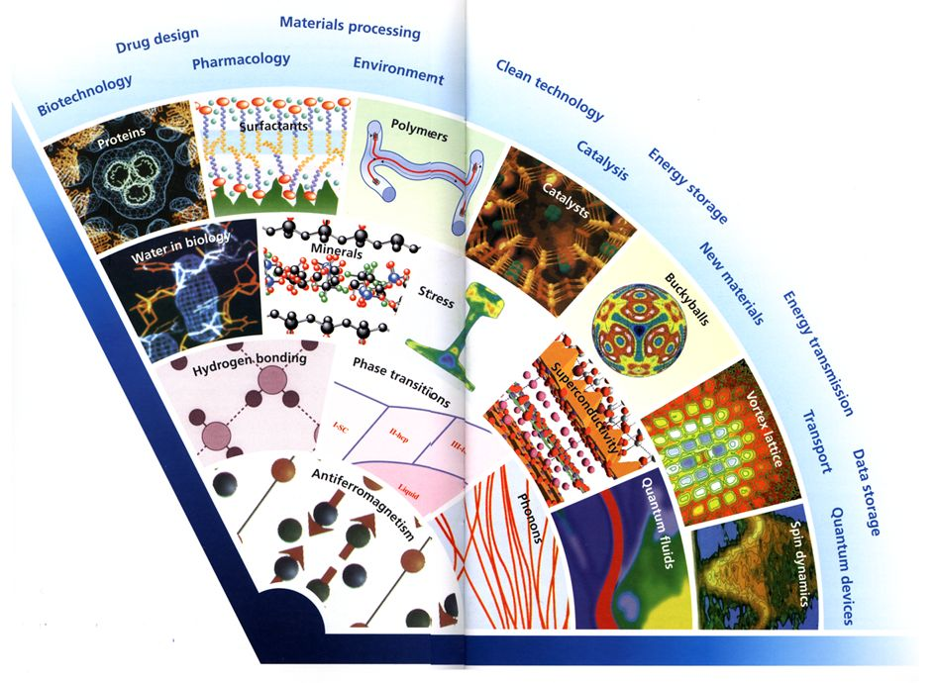
Neutron scattering - an expanding field
Because of their unique properties, neutrons are a powerful tool for investigating Nature at all levels, from testing theories about the evolution of the Universe to elucidating the complex processes of life.
2000
1990
1980
1970
1960
1950
1950
1960
1970
1980
1990
2000

Slide 20
X-Ray and Neutron beam

Slide 21

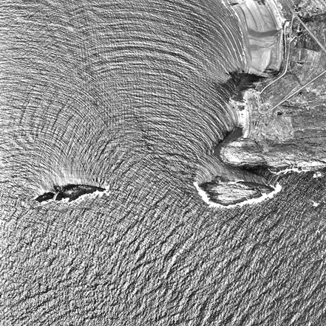
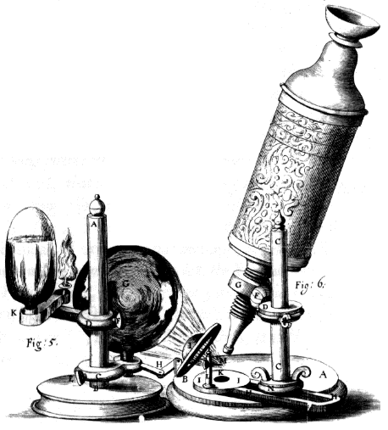
Complementarity between X-rays and Neutrons
Consider ESS/MaxIV equal in terms of functionality

Slide 22
Complementarity between X-rays & Neutrons
Neutrons | Synchrotron radiation
Particle beam (neutral subatomic particle) Interactions with the nuclei and the magnetic moment of unpaired electrons (in the sample) Scattered by all elements, also the light ones like the hydrogen isotopes Deep penetration depth (bulk studies of samples) Less intense beam measuring larger samples | Light beam (electromagnetic wave) Interactions with the electrons surrounding the nuclei (in the sample) Mainly scattered by heavy elements Small penetration depth (surface studies of samples) Very intense beam measuring small or ultra-dilute samples

Slide 23
Complementarity between X-rays & Neutrons
Neutrons Applications | SR Applications
Magnetic structures & excitations Organic structures using the H-D isotope effect Bulk studies (strains, excitations) Low-energy spectroscopy e.g. molecular vibrations | Protein-crystal structures Fast chemical reactions Surface studies (defects, corrosion) High-energy spectroscopy e.g. measurements of electron energy-levels

Slide 24
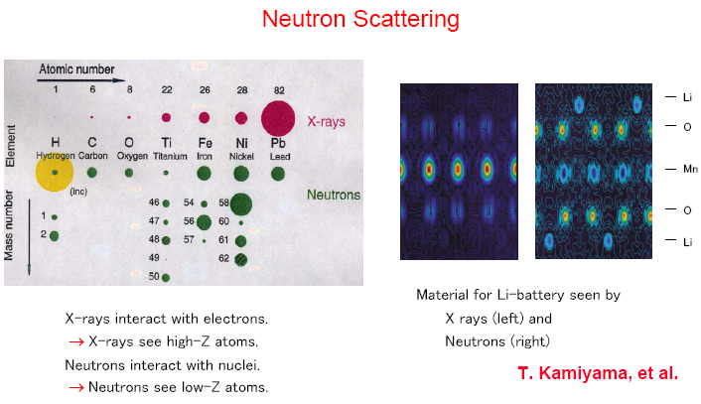
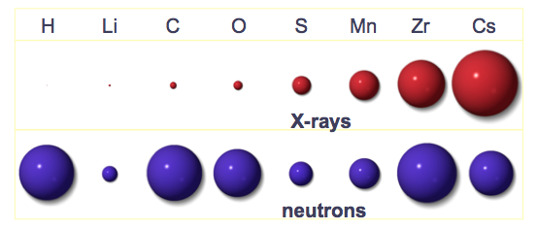
Complementarity between X-rays & Neutrons
X-ray interact with electrons
X-rays see high-Z atoms
Neutron interact with nuclei
→ Neutrons see low-Z atoms
- 24 -

Slide 25
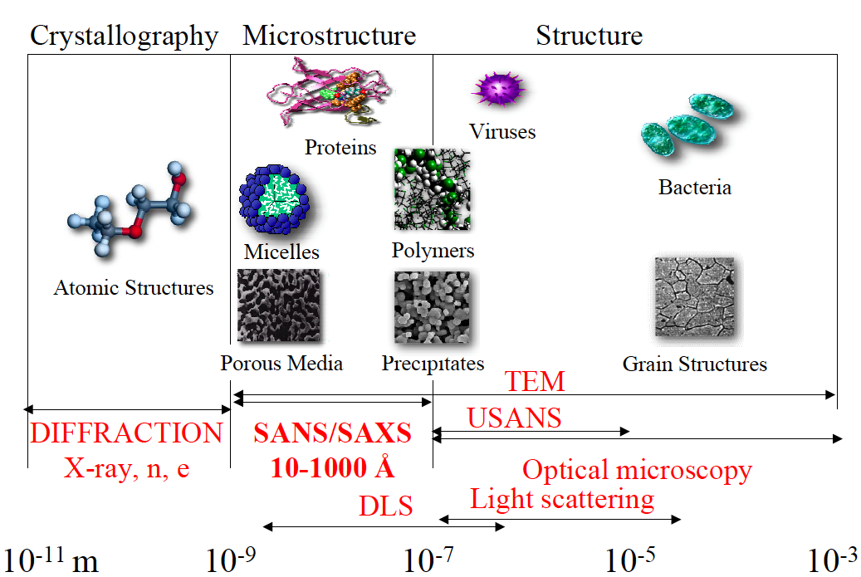
Small Angle Neutron Scattering
Advantages of SANS over SAXS are its sensitivity to light elements, the possibility of isotope labeling, and the strong scattering by magnetic moments.
Notes:
Advantages of SANS over SAXS are its sensitivity to light elements, the possibility of isotope labeling, and the strong scattering by magnetic moments.

Slide 26
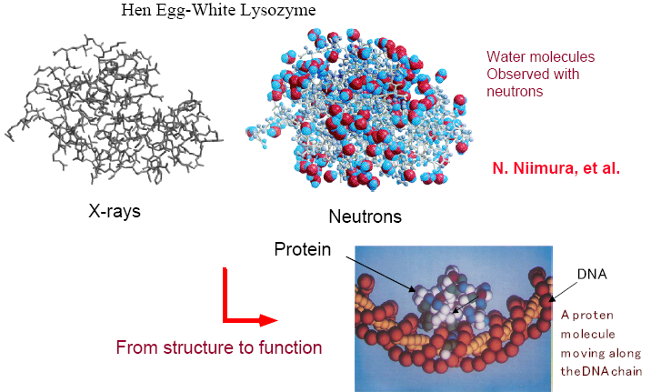
Complementarity between X-rays & Neutrons

Slide 27
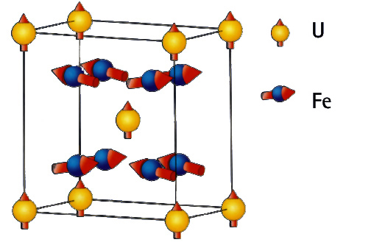
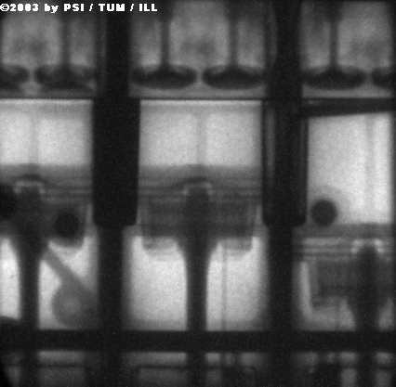
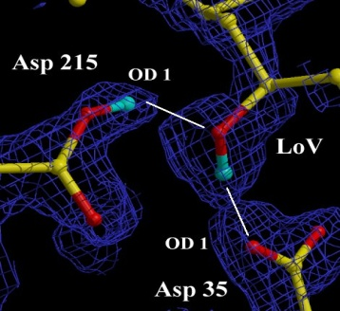
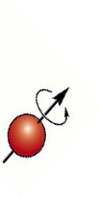

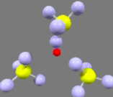
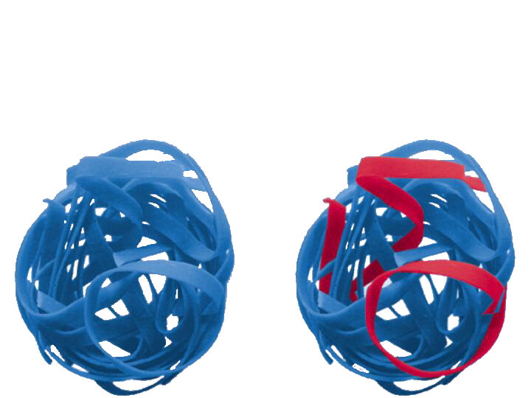
Complementarity between X-rays & Neutrons
..see magnetic atoms
..see inside materials
..see light atoms
..see atoms move
..see isotopes
Notes:
Neutron scatter from the nucleus and not the electrons -> penetrating, see light atoms, and magnetic structures.
Top clockwise:
Neutron Radiograph (from Munich) of an operating BMW engine
X-rays reveal the protein crystal structure – neutrons reveal the positions of the H atoms which are key to the catalytic activity
Isotope contrast (H/D in this case) allows specific strands to be picked out in this complex polymer
Neutrons have mass similar to atoms – and can measure dynamics easily. This is a CH4 electrolyte – the H is transferred via a rotation and cross over mechanism – revealed by neutrons
Neutrons have a magnetic moment. Most magnetic structures have been determined with neutrons. Can also be applied to magnetic dynamics e.g. Spin waves – important in studies of high Tc materials.

Slide 28
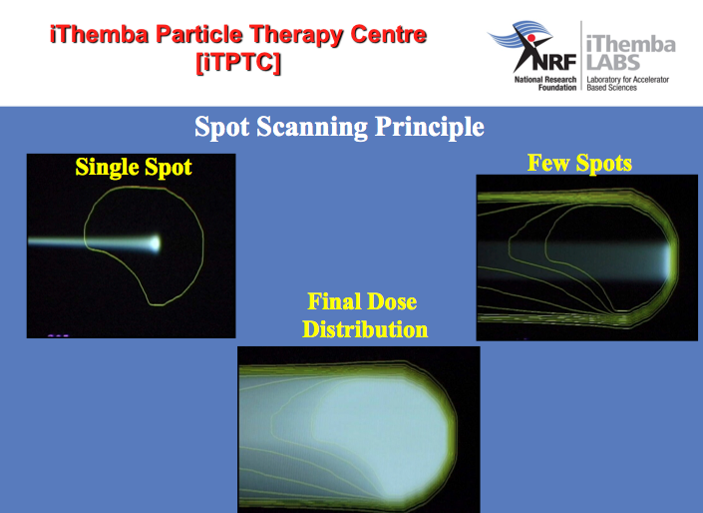
Neutron beam and X-Ray for Medical Applications

Slide 29
Scattering and Diffraction

Slide 30

Neutron Scattering Techniques
Quasi-elastic
Inelastic
Reflectivity
Polarized
Small-angle
Diffraction
Diffuse
Magnetic

Slide 31
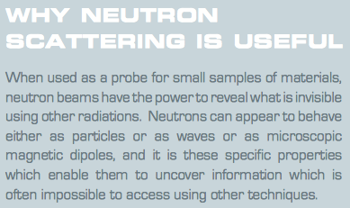
Scattering – coherence and incoherence
Definition of barns as scattering cross section units.
One depends on energy the other doesn't (where atoms are, what they do)
Isotopes and spin?
Notes:
Definition of barns as scattering cross section units. History and theory. One depends on energy the other doesn't (where atoms are, what they do)

Slide 32
Inelastic Scattering of plane wave
σ_{tot}=number of neutrons scattered in all directions per sec/incident flux
Scattered spherical wave: –b exp(ikr)/b
Simple spherical object!!
b
k
dΩ
Plane incident wave: exp(ikr)
k’

Slide 33
Diffraction = Coherent Elastic Scattering of plane wave
σ_{tot}=number of neutrons scattered in all directions per sec/incident flux
Scattered spherical wave: –b exp(ikr)/b
Simple spherical object!!
b
k
dΩ
Plane incident wave: exp(ikr)
k’

Slide 34
Scattering
Cross section:
Volume fraction
Contrast
Shape
Interaction

Slide 35
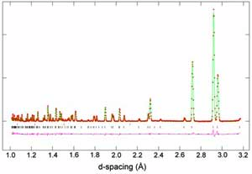
Scattering
Coherent XS~ Signal
Incoherent XS~ Background
Absorption XS~1/Intensity
The neutron diffraction pattern of sulfuric acid tetrahydrate at 4.2 K as seen by the 90 degree detectors on HRPD, and fitted with the existing X-ray derived structural model for the deuterated species.
Notes:
cross section for SANS: scattering depending on contrast, size, shape and correlation of particles.

Slide 36
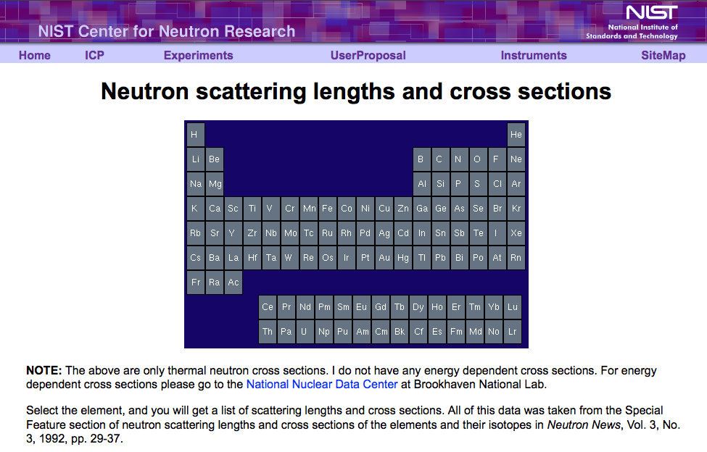
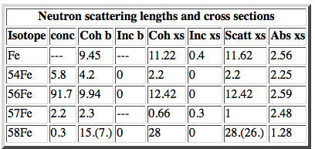
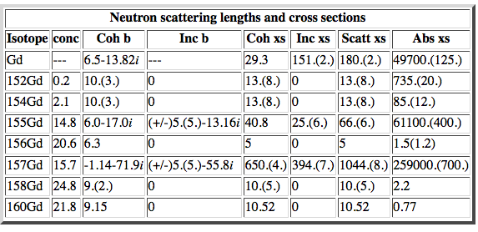
Neutron cross sections

Slide 37
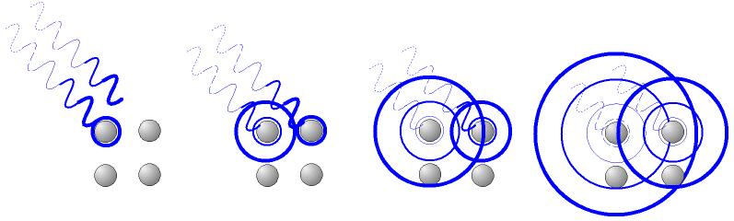
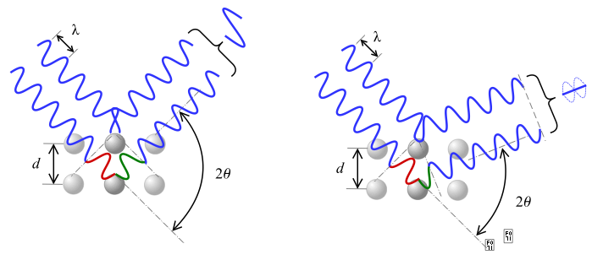
Diffraction - Bragg
Diffraction of X-rays or neutrons by polycrystalline samples is one of the most important, powerful and widely used analytical techniques available to materials scientists. For most crystalline substances of technological importance, the bulk properties of a powder
or a polycrystalline solid, averaged throughout the sample, are required; in general a single-crystal data, even if they can be obtained, are usually of little interest except for determination of the crystal structure or for studying some other fundamental physical property. By J Ian Langford and Daniel Louer
X-rays interact with the atoms in a crystal.
According to the 2θ deviation, the phase shift causes constructive (left figure) or destructive (right figure) interferences.

Slide 38
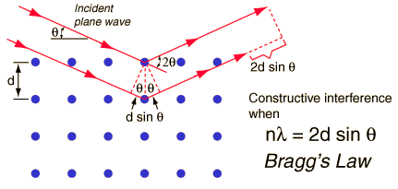
Diffraction - Bragg
Bragg / Laue scattering
Coherent elastic scattering
Two beams with identical wavelength and phase approach a crystalline solid and are scattered off two different atoms within it. The lower beam traverses an extra length of 2dsinθ. Constructive interference occurs when this length is equal to an integer multiple of the wavelength of the radiation.

Slide 39
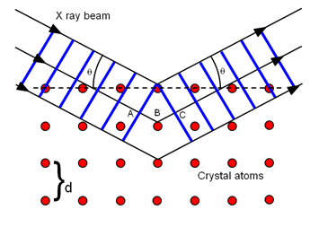
Diffraction - Bragg
Using the grains as internal strain gauges
Texture
Phase Volume
Two ways to measure d:
-keep λ fixed and measure θ
constant wavelength
-keep θ fixed and measure λ
time-of-flight
Microstructure
Braggs law gives information about position of a diffraction peak from a type of lattice planes. Rietveld approach calculated height, position and width of diffraction peaks from first principles, I.e. Temperature, composition, vacancies, etc.
Single peak
Lattice spacing
Strain
2q
Notes:
Braggs law gives information about position of a diffraction peak from a type of lattice planes. Rietveld approach calculated height, position and width of diffraction peaks from first principles, I.e. Temperature, composition, vacancies, etc. Possible because scattering intensity is accurate in first order (born) approximation due to weak interaction.

Slide 40
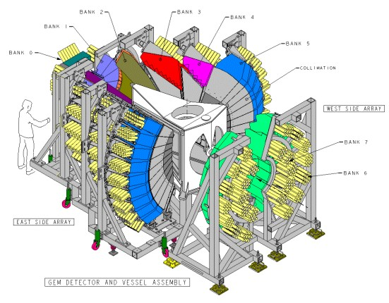



Diffraction: Texture
ISIS: GEM instrument
Near 4π coverage
Example:
Cold rolled copper, simulating manufacturing process for archeometry
2mm thick disks
20x20mm² beam
2 min counting times
Neutron texture analysis on GEM at ISIS
W. Kockelmann, L.C. Chapon and P.G. Radaelli
Physica B, Vol. 385-386 (1), pp639-643 (2006)
Intensity of diffraction peak

Slide 41


Diffraction: Stress and Strain
Applications:
Residual stresses
Fatigue/Structural Integrity
Welds
Alloy development
Microstructure/Texture
Phase transformation
In-situ experiments

Slide 42




Example - Diffraction
Intensity of diffraction peak
D2B at the ILL, Grenoble, 50 years later

Slide 43

Time of Flight
De Broglie
Bragg
Time-of-Flight:
Fast, short-wavelength neutrons arrive earlier at detector!
Diffraction in ToF mode at pulsed source. Flight time is propre to wavelength
Notes:
Diffraction in Time of Flight mode at pulsed source. Flight time is prop to wavelength

Slide 44



Ice

Slide 45




Batteries
Nature, Vol 7, Sept 2008
application of diffraction in battery research: patterns as function of temperature. Peak position and intensity give structure. Peak broadening give anisotropic atomic oscillations and hence likely migration path (the ellipses), then 46-50 diffraction in other fields of research, from chemistry to engineering measuring stresses…
Notes:
application of diffraction in battery research: patterns as function of temperature. Peak position and intensity give structure. Peak broadening give anisotropic atomic oscillations and hence likely migration path (the ellipses), then 46-50 diffraction in other fields of research, from chemistry to engineering measuring stresses…

Slide 46






Fuel Cells
Application in fuel cells, neutrons used for optimization of microstructural crystal structure, composition of membrane material (proton transport) and engineering (water transport) on macro scale.
Schematic of a fuel cell
Notes:
application in fuel cells, neutrons used for optimisation of microstructural crystal structure and composition of membrane material (proton transport) and engineering (water transport) on macro scale.

Slide 47
Small Angle Scattering
Scattering Vector
Sin θ = Qλ/4π = λ/2d
→ d = 2π/Q
Q=k_{i}-k_{j}
Small angle → small Q → large distances
long λ (cold neutrons) = 6 Å, d = 200 Å, 2θ = 1.7 °
k_{j}
k_{i}
→ The larger the object, the smaller the angle
Notes:
formulas for small angle scattering (this is reason why Centre for Nanostructured Materials is based at SNS), the larger the object, the smaller the angle

Slide 48



SANS: Experimental Setup
Measures structures at length scales from 1 nm to 100 nm
Beam:
Neutron (SANS)
or X-ray (SAXS)
Q_{min}≈0.03°, Q_{max}≈3°
In a standard crystallography experiment, theta_max is typically 45 degrees
Notes:
In a standard crystallography experiment, theta_max is typically 45 degrees

Slide 49



Small Angle Instruments

Slide 50
Scattering
Cross section:
Volume fraction
Contrast
Shape
Interaction

Slide 51
SANS: Scattering of plane wave
σ_{tot}=number of neutrons scattered in all directions per sec/incident flux
Scattered spherical wave: –b exp(ikr)/b
b
Simple spherical object!!
k
dΩ
Plane incident wave: exp(ikr)
k’
Volume fraction
Contrast

Slide 52
SANS: Particles: contrast!
Density:
Contrast!
Solvent: S
Density:
6.4
Water
RNA
Volume: V
Protein
Phospholipids
-0.56
%D₂0
Notes:
Reason why mixing of H2O and D2O gives contrast variation

Slide 53

SANS: quick example
Protein based drugs:
Typically proteins in solution to be injected
Long shelf life (up to 2 years)
Control of release profile is desirable
Insulin Hexamer
Fast action: Monomeric and dimeric insulin
Medium action:
Hexameric insulin
Slow action: Large complexes of hexameric insulin
10 nm
Knowledge and control of solution
properties of the proteins are crucial
Source: L Arleth, Uni Copenhagen
Notes:
example of monomeric (small) to multimeric insulin (agglomerated) with different time scales for body breakdown

Slide 54
SANS versus SAXS
SAXS contrast
SANS contrast 1
SANS contrast 2
SANS contrast 3
SANS gives the possibility of not seing everything at the same time….
Notes:
examples of neutron contrast variation ability versus single image with xrays small angle scattering

Slide 55


SANS: Different Shapes
Spheres:
R = 60 Å
Rods: R = 60 Å
L = 1200 Å
Worms: R = 18 Å
L = 5000 Å,
Kuhn Length = 300 Å
I(Q) 1/cm
I(Q) 1/cm
Q 1/Å
I(Q) 1/cm
Q 1/Å
Q 1/Å
Notes:
This also implies that something that look different in ”direct space”
Will also look different in reciprocal space

Slide 56




SANS: Selective Deuteration
sensitivity and selectivity
isotopic substitution/contrast variation
+
+
=
Notes:
56
contrast variation allows the determination of structure of complex proteins by selectively (contrast variation) deteuterating parts of molecule and then combining

Slide 57



Neutron Reflectivity
Basic principle
Neutrons
Air
Interface
Solvent

Slide 58






Neutron Reflectivity

Slide 59
Fission and Spallation

Slide 60



Fission and Spallation
Spallation is a non-elastic nuclear interaction induced by a high-energy particle producing numerous secondary particles
- 60 -

Slide 61

Fission and Spallation

Slide 62

Fission and Spallation

Slide 63
Spallation Process
  Spallation Neutron Yield (i.e. multiplicity of emitted neutrons)
  determines the requirement in terms of the accelerator power
  (current and energy of incident proton beam).
  Spallation Neutron Spectrum (i.e. energy distribution of emitted neutrons)
  determines the damage and activation of the structural materials
  (design of the beam window and spallation target)
  Spallation Product Distributions
  determines the radiotoxicity of the residues (radioprotection requirements).
  Energy Deposition
  determines the thermal-hydraulic requirements (cooling capabilities and nature of the spallation target).
➔ Sub-critical Reaction

Slide 64

Spallation : choice of target materials
Y(E,A)=0.1 [A+20] [E (GeV) -0.12)] n/p

Slide 65



High time average and peak flux
ESS
Evolution of the performance of neutron sources
10²⁰
J-PARC
SNS
HFIR
ILL
ISIS
10¹⁵
MTR
NRU
NRX
HFBR
ZINP-P/
IPNS
FRM-II
X-10
WNR
KENS
SINQ
Effective thermal neutron flux n/cm²-s
ZINP-P
10¹⁰
CP-2
CP-1
10⁵
Berkeley 37-inch cyclotron
350 mCi
Ra-Be source
Steady State Sources
Pulsed Sources
1
Chadwick
1930
1940
1950
1960
1970
1980
1990
2000
2010
2020
(Updated from Neutron Scattering, K. Skold and D. L. Price, eds., Academic Press, 1986)

Slide 66
Outline
  Neutrons properties and their interactions
How to generate intense neutron beams using high power proton linear accelerator: The example of the ESS
for further reading
Applications using Neutrons

Slide 67


ESS: Materials, Life Science and Society
EU Horizon 2020 – strategy
LIGHTNING
NEW
MATERIALS
SOLAR
ENERGY
FUNCTIONAL
FOOD
COSMETICS
MEDICINE
PACE-
MAKERS
MOBILE
PHONES
TAILOR
MADE
MATERIAL
TRANSPORTS
IMPLANTS
BIO FUEL
GEO SCIENCE
Notes:
To cope with the multidisciplinary societal challenges
The development of neutron scattering over the past 40 years has been from the initial studies of basic solid state physics in model systems, to detailed studies of complex systems with applications. Similar development can be expected in the next 40 years.
Today society: Material science, bio
Connect scientific field : target a larger scientific communities
to support innovation, capacity building and industry
Neutrons are everywhere
The major players in the industry take the challenge of sustainable development seriously - taking actions that combine strong economic performance with sound environmental management and attention to social conditions.
Take the challenge we all face of constant innovation in a modern society in which knowledge is the cornerstone of long-term growth, making education is absolute priority.

Slide 68






Spallation Sources
Philosophie de “Pré-vert”: Greenfield
Will bring new insights to the grand challenges of science and innovation
Collaborative project: more than 17 countries
2014: Start of construction phase of the world's most powerful linear proton accelerator
2019: Provide the world's most advanced tools for studying materials with neutrons
(~ 450 employees; > 2500 users / year)
Europe 2019: The European Spallation Source
(<5 MW)
2.86 ms long pulse !
Lund, Sweden
Japan 2008:
JPARC (<1MW)
USA 2006:
SNS (<1.4 MW)
1 GeV, 26 mA in linac, 627 ns long pulse, 60 Hz
Notes:
Promote science, competitivity and complementarity of Life Science as operated in the USA and Japan.
USERS
Build capacity and partnership (in Europe) around science and innovation
Green-field – new investment – pre-vert
Complementarity of scientific tool: LS and NS
Each builds on the previous and prepares for the next
regional and European impact
Intensity frontiers
Beam-to-target : 2006—2019

Slide 69
Helicopter view of ESS

Slide 70
Collaborative projects
ESS is an emerging research laboratory with (still) very limited capacity in-house
Two possibilities:
  Limit the scope of the project so that it can be done with in-house resources
  Work in a collaboration where the scope of the project can be set by the total capacity (distributed) of the partners
The accelerator part of the project well suited for this as this community has a strong tradition of open collaboration (e.g. E-XFEL, FAIR, LHC, European Commission Framework Programs and design studies)
To keep cost down and to optimize schedule this requires that investments in required infrastructure is done at the partner with best capacity to deliver
Notes:
User driven innovation – external actor to be collective ownership
Limit risk by reusing and improving an existing technology

Slide 71


Linac redesign to meet ESS cost objective
WP4
WP5
Beam power (MW) | 5
Beam current (mA) | 62.5
Linac energy (GeV) | 2
Beam pulse length (ms) | 2.86
Repetition rate (Hz) | 14
 | Num. of CMs | Num. of cavities
Spoke | 13 | 26
Medium β (6-cell) | 9 | 36
High β (5-cell) | 21 | 84
[SRF2013 – “The ESS Superconducting Linear Accelerator”, C. Darve, M. Eshraqi, M. Lindroos, D. McGinnis, S. Molloy, P. Bosland and S. Bousson]
Notes:
400 m/ 600 m tunnel = SRF

Slide 72



























Accelerator collaborations for ESS “start-up”
Søren Pape Møller
WP4 : Sebastien Bousson
Roger Ruber
WP5 : Pierre Bosland
Anders J
Johansson
CERN
The National Center for Nuclear Research, Swierk
Roger Barlow
Ibon Bustinduy
Santo Gammino

Slide 73


Cavity Cryomodule Technology Demonstrators
One full scale 704 MHz medium and high-beta cavity cryomodules
A staged approach towards the series industrialization and
the ESS Linac tunnel installation
Validate designs and construction capability of SRF components
Prepare the industrialization process by validating
component life-cycles (incl. assembling process, QA)
Validate component performances (incl. RF, mechanical, thermal)
Develop ESS 704 MHz SRF linac operating procedures
Validate control command strategy (Control box, PLC, EPICS, LLRF)
Validate ESS integration and interfaces with RF, cryogenics, vacuum and control systems
Train people in ESS SRF Technology and build an ESS collaboration
→ Similar process for the spoke cryomodules

Slide 74



ESS SRF Cavity Cryomodules
2 Spoke Cavities per Cryomodule
Segmented SRF linac with RT focusing elements
Ti. Helium tank
Cold tuning System
Power coupler
4 Elliptical Cavities per Cryomodule
Notes:
2 spoke – 3 gap
4 cavity – SNS like
Segmented SRF linac with RT focusing elements

Slide 75


SRF Cavities Development
Spoke cavity
Elliptical cavities
→ Stiffeners on the Spoke bars
(vacuum pressure)
→ No HOM power couplers
Hydroformed Ti bellows
(+/- 3mm range)
994 mm
Stiffeners (LFD compensation)
NbTi flange
(w/bore holes for alignment & assembly tool)
+Al hex. gaskets
550 mm
418 mm
Power coupler port
Ti He vessel
Medium beta:
6 cells – beta=0.67
Length 1259,40mm
High beta:
5 cells – beta=0.86
Length 1316,91mm

Slide 76
ESS Requirements and RF Parameters
Spoke cavities
Elliptical cavities
Frequency (MHz) | 352,2
Optimum beta | 0,50
Operating temperature (K) | 2
Nominal Accelerating gradient (MV/m) | 9
Lacc (βopt.x nb gaps x λ/2) (m) | 0,639
Bpk (mT) | 79 (max)
Epk (MV/m) | 39 (max)
Bpk/Eacc (mT/MV/m) | <8,75
Epk/Eacc | <4,38
Beam tube diameter (mm) | 50
RF peak power (kW) | 335
G (Ω) | 130
Max R/Q (W) | 427
Qext | 2,85 10⁵
Q0 at nominal gardient | 1,5 10⁹
 | Medium | High
Geometrical beta | 0.67 | 0.86
Frequency (MHz) | 704.42
Number of cells | 6 | 5
Operating temperature (K) | 2
Epk max (MV/m) | 45 | 45
Nominal Accelerating gradient (MV/m) | 16.7 | 19.9
Q₀ at nominal gradient | > 5e9
Q_{ext} | 7.5 10⁵ | 7.6 10⁵
Iris diameter (mm) | 94 | 120
Cell to cell coupling k (%) | 1.22 | 1.8
p,5p/6 (or 4p/5) mode sep. (MHz) | 0.54 | 1.2
Epk/Eacc | 2.36 | 2.2
Bpk/Eacc (mT/(MV/m)) | 4.79 | 4.3
Maximum. r/Q (W) | 394 | 477
Optimum β | 0.705 | 0.92
G (Ω) | 196.63 | 241
RF peak power (kW) | 1100

Slide 77






Medium-β Elliptical Cavities
K_{L} reduction using compensation rings for medium and high-beta
RF/mechanical design
Lorentz detuning
Nominal wall thickness [mm] | 3.6
Cavity stiffness Kcav [kN/mm] | 2.59
Tuning sensitivity Df/Dz [kHz/mm] | 197
K_{L} with fixed ends [Hz/(MV/m)²] | -0.36
K_{L} with free ends [Hz/(MV/m)²] | -8.9
Pressure sensitivity K_{P} [Hz/mbar] (fixed ends) | 4.85
K_{ext} (tank + tuner)≈30 kN/mm
K_{L}≈-1 Hz/(MV/m)²
Δf ≈ 325 Hz @ 18 MV/m (1/3 of cavity bandwidth )
77

Slide 78


Cryomodule Interfaces
Most AD internal Work Packages (beam optics, RF, cryo, vacuum, test stands, electrical, cooling, installation)
External WPs cryomodule, cavity and designers and potential In-Kind collaborators
Control command (Control Box, PLC, LLRF, MPS, EPICS)
Data-logging ICS teams
ESS ES&H
Conventional Facility
ESS system engineer, QA
Survey experts
Transport
Cryogenic distridution
Cryogenic distribution
Control system
Beam Diagnostic
Beam Optics
Previous Linac version for comparison ➔
Beam Vacuum
Radio-Frequency

Slide 79



Cold Tuning System
Spoke CTS
Elliptical CTS
Type V ; 5-cell prototype
+/- 3 mm range on cavity
Stepper motor and planetary gearbox (1/100e) at cold and in vacuum
2 piezo stacks
Slow tuner
Main purpose : Compensation of large frequency shifts with a low speed
Actuator used : Stepper motor
Fast tuner
Main purpose : Compensation of small frequency shifts with a high speed
Actuator used : Piezoelectric actuators
&

Slide 80


Fundamental Power Coupler
Antenna
Vacuum
Outer conductor
(LHe-cooled)
Spoke:
335 kW
Elliptical:
1.1 MW
Inner conductor
(water-cooled)
Al₂O₃
ceramic disc
WR2300
Short circuit
RF input
Doorknob
air

Slide 81

Magnetic shield, e.g. Elliptical cavity
Courtesy of J. Plouin/ CEA
Achievable with 1.5 mm,
µ_{r} =20000 shielding material
Limit contribution of the trapped flux to the surface resistance to 4 nΩ
Limit the external static field to Bext = 14 mG.
→ Required shielding efficiency equal to 35.

Slide 82




Cryomodule Heat Load Distribution
Per cryomodule
Sum for the Linac cryoplant (incl. 14 extra HB for contingency space)
Heat load due to the beam losses deposit a maximum of 0.5 W/m to the Spoke, medium and high-beta cavities sections 2 K temperature levels.

Slide 83



Cryomodule life-cycle
High pressure rinsing
In clean room (ISO5 or ISO4)
Cavity fabrication
Chemical treatment
Validation test of the cavity in vertical cryostat
Transport
Cryomodule components fabrication
Cryomodule reception and storage
Qualified cavity storage
Cavity string assembling in clean room
Cryomodule assembling
Validation test of the cryomodule
Processed couplers storage
Tools fabrication
Cryomodule storage
Coupler RF processing
Space frame
Tuning system
Assembling in clean room
Magnetic shield
Cryomodule on beam line
TA6V rods in X pattern to keep the beam axis at the same position during cool down
Power coupler fabrication
Beam valves and extremity flange
Courtesy of Pierre Bosland CEA/IRFU
83
Notes:
QA control

Slide 84



Elliptical Cavity Preparation
High beta cavity fabrication (Zanon and RI)
Vertical Electropolishing system@ CEA
    Study of the tooling in progress @ CEA
    Example of the tooling for the assembling of the coupler on the cavity in clean room

Slide 85





Elliptical Assembly Procedure
Cavity string assembly in clean room
Build on existing knowledge (SNS, XFEL)
Develop Training and “Fabrication file”
Pre-industrialization
Industrialization
Cold mass assembly (outside the clean room)
Spaceframe
Thermal shield
Vacuum
vessel
Design concept of the tooling: most of parts will be used for both types of elliptical cryomodules
Notes:
Only minor differences:
Length of the inter-cavity bellows, details in cryo piping, beam pipe bellows
Tuner piezo frames
Penetration of the antenna for Q_{ext} adjustment

Slide 86






Infrastructure in Saclay
    Clean room for the M-ECCTD (and H-ECCTD)
High Pressure Rinsing HPR
    Possible IKC for the assembly by industry at Saclay (XFEL cryomodules assembly)
    Uses the current infrastructure at Saclay
    Benefits from the experience of the XFEL cryomodule assembly (ALSYOM)
IS0 7 27,5 m²
Water cleaning
IS0 5
52,69 m²
    The clean room inauguration
    → May 13th 2014
Notes:
Only minor differences:
Length of the inter-cavity bellows, details in cryo piping, beam pipe bellows
Tuner piezo frames
Penetration of the antenna for Q_{ext} adjustment

Slide 87


Assembly of elliptical cryomodules
Courtesy of N. Bazin / CEA
Detailed procedures will be defined for every phases
  Components and tools
  Operations
  Controls and tests
Tooling for elliptical cavities:

Slide 88


Assembly: outside clean room
Courtesy of N. Bazin / CEA
88

Slide 89

Spoke assembling in clean room/IPNO
Courtesy of D. Reynet / IPNO
89

Slide 90

Road to realizing the world’s leading facility for research using neutrons
2025
ESS construction complete
2014
Construction work starts on the site
2023
ESS starts
user program
2009
Decision: ESS will be built in Lund
2019
First neutrons on instruments
2012
ESS Design Update phase complete
2003
First European design effort of ESS completed

Slide 91
EXTRA SLIDES

Slide 92

Secondary particle produced at J-PARC

