Slide 1

Neutron Sources
Christine Darve
African School of Fundamental Physics and its Applications
www.europeanspallationsource.se
August 20, 2014

Slide 2
Outline
  Neutrons properties and their interactions
How to generate intense neutron beams using high power proton linear accelerator: The example of the ESS
for further reading
Applications using Neutrons

Slide 3




General Applications
Consumer, Health, Life, IT
Automotive
Aerospace
Energy

Slide 4
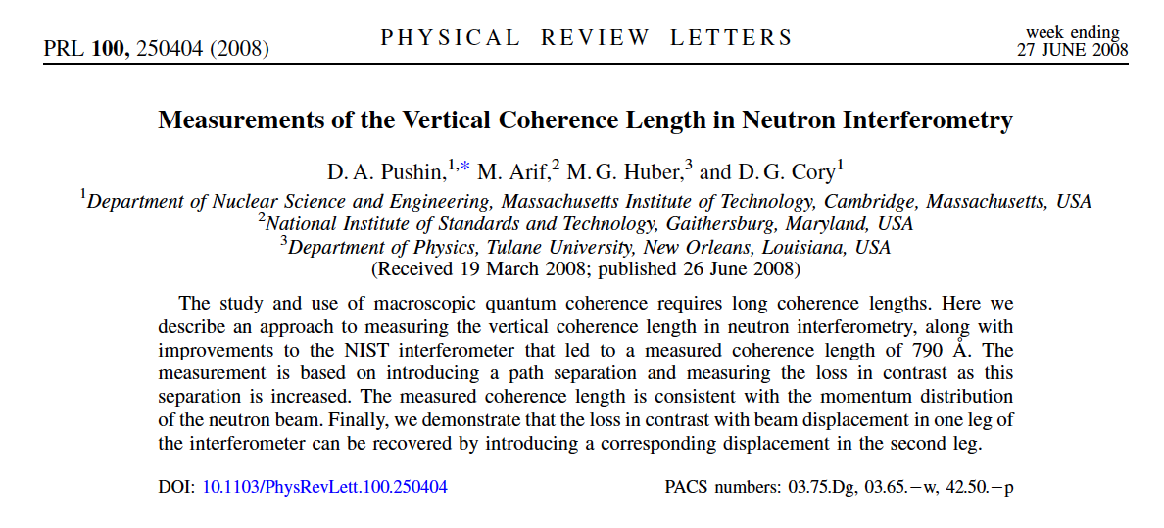
Neutron Coherency Length

Slide 5
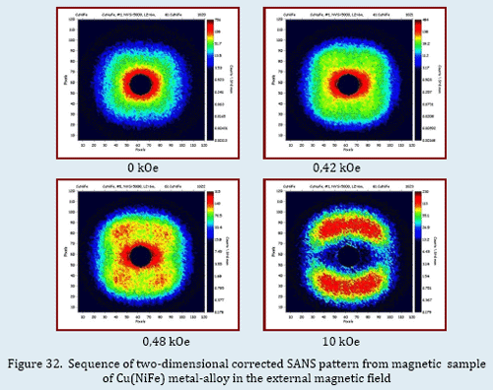
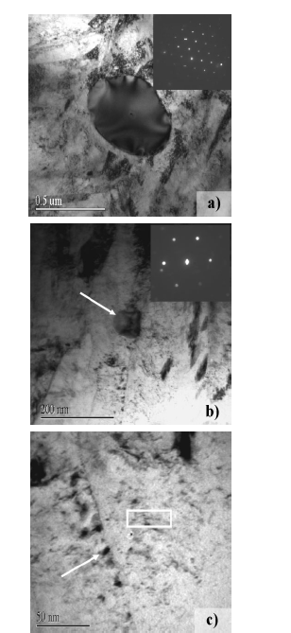
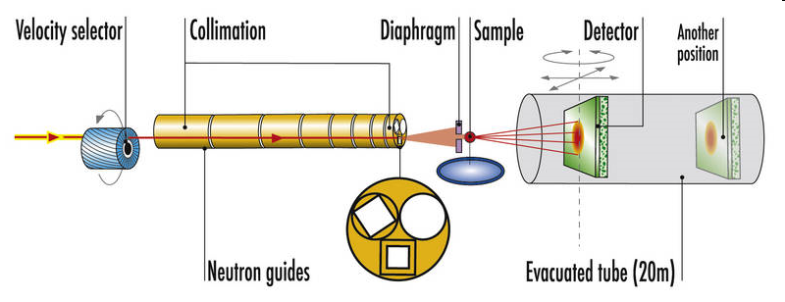
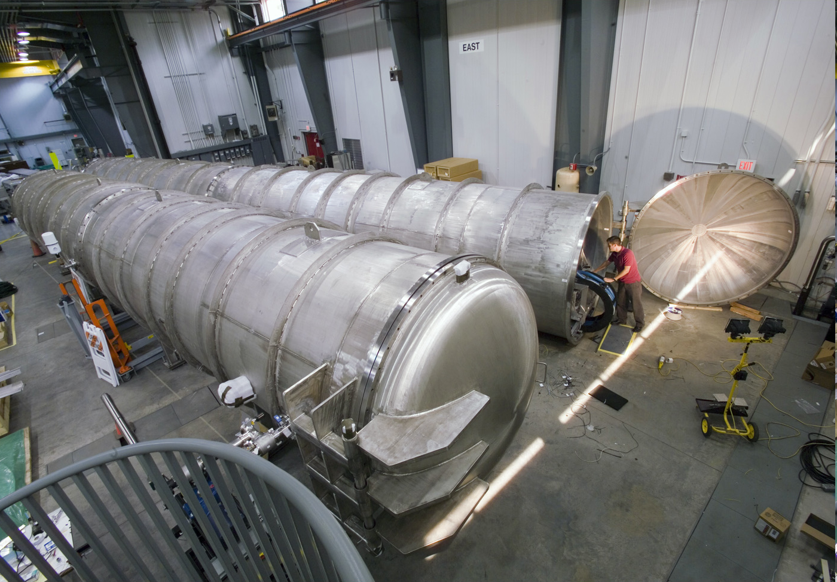
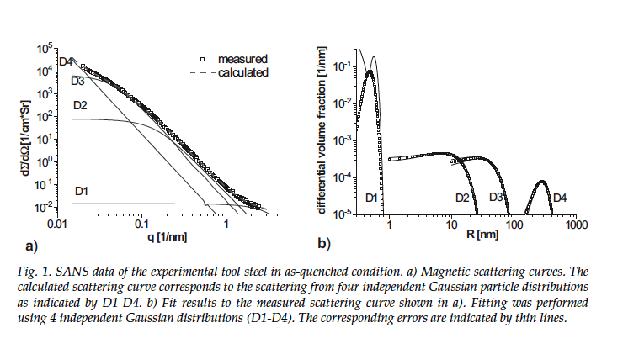
Small-Angle (SANS/SAXS)
Polymers and colloids, e.g.
  Micelles
  Dendrimers
  Liquid crystals
  Gels
  Reaction kinetics of mixed systems
Materials Science
  Phase separation in alloys and glasses
  Morphologies of superalloys
  Micro-porosity in ceramics
  Interfaces and surfaces of catalysts
Biological macromolecules
  Size and shape of proteins, nucleic acids and of macromolecular complexes
  Bio-membranes
  Drug vectors
Magnetism
  Magnetic correlations
  Flux line lattices in superconductors
Contrast variation H↔D
Objects 1-300+ nm
Measure size, vol. fraction
D22 at www.ill.eu

Slide 6
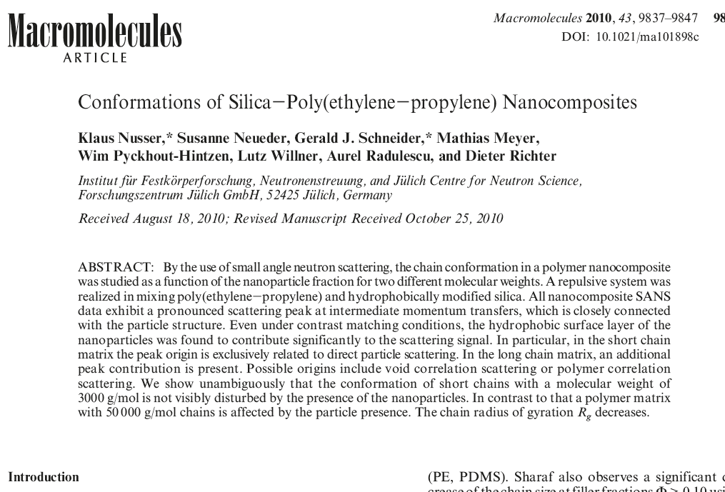
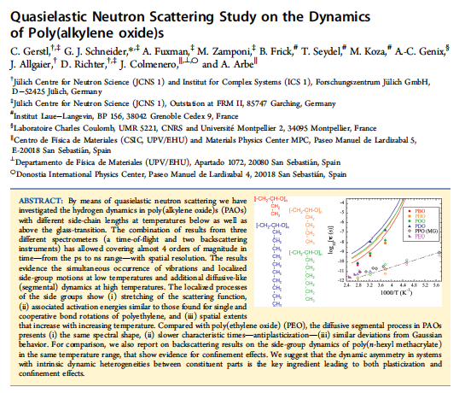
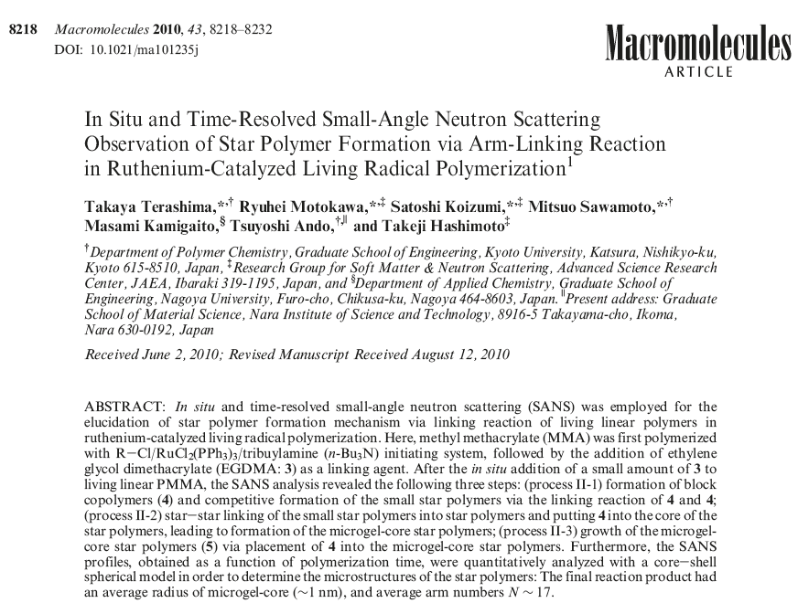
Polymers
AS -

Slide 7
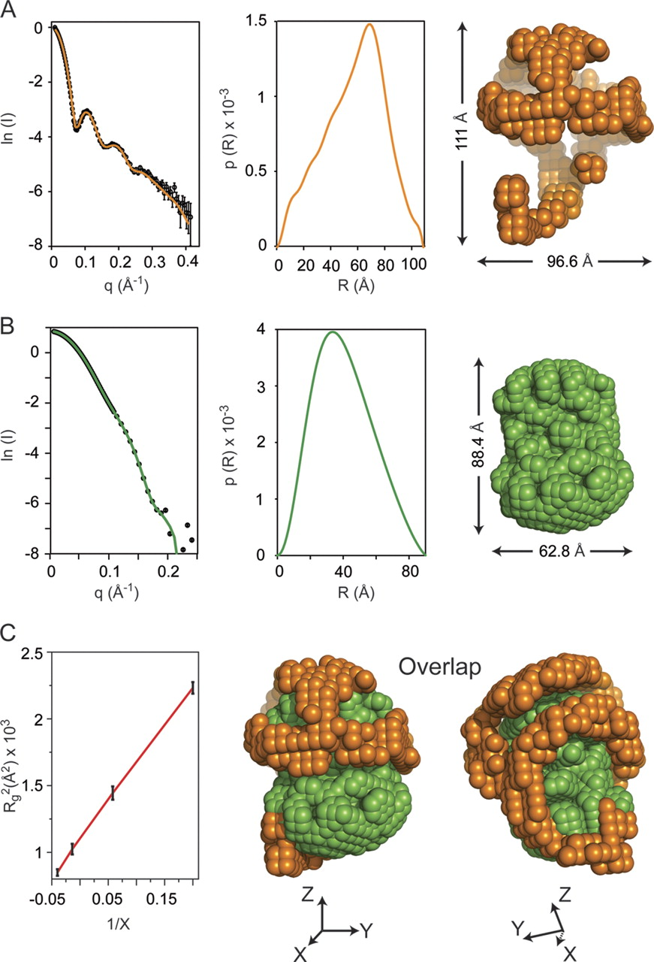

Contrast Variation
Spherical high density lipoprotein (sHDL), a key player in reverse cholesterol transport and the most abundant form of HDL, is associated with cardiovascular diseases.
Small angle neutron scattering with contrast variation was used to determine the solution structure of protein and lipid components of reconstituted sHDL.
Apolipoprotein A1, the major protein of sHDL, forms a hollow structure that cradles a central compact lipid core. Three apoA1 chains are arranged within the low resolution structure of the protein component as one of three possible global architectures: (i) a helical dimer with a hairpin (HdHp), (ii) three hairpins (3Hp), or (iii) an integrated trimer (iT) in which the three apoA1 monomers mutually associate over a portion of the sHDL surface. Cross-linking and mass spectrometry analyses help to discriminate among the three molecular models and are most consistent with the HdHp overall architecture of apoA1 within sHDL
Courtesy Z. Wu (Cleveland) 10.1074/jbc.M110.209130

Slide 8
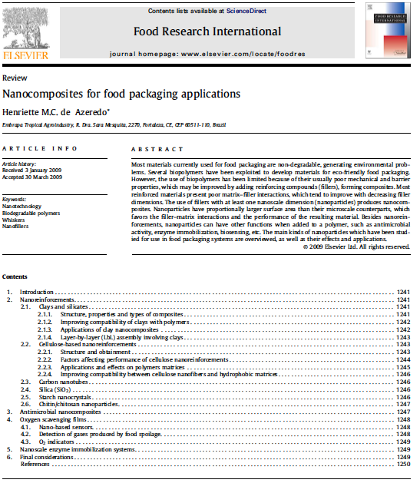
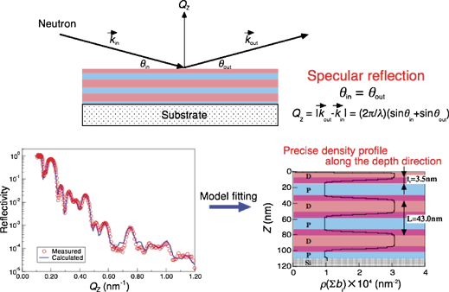

Slide 9
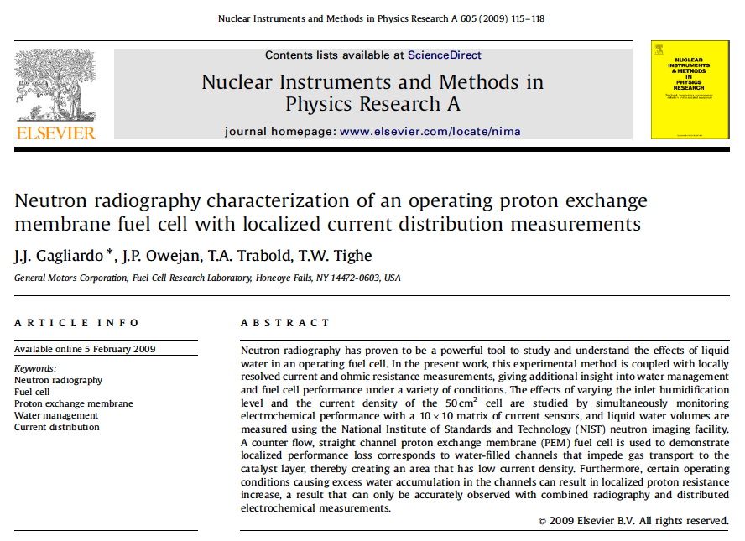
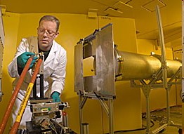
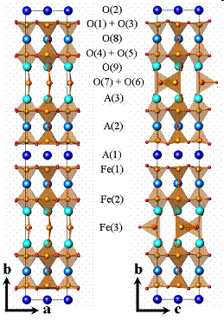
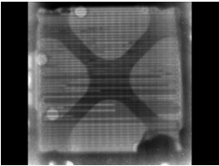
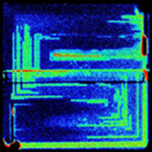
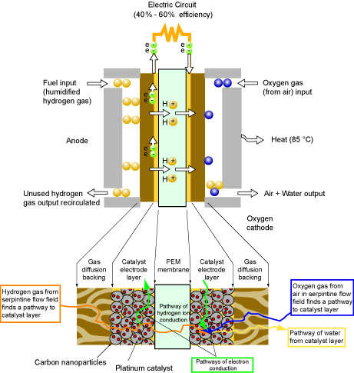
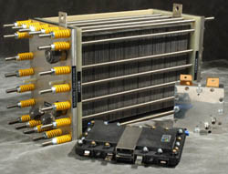
Fuel Cells & Hydrogen Economy
Structure
Proton transport in membrances
Hydrogen flow
Storage devices and materials
In-situ operation and optimisation
Notes:
application in fuel cells, neutrons used for optimisation of microstructural crystal structure and composition of membrane material (proton transport) and engineering (water transport) on macro scale.

Slide 10

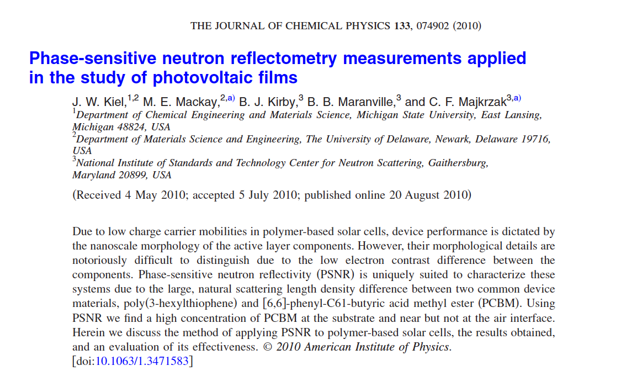
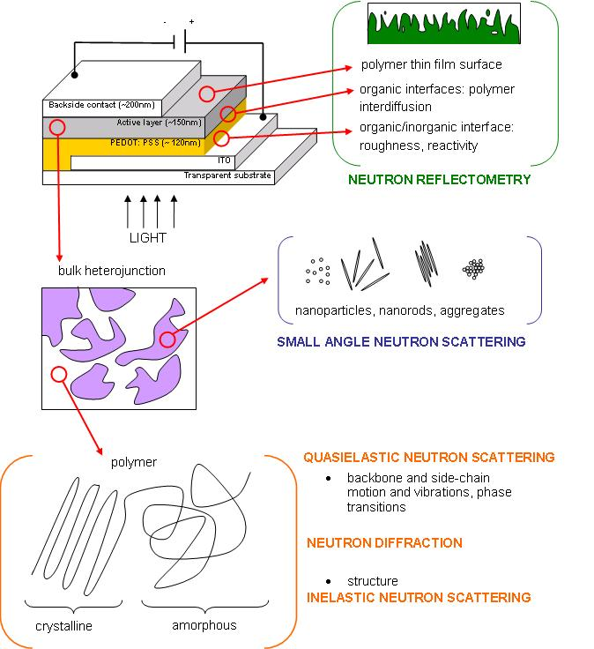
Solar Cells
Courtesy: STFC, UK

Slide 11
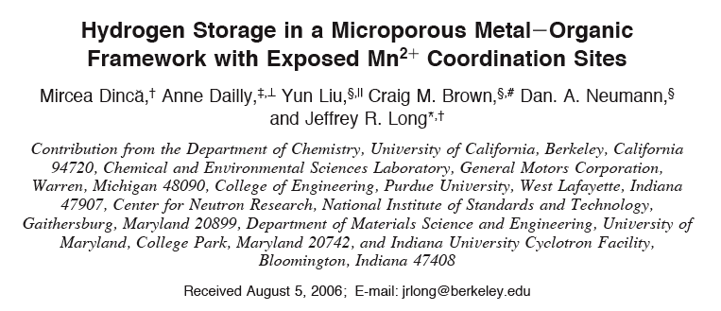
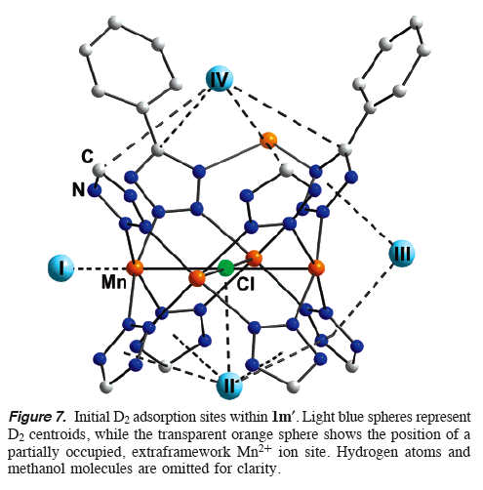
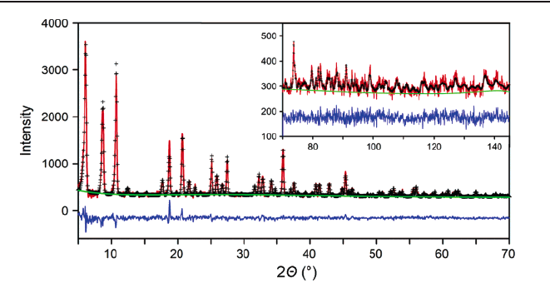
Hydrogen Storage

Slide 12
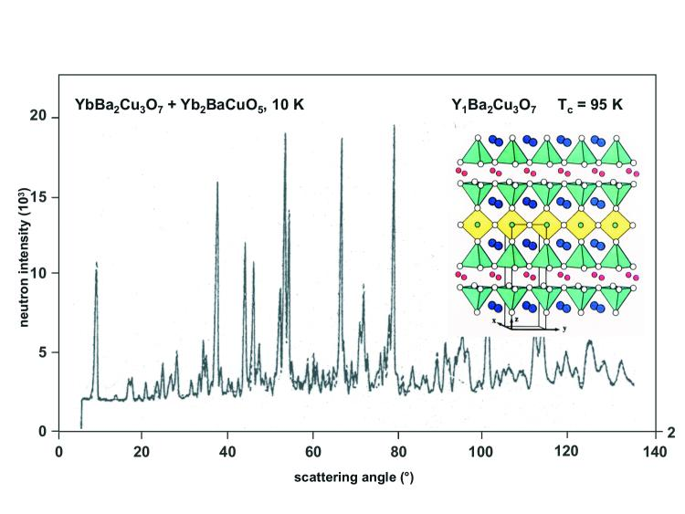
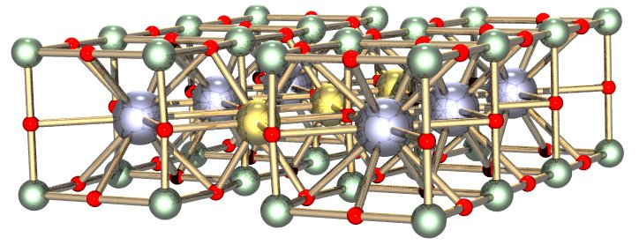
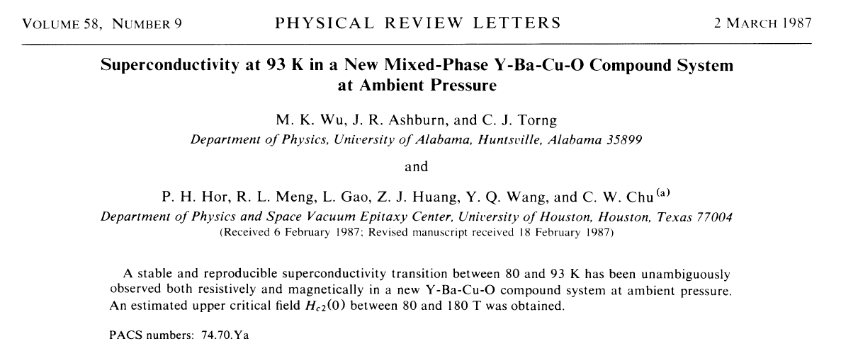
YBCO
YBa₂Cu₃O₇, YBa₂Cu₃O_{7-x}
High-Tc superconductor
x=0.07, Tc=93K most efficient

Slide 13
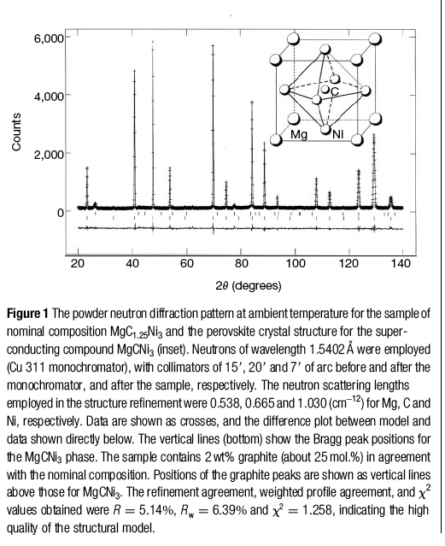
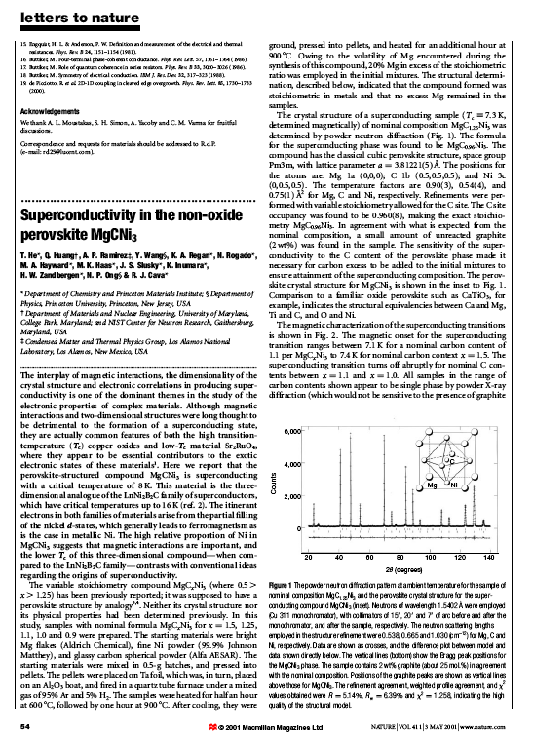
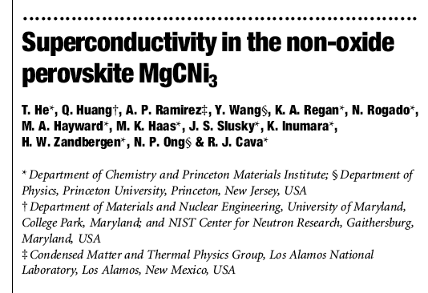
Forefront of Science

Slide 14
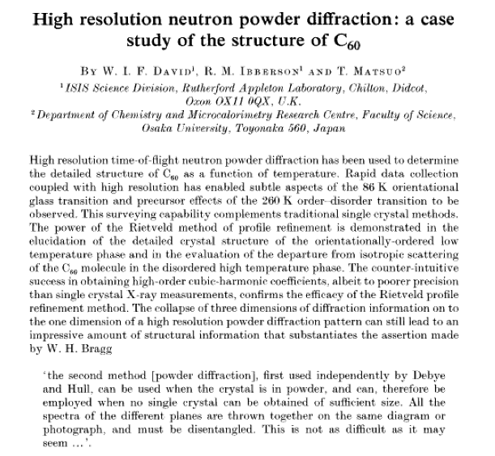
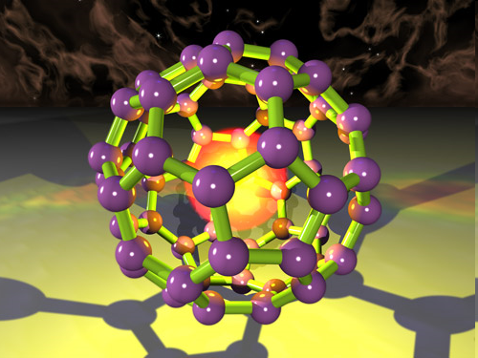
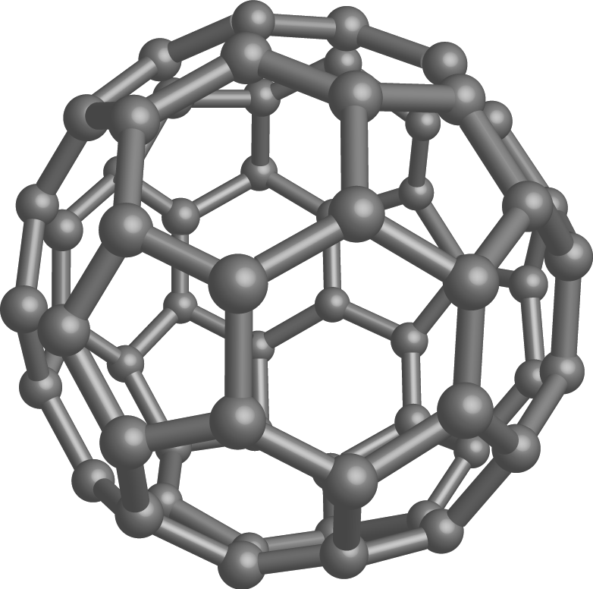
Buckminster Fullerenes

Slide 15
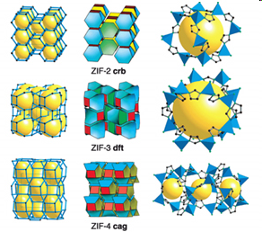
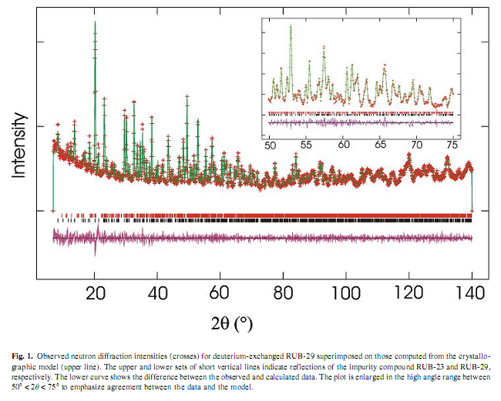
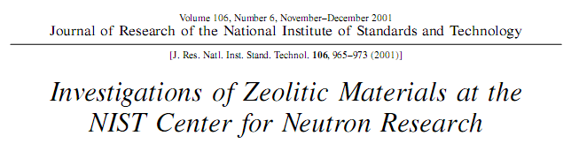
Diffraction: Zeolites
Brian Toby
Applications:
Detergents: Ion exchange capability
Gas separation: Microporosity
Dessicants: Adsorption
Catalysis: acidity, porosity, high surface area
Large Unit Cell!
Source: B Toby NIST

Slide 16
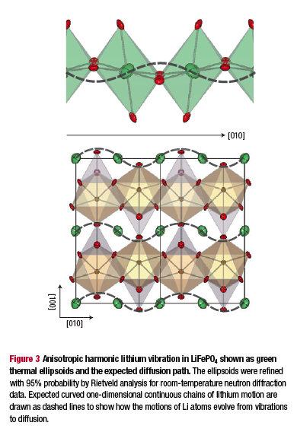
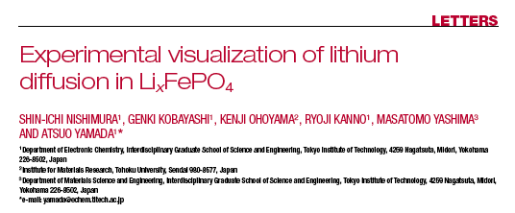
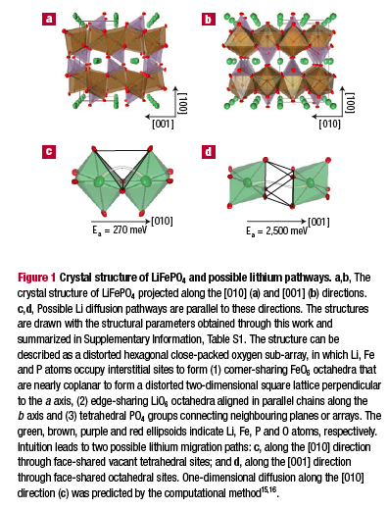
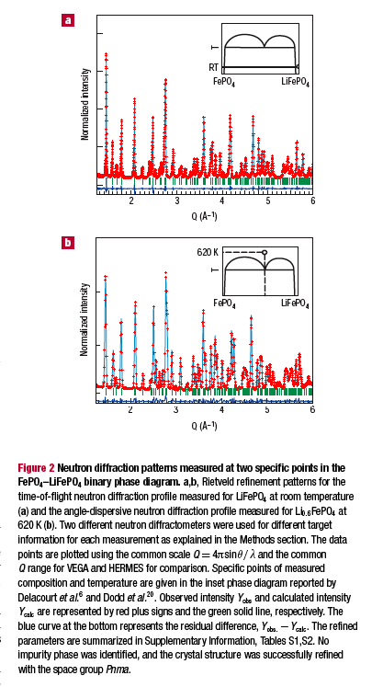
Batteries
Nature, Vol 7, Sept 2008

Slide 17

Research at Large Facilities
Laboratory work
Large Scale Facility

Slide 18



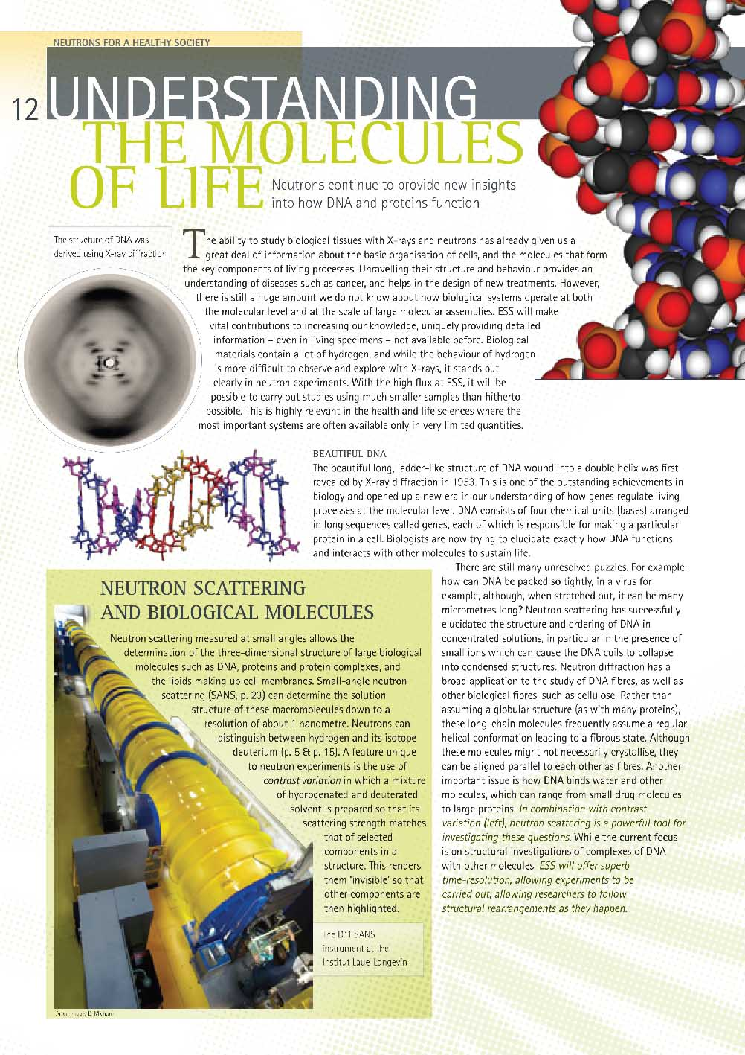
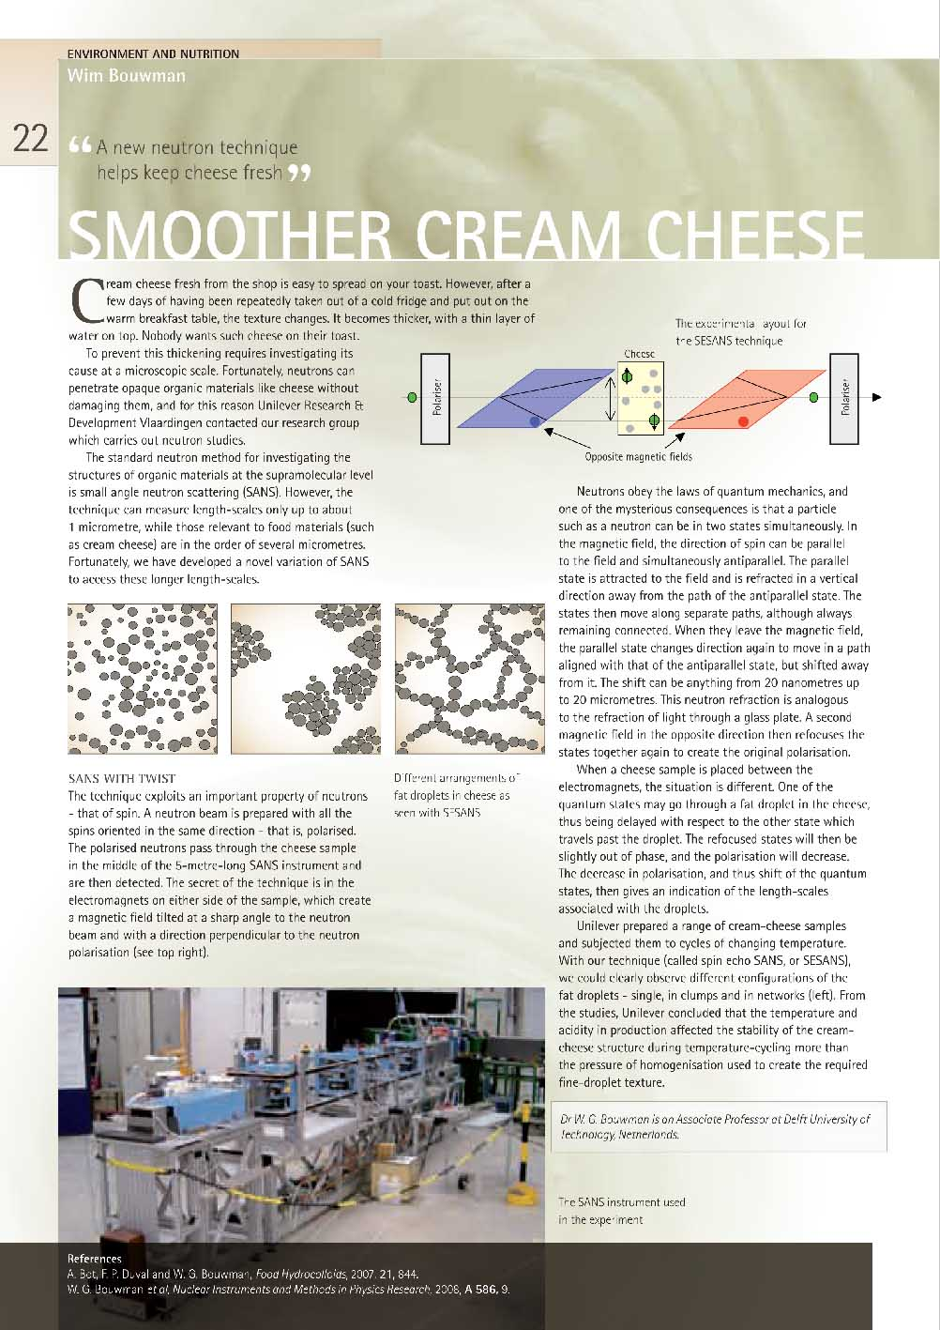
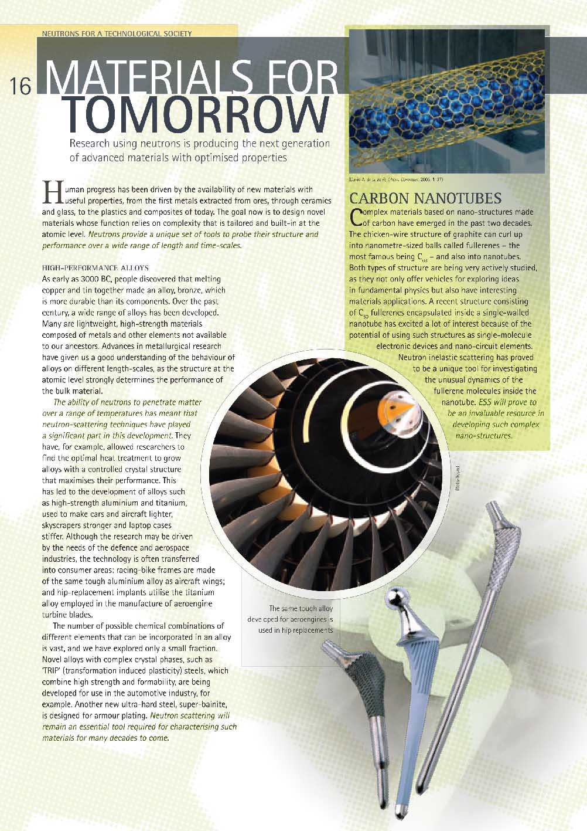
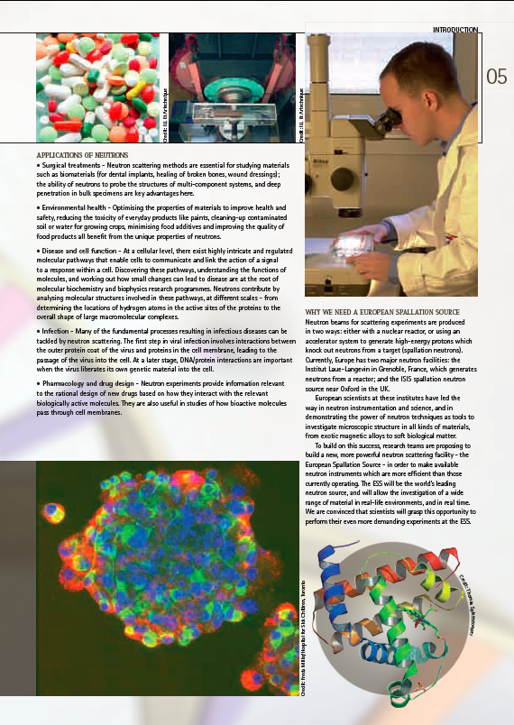
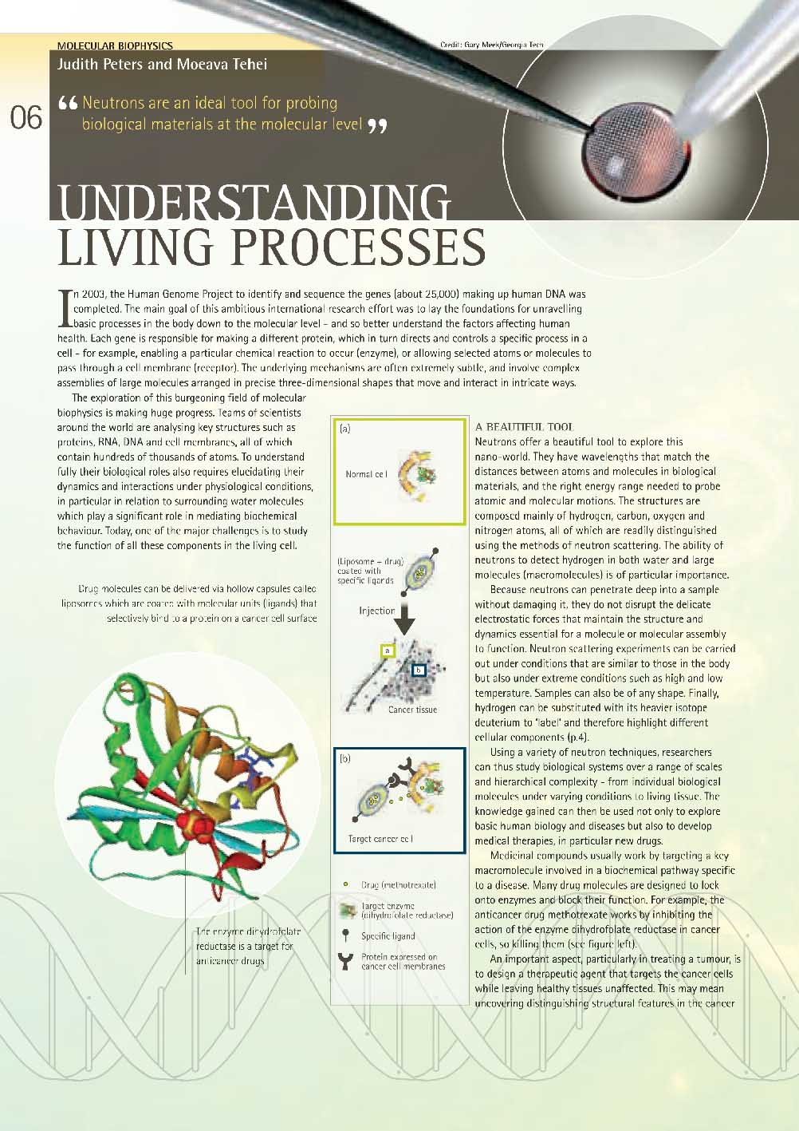
Science with Neutrons
AS -

Slide 19
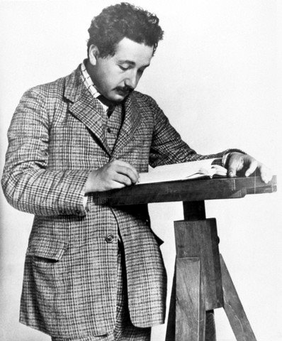


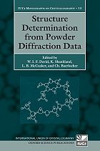


Further Reading
B.T.M. Willis & C.J. Carlile ‘Experimental Neutron Scattering’, Oxford University Press
G.L. Squires ‘Introduction to the Theory of Thermal Neutron Scattering’, Cambridge University Press / Dover
W.I.F. David, K. Shankland, L.B. McCusker, and C. Bärlocher (Eds.) ‘Structure Determination from Powder Diffraction Data‘ IUCr Monographs 13
Liyuan Liang, Romano Rinaldi, and Helmut Schober, eds, ‘Neutron Applications in Earth, Energy and Environmental Sciences’, ISBN 978-0-387-09415-1, Springer 2009
A Furrer, J Mesot, T Strässle, ‘Neutron Scattering in
Condensed Matter Physics;, World Scientific,
Google, ISI Web of Science, ScienceDirect..

Slide 20
EXTRA SLIDES

Slide 21
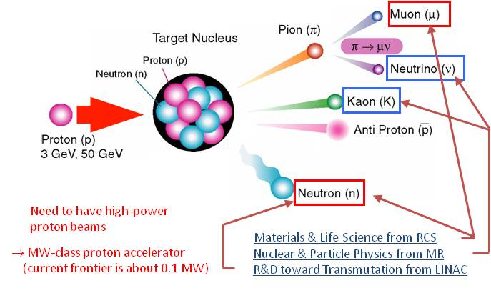
Secondary particle produced at J-PARC

