Slide 1


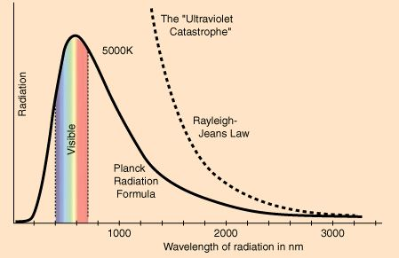
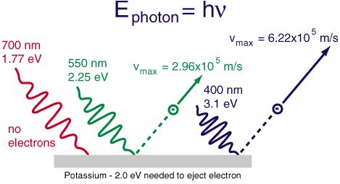
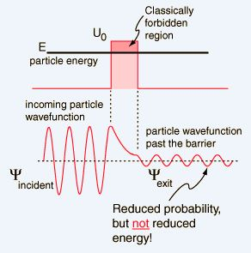
Some Experimental Basis of
Quantum Theory
Faten BEN CHAABANE
Faculty of sciences of Tunis – University of Tunis El Manar
fattouna.2.6.93@gmail.com
ASP
Dakar, Senegal
August 3-23, 2014
WHAT IS A QUANTUM THEORY ? Quantum theory is the theoretical basis of modern physics that explains the nature and behavior of matter and energy on the atomic and subatomic level. In 1900, physicist Max Planck presented his quantum theory to the German Physical Society. Since then, it has prompted a fundamental rethinking of physical theory and at the same time it has helped make sense of a whole range of peculiar behaviors principally manifested at microscopic levels.
Introduction :
Experimental Basis :
We are interested in some experimental basis that gave birth to quantum physics and its concepts. Some of the areas in which discrepancies were observed between the classical model and experiment are : blackbody radiation, the photoelectric effect and tunnel effect.
1- Blackbody Radiation :
2- Photoelectric Effect :
A classical law approximately describing the intensity of radiation emitted by a blackbody in the case of small frequencies , derived by Rayleigh by counting the number of standing wave modes in an enclosure. This law was an important step in our understanding of the equilibrium radiation from a hot object. Thanks to Planck in 1900 who derived a radiation formula which is a pioneering result of modern physics and quantum theory, a quantum law was based on the assumption that the electromagnetic modes in a cavity were quantized in energy (the quantum energy equal to Planck's constant times the frequency).
Classical physics describes light as a wave which was observed to cause electrons to be ejected from a metal's surface. The classical explanation was that the metal's electrons would oscillate with the light and eventually break a way from the surface with a kinetic energy that would depend on the intensity of the incident radiation. However, the kinetic energy of the ejected electrons was shown to be independent of the intensity of the radiation.
Einstein (1905) resolved this paradox by proposing that the incident light consisted of individual quanta, called photons, that interacted with the electrons in the metal like discrete particles, rather than as continuous waves.
3- Tunnel Effect:
- Classically the particle cannot overcome the barrier.
- Quantum mechanically the particle can penetrated the barrier and appear on the other side then it is said to have tunneled through the barrier.
Examples: * Emission of alpha particles from radioactive nuclei by tunneling through the binding potential barrier.
* Invention of scanning tunneling microscope (STM) which is an instrument for imaging surfaces at the atomic level.
Conclusion :
Quantum physics unfolds in all areas of atomic physics, molecular and nuclear course like for example quantum chemistry, quantum optics and condensed matter. Thus, the laws of quantum mechanics explain why atoms and molecules are stable, can transmit and absorb light, but also combine in chemical reactions. Those laws explain various phenomena as superconductivity, photoelectric effect, tunnel effect, ferromagnetism magnets, electrical conduction of metals or semiconductors…

