Slide 1
Data Acquisition and Grid Computing For Africa
Dr. Julia Gray
on behalf of DOSAR and OSG

Slide 2
Outline
History & OSG connection of DOSAR organization
Grid computing outreach in Brazil
DOSAR involvement in Africa
  South Africa
    SA Grid
    University of Johannesburg and ATLAS
    Paleontology project
  ASP workshops
    Ghana and updates
Senegal and Future of Grid computing

Slide 3
What is DOSAR?
Distributed Organization for Scientific & Academic Research
  Community and campus based Grid organization
  Its primary goal is spreading/enabling Grid use
    DOSAR in Korean is the God of Martial Arts
DOSAR evolved from the Fermilab National Accelerator Laboratory experiment DØ Remote Analysis effort
  Coordinated group efforts in DØ simulation, reconstruction, and production

Slide 4
DOSAR History
Ancient Times: DØ Remote Computing Era
  SAM, DØ data management system: pre-2001
  DØ remote analysis model proposed: Nov. 2001
  Proposal for Regional Analysis Center (RAC) accepted and endorsed by DØ: Aug. 2002
  UTA awarded MRI for RAC: June 2002
  Formation of DØ Southern Analysis Region (DOSAR 1.0): April 2003
    DOSAR DØ Monte Carlo (MC) production begins
  Activation of first RAC at UTA: Nov. 2003
  Formation and Activation of DOSAR Grid for MC: April 2004

Slide 5
DOSAR History
Modern Times: Beyond DØ
  Transition to Distributed Organization for Scientific & Academic Research (DOSAR 2.0): April 2005
    Active engagement with LHC experiments began
  DOSAR VOMS installed at UTA: May 2005
  DOSAR registered as a VO in OSG: July 2005
  ATLAS distributed production and analysis system, Panda, implemented at OU and UTA: Jan. 2006
  All groups engaged in LHC experiments
  Outreach in Brazil and South Africa: 2008
  DOSAR involvement with ASP: July 2011

Slide 6
Who is DOSAR?
First Generation IAC’s University of Texas, Arlington Louisiana Tech University Langston University University of Oklahoma Tata Institute, India | Second Generation IAC’s Cinvestav, Mexico SPRACE – São Paulo Regional Analysis Center, Universidade Estadual Paulista, Brazil University of Kansas Kansas State University
Third Generation IAC’s Ole Miss, University of Mississippi Iowa State University Lousiana State University Oklahoma State University | Fourth Generation IAC’s University of South Alabama University of Johannesburg GridUNESP

Slide 7
DOSAR Goals
DOSAR seeks to bring together institutions which can/must use Grid technology to solve their computing problems (esp smaller institutions)
  Computing needs increasing faster than funding for any one institution so harness strength in collaboration
  DOSAR member institutions should serve as nucleation points for regional/statewide Grids
  DOSAR should serve as a representative/liason for these institutions to the greater Grid community
  DOSAR should help enable maximal use of available resources at the member institutions

Slide 8
DOSAR and OSG
DOSAR currently holds a seat on the Open Science Grid (OSG) counsel
Engagement of non-HEP science
  MPI jobs being submitted to NERSC by OU
  Paleo project in South Africa.
DOSAR works as the OSG Outreach and Educations organization
  Grid computing workshops in South America and Africa
    South Africa Grid School July 2008
    São Paulo Grid School Dec 2008
    GridUNESP Liasion to OSG: Fall of 2009
    UJ/Wits strongly involved in Grid Education
    ASP 2012 in Ghana

Slide 9
Outreach in Brazil
DOSAR supported development of UNESP site and LHC CMS-Tier 2 computing facility
  CMS Tier 2 and UNESP Grid now flourishing!
Held several workshops to build local capacity
  DOSAR Workshop, University of São Paulo: Sept. 2005
  Brazilian LHC Computing Workshop I, University of São Paulo: May 2006
  Brazilian LHC Computing Workshop II, University of São Paulo: Dec 2008
  DOSAR Workshop, University of São Paulo: Sept. 2009
  GridUNESP Workshop, University of São Paulo: Dec. 2009
  OSG Workshop, University of São Paulo: Dec. 2010

Slide 10
Brazil Network

Slide 11
Brazil Grid Testbed
Hardware: Sponsorship from leading manufacturers & suppliers
  Intel (Xeon quad-core processors, network adapters, software tools)
  SGI (Altix XE-310 barebones w/2 half-sized mainboards)
  Kingston (DDR2 FB-DIMM memories)
  Seagate (SATA-II hard disks)
Software: Open-source tools and techniques
  Virtualization provides server consolidation, minimizing hardware, physical space, and operational costs
  Grid middleware based on the VDT (Virtual Data Toolkit)
    VDT is a product of the OSG, a consortium of US universities, national labs, and computing centers

Slide 12
Outreach in South Africa
DOSAR supported development of LHC computing facility and use of OSG software
  Support for SA-ATLAS Grid facility
  Non-LHC computing projects
Held workshops to build local expertise
  The South African Grid School, University of Witwatersrand: July 2008
  DOSAR Workshop, University of Johannesburg: April 2010
South Africa now active in outreach and training in Grid computing

Slide 13
SA Grid
SA Grid started as the initiative of High Energy Physics group at UJ with support from DOSAR
  User groups now include High Energy Physics, Astrophysics, Molecular Dynamics (Chemistry), Quantum Chemistry, Applied Mathematics, Numerical Studies (Engineering)
National Grid to provide a national computing infrastructure to support scientific computing and collaboration
Managed by a consortium of universities, national laboratories, and the Meraka Institute
  Uses gLite middleware

Slide 14
UJ ATLAS Computing
Jeremy Dodd (Nevis Labs) prepares proposal to OSG for HPC facility at University of Witwatersrand: Jan 2006
Martin Cook, Claire Gray, Norman Ives attend Nebraska OSG school: Aug 2006
OSG funding for HPC facility at Wits approved: Sept. 2006
Grid site at Wits receive jobs and submit to OSGEDU VOs: Oct. 2007
Developed model for SA participation in ATLAS via affiliation to Brookhaven: Oct. 2007
Bruce Becker SA Grid development with gLite. SA-ATLAS agree to interoperability and resource sharing: 2008
Horst Severini, Ben Clifford give OSG Grid School at Wits: July 2008
Grid site rebuilt at UJ with OSG and gLite interoperability: Dec. 2008
Wits joins UJ in SA-ATLAS: Jan 2010
Currently contributing to HEP and computing training with OSG and ATLAS resources, gLite resources

Slide 15
South African Paleo Project
Scan fossils at synchrotrons in X-ray radio-tomography and x-ray phase contrast tomography
  Possible to acquire high resolution 3- D images and 3-D quantitative histograms of electron density.
  Resolution can be submicron, and the specimen size can be as a large as a skull
  Raw sinogram can be a data file of the order of 1 TB.
  To analyze the 3-D histogram to define and virtually extract objects representing all anatomical and geological features, with due consideration to the body of knowledge in the several fields of paleontology, anatomy, chemistry, geology, biology, applied mathematics, physics and computer science is the bottleneck step of several years.
  Developing algorithms to facilitate this analysis by unifying the knowledge and skill from these fields is an important enabling step to properly beneficiate this new
The SA Paleo Project to develop the mathematics for the algorithms described above
  Facilitate a higher degree of automation of the analysis of paleo-tomography data with a higher degree of fidelity.
  The new algorithms would make full use of the quantitative nature of the data, the physics that it represents, the anatomical context, the diagenesis process and other geological, chemical and biologically relevant aspects.
  Deliver a toolkit for processing based on modern computing practice.
The project is very impactful for international paleontology
Significant for Southern African Heritage studies

Slide 16
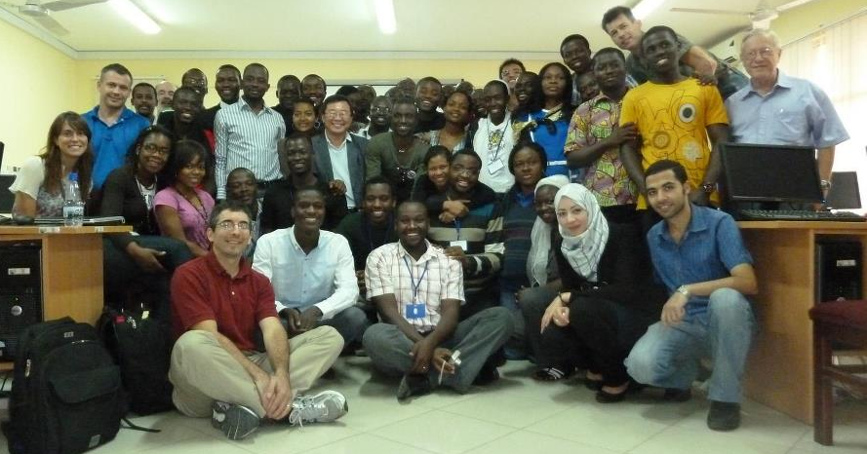
DOSAR & African School of Physics
In 2012, dedicated 3 day workshop added to the end ASP
  Distributed and high-throughput computing, security, processing, and distributed storage covered during school
  Partnership to install Grid software on existing cluster
  Computing cluster donated to KNUST in Kumasi, Ghana after ASP
  Ghana is looking to join ATLAS and CMS at CERN
Now African Grid School integrated part of ASP curriculum
  Two days of Grid lectures as part of the school in Senegal

Slide 17
Senegal the Future of Grid Computing
The future of Grid computing is Graphical Processing Unit (GPU)
  Can process images, simulations, and data quickly
Senegal is receiving a donation of computers from CERN
  Size is sufficient for a Tier 3 site for LHC experiments
Distributed computing and storage useful for digital library
  Over 18,000 documents currently stored at UCAD
  Library access to Senegalese university network and consortium of 8 countries
  Grid computing can enable the storage, search, and access documents as one system no matter where they are stored or accessed

