Slide 1
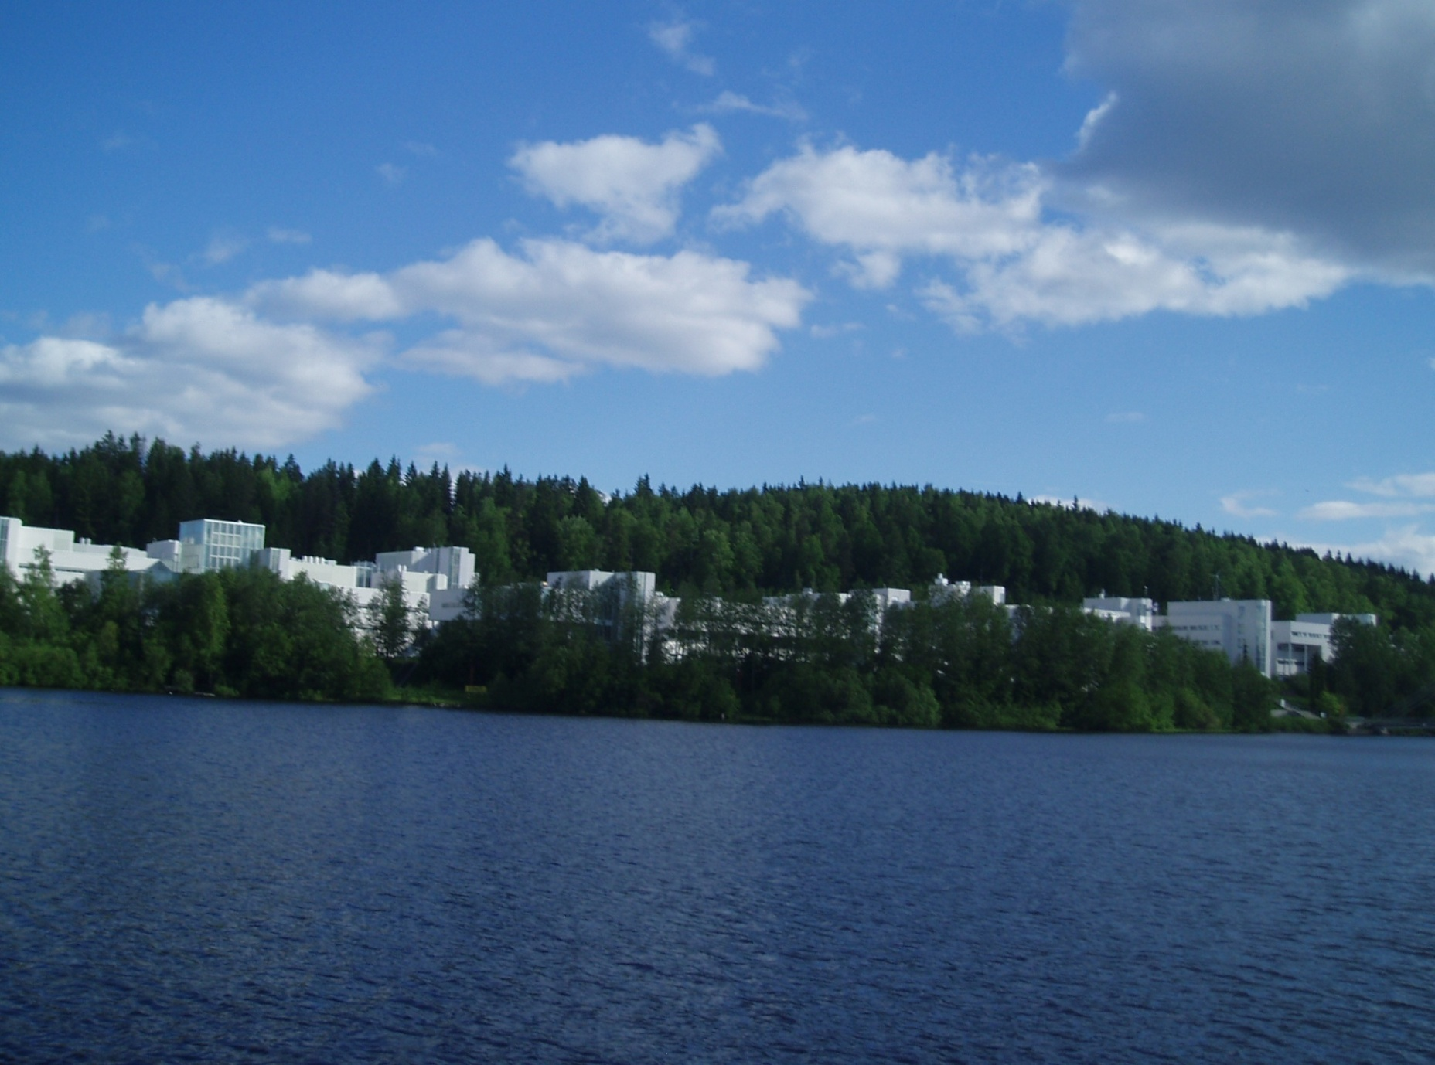
PhD Experience
By Suzan Bvumbi
From University of Johannesburg South Africa

Slide 2
OUTLINE
Personal details
PhD experience
Teaching and Research experience
Outlook

Slide 3
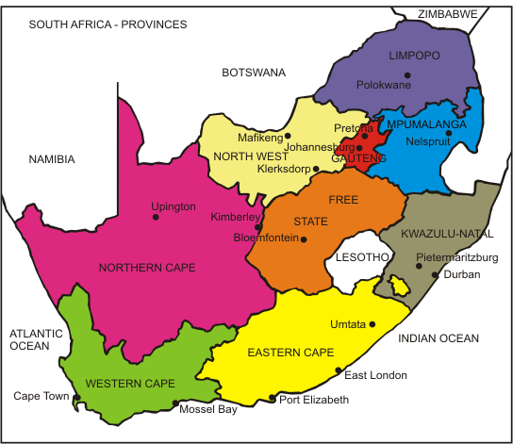

Slide 4
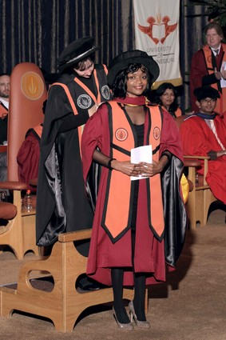
PhD Experience
Undergraduate studies (Bsc) at UNIVEN in Limpopo (2003-2006)
Postgraduate studies (Bsc Hons. And Msc) at UWC under MANUS/MATScie program (2007-2009)
  Why I moved to Western Cape
  Experiments I did
PhD at UJ (2010-2014)
  Experiments performed at iThemba LABS

Slide 5
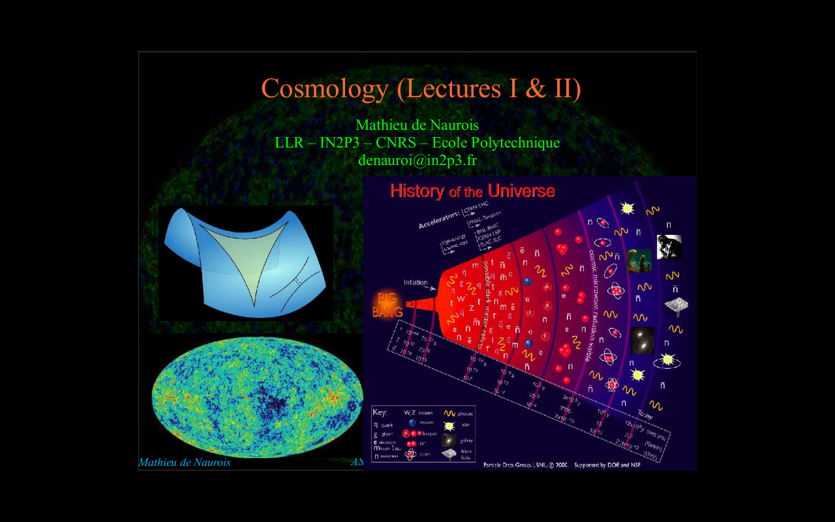
How I chose to do Nuclear Physics

Slide 6
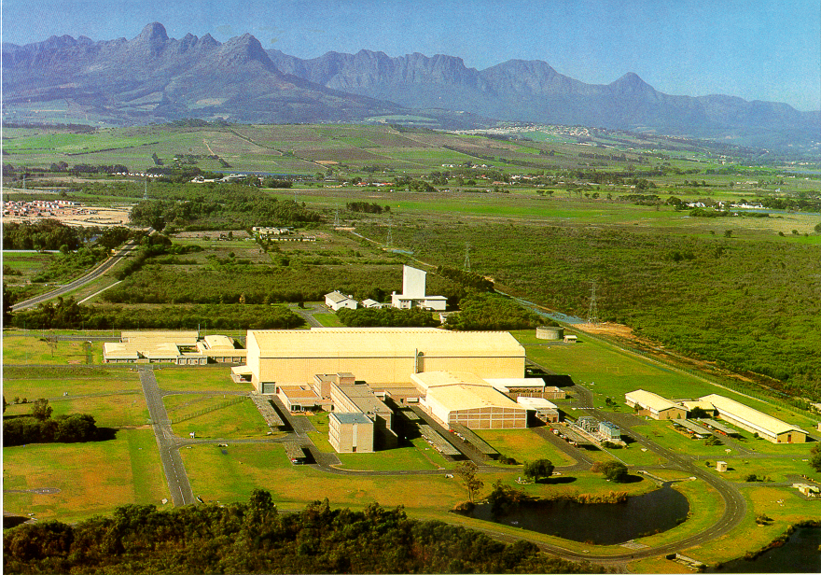

Slide 8
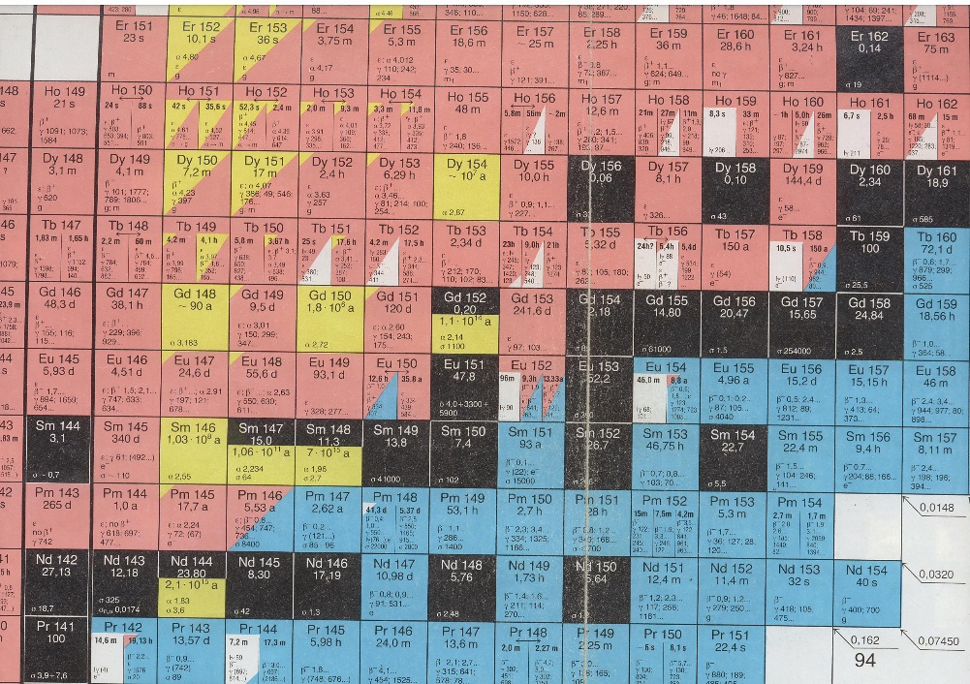

Slide 9
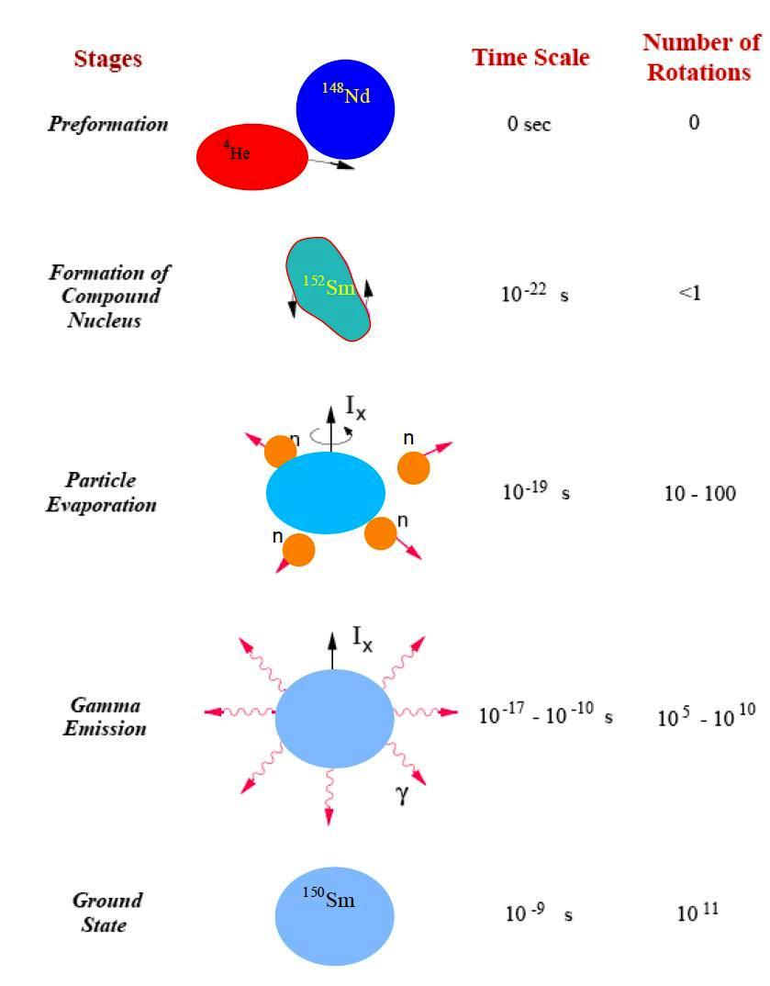

Slide 10
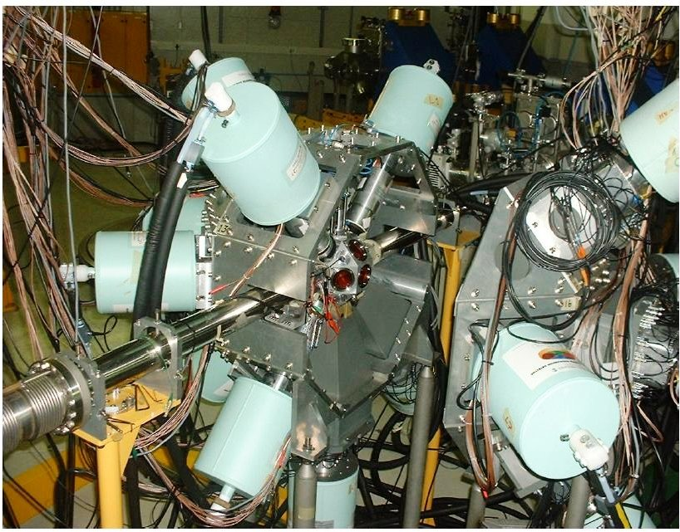

Slide 11
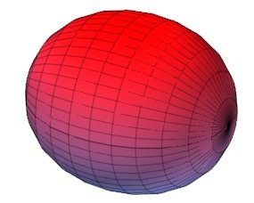
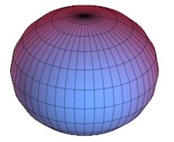
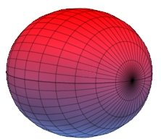
We want to classify the levels in terms of:
Nuclear Shape
Excitation Mode
----Collective Excitation
    is the nucleus rotating ?
    vibrating ?
  Single Particle Excitation
    What orbitals are the protons and neutrons moving in ?
Prolate
Oblate
Triaxial

Slide 12
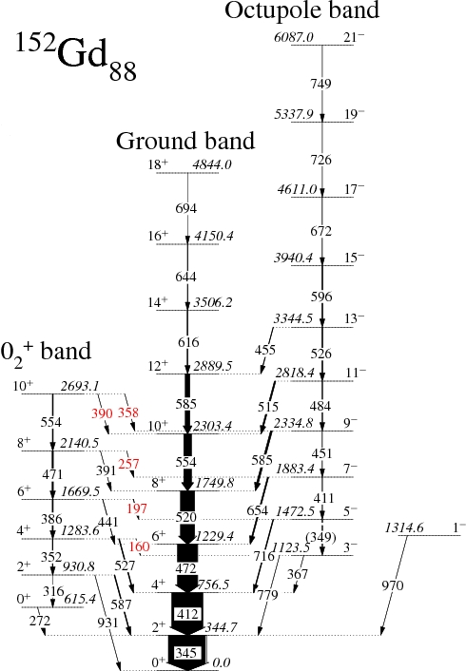
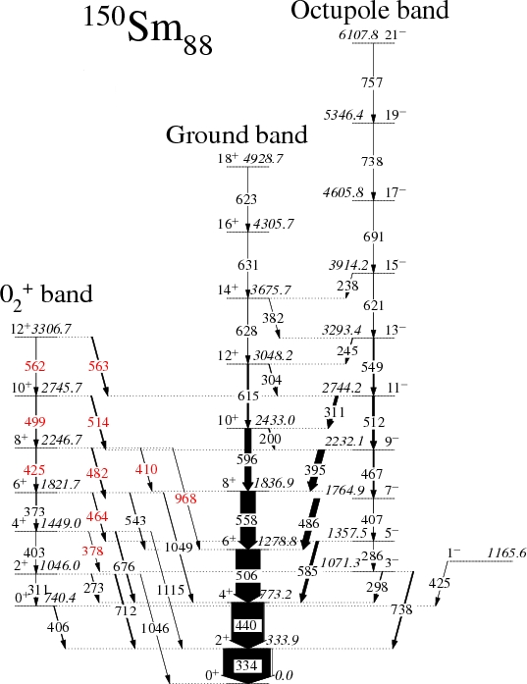

Slide 13
Phys. Rev. C 87 (2013) 044333 ”Octupole correlations in the structure of 0₂⁺ bands in the N=88 nuclei ¹⁵⁰Sm and ¹⁵²Gd”
S. P. Bvumbi et al.

Slide 14
International collaborations
PhD experiment performed in Finland
Part of Analysis performed in Hungary
Presentations made at ASP-Ghana,Italy

Slide 16
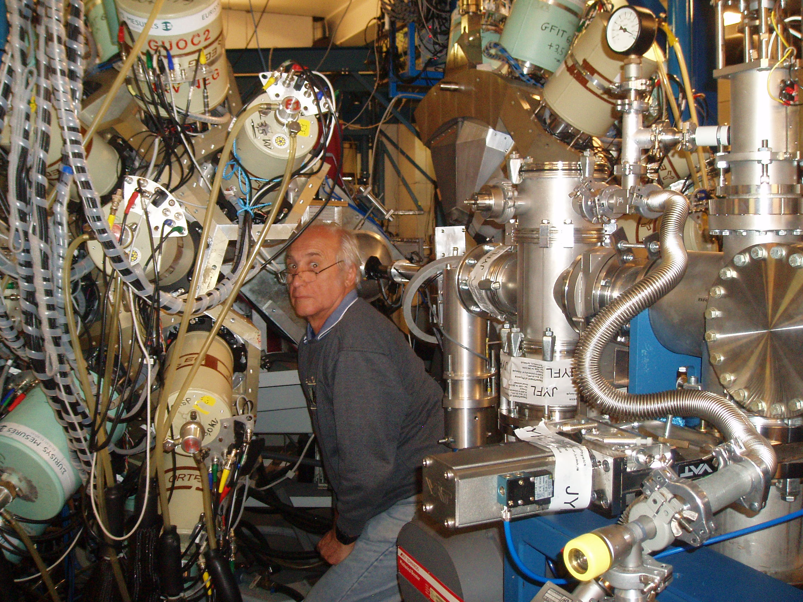
Inspiration from mentors

Slide 17
Current activities
Teaching
  Physics for Radiography students
  Physics for Somatology students
  Engineering Metallurgy
Research
  Supervising two MSc students
  Grants

Slide 18
OUTLOOK
I will be teaching at UJ for the next coming three years
Data is available for Msc/PhD students
Possibility of doing a postdoc
Writing grant proposals
I will be teaching in ASP2016

Slide 19
THANK YOU
A proton and a neutron were walking one day, and the proton said to the neutron! I think I lost an electron! The neutron said, are you sure?
The Proton replied and said! Yes I'm positive!!!

