Slide 1
Supersymmetry:
Introduction to Experimental Searches
S. Muanza, CPPM Marseille, CNRS-IN2P3

Slide 2
Outline
II. Basic Introduction to Experimental Searches for SUSY
  Standard Steps for SUSY Searches at Colliders
  One Example of Direct SUSY Search at a Collider
  Complementarity between Hadron and Lepton Colliders
  One Example of Indirect Search at a Collider
  One Example of Non-Collider SUSY Search
  Putting Together Constraints on SUSY

Slide 3
Standard Steps for
SUSY Searches at Colliders

Slide 4
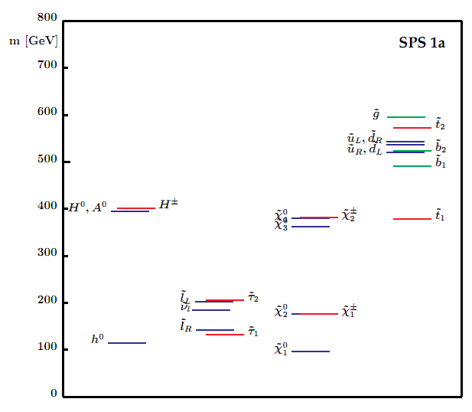
Setup Masses & Couplings
Example in Minimal Supergravity Model

Slide 5
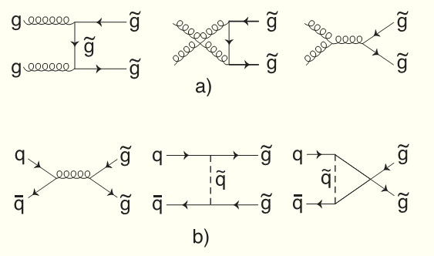
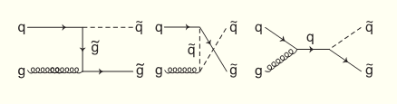
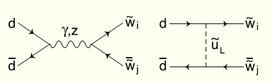
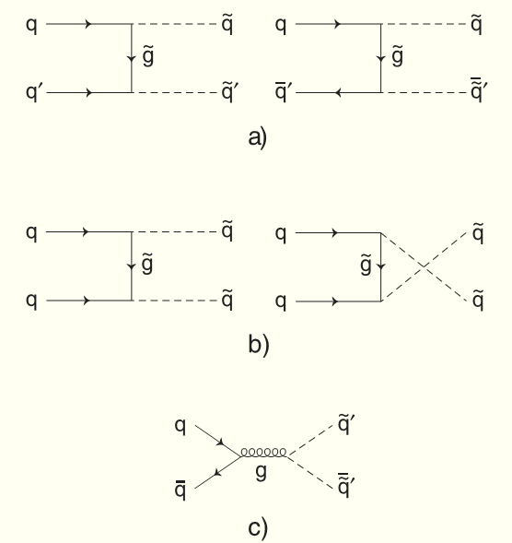
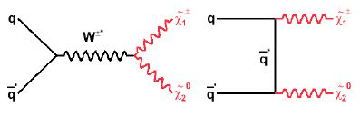
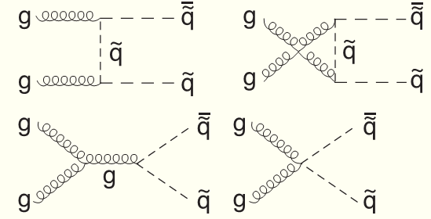
Production Mechanisms (1)
How are these Sparticles produced?
  Gluino pairs:
  Squark pairs:
  Gluino+Squark pairs:
  Chargino pairs:
  Chargino+Neutralino pairs:

Slide 6
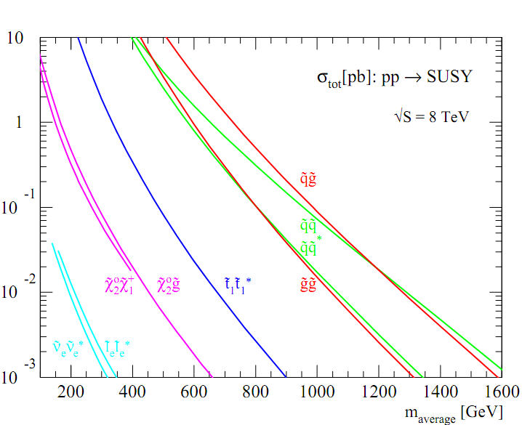
Production Mechanisms (2)
What are the cross sections?
Obtained with Prospino (include NLO-QCD corrections)
They determine which Sparticles are accessible and the hierarchy in their search

Slide 7
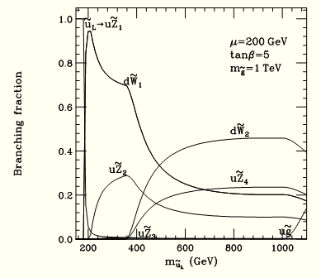
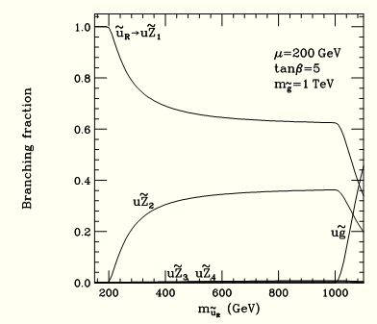
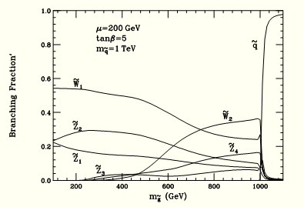
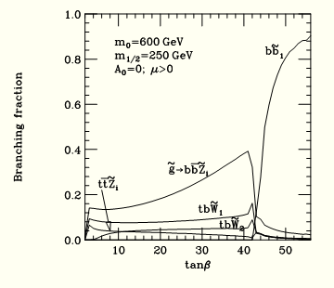
Decay Modes
How do these Sparticles decay?
Squarks:
Gluinos:
Search topologies are chosen wrt to some decay chains
In RPC searches the phase space is limited by a ΔM

Slide 8
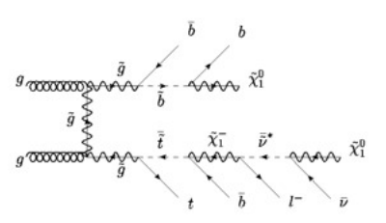

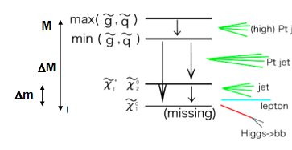
Search Topologies
What are the search topologies?

Slide 9
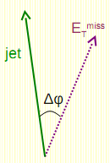
Useful Kinematic Variables
Pseudo-rapidity:
Angular distance in space:
Missing Transverse Energy:
Total Transverse Energy & Effective Mass:
These are scalar sums, not vector sums
:
Lower bound helps reduce from jets mis-measurements

Slide 10
One Example of Direct
SUSY Search at Collider

Slide 11
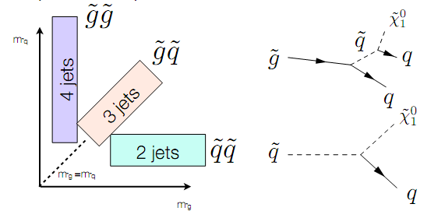
Jets+mET Analysis (1)
L=1.04 fb⁻¹
Dataset:
2011 p+p collisions
Trigger:
LVL1: multijets
HLT: 5j55 or 6j45
Performance: ε=99%
Data Quality:
Remove bad L blocks
Remove evts w/ bad jets
Reject evts w/ cosmics or noise
Object ID:
Jets:
  anti-k_{T}, ΔR=0.4
  p_{T} > 20 GeV
  |η|<2.5
e: medium, p_{T} > 20 GeV, |η|<2.47
e isolation: H_{T}(tracks) (ΔR=0.2)<10% p_{T}(e)
μ: matched, p_{T} > 20 GeV, |η|<2.4
μ isolation: H_{T}(tracks) (ΔR=0.2)<1.8GeV
Veto isolated e or μ

Slide 12
Jets+mET Analysis (2)
Main Background Processes:
Z+jets: especially Z(→νν)+jets
W+jets: especially W(→τν)+jets or W(→e/μν)+jets w/ missed e/μ
QCD multijet
Background Estimation:
Evaluate each process in a « Control Region » (5 CRs x 5 SRs)
Extrapolate the CR to SR using transfer factors:
Estimate Signal Sensitivity:
Profile log-likelihood fit (with correlated systematic uncertainties and CRs cross-contamination)
NB:
  SR: Signal Region. A region of phase space where the signal yield is large.
  CR: Control Region (for a given background process). A region of phase space where largely dominated by the contribution of the considered background process.

Slide 13
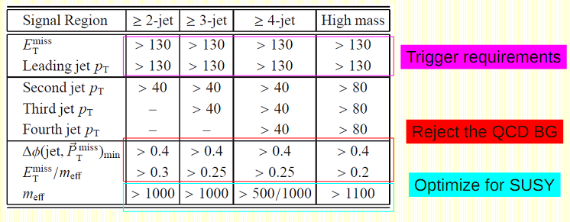
Jets+mET Analysis (3)

Slide 14
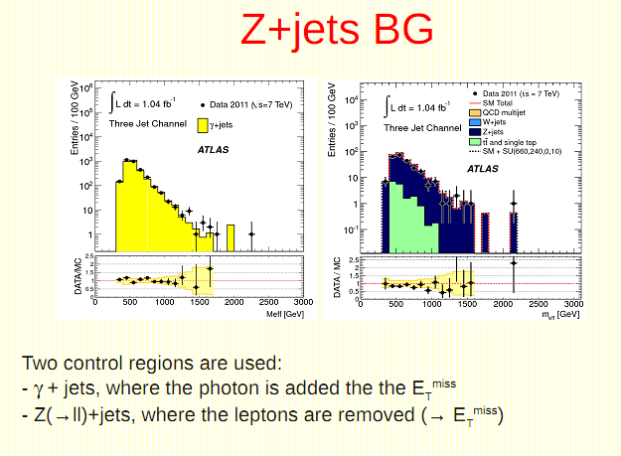
Jets+mET Analysis (4)

Slide 15
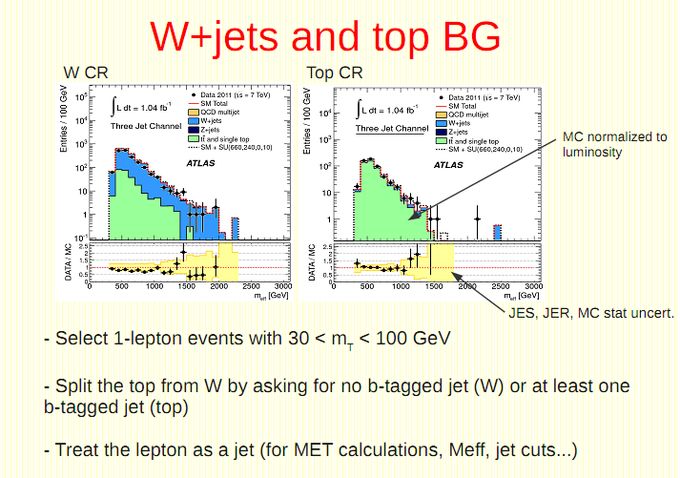
Jets+mET Analysis (5)

Slide 16
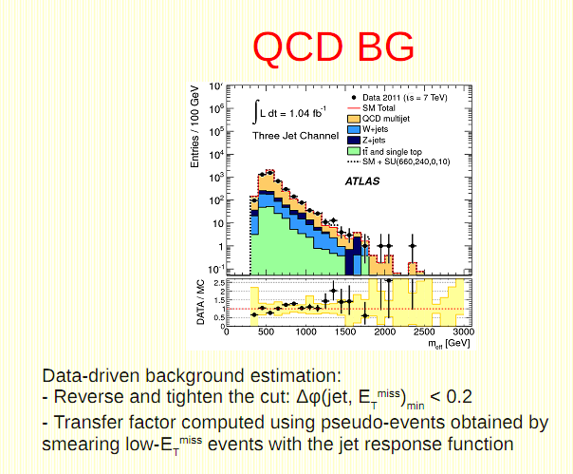
Jets+mET Analysis (6)

Slide 17
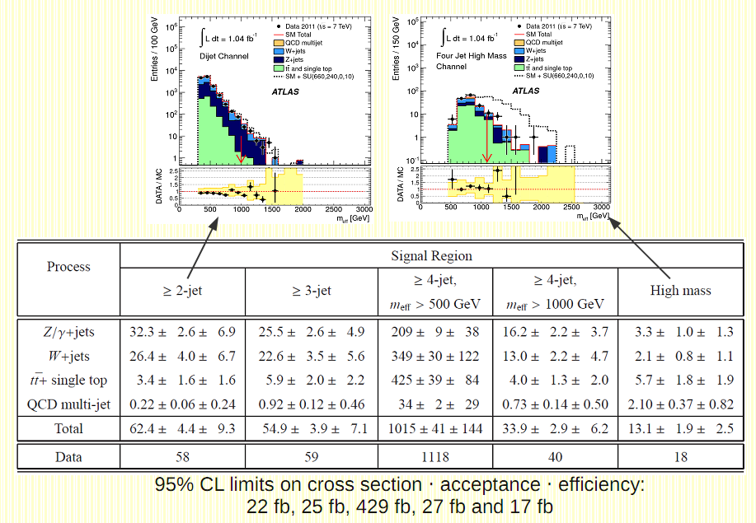
Jets+mET Analysis (7)

Slide 18
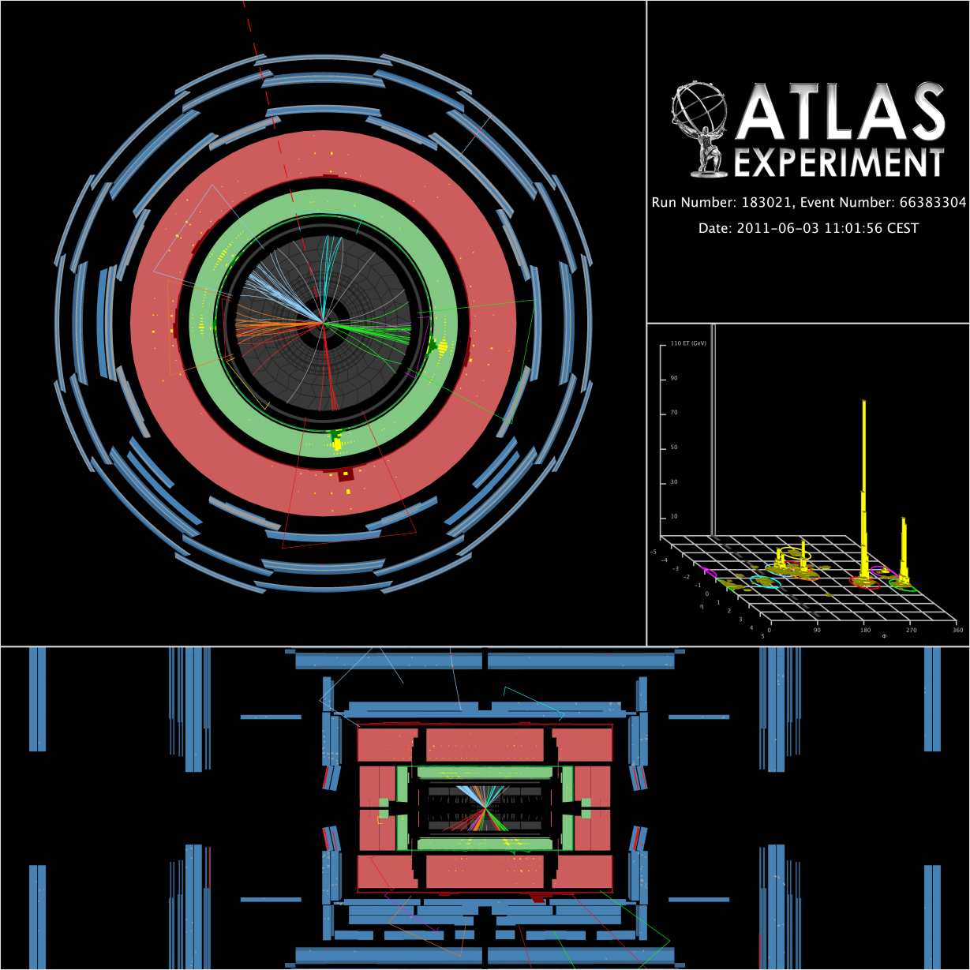
Jets+mET Analysis (8)
Event w/ highest M_{eff} found
5 jets with pt > 40 GeV:
pT = 528, 418, 233, 171, 42 GeV
mET = 460 GeV
M_{eff} =1810 GeV (4 leading jets)

Slide 19
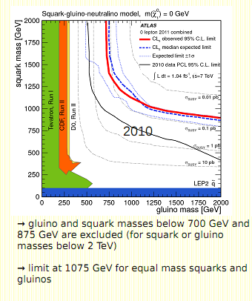
Jets+mET Analysis (9)

Slide 20
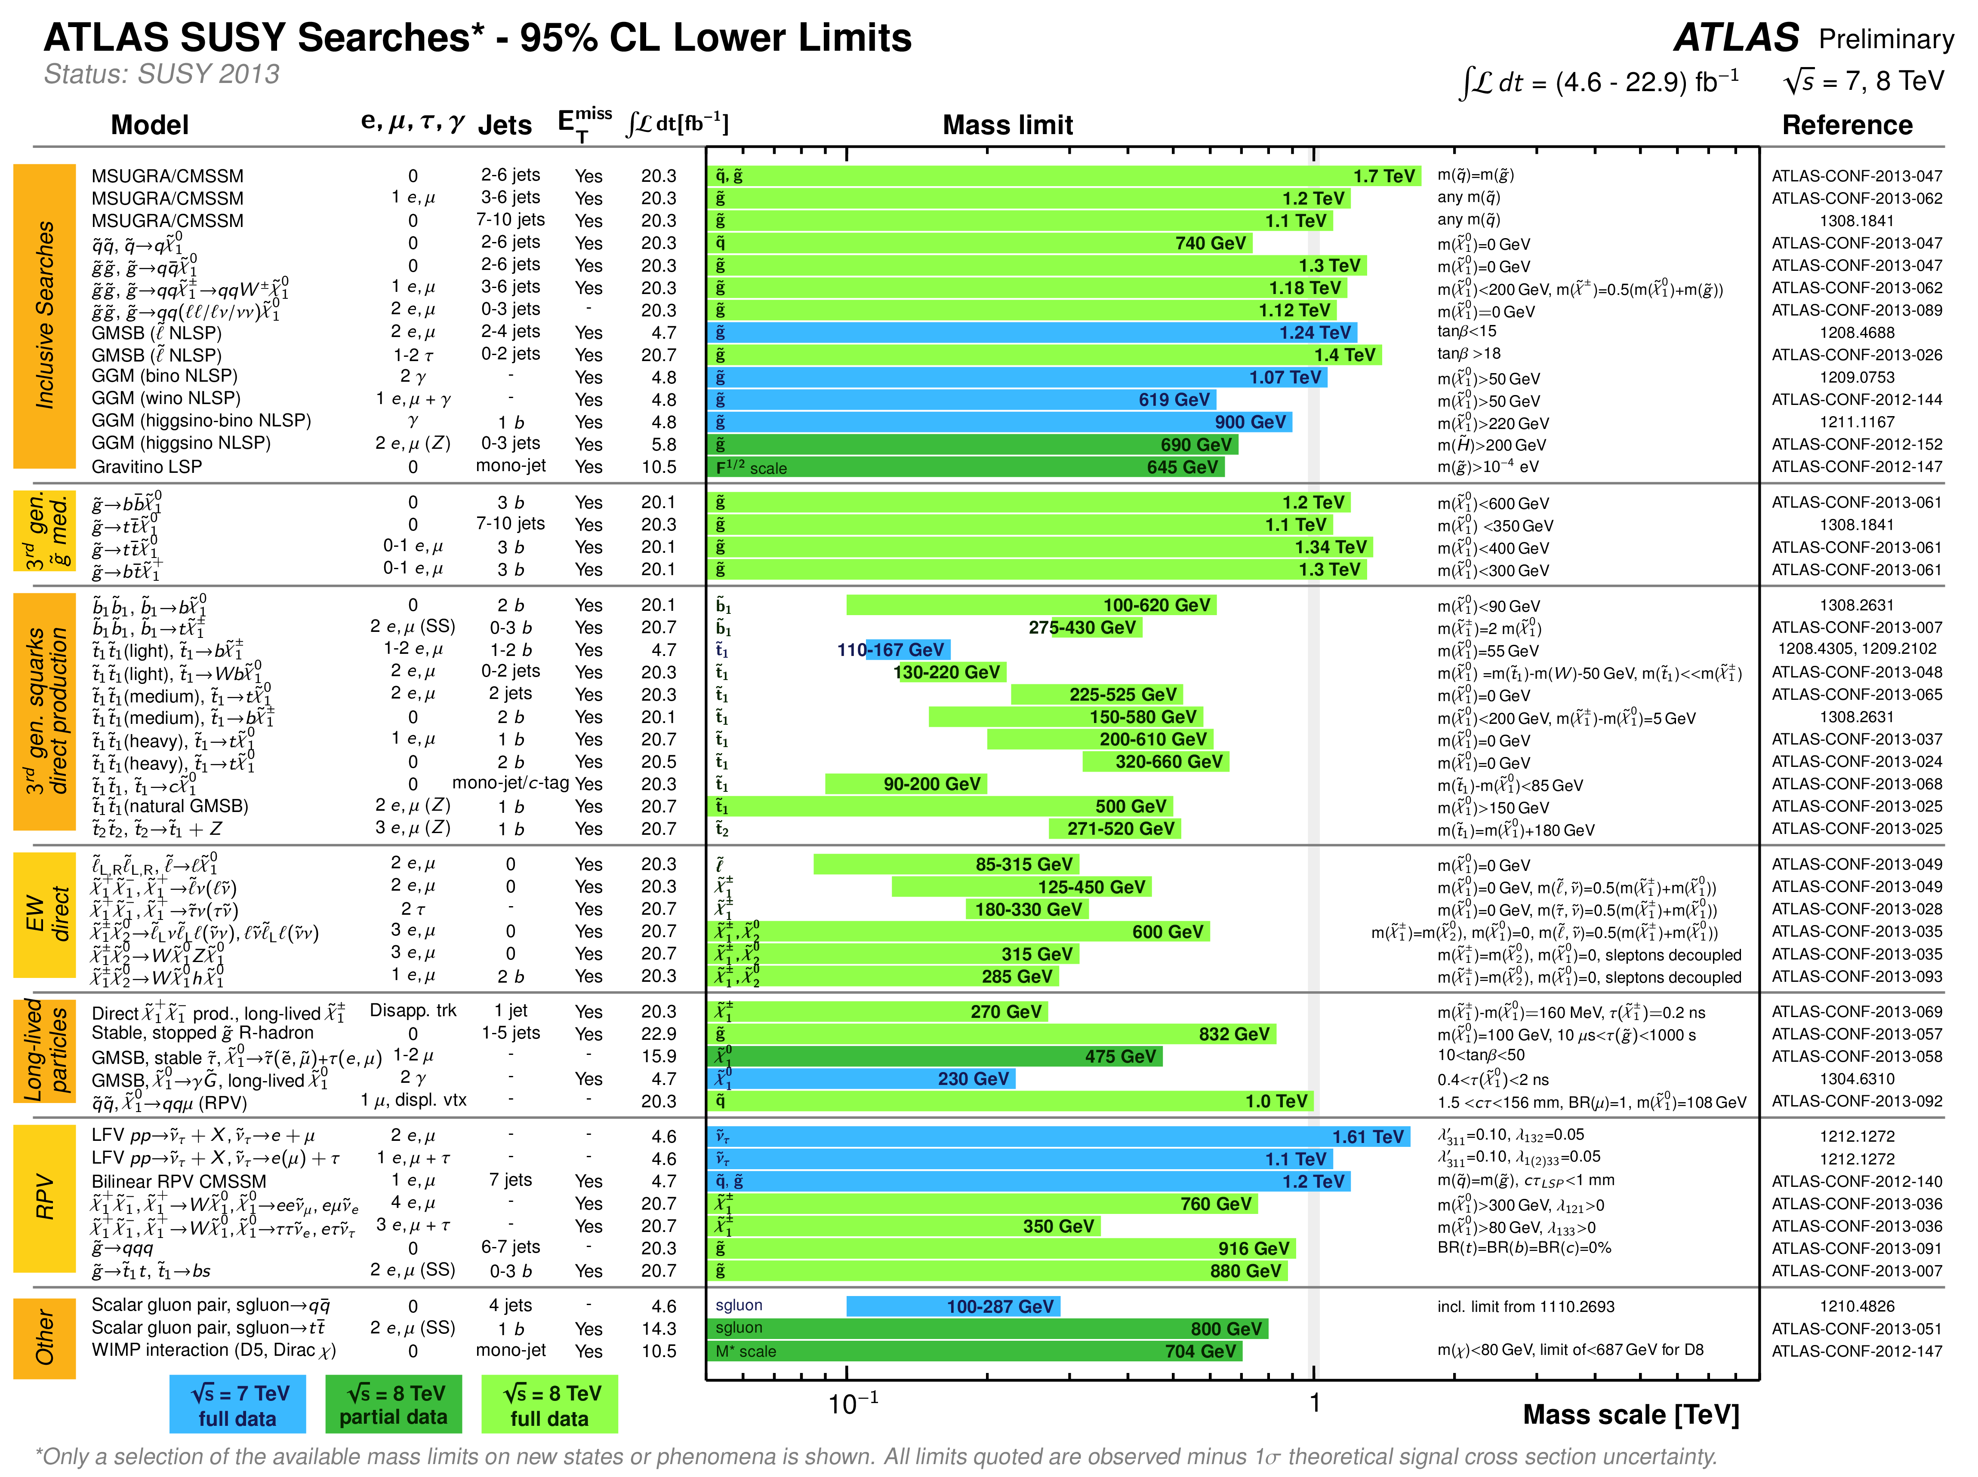
SUSY Searches: ATLAS Summary

Slide 21
Complementarity between
Hadron and Lepton Colliders

Slide 22
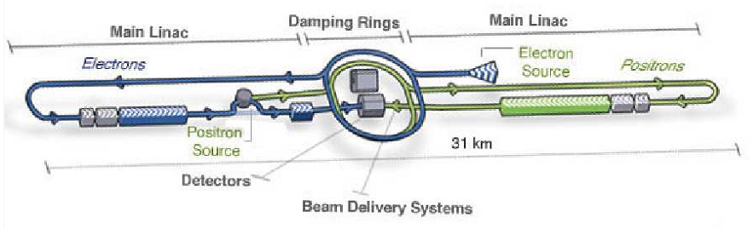
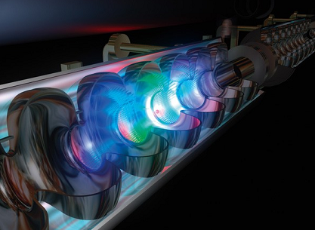
Main Features
structures the beam bunches
Advantages:
Very clean and flexible environment:
tuneable E:
polarized beams:
low rate: 15-30 kHz
sensitivity to virtual effects
Drawbacks:
large γγ background (0.1 evt / bunch X)
  10% evts w/
  monitor accolinearity of Bhabha’s
  to estimate
accelarating niobium cavities
(Phase I: ~500 fb⁻¹)
(Upgrade → Phase II)

Slide 23
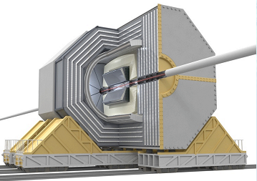
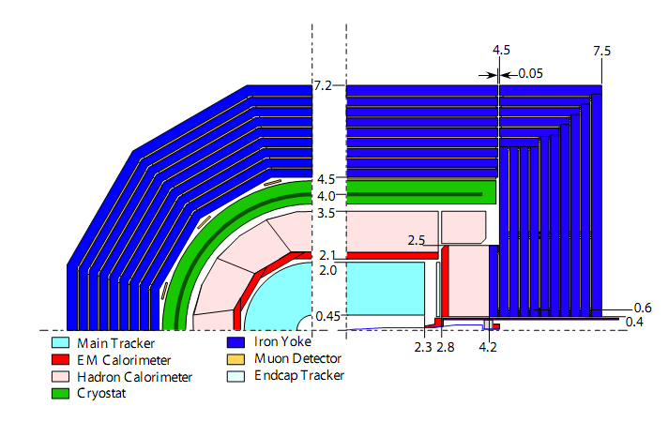
Detector Concepts
Global Detector Concept
B=3.5 T
« Triggerless Mode » Collider:
Low rate enables:
  No hardware trigger
  Just a software-based
  trigger for loose filtering
Typical Requirements:
Inner Tracking:
  Vertex Detector:
  Outer Tracking:
Calorimetry:
  EM:
  Jets:

Slide 24
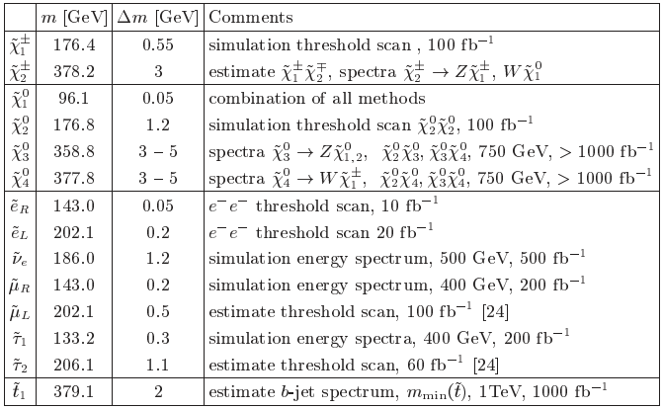
SUSY Measurements

Slide 25
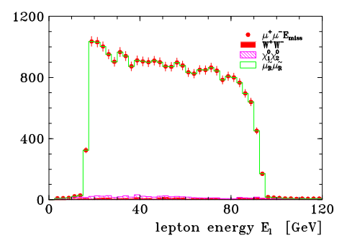
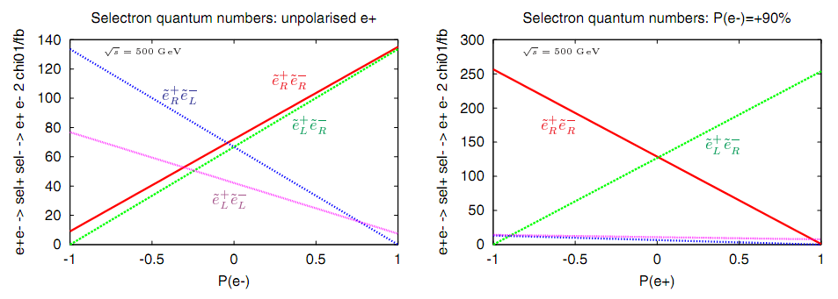
Thresholds & Edges Measurements
L=200 fb⁻¹
Beam Polarization

Slide 26
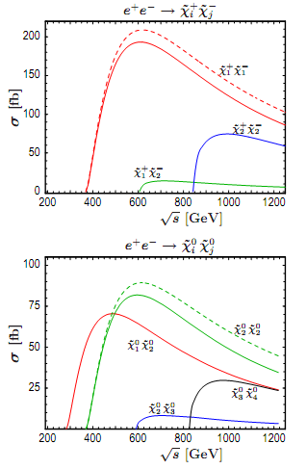
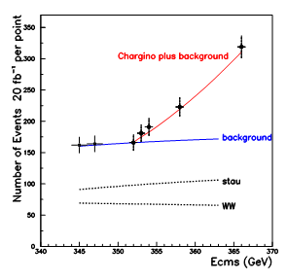
Threshold Scans
Sharp production thresholds =>
E scan gives good sensitivity M(FS)
L=100 fb⁻¹

Slide 27
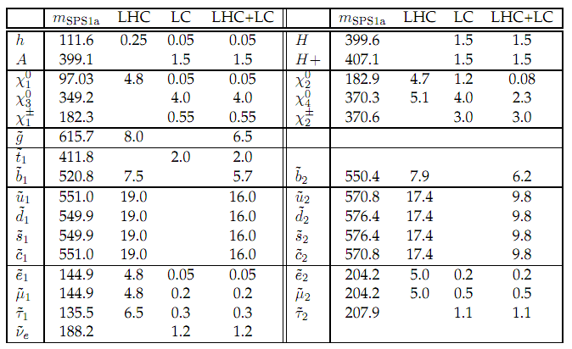
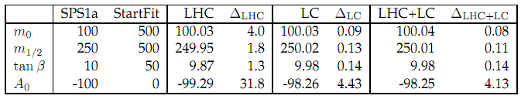
mSUGRA Fit
SFitter

Slide 28
4. One Example of Indirect
SUSY Search at Collider

Slide 29
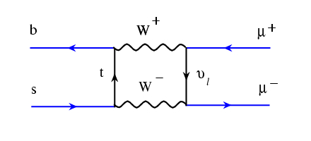
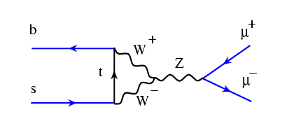
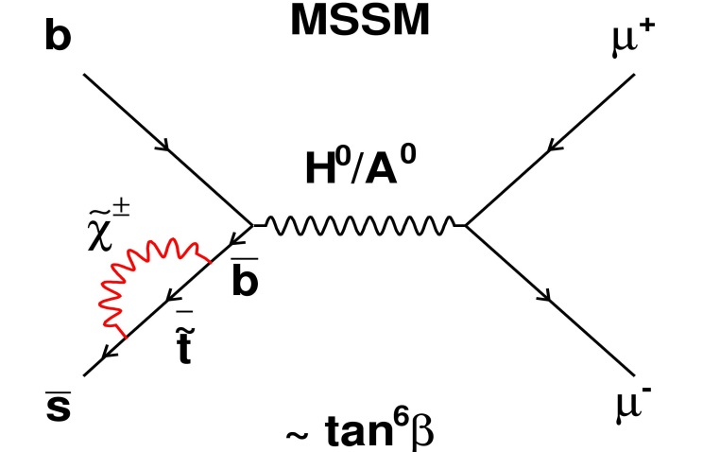
B_{s}→μ⁺μ⁻ (1)
In SM B_{s}→μ⁺μ⁻ is suppressed (need FCNC)
  SM predicts
SUSY can enhance BR by 1 order of magnitude
Ref: M. Blanke et al., JHEP 0610 (2006) 003
A key early measurement for LHC

Slide 30
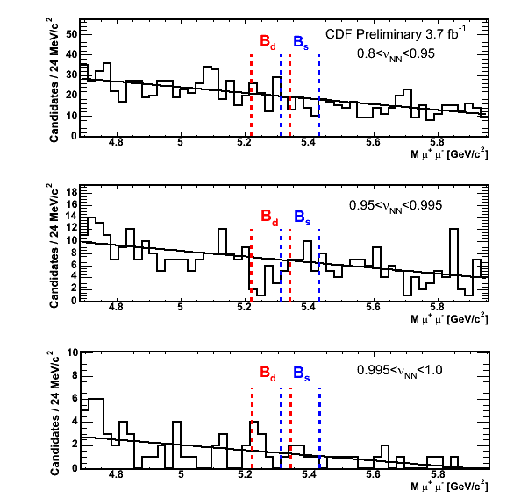
B_{s}→μ⁺μ⁻ (2)
CDF Result: No excess seen
L=3.7 fb⁻¹
Aug 2009
D0 Result: No excess seen
L=6.1 fb⁻¹
Jun 2010

Slide 31
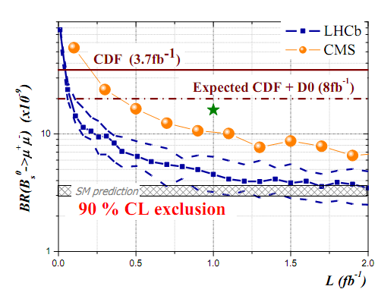
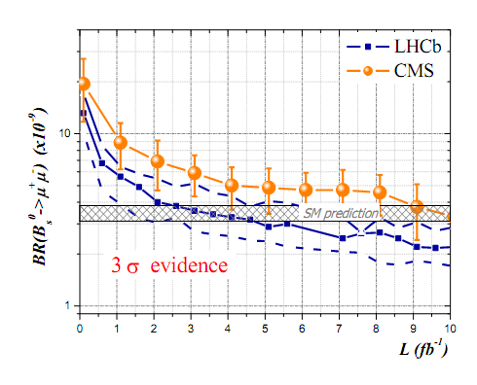
B_{s}→μ⁺μ⁻ (3)
ATLAS & CMS:
  |η_{μ}|<2.5, L=10³²⁻³³ cm⁻²s⁻¹
  Single & di-muon triggers
LHCb:
  1.9<|η_{μ}|<2.5, L=2x10³² cm⁻²s⁻¹
  Low p_{T} trigger (sensitivity to σ_{bb} 2.3 larger than ATLAS & CMS)
Evt Selection:
  based upon several variables, including M_{μμ}
  mass resolutions: 90 MeV (ATLAS), 53 MeV (CMS), 22 MeV (LHCb)
CMS: 1fb⁻¹ (incl. syst.)

Slide 32
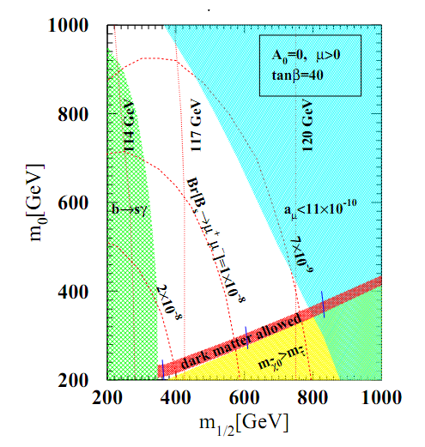
B_{s}→μ⁺μ⁻ (4)

Slide 33
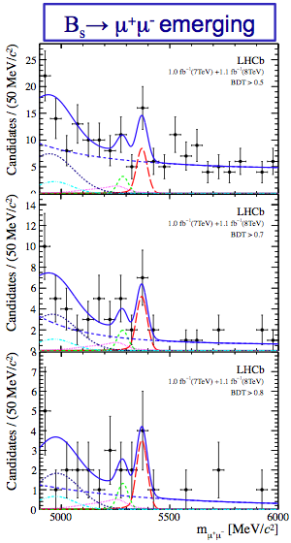
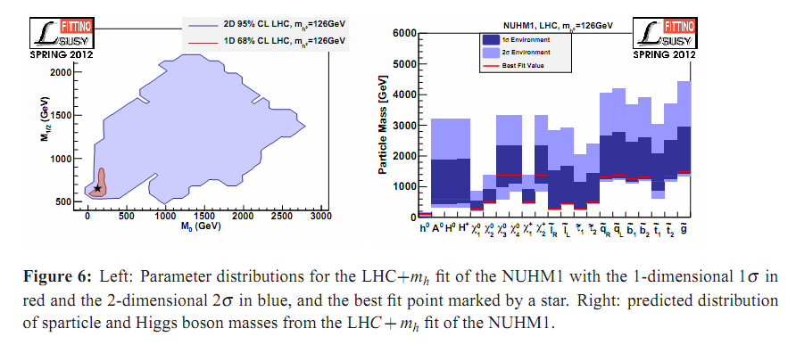
B_{s}→μ⁺μ⁻ (5)
- Epilogue -
LHCb: Finally observed this rare DK mode!
  2011 & 2012 Datasets:
    resp. 1.0 & 1.1 fb⁻¹
    resp. 7 TeV & 8 TeV
Fittino:

Slide 34
5. One Example of
Non-Collider SUSY Search

Slide 35
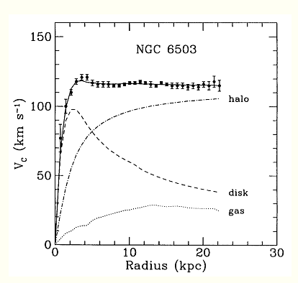
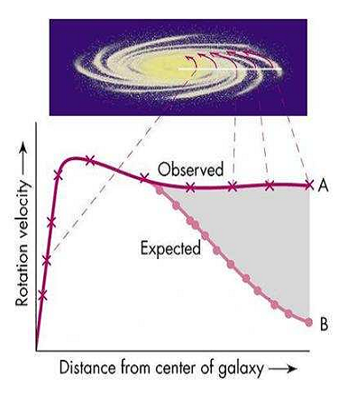

Evidence for Dark Matter
Galaxy Rotaion Curve
Spiral galaxy rotation curves are incompatible
w/ only visible matter contributions
Ref: F. Zwicky, Helv Phys Acta 6(2) (1933) 110-127
Other indications:
  Clusters and Super-Clusters (gravitational lensing, X-rays,…)
  Large Scale Structures (formation)
  …
Notes:
35

Slide 36
Main Properties of Dark Matter
Its composition cannot be explained by SM particles
Features of the « Usual Suspect »:
  Massive: compatible w/ measured Ω_{m}, « Cold Dark Matter »: β < 0.1
  No electric charge (Dark)
  No color charge (no bound states found in exotic nuclei or atoms)
  Only interactions: Weak & Gravitational
  So-called WIMP: « Weakly Interacting Massive Particle »
SM Particles:
  Neutrinos:
    Hot Dark Matter (β>0.95): not suitable to explain properties of galaxies
SUSY Particles:
  Gravitino: when LSP: in general too light => Hot Dark Matter
  Sneutrino: large annihilation σ (=> mass > 500 GeV), too σ_{el}(sneutrino+N)~O(fb)
  Lightest Neutralino: ideal candidate
  or even Axion, Axino (SO(10)-inspired)
Other BSM candidates:
  LKP (ED), LTP (LH), branons, black holes,…
Notes:
36

Slide 37
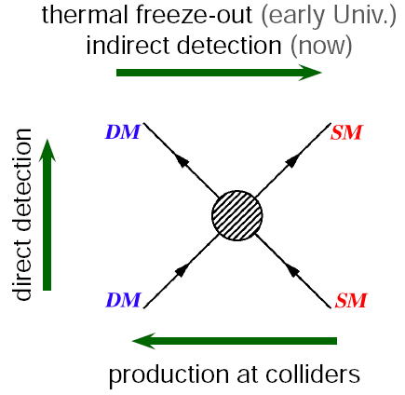
Dark Matter Searches: Two Methods
Direct Detection:
Look for DM+N interactions => nuclear recoil
Indirect Detection:
Look for SM particles (e⁻, e⁺, γ-rays, ν, p) produced through DM annihilation processes
Notes:
37

Slide 38
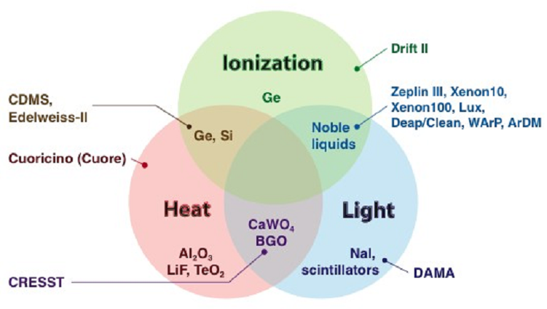
Dark Matter Searches: Direct Detection (1)
Search Hypotheses
DM forms a static halo in the galactic rest frame
  The sun rotates at 230 km/s around the galactic center
  The earth rotates at (230+/-15) km/s => annual modulation
DM elastically scatters on ordinary matter
10 GeV < m(WIMP) < 10 TeV
=> nuclear recoil E: 1-100 keV
Heat: phonons in crystaline lattice structure
Ionization: free electrons in materials
Light: scintillation in materials

Slide 39
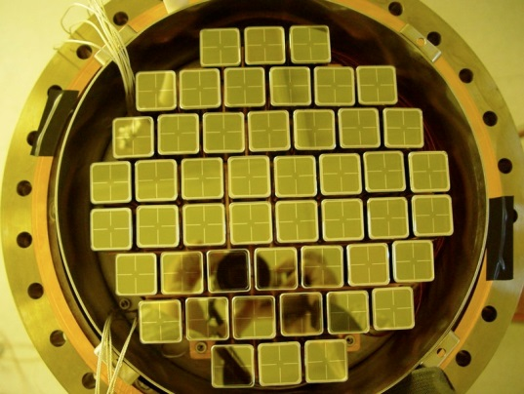
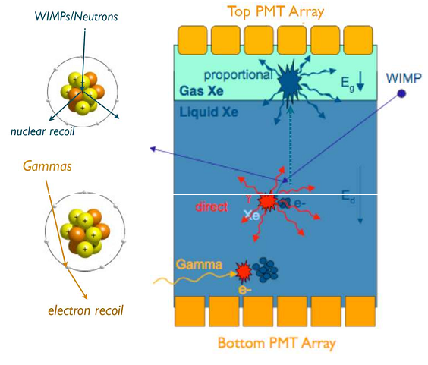


Dark Matter Searches: Direct Detection (2)
XENON-100 Experiment
Location:
  LN Gran Sasso
Detection Technique:
  dual phase Xe detector + PMTs
  prompt scintillation in liquid
  ionization => proportional scintillation in gas
  Phase I (05-07): 10 kg target mass
  Phase II (08-10): 100 kg target mass, bkgd/100
Data samples:
  190.4 kg-day
S1: scintillation
in LXe (bottom)
S2: top ionization
in GXe (top)

Slide 40

Dark Matter Searches: Direct Detection (3)
XENON-100 Results

Slide 41
6. Putting Together
Constraints on SUSY

Slide 42

SUSY Global Fits (1)
Versions of SUSY filts that include the non-accelerator constraints

Slide 43

SUSY Global Fits (2)

Slide 44

SUSY Global Fits (3)
Tools: http://www.cern.ch/matsercode

Slide 45

SUSY Global Fits (4)

Slide 46


SUSY Global Fits (5)

Slide 47


SUSY Global Fits (6)

Slide 48
BACK-UP

