Slide 1
SCT DAQ
Bruce Gallop
RAL
+ many others

Slide 2
What we need to do
Get ready for run 2
  Expanded ROD DAQ
    90 to 128 RODs for high trigger and high pileup
  Run smoothly
    Monitor and mitigate/recover from potential errors
    Calibration

Slide 3
Barrel fibres remapping
Remap Txs to RODs to even out load
Installed in crates
Cross check mappings using PIN currents
Bad pin in crate 3 (previously unused)
  Replace crate
Minimal movement (keep tower mapping)
Mapping to ROS is flexible
  Originally proposed 3 ROSs per half (11 per ROS)
  Could use ROD crate -> ROS (16 per ROS)

Slide 4
Endcap fibre mappings
Barrel was straight forward
  4 barrels -> 4 different link occupancies
Endcap more difficult
  Wide variety of types with different occupancies
ROS gen-III
  16 rather than 12 links per PC
Keep current ROD crate to ROS mapping
  Don’t have to force quadrants into thirds
  Keep quadrants in half crates

Slide 5
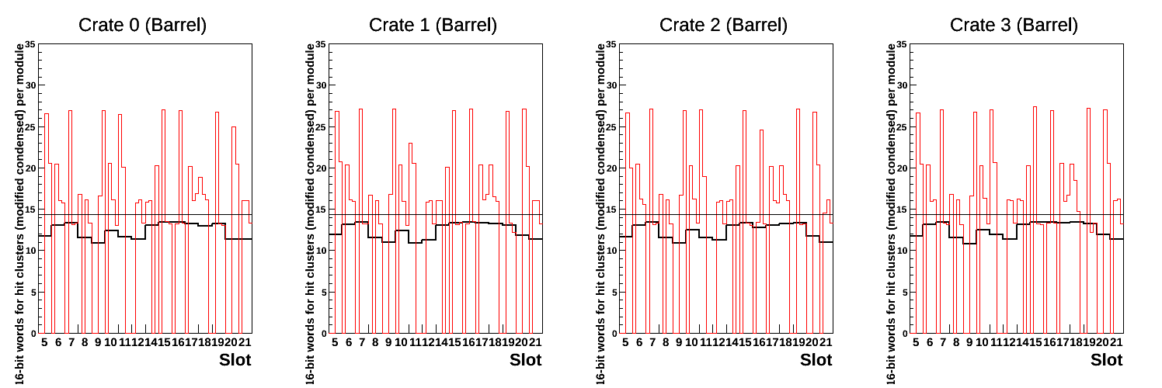
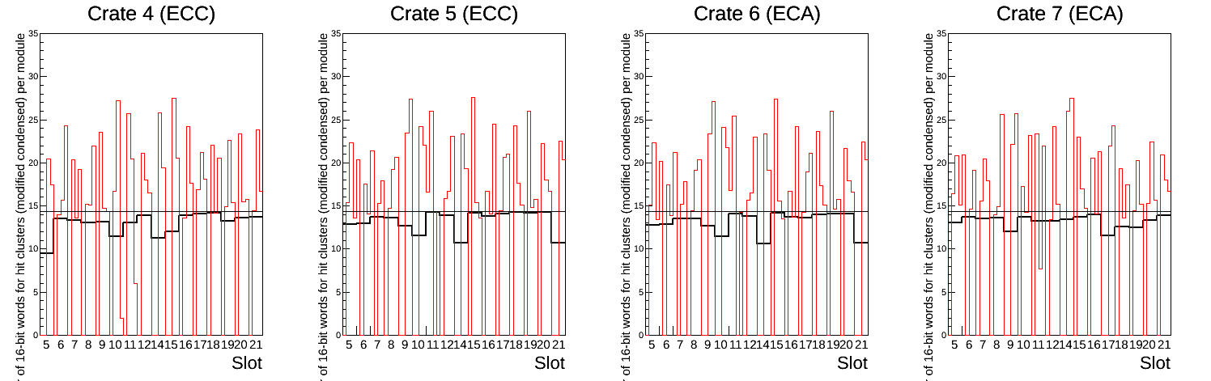
Predicted ROD data rates
14.4 words per module = limit for 90% occupancy at 100kHz

Slide 6
“External” Software
SLC5 to SLC6 migration
  Complete in Point1
  Nearly there in SR1 (“mon” machines this week)
    Also web server and DB server
tdaq-05-03-00
  Stricter run control state machine
    Barriers -> sub-states
  Fixes due to java, new gcc etc.
Mixed 32/64bit (SBCs can only be 32bit)
Will C++11 gain us anything?

Slide 7
Hardware
New Tx plugins
  Install in one crate initially
  Addition to software for new firmware
FPGA FE simulator
  Off-the-shelf FPGA dev board
  Connect to ROD via passive mezzanine
  Pretend to be 48 modules in beam conditions
  Cross-check of updated ROD firmware

Slide 8
Module recovery
Protection against SEUs
  If error from module, resend configuration
  Every ½ hour send configuration to all modules
Currently done by GUI, which won’t be needed
New process proposed to do this
  Also tidy up interaction with ECR

Slide 9
Configuration
ATLAS Conditions move to new COOL instance
This is where we store DAQ configuration
  CoraCool
Now an integrated alternative
  COOL vector payload
Take opportunity to change schema
  Preliminary version done
  Decide whether to make further improvements
    Database normalisation

Slide 10
Training
Common ID shifts
  Need to do everything from previous SCT shifts ++
  With shorter training
Continue to streamline user interface
Predict what problems might occur
Having representative system in SR1 useful
  Physics mode running is difficult to simulate

Slide 11
Summary
Good progress
  New RODs and BOCs
  Draft of new configuration schema
  Fibre mappings
Still plenty to do
  Module recovery
  ROD online monitoring
  Calibration updates
  Streamlining

