Slide 1


PROOF tests at BNL
  Sergey Panitkin, Robert Petkus, Ofer Rind
  BNL
May 28, 2008
Ann Arbor, MI

Slide 2
Outline
Hardware tests
  SSD vs HDD
PROOF clusters federation tests

Slide 3
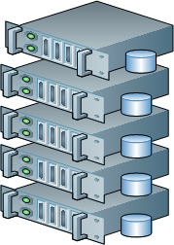
Current BNL PROOF Farm Configuration
“Old farm”-Production
40 cores: 1.8 GHz Opterons
20 TB of HDD space (10x4x500 GB)
Open for users (~14 for now)
Root 5.14 (for rel 13 compatibility)
All FDR1 AODs and DPDs available
Used as Xrootd SE by some users
Datasets in LRC (-s BNLXRDHDD1)
“New Farm” – test site
10 nodes - 16 GB RAM each
80 cores: 2.0 GHz Kentsfields
5 TB of HDD space (10x500 GB)
640 GB SSD space (10x64 GB)
Closed for users (for now)
Latest versions of root
Hardware and software tests
+

Slide 4
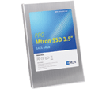
New Solid State Disks@ BNL
Model: Mtron MSP-SATA7035064
Capacity 64 GB
Average access time ~0.1 ms (typical HD ~10ms)
Sustained read ~120MB/s
Sustained write ~80 MB/s
IOPS (Sequential/ Random) 81,000/18,000
Write endurance >140 years @ 50GB write per day
MTBF 1,000,000 hours
7-bit Error Correction Code

Slide 5
Test configuration
1+1 or 1+8 nodes PROOF farm configurations
2x4 core Kentsfield CPUs per node, 16 GB RAM per node
All default settings in software and OS
Different configuration of SSD and HDD hardware depending on tests
Root 5.18.00
“PROOF Bench” suit of benchmark scripts to simulate analysis in root. Part of root distribution.
  http://root.cern.ch/twiki/bin/view/ROOT/ProofBench
  Data simulate HEP events ~1k per event
  Single ~3+ GB file per PROOF worker in this tests
Reboot before every test to avoid memory caching effects
My set of tests emulates interactive, command prompt root session
  Plot one variable, scan ~10E7 events, ala D3PD analysis
Look at read performance of I/O subsystem in PROOF context

Slide 6
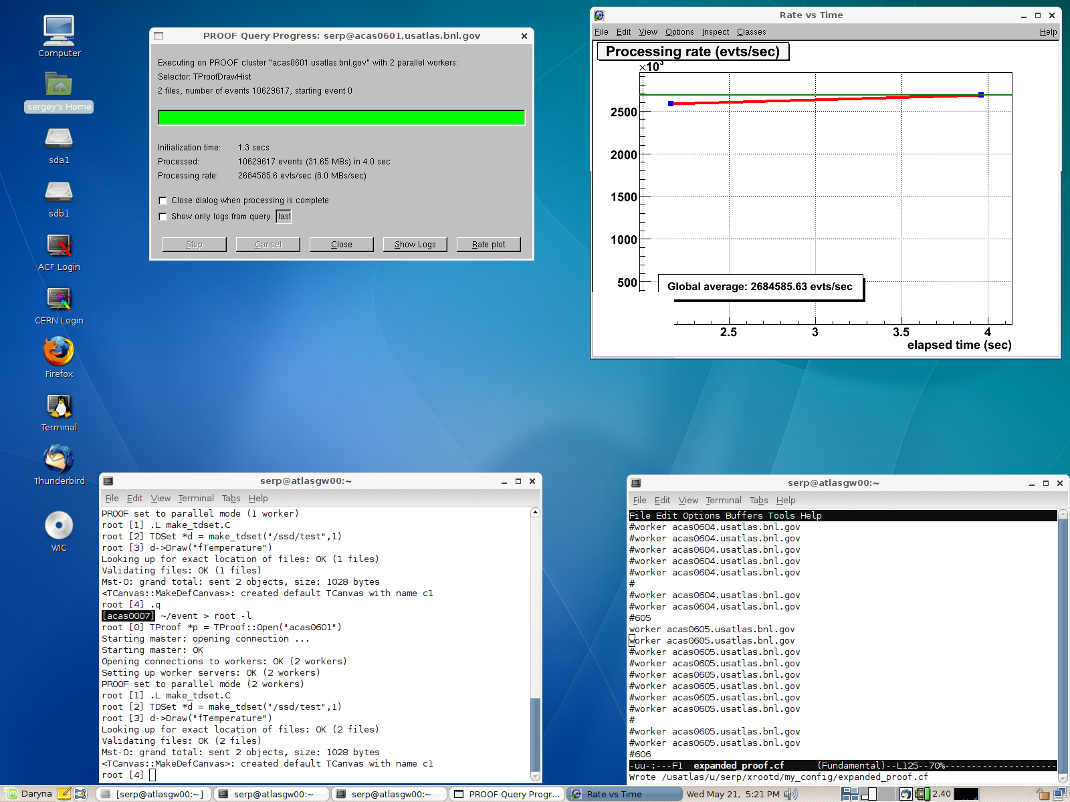
SSD Tests
Typical test session in root

Slide 7
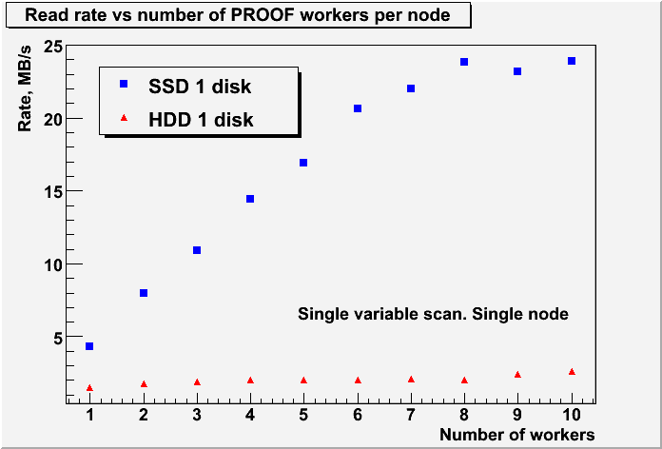
SSD vs HDD
CPU limited
SSD holds clear speed advantage
~ 10 times faster in concurrent read scenario

Slide 8
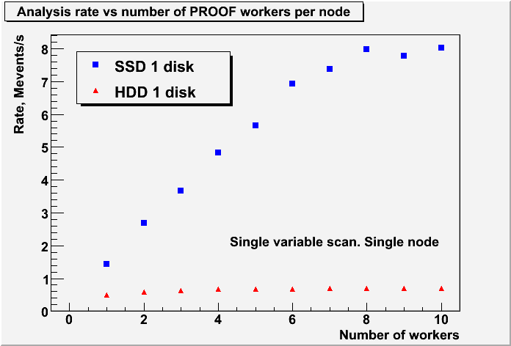
SSD vs HDD
With 1 worker : 5.3M events, 15.8 MB read out of ~3 GB of data on disk
With 8 workers: 42.5M events, 126.5 MB read out of ~24 GB of data

Slide 9
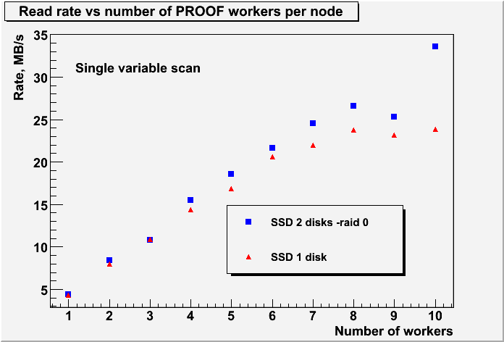
SSD: single disk vs RAID
SSD raid has minimal impact until 8 simultaneously running jobs
Behavior at 8+ workers is not explored in details yet

Slide 10
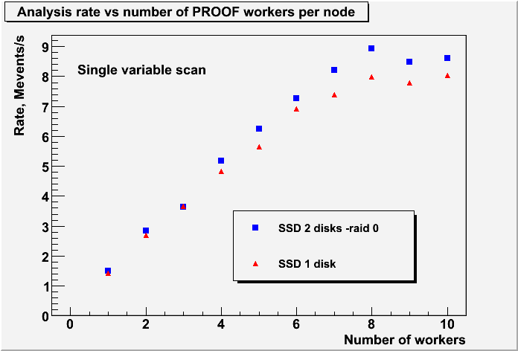
SSD: single disk vs RAID

Slide 11
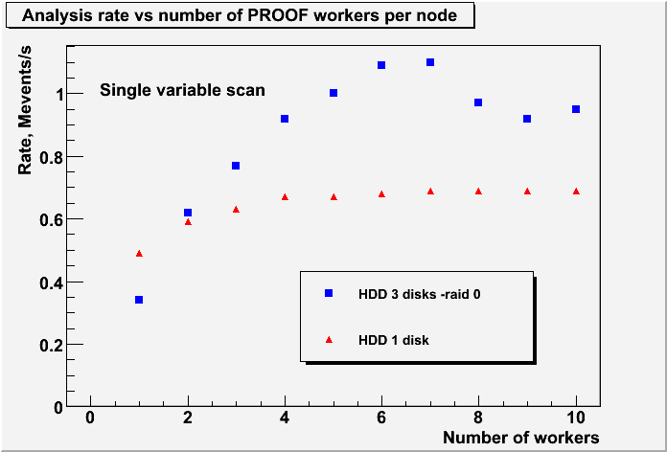
HDD single disk vs RAID
I/O limited?
I/O and CPU limited?
3x750GB disks in RAID 0 (software RAID) vs 1x500GB drive
1 disk shows rather poor scaling in this tests
3 disk raid supports 6 workers?

Slide 12
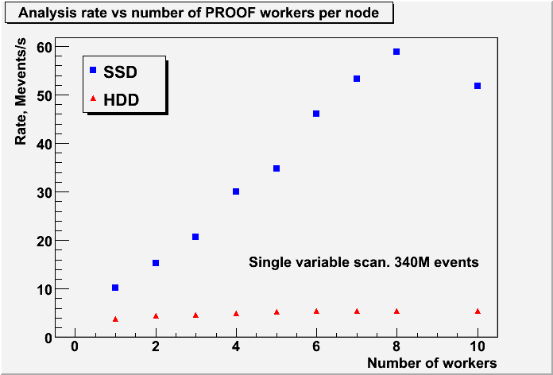
SSD vs HDD. 8 node farm
Aggregate (8 node farm) analysis rate as a function of number of workers per node
Almost linear scaling with number of nodes

Slide 13
Discussion
The main issue, in PROOF context, is to match I/O demand and supply
Some observations from our tests (current and previous)
  Scan of a single variable in root generates ~4 MB/s read load per worker
  One SATA HDD can sustain ~2-3 PROOF workers
  HDD raid array can sustain ~2xN workers (N –number of disks in array)
  One Mtron SSD can sustain ~8 workers
8 core machine with 1 HDD makes little sense in PROOF context. Unless you will feed PROOF jobs with data from external SE (dCache, NFS disk vault, etc)
Solid State Disks (SSD) are ideal for PROOF (our future?).
We plan to continue tests with more realistic loads
  ARA on AODs and DPDs
  Full PROOF bench tests
  RAID and OS optimization, etc
Main issue with SSD is size -> efficient data management is needed!

Slide 14
PROOF Cluster federation tests
In principle Xrootd/PROOF design supports federation of geographically distributed clusters
  Setup instructions at: http://root.cern.ch/twiki/bin/view/ROOT/XpdMultiMaster
Interesting capability for T3 applications
  Pool together distributed local resources: disk, CPU
  Relatively easy to implement:
    Requires only configuration files changes
    Can have different configurations
  Transparent for users
    Single “name space” – may require some planning
    Single entry point for analysis
New and untested capability

Slide 15
PROOF Cluster federation tests
We could not run federation tests in root 5.18.00 – queries crashed
Bug in filename matching during file validation was identified during visit of primary PROOF developer (Gerri Ganis) to BNL in April.
New patched version of root is available at CERN (5.18.00d) since last week (May 21).
We successfully configured and tested 2 sub-domain federation at BNL
All that is required for the test is modified Xrootd/PROOF configuration files (and Xrootd/PROOF daemon restart)

Slide 16
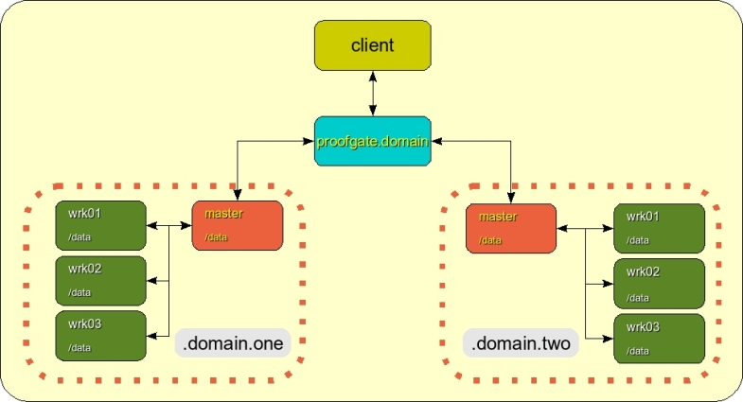
Federated PROOF Clusters
Our test configuration:
1 super-master
2 sub-masters with 3 worker nodes each

Slide 17
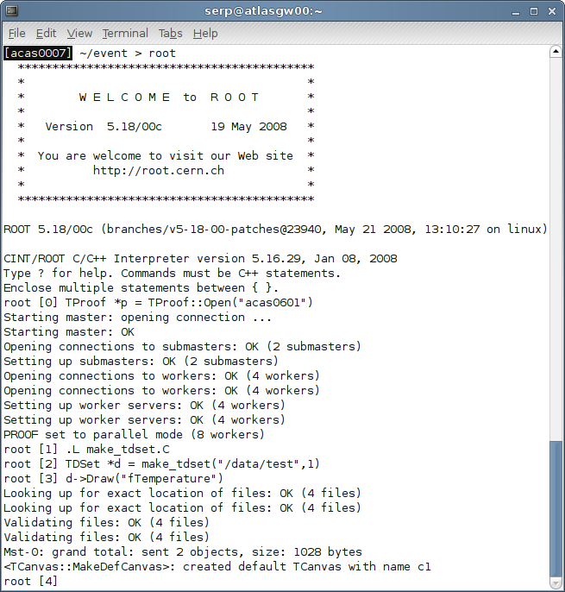
Multi-cluster root session I

Slide 18
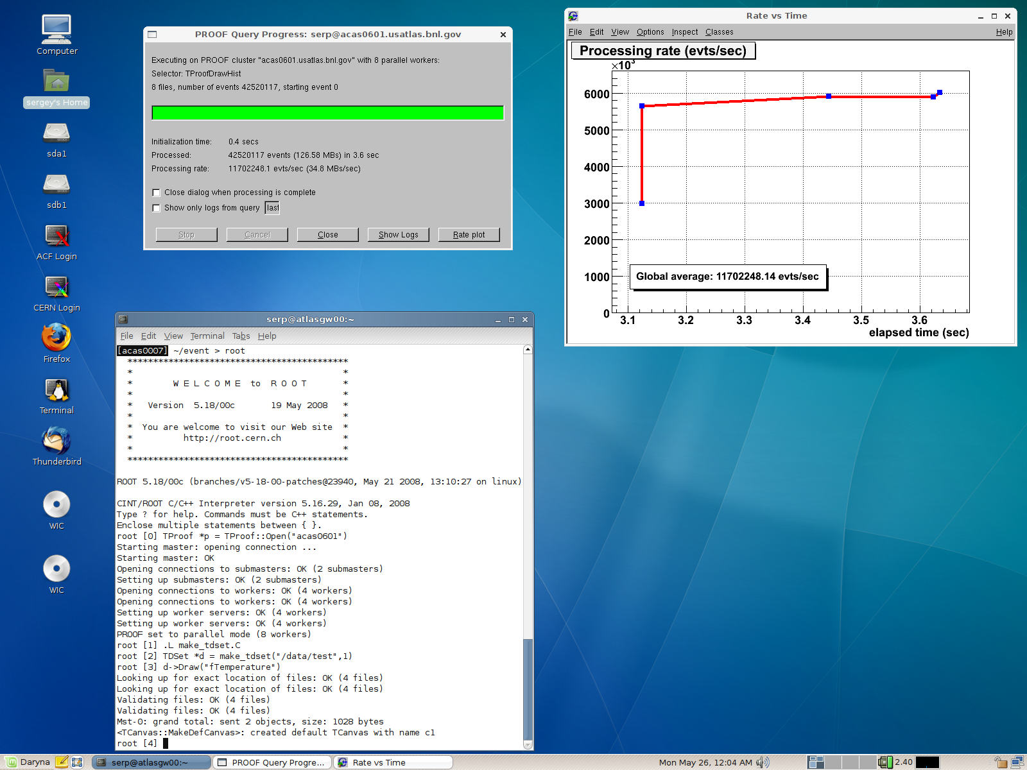
Multi-cluster root session II

Slide 19
Summary and Plans
SSD offer significant performance advantage in concurrent analysis environment
~x10 better read performance than HDD in our test
We successfully tested PROOF cluster federation
We plan to expand our hardware tests with more use cases
SSD integration in PROOF will require understanding data management issues involved
We will test PROOF federation with Wisconsin T3 to explore issues of:
  Performance
  Name space integration
  Security

