Slide 1






Engagement
Tasks
Engage stakeholders
Raise awareness
Organise meetings
Promote Research & Innovation
Build community network
Collaboration to Clarify the
Costs of
Curation
Assessment
Tasks
Assess cost models & strategies
Examine good practice
Analyse requirements
Integrate components
Produce guidance & briefing materials
Setup costs exchange
Networking & Coordination
Outputs
Events, Workshops, Meetings & Reports
Affiliate Partners & Stakeholders
Reports for General Dissemination
Curation Costs
Exchange
Enhancement
Tasks
Examine and refine related concepts
Value
Risk
Benefits
Sustainability
Economic Reference Model
Project Coordination
Tasks
Project meetings
Project reporting
EC liaison
Budget oversight
Outputs QA
Reports for European Commission
Submission of Roadmap to the EC

Slide 2


Collaboration to Clarify the Costs of Curation
Possible steps for CCEx input routine ...?
In one big chunk
COSTS DATA DEPOSIT
Why should I deposit?
How will my data be used?
How do I deposit data?
Please describe your organisation
In whatever way you have it broken down
Using the 4C suggested structure
Cost Concept Model
If you can’t list the benefits or are unsure about why you are doing curation – you might get ideas or guidance from the ESRM questionnaire!
Can you list the benefits you realise from your investment in digital curation?
Which indirect economic determinants are most relevant to your organisation?

Slide 3
Curation Cost Exchange
Access to increasing levels of detail and attribution
At the end of the project we could setup the access levels as below ... In the meantime we want barriers to deposit as low as possible
The data trustee
Structured data submitter
CCEx Admin
Login required
Partner
Member
User
Lurker
CCEx levels of engagement / ownership

Slide 4
Curation Cost Exchange Roles
All data is presented as anonymised
Lurker - Someone who just browses the top level of the CCEx and doesn’t interact. The only trace we will have is a page view statistic
User - Someone who actively uses the CCEx and associated pages, downloads reports, drills down into resources, uses the forum or the comments function to join the discussion. We will get statistics and commentary about the CCEx
LOGIN Required
Member - Someone who registers to use the CCEx and wants to really engage with the data in the CCEx. This will assume that they have either detailed comments or some data of their own - possibly estimated, ordinal, chunked, unstructured and/or non-financial (e.g. processual, effort or ratio information) that they may be able to submit to the CCEX
Some data is presented as attributed by agreement with depositors
Partner - Someone who wants to fully engage with the CCEx and is prepared to spend time and resources supplying structured or researched data for inclusion into the exchange. They may wish to have brokered exchanges of information with other CCEx partner organisations and should be prepared to update their data from time to time.
All data is visible
CCEx Admin – The project group who have access to the CCEx back end and can identify all the sources of data and the confidentiality conditions under which it was deposited

Slide 5
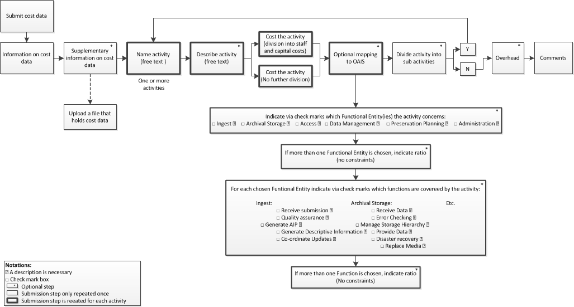
Collaboration to Clarify the Costs of Curation
Curation Costs Exchange - workflow

Slide 6
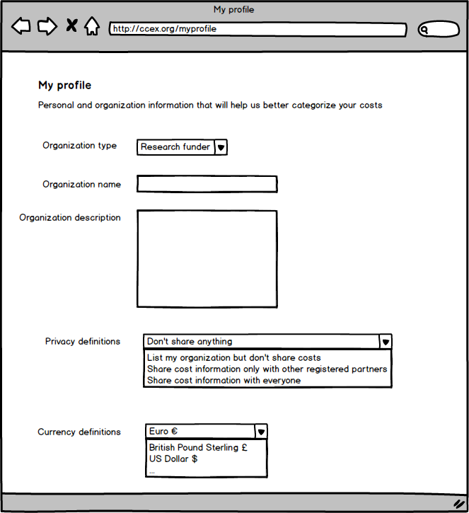
Collaboration to Clarify the Costs of Curation

Slide 7
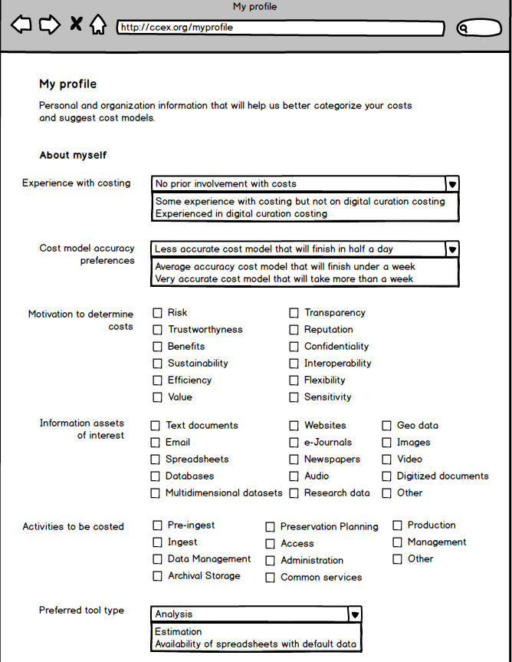
Collaboration to Clarify the Costs of Curation

Slide 8
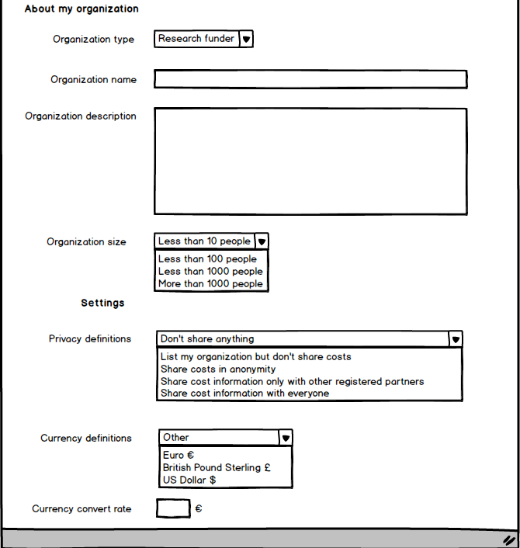
Collaboration to Clarify the Costs of Curation

Slide 9
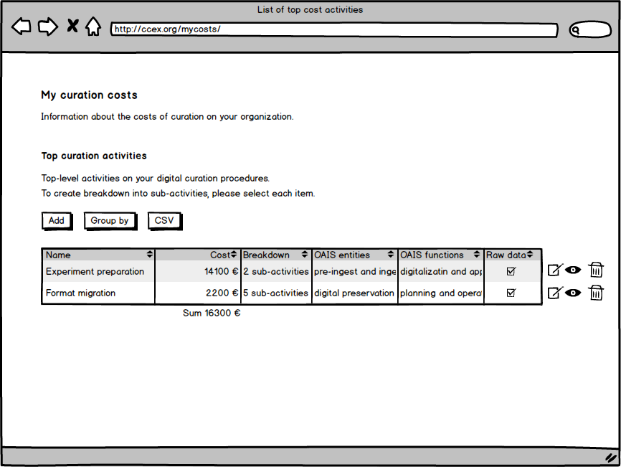
Collaboration to Clarify the Costs of Curation

Slide 10
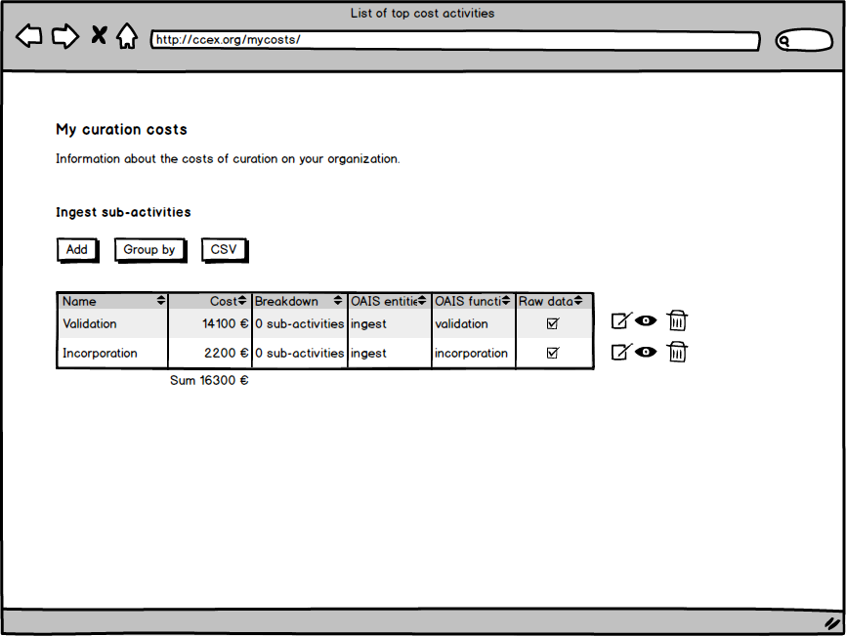
Collaboration to Clarify the Costs of Curation

Slide 11
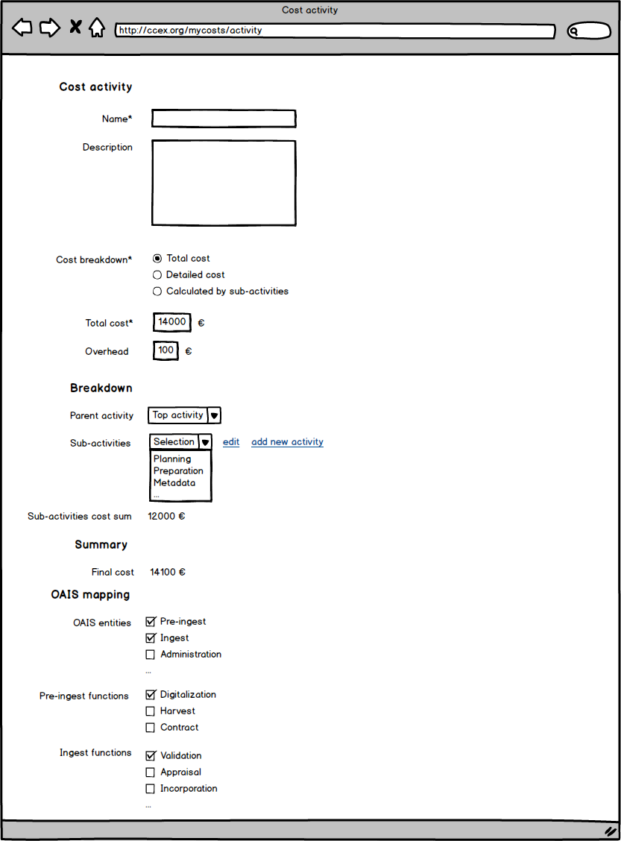
Collaboration to Clarify the Costs of Curation

Slide 12

Collaboration to Clarify the Costs of Curation

Slide 13
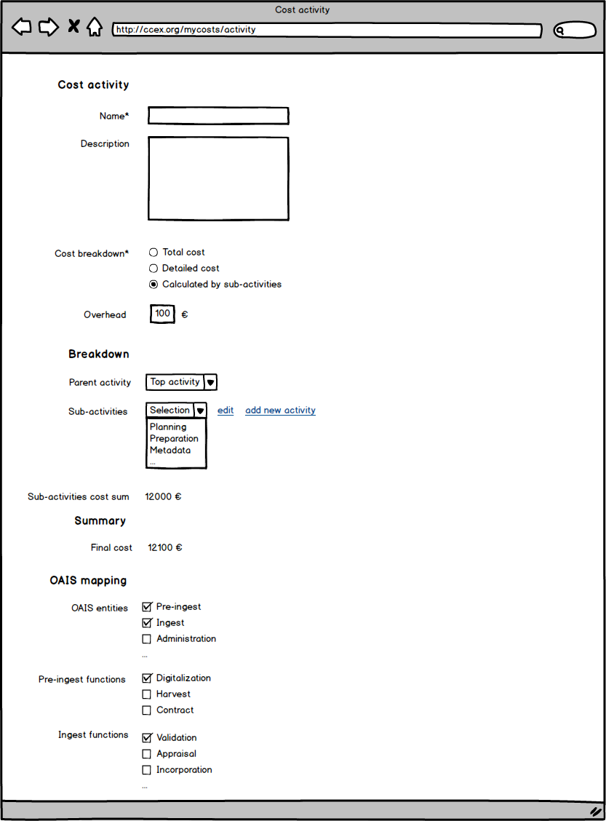
Collaboration to Clarify the Costs of Curation

Slide 14
Collaboration to Clarify the Costs of Curation
http://4c.keep.pt/ccex/index.php/my-curation-costs

