Slide 1
The Objectivity migration
(and some more recent experience with Oracle)
Andrea Valassi
(CERN IT-SDC)
DPHEP Full Costs of Curation Workshop
CERN, 13th January 2014

Slide 2
Outline – past and present experiences
Objectivity to Oracle migration in pre-LHC era (2004)
  COMPASS and HARP experiments – event and conditions data
    Preserving (moving) the bits and the software
Oracle conditions databases at LHC (2005-present)
  ATLAS, CMS and LHCb experiments – CORAL and COOL software
  What would it take to do data preservation using another database?
    Preserving (moving) the bits and the software
  Operational “continuous maintenance” experience
    Preserving (upgrading) the software and the tools
Conclusions

Slide 3
COMPASS and HARP
Objectivity to Oracle migration (2004)

Slide 4
Objectivity migration – overview
Main motivation: end of support for Objectivity at CERN
  The end of the object database days at CERN (July 2003)
  The use of relational databases (e.g. Oracle) to store physics data has become pervasive in the experiments since the Objectivity migration
A triple migration!
  Data format and software conversion from Objectivity to Oracle
  Physical media migration from StorageTek 9940A to 9940B tapes
Two experiments – many software packages and data sets
  COMPASS raw event data (300 TB)
    Data taking continued after the migration, using the new Oracle software
  HARP raw event data (30 TB), event collections and conditions data
    Data taking stopped in 2002, no need to port event writing infrastructure
  In both cases, the migration was during the “lifetime” of the experiment
  System integration tests validating read-back from the new storage

Slide 5
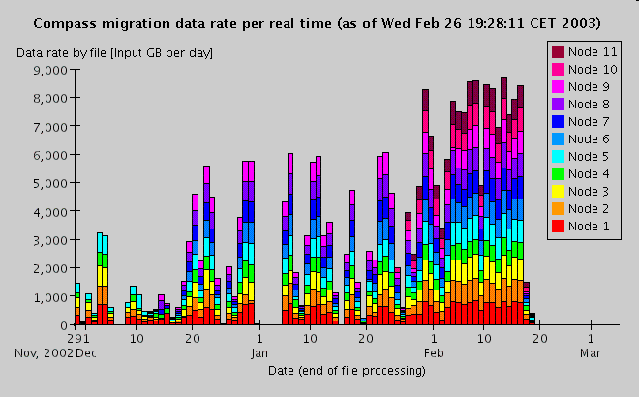
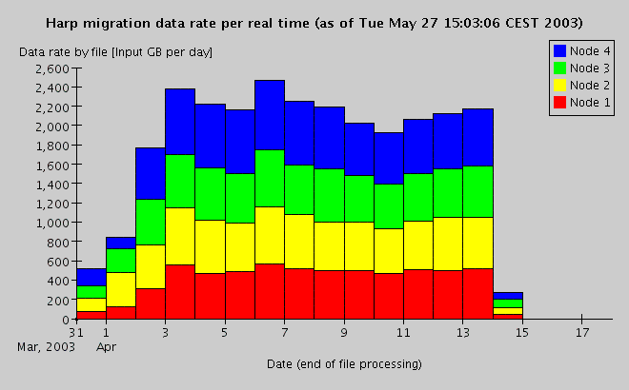
Migration history and cost overview
COMPASS and HARP raw event data migration
  Mar2002 to Apr2003: ~2 FTEs (spread over 5 people) for 14 months
  Dec2002 to Feb2003: COMPASS 300TB, using 11 nodes for 3 months (and proportional numbers of Castor input/output pools and tape drives)
  Feb2003: COMPASS software/system validation before data taking
  Apr2003: HARP 30 TB, using 4 nodes for two weeks (more efficiently)
HARP event collection and conditions data migration
  May2003 to Jan2004: ~0.6 FTE (60% of one person) for 9 months
  Collections: 6 months (most complex data model in spite of low volume)
  Conditions: 1 month (fastest phase, thanks to abstraction layers…)
  Jan2004: HARP software/system validation for data analysis
COMPASS
3 months, 11 nodes
Integrated on nodes:
- 100 MB/s peak
- 2k events/s peak
HARP
2 weeks, 4 nodes

Slide 6
Raw events – old and new data model
COMPASS and HARP used the same model in Objectivity
  Raw data for one event encapsulated as a binary large object (BLOB)
    Streamed using the “DATE” format - independent of Objectivity
    Events are in one file per run (COMPASS: 200k files in 4k CASTOR tapes)
  Objectivity ‘federation’ (metadata of database files) permanently on disk
Migrate both experiments to the same ‘hybrid’ model
  Move raw event BLOB records to flat files in CASTOR
    BLOBs are black boxes – no need to decode and re-encode DATE format
    No obvious advantage in storing BLOBs in Oracle instead
  Move BLOB metadata to Oracle database (file offset and size)
    Large partitioned tables (COMPASS: 6x10⁹ event records)
/castor/xxx/Run12345.raw
……..………………..……xxxxxxxxxxxxxxxxxxxxxxxxx…………..………………….……….……xxxxxxxxxxxxxxxxxxxxxxxxxxx..………………………….………..

Slide 7
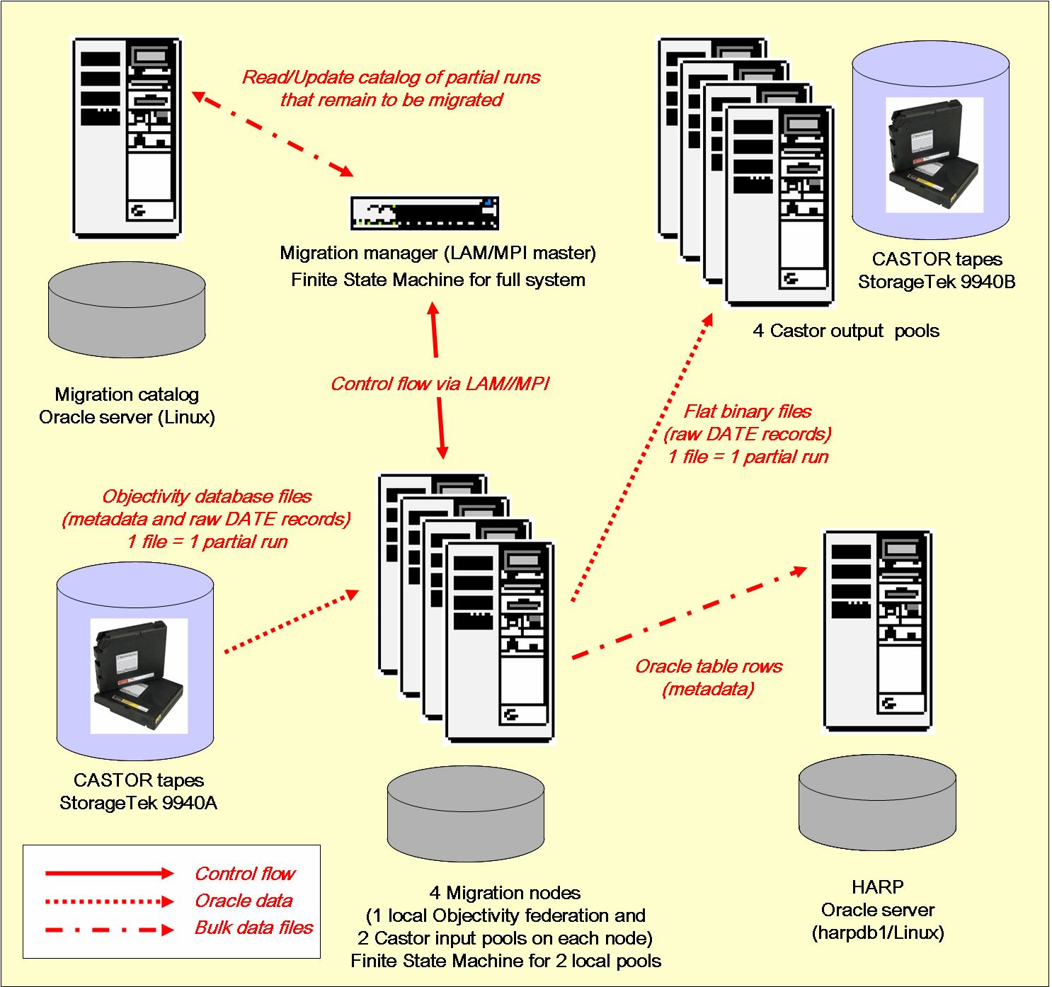
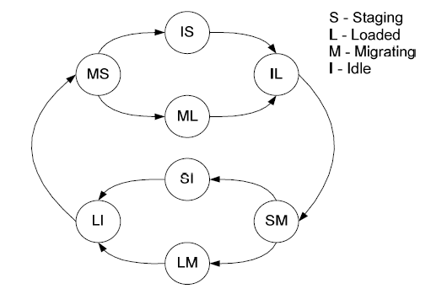
Raw events – migration infrastructure
Two jobs per migration node (one staging, one migrating)
Setup to migrate the 30 TB of HARP (4 migration nodes) – a similar setup with more nodes (11) was used to migrate the 300 TB of COMPASS (@100MB/s peak)
A “large scale” migration by the standards of that time – today’s CASTOR “repack” involves much larger scales O(100PB @ 4GB/s)

Slide 8
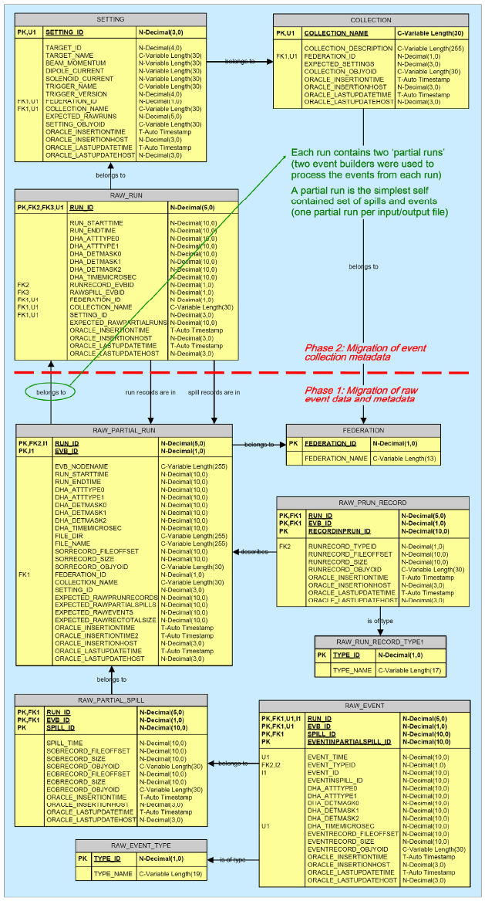
HARP event collections
Longest phase: lowest volume, but most complex data model
  Reimplementation of event navigation references in the new Oracle schema
  Reimplementation of event selection in the Oracle-based C++ software
    Exploit server-side Oracle queries
  Completely different technologies (object vs. relational database)
Re-implementing the software took much longer than moving the bits

Slide 9
HARP conditions data
Stored using technology-neutral abstract API by CERN IT
  Software for time-varying conditions data (calibration, alignment…)
  Two implementations already existed for Objectivity and Oracle
This was the fastest phase of the migration
  Abstract API decouples experiment software from storage back-end
    Almost nothing to change in the HARP software to read Oracle conditions
    Migration of the bits partly done through generic tools based on abstract API
Compare to LHC experiments using CORAL and/or COOL
  See the next few slides in the second part of this talk

Slide 10
ATLAS, CMS and LHCb conditions databases:
the CORAL and COOL software (2005-now)

Slide 11



CORAL component architecture
C++ code of LHC exp.
(DB-independent)
CORAL is used in ATLAS, CMS and LHCb in most of the client applications that access Oracle physics data
Oracle data are accessed directly on CERN DBs (or their replicas at T1 sites), or via Frontier/Squid or CoralServer
COOL
C++ API
use CORAL
directly
CORAL C++ API (technology-independent)
XMLLookupSvc
XMLAuthSvc
(CORAL Plugins)
OracleAccess
(CORAL Plugin)
FrontierAccess
(CORAL Plugin)
CoralAccess
(CORAL Plugin)
SQLiteAccess
(CORAL Plugin)
MySQLAccess
(CORAL Plugin)
MySQL C API
OCI C API
Frontier API
coral protocol
SQLite C API
OCI (password, Kerberos)
http
http
coral
coral
MySQL
DB
SQLite DB (file)
Squid
(web cache)
CORAL
proxy
(cache)
No longer used but minimally maintained
DB lookup XML
http
CORAL plugins interface to 5 back-ends
Oracle, SQLite, MySQL (commercial)
Frontier (maintained by FNAL)
CoralServer (maintained in CORAL)
Authentication XML (file)
Oracle
DB
Frontier Server (web server)
JDBC
coral
CORAL
server
OCI

Slide 12
Data preservation and abstraction layers
Conditions and other LHC physics data are stored in relational databases using software abstraction layers (CORAL and/or COOL)
  Abstract API supporting Oracle, MySQL, SQLite, Frontier back-ends
    May switch back-end without any change in the experiment software
  Same mechanism used in HARP conditions data preservation
    Objectivity and Oracle implementations of the same software API
Major technology switches with CORAL have already been possible
  ATLAS: replace Oracle direct read access by Frontier-mediated access
  ATLAS: replicate and distribute Oracle data sets using SQLite files
  LHCb: prototype Oracle conditions DB before choosing SQLite only
CORAL software decoupling could also simplify data preservation
  For instance: using SQLite, or adding support for PostgreSQL

Slide 13
Adding support for PostgreSQL?
C++ code of LHC exp.
(DB-independent)
COOL
C++ API
4
use CORAL
directly
CORAL C++ API (technology-independent)
1
PostgresAccess
(CORAL Plugin)
OracleAccess
(CORAL Plugin)
FrontierAccess
(CORAL Plugin)
CoralAccess
(CORAL Plugin)
Main changes:
1. Add PostgresAccess plugin
2. Deploy DB, copy O(2 TB) data
In addition:
3. Support Postgres in Frontier
4. Query optimization (e.g. COOL)
In a pure data preservation scenario, some of the steps above may be simple or unnecessary
Most other components should need almost no change…
Postgres C API
OCI C API
Frontier API
coral protocol
libpq
OCI
http
http
coral
coral
Oracle
DB
Squid
(web cache)
CORAL
proxy
(cache)
http
2
OCI
JDBC
Frontier Server (web server)
Postgres
DB
3
coral
JDBC
CORAL
server
libpq

Slide 14
Continuous maintenance – software
COOL and CORAL experience in these ten years
  O/S evolve: SLC3 to SLC6, drop Windows, add many MacOSX
  Architectures evolve: 32bit to 64bit (and eventually multicore)
  Compilers evolve: gcc3.2.3 to 4.8, icc11 to 13, vc7 to vc9, clang…
    Languages themselves evolve: c++11!
  Build systems evolve: scram to CMT (and eventually cmake)
  External s/w evolves: Boost 1.30 to 1.55, ROOT 4 to 6, Oracle 9i to 12c...
    API changes, functional changes, performance changes
  Need functional unit tests and experiment integration validation
    Smoother transitions if you do quality assurance all-along (e.g. Coverity)
Continuous software porting has a (continuous) cost
  O(1) FTE for CORAL/COOL alone adding up IT, PH-SFT, experiments?
  Freezing and/or virtualization is unavoidable eventually?

Slide 15
Continuous maintenance - infrastructure
CORAL: CVS to SVN migration – software and documentation
  Preserve all software tags or only the most recent versions?
    Similar choices needed for conditions data (e.g. alignment versions)
  Keep old packages? (e.g. POOL was moved just in case…)
  Any documentation cross-links to CVS are lost for good
CORAL: Savannah to JIRA migration – documentation
  Will try to preserve information – but know some cross-links will be lost
Losing information in each migration is unavoidable?
  Important to be aware of it and choose what must be kept

Slide 16
Conclusions

Slide 17
Conclusions - lessons learnt?
The daily operation of an experiment involves “data preservation”
  To preserve the bits (physical media migration)
  To preserve the bits in a readable format (data format migration)
  To preserve the ability to use the bits (software migration and upgrades)
  To preserve the expertise about the bits (documentation and tool migration)
  It is good (and largely standard) practice to have validation suites for all this
    Everyday software hygiene (QA and documentation) makes transitions smoother
Data and software migrations have a cost
  For Objectivity: several months of computing resources and manpower
  Layered approach to data storage software helps reducing these costs
Continuous maintenance of software has a cost
  Using frozen versions in virtualized environments is unavoidable?
Continuous infrastructure upgrades may result in information loss
  Watch out and keep in mind data preservation…

Slide 18
Selected references
Objectivity migration
M. Lübeck et al, MSST 2003, San Diego
http://storageconference.org/2003/presentations.html
M. Nowak et al., CHEP 2003, La Jolla
http://www.slac.stanford.edu/econf/C0303241/proc/cat_8.html
A.Valassi et al., CHEP 2004, Interlaken
http://indico.cern.ch/contributionDisplay.py?contribId=448&sessionId=24&confId=0
A.Valassi, CERN DB Developers Workshop 2005
http://indico.cern.ch/conferenceDisplay.py?confId=a044825#11
CORAL and COOL
R. Trentadue et al., CHEP 2012, Amsterdam
http://indico.cern.ch/getFile.py/access?contribId=104&sessionId=6&resId=0&materialId=paper&confId=149557
A.Valassi et al., CHEP 2013, Amsterdam
http://indico.cern.ch/contributionDisplay.py?contribId=117&sessionId=9&confId=214784

