Slide 1
Bit preservation cost outlook:
Cost for 10, 20, 30 years archive
DPHEP Topical Workshop on "Full Costs of Curation” Jan 13/14 2014
Germán Cancio
Tapes, Archives and Backup
CERN IT-DSS
German.Cancio@cern.ch

Slide 2
Overview
What is the approximate cost of a data archive over 10, 20 and 30 years?
Generic archive (not necessarily at CERN)
Start from scratch in terms of HW/media, with some initial data to be added
  Consider hardware, media, maintenance and electrical power costs
3 base scenarios
  a) 10 PB initially, growing @ 50PB / year
  b) 10 PB initially, growing @ 50PB +15% / year
  c) 100 PB initially, no further data (“stable large archive preservation”)

Slide 3
Assumptions / limitations (1)
Archive is tape based with a disk cache front-end
  Single copy of data on tape
Archived data is not compressible / deduplicable, tapes working at 100% capacity
Access patterns:
  write w/o high deletion
  read of ~30% of archive/year, high latency for non-cached data
Model based on 3 year cycles (10 cycles = 30 years)
  Corresponding to HW generations and warranty lifetime
  After each cycle, all disk cache servers and tape drives are replaced by new generation equipment
Tape media is kept for 2 cycles
  Enterprise-class equipment (IBM or Oracle, LTO discarded)
  All media repacked to higher density on second cycle
Disk cache capacity for 10% of the archive
  No replication (JBOD or RAID0)
  Disk cache used for data influx, reading, repacking
Duty cycle of 30% for both disk and tape servers
  Relevant for power consumption
Notes:
LTO discarded for lower reliability, lower density (and density evolution, cf LTO roadmap); enterprise price similar taking into account repacking

Slide 4
Assumptions / limitations (2)
Technology evolution forecast risky for 30 years
  Model assumes no architecture paradigm shift (tape/disk)
  Forecasts may hold true for 5 years, but longer-term extrapolation is risky
  Will cloud storage affect storage capacity/pricing evolution?
But, assuming similar storage capacity growth rates as over the last 30 years, archive cost becomes almost insignificant after 20 years
Example: TODAY, CERN’s 100PB archive requires 11.7K new-generation tapes (@ 8.5TB each)
With 11.7K tapes, what were we able to store in the past?
  10 years ago (2004): tape @ 200GB -> 2.4 PB -> 277 of today’s tapes
  20 years ago (1994): tape @ 20 GB -> 235 TB -> 28 “ “ “
  30 years ago (1984): tape @ 200MB -> 2.35 TB -> less than one of today’s tapes!!!

Slide 5
Assumptions / limitations (3)
Pricing mostly based on USD prices for a public US contracting alliance
  Including educational discount
Manpower costs not included
  Estimations: 1FTE (engineer) + 0.5FTE (technician) for disk; 2 FTE (engineer) + 0.5 FTE (technician) for tape
Software development / licensing costs not included
General DC operations / floor space cost not included
No assumptions on HW/media resale
  Outdated / redundant HW/media is just decommissioned
No inflation / interest rates; payments done upfront

Slide 6
Technology evolution
Assuming
  +20% yearly disk capacity per constant $
  +30% yearly tape capacity per constant $
(Note: log scale)

Slide 7
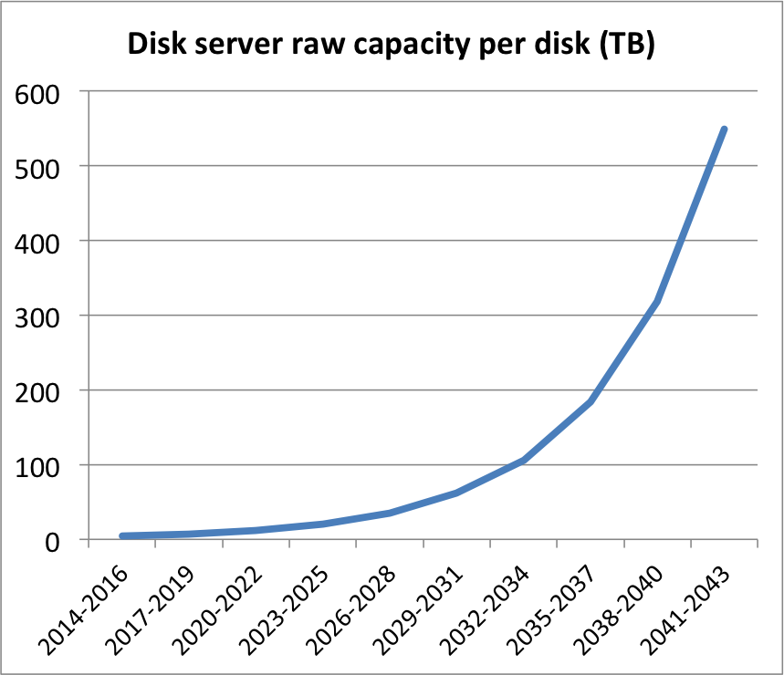
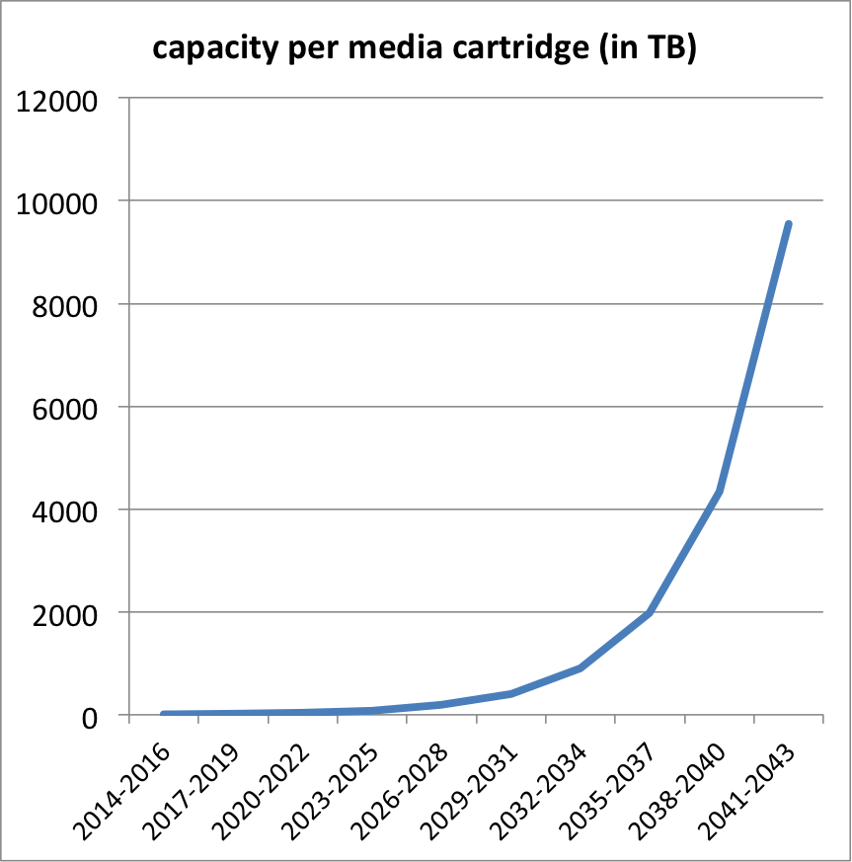
Technology evolution(2)
Assuming
  +20% yearly disk capacity per constant $
  +30% yearly tape capacity per constant $
2044: 550TB
2044: 9.5PB(!)
2034: 106TB
2034: 900TB
2014: 4TB
2024: 20TB
2014: 8TB
2024: 85TB

Slide 8
XLS spreadsheet
Available on Indico page (link)
1 tab for global parameters
1 tab for each scenario
  Including graphs (scrolling down)
Green fields == input data
Please try it out and feed back ☺

Slide 9
Global parameters
cartridge capacity growth % per year | 30% | 33% according to INSIC
cartridge capacity growth factor (3 years) | 2.20
disk capacity growth % per year | 20% | 20% approx according to CERN IT CTO
disk capacity growth factor (3 years) | 1.73
slots per tape library | 12000 | 12K - average btw Oracle, IBM, Spectralogic
cartridge / tape drive ratio (archiving access + repack + verification overhead) | 500 | 500 at CERN
Overhead factor for decommissioning libraries | 1.2 | We don't decommission libraries immediately after removing cartridges, but keep a certain overhead
Disk cache total capacity (% of data at end period) | 10% | 10% sufficient for archiving + repacking functionality
Power consumption(W) tape library | 550.00 | Oracle SL8500 excluding drives, cf http://www.oracle.com/us/products/servers-storage/sun-power-calculators/calc/sl8500--power-calculator-161830.html
Power consumption(W) tape drive at 30% load | 52.20 | Oracle T10000D
Power consumption(W) disk server at 30% load | 380.00 | estimate
Power cost per kWh | $0.14 | (cf Wikipedia - Germany prices)
Power cost per W / 3 years | $3.68

Slide 10
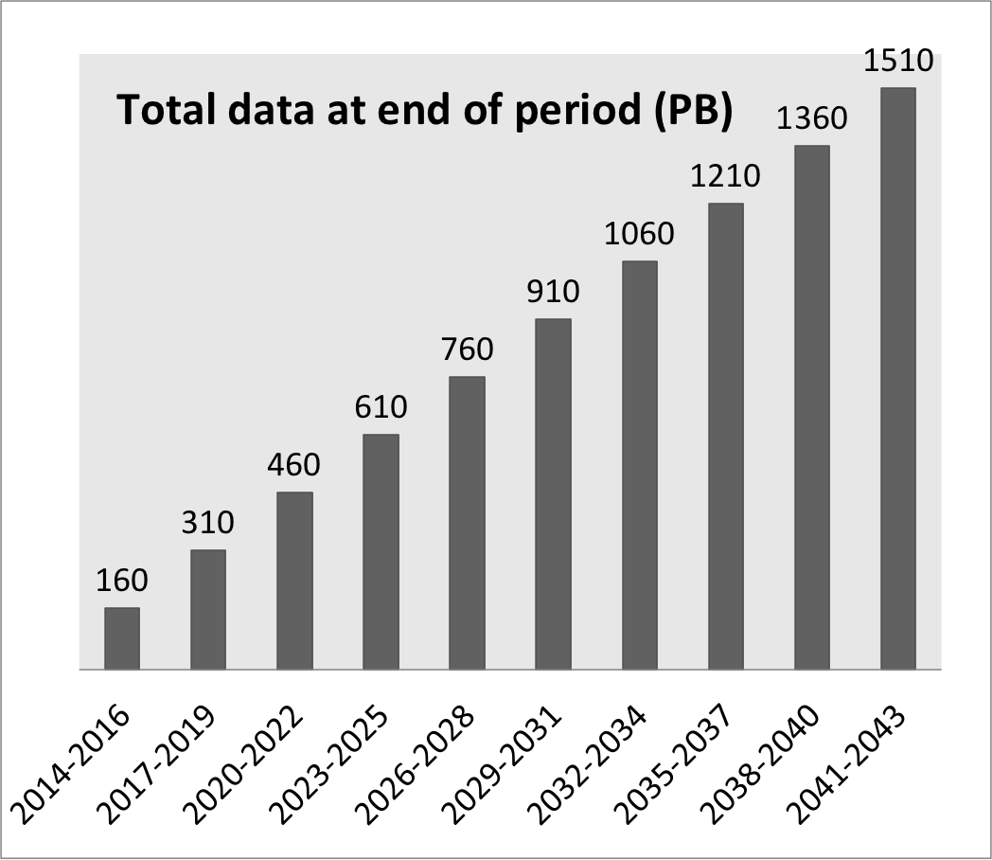
Case A) steady growth
Start with 10PB, then +50PB/year (150PB / 3y period)

Slide 11
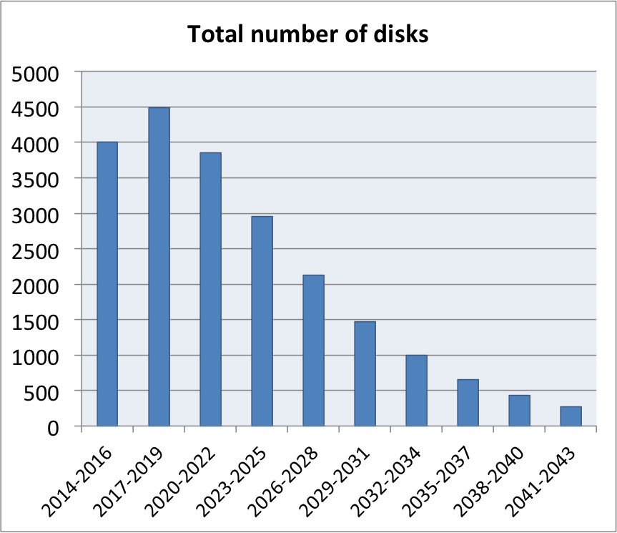
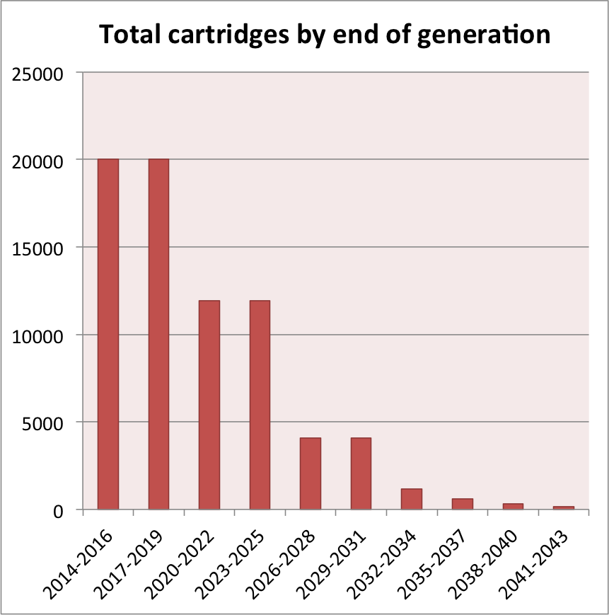
Case A) steady growth

Slide 12
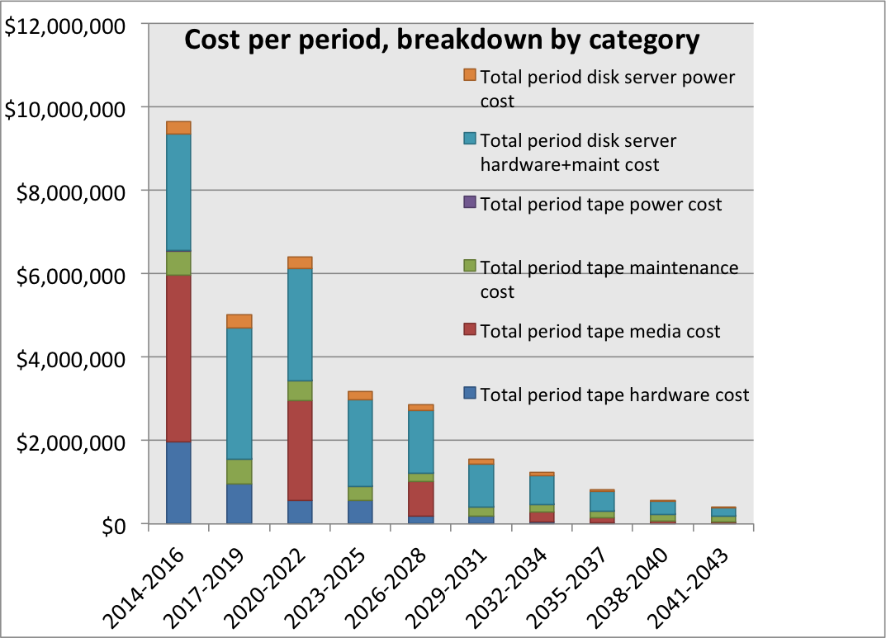
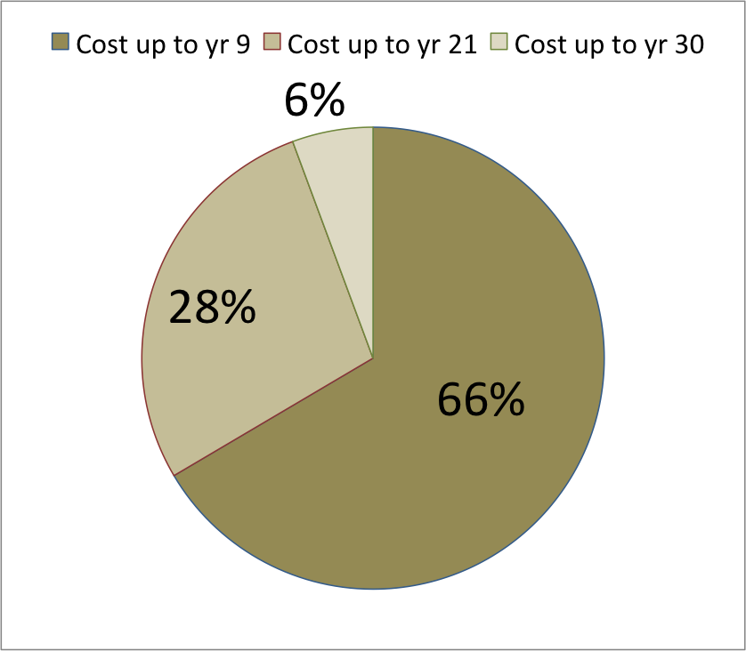
Case A) steady growth
Total cost: ~31.6M$
(~1M$ / year)

Slide 13
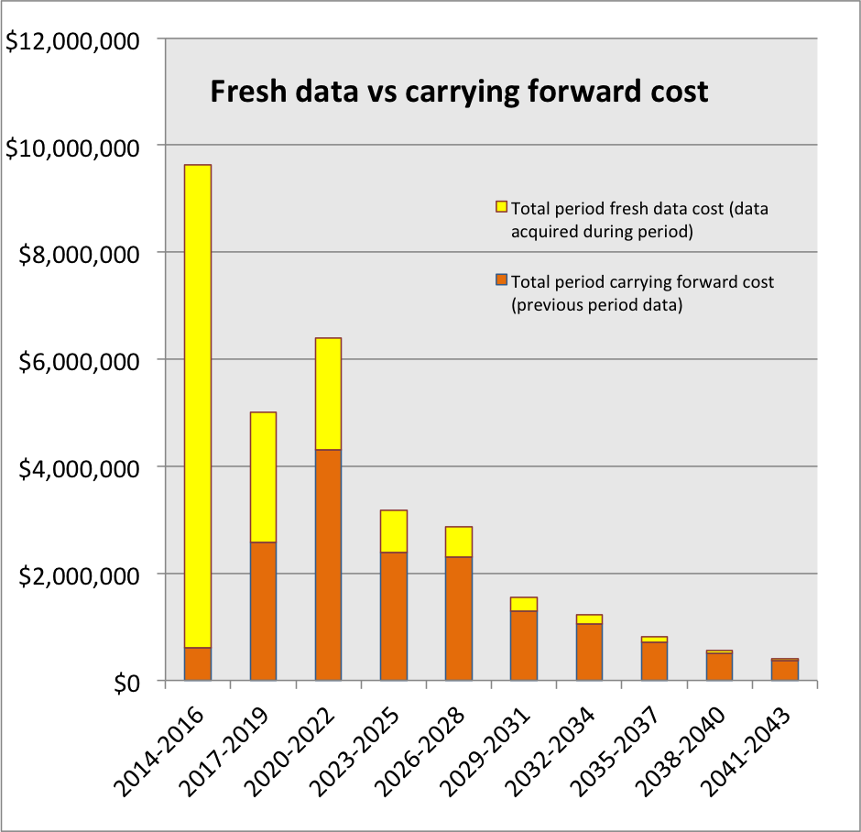
Case A) steady growth

Slide 14
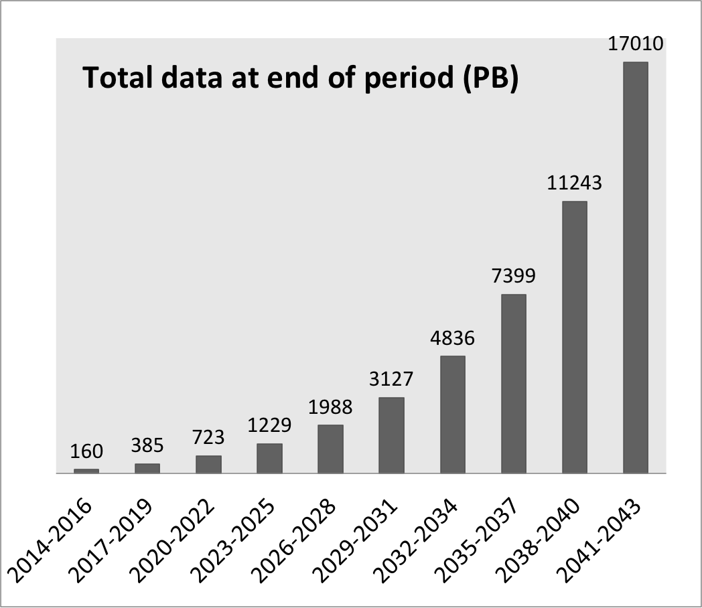
Case B) increasing archive growth
Start with 10PB, then +50PB/year, then +50% every 3y (or +15% / year)

Slide 15
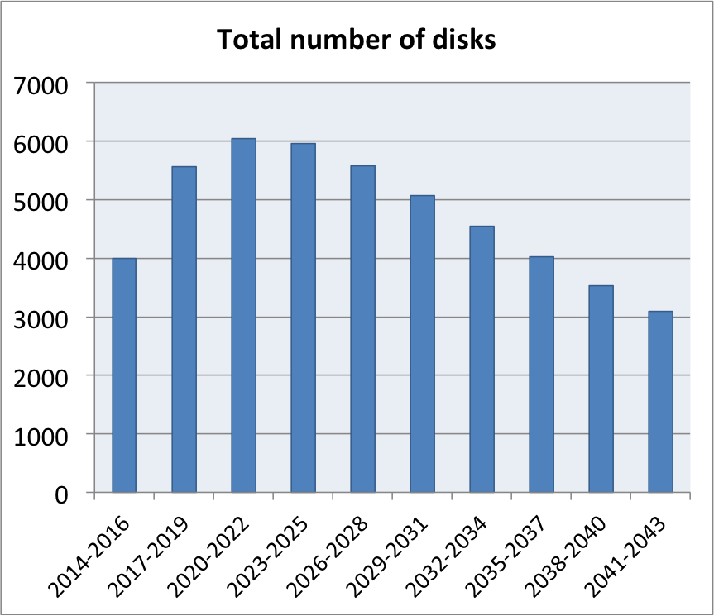
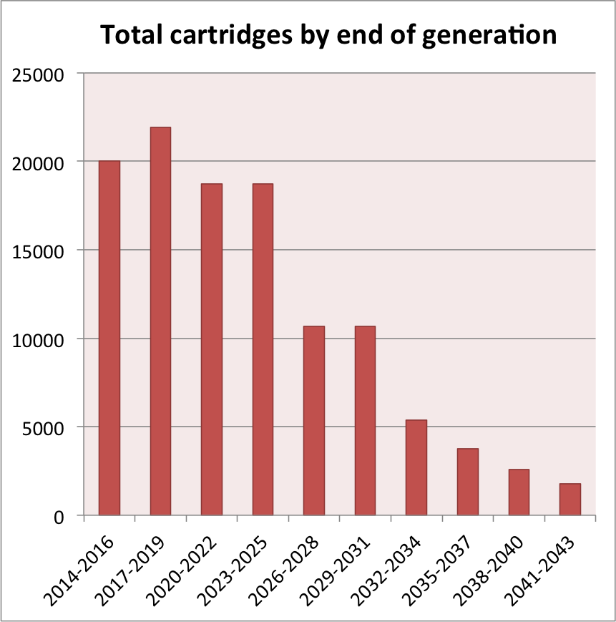
Case B) increasing archive growth

Slide 16
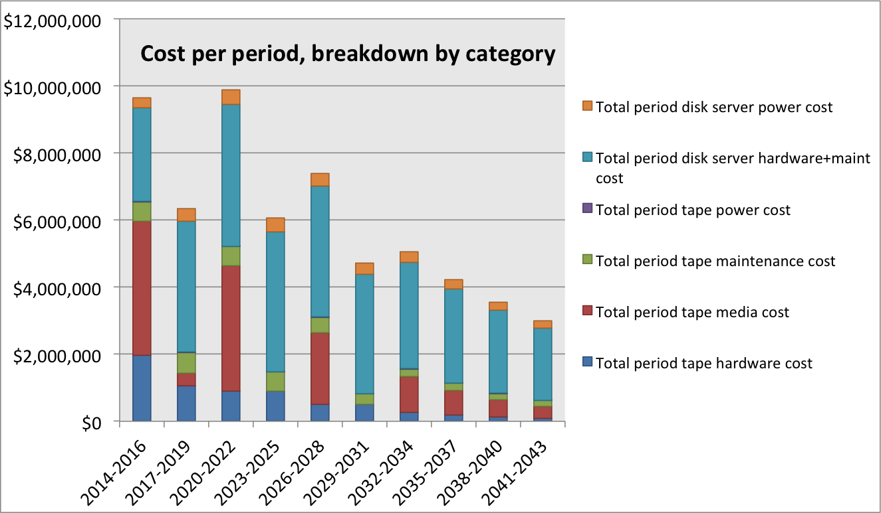
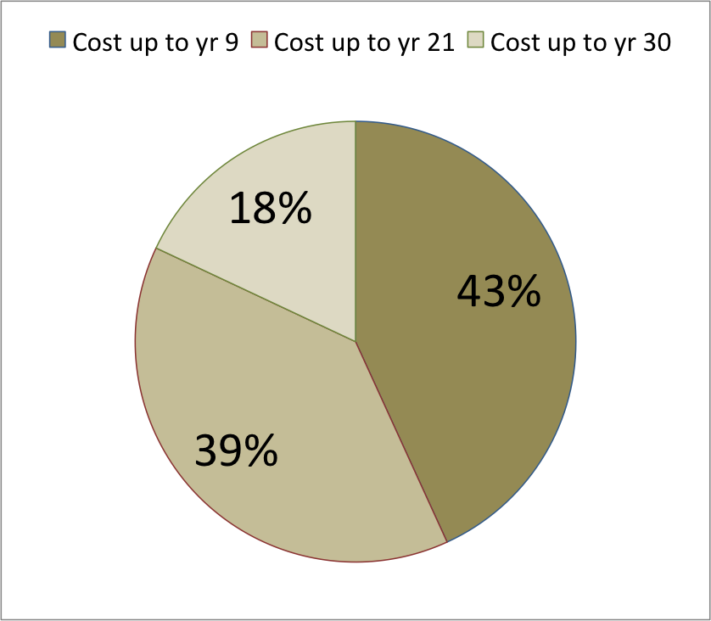
Case B) increasing archive growth
Total cost: ~59.9M$
(~2M$ / year)

Slide 17
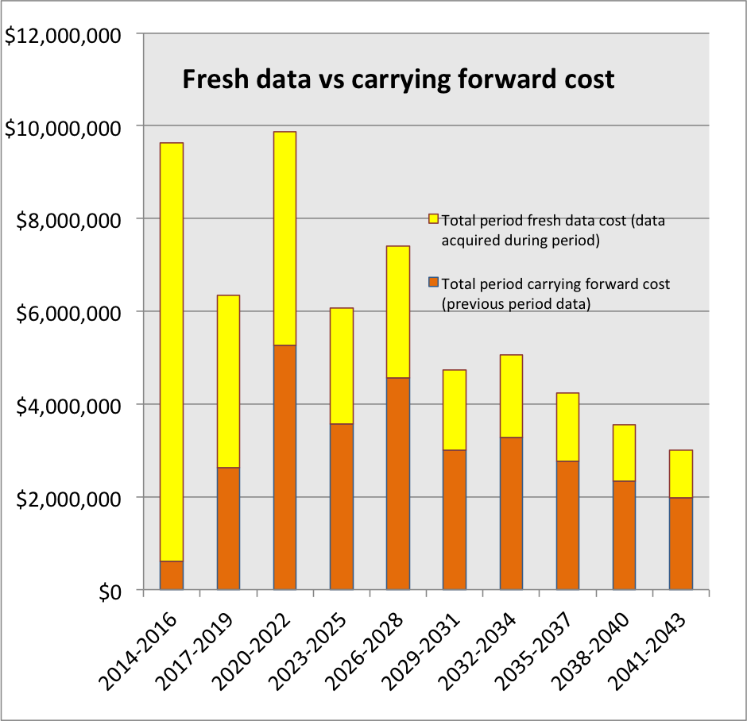
Case B) increasing archive growth

Slide 18
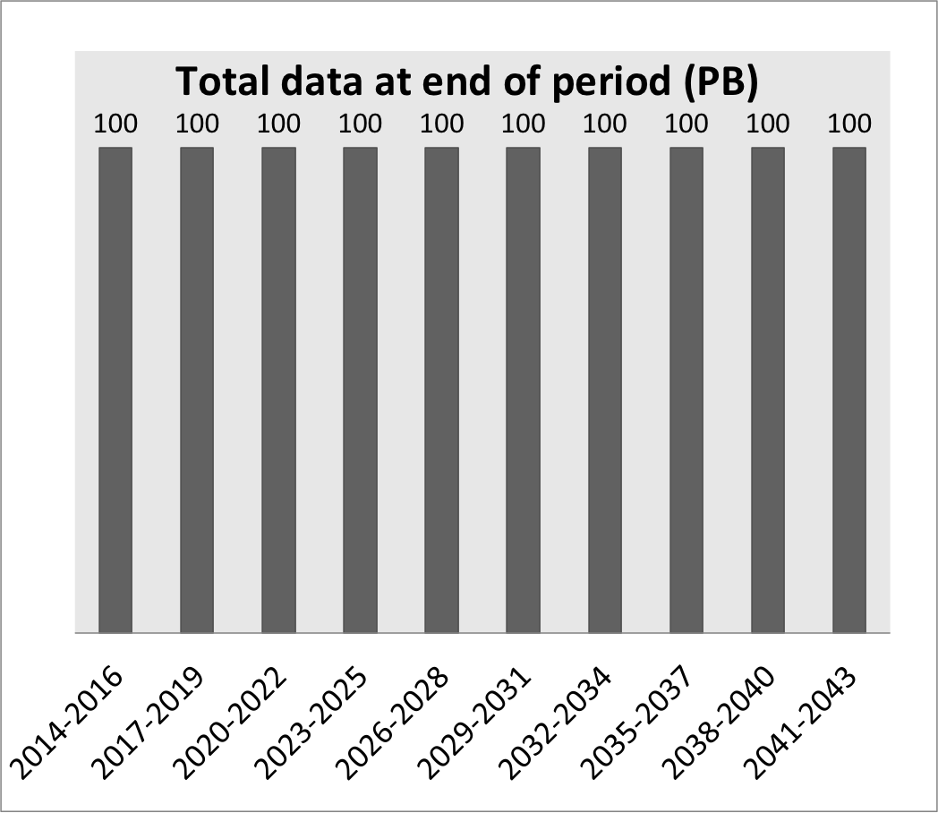
Case C) stable large archive
Start with 100PB, do not add any data

Slide 19
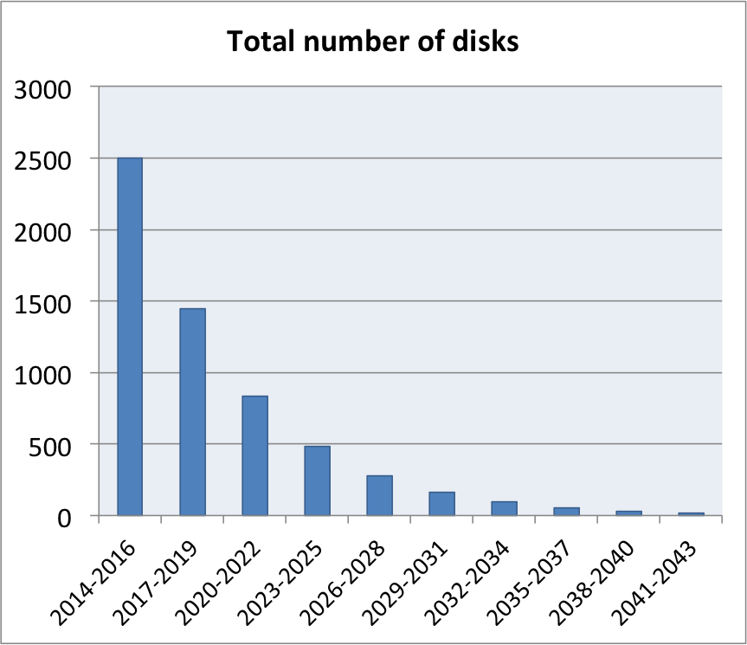
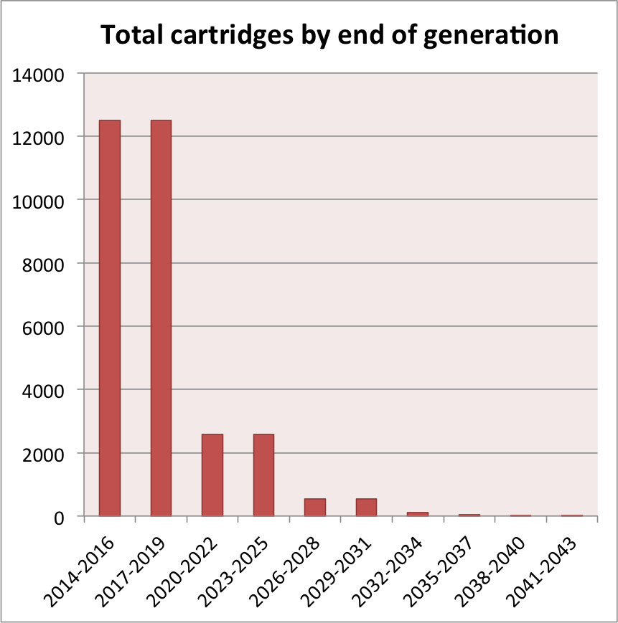
Case C) stable large archive

Slide 20
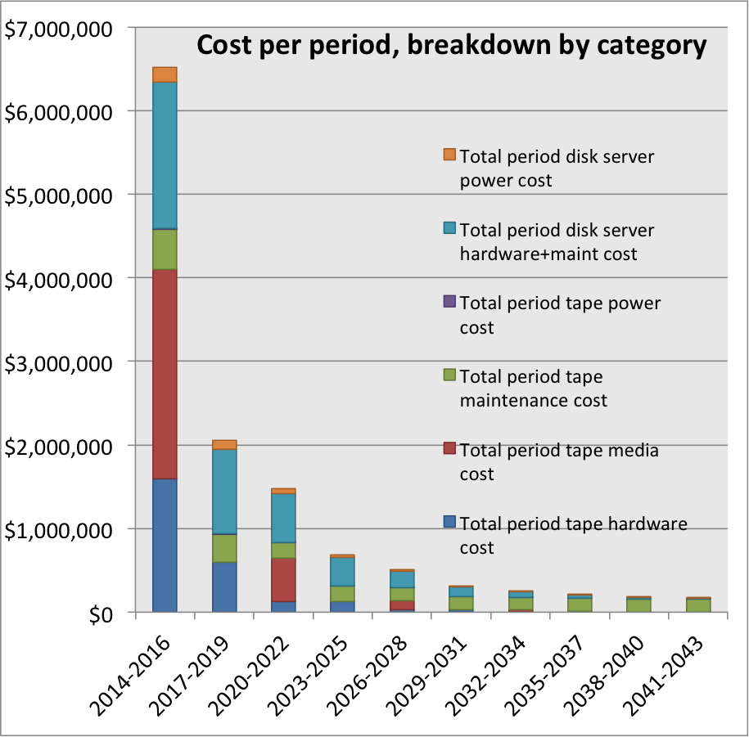
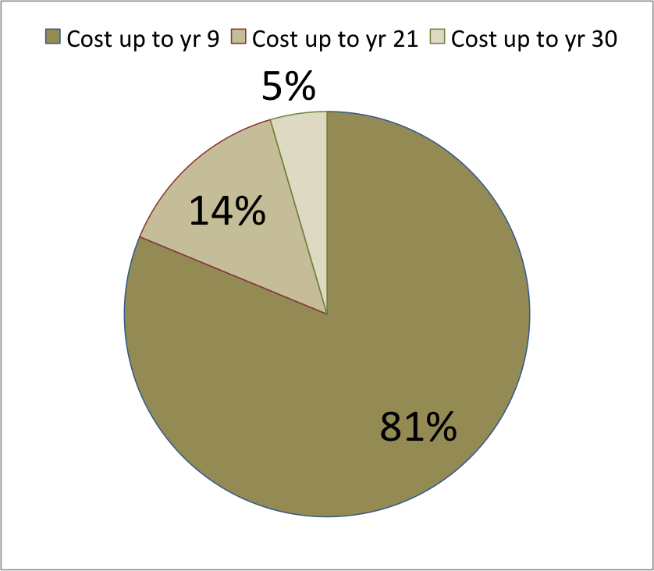
Case C) stable large archive
Total cost: ~12.3M$
(400K$ / year)

Slide 21
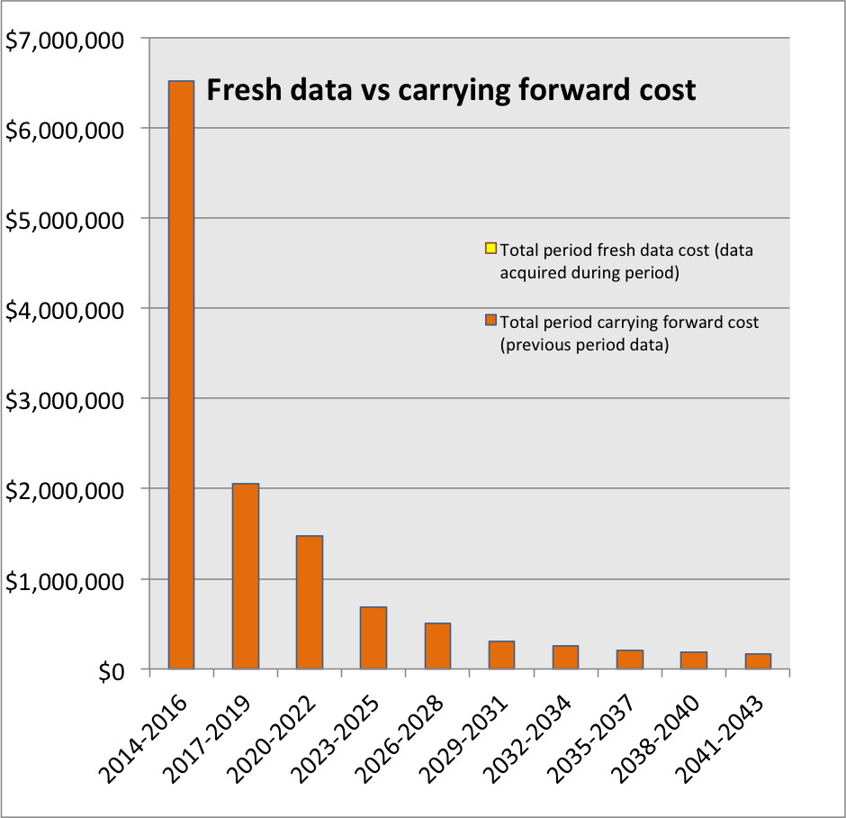
Case C) stable large archive

Slide 22
References
INSIC Tape Roadmap, 2012 www.insic.org
“A TCO analysis for Tape and Disk”, The Clipper Group, 2013 www.clipper.com
“Enterprise Tape for Archival Storage?”, The Clipper Group, 2013 www.clipper.com
“100 Year Archive Requirements Survey”, 2007 www.snia.org
“Bit Preservation: A Solved Problem?”, D. Rosenthal, Stanford University, 2010 http://www.ijdc.net
Oracle - Western States Contracting Alliance price list http://www.oracle.com/us/corporate/pricing/wsca-homepage-081353.html

Slide 23
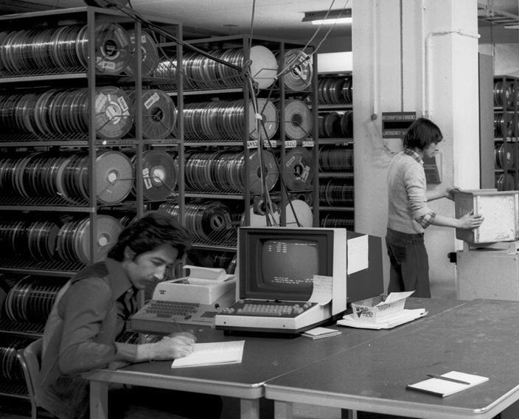
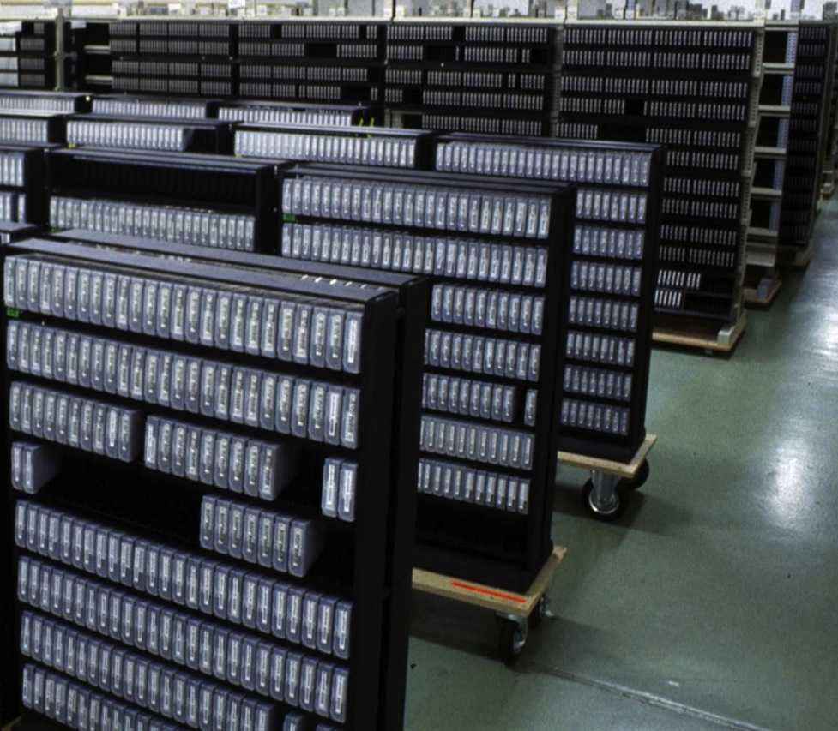
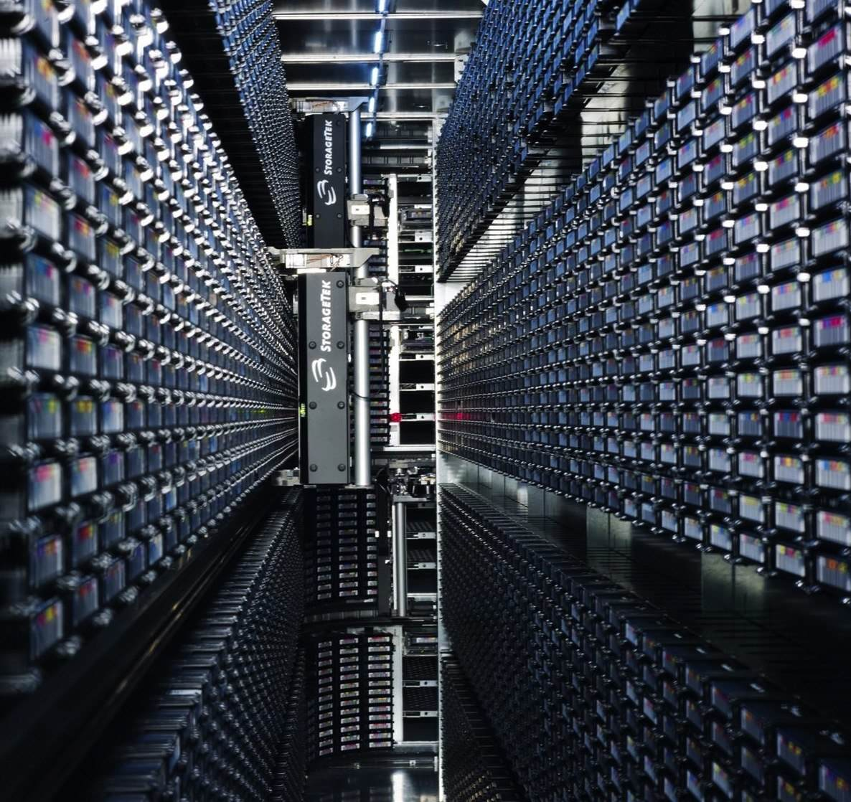
Discussion

Slide 24
Reserve material

Slide 25
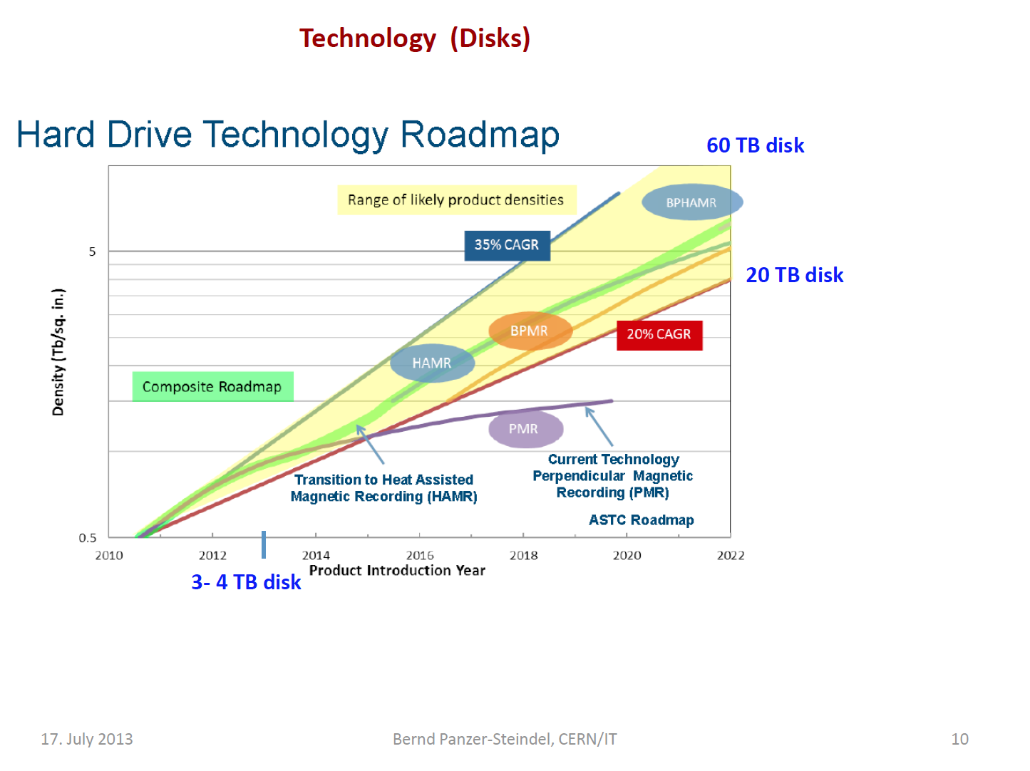

Slide 26
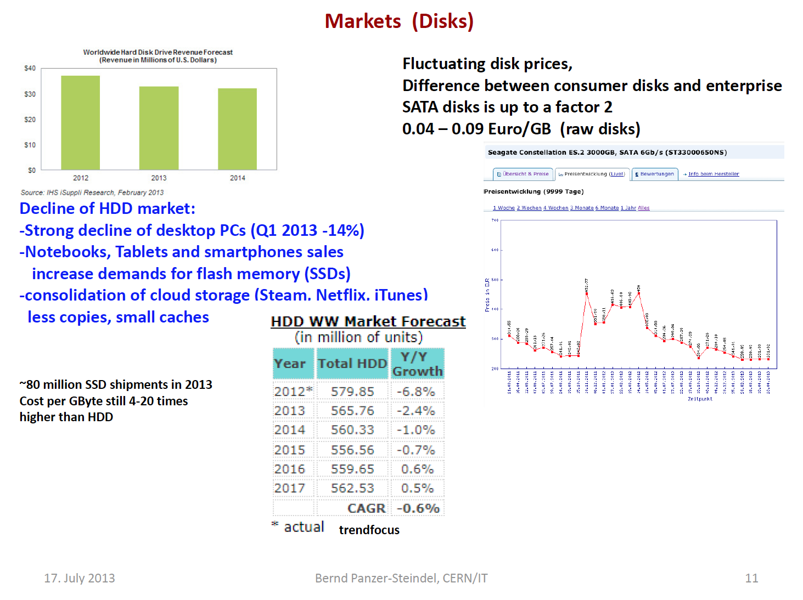

Slide 27
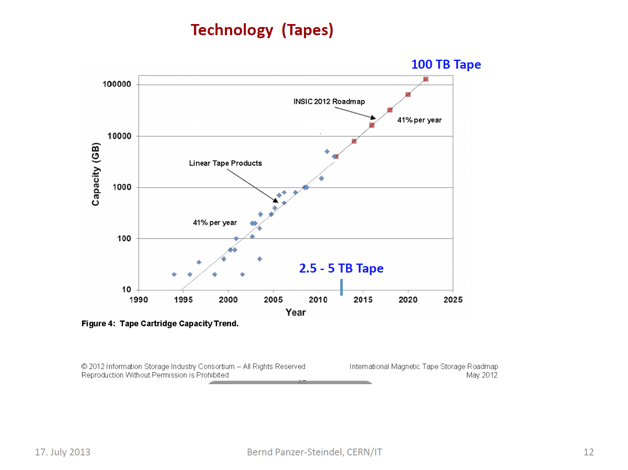

Slide 28
