Slide 1
Challenges in
Compute Management and Provisioning
Tim Bell
CERN
tim.bell@cern.ch
10th December 2013

Slide 2
What Happened Last Time?

Slide 3
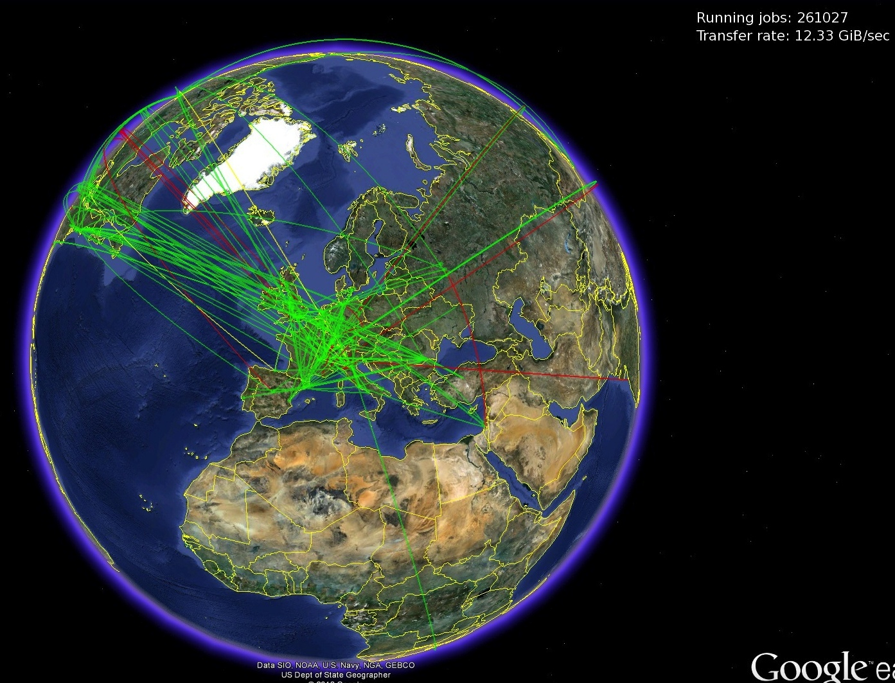
Now–Worldwide LHC Computing
Typical simultaneous jobs: more than 250,000
Global Transfer rate: 12-15 billion bytes per second

Slide 4
Current Models
Software limits are being reached
  Scheduling–7K workers handing 100K jobs
  Flexibility–Linux migrations
Staffing limits
  Significant effort to maintain code base
  Operations cost is high
  Migrations require major team effort
Expect continued growth of compute
  300,000 cores by 2015

Slide 5
Learn from Others
Move towards a cloud model
  OpenStack based IaaS
  PaaS and SaaS to come
Exploit open source software
  Strong communities
  Staff motivation
  Replication to other labs

Slide 6
Challenge: Scale
Running OpenStack with 300,000 cores will be non-trivial
Simple operations become major
  Upgrading while running production workloads
  Deploying kernel upgrades on hypervisors
  Installing the latest hardware deliveries

Slide 7
Challenge: Efficiency
Need to measure efficiency
  Get the most out of what we’ve got
  Analytics for low efficiency identification
Minimise overhead
  Containers
  Hypervisors
Maximise usage
  Quota vs spot market
Minimise cost
  Pricing services (Private, Public)
  Optimise for performance
  Optimise for power

Slide 8
Challenge: Management
Service Levels
  What is affordable and achievable ?
  How can we measure it ?
Capacity Planning and Quota
  Elastic resources
  Delegation of resource management
  Fair share allocation
Process optimisation
  Hardware repair window vs redundancy

Slide 9
Challenge: Research Usability
Choose my service
  Single federated account
Flexibility
  OS version, CPUs, RAM, Disk
Self-Service
  No tickets
  CLIs and one-click interfaces
  Support sharing of applications
Transparent costing
  Simple model

Slide 10
Conclusions
Compute Management and Provisioning is undergoing dramatic transformation
  Agility
  Scale
Many challenges ahead for CERN
  These are common with others
  Solve them together

