Slide 1
HTS coil test at CNRS
Gerard Willering
Jeroen van Nugteren
Glyn Kirby

Slide 2

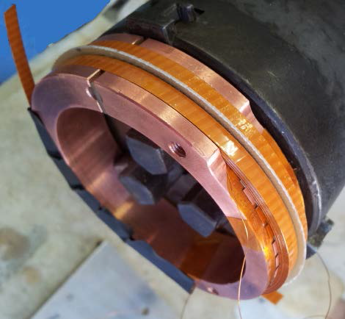
Reminder of EuCARD program WP-7 task 4
Subtasks:
- Specification, characterization and quench modelling
- Design, construction and test of solenoid insert coils
- Design, construction and test of dipole insert coils
Multiple solenoid pancake coils have been made, focusing on quench propagation and Quench Energy limits.

Slide 3
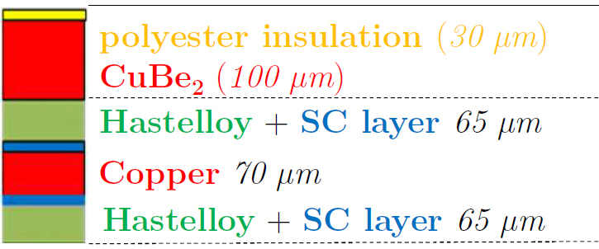
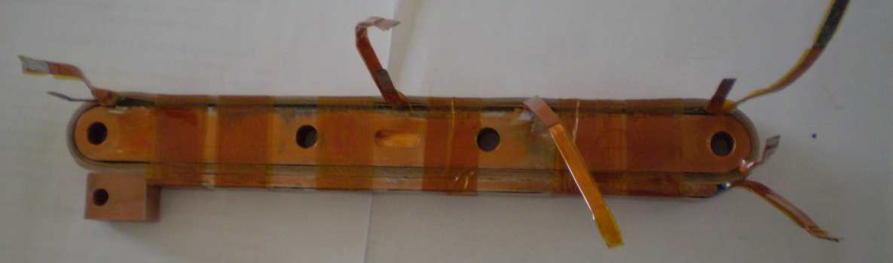
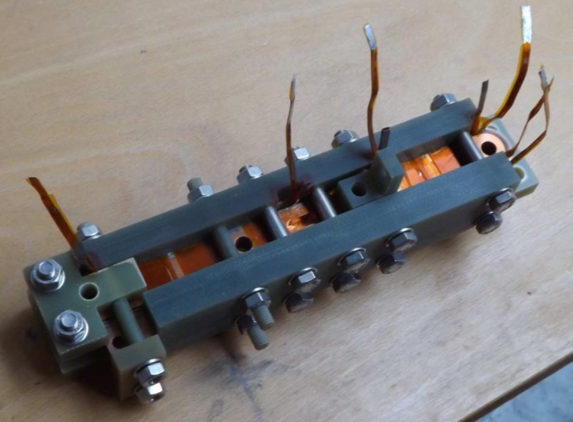
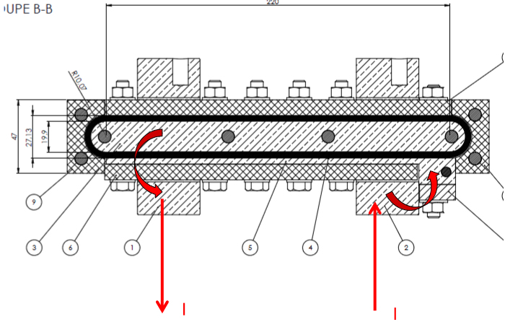
Conductor
- 2 SuperPower YBCO tapes sandwiched and soldered.
- CuBe₂ layer wound around
Coil
10 windings
1 heater
6 V-taps
Nominal current 1400 A at 10 degree field.

Slide 4
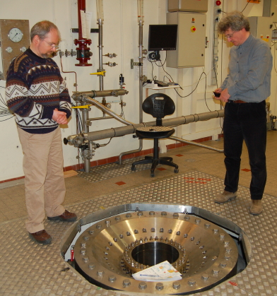
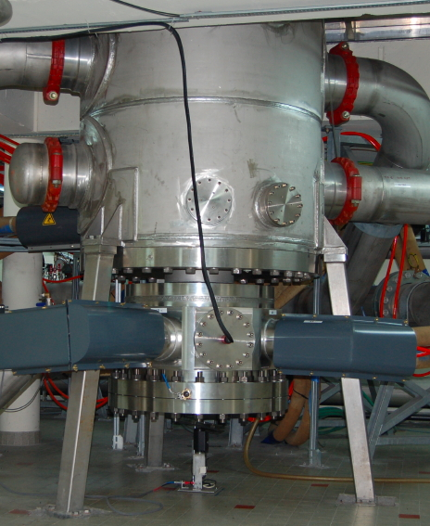
10 T test station at CNRS, Grenoble
Test station
- 376 mm room temperature bore
- Magnetic field: 0 to 10 T
- Current: 0 to 3 kA / 5 V
- Operating Temperature: 4.2 K
- Cool down # 2 hours
- HTS current leads (2*6* 4 mm YBCO tape with brass shunt)

Slide 5
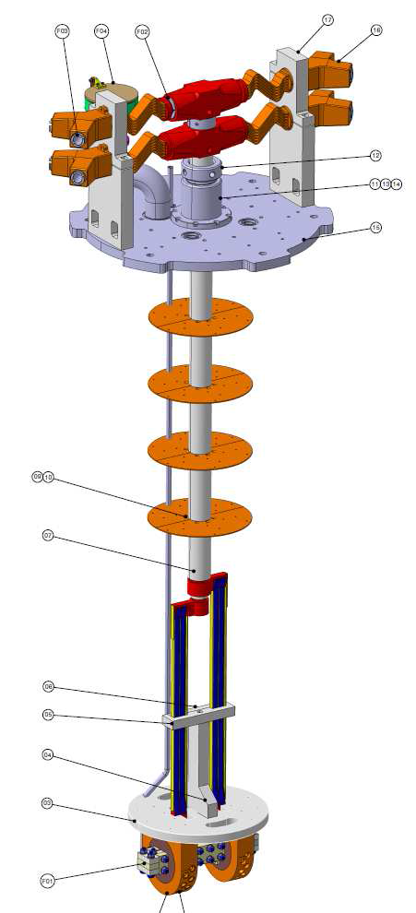
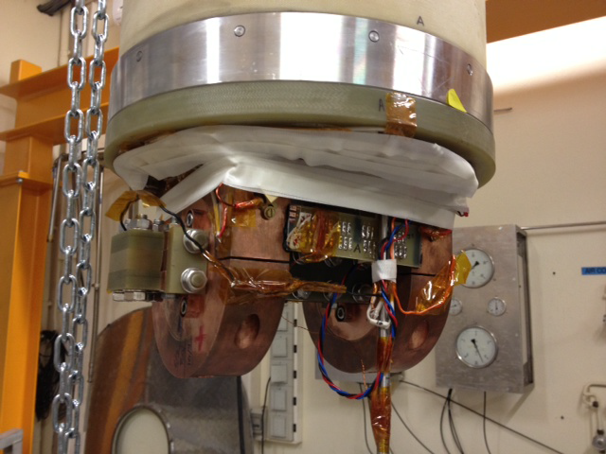
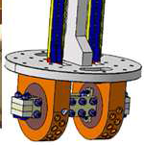

Sample insert
- 3 kA rating
- Sample can be fixed at any angle.

Slide 6
Measurement goals
Check normal operation at 1400 A with different orientations (0, 5, 10 and 20 °)
Determine MQE for each angle
Achievements
1400 A reached for all angles (far below I_{c}, so no surprise
Quench energy: Pulses given at all angles to determine the quench energy
Degradation
During winding a conductor damage was already seen: Around one voltage tap the two tapes in the cables were delaminated and the tapes had a sharp angle.
During all the ramps at above about 400 A a resistive slope started in this area.
At the 5th day of test, a quench was observed at 1400 A in this location and in later ramps the cable degraded strongly with quenches at 1300 and 700 A and the testing was stopped.
Degradation cause:
Imperfections in winding?
Delamination due to soldering

Slide 7
Discussion and conclusions
Successful coil test at nominal current
However,
No I_{c} runs, partially due to conductor damage
Heat pulse data (with angular dependence) is very difficult to characterize, due to relatively long pulse, uncertainty about thermal conductivity parameters. Still quite some work to do on modeling.
Future
Improved winding necessary
Coil test up to I_{c} would help
Quench protection to be improved
Modeling by Jeroen shows current distributions in background field, see his presentation.
Experimental verification is needed.

