Slide 1
MC2014 – Z-Path Updates
M. Bugge, F. Ould-Saada et al.
Z-path website moving to Oslo.
  Help from Magnar Bugge and Dresden team (Julia Woithe, Konrad Jende, Tim Herrmann, Florian Brunzlaff, Uta)
  → This should make updates somewhat easier to make
Conference proceedings - ATLAS Masterclasses – W- and Z path physics and presentation of the Z path measurement, M. Bugge et al.
  → soon available
MC 2014 Z-path improvements wrt 2013
  Updates / improvements ongoing on description of measurements
  → Web site implementation
Concerns about "difficult di-photons" at "4-leptons" being sorted out.
  Wish to have 1/fb more for Higgs measurements
    → to be decided very soon. If yes, run selection with somewhat harder cuts
  Simpler (harder photon cuts) OR 2-step measurement (simple + more challenging)
    → to be decided here or soon
  4-leptons
    separate plots for 4mu, 4e, 2mu2e (Hypathia implementation)

Slide 2
MC2014 – Z-Path Updates
M. Bugge, F. Ould-Saada et al.
Web-based Hypathia?
Looping over full statistics
  Magnar wrote an automatic analysis code running on XML files I
  implemented basic object selections and basic dilepton and diphoton analyses.
  also implemented both a very basic four lepton analysis, and a "full" analysis with cuts on deltaR between leptons and cuts on the subleading and leading pair masses, pretty much as defined in the official analysis (when implementing our selection for MasterClass)
  results can be seen in OPloT under 2012-01-01, Test-Trondheim, Group 13A and 13B. The difference between the two groups is the selection used for the four lepton analysis, where 13B has the full analysis with leading and subleading mass cuts.
  code runs over the 13000 events used for MasterClass last year "out of the box".
  takes about 5 minutes, since python is a bit slow (we can think about how to speed things up if necessary).
  currently, the output is just an invariant mass file for OPloT
  can also easily add ROOT functionality for displaying plots "on the fly".
To do – looping
  → work on interfacing the tool to "Hypathia+OPloT" including possibilities for setting cuts
  → for 2014?
  → in any case for an advanced version for university students (short or longer term projects)

Slide 3
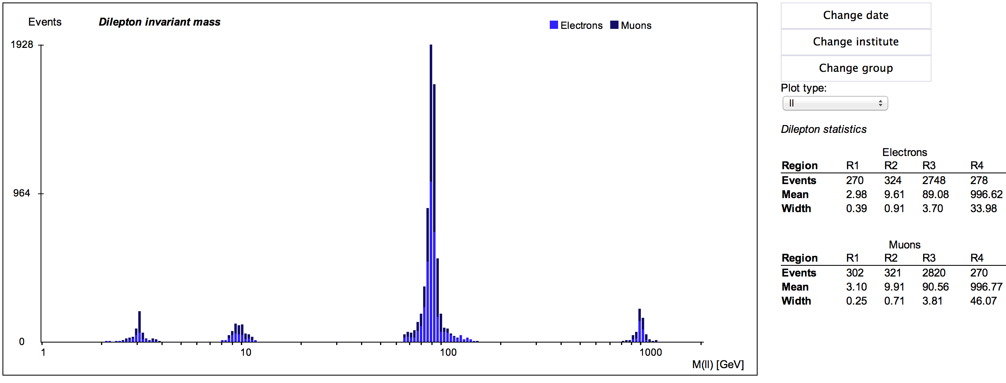
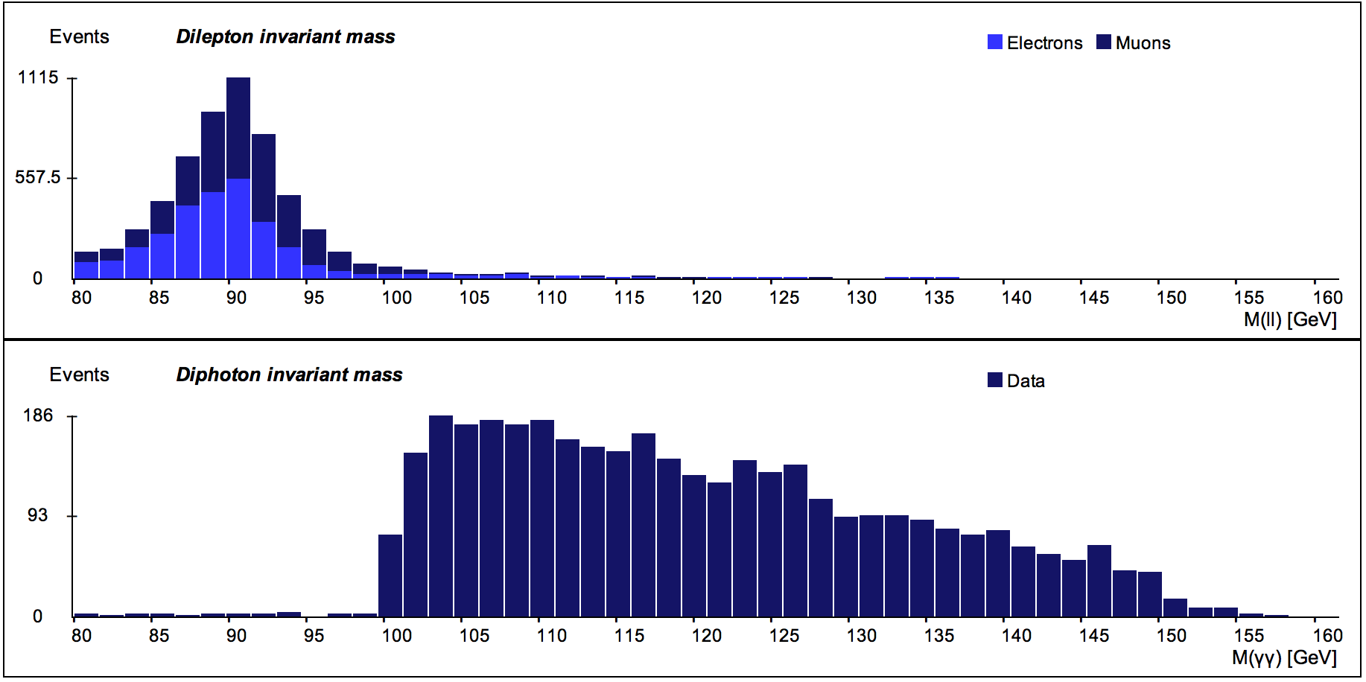
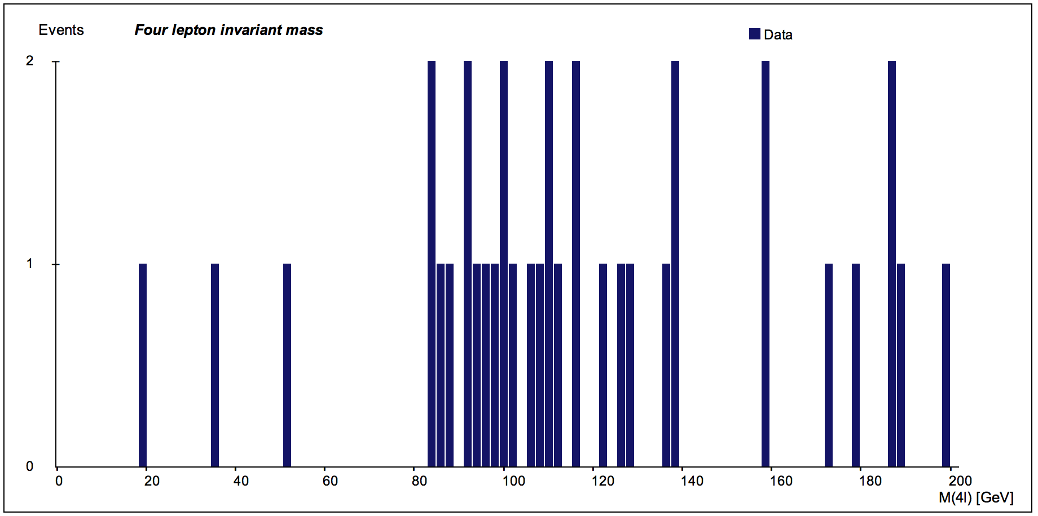
MC2014 – Z-Path Updates
M. Bugge, F. Ould-Saada et al.
Full statistics – 13000 events
J/ψ Υ Z Z’

