Slide 1

New alternative filling schemes
for the HL-LHC
O. Domínguez and R. Tomás
Acknowledgements
H. Damerau, S. Fartoukh, G. Iadarola, G. Rumolo and F. Zimmermann
e-cloud meeting, 21 October 2013

Slide 2

Outline
PART I – Quick revision of the “old” alternative filling schemes
PART II – New exotic proposals
O. Domínguez – e-cloud metting– 21 October 2013

Slide 3
Outline
PART I – Quick revision of the “old” alternative filling schemes
PART II – New exotic proposals
O. Domínguez – e-cloud metting– 21 October 2013

Slide 4
HL-LHC
Integrated luminosity goal ≈ 250 fb⁻¹/year
Potential showstoppers:
  LRBB interactions
  Excessive event pile-up in the detectors
  e-cloud
Different filling schemes have been suggested to minimize them
Main figures of merit considered to characterize the different scenarios:
Luminosity performance
e-cloud activity
Heat load in the arcs
δ_{max,threshold}
(150 days/year dedicated to physics)
O. Domínguez – e-cloud metting– 21 October 2013

Slide 5
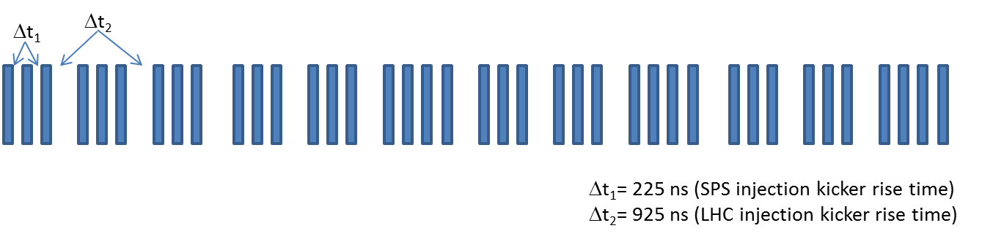
HL-LHC
Standard scheme (2808 bunches):
N.B: Schemes with less bunches (≈2540b) are being under consideration. Nevertheless, the comparison for the different scenarios with this scheme should be valid
O. Domínguez – e-cloud metting– 21 October 2013

Slide 6
HL-LHC
The suggested filling schemes
24 bunches
(
)
Microbatches
(s_{b}= 25ns)
× 10
Minimizes the effect of LRBB interactions
24 empty bunches
12.5 ns
Reduced s_{b}
(with I_{b} ≈ const.)
5 ns
2.5 ns
1.25 ns
Bunch “Doublets”
(s_{b} = 25 and 50 ns)
1.25 or 2.5 ns
25 or 50 ns
Reduce the event pile-up in the detectors
(Schemes suggested by S. Fartoukh)
12-bunch gaps
(s_{b}= 25ns)
12 empty bunches
(1 missing injection from PSB to PS)
Reduces e-cloud activity
12 bunches
O. Domínguez – e-cloud metting– 21 October 2013

Slide 7
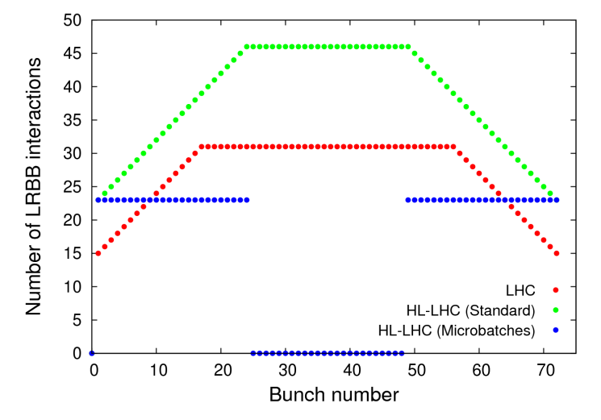
HL-LHC: Microbatches
(Idea by S. Fartoukh, presented at the HL-LIU Brainstorming, 30.03.2012)
PACMAN bunches: First and last bunches from a train → They experience less LRBBI
This can affect dynamic behaviour and beam life time → Direct impact of Luminosity
The effect will scale up for the HL-LHC due to:
  a longer inner triplet, i.e. more LR encounters:
  typically 20-23 instead of 15 for 25 ns
  a higher bunch charge (stronger kicks):
  typically 2.5∙10¹¹ ppb instead of 1.15 for 25 ns
Removing properly the central bunches and separating
the trains sufficiently would cancel this effect
If so all the bunches will see strictly the same number of LRBBIs, of course not at the same location, but the integrated kick would be very similar for all bunches
Assuming 23 LRBBI for the longer HL-LHC triplet (most pessimistic case with 100 T/m NbTi), one gets the most symmetric (25 ns) micro-batch filling scheme:
10 x ( 7 x (24b+24e) + 12e ) +84e
(corresponding to 10 LHC injections and 1680 bunches)
O. Domínguez – e-cloud metting– 21 October 2013

Slide 8
HL-LHC: Microbatches
 | 25 ns* | 50 ns* | Microbatch (25 ns)
# Bunches | 2808 | 1404 | 1680
p/bunch [10¹¹] | 2.2 (1.12 A) | 3.5 (0.89 A) | 2.2 (0.67 A)
Minimum β∗ [cm] | 15 | 15 | 15
ε_{N} [μm] | 2.5 | 3.0 | 2.5
σ_{z} [cm] | 11.8/7.5** | 11.8/7.5** | 11.8/7.5**
L_{peak} (Virtual) [10³⁴cm⁻²s⁻¹] | 24 | 26 | 14.5
L_{level} [10³⁴cm⁻²s⁻¹] | 5.0 | 2.5 | 3.0
Events / crossing*** | 135 | 135 | 135
t_{leveling} [h] @ L_{level} | 8.5 | 17.1 | 8.5
t_{opt} [h] | 10.2 | 18.1 | 10.0
Availability**** | 59% | 99% | 99%
* US2 parameters
** injection/top energy
*** σ_{inel} = 85 mb
**** Needed to achieve
250 fb⁻¹ in 150 days
The reduction in the number of bunches (40%) requires the machine availability to increase up to 99%
O. Domínguez – e-cloud metting– 21 October 2013

Slide 9
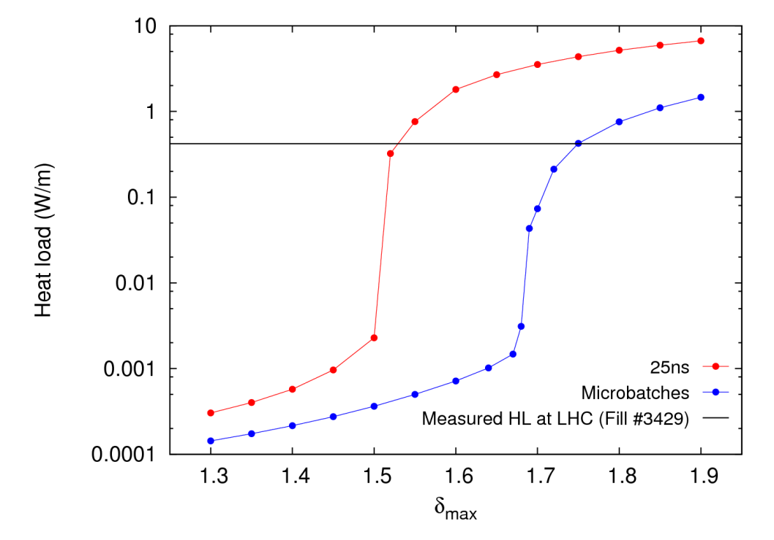
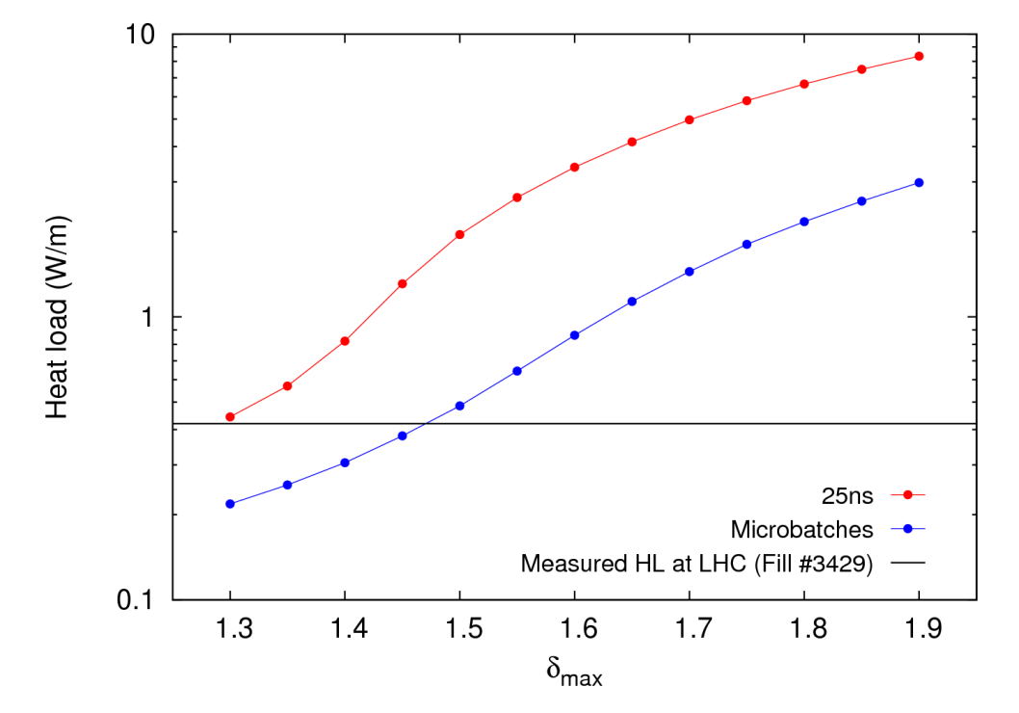
HL-LHC: Microbatches
Injection
Top energy (7 TeV)
δ_{max, thres. 25ns}
δ_{max, thres. MB}
δ_{max, thres. MB}
δ_{max, thres. 25ns}
There is a clear reduction of the e-cloud activity with respect to the 25-ns scheme
Nevertheless still far away from 50 ns (well outside the plots)
If the 25-ns filling scheme can’t be implemented due to e-cloud issues, this scheme could be another fallback option since it offers a very similar performance to the
50-ns scheme
O. Domínguez – e-cloud metting– 21 October 2013

Slide 10
HL-LHC: Reduced s_{b}
Reducing bunch spacing → Straightforward way to reduce pile-up in the detectors
Bunch spacings explored: 12.5 ns, 5 ns, 2.5 ns and 1.25 ns
Not possible for experiments (a priori)
 | 25 ns* | 12.5 ns | 5 ns | 2.5 ns | 1.25 ns
# Bunches | 2808 | 5616 | 14040 | 28080 | 56160
p/bunch [10¹¹] | 2.2 | 1.1 | 0.5 | 0.25 | 0.125
Minimum β∗ [cm] | 15 | 15 | 15 | 15 | 15
ε_{N} [μm] | 2.5 | 2.5 | 2.5 | 2.5 | 2.5
σ_{z} [cm] | 11.8/7.5** | 11.8/7.5** | 11.8/7.5** | 11.8/7.5** | 7.5/7.5**
L_{peak} (Virtual) [10³⁴cm⁻²s⁻¹] | 24 | 12.1 | 6.3 | 3.1 | 1.6
L_{level} [10³⁴cm⁻²s⁻¹] | 5.0 | 10.0 | > L_{peak} | > L_{peak} | > L_{peak}
Events / crossing*** | 135 | 135 | 34 | 8 | 2
t_{leveling} [h] @ L_{level} | 8.5 | 0.8 | - | - | -
t_{opt} [h] | 10.2 | 5.9 | 9.2 | 14.6 | 25.9
Availability**** | 59% | 56% | 74% | 109% | 161%
I_{b} ≈ const.
* US2 parameters
** injection/top energy
*** σ_{inel} = 85 mb
**** Needed to achieve
250 fb⁻¹ in 150 days
O. Domínguez – e-cloud metting– 21 October 2013

Slide 11
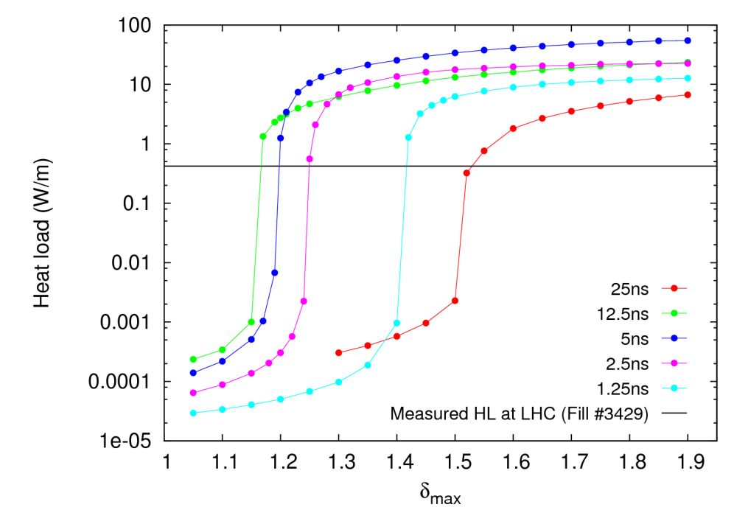
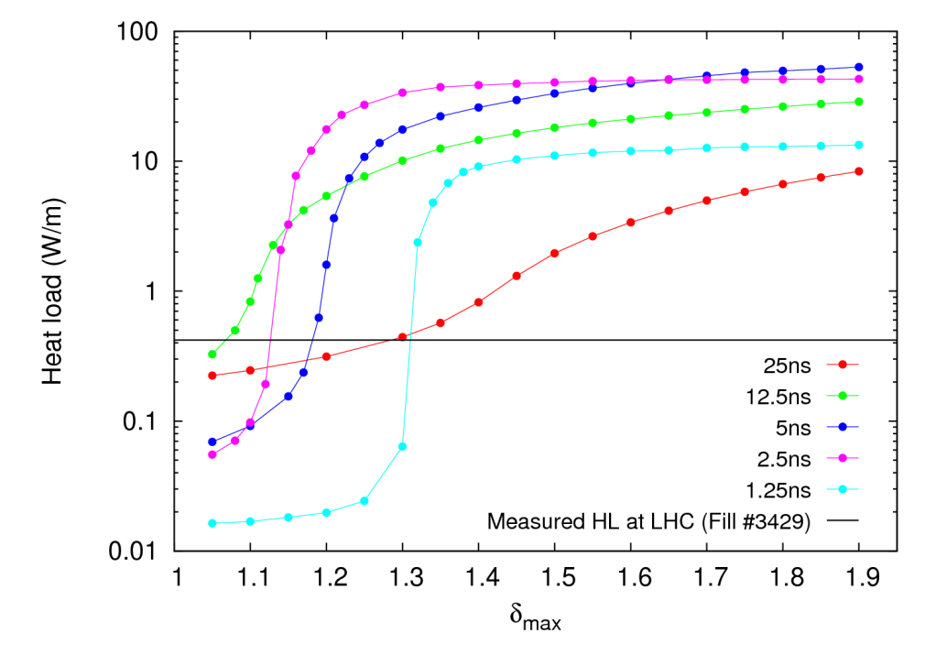
HL-LHC: Reduced s_{b}
Injection
Top energy (7 TeV)
Lowest threshold → 12.5 ns
Peak activity → 5ns. Similar for 2.5 – 12.5 ns. Behaviour changes slightly with energy
1.25 ns marks the backward tendence for e-cloud activity for further reduced bunch spacings
All these schemes must be discarded for operation
O. Domínguez – e-cloud metting– 21 October 2013

Slide 12
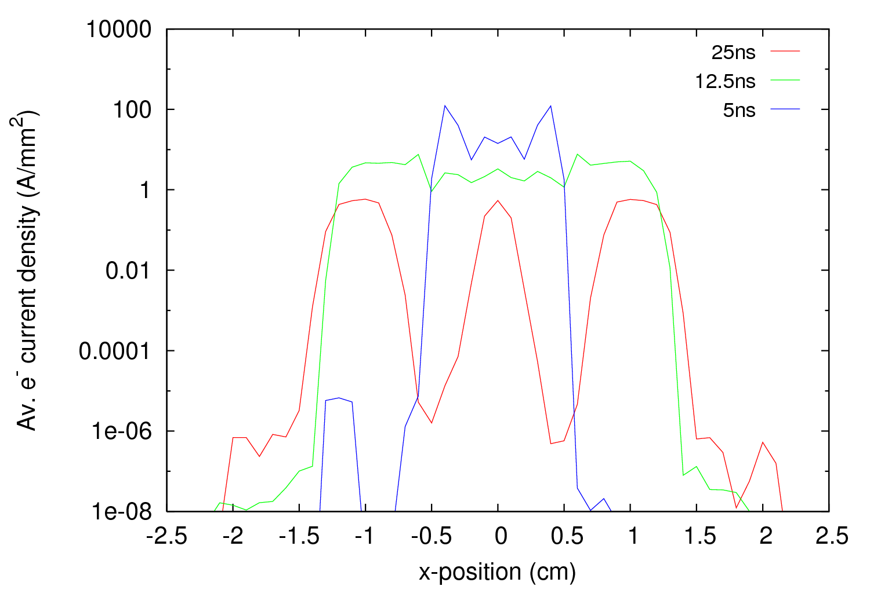
HL-LHC: Reduced s_{b}
Scrubbing with reduced bunch spacing?
O. Domínguez – e-cloud metting– 21 October 2013

Slide 13
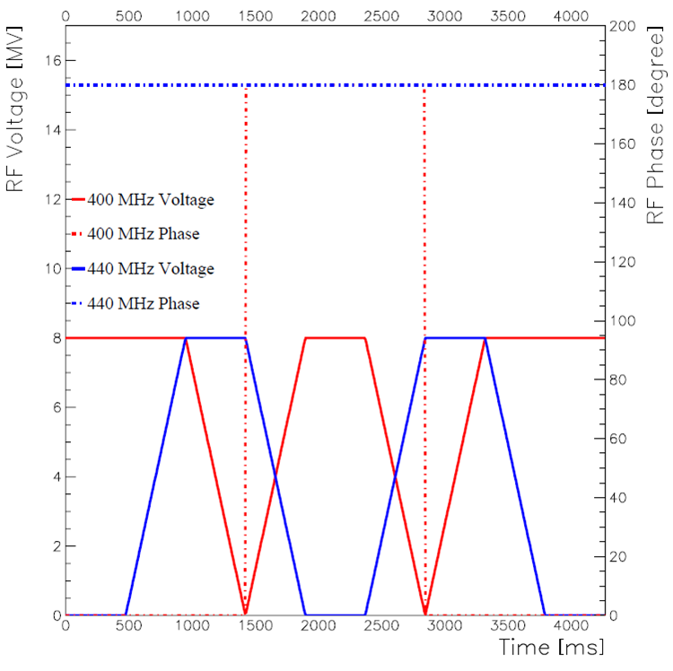
HL-LHC: “Doublets”
(Idea and RF simulations by S. Fartoukh)
800 MHz RF cavity could split a bunch into two “bunchlets” separated by 1.25 ns
Not interesting:
- Additional LRBBI
- Incompatibility with crab cavities
- More difficult for detectors
400 MHz + 440 MHz RF cavities could split a nominal bunch into two “bunchlets” separated by 2.5 ns
Only possible at top energy thanks to a lower phase space filling factor
Courtesy S. Fartoukh
RF cycle used for the splitting and recombination processes. One second appears to be a time sufficient for carrying out the two processes adiabatically.
O. Domínguez – e-cloud metting– 21 October 2013

Slide 14
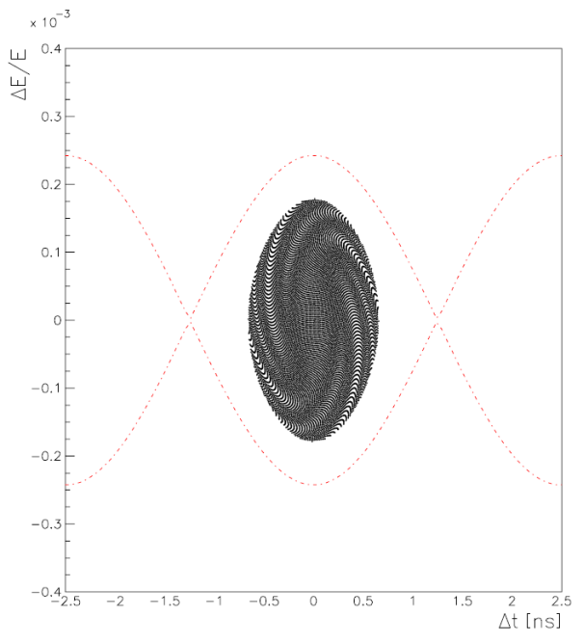
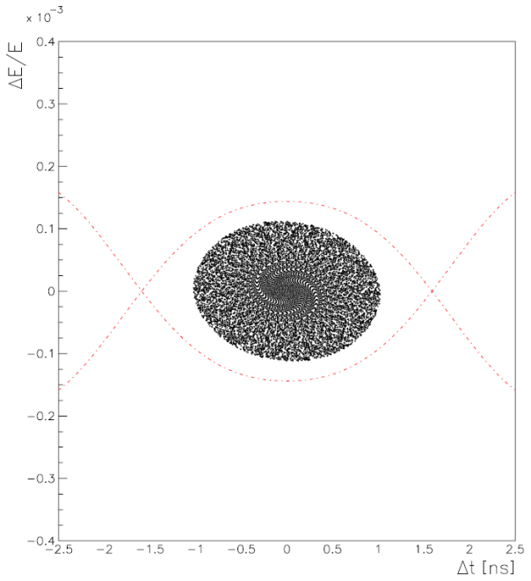
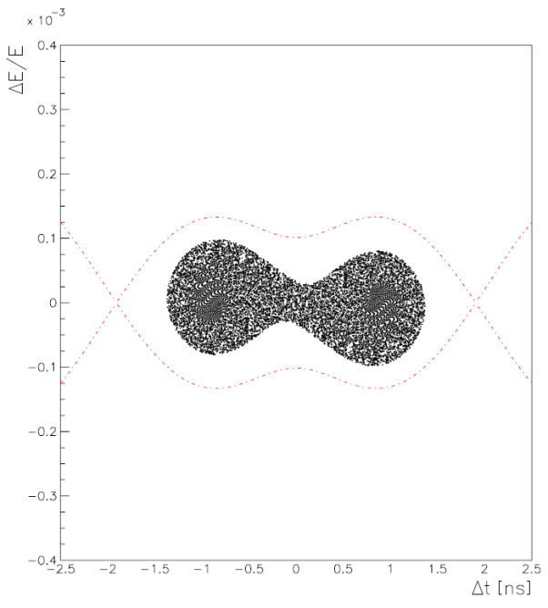
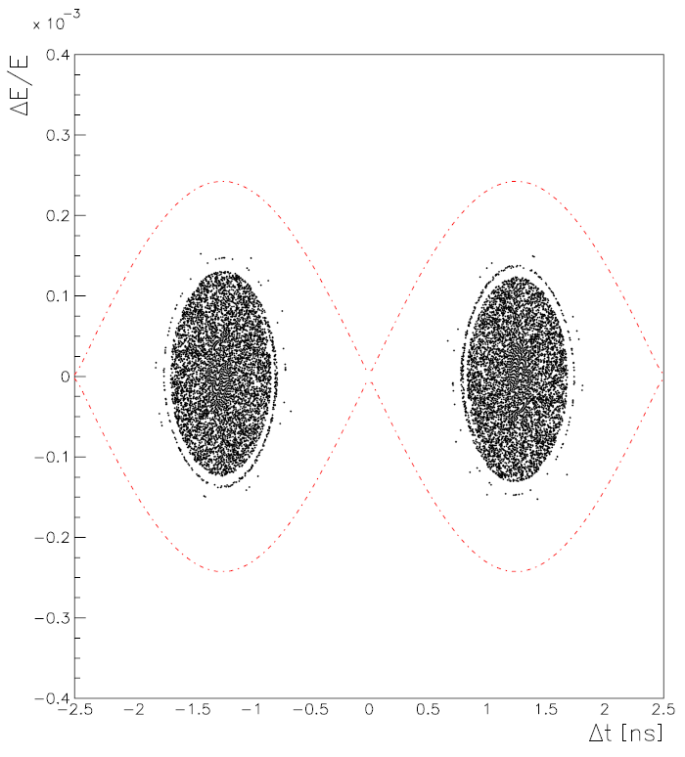
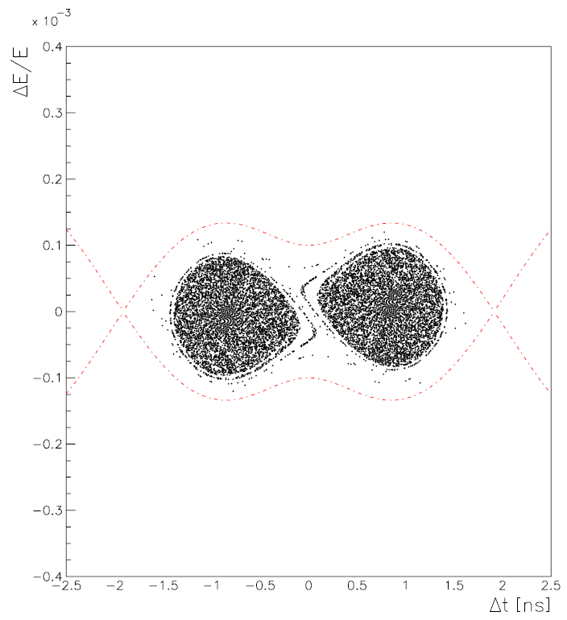
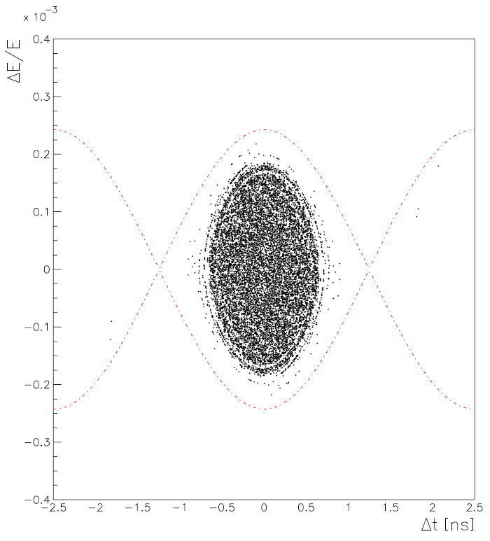
HL-LHC: “Doublets”
Courtesy S. Fartoukh
O. Domínguez – e-cloud metting– 21 October 2013

Slide 15
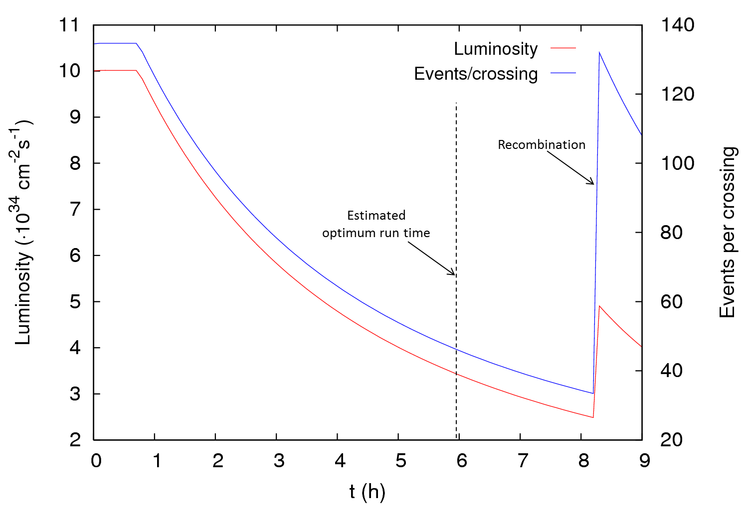
HL-LHC: “Doublets”
One advantage of this kind of beams is the possibility of recombination
With 25 ns, the optimum run time is shorter than the recombination time
In terms of luminosity performance, it is identical to pure 12.5-ns bunch spacing (56% machine availability needed)
O. Domínguez – e-cloud metting– 21 October 2013

Slide 16
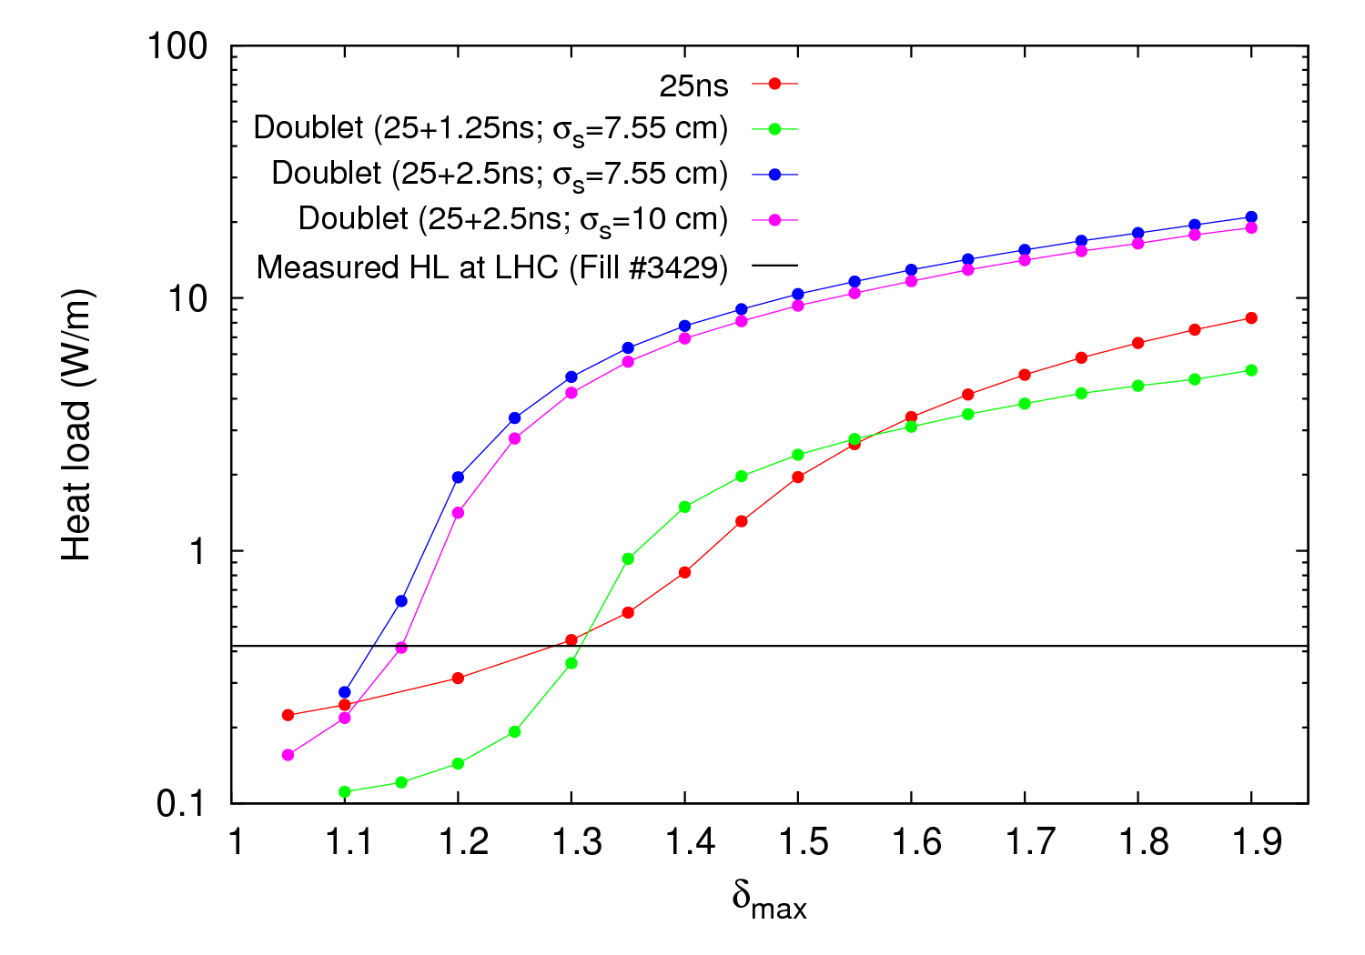
HL-LHC: “Doublets”
Similar behaviour as observed with regular bunch spacings (backward tendence for 1.25 ns)
Longer bunch length explored (10 cm, as nowadays in the LHC) → Negligible reduction
25-ns “Doublets” can be also discarded
O. Domínguez – e-cloud metting– 21 October 2013

Slide 17
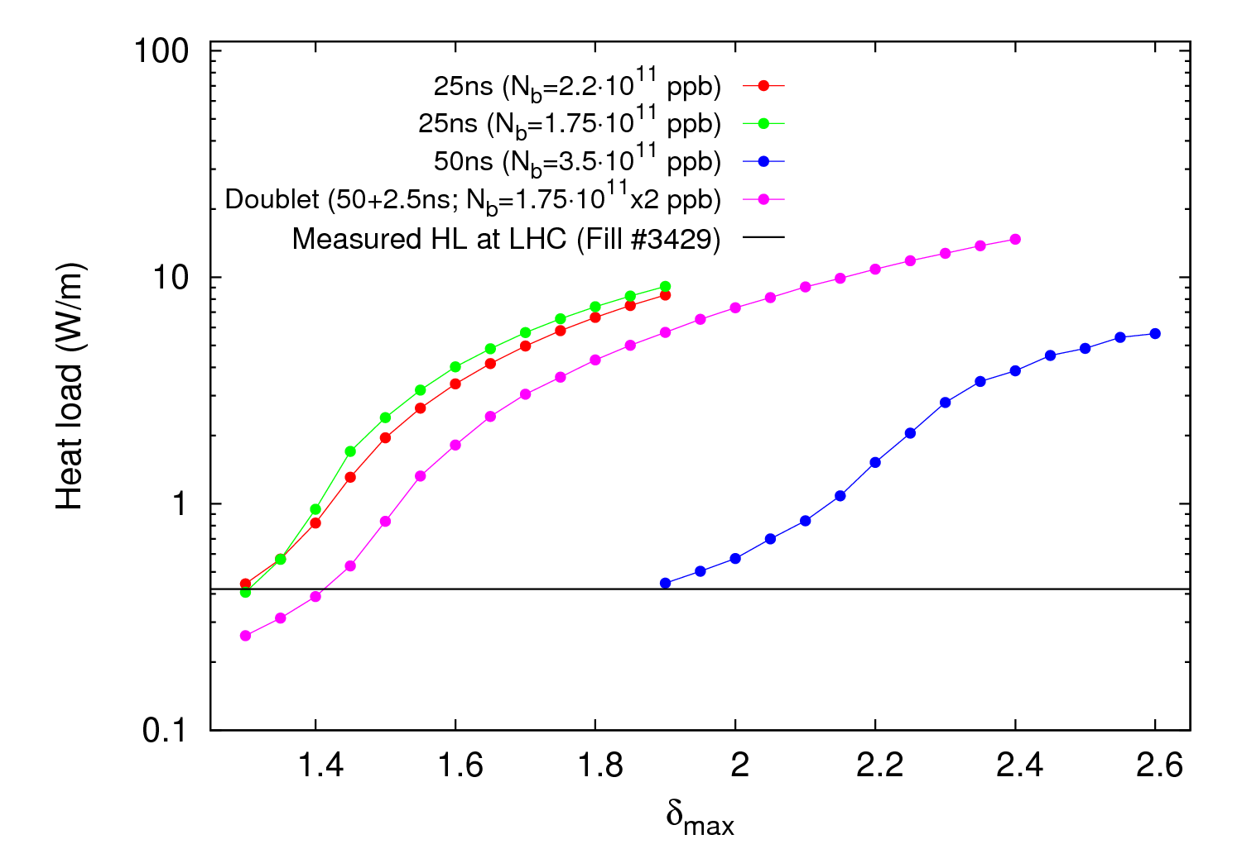
HL-LHC: “Doublets”
And what if instead of 25 ns we use 50-ns bunch spacing?
Luminosity performance similar to pure 25 ns with N_{b}=1.75∙10¹¹ ppb (~70% machine availability), although still t_{recomb.} > t_{opt}
e⁻ cloud activity much worse than pure 50 ns but considerably better than the base line 25 ns
In case of long fills (for whatever reason), recombination could still be used
50-ns “Doublets” could be another backup option for operation
O. Domínguez – e-cloud metting– 21 October 2013

Slide 18
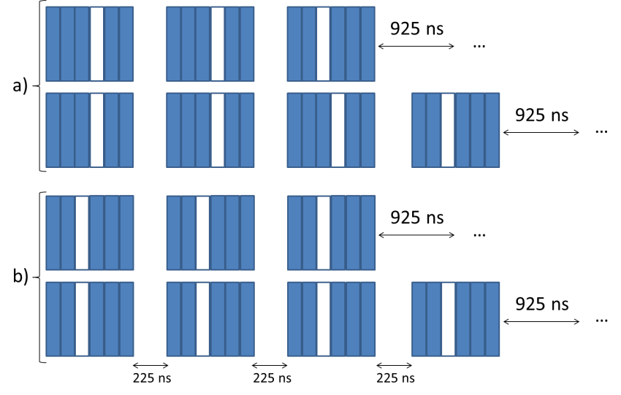
HL-LHC: 12-bunch gaps
e⁻ cloud maps have been used to minimize the electron cloud with 12-bunch gaps in several filling schemes (pure 25 ns, 25-ns doublets and pure 15 ns)
The structure of the batch minimizing the e⁻ cloud activity is always the same:
The machine availability in the threes cases is reasonable:
Scheme | Machine availability* (%)
Baseline (25 ns) | 59
12-bunch gaps (25 ns) | 71
12-doublet gaps (25 / 2.5 ns) | 68
12-bunch gaps (15 ns) | 65
* Needed to achieve 250 fb⁻¹
in 150 days
O. Domínguez – e-cloud metting– 21 October 2013

Slide 19
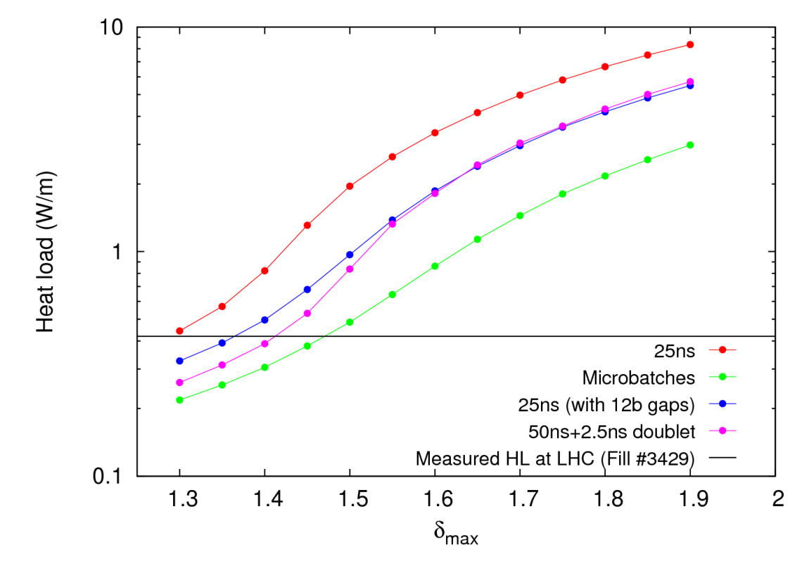
HL-LHC: 12-bunch gaps
Only the heat load for the scheme with pure 25 ns is lower than the baseline scenario
The e⁻ cloud activity is comparable to the 50-ns doublets
No extra hardware would be needed
Slow conditioning could allow filling the gaps over time, thereby increasing luminosity
This option could be already used after LS1 if e⁻ cloud hinders operation
O. Domínguez – e-cloud metting– 21 October 2013

Slide 20
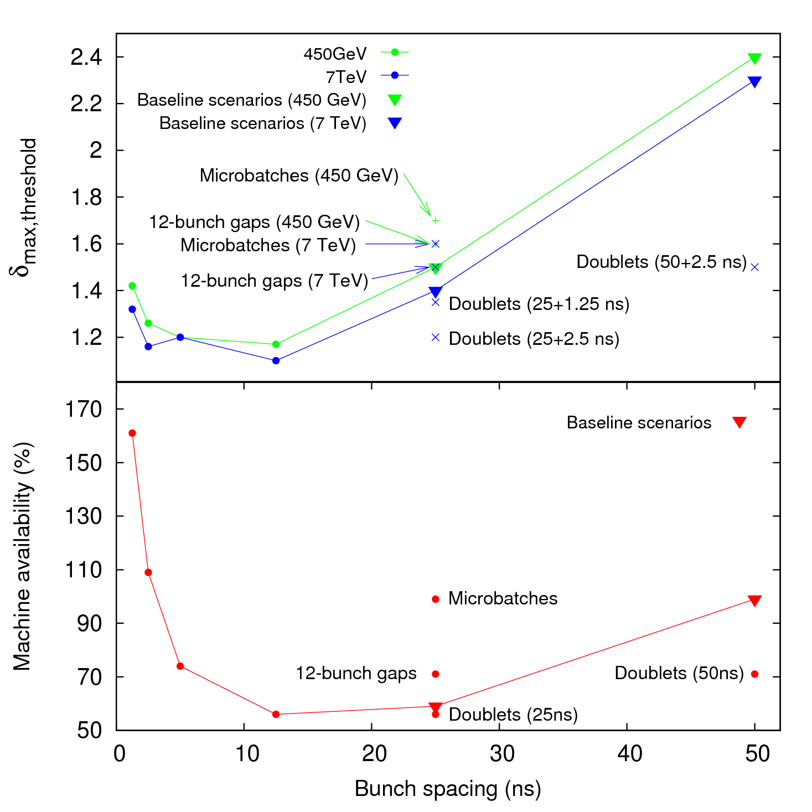
HL-LHC
Summary of the alternative filling schemes
δ_{max, 2012} ≈ 1.45 (arcs)
Levelling at 135 events per Xing
Turn-around time = 5 h
Microbatches: 24 bunches/batch
Doublets: generated with
LHC RF gymnastics
12-bunch gaps: missing injection
from PSB to PS
Suggested fallback scenario:
25 ns with 12-bunch gaps
  No extra hardware
  Better e-cloud than baseline
  Slow conditioning
  Possible for LHC after LS1
O. Domínguez – e-cloud metting– 21 October 2013
Notes:
Mention that if pile-up or PACMAN bunches present problems, Microbatches is another fall-back scenario

Slide 21
Outline
PART I – Quick revision of the “old” alternative filling schemes
PART II – New exotic proposals
O. Domínguez – e-cloud metting– 21 October 2013

Slide 22
HL-LHC: “8b + 4e”
Split in 12 bunches (2-2-3)
72 bunches/batch
1 LHC batch
N_{b}
1.5 x N_{b}
6 PBS-to-PS injections
Split in 8 bunches (2-2-2)
48 bunches/batch
Similar or better luminosity performance than standard
No extra hardware is needed Could also be used after LS1!
O. Domínguez – e-cloud metting– 21 October 2013

Slide 23
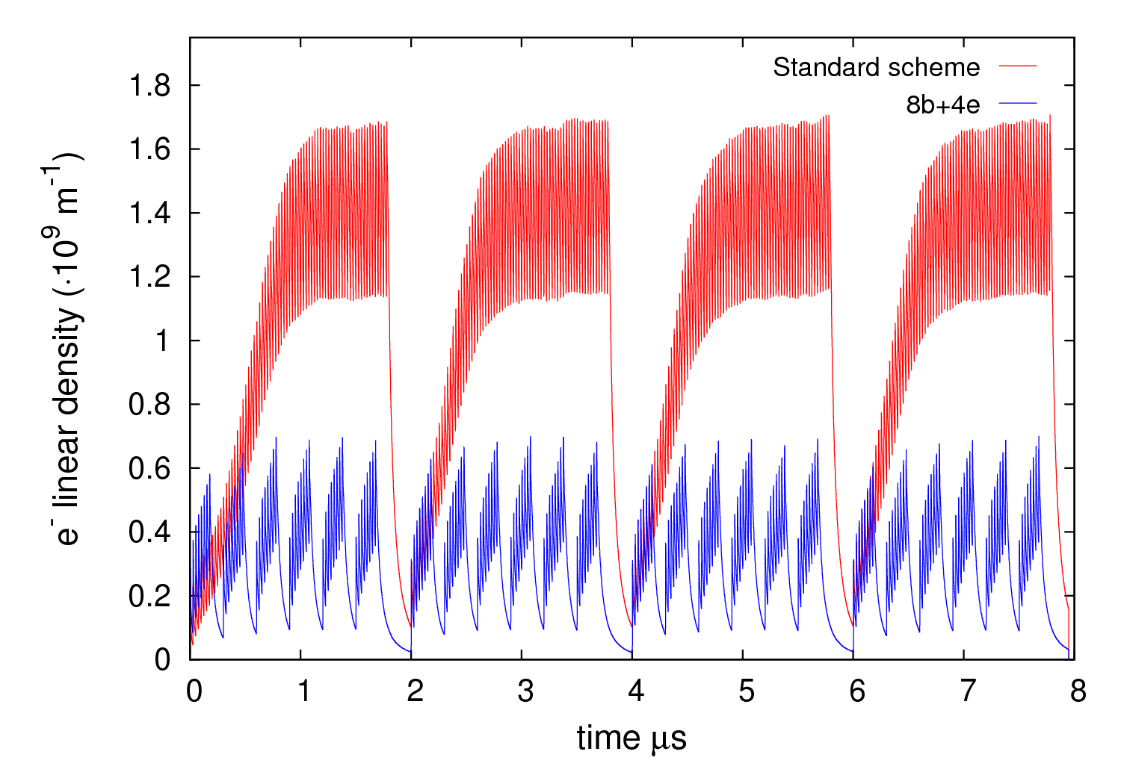
HL-LHC: “8b + 4e”
Example for US1 scenario:
N_{b} = 1.9(2.85)∙10¹¹ ppb
ε_{x,y} = 2.62 μm
δ_{max} = 1.55
R = 0.7
ε_{max} = 332 eV
7 TeV
O. Domínguez – e-cloud metting– 21 October 2013

Slide 24
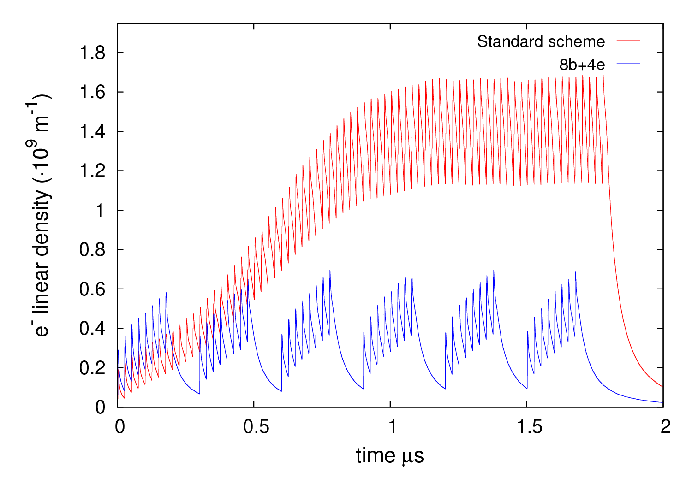
HL-LHC: “8b + 4e”
Example for US1 scenario:
N_{b} = 1.9(2.85)∙10¹¹ ppb
ε_{x,y} = 2.62 μm
δ_{max} = 1.55
R = 0.7
ε_{max} = 332 eV
7 TeV
O. Domínguez – e-cloud metting– 21 October 2013

Slide 25
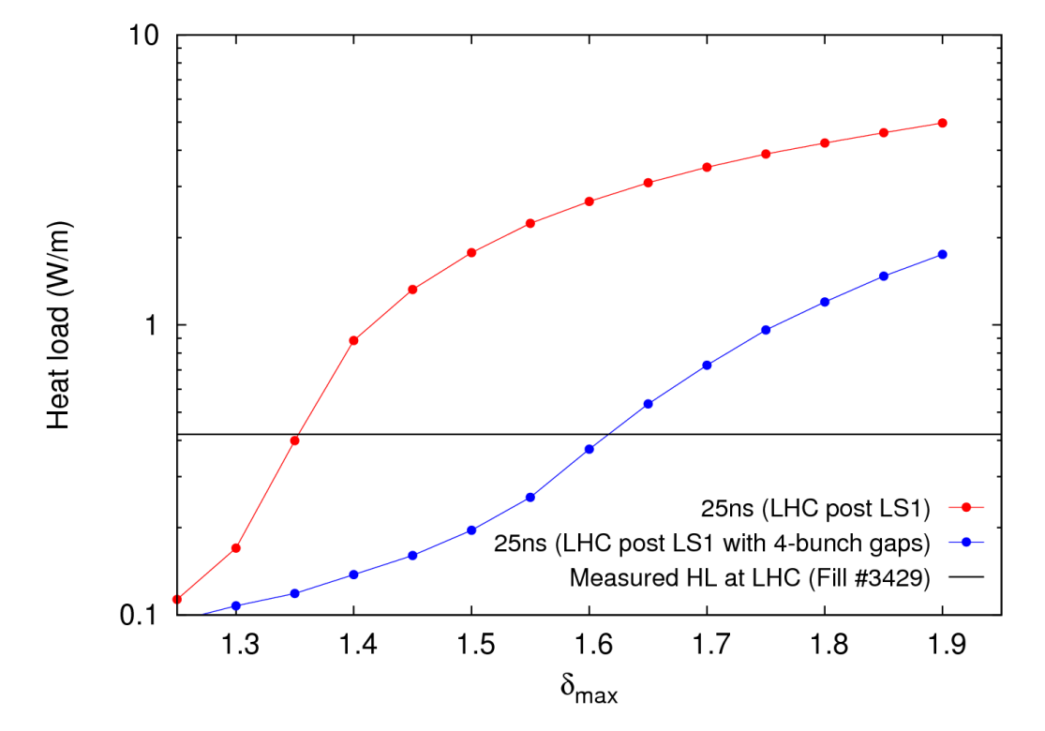
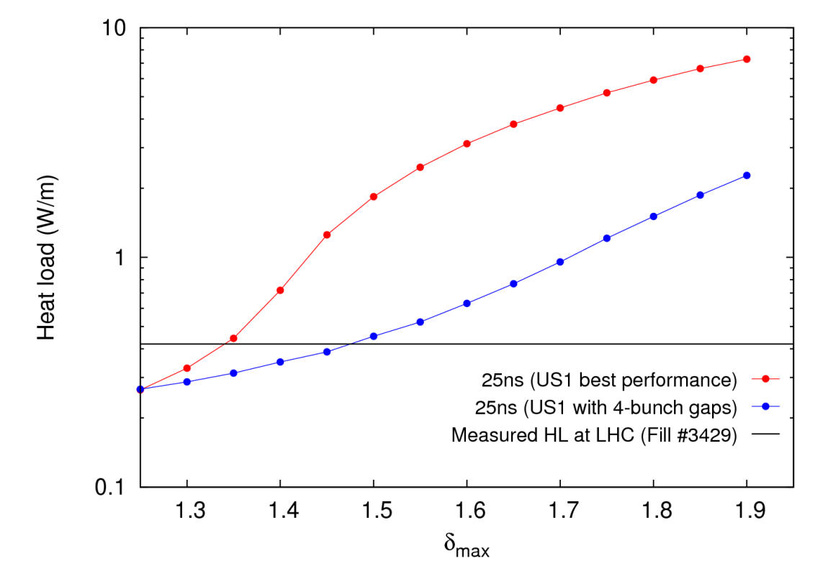
HL-LHC: “8b + 4e”
LHC post LS1
Only dipoles considered
β* levelling assumed for performance analysis
HL-LHC US1
O. Domínguez – e-cloud metting– 21 October 2013

Slide 26
HL-LHC: 200 MHz (US2)
200 MHz superconducting cavities with σ_{z} leveling and a cheap triplet give 11% lower performance than baseline US2 scenario (with new triplet and crab cavities) but offer:
  lower risk
  lower e-cloud
  lower cost
  20% lower pile-up density
  shorter fill
  lower beam-beam tuneshift
And if we add this cavities to the US2 scenario (most expensive option) we increase a 6% the performance
O. Domínguez – e-cloud metting– 21 October 2013

Slide 27
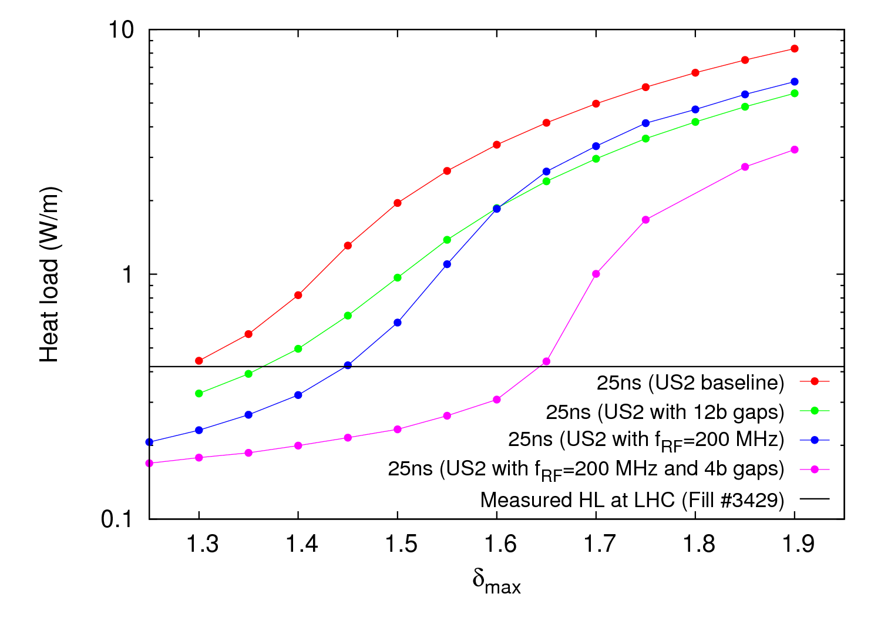
HL-LHC: 200 MHz (US2)
Only dipoles considered
β* levelling assumed for performance analysis
 | N_{b} (∙10¹¹ ppb) | σ_{z} (cm) | ε_{x,y} (μm)
US2 (baseline) | 2.2 | 7.55 | 2.5
US2 (200 MHz) | 2.56 | 15 (lev.) | 3.0
US2 (200 MHz+”8b+4e”) | 3.3* | 15 (lev.) | 3.0
* N_{b} should be 3.75∙10¹¹ ppb
O. Domínguez – e-cloud metting– 21 October 2013

Slide 28
Conclusions
New alternative scenarios are being considered for HL-LHC
  “8b+4e”:
    No extra hardware is needed
    Similar (or slightly better) performance
    Much lower e-cloud activity
    Can be used after LS1
  200 MHz for a US2 scenario:
    Cheaper
    Lower risk (shorter fill, weaker beam-beam effects)
    Lower e-cloud activity
    200+400 MHz (2.5 ns) doublets? Too large e-cloud
    200+400 MHz (2.5 ns) doublets+”8b+4e”? Under study
O. Domínguez – e-cloud metting– 21 October 2013

Slide 29
THANKS FOR
YOUR ATTENTION

