Slide 1
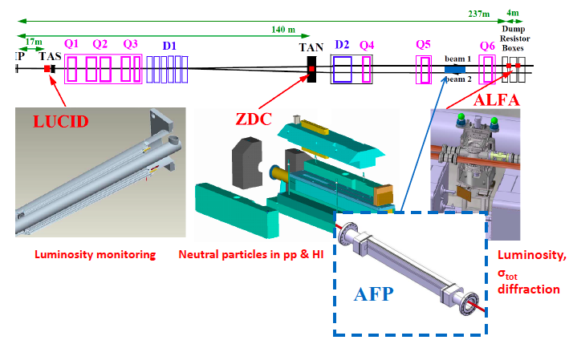
AFP Project
Brief Update
Progress Report status
Forward physics
Detector
Physics program
Why AFP is necessary in addition to ALFA
Summary of running conditions
Background
AFP Physics Review
AFP Technical Review
The collaboration

Slide 2
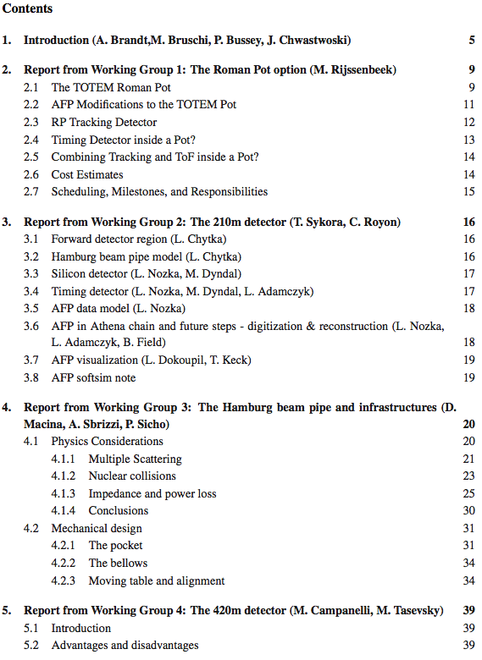
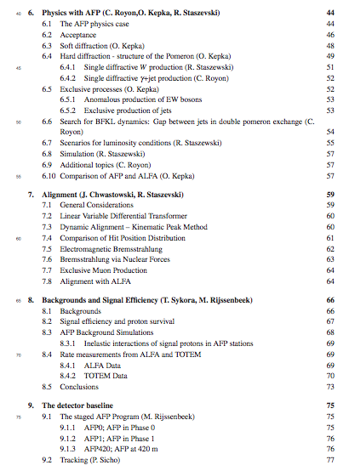
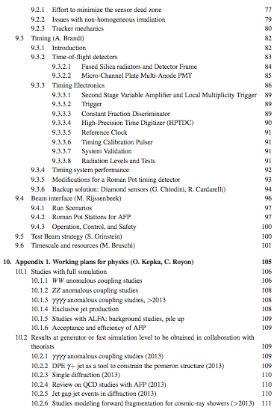
AFP Progress Report
http://cds.cern.ch/record/1595300
Updated version posted on CDS on September 28th

Slide 3
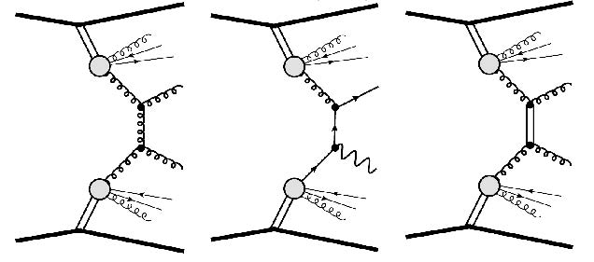
Forward Physics: any process where at least one particle goes forward
At proton colliders, the protons typically interact inelastically, i.e. the collisions are between partons from protons
  While most of particles produced in these collisions are detected in the central detector, most of energy escapes undetected.
    In a fraction of Forward Physics: one or both protons stay intact: measure them with AFP and provide ξ & t (these make up around 20% of total pp x-section)
Single-tag: Single Diffraction
Jets, W, Z: Soft survival prob. S²
Double-tag: Double-Pomeron Exchange
Dijet: constrain gluon content of IP
γ+Jet: constrain quark content of IP
Jet-gap-jet: test BFKL IP
Double-Photon Exchange
γγ→ WW/ZZ: Anomalous quartic couplings → sensitivity ~x100 wrt only central det.
γγ→ µµ: calibration/alignment of AFP
Central Exclusive Production
Dijets, Trijets: constrain predictions to CEP of Higgs (S², Sudakov suppr., unintegr. f_{g})
Interested in Forward Physics? → instrument the forward region
Primary goals of AFP:
p*
IP:= ‘Pomeron’, a color-less object with Q-numbers of the vacuum
IP
IP
IP
IP
IP
IP
γ
γ
AFP Progress report : Section 6
IP
IP

Slide 4
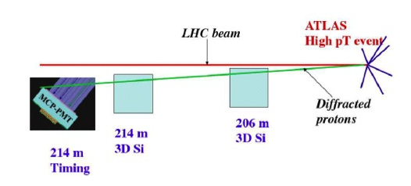
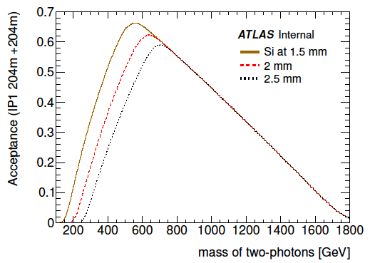
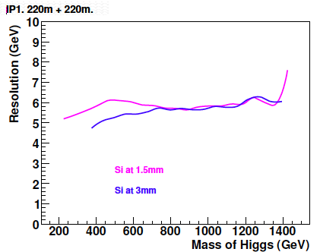
The AFP detectors
AFP Progress report : Section 9
214 m
3D Si
204 m
3D Si
214 m
Timing
Purpose:Tag and measure diffractive protons at 210 m (two arms)
Precision MASS SPECTROMETER. In case of both p are tagged M=√(ξ₁ξ₂s)
Detectors
  Radiation hard “edgeless” 3D Silicon detectors with ~μrad angular resolution for proton tracks reconstruction
  High performing timing detectors
  (~ 10ps resolution, for proton pile-up background rejection at high mu)

Slide 5
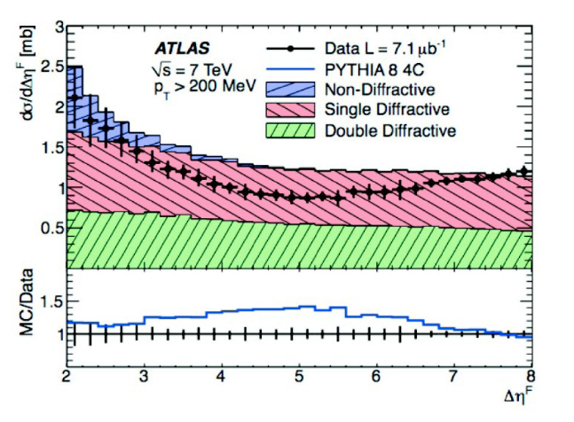
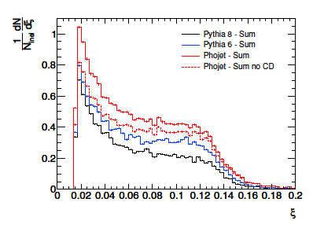
Soft diffraction program
Measure as a function of ξ and t to test triple-Pomeron approach in the Regge Theory. Theoretical models differ factor of ~2
High mass soft diffraction
  charged particle distribution constrains particle production as a function of ξ
  Since Pomerons are gluons dominated, production of strange particles in soft diffraction can lead to a better understanding of strangeness formation in hadronic processes
Nearly all the analyses performed by sQCD group of SM, and that are mainly sensitive to non-diffractive events, could be repeated with one or two proton tags.
All these measurements are useful to tune MC generators
AFP Progress report : Section 6.3

Slide 6
Hard Diffraction program
Proton tagging at ATLAS will allow the study of hard diffraction, expanding and extending the investigations carried out at CERN by UA8, at HERA by H1 and ZEUS and at Fermilab by CDF and D0, and recently also by CMS
From HERA and Tevatron measurements, a consistent picture emerged of Pomeron having a structure and dPDF governed by DGLAP evolution.
There are however alternative theoretical developments where diffraction is a byproduct of a color rearrangement in the final state – Soft Colour Interaction (SCI)
At LHC it will be possible to test the Pomeron model and search for deviations signaling other production mechanisms.
AFP Progress report : Section 6.4

Slide 7
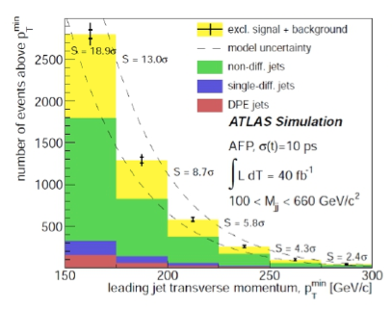
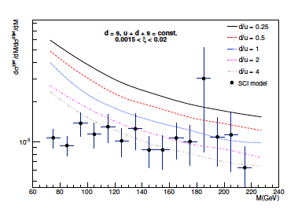
Hard Diffraction program
• Exclusive processes
• QED: γγ exchange
  • Anomalous couplings: Test of EW symmetry breaking (γγWW, γγZZ, γγγγ)
  • Search for Monopoles
• QCD: DPE
  • Exclusive Jet production: constrain
  diffractive Higgs production
  • Jet-gap-Jet to test BFKL dynamics
  • γ+jet production. Measurement of ratio of γ+jet over dijet cross sections will allow direct study of the quark content of the Pomeron
• SD W production (to be finalized)
• W charge asymmetry in single diffractive
production is sensitive to the flavour structure
of the Pomeron, in particular to u/d ratio
• HERA measurements cannot distinguish
between different quark flavours, but AFP can!
AFP Progress report : Section 6.4

Slide 8
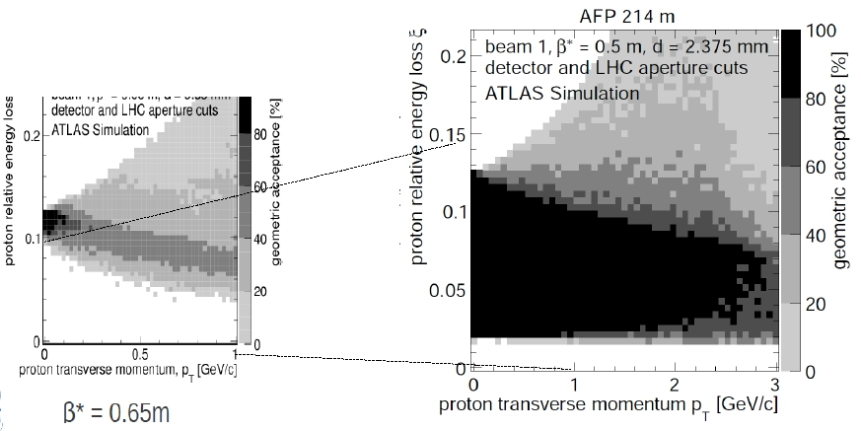
Why can’t it be done with ALFA
Some diffractive program can, but the acceptance is not ideal at nominal LHC optics
  - horizontal detectors missing !
Trigger complications – ALFA can only trigger on separated bunches (>600ns)
  - Dead time probably improved after shutdown to 100-200ns
ξ~0.1 really the limit of Pomeron model, we would like to measure below that
AFP acceptance also larger then of CDF acceptance 0.035 < ξ< 0.09
Both detectors at ~15 sigma
ALFA

Slide 9
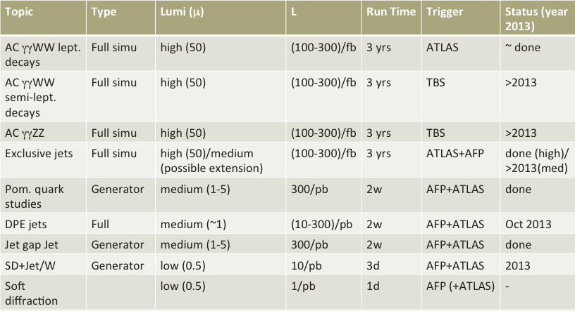
Summary of running conditions
All these studies have been reported in the progress report or in separate notes addressed by the progress report itself (see slide 13)

Slide 10
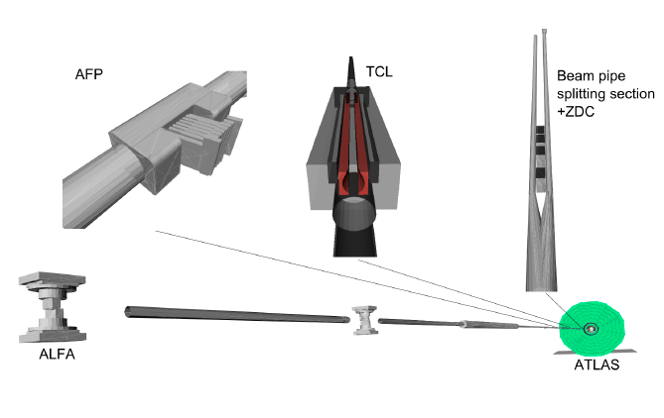
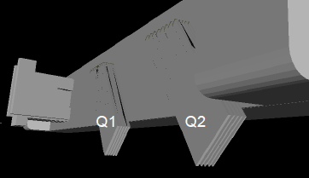

Forward region full simulation
Decisive improvements for
Detector studies
Physics analysis
Beam background studies
Full Integration in ATHENA:
a few details missing (dump D3PD)
Recently ADDED:
Roman Pot (RP) simulation for AFP (also timing in RP)
Reconstruction for tracking
AFP Progress report : Section 3

Slide 11
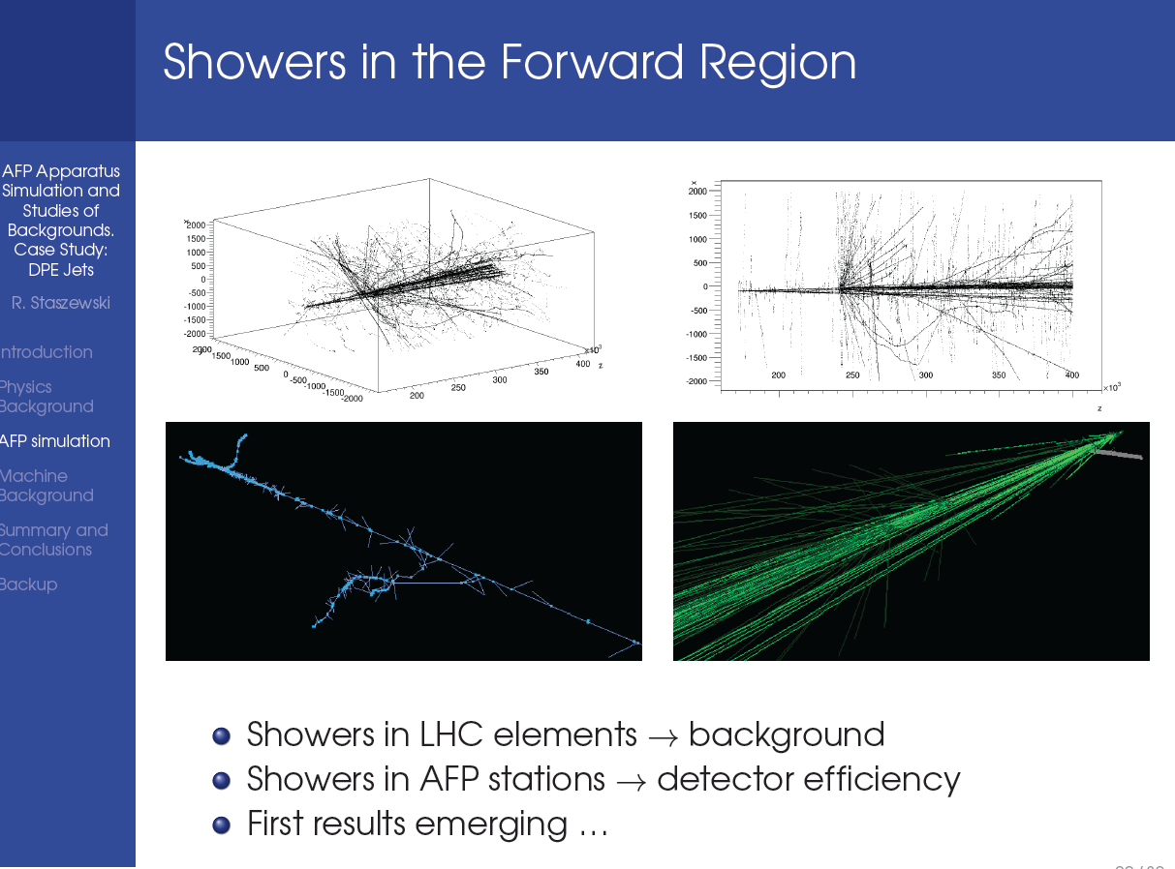
Full MC simulation ready
AFP Progress report : Section 3

Slide 12
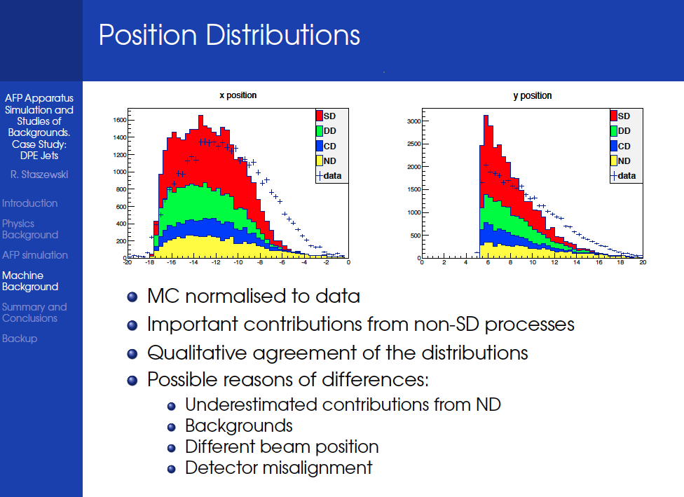
Background studies
AFP Progress report : Section 8

Slide 13
AFP Physics Review
ATLAS Reviewer committee
Paul Newman (chair)
Halina Abramowicz
Richard Hawkings
Mika Huhtinen
Koji Terashi
plus ex officio
Phil Allport (upgrade coord.)
Beniamino Di Girolamo (TC)
Bill Murray (physics coord.)
The AFP physics review process started on August 28th with the submission of the prepared material to the ATLAS reviewers
The progress done by AFP in the simulation and background was acknowledged
Final Physics Review after middle October when full simulation of DPE+jets analysis is expected to be also available and background normalization will be more settled
Interaction with reviewers mostly on the CDS page of the AFP progress report (everybody is welcome to participate)
First set of reviewers’ questions in CDS were already answered last week : http://cds.cern.ch/record/1595300
All the documents prepared for the physics review can be found in the AFP twiki page: https://twiki.cern.ch/twiki/bin/viewauth/Atlas/AFPDocuments

Slide 14
AFP Technical Review
This talk is mostly centered in giving details about the physics review
However, the activity around the detector is also advancing
  Beam Interface (HBP, RP well advanced)
  Timing detector (integration in RP, irradiation of the electronics)
  Tracking detector (Test beam results on non uniformly irradiated sensors, demonstrator available)
  Test beam (Organization of Test beam this year, and Tracking+Timing next spring)
All this can be found in the Progress Report
TC has all the material available and interaction has started, probably mini-reviews of different parts in the next weeks
This review also should be finished before the end of November

Slide 15
The AFP collaboration
Canada: Alberta, Toronto
Czech: Olomouc, Prague AS, Prague CTU
France: Saclay
Italy: Bologna, Genova, Milano, Roma2, Trento
Norway: Bergen, Oslo
Poland: Cracow AGH UST, Cracow AFJ PAN
Portugal: Lisbon
Spain: Barcelona
Switzerland: Bern, Geneva
USA: Arlington (Texas), New Mexico, Oklahoma, Stony Brook
AFP Progress report : Section 9.6 for details
Presently: 20 people involved at >50%
Future potential:23 Institutes, 80 people (30 FTE) !
AFP MUST pass Physics and Technical reviews
before the end-2013 if we want to realize it
Institutional/National commitments for AFP are time-critical
  Timing (USA): only R&D funds available now
  Tracking: needs institutional commitments for manpower
  Both require a strong message of support from ATLAS

Slide 16
Backup

Slide 17
Conclusions
AFP Program covers all luminosity scenarios and adds to the existing forward physics significantly
  - Especially for nominal running conditions
From bread and butter QCD, Pomeron structure, to more fancy topics, BFKL and exclusive production of vector bosons, search for highly interacting particles (monopoles)
Feasibility studies done at different schemes, driven by pile-up contamination
With the handled document we think we have provided enough motivation for the physics case
Supporting documentation – link to notes and papers presented here & more
- https://twiki.cern.ch/twiki/bin/viewauth/Atlas/AFPDocuments

Slide 18
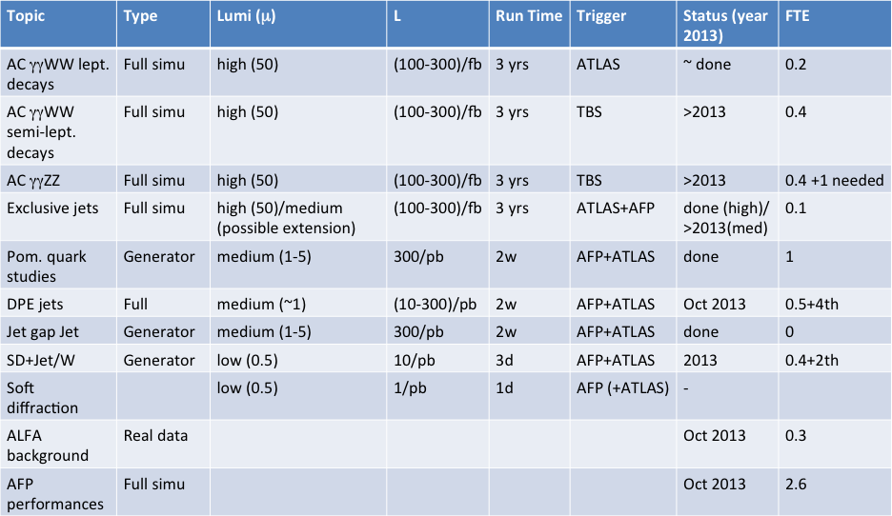
Summary

Slide 19
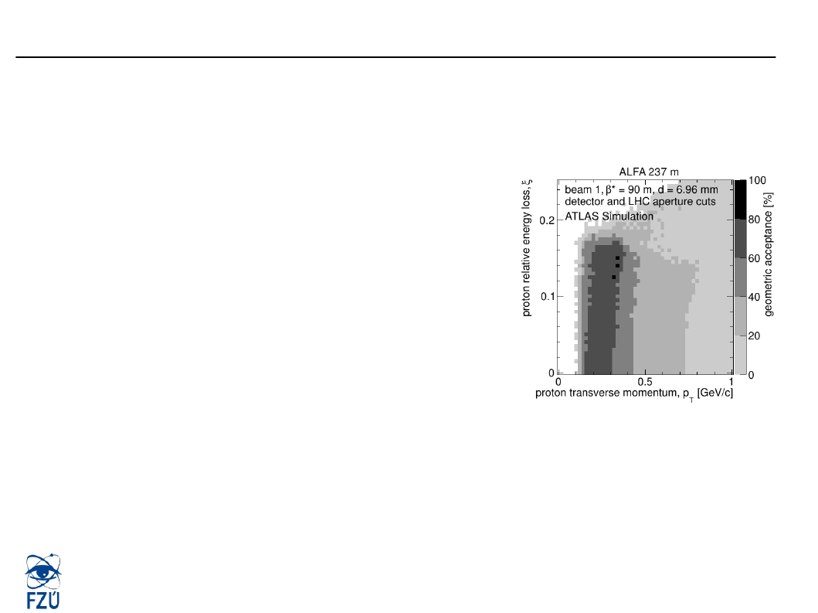
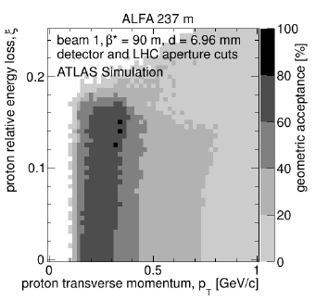

AFP and ALFA
●
●
●
●
Does it mean that AFP is a replacement of ALFA in terms of diffraction (ALFA total
cross section program is justified by itself)?
- No! At least until AFP is equipped with vertical pots with silicon detectors and a
trigger system (timing detector)
High-beta* parallel LHC optic has it's advantages with
vertical detectors
- Acceptance for all ξ, but limited in t
- Below ξ<10-3 resolution bad, only tagging
- TOTEM clearly prefers this high-beta* optics
as a main low-mu optics for initial low-mu runs
The advantage of AFP is running at nominal collision optics (nominal beta*)
- Requesting low-mu special runs but nominal collision optics is easier, radiation
hardness
Nevertheless ALFA+AFP need to work together to make a good diffractive program of
ATLAS
PRAGUE
Oldrich Kepka
36

Slide 20
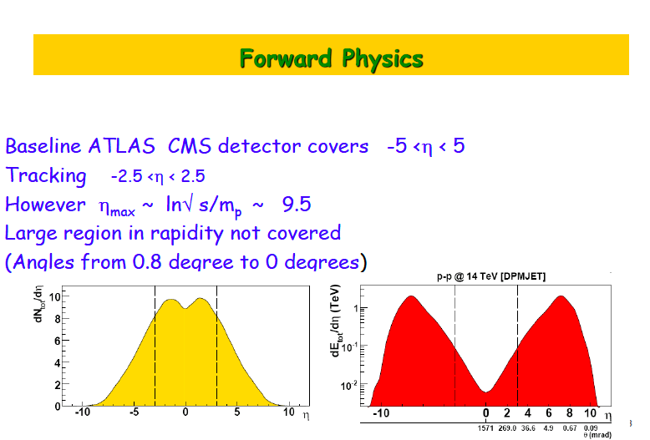

Slide 21
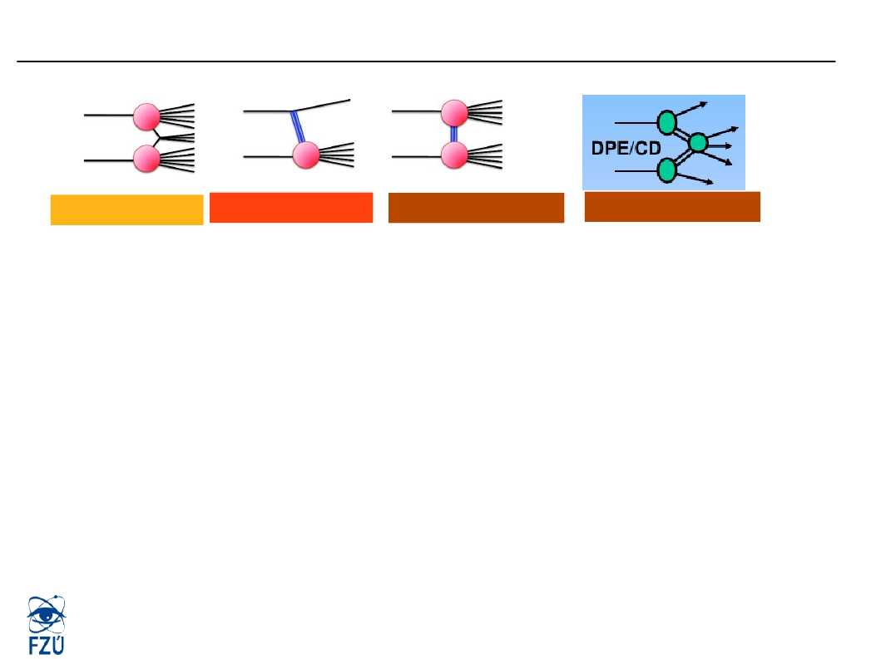

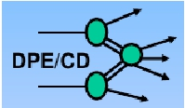
Soft Diffraction - Inclusive measurements
Non-diffractive
Single-diffractive
Double-diffractive
Central diffractive
●
●
●
●
Traditional measurements use rapidity gap method to separate contributions of
inelastic production
- Horizontal detectors in AFP very little acceptance to elastics for any optics
ATLAS has limited |η| < 4.9 coverage works only for relatively small Mx = sqrt(sξ) of
diffractive system because Δη = - log(ξ)
- Indirect measurement of ξ via energy seen in calorimeter not very precise due to
invisible energy and works only in a limited region of ξ
No measurement of t
Proton tagging is the only way if diffraction to be probed in detail
PRAGUE
Oldrich Kepka
5

Slide 22
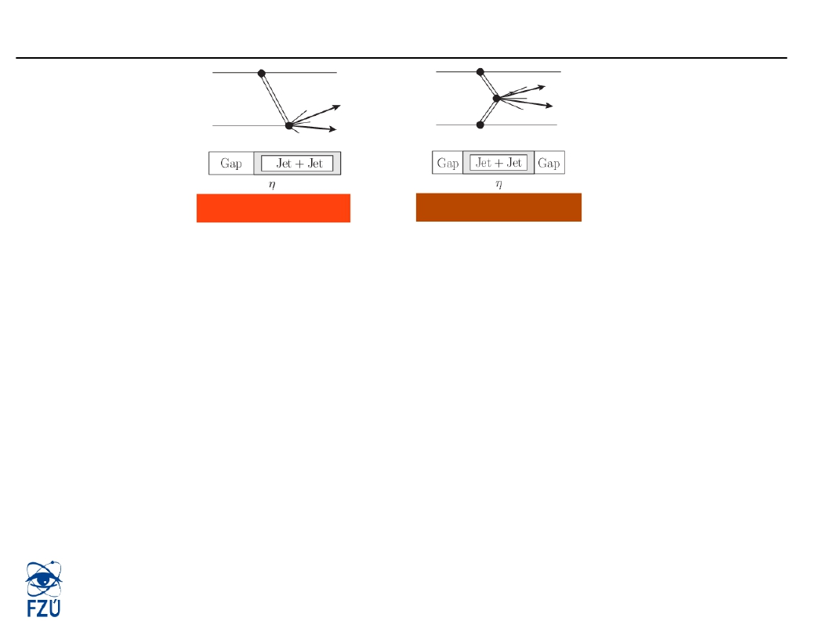
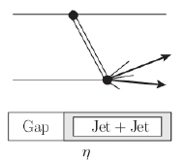
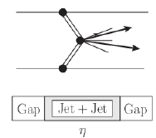
Hard diffraction
Single-diffractive
Central diffractive
●
●
●
●
Single diffractive events – pp → pX
- Dijets, meson, γ+jet, vector boson production
Double Pomeron exchange (Central Diffraction)
- Smaller rate compensated by a possibility to remove combinatorial background
using fast-timing
Single diffraction restricted to runs with low pile-up: mu < 0.1
Background due to pile-up negligible for mu=0.01
PRAGUE
Oldrich Kepka
14

Slide 23

Running conditions
●
●
●
●
●
1. Start from very low luminosity at µ=<0.1 for one or two days (1/pb)
- Performance studies of the detector and soft diffraction measurements.
2. Increase the luminosity to µ=3 for one or two days in order to check how the
detectors perform in higher luminosity and how we deal with pileup.
3a. If we see problems with pileup, have a one week run with the condition between
µ=0.1 (10/pb) and µ=1 (100/pb)
- This should allow for studies of SD jets, SD W, SD Z (µ=0.1 preferred), DPE jets and
DPE JGJ
- Triggering rates impact mainly jets at µ=0.1
3b. If we can deal with pileup, we can run one week at µ=3 (or higher), which will give
greater statistics in all processes and additionally allow for DPE gamma+jet
measurement.
Calculated for 2800 bunches and 25 ns
PRAGUE
Oldrich Kepka
37

Slide 24
Needed run conditions
1) Low luminosities (1-few days)
  <1 pb⁻¹– 10 pb⁻¹ , μ<0.5
  Soft diffraction, pA runs, SD (dijets/W/..) – particle production, etc.
2) Medium luminosities (1-3 weeks)
  Hundreds of pb⁻¹, μ=0.5
  Hard diffraction DPE, Pomeron structure –double tag-timing needed
3) High luminosity (3 years)
    Hundreds of fb⁻¹, μ=50-100
    Exclusive production, Anomalous quartic coupling γγWW, detailed study of electroweak symmetry breaking, Exclusive DPE jets

Slide 25
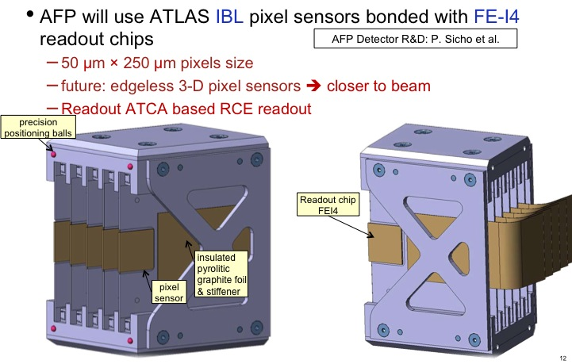
Tracking Detectors
AFP Progress report : Section 9.2

Slide 26
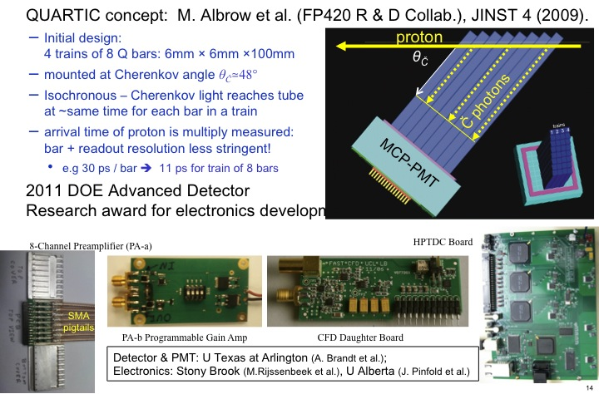
AFP Fast ToF
AFP Progress report : Section 9.3

Slide 27
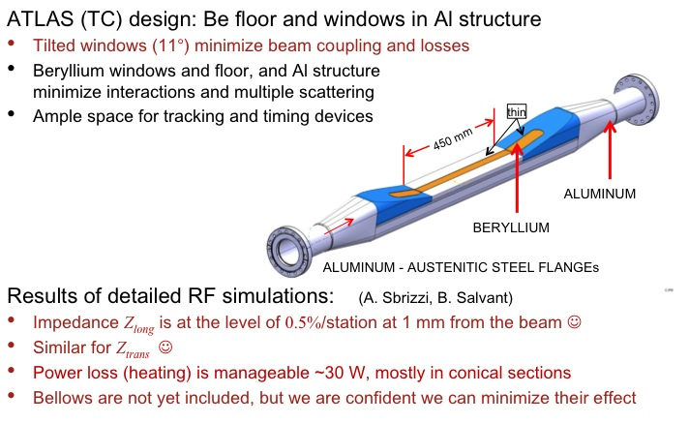
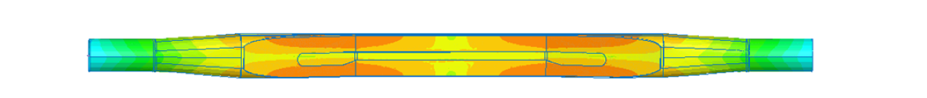
Hamburg Beam Pipe
Power loss surface density over the HBP with an 11° pocket
AFP Progress report : Section 4

Slide 28
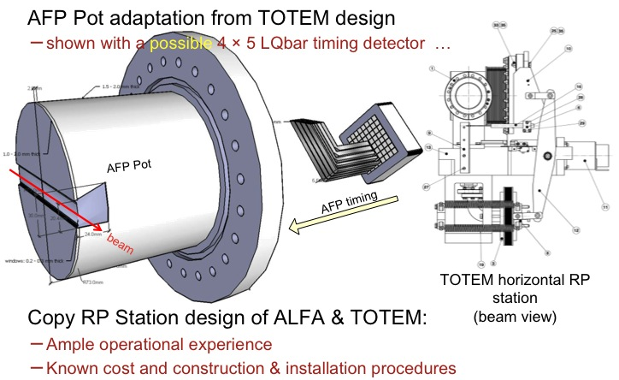
AFP RP & STATION
Simulations (+test beam) show that ~20/(10) ps res.
can be achieved in a shared/(dedicated) RP
AFP Progress report : Section 2

Slide 29
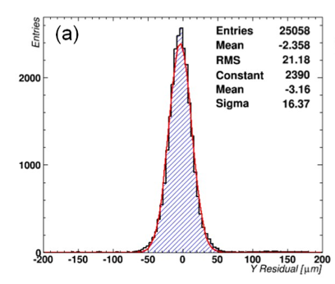
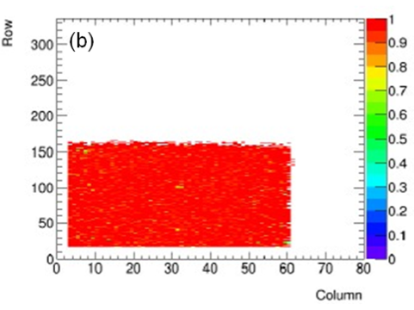
AFP Beam Tests: Schedule ,
Plans & Manpower
Tracking
  June 2013 at DESY (4GeV electrons) - DONE
    Tested four AFP (slim-edged) un-irradiated prototypes
    Obtained good efficiency (97-98% after removing noisy pixels)
  July 2013 at DESY - DONE
    Tested non-uniformly irradiated device (not slim-edged)
    Analysis in progress, consistent with previous results (arxiv.org/abs/1302.5292)
  Plan: January 2014 at DESY
    Objective: Measure irradiated slim-edge samples
  Manpower: IFAE, UW, Prague, CERN, Bologna
Timing
  January 2014 at FNAL (120 GeV protons)
    focused on optimizing RP timing detector
  Manpower: Stony Brook, UTA
Full system test
  Spring 2014 at SLAC (~10GeV electrons)
  Tracking + timing system integration tests
  Objective: system integration, triggering and mechanical setup, alignment
  Manpower: Prague, SLAC, UTA, Stony Brook, IFAE, Bologna
16um resolution
(including contribution from telescope)
98.3% hit reconstruction efficiency
Preliminary results from AFP/3D June 2013 DESY Test beam
for a CNM device
AFP Progress report : Section 9.5

Slide 30
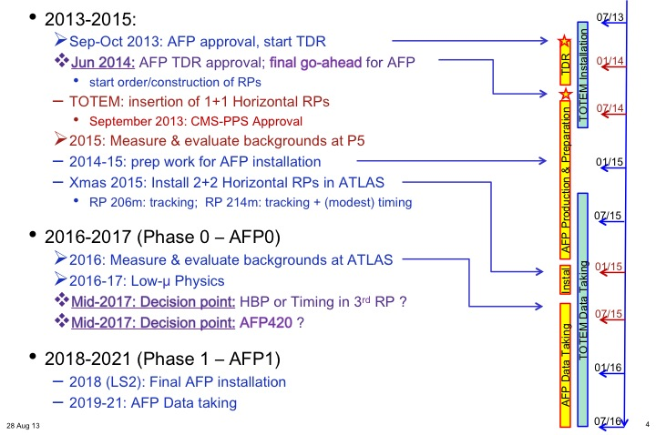
AFP staged approach
AFP Progress report : Section 9.1

Slide 31
Resources
Detailed tables available on the Progress Report about
  Manpower
  Time schedule
  Costs
Some fine tuning expected for the technical review
Funding scheme critical (for the US collaboration, but not only)
CRITICAL PATH: Any delay in reaching the ok for TDR can kill the project
Since we are convinced on the quality of the understanding of the detector and of the physics potential we look forward for a quick physics and technical review process
AFP Progress report : Section 9.6

Slide 32
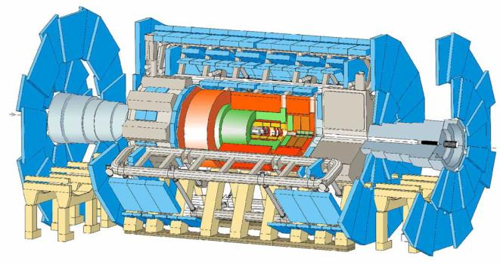
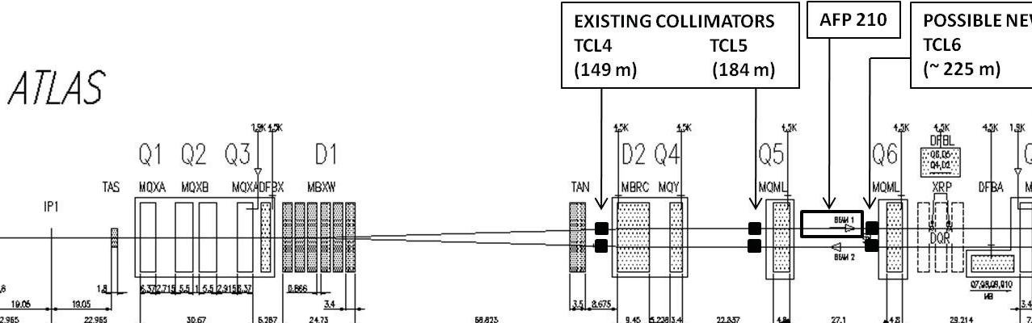
ATLAS Forward detectors
LUCID
~17m
Particles at |η|~5
ZDC
140m
Proton / Ion remnants: γ, π⁰, n
AFP
206m-214m
Diffractive
protons
ALFA
237m-241m
Elastic protons
The 40 m long central ATLAS detector detects/identifies/measures most interaction products, except those going down the beam pipe!
➔ ATLAS Forward Detectors

Slide 33
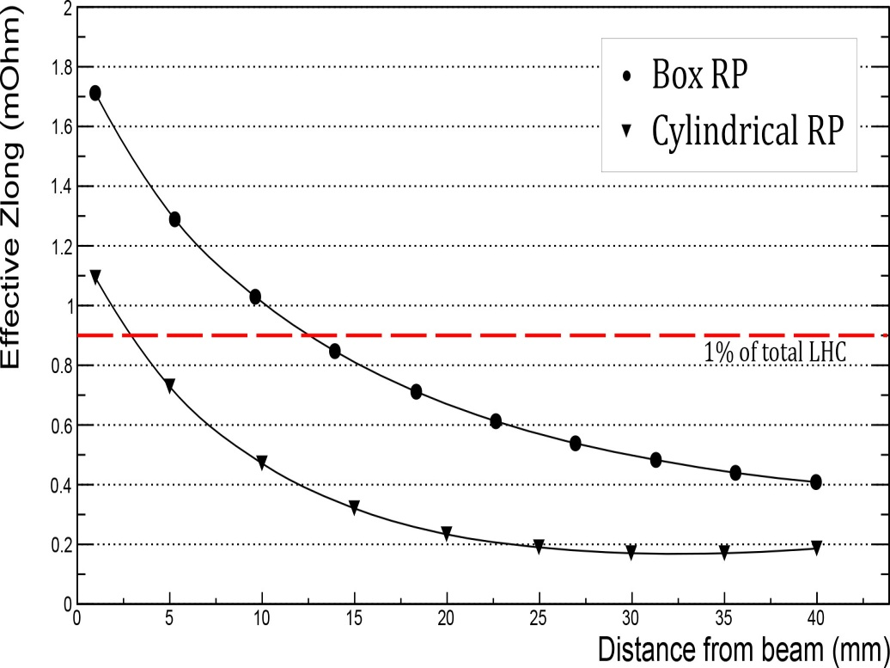
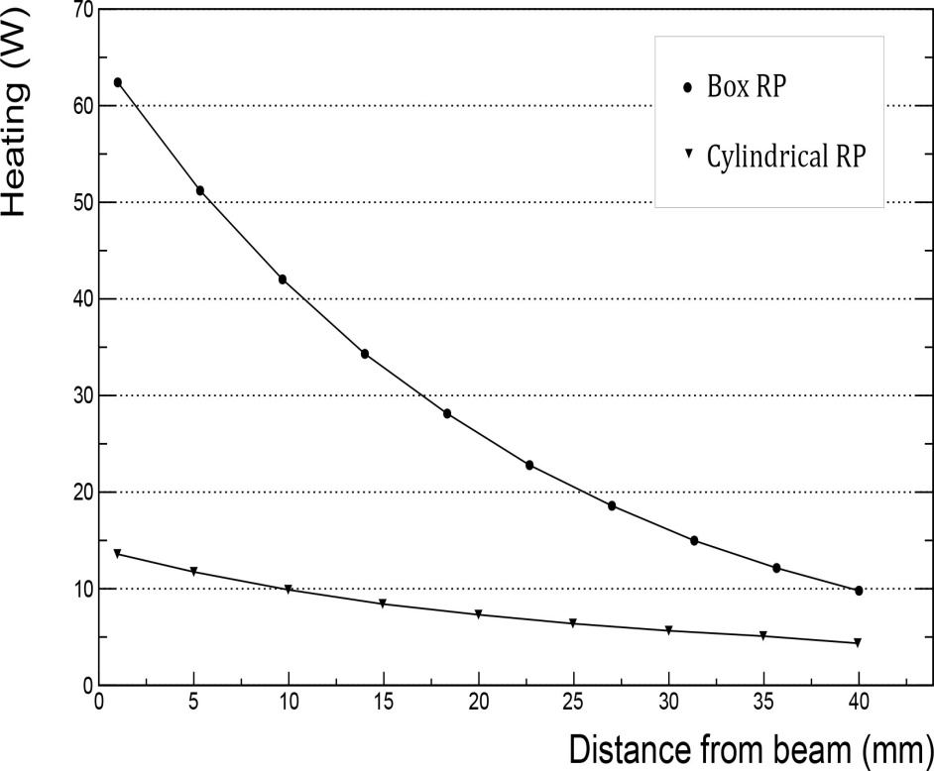
Simulations: Impedance and Heating
TOTEM simulations (N.Minafra, B.Salvant, et al.)
 | Distance to beam (mm) | (mΩ) | cfr. LHC: 90 mΩ (%) | (kΩ/m) | cfr. LHC: 25 MΩ/m (%) | Power Loss (W)
Cylindrical RP | 1 5 40 | 1.1 0.73 0.18 | 1.2 % 0.81 % 0.20 % | 60 | 0.2 % | 13 11 4
TOTEM Upgrade TDR – June 2013

Slide 34
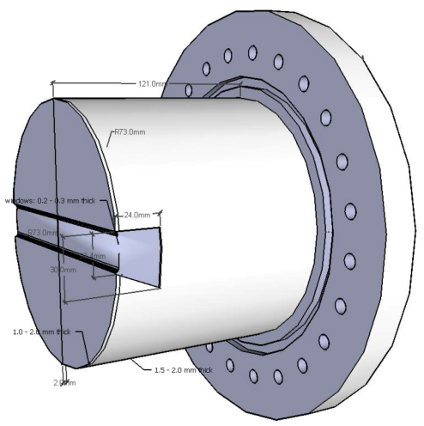
Pot and Window Materials
Al pot with Be window and floor?
  Started discussion with BNL RP physicist & engineer
  Discussing with Materion Corp. re Beryllium & Composites
    Be window with 2 mm SS pot (incl. conflat): ~18 k$
    Materion makes Be beam pipes for LHC experiments
    and Be supports, X-ray windows
      see e.g. https://indico.cern.ch/conferenceDisplay.py?confId=245511
➔
➔
➔
Al/SS
Be

Slide 35
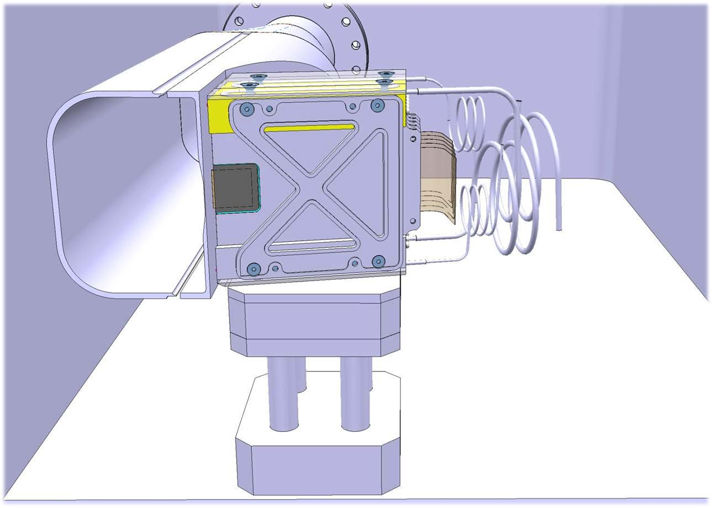
Si Tracker in Hamburg Beam Pipe
readout flex
thin floor
sensors
evaporative
cooling ?
7 TeV
proton beam
6.5 TeV
diffractive proton
IBL Pixel sensors with FE-I4 readout
dead region ~100 μm

Slide 36
Electronics Layout Phase 0
AFP1 Baseline: 5 trains of 4-6 channels/side:
  if the CFD is sufficiently radiation-hard, it can be located at 214 m
  if the HPTDC is sufficiently radiation-tolerant, it can be located at 214 m
      active irradiation tests Sep, Dec 2013
Feed
through
AFP2
crate
RR13 ?
crate
USA15
crates
Quartic
Trigger (LMR600)
CTF
PA-b
Trigger
64× Signal
(SMA)
LE
TDC
ToT
PA-a
Att
CFD
ToT
(50 Ω)
Signals
Opto
Board
Data
BOC-ROD
or RCE
LV
+6V 5A
LV
+6V 20A
DCS
DCS
DCS
8× Temp
(uD)
DCS
DCS
2× Pressure
iseg
HV
8× HV
(32 ch REDEL-HV)
214 m
214 m
240 m
0 m

Slide 37
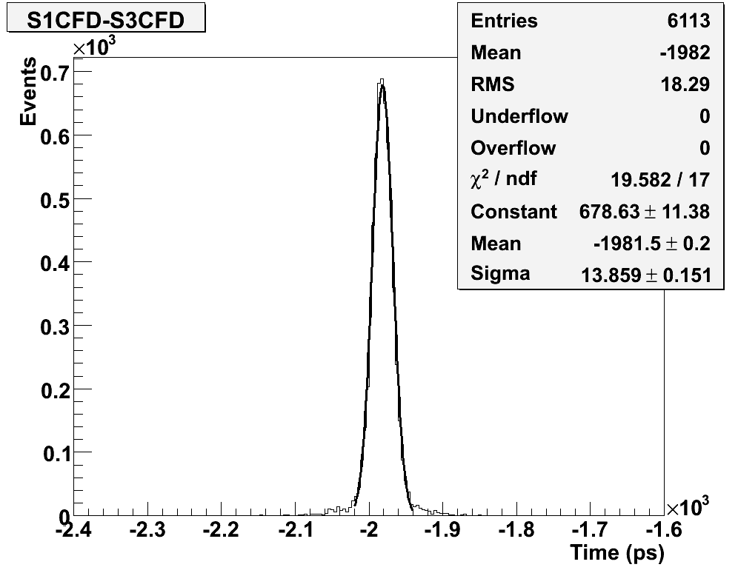
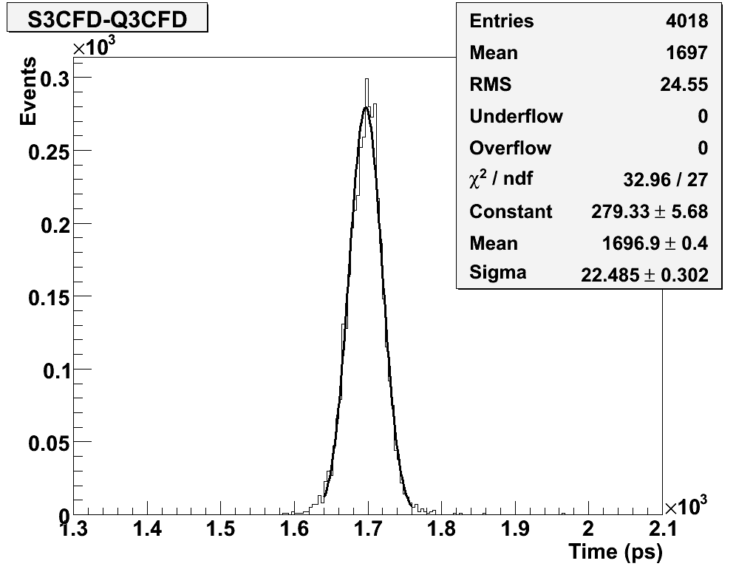
ToF Resolution: Test beam 2012 FNAL
30 mm long Quartz bar // beam read
by SiPM: σ_{t} ≃ 10 ps for a SiPM (CFD only!)
  excellent resolution! ☺
  not very radiation hard ☹
2 mm wide × 6 mm deep (in beam
direction) Quartz bar positioned
at 48° with beam (Cherenkov angle),
read by 10 μm pore MCP-MAPMT
  single bar: σ_{t} ≃ 20 ps (CFD only!)
    4 bars at 48° (~32 mm): expect ~10 ps ☺
  single bar with 17 ps HPTDC: σ_{t} ≃ 26 ps
    6 bar train measurement (Test Beam): ~11 ps
  rad hard tube (no degradation seen yet up to 5 C)
Multiple measurements ➔
  Modular system: ‘tunable’ resolution, size,
  and interaction length …
SiPM₁ – SiPM₃
SiPM₃ – Qbar₃

Slide 38
Some Highlights of Timing R&D
Using test beam and laser tests we have demonstrated a prototype timing system for a Hamburg Beampipe capable of 11 ps resolution including electronics
Developed with background group new simulation and visualization techniques that allow us to conclude that we can achieve <10 ps in a dedicated Roman pot, and <20 ps in a shared Roman pot
We have developed with Arradiance+Photonis a special phototube capable of sustained proton rates in the 5-10 MHz /pixel range, with a lifetime estimated to >100 fb⁻¹
Plan to have a 20 ps detector suitable for sharing a Roman pot in 2014
With funding and a dedicated RP, no known obstacles to a 10 ps high lum ToF system in 2015

Slide 39
Ultimate Timing System Resolution
reached and extrapolated timing resolutions:
  Currently at 11-12 ps (Fall 2012 Test beam) with 6 bars;
  ultimate performance of this system is probably about 8 ps
Component | σ_{t} (ps) Current | σ_{t} (ps) Projected | Action
Radiator/MCP-PMT (~10 pe’s with 10 µ pores) | 19 | 17 | Optimize radiator
CFD | 5 | 5 | -
HPTDC | 18 | 9? | New HPTDC chip?
Reference Clock | 3 | 3 | -
Total/bar | 27 | 20
Total/ detector (6 ch) | 11 | 8 | -

Slide 40
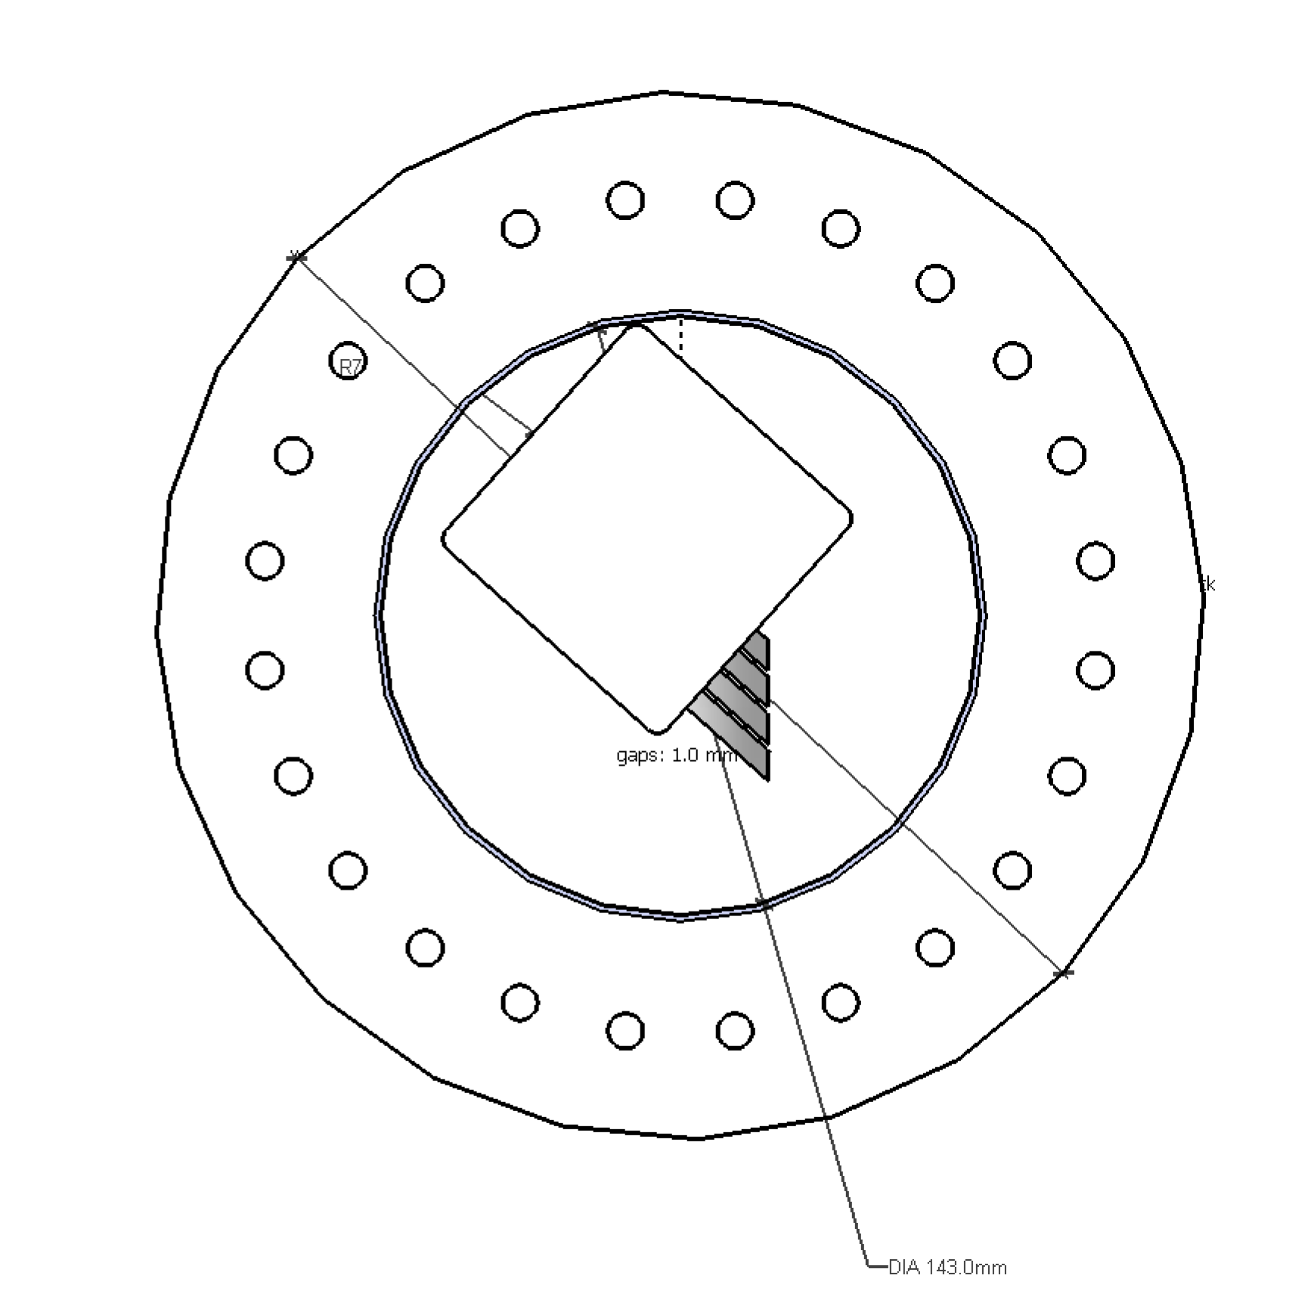
Tracking + Quartic ToF Detector in RP?
Sketch only: to be designed …
  If only 4 LQbars in z-direction:
    material reduced by ½
    σ_{t} increased by √2
    room for tracking planes?
  Make-up the reduction in
  σ_{t} by improved MCP-PMT
  (pore-size) and electronics
  Not doubt, diamond ToF could be fitted together with tracking, but σ_{t} for diamonds is not yet competitive …
Contour of PMT
(Center of uppermost pad to PMT housing edges is 13 mm)
65x15 mm²
θ_{Č} =48°
65x25 mm²
Cylinder Contour
(142 mm ID)
side view (along +x)

Slide 41
AFP POT Modifications
AFP needs changes in the POT design:
  the TOTEM design has a different thin window size, not optimally matched to our acceptance
  the TOTEM floor is a groove in the pot bottom:
    requires a bump-out of the tracking sensor,
    making it difficult to insert a Quartic detector close to the beam …
We have more time than TOTEM ➔ use to investigate improvements
  We should make the AFP pot a bit larger (to ~144 mm) by reducing the 2.5 mm gap between the bellows and the pot itself to ~1 mm.
    Making it even larger than that requires a different ‘Tee’ design and RF calculations will have to be repeated to validate a larger cylinder. Unless absolutely necessary, I would prefer to keep the pot to 144 mm ID.
  We should investigate alternative pot and window materials, coatings, etc.
    e.g., a Be window of 200-400 μm thickness welded to an Al pot (cfr. Daniela) would be a huge improvement over the current TOTEM pot in terms of conductivity, radiation length (MS), and interaction length.
Need our own feedthrough plate with the services as we require them, adapting the plate as designed for TOTEM to AFP needs.
    Possibly the plate for the ‘timing’ will be different from the plate for the ‘tracking’

Slide 42
420m
Very useful information from the WG4
Potential for new discovery: presently not foreseen
Several processes studied:
  MSSM exclusive Higgs production (7 recently proposed benchmark scenarios tried out): the only viable is LowMH scenario which needs ~1000 fb-1 and only 420+420 configuration
  Exclusive chargino production: low S/B, Pile-up issue
  NMSSM Charged Higgs: rather low x-section
Experimental challenges:
  420 can hardly be put into L1 trigger
  420 can only be put after LS2 -> very high pile-up
Potential for improving 210m physics program: VERY HIGH
  Acceptance is extended to low mass region
  A better understanding of background for high mass search is provided
CONCLUSION: The AFP collaboration will reconsider 420m installation after year 2016, depending on the following:
  experience gained after one year of running the 210m stations
  experience gained from TOTEM/CMS
  strength of the collaboration

Slide 43
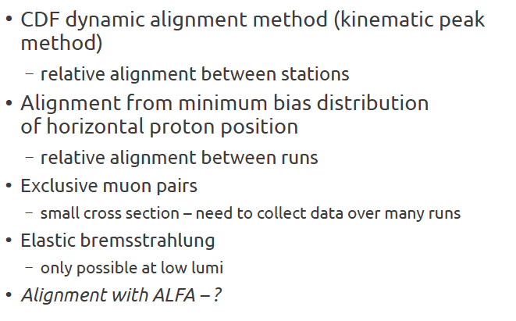
Alignment
AFP Progress report : Section 7
J. Chwastowski, R. Staszewski

