Slide 1
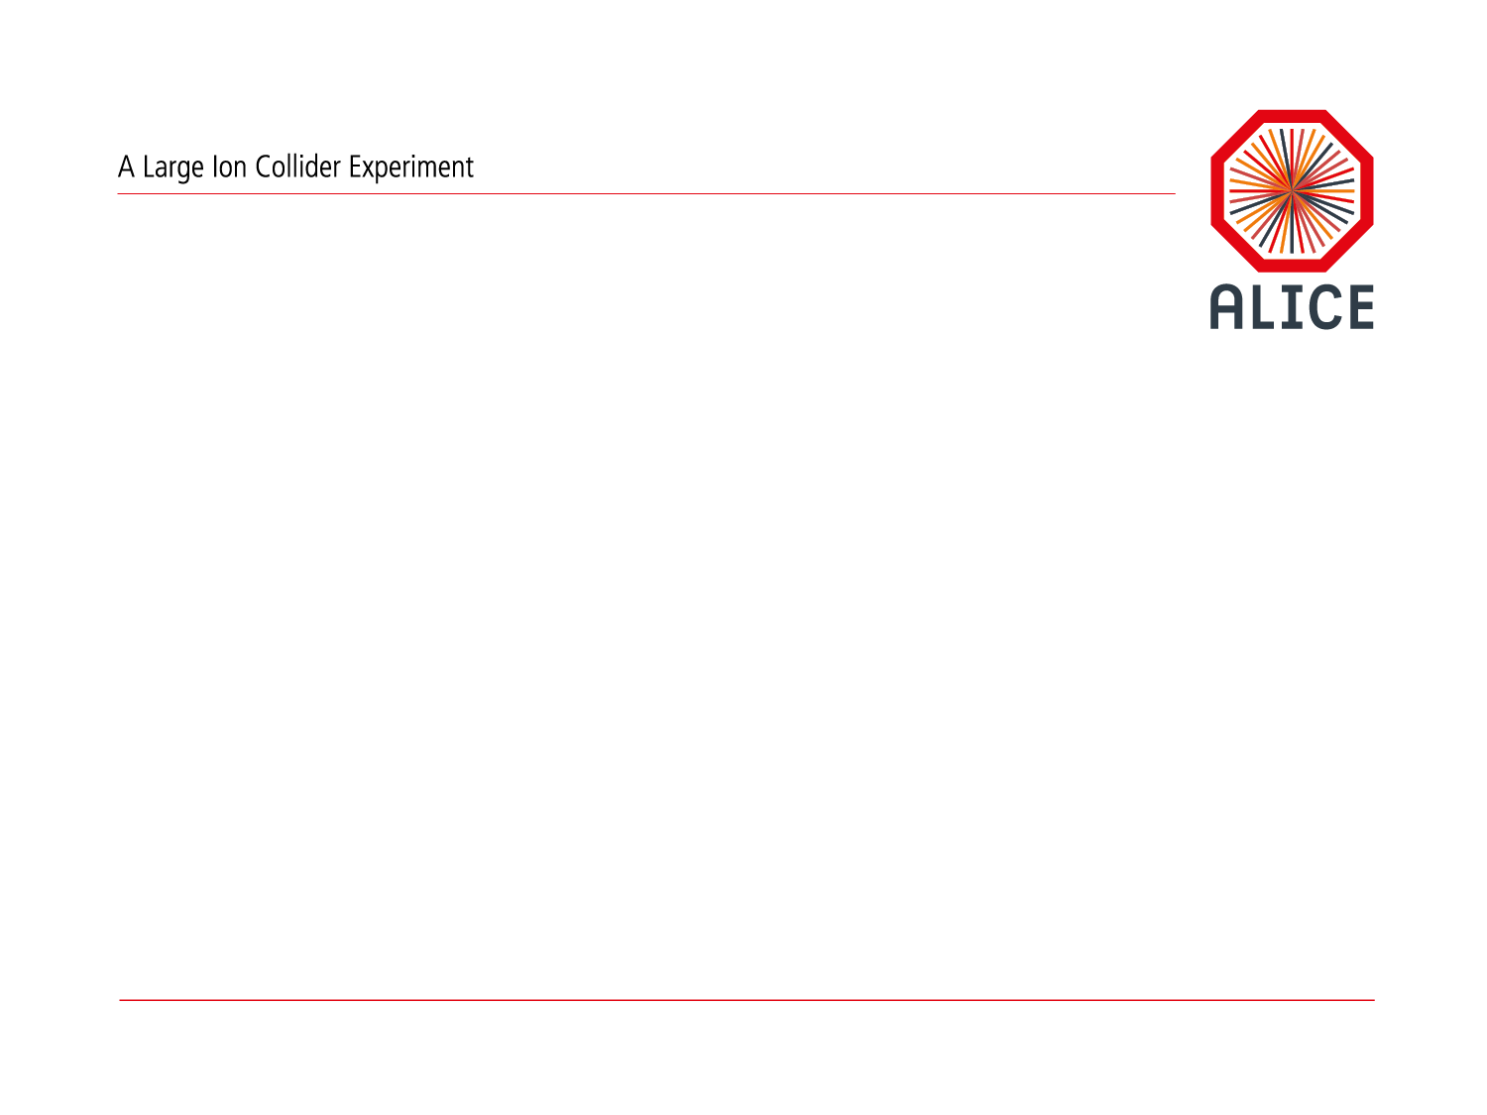
AliEn in ALICE
Predrag Buncic

Slide 2



Alice Environment @ Grid
User Interface
VTD/OSG stack
AliEn stack
EDG stack
Nice! Now I do not have to worry about ever changing GRID environment…

Slide 3
AliEn v1.0 (2001)
New approach
  Using standard protocols and widely used Open Source components
  Interface to many Grids
End-to-end solution
  SOA (Service Oriented Architecture)
    SOAP/Web Services (18)
      Core Services (Brokers, Optimizers, etc)
      Site Services
      Package Manager
      Other (non Web) Services (ldap, database proxy, posix I/O)
  Distributed file and metadata catalogue
  API and a set of user interfaces
Used as production system for ALICE since the end of 2000

Slide 4
AliEn v2.0 (2007)
New API Service and ROOT API
  Shell, C++, perl, java bindings
Analysis support
  Batch and interactive
  ROOT/PROOF interfaces
  Complex XML datasets and tag files for event level metadata
  Handling of complex workflows
New (tactical) SE and POSIX I/O
  Using xrootd protocol in place of aiod (glite I/O)
Job Agent model
  Improved job execution efficiency (late binding)

Slide 5
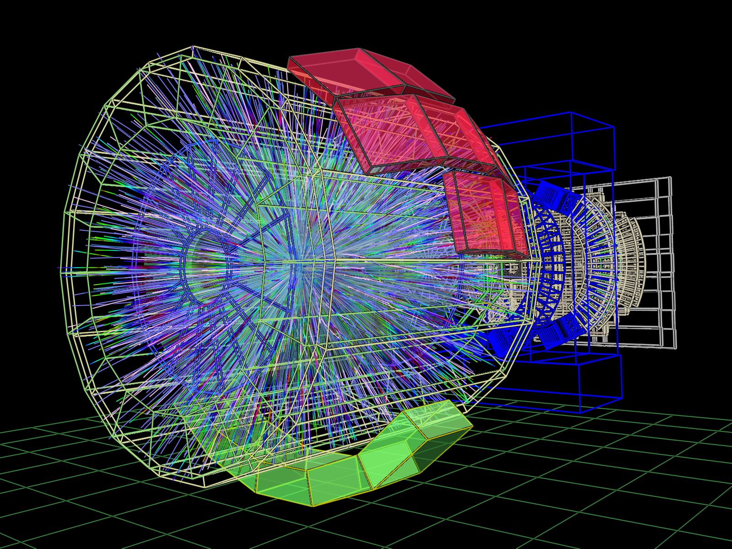
Distributed Analysis
File Catalogue Query
User Job (many events)
Data set (ESD’s, AOD’s)
Job Output
Job Optimizer
Sub-job 1
Sub-job 2
Sub-job n
Grouped by SE
files location
Job Broker
Submit to CE
with closest SE
CE and SE
Processing
CE and SE
Processing
CE and SE
Processing
Output file 1
Output file 2
Output file n
File-merging Job

Slide 6
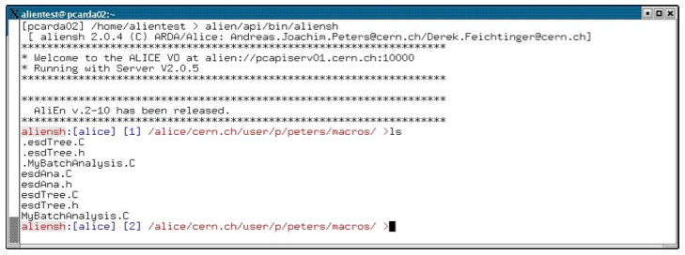
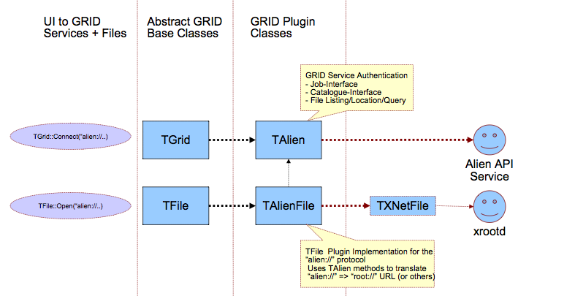
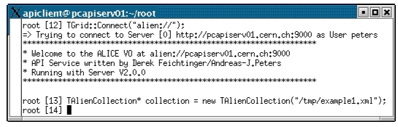
ROOT / AliEn UI

Slide 7
Workflow engine

Slide 8
Analysis trains

Slide 9
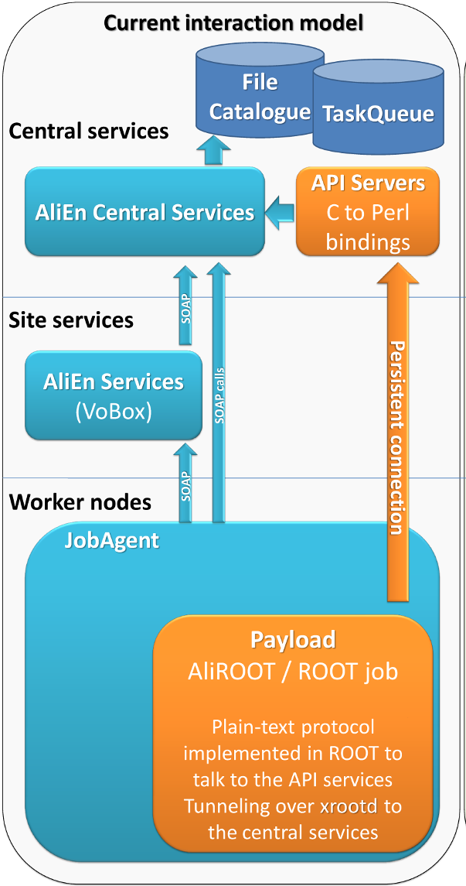
AliEn Summary
  3-layer system that leverages the deployed resources of the underlying WLCG infrastructures and services
    including the local variations, such as EGI, NDGF and OSG
  Interfaces to AliRoot via ROOT plugin(TAliEn) that implements AliEn API
  Complex workflows including distributied analysis built on top of AliEn API
  Used by Panda (at GSI)

Slide 10
MonALISA - Monitoring
50k concurrent jobs
200k jobs per day

Slide 11

ALICE Upgrade plans
  ALICE plans some serious detector upgrades
  Run2 (2015-2017)
    4 fold increase in instant luminosity for Pb-Pb collisions
    consolidation of the readout electronics of TPC and TRD ( readout rate x 2)
  Run3 (2019-2021)
    Continuous readout TPC, ITS upgrade
    50kHz Pb-Pb interaction rate (current rate x 100)
    1.1 TB/s detector readout
    Needs online reconstruction in order to better compress data for storage

Slide 12
Why changes in AliEn?
  While the system currently fulfills all the needs of ALICE users for reconstruction, simulation and analysis there are concerns about scalability of the file catalog beyond Run2
  Need to address the use for emerging cloud, volunteer as well as the opportunistic resources for ALICE
  In general, no manpower for maintenance and continuous development of the current system

Slide 13
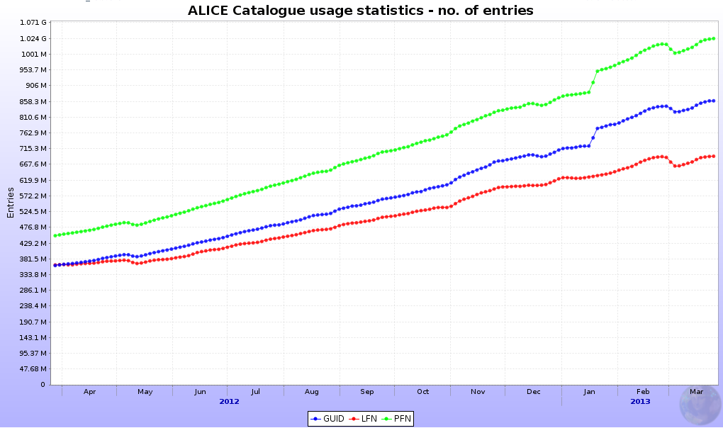
AliEn File Catalog
Over 1B files
2M new files per day
  Data management is built in AliEn, data access using xrood

Slide 14
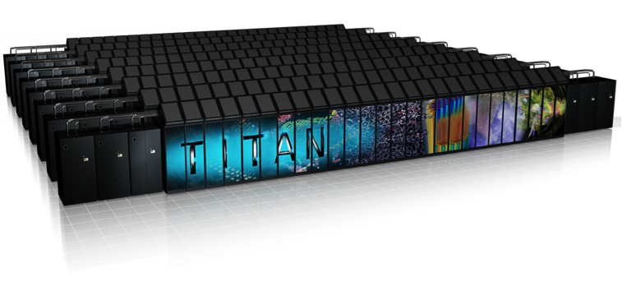

Opportunistic use of SC resources for simulation
18,688 nodes with total of 299,008 processor cores and one GPU per node. And, there are spare CPU cycles available…
Ideal for event generators/simulation type workloads (60-70% of all CPU cycles used by the experiments).
Simulation frameworks must be adapted to efficiently use such resources where available

Slide 15

Not an easy job…
No internet, minimal OS
Compute
Node
Compute
Node
ssh
Login
Node
qsub
Service
Node
arun
Compute
Node
Login
Node
Service
Node
Compute
Node
CVMFS
Squid
Squid
$ [titan-batch6][12:12:09][/tmp/work/atj/cvmfs_install/bin]$ aprun ./parrot_run -t/tmp/scratch /cvmfs/alice.cern.ch/bin/alienv setenv AliRoot -c aliroot -b
*******************************************
* W E L C O M E to R O O T *
* Version 5.34/08 31 May 2013 *
* You are welcome to visit our Web site
* http://root.cern.ch *
* *
*******************************************
ROOT 5.34/08 (v5-34-08@v5-34-08, Jun 11 2013, 10:26:13 on linuxx8664gcc)
CINT/ROOT C/C++ Interpreter version 5.18.00, July 2, 2010
Type ? for help. Commands must be C++ statements.
Enclose multiple statements between { }.
2+2
(const int)4
Thanks to CMS parrot (from cctools) extended
to allow access to CVMFS
(some restrictions apply)
Adam Simpson, ORNL

Slide 16
Interfacing with PanDA (Plan A)
Tactical
SE
AliEn
CE

Slide 17
Interfacing with PanDA (Plan B)
Job
Agent
AliEn
CE

Slide 18
Interfacing with PanDA (Plan C)
ALICE
Plugins
AliEn
CE

Slide 19
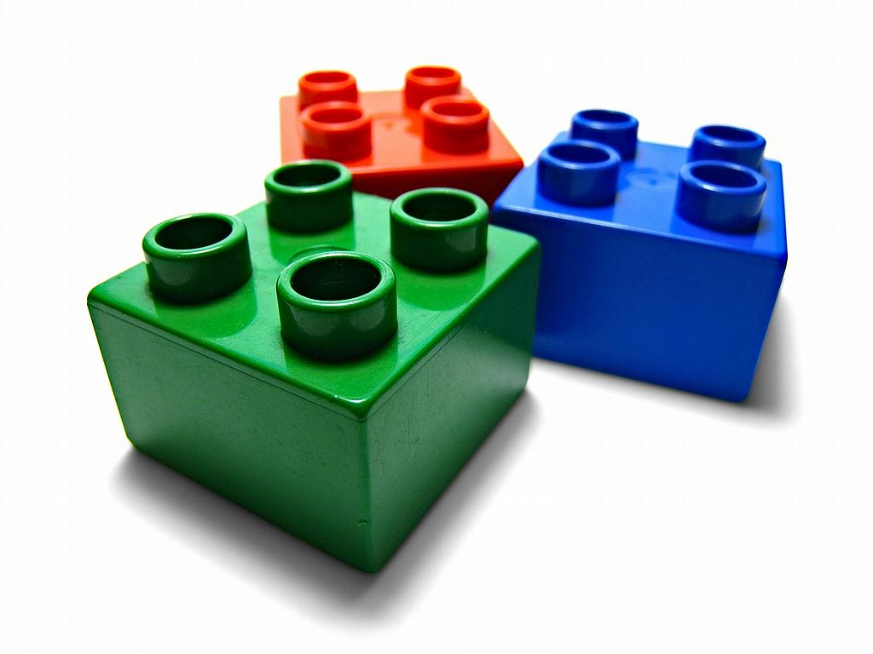
Conclusions
Development is fun, maintenance is boring
  We have to concentrate on upgrade and facing manpower issues
We expect to carry on with current AliEn implementation throughout Run2
  Room for improvement (catalog, data management, clouds)
Run3 will impose much higher requirements compared to Run2
  100x more events to handle
  Huge simulation needs
We need to prepare ourselves to use opportunistic resources to complement our simulation needs
  PanDA is our chance to open a door of potentially large supercomputing facilities
Several scenarios of integration exist, need to find the best one
We have to preserve AliEn APIs to preserve investment in tools built on top of AliEn

