Slide 1
Experience in CMS with the Common Analysis Framework
Ian Fisk & Maria Girone

Slide 2
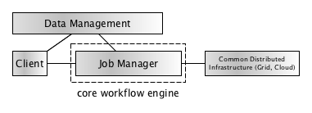
The Objective
To develop a common system for submitting analysis jobs to the distributed infrastructure
  Leveraging on the similarities of the experiments analysis workflows
Using components from the PanDA workload management system, but integrated in the CMS analysis environment
  Building on the proven scalability and stability of the PanDA system

Slide 3
The Project
A three phase project with a defined timeline
  A Feasibility Study – presented in May 2012, at CHEP , New York ⁽¹⁾
  A Proof of Concept Phase – June 2012 - December 2012
  A Prototype Phase – January 2013 - September 2013
Contributions from CERN IT, ATLAS and CMS
  An opportunity for collaborative work
(1) M Girone et al.., The common solutions strategy of the experiment support group at cern for the lhc experiments Journal of Physics: Conference Series, 396(3):032048, 2012.

Slide 4
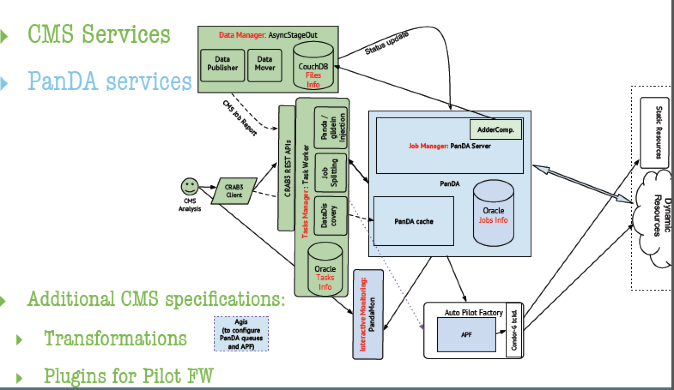
Components Overview

Slide 5
Status of the Test-Bed
We have integrated the CMS specific components and exposed them for validation to power users
We have deployed the CMS instance
  Oracle DB cloned from the PanDA production database
  10 machines installed for all services
  47 CMS sites added to the APF configuration
  Configuration of the APF done through the ATLAS Grid Information System
    Was not easy to separate
Next step is to demonstrate the compatibility of the experiment specific components to the currently used CMS production scheduler (based on Condor and GlideInWMS)
  Completing the original test-bed plan for CMS needs

Slide 6
Components Overview

Slide 7
Components Overview
Job output Manager
Resources
Task Manager
Client UI
Client API
Scheduler
(PanDA)
Monitoring
Resource Provisioning(APF)

Slide 8
Experiment Components
Experiment specific elements are in these layers
  Allowing for interface to other scheduling services
  Task Manager is potentially a generic service
    (Run A before 10 Bs and then run a C)
Task Manager
Client UI
Client API
Job Output manager was written for CMS to avoid integrating the entire ATLAS data management solution into the workflow
  It can be seen as a general component and used by other experiments
Job output Manager

Slide 9
Scheduler
Scheduling element enforces experiment policy and will have experiment specific elements
  The PanDA approach to configuration/scheduling policy changes involves a new release
Scheduler
(PanDA)

Slide 10
Resource Provisioning and Monitoring
Resource provisioning should be entirely independent of the experiment. A generic component for specific resources
  Most obvious for a common component or service
Resource Provisioning(APF)
Monitoring is potentially a passive service and may have experiment specific views and projections, but does not obviously require experiment specific services
Monitoring

Slide 11
Next Steps and Plans
CMS wants to capitalize on the architecture of the CRAB3-PanDA test-bed
  Next important step is to validate the test-bed architecture with the CMS production scheduler (Condor/GlideIn
  This will demonstrate that we fully understand the separation of the interface between the experiment specific services and the scheduling services
Today CMS uses the same scheduler for production and analysis
  Moving to PanDA for analysis would add increased scalability but also complexity to the system (two independent schedulers)
Before CMS embarks on such a system we need to understand the concrete benefit and improvements to sustainability
  A direct comparison is only possible after demonstrating the current testbed with the production scheduler, work ongoing with first results expected in November

