Slide 1
Network awareness and network as a resource (and its integration with WMS)
Artem Petrosyan (University of Texas at Arlington)
BigPanDA Workshop, CERN, 21 October 2013

Slide 2
PanDA and Networking
Goal for PanDA
  Direct integration of networking with PanDA workflow – never attempted before for large scale automated WMS systems
Why PanDA and networking
  PanDA is a distributed computing workload management system
  Data transfer/access is done asynchronously: by DQ2 in ATLAS, PhEDEx in CMS, pandamover/FAX for special cases…
    Data transfer/access systems can provide first level of network optimizations – PanDA will use these enhancements as available
    Will also discuss with FTS team at CERN IT in few weeks
  PanDA relies on networking for workload data transfer/access
    Higher level of network integration – directly in workflow management
    Networking is assumed in PanDA – not integrated in workflow

Slide 3
Concept: network as a Resource
PanDA as workload manager
  PanDA automatically chooses job execution site
    Multi-level decision tree – task brokerage, job brokerage, dispatcher
    Also manages predictive future workflows – at task definition, PD2P
  Site selection is based on processing and storage requirements
    Can we use network information in this decision?
    Can we go even further – network provisioning?
  Further – network knowledge used for all phases of job cycle?
Network as resource
  Optimal site selection should take network capability into account
    We do this already – but indirectly using job completion metrics
  Network as a resource should be managed (i.e. provisioning)
    We also do this crudely – mostly through timeouts, self throttling

Slide 4
Scope of Effort
Three parallel efforts to integrate networking in PanDA
  US ATLAS funded – primarily to improve integration with FAX
  ASCR funded – BigPanDA project, taking PanDA beyond LHC
    Next Generation Workload Management and Analysis System for Big Data, DOE funded (BNL, U Texas Arlington)
  ANSE funded – NSF CC-NIE program

Slide 5
PanDA Use Cases
Use network information for cloud selection
Use network information for FAX brokerage
Use network information for job assignment
  Improve flow of ‘activated’ jobs
  Better accounting of ‘transferring’ jobs
Use network information for PD2P
Use network information for site selection
Provision circuits for PD2P transfers
Provision circuits for input transfers
Provision circuits for output transfers

Slide 6
FAX for User analysis
Goal - reduce waiting time for user jobs (FAX job brokerage)
  User analysis jobs go to sites with local input data
  This can lead to long wait times occasionally (PD2P will make more copies eventually to reduce congestion)
  While nearby sites with good network access may have idle CPU’s
  We could use network information to assign work to ‘nearby’ sites
Use cost metric generated with HammerCloud tests initially – treat as ‘typical cost’ of data transfer between two sites
Brokerage should use concept of ‘nearby’ sites
  Calculate weight based on usual brokerage criteria (availability of CPU…) plus network transfer cost
  Jobs to be sent to site with best weight – not necessarily the site with local data or with available CPU’s

Slide 7
Cloud Selection Plan
Optimize choice of T1-T2 pairings (cloud selection)
  In ATLAS, production tasks are assigned to Tier 1’s
  Tier 2’s are attached to a Tier 1 cloud for data processing
  Any T2 may be attached to multiple T1’s
  Currently, operations team makes this assignment manually
  This could/should be automated using network information
  For example, each T2 could be assigned to a native cloud by operations team (e.g.. AGLT2 to US), and PanDA will assign to other clouds based on network performance metrics

Slide 8
First Steps
Started the work on integrating network information into PanDA few months ago, following community discussions
Step 1: Introduce network information into PanDA
  Start with slowly varying (static) information from external probes
  Populate various databases used by PanDA
Step 2: Use network information for workload management
  Start with simple use cases that lead to measurable improvements in work flow / user experience
From PanDA perspective we assume
  Network measurements are available
  Network information is reliable
  We can examine this assumption later – need to start somewhere

Slide 9
Sources of Network Information
DDM Sonar measurements
  ATLAS measures transfer rates for files between Tier 1 and Tier 2 sites (information used for site white/blacklisting)
  Measurements available for small, medium, and large files
PerfSonar measurements
  All WLCG sites are being instrumented with PS boxes
  US sites are already instrumented and fully monitored
FAX measurements
  Read-time for remote files are measured for pairs of sites
  Standard PanDA test jobs (HammerCloud jobs) are used
This is not an exclusive list – just a starting point

Slide 10
Data Repositories
Native data repositories
  Historical data stored from collectors
  SSB – site status board for sonar and PS data (currently)
  HC FAX data is kept independently and uploaded
AGIS (ATLAS Grid Information System)
  Most recent/processed data only – updated periodically
  Pushed via JSON API
SchedConfigDB
  Internal Oracle DB used by PanDA for fast access
  Data updated by extension of standard SchedConfig collector
All work is currently in ‘dev’ branch

Slide 11
Dataflow
SSB
AGIS
SchedConfigDB
Raw data, historical data
Most recent network data for atlas sites
Weights for panda sites
Brokerage
Site selection
Measurement sources
Sonar
PerfSonar
XRootD
Data is being transformed
  Historical to most recent
  Mb/sec to weights
  Atlas sites to panda queues
PanDA

Slide 12
Brokerage mechanism extension
Site selection basing on network info is an extension of standard PanDA brokerage mechanism:
  Select several sites basing on preset parameters – standard brokerage
  Select additional N sites basing on network info - dynamic
Network weights calculation formula:
  Throughputs > 50Mb/sec considered “good” and equal 50
  (Throughput/50)*0.5 – maximum weight should not exceed 0.5 so that we set priority to sites selected basing on configuration parameters
Site selection module:
  Returns N best destinations for source S with protocol P with weight higher than T: selectNBestNetworkSites(source=‘AGLT2’,protocol=‘xrd’,N=5,threshold=0.4)

Slide 13
Monitoring sources
SSB
  http://dashb-atlas-ssb.cern.ch/dashboard/request.py/siteview?view=Sonar
  Update by different sources with different frequency
AGIS throughput source-destination pairs (dev)
  http://atlas-agis-dev.cern.ch/agis/close_sites/atlassites_links/
  Updated every hour
Intelligent Networking weights source-destination pairs (dev)
  http://voatlas142.cern.ch/network/sites_matrix/
  Updated every hour, synchronized with AGIS update

Slide 14
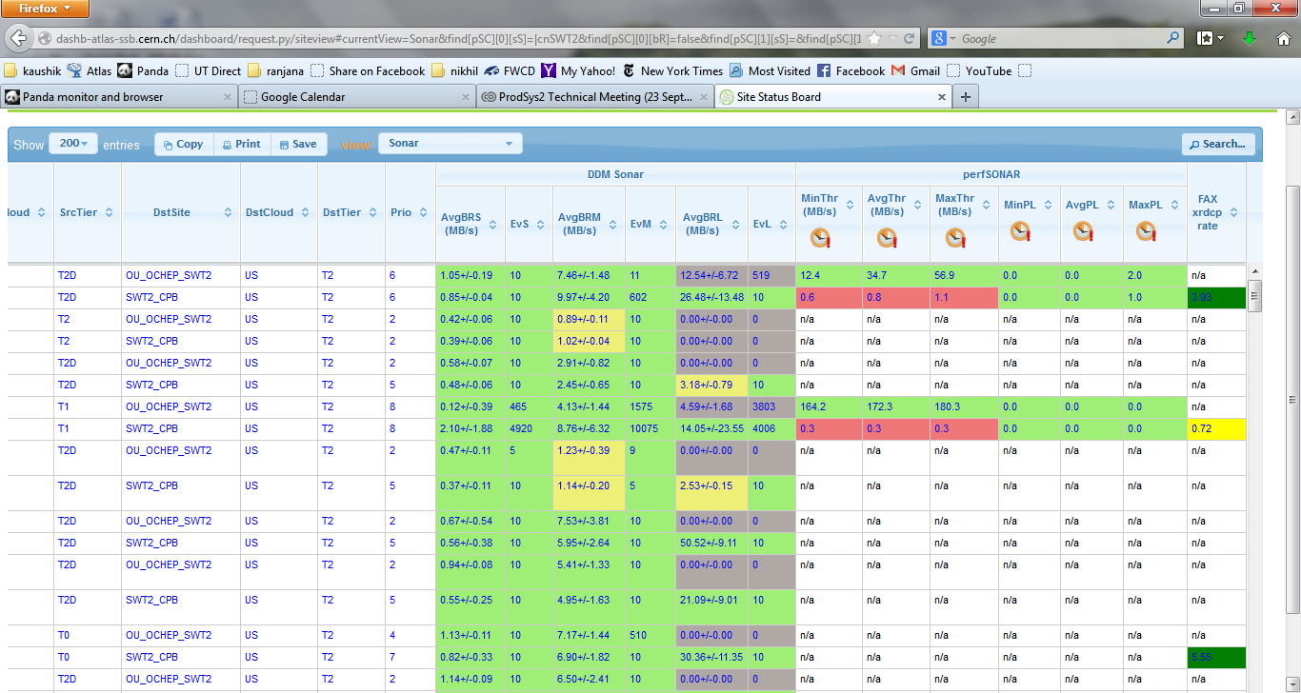
SSB

Slide 15
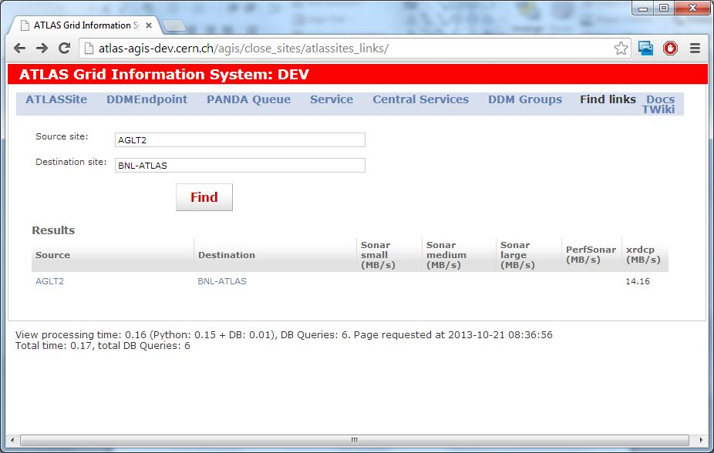
AGIS

Slide 16
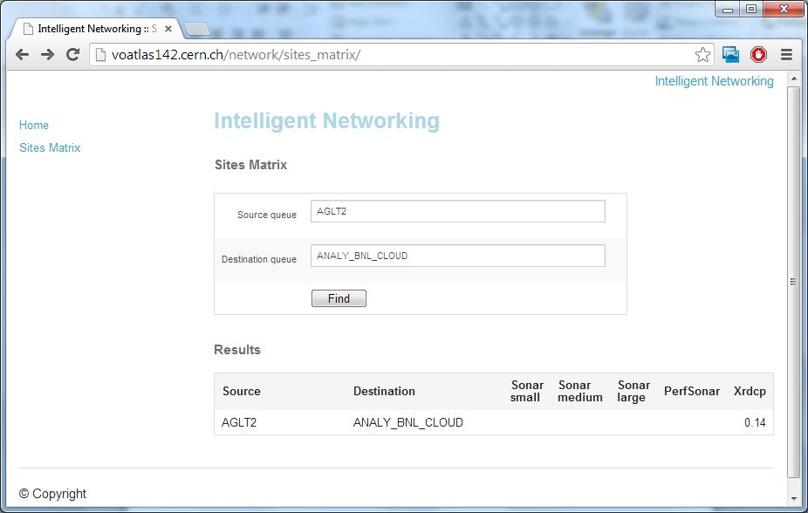
Intelligent Networking

Slide 17
Short Term Plan
In the next few months
  Network information in PanDA – move from development to production branch
  Implement FAX brokerage algorithm
  Implement cloud selection algorithm
  Evaluate algorithm after few months
  Extend monitoring

Slide 18
Medium Term Plan
Improve source of information
  Reliability of network information
  Dynamic network information
  Internal measurements

Slide 19
Long Term Plans
Look at list of topics discussed at various meetings over the past year

