Slide 1
Event Service https://twiki.cern.ch/twiki/bin/viewauth/AtlasComputing/EventServer
Torre Wenaus, BNL
For P. Calafiura, K. De, T. Maeno, D. Malon, P. Nilsson, V. Tsulaia, P. Van Gemmeren, R. Vitillo, and other contributors
PanDA Workshop
CERN
October 21, 2013

Slide 2
What’s an event service?
On the model of… ask for exactly what you need, have it delivered to you by a service that knows how to get it to you efficiently
Why ask for files when what you really want are (particular) events
(Perhaps the events you’re asking for don’t even exist in the required form, and they’ll be transparently created for you – that’s another discussion… virtual data… but on the same path)

Slide 3
Why an event service?
Do for data what PanDA did for processing
PanDA shows that intelligent automated dispatch of jobs to intelligent clients works very well
  Makes processing self-correcting – you use the resources that work
The biggest operational load is in data management
  We are hit hard by storage resources that don’t work, or are full
  DDM is complex
PD2P showed that dynamically distributing only the data that is needed can improve resource usage efficiency – use the network dynamically rather than using storage statically
  In general it’s much cheaper to transport data than to store it
The event service is a further step
  In making the client agnostic to where the data is – transparently use the data sources that work – to reduce the operational burden and user impact of storage problems
  In making full use of the network to deliver just the data needed from an optimized (and minimal) set of sources
We have a distributed processing infrastructure very well suited to give it a try
  PanDA brokers and dispatches jobs in an (increasingly) intelligent way
  Let’s use the same infrastructure to deliver events
  Make resilient data access an integral, automated part of the processing; no DDM in the production workflow and no precondition of data pre-placement
We have a software infrastructure ready to support it

Slide 4
Why an event service? Opportunistic resources to expand computing throughput
Opportunistic use of HLT after LS1
Opportunistically soaking up cycles on supercomputers
Free research clouds, commercial clouds
  More/cheaper resources available if we can be highly opportunistic
    e.g. Amazon spot market – cheap, even free under 1 hour
‘ATLAS@Home’ via BOINC on tens of thousands of computers in China?
Common characteristic to using opportunistic resources: we have to be agile
  Quick start (rapid setup of software, data and workloads) when they appear
  Quick exit when they’re about to disappear
  Robust against their disappearing with no notice : minimize losses
  Use them until they disappear – soak up unused cycles
  Fill them with fine grained workloads
    Send a steady stream of events, and return outputs in a steady stream
      No heavy data prestaging, and a hasty exit loses very little
Event service is a means of enabling agile, efficient use of opportunistic resources

Slide 5

Why an event service?
Efficient use of storage is essential for us
Lib of
Congress
Big Data in 2012
Business emails sent
3000PB/year
(Not managed as
a coherent data set)
In 2012: 2800 exabytes created or replicated
1 Exabyte = 1000 PB
Reputed capacity of NSA’s new Utah center: 5000 ExaB
(50-100 MW)
Climate
DB
Facebook uploads
180PB/year
We are big… not NSA-big, but big
(and more cost efficient… and poorer)
Current ATLAS data set, all data products: 140 PB
LHC data
15PB/yr
Google search
100PB
Nasdaq
US
Census
YouTube
15PB/yr
Kaiser
Permanente
30PB
Wired 4/2013
http://www.wired.com/magazine/2013/04/bigdata/
Notes:
http://www.wired.com/magazine/2013/04/bigdata/

Slide 6
Other event service advantages
Avoid idle cores in athenaMP processing – if parallel threads process events in large chunks (files), cores can sit idle while the slowest one completes
DDM simplification – no DDM involvement on input or output
Output merging flexible and simple: file size is tunable, aggregation of outputs to merge site proceeds concurrently with processing, JEDI knows when to trigger merge
A crash doesn’t lose the job, only a few events which will be re-dispatched

Slide 7
Required for an event service
Managing workflows at the event level the way PanDA has been managing them at the file level, with the necessary event-level bookkeeping
  Check – JEDI now provides this
Excellent networking; check
Workloads with high CPU/IO; check – simu
Network-efficient event data access; check – the event I/O optimizations of recent years makes remote event streaming possible
  Preferably buffered by asynchronous caching
  Just as JEDI is an enabler for the event server scheme on the grid side, athenaMP and associated I/O developments and optimizations are enablers on the core sw side
    Queueing and streaming events to be consumed by workers
    I/O optimizations making event reading over WAN practical
    Asynchronous pre-fetch to remove network latencies from processing workflow

Slide 8
Event Service schematic V4
Oct 2013
getJob request returns event service job
1
Pilot
getJob
Job spec
JEDI
Event table
PanDA/JEDI
Dispatcher
Event
list
runEvent module
manages event loop
2
Event index
Events
complete
notification
getEvents
Returns run#/ev#/guid list
Event list
Local
files
Athena
evReader
Event
Server
Token extractor
Event
tokens
3
PanDA
creates
merge job
Data file read
or event server request
or event index query
Token list
Data sources
SE
Data sources
Data sources
SE
Token
Scatterer
Event
loop
Local
files
8
AthenaMP
Event
data
4
Data sink
SE
http or xrootd
endpoint
5
PanDA
merge
job
Event cluster
staging
Worker
Worker
9
Output
stager
6
7
Worker Out
Worker
Out
Output aggregation site
N events
Remote
Worker node

Slide 9
Pilot requests a job from PanDA
ATLAS Event Service
Workflow
PanDA sends the pilot an event mode job
Pilot enters event service mode and requests event list
Event
loop
PanDA selects and dispatches event(s), updating its event bookkeeping
Pilot forwards event list to AthenaMP, GUID resolved to PFN in PFC
AthenaMP payload receives event list, translates to event header tokens (specifying how to read event), distributes tokens to workers
Workers read event data, process, and write 1- or few-event files
Pilot monitors outputs, uploads new files to aggregation site, informs PanDA
PanDA detects when a job’s events are done and uploaded, and initiates a merge

Slide 10
Workflow
Pilot makes a getJob request to PanDA
PanDA determines event service type job is appropriate, selects and dispatches one
Pilot’s runEvent module invoked to manage event processing
  Determines input files, makes POOL catalog file
  Triggers athenaMP launch, configuration
  Enters event processing loop
    Requests event list from PanDA dispatcher
    Receives list, GUID, retry number; PanDA marks events as in process
    Event list passed to token extractor
      Obtains tokens via direct data file read, event server or event index
    Token list sent to athenaMP TokenScatterer for distribution to workers
    Workers read event data from source and process events
    Each worker writes its own output file
      Single-event files initially; appropriate for simu with long event processing time

Slide 11
Workflow (2)
Outputs managed in a near real time, granular way, just as inputs are
  Output aggregation and monitoring concurrent with task processing
  Minimal losses in case of sudden eviction from or disappearance of resource
Output stager monitors output directory, detects completed output files
  Transfers them to aggregation point using lightweight service (http, xroot) or just a copy if local
  Informs PanDA of event completion; PanDA updates event table
  Cleans up output files
PanDA monitors event completion in the event table
When event processing for a job is complete, PanDA merge job is generated to merge output files, store merged outputs on SE and register in DDM
If processing of an event cluster by a consumer times out, PanDA invalidates that consumer by incrementing the retry number for those events and reassigning them to another consumer
  If original consumer does finally return results, they will be ignored; their retry number is no longer the latest

Slide 12
Workplan as of Aug (with updates)
(done) = first prototype in place, only limited testing done
Support Geant4 simulation (AtlasG4_tf) for event service jobs (Peter, Vakho) (done)
  The prime candidate for the opportunistic resources that have the most to gain
  Requires single-event EVGEN file to startup the payload in initial version
Support closing/opening multiple output files per job, with associated metadata management (for simu in the first instance) (Peter) (done)
Settle the dispatcher communication protocols for specifying a job as event type and sending an event cluster in response to a request from runEvent (Tadashi, Paul) (done)
Set up POOL catalog file creation for event type jobs (Paul) (done)
Implement token extractor and translation of event list received from pilot into token list delivered to Scatterer. Tools are mostly there to create the token extractor, in the form of tag collection utilities to extract tokens out of files. (Vakho, Peter) (done)
Set up the invocation and execution of the athenaMP payload initialization step (Vakho, Paul) (in progress)
Set up the athenaMP workflow in the event loop from receipt of token list, to WN event processing using the pilot-generated POOL file catalog, to output generation in dedicated output directory (Vakho, Peter) (done)
Check WAN performance on POOL event read. Can we use TTreeCache asynchronous pre-fetch? (Ilija reports TTreeCache asynch prefetch is working in his lastest tests)
Look into how to handle IOV metadata. (Peter) (prototype under test)

Slide 13
Workplan (2)
Implement the communication from pilot to PanDA/JEDI to inform PanDA of completed events: status of completion and transmission to aggregation point, retry number (Tadashi, Paul) (in progress)
Implement the output monitor to detect completed output files, invoke procedure to send them to aggregation point + inform PanDA/JEDI + and clean them up (Paul) (in progress)
Implement prototype output aggregation point (local and/or remote/http/xrootd implementation)
  No effort on this. Ideal item for someone new to come in and help with… particularly if they’re interested in trying out an object store…
Implement PanDA merge job to build cluster files from aggregation area into full output file for registration with DDM (Tadashi) (done, same as prod/analysis workflow)
Implement PanDA/JEDI service that detects event job completion (from accumulation of event completion metadata) and triggers PanDA merge job, and times out/reassigns events held by non-responding consumers (Tadashi)
Establish testing setup. NB runEvent can be used outside the context of the full pilot, for testing purposes
Establish Hammercloud based testing setup for full infrastructure. (all)

Slide 14
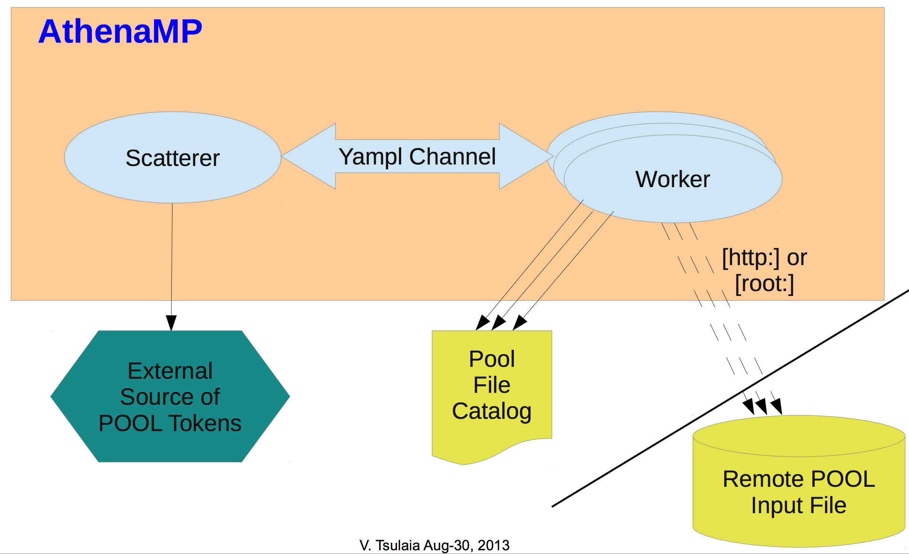
Event reading and processing status
Event reader and event server web service prototypes exist
First reader implementation was with bytestream events, now extended to POOL files
  Targeting G4 simulation as first use case
AthenaMP workers receive POOL event tokens from the TokenScatterer, ROOT retrieves event data
  First version exists, relies on POOL file catalog for file/protocol info
Successfully tested with sample AtlasG4_tf job
  Currently needs 1-event input file for configuration
  Remote http read works, outputs are identical to local read
V. Tsulaia, R. Vitillo, P. Van Gemmeren

Slide 15
OutputFileSequencerSvc
New component of Athena I/O infrastructure
  Allows closing output files during the runtime of a job
    Writes events and metadata processed so far
  Opens new file for the remaining events (and metadata)
  Creating a sequence of Output Files
    Naming similar to RAW
  Transition controlled via incident
    Configurable
Example: Splitting Output File on Input File transition
from AthenaCommon.AppMgr import ServiceMgr as svcMgr
from AthenaServices.AthenaServicesConf import OutputStreamSequencerSvc
outputStreamSequencerSvc = OutputStreamSequencerSvc()
outputStreamSequencerSvc.SequenceIncidentName = "EndFileIncident"
svcMgr += outputStreamSequencerSvc
Peter Van Gemmeren

Slide 16
Metadata
Event data handling is rather straight forward.
  Events never span file boundaries, store is cleared after execute
In-File Metadata is not so simple.
  Accumulated/summarized over the run time of the job
  Or propagated from Input to Output File
    Done by metadata tools, which a invoked by Begin/End File incidents
      Not executed for every event
  Currently written at finalize only, store is cleared at the end of the job
    Unfortunately, not everyone plays nicely and some modules hold on to pointers to store (which are obsolete once the store gets cleared).
      Fixed a few of them
  Limit Output file transition to Input file transition (by policy)
    No splitting of input file metadata records.
    MetaDataTools can prepare for possible transition during EndFile incident
Peter Van Gemmeren

Slide 17
Output File Sequence for EventServer Simulation jobs
Simulation only needs: IOVMetaData and EventStreamInfo
  No Lumi or EventBookkeeper
EventServer will write ‘transient’ 1 event output files, but merge them before use.
  Can use EndEvent incident to trigger Output File Transition
    Provide override for Input File Transition requirement
  Use athena.py runargs.MergeHIT.py PATJobTransforms/skeleton.MergeHIT.py to merge Output Files
    Please do slow merge
First Prototype ~kind off works
  Doesn’t crash, that was progress
  Produces metadata (merging adds unneeded metadata due to over configuration)
  Produces extra file, but that is ‘merged away’
  ERROR logs from CutFlowSvc, but EventBookkeeper is not used…
Peter Van Gemmeren

Slide 18
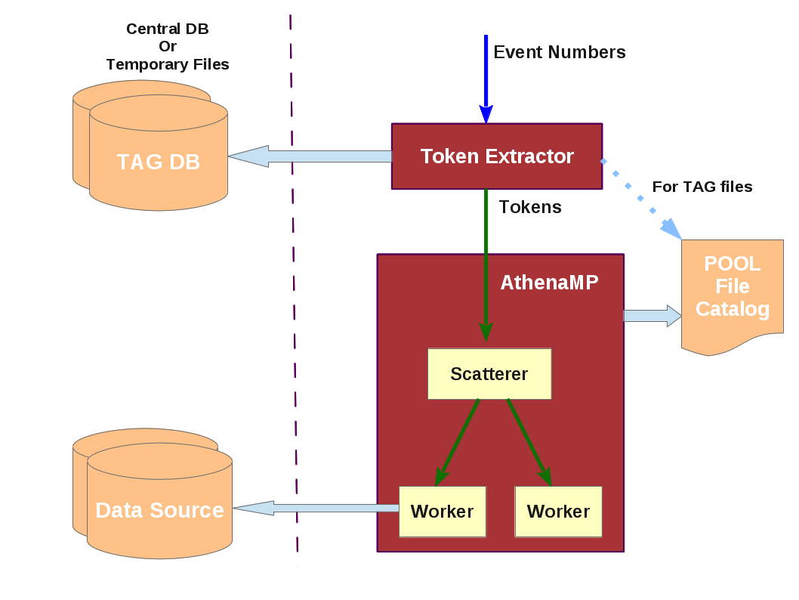
Token Extractor
Prototype implemented, derived from existing event collection utilities
Turned the existing CollListToken utility into a TokenExtractor
Receives a list of event numbers over incoming Yampl channel, queries the database (or, as at present for EVGEN, reads from file) in order to convert event numbers to event tokens and sends the tokens over outgoing Yampl channel
Connected it to prototype AthenaMP Token Scatterer and successfully ran some tests
Vakho Tsulaia

Slide 19
Event Service Support in the Pilot
Pilot runs as normally, downloads a job definition from the dispatcher
  For a normal job, pilot will fork and monitor the runJob subprocess
  For an event job, pilot will fork and monitor the new runEvent subprocess, currently in development
runEvent will be selected by the pilot when it sees the presence of an eventRangeID field in the job definition
For an event job, the dispatcher response(s) will contain
  eventRangeID: <string>
  startEvent: <string>
  lastEvent: <string>
  lfn: <list>
  guid: <list>
  attemptNr: <string>
Paul Nilsson

Slide 20
Pilot runEvent subprocess vs EventService module
Basic functionality of runEvent:
  Main loop running over all events within the given event range; download event(s) from Event Server and process them; download new event range until all ranges are exhausted (as determined by dispatcher)
  An asynchronous thread is staging out finished output files
EventService class also in development
  Contains all the methods for interacting with the Event Server; download events, event processing, any server/dispatcher updates, etc
  Same plug-in mechanism as other classes, i.e. an experiment can have its own subclass in case there are any differences with the default (read: ATLAS) implementation
Paul Nilsson

Slide 21
Pilot runEvent workflow
[ Initial event range already downloaded with the first getJob() call by the pilot ]
Stage-in (unless already present in CVMFS) of necessary preliminaries (DBRelease)
Configuration and launch of AthenaMP (or other payload)
  AthenaMP goes through its initialization phase and forks worker processes
runEvent will enter the event processing loop when the AthenaMP payload is ready (next slide)
Stage-out files as they become available
  Remove file immediately if transfer is successful
Paul Nilsson

Slide 22
Pilot event processing loop
Request an event list from the dispatcher (if initial event range has been processed)
  Size of event list can be optimized
  Attempt number will be recorded in the event table for these events
Determine the physical file replica(s) to be used as the source for input event data, based on the LFN and GUID lists in the event list
  PFC is created
Execute payload using event list and PFC
Dispatcher is updated on a regular basis (heartbeat)
  eventRangeID: <string>, status: <string>, attemptNr: <string>, xml: <string>, where status can be 'running','finished','failed'
Paul Nilsson

Slide 23
Panda Server/JEDI updates for Event Service 1/2
Two functions for the server ↔ pilot communication available as extension of dispatcher’s API
  getEventRanges(PandaID)
    To get a list of {eventRangeID, startEvent, lastEvent, attemptNr, LFN, GUID}
      eventRangeID : unique identifier in the event table
      attemptNr : incremented when the range is retried
  updateEventRange(eventRangeID, attemptNr, status, xml)
    To update status of an event range
      status : ready → sent → running → finished/failed
      eventRangeID + attemptNr : to update the latest attempt
      xml : contains LFN and SURL (or PFN) of unmerged files
If unmerged files are not registered to DDM, a new column for SURL/PFN would be required in the JEDI file or event table
Tadashi Maeno

Slide 24
Panda Server/JEDI updates 2/2
Merging is being implemented as a part of normal production or analysis workflow
  Use the same function for Event Service as well
  Functions
    Merge job generation
    Creation and deletion of intermediate datasets
    Job chaining from unmerge jobs to merge jobs
    Killing unmerge jobs when merge jobs permanently fail
Possible sequence
  getJob →
  getEventRanges → updateEventRange × N →
  getEventRanges → updateEventRange × M →
  …
  updateJob (last heartbeat) →
  merge job generation
Tadashi Maeno

Slide 25
Issues, questions
How will runEvent know when AthenaMP is ready to process events?
Because unmerged files are not registered to DDM, a new column for SURL/PFN is required in the JEDI file or event table
  Unless filename is derivable by construction, and location can be inferred from the aggregation point?
  Add aggregation point as a PanDA job attribute?
Where do we get the (EVGEN) event tokens for G4 simu production? (No EVGEN TAGs in DB)
  Make TAGs during EVGEN production? Make them specifically for event service needs? Second is most practical in near term; event index in longer term
  Entries for TAG files need to be in PFC available to payload jobs
What exactly should the EventIndex contain such that it can serve as the token lookup for the event service?

Slide 26
Event Index content for Event Service token retrieval
Basis of the query is run#, ev#, GUID (LFN also available)
  As obtained from PanDA/JEDI
  From GUID we also have PFN/TURL as obtained by pilot and recorded in PFC
  Because the file is specified, the exact processing stage / format / version is specified
What we want returned from the query is the token(s) for that event in that file
Bulk queries should be supported, either individual event numbers or event ranges

Slide 27
Conclusion
PanDA extensions for Prodsys2 are designed to enable efficient & flexible resource usage across a diverse range of resources – multi/many-core, HPC, clouds, opportunistic, …
Together with AthenaMP, event I/O and FAX, we have the basis for implementing an event service to use these resources efficiently
Effective WAN direct access to data is an enabler and a prerequisite
Progress towards a prototype is good, thanks to enthusiasm of our key developers
Most of the ‘who’ and ‘how’ questions for an initial implementation answered, but not all
  In particular output aggregation needs attention
Status following this meeting and discussions this week will be described by Vakho in an event service plenary on Friday
  And will update twiki

