Slide 1
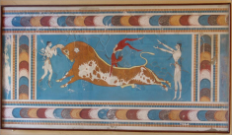

Hadron Form factors
in space-like and time-like regions
Egle Tomasi-Gustafsson
IRFU, SPhN-Saclay,
and
IN2P3 - IPN Orsay France
ICNFP, July 28 - August 6, 2014
On behalf of the Collaboration

Slide 2
Plan
Introduction
  formalism
The Experimental Status
  The space-like region
      Unpolarized experiments
      Polarized experiments
      Issues and open questions
  The time-like region: the PANDA Contribution
      The unphysical region
      The threshold region
      The asymptotics
Interpretation(s)
Future prospects and Conclusions

Slide 3

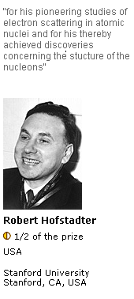
Hadron Electromagnetic Form factors
Characterize the internal structure of a particle (≠ point-like)
Elastic form factors contain information on the hadron ground state.
In a P- and T-invariant theory, the EM structure of a particle of spin S is defined by 2S+1 form factors.
Neutron and proton form factors are different.
Deuteron: 2 structure functions, but 3 form factors.
Playground for theory and experiment
at low q² probe the size of the nucleus, at high q² test QCD scaling

Slide 4
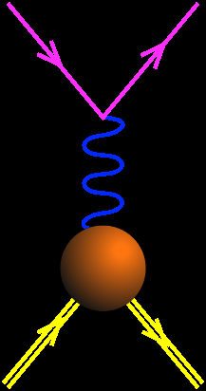
Electromagnetic Interaction
e⁻
e⁻
The electron vertex is known, γ_{μ}
The interaction is carried
by a virtual photon of mass q²
q²<0
The proton vertex is parametrized
in terms of FFs: Pauli and Dirac F₁,F₂
p
p
What about high order
radiative corrections?
or in terms of Sachs FFs:
GE=F₁-τ F₂, GM=F₁+F₂, τ=-q²/4M²

Slide 5
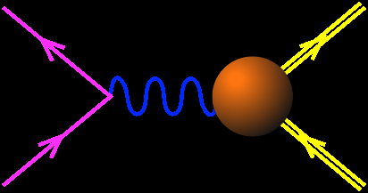
Hadron Electromagnetic Form factors
e⁻
e⁻
Asymptotics
- QCD
- analyticity
q²<0
GE(0)=1
e⁺
p
GM(0)=μ_{p}
q²>0
p+p ↔ e⁺+e⁻ +π⁰
Unphysical region
p
p
e⁻
p
_
Time-Like
FFs are complex
Space-like
FFs are real
_
q²=4m_{p}²
q²
e+p → e+p
p+p ↔ e⁺+e⁻
GE=GM

Slide 6
Hadron Electromagnetic Form factors
e⁻
e⁻
Asymptotics
- QCD
- analyticity
q²<0
GE(0)=1
e⁺
p
GM(0)=μ_{p}
q²>0
p+p ↔ e⁺+e⁻ +π⁰
Unphysical region
p
p
e⁻
p
_
Time-Like
FFs are complex
Space-like
FFs are real
_
q²=4m_{p}²
q²
e+p → e+p
p+p ↔ e⁺+e⁻
GE=GM

Slide 7
The Space-Like region: low Q²
e+p → e+p

Slide 8
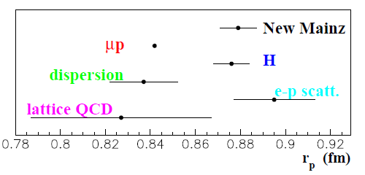


The Proton Radius
Rp=0.84184(67) fm (muonic atom)
Rp=0.879(8) fm
(e-p Mainz)
Rp=0.8768(69) fm
Rp=0.897(18) fm
Rp=0.82-0.85 fm
(DR PRC75 035202(2007))
Rp=0.78-0.86 fm
(lattice QCD PRD 79 094001(2009))

Slide 9
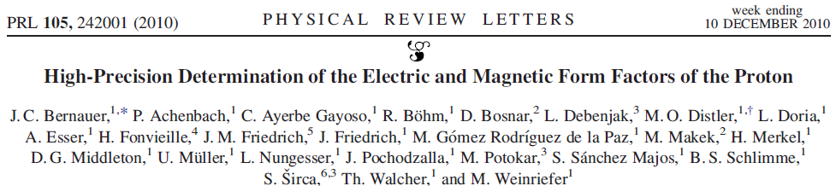

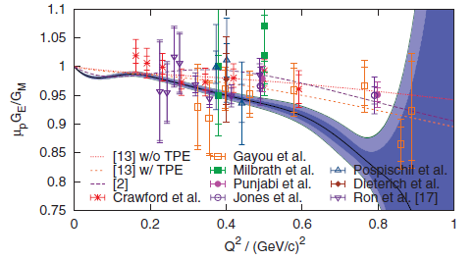
Mainz, A1 collaboration (1400 points)
Q²>0.004 GeV²
Radiative corrections
Two photon exchange
Coulomb corrections
…..comments
MUSE Experiment
Jlab CLAS
What about extrapolation to
Q²→ 0?

Slide 10
The Space-Like region
e+p → e+p

Slide 11
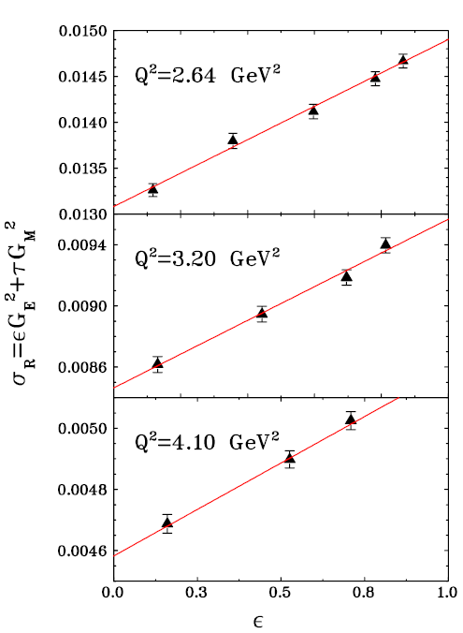
The Rosenbluth separation
Q² fixed
Linearity of the reduced cross section
ε
        tan²θ_{e} dependence
Holds for 1γ exchange only
PRL 94, 142301 (2005)

Slide 12
Proton Form Factors ... before
Dipole approximation: G_{D}=(1+Q²/0.71 GeV²)⁻²
Rosenbluth separation/ Polarization observables
V. Punjabi, M. Jones,C. Perdrisat et al, JLab-GEp collaboration

Slide 13
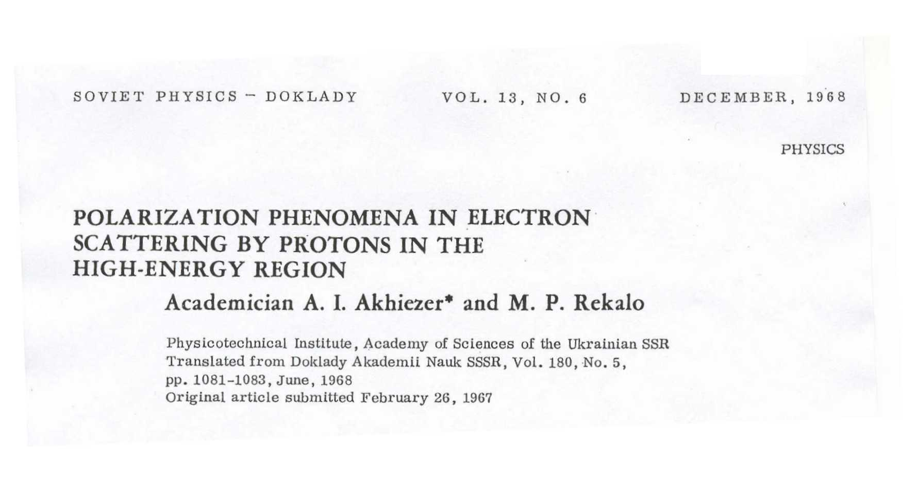
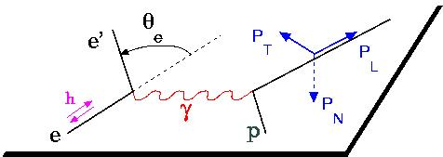
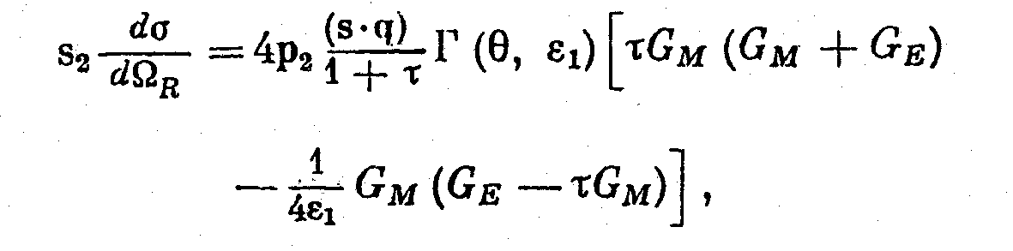
The polarization method (theory:1967)
The polarization induces a term in the cross section proportional to G_{E} G_{M}
Polarized beam and target or
polarized beam and recoil proton polarization

Slide 14
Polarization experiments
A.I. Akhiezer and M.P. Rekalo, 1967
  Jlab-GEp collaboration
  "standard" dipole function for the nucleon magnetic FFs GMp and GMn
  2) linear deviation from the dipole function for the electric proton FF Gep
  3) QCD scaling not reached
  3) Zero crossing of Gep?
  4) contradiction between polarized and unpolarized measurements
A.J.R. Puckett et al, PRL (2010), PRC (2012)

Slide 15
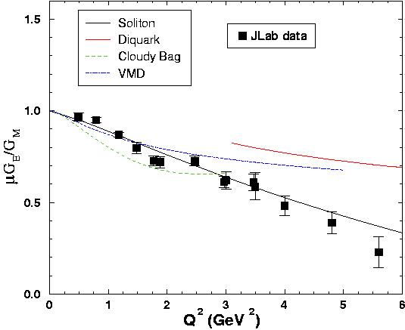
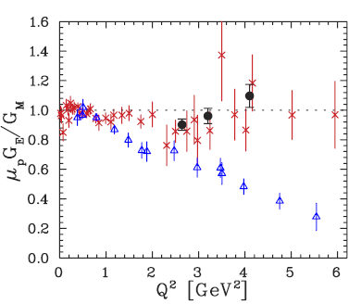
Issues
Some models (IJL 73, Di-quark, soliton..) predicted such behavior before the data appeared
BUT
Simultaneous description of the four nucleon form factors...
...in the space-like and in the time-like regions
Consequences for the light ions description
When pQCD starts to apply?
Source of the discrepancy

Slide 16
The Time-Like region
p + p → e⁺ + e⁻ (γ)
GE=GM
4M²

Slide 17
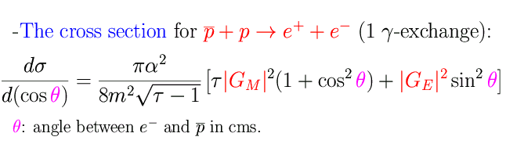
Time-like observables: | G_{E}| ² and | G_{M}| ² .
A. Zichichi, S. M. Berman, N. Cabibbo, R. Gatto, Il Nuovo Cimento XXIV, 170 (1962)
B. Bilenkii, C. Giunti, V. Wataghin, Z. Phys. C 59, 475 (1993).
G. Gakh, E.T-G., Nucl. Phys. A761,120 (2005).
As in SL region:
- Dependence on q² contained in FFs
- Even dependence on cos²θ (1γ exchange)
- No dependence on sign of FFs
- Enhancement of magnetic term
but TL form factors are complex!

Slide 18



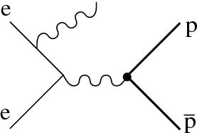
The Experimental facilities
Antiproton-proton colliders:
  LEAR, FERMILAB, PANDA
Electron –positron colliders
  FENICE, VEPP, BABAR, BES
Initial State Radiation
  BABAR, BES
VEPP-Novosibirsk
IHEP

Slide 19
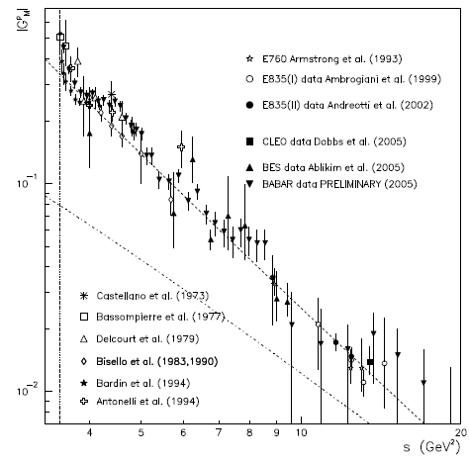
The Time-like region
The Experimental Status
  No individual determination of GE and GM
  TL proton FFs twice larger than in SL at the same Q²
  Steep behaviour at threshold
  Babar:
  Structures?
  Resonances?
  -> Panda contribution
GE=GM
5
10
20
s[GeV²]
  MP. Rekalo, E.T-G., preprint DAPNIA-04-01, ArXiv:0810.4245.

Slide 20
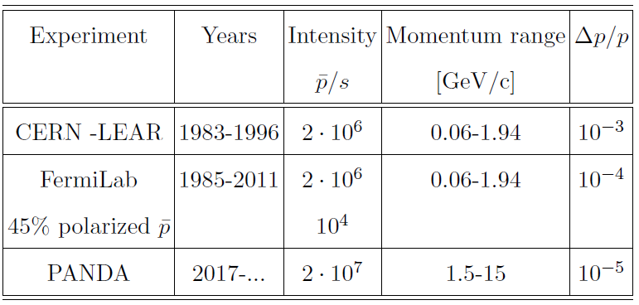
Antiproton facilities
<8.9
(Low energy beams)
Panda will have:
- Better luminosity
- Better beam momentum resolution
- Better detector (coverage, PID,magnetic field..)

Slide 21
About cross sections…
A.Dbeyssi amd E.T.-G, Prob Atomic Sci. Technol. 2012N1, 79 (2012).
Most probable in the mb region :
Five pion production
- Charge exchange

Slide 22
The following slides concerning ongoing PANDA simulations :
are extracted/derived from:
Dbeyssi, PhD thesis
Université Paris XI, 27-IX-2013
they are considered
‘PANDA unofficial results‘
Past its prime PANDA simulations are published in:
- M.C. Mora Espi PhD Mainz 2013
- M. Sudol et al., EPJA A44(2010)373

Slide 23
Hadron Physics with Antiprotons
Dedicated experiments in the past decades for
  Hadron spectroscopy
  Hadron structure
  Interaction of Hadrons
need of
Highest Rates
Good Resolution
Good Particle Identification
12m
detector
Fixed target experiment
and
Internal experiment
in HESR storage ring
(not interacting antiprotons
recirculate)
p
Accelerator and Detector
are built and optimized together
for the best performances
Forward Spectrometer
Target
Spectrometer

Slide 24
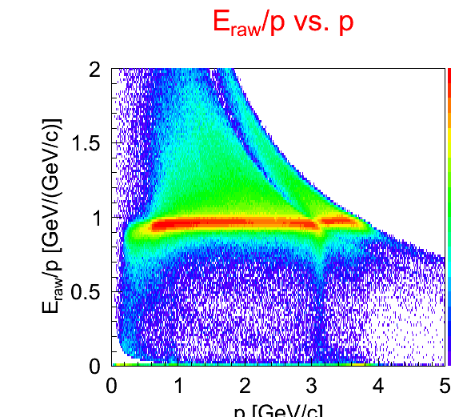
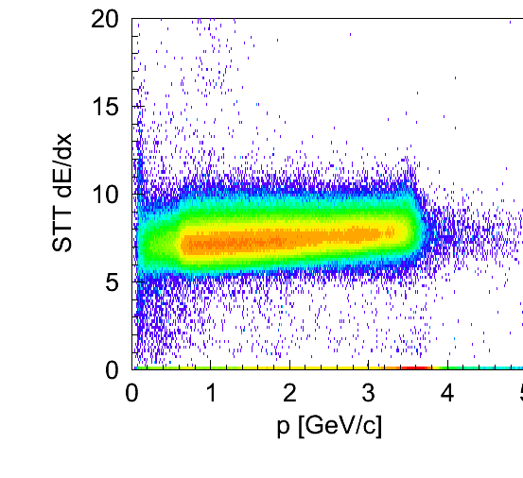
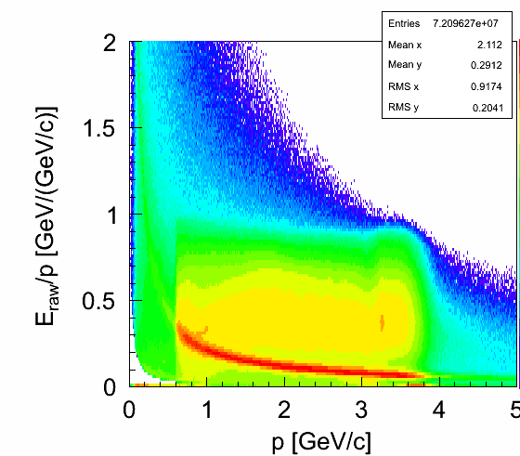
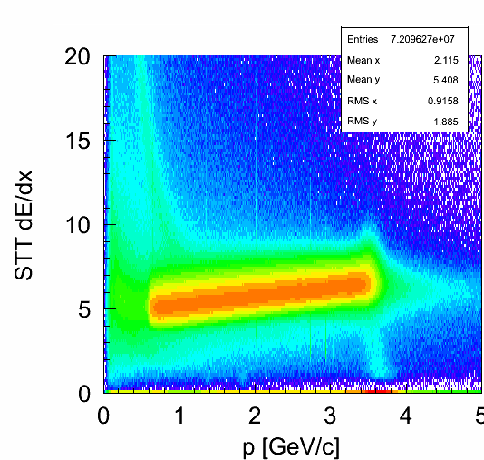
MC spectra…
A.Dbeyssi, PhD 2013
EMC
STT dE/dx vs p
Barrel DIRC Θ Cherenkov
SIGNAL
BACKGROUND

Slide 25

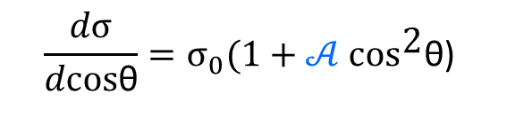
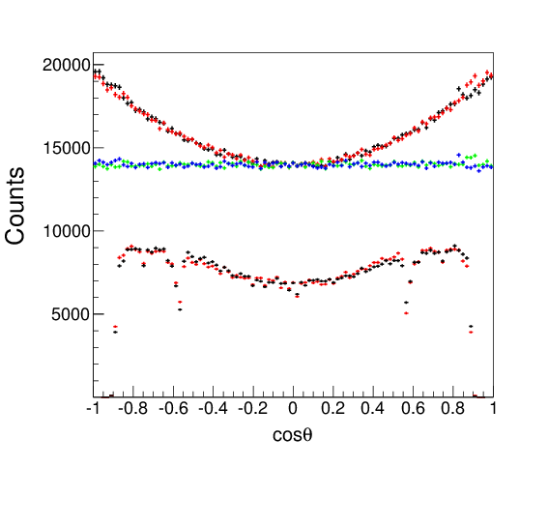



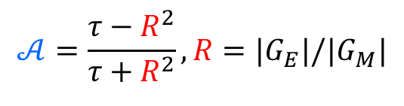
From PHSP to physical angular distributions
A.DBEYSSI
PhD-2013
$$𝒜=\frac{τ−R^{2}}{τ+R^{2}},{R=|G}_{E}|/{|G}_{M}|$$
$$,τ=\frac{s}{4M^{2}}$$
A. Zichichi et al., Nuovo Cim. 24 (1962) 170
E. Tomasi-Gustafsson and M.P. Rekalo, Phys.Lett. B504 (2001) 291-295
Monte Carlo events, PHSP
MC, R=1
MC PHSP
Physical Monte Carlo events
Reconstruced, R=1
Physical reconstructed events

Slide 26
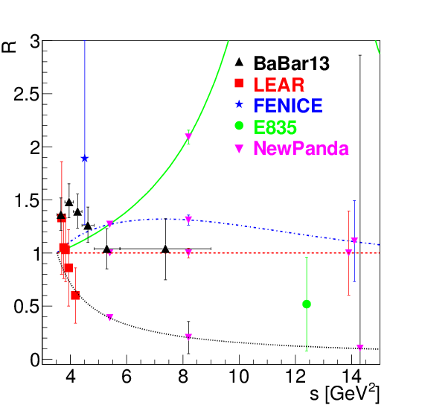
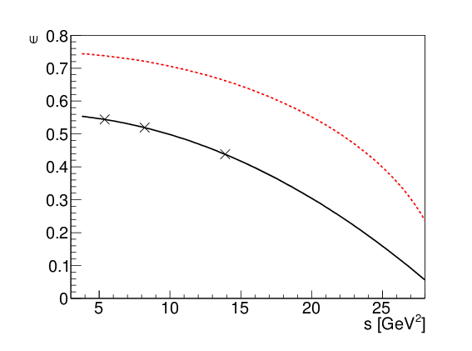
Individual determination of |G_{E}| and |G_{M}|
A.Dbeyssi
PhD 2013
ε≤50%
VMD
ε
0.5
pQCD
0
F. Iachello et al., Phys. Rev. C 69 (2004) 055204
E. L. Lomon, Phys. Rev. C 66 (2002) 045501
E. A. Kuraev et al., Phys. Lett. B 712, (2012)
V. A. Matveev, S. J. Brodsky , D. V. Shirkov….

Slide 27

Radiative return (ISR)
e⁺ +e⁻ → p + p + γ
B. Aubert ( BABAR Collaboration) Phys Rev. D73, 012005 (2006)

Slide 28

Angular distribution
1.877÷1.950
1.950÷2.025
2.025÷2.100
2.100÷2.200
2.200÷2.400
Events/0.2 vs. cos θ
2.400÷3.000

Slide 29
The “unphysical region”
p+p ↔ e⁺+e⁻ +π⁰
4M²

Slide 30



The reaction p + p e⁺ + e⁻ + π⁰
E.A. Kuraev,
PRC, 2008
JETP, 2012
G.I.Gakh et al,
PRC, 2011
γ∗NN(*)
πNN
M. P. Rekalo, 1967
V=ρ,ω,φ, J/Ψ, ..
Forward/backward
Regge trajectory
of the proton
VNN
Vπγ∗
Large angle: VM exchange

Slide 31
Results with IJL FFs
Czx: large at small angles
2E=5.4 GeV
Ay: small except
on resonances
Polarization phenomena help
to distinguish the reaction mechanism!
G.I. Gakh, J. Boucher, E.T-G., Phys.Rev. C83 (2011)

Slide 32
The Time-like region: the threshold

Slide 33
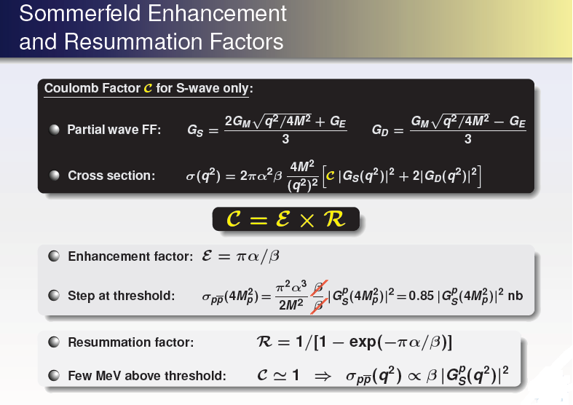
Point-like form factors?
S. Pacetti

Slide 34
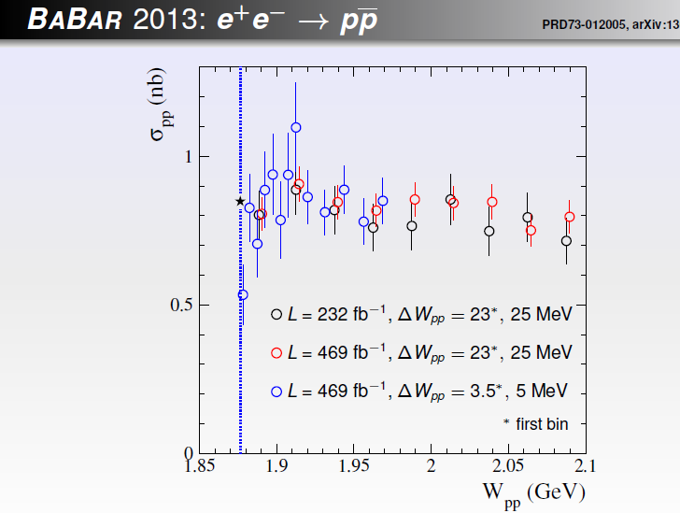

Slide 35
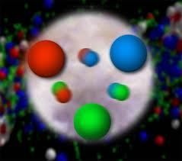


The nucleon
3 valence quarks and
a neutral sea of qq pairs
antisymmetric state of
colored quarks
Main assumption
Does not hold in the spatial center of the nucleon: the center of the nucleon is electrically neutral, due to strong gluonic field
E.A. Kuraev, E. T-G, A. Dbeyssi, Phys.Lett. B712 (2012) 240

Slide 36




Model: generalized form factors
Definition:
space-time distribution of the
electric charge in the space-time volume
In SL- Breit frame (zero energy transfer):
In TL-(CMS):
: time evolution of the charge distribution
in the domain

Slide 37

Proton Form Factors
GEp Akhiezer-Rekalo
|GMp|=|GEp|
GEp Rosenbluth
GMp
E.A. Kuraev, E. T-G, A. Dbeyssi, Phys.Lett. B712 (2012) 240

Slide 38
The asymptotic region

Slide 39
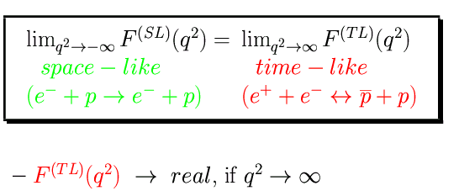
Proton form factors at large q²
L = 2 ⋅ 10 ³² cm⁻² s⁻¹
Phragmèn-Lindelöf theorem
100 days
Sim2013
Applies to NN and NN
Interaction
(Pomeranchuk theorem)
t=0 : not a QCD regime!
Analyticity
Connection with QCD asymptotics?
E. T-G. and M. P. Rekalo, Phys. Lett. B 504, 291 (2001)

Slide 40
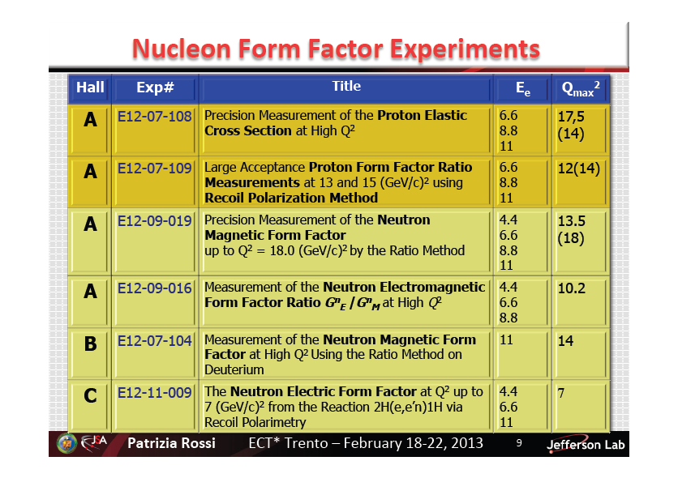
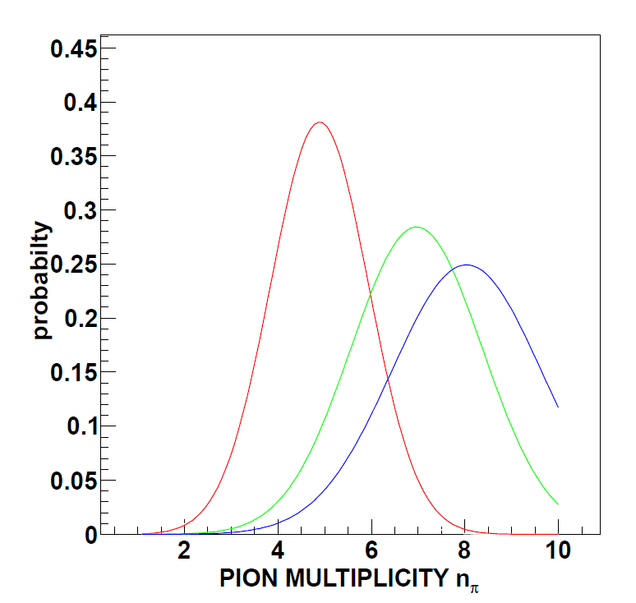
Exclusive final states
Five pions are preferentially created in annihilation at rest
Quark-gluon dynamics (similar to quark-gluon plasma)
Statistical models
Quasi-two-body dorway states
……
At rest
p=5 GeV/c
p=10 GeV/c
Role of the different contribution to the NN potential
(dynamical selection rules)

Slide 41
Conclusions
Jefferson Lab
Large activity both
in Space and Time-like regions
VEPP-3 Novosibirsk
IHEP
Unified models in SL and TL regions:
- describe proton, neutron, electric, magnetic FFs
- pointlike behavior at threshold?
- understand GE, GM(SL) < GE,GM(TL);
To measure
- zero crossing of GE/GM in SL? 2γ? Proton radius?
- GE and GM separately in TL (PANDA)
- complex FFs in TL region: polarization

Slide 42
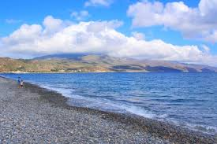
Σας ευχαριστώ
για την προσοχή σας

Slide 43
The polarization method (exp: 2000)
C. Perdrisat et al,
JLab-GEp collaboration
The simultaneous measurement of P_{t} and P_{l} reduces the systematic errors

Slide 44
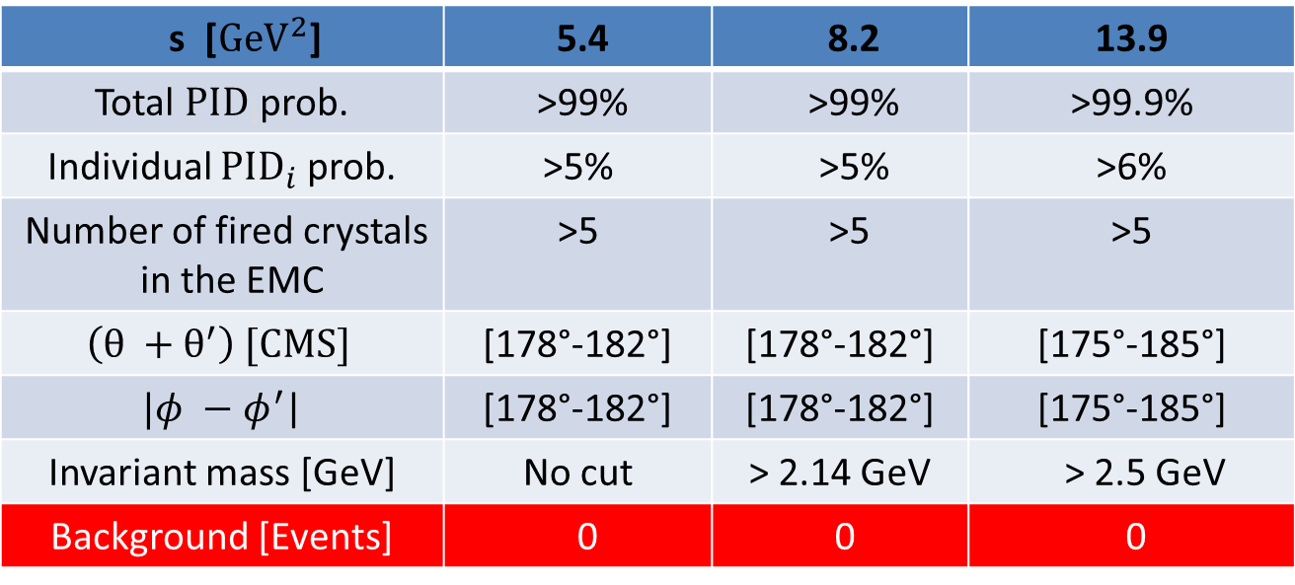
PID and kinematical Cuts
A. DBEYSSI ,PhD 2013
 | 5.4 | 8.2 | 13.9
 | >99% | >99% | >99.9%
 | >5% | >5% | >6%
Number of fired crystals | >5 | >5 | >5
 | [178°-182°] | [178°-182°] | [175°-185°]
 | [178°-182°] | [178°-182°] | [175°-185°]
Invariant mass [GeV] | No cut | > 2.14 GeV | > 2.5 GeV
Background [Events] | 0 | 0 | 0
PID --> probability for the detected particle to be identified as the signal.
PID information are taken from EMC, STT, DIRC and MVD subdetectors.

