Slide 1
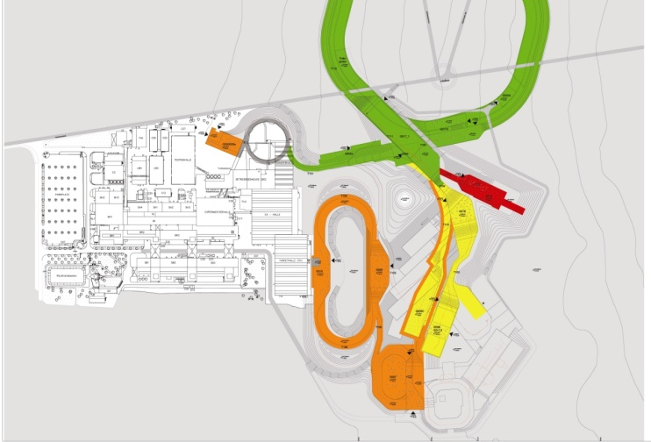
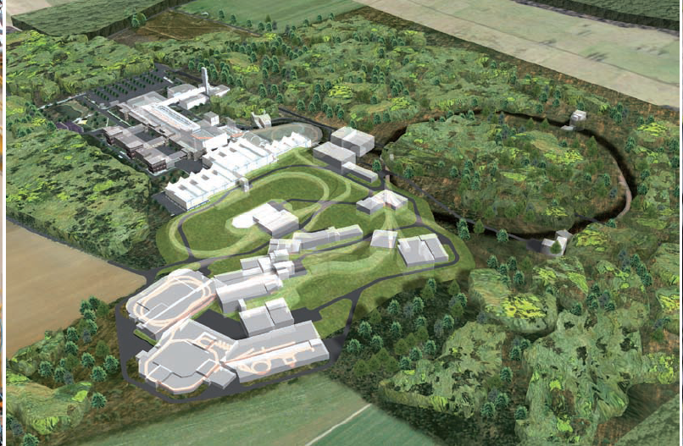
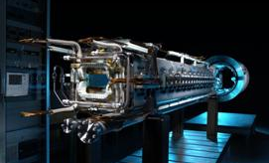












BIOMAT - Biophysics and
Material Research at FAIR
Radek Pleskac (BIOMAT Project)
Finland
France
Germany
India
Poland
Romania
Russia
Slovenia
Spain
Sweden
UK

Slide 2

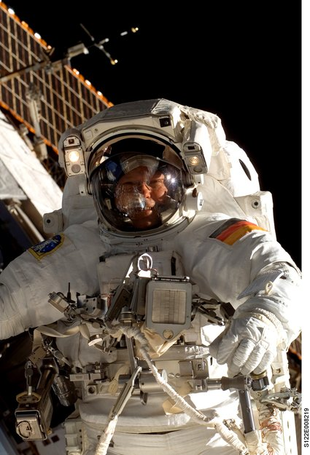
BIOMAT Project at FAIR
Introduction
Biophysics
  Space Research
  Some Examples
  Heart Arrhythmia
  Proton Theranostics
Material Science
  Matter under Extreme Conditions
BIOMAT facility
  Beamline and Instrumentation
  Biolab
  Timeline
Summary/Oulook
28/07/2014 FAIR Workshop, Kolimbari
2

Slide 3
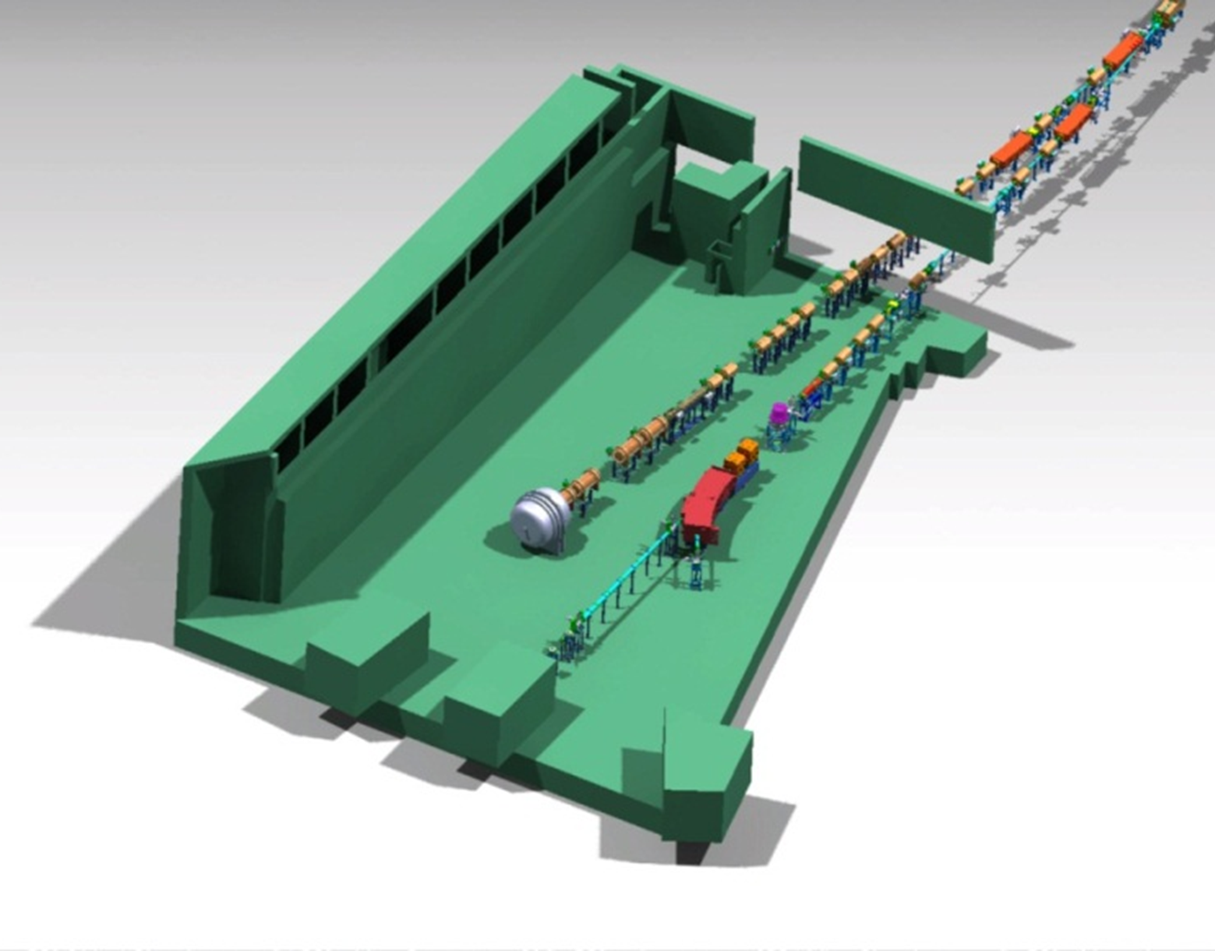
BIOMAT - User Facility and Collaborations
Main physics goal: to construct a world-leading, unique facility for experiments in applied sciences (biology, medicine, material science)
Biophysics
Spokesperson:
Marco Durante
Topics
space radiation protection
theranostics
particle therapy
BIOMAT
facility
Materials research
Spokesperson:
Christina Trautmann
Topics
radiation hardness
extreme conditions (p, T, irradiation)
geophysics
nanoscience
Collaboration/users
20 Countries
70 Institutes
28/07/2014 FAIR Workshop, Kolimbari
3

Slide 4
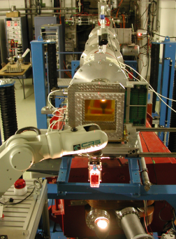
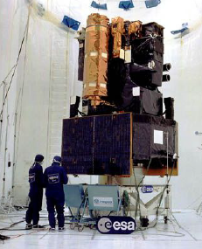
Space Research at GSI
Radiation environment in space has severely adverse aspects on human, electronics and materials
Effects of highly charged highly energetic (HZE) heavy ions in the space are the most challenging
Simulation of cosmic particle radiation using high-energy accelerators
Radiobiological effects on human beings (risk assessment for manned space missions)
Electrronic components (radiation hardness tests)
Shielding materials
Test and calibration of space flight instruments
28/07/2014 FAIR Workshop, Kolimbari
4

Slide 5
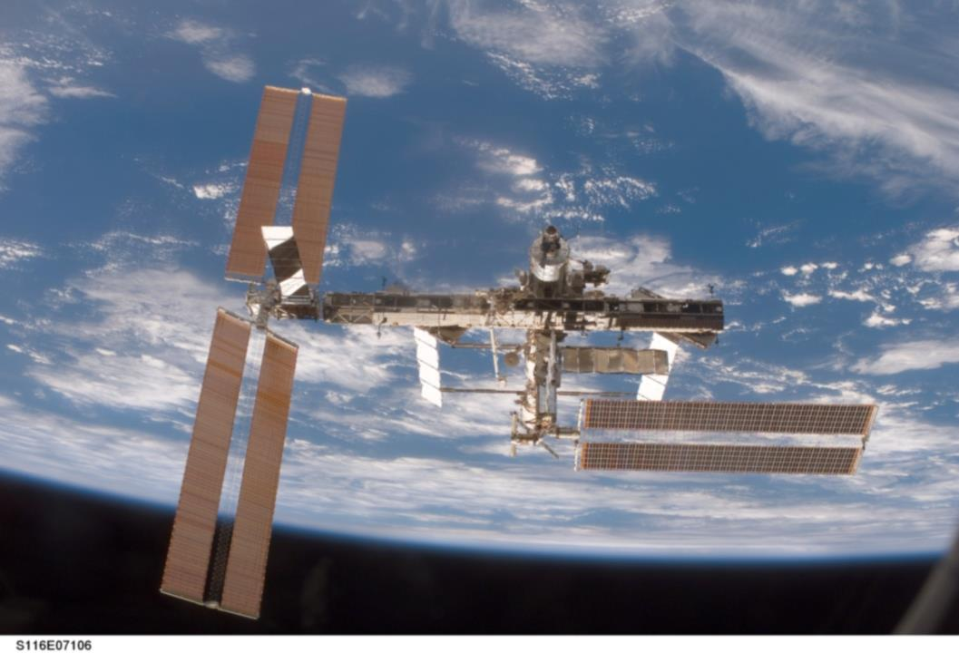
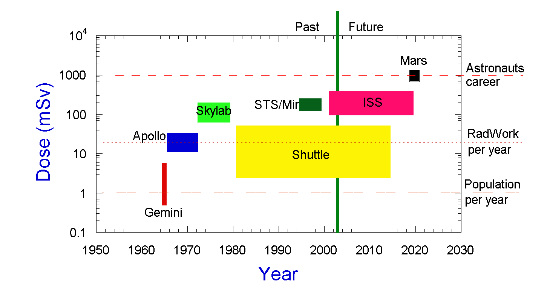
Radiation Dose in Different Missions
STS and ISS programs will be dropped, in favour of Moon and Mars manned exploration
Radiation risk is a big problem for human planet exploration
28/07/2014 FAIR Workshop, Kolimbari
5

Slide 6
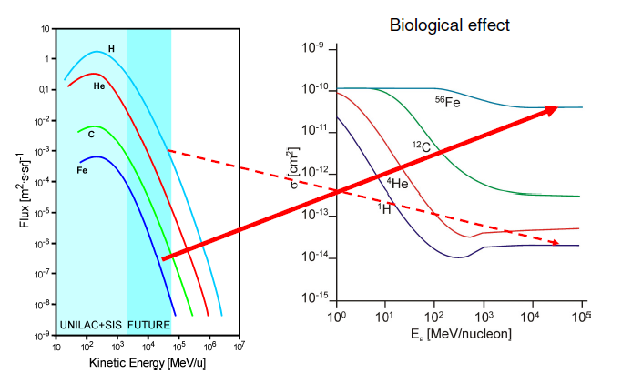
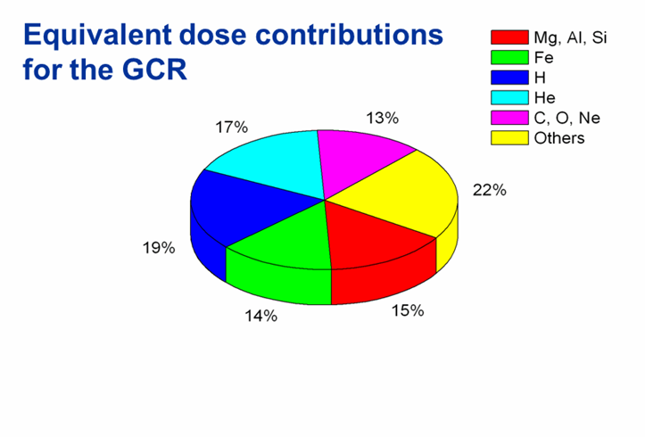
Galactic Cosmic Radiation (GCR)
2% electrons / positrons
98% particles
  87% protons
  12% helium
  1% heavier particles
28/07/2014 FAIR Workshop, Kolimbari
6

Slide 7
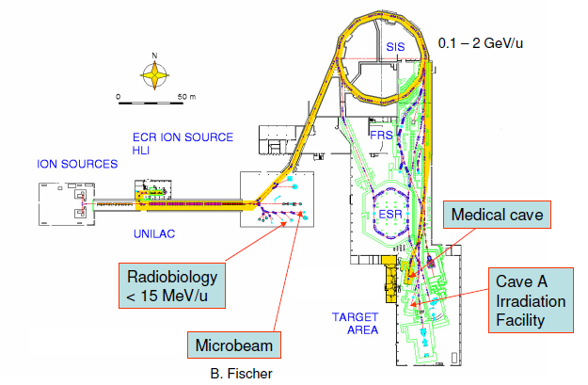
Irradiation Facilities at GSI
28/07/2014 FAIR Workshop, Kolimbari
7

Slide 8
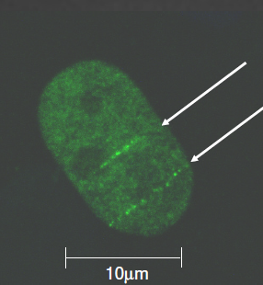
Microbeam – Irradiation of single cells
Nucleus of a human fibroblast cell
Biological response visualized by immuno-staining;
Barberet et al., Rad. Res 166, 682 (2006)
B. Jakob et al., Rad. Res. 163, 681 (2005)
28/07/2014 FAIR Workshop, Kolimbari
8

Slide 9
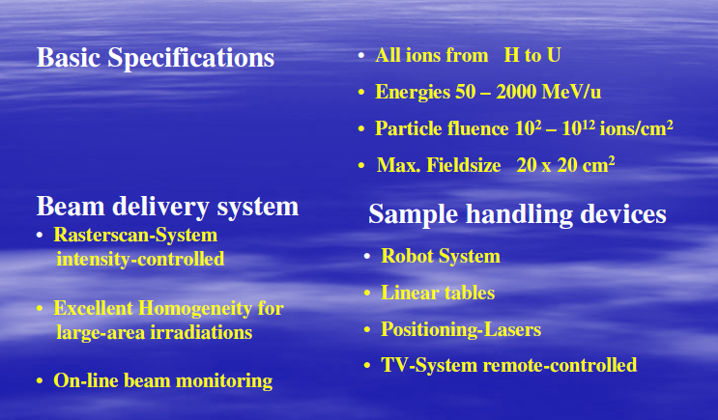
High-Energy Irradiation Facility Cave A
28/07/2014 FAIR Workshop, Kolimbari
9

Slide 10
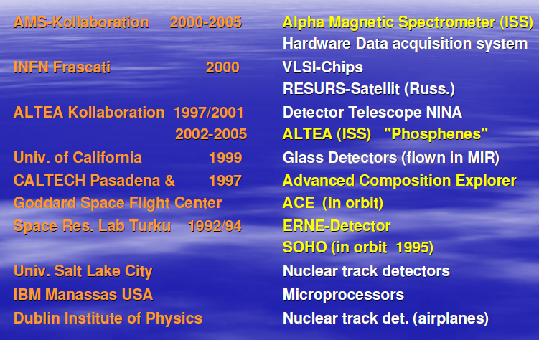
Space Flights Instrument at GSI
28/07/2014 FAIR Workshop, Kolimbari
10

Slide 11
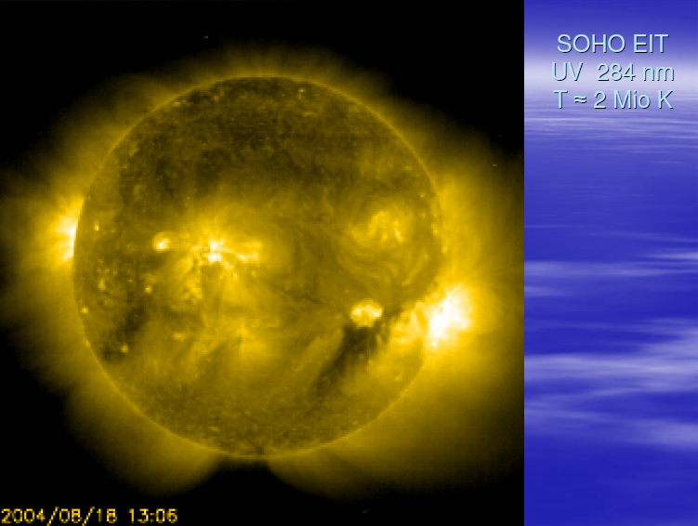
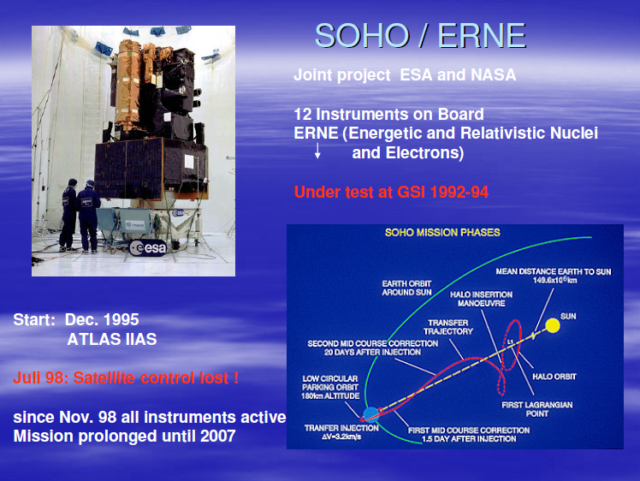
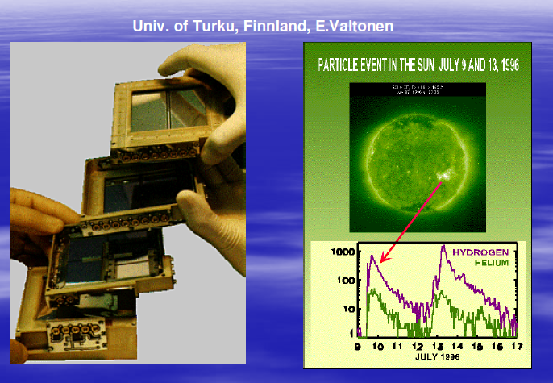
Example 1 (SOHO/ERNE)
28/07/2014 FAIR Workshop, Kolimbari
11

Slide 12
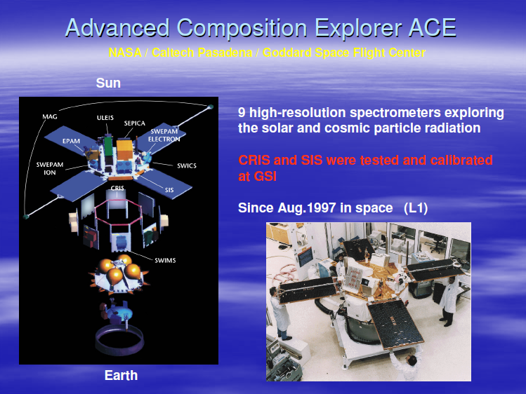
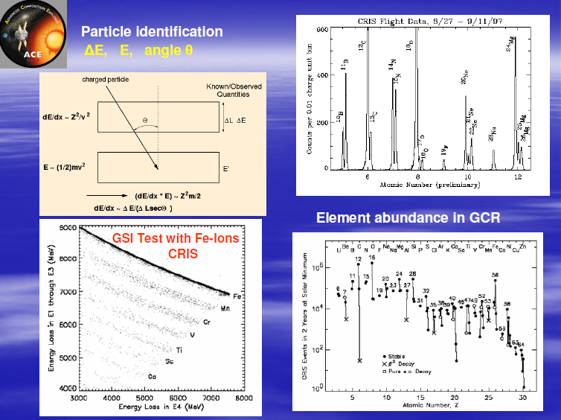
Example 2 (ACE)
28/07/2014 FAIR Workshop, Kolimbari
12

Slide 13
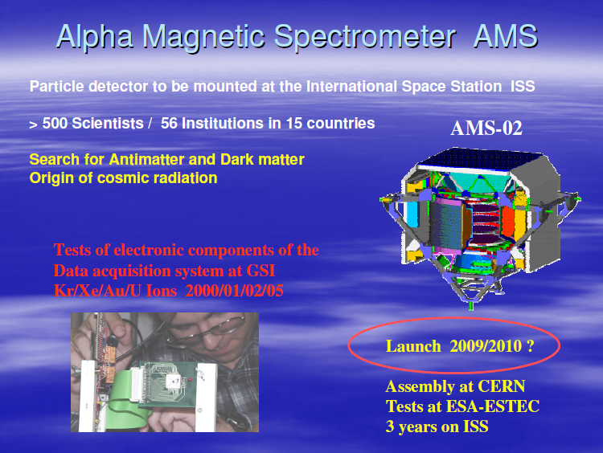
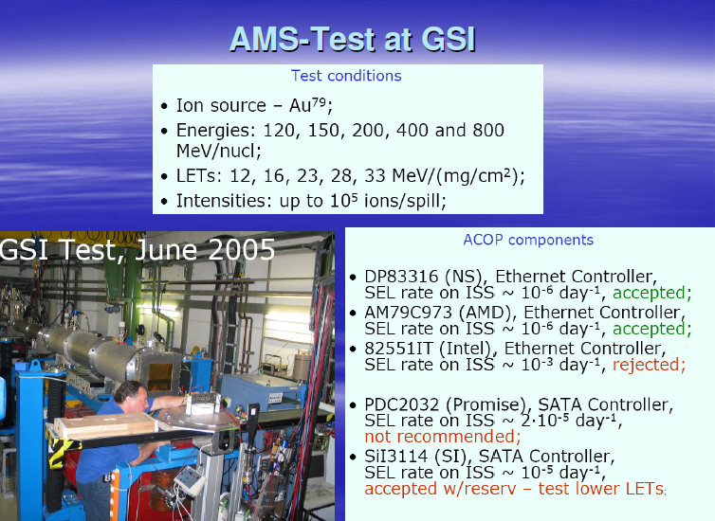
Example 3 (AMS)
28/07/2014 FAIR Workshop, Kolimbari
13

Slide 14
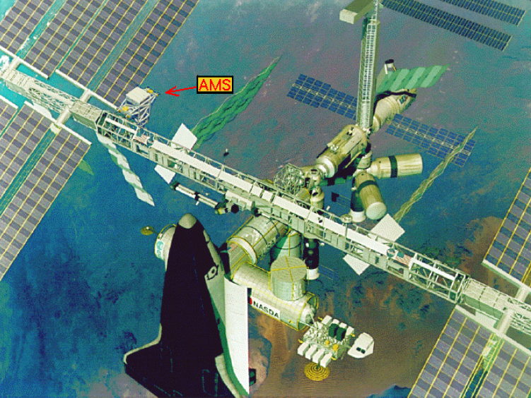
Example 3 (AMS)
28/07/2014 FAIR Workshop, Kolimbari
14

Slide 15
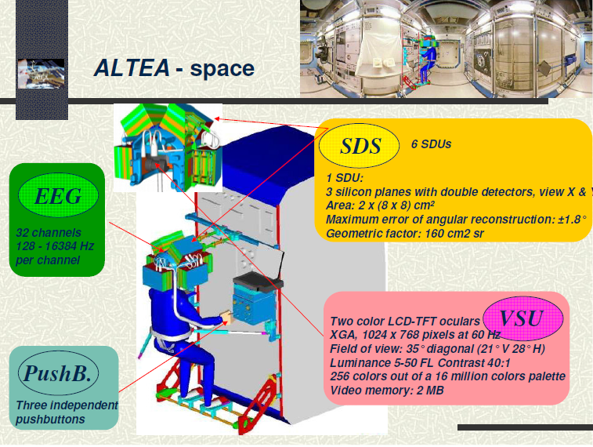
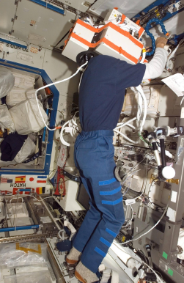
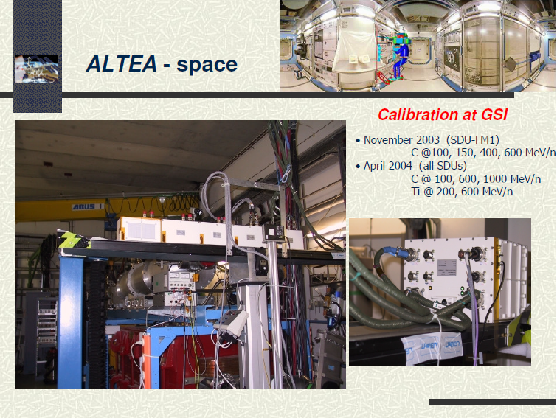
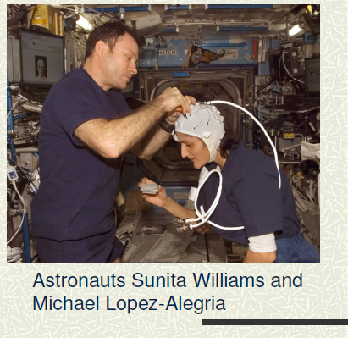
Example 4 (ALTEA)
28/07/2014 FAIR Workshop, Kolimbari
15

Slide 16
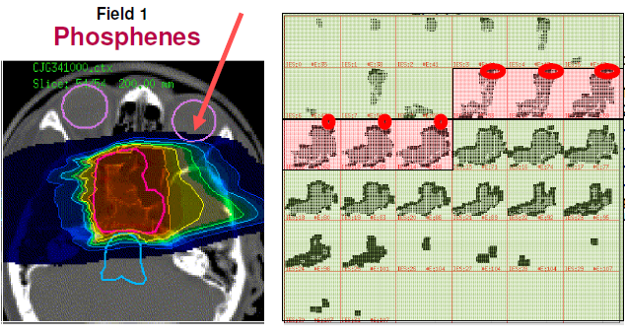
Example 5 –
- Phoshenes in Radiation Therapy with C-Ions
39 patient studied at GSI (O. Kavatsyuk, D. Schardt, M. Krämer)
28/07/2014 FAIR Workshop, Kolimbari
16

Slide 17
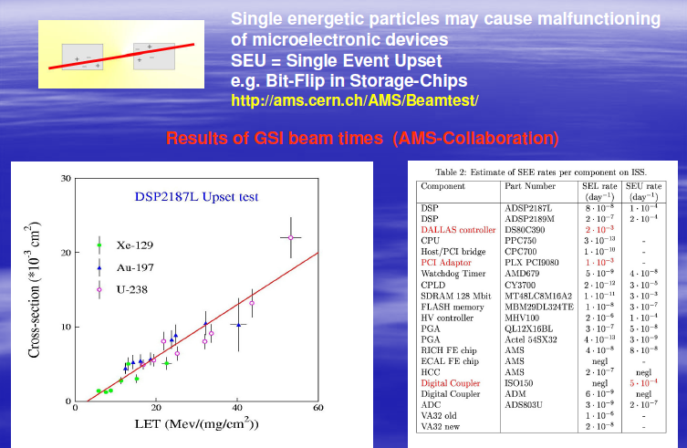
Radiation Damage in Electronic Components
28/07/2014 FAIR Workshop, Kolimbari
17

Slide 18
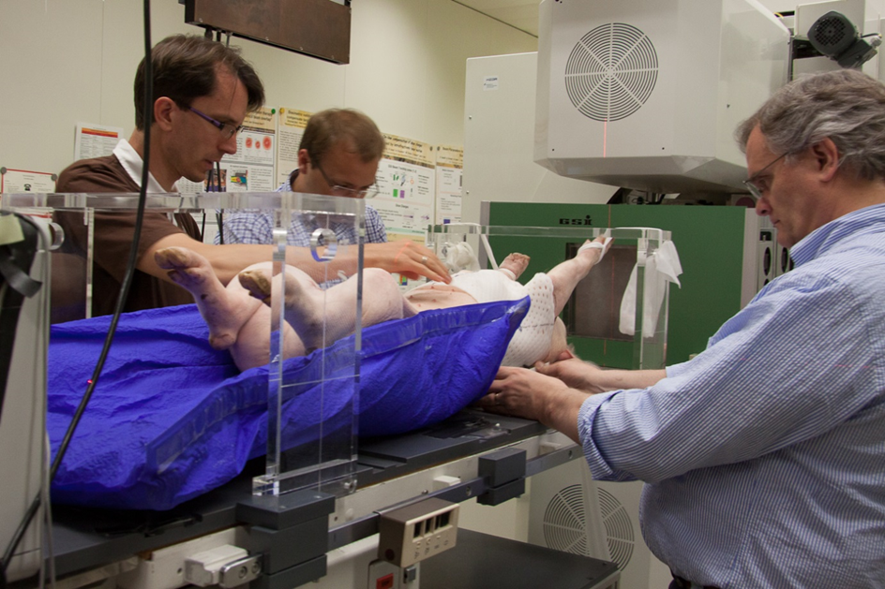
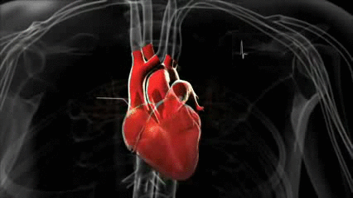
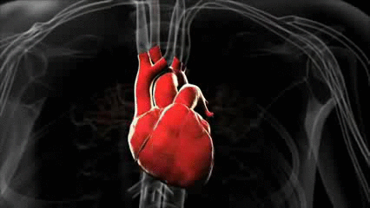
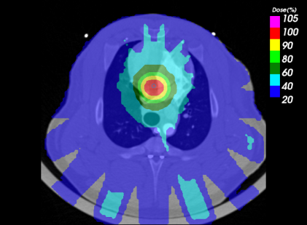
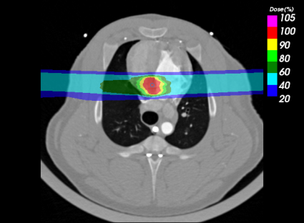
Heart Arrhythmia Project
Description
First worldwide experiment in July 2013 in swines for the treatment of heart arrhythmia with heavy ions
collaboration with Mayo Clinics, USA, and Heidelberg University Clinics
First experiment at GSI (cave M) from July 17 -23, 2014
Specification
Update of the electronics for the beam scanner currently in Cave M
Authorization by Hessian authorities for animal experiments at GSI/FAIR, including swines
28/07/2014 FAIR Workshop, Kolimbari
18

Slide 19
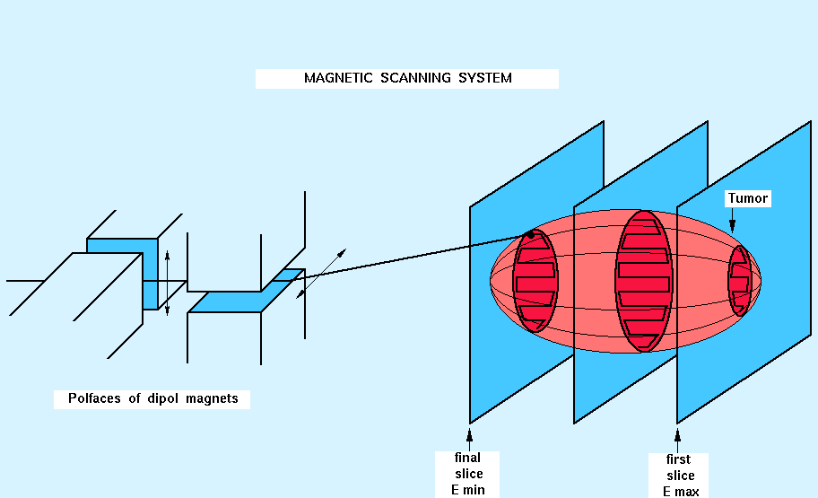
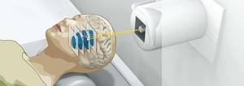
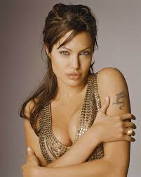
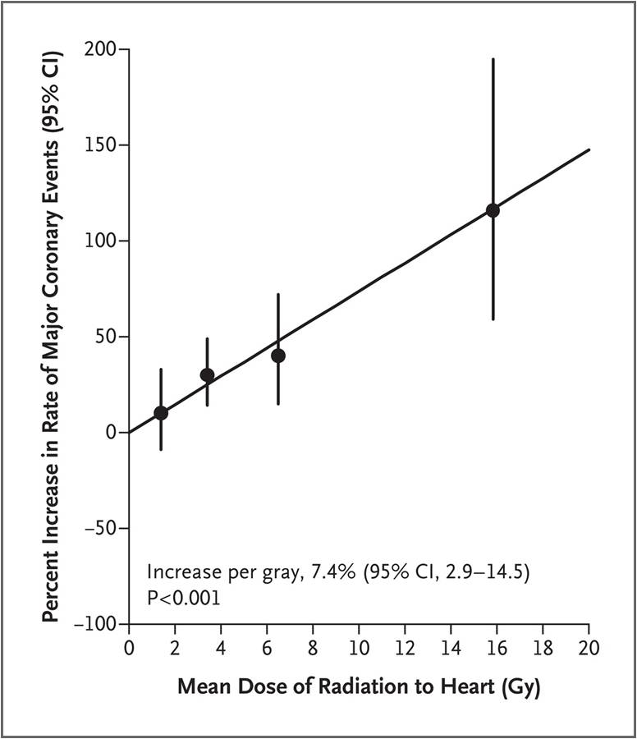
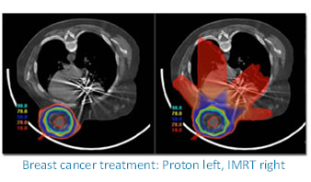

Particle Therapy
Breast cancer
1st cancer in women (1 in 8)
survival rate 80%
high risk of late cardiac mortality
14.3.2013
19

Slide 20
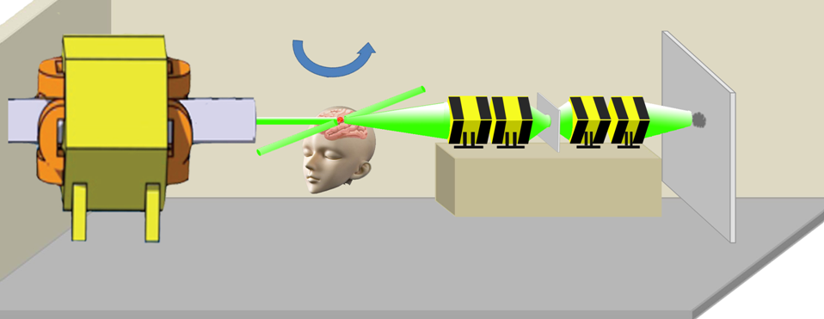
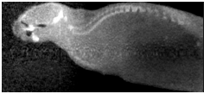
PANTERA Project
Proton therapy and radiography
Collaboration between biophysics and plasma physics
to exploit the PRIOR setup for therapy
Relativistic protons (4.5 GeV) for image-guided, high-resolution, real time, stereotactic radiosurgery at PRIOR setup
First image of a biological target (zebra fish) with 800 MeV protons at ITEP in 2011
Images of human-like phantom and mouse recorded at LANL using 800 MeV protons in 2013
Proposed setup for image-guided stereotactic particle radiosurgery
Zebra fish, first image of biological target
image of anthropomorphic phantom
28/07/2014 FAIR Workshop, Kolimbari
20

Slide 21
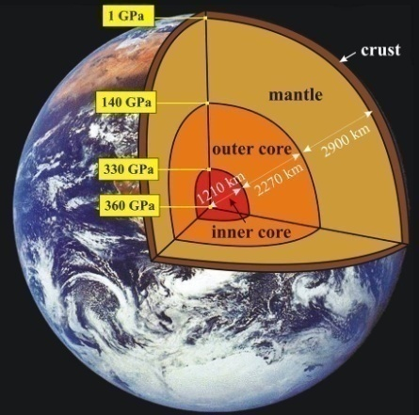
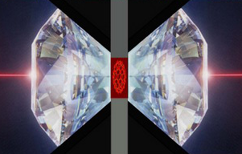
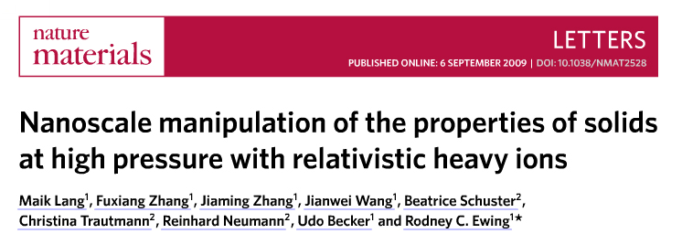
Matter under extreme conditions
Simulating geological processes in the inner Earth
Ion-beam stabilized high pressure phases
pressure
irradiation
temperature
During irradiation T and p like in the inner earth is applied to minerals. So, tracks induced by natural fission fragments in the minerals of the inner earth can be simulated.
21
Notes:
21

Slide 22
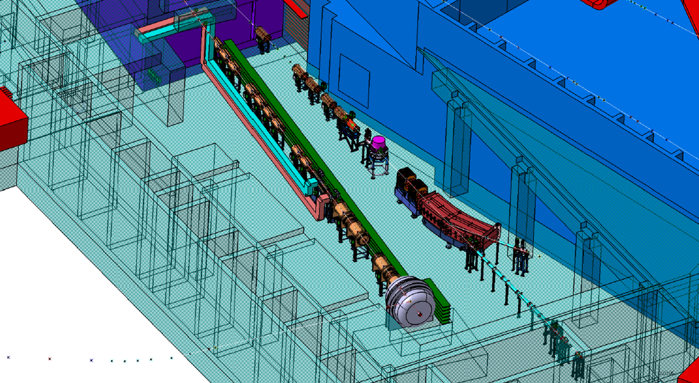
BIOMAT Irradiation Facility in APPA Cave
SPARC/BioMat
beamline
HEDgeHOB/WDM
beamline
Projectile E [GeV/u]
protons 29
light ions 14
(⁴He, ¹²C, ²⁰Ne, ⁴⁰Ar)
medium mass ions 11
(⁵⁶Fe, ⁸⁴Kr, ¹³²Xe)
heavy ions 11
(¹⁷⁹Au, ²³⁸U)
SIS18 or SIS18+SIS100 option
All intensities offered by the machine
BIOMAT
facility
28/07/2014 FAIR Workshop, Kolimbari
22

Slide 23
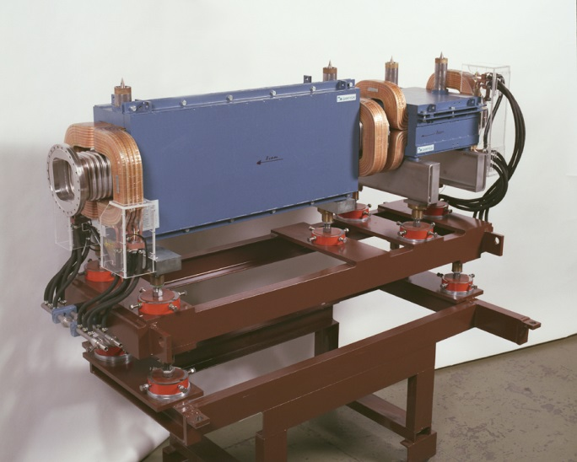
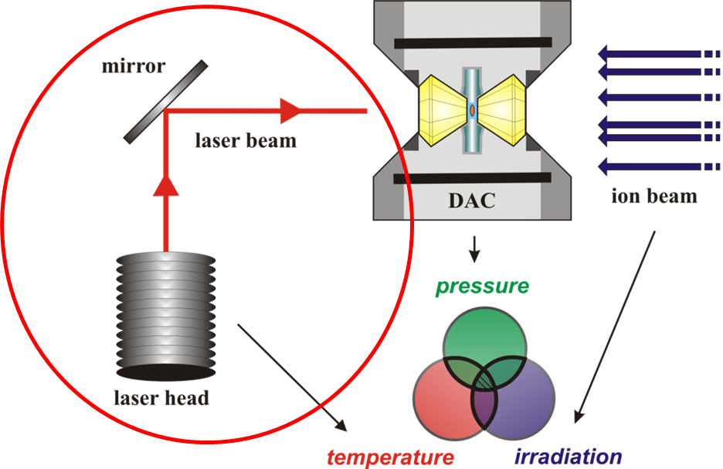
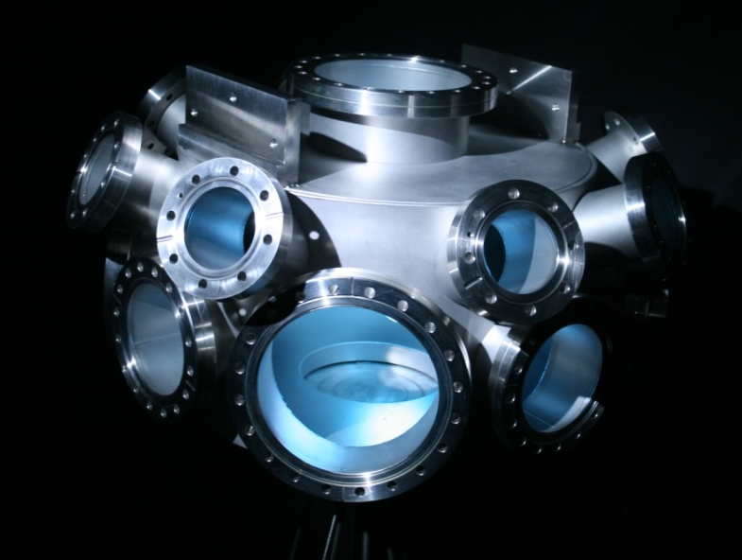
BIOMAT Beamline
Beamline
(ion optics, vacuum, beam diagnostics)
Control room
Beam scanning system
Target station
(target handling, multi-purpose UHV chamber, high-pressure equipment, X-ray machine)
Intensity-controlled raster scan technique allows high-quality irradiations of larger sample areas (max. irradiated area of 10 x 10 cm²)
UHV target chamber for sample irradiation and in-situ analysis
High-pressure cells (PE type) and laser heating system
28/07/2014 FAIR Workshop, Kolimbari
23

Slide 24
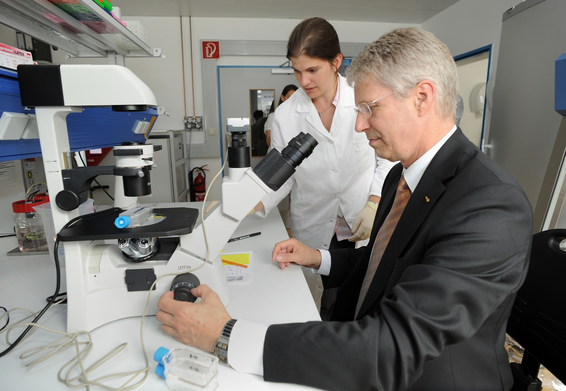
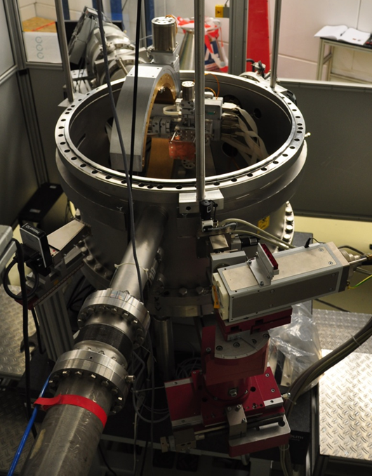
BioLab Equipment
Description
Preparations of biological samples before irradiation and analysis of the samples after irradiation
Specifications
Very close to the irradiation facility, equipped with incubators, laminar flow boxes, Coulter counters, microscopes, etc.
29.2.2012
T- Reiter (ESA) visiting GSI in 2013
X-ray machine
24
Notes:
24

Slide 25
Timeline for BIOMAT
2013
2014
2015
2016
2017
2018
2019
APPA Cave Ready
FAIR
First Beam
Full Beam
TDRs
Instrumentation via Verbundforschung
Preparations
Purchase Beamline Parts
Setup beamline
Commissioning with
beam
Experiments
User operation
28/07/2014 FAIR Workshop, Kolimbari
25

Slide 26
Summary / Outlook
Broad scientific program
Large international collaboration / user community
TDR for the BIOMAT irradiation facility in preparation
Cooperation with European Space Agency
Thank you!
28/07/2014 FAIR Workshop, Kolimbari
26

Slide 27




April, 3, 2013
May, 30, 2013
Dose=1.8 mSv/dayx501x2=1.8 Sv
27

