Slide 1

Report to ECFA, 21 Nov 2013
Prepared by IPPOG Co-Chairs:
Hans Peter Beck: Bern University
Marjorie Bardeen: Fermilab
Presented by Steven Goldfarb, ATLAS Outreach Coordinator

Slide 2
The European Strategy for Particle Physics
CERN-Council-S/106
What the European Strategy for Particle Physics says on the
Wider impact of particle physics
Sharing the excitement of scientific discoveries with the public is part of our duty as researchers. Many groups work enthusiastically in public engagement.
They are assisted by a network of communication professionals (EPPCN) and an international outreach group (IPPOG).
For example, they helped attract tremendous public attention and interest around the world at the start of the LHC and the discovery of the Higgs boson.
Outreach and communication in particle physics should receive adequate funding and be recognised as a central component of the scientific activity.

Slide 3
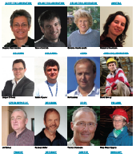
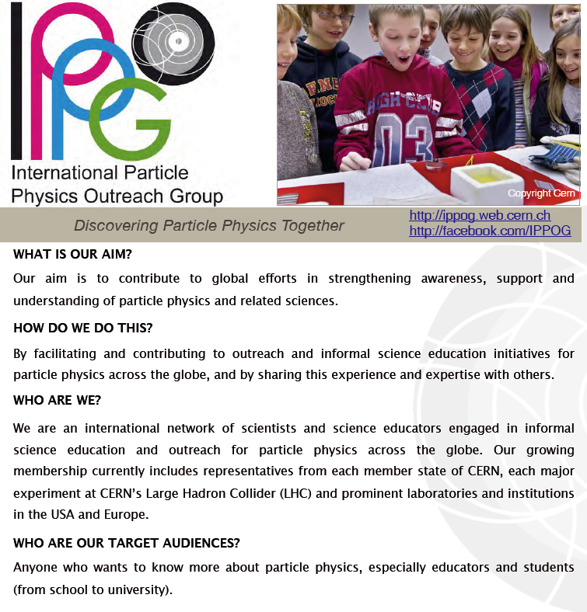
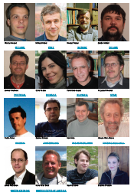

Who is IPPOG?
+ many
associates

Slide 4
IPPOG PURPOSE
The principle aim of the International Particle Physics Outreach Group (IPPOG) is to contribute to global efforts in strengthening cultural awareness, understanding and support of particle physics and related sciences.
More specifically, IPPOG’s purpose is to raise standards of global outreach and informal science education efforts of particle physics and to communicate its results and findings to the public by, amongst other things:
Strengthening the sustainability, reproduction and growth of outreach activities in particle physics and related disciplines
through the provision of reliable and regular discussion forums and information exchange for science institutions and laboratories as well as for individual scientists engaged in science outreach and informal science education world-wide.
Raising standards
for outreach and informal science education initiatives by proposing and implementing strategies designed to share lessons learned and best practices for outreach in particle physics and related fields.
Providing explanatory materials
for helping disseminate results from particle physics
and related subjects.

Slide 5
IPPOG History
IPPOG was formed in 1997 under the joint auspices of the European Committee for Future Accelerators (ECFA) and the High Energy Particle Physics Board of the European Physical Society (EPS-HEPP Board). Initially IPPOG was called European Particle Physics Outreach Group (EPPOG) which transformed to IPPOG in 2011, to reflect its true international stature.
IPPOG (EPPOG) has been chaired in the past by:
Frank Close 1997 - mid-2002
Eric Johannson 2002 - 2008
Dave Barney & Michael Kobel 2009 - 2012
Marjorie Bardeen & Hans Peter Beck 2013 -
+ many
associates

Slide 6
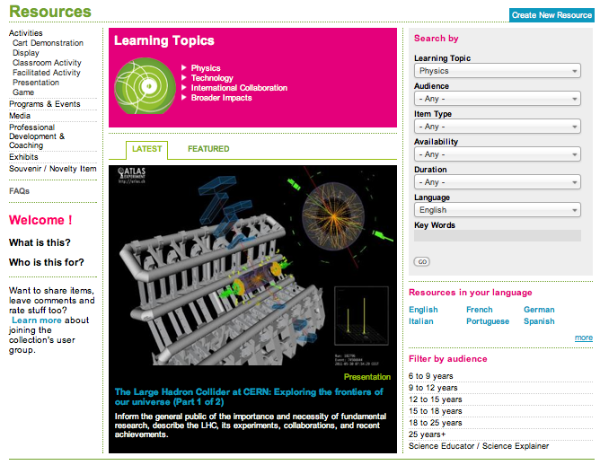
IPPOG Resources
Education & Outreach Collection – The IPPOG DB
http://ippog.web.cern.ch http://facebook.com/IPPOG

Slide 7
http://ippog.web.cern.ch/resources
What is it?
  Collection of tools and materials
  to be used in outreach
  videos, brochures, posters, talks, exhibits
  ideas for hands-on activities and more.
Who is it for?
  Collection for use by anyone
  engaged in particle physics outreach and informal education initiatives.
  including informal science educators & explainers,
  and anyone else wishing to help others understand fascination of particle physics
Current Status
  Testing and feedback stage
  In need of a developer

Slide 8
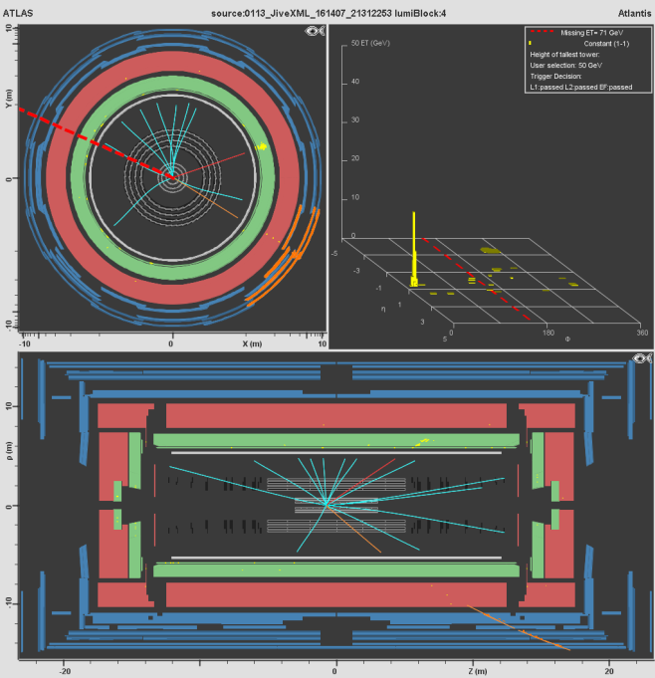
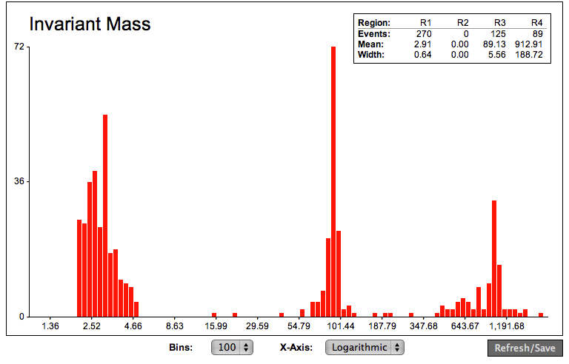
IPPOG Activities
International Masterclasses
Particle Physics Masterclass
  Target: 16-19 year-old students, teachers, public
  Introduced and guided by scientists („masters“)
  Work (in pairs) on experimental data from CERN
      Classify ~ 100 particle collision images, each
      Combine: compare abundance or plot spectra
      Draw conclusions, get insights
ATLAS, CMS, ALICE, LHCb
  Make data available for educational use
  Students can
    (re)-discover the W & Z bosons
    examine the structure of the proton
    see how b hadrons decay
    reconstruct “strange particles”
    hunt for the Higgs boson
    have their questions answered

Slide 9
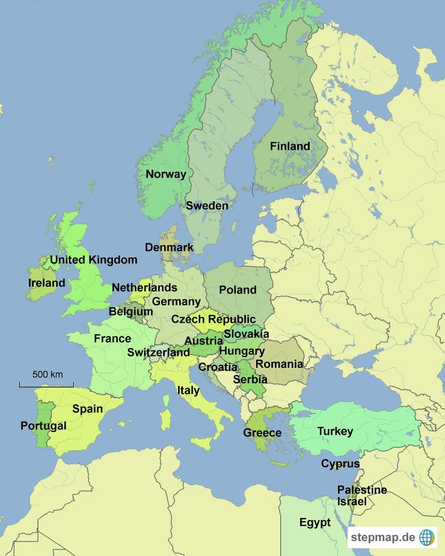
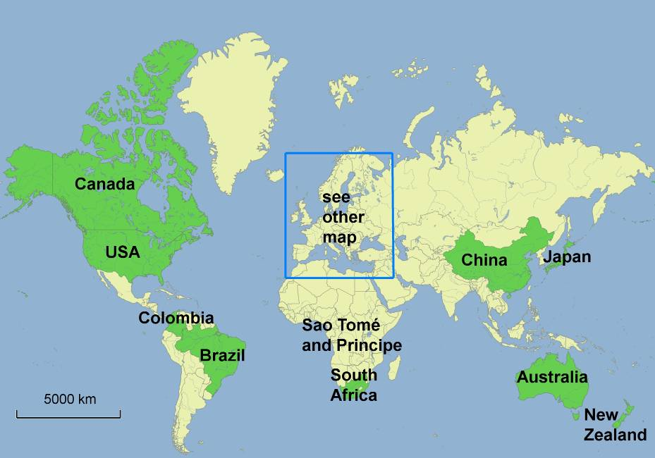
International Masterclasses 2014
37 countries, 160 institutes
12 Mar – 12 Apr (24 days) (22 days last year)
Measurement type decided by students, organisational team (2 slots / day)
40 video conferences with CERN (36)
108 institutes registered to connect (129)
132 masterclasses registered (158)
  ALICE: 11 (10)
  ATLAS W: 39 (50)
  ATLAS Z: 51 (58)
  CMS: 32 (40)

Slide 10
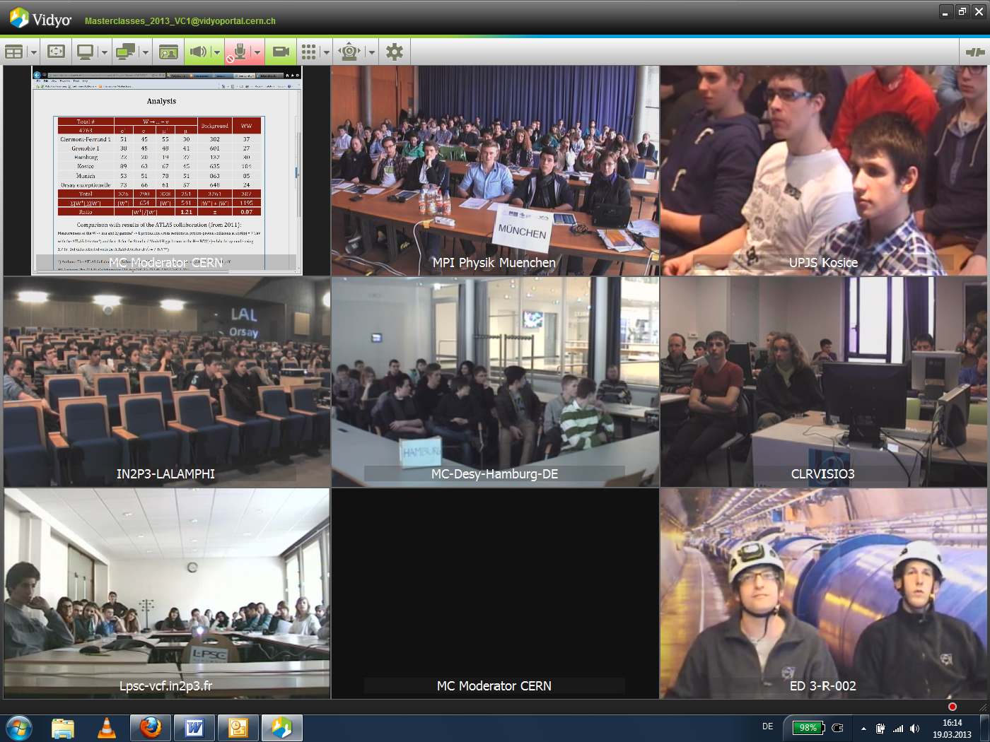
Masterclass Video Conferences 2013
37 CERN-based:
Training for moderators at CERN 18.2.
Rooms (teachers´ lab, CMS centre)
Test period 4.2. – 15.2.
(Vidyo support team)
86 institutes tested
(14 new institutes)
33 Moderators!
12 Fermilab-based:
Crew of 3-4:
  Facilitator
  Moderator (FNAL/ANL)
  Tech support
  (Featured scientist)

Slide 11
Masterclass Coordination and Support
Coordination
  Uta Bilow (Dresden)
  Ken Cecire (Notre Dame)
  Steering Group of experts from various experiments, labs
Support from
  CERN
  Fermilab
  EPS HEPP (High-Energy and Particle Physics Division of the European Physical Society)
  TU Dresden
  US National Science Foundation and the US Department of Energy
In Kind Support
  Measurements provided / supported by IPPOG members
  Other support from Vidyo team, moderators, local teams at universities,…

Slide 12
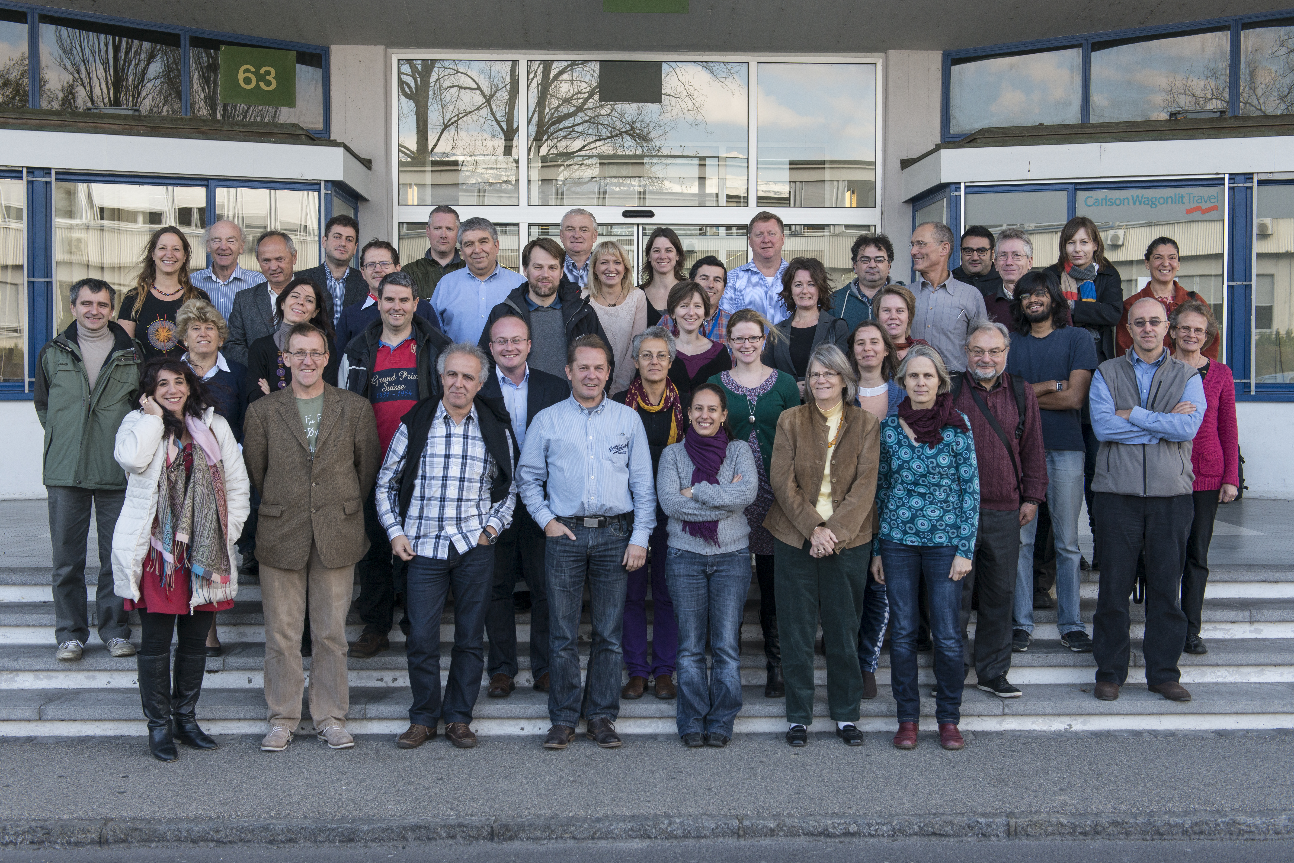
Relation to EPPCN
IPPOG and EPPCN have distinct profiles and expertise
  IPPOG :
  National or international professional physics and physics education societies, particle physics and related sciences experiments and laboratories / institutes
  EPPCN :
  Communication professionals
½ day common meeting each year gives good insight into mutual work
IPPOG & EPPCN participants of November 2013 meeting at CERN

Slide 13
IPPOG & EPPCN
EPPCN and IPPOG can build up on synergies
Example Joint Efforts
  ICHEP 2014
    2-9 July, Valencia, Spain
    can support outreach and communication
    at the conference site and internationally
  Beamline for schools
    Communication via EPPCN
    Support for physics program from local IPPOG members
  CERN 60th anniversary
    Actively involved

Slide 14
SUMMARY
IPPOG
  is an established successful outreach and education group now integrated into the European Strategy
  provides tools & activities ready to be implemented at any institute
  is moving beyond Europe and the LHC
    Romania & Ireland have recently joined IPPOG
    Ongoing discussions with more new countries
    Spreading programs and experiences
  is sharing experiences with existing successful national networks
    QuarkNet (US, teachers)
    Netzwerk Teilchenwelt (DE+CERN, teachers and students)
    Et al.

