Slide 1
Potentials of Petri nets for
Availability Modeling and Analysis

Slide 2

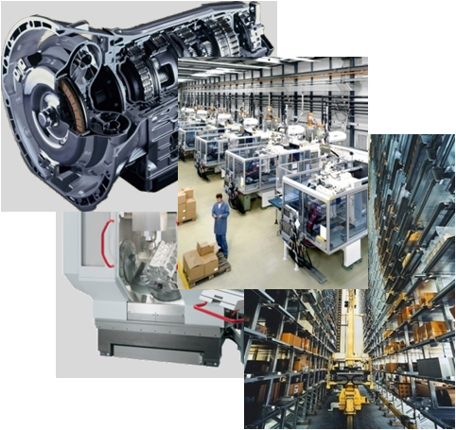


Outline
Introduction
Availability Modeling
Analysis and Prediction
Software Tool: REALIST
Large and Complex Systems
Application Example
Summary & Conclusions

Slide 3
Introduction

Slide 4



Motivation
Availability Modeling and Analysis
Production Process
Structure & States
Operations
Functions
Availability
Costs
Maintenance & Logistics
Dependencies
Reliability
Numerous interactions, extremely complex system description

Slide 5
Motivation
Prediction of operational availability
Decision between alternatives:
      Operation strategy
      Production process
      System configurations
      Reliability demands
      Maintenance strategy
      Logistics concepts
Necessary: Powerful methods for availability analysis and prediction
Notes:
Yesterday: Separation of product (P) and service (S)
Today: Extension with product-related services
Tomorrow: „hybrid performance bundles“

Slide 6
Availability Modeling

Slide 7
Availability Modeling and Analysis
Availability
Modeling and Analysis
Modeling
Analysis & Prediction

Slide 8
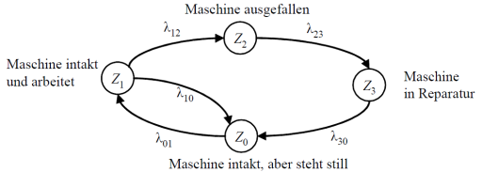
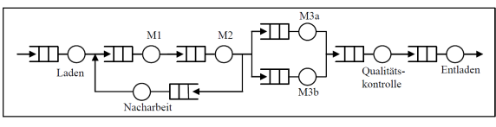
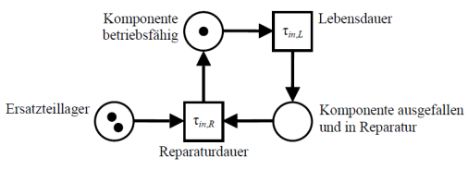
Overview and Comparison of Modeling Methods
Modeling methods
Combinatorial models
Queue oriented models
State-space oriented models
Reliability block diagram
Fault tree
Queues
Markov state graphs
Petri nets
B 1
B 2
machine failure
machine is intact and is working
machine under repair
B 3
B n
B 4
loading
quality control
unloading
machine is intact but shut down
rework
component ok
durability
spare parts depot
component failure and under repair
Time to repair

Slide 9
Extended Stochastic Petri Net (ESPN)
Statical elements
  Places (States, Objects)
  Transitions (Time & Logic)
  Arcs (Relations, Structure)
Dynamical description
  Marking
  Activation (or deactivation)
  Switching
Initial marking
Sequence of activating (or deactivating) and switching results in marking changes
component operable
lifetime
τ_{in,L}
spare parts depot
τ_{in,R}
time to repair
components
failed and under repair
Few basic elements: great flexibility in modeling

Slide 10
Extended Coloured Stochastic Petri Net (ECSPN)
1`(0,0, 2)
[X_1 = 1 AND X_Sys = 0]
Extensions
Markings with complex information
(„Colour“ = Data type)
Activation condition and switching rule are colour dependent
Special elements and switching processes
  State behaviour with ageing
  Queuing discipline
  Degree of renewal
  Operational costs
active
passive
1`(k, m)
0
1`(AgeDis(tr₁), m)
p₁
Comp
tr₂
Π = 3
p₂
Comp
Cost_OP, 1200
Passivation
Cost_P, 400
1`(k, m)
1`(k, m)
AgeEn = k
AgeEn = k
Lifetime
active
Wb
failed / negotiable
Lifetime
passive
Wb
τ
AgeIn
|
τ
AgeIn
1`(AgeFire, m)
p
1`(AgeFire, m)
tr₁
Priority = m
p₃
Comp
Priority = m
tr₃
Set(X_1 = 0)
Set(X_1 = 0)
1`(k, m)
Spare parts depot
Wb
Maintenance personnel
3`(2) + 2`(4)
Time to repair
AgeMem
1`(2)
1`(sp)
τ
1`(mp)
p₄
SP
tr₄
[sp = 1 AND mp = 2]
p₅
MP
Cost_R, 580
1`(0,2*k, m)
Set(X_1 = 1)
active
1`(0,0, 2)
rp₁/p₁
Comp
Cost_OP, 1200

Slide 11
Conjoint System Modeling (CSM)
Hybrid system model
ECSPN state space oriented
  Reliability structure is not directly representable
  System state complex
Reliability Block Diagram (RBD) favorable for reliability structure
Extended Coloured
Stochastic Petri Net
Conjoint
System Model
Reliability
Block Diagram
Presentation of various aspects using the optimal modeling technique in each case

Slide 12
Hierarchy of Modeling Methods
Conjoint System Model (CSM)
Extended Coloured Stochastic Petri Nets (ECSPN)
Extended Stochastic Petri Nets (ESPN)
Fault Tree
Reliability block diagram (RBD)
Queue (Q)
Petri nets
Markov state graphs (MG)
Combinatorial models
Queue oriented models
State-space oriented models

Slide 13
CSM/ECSPN – Modeling capability
General
Concurrency/Synchronization
Chronological sequences
Competition
Logic conditions
Queuing behavior
Timed/Stochastic system behavior
Dynamic changing system behavior
Fuzzy input data

Slide 14

CSM/ECSPN – Modeling capability
LHC-Operation
Operation
Operation schedule
Mission profile
Production
Material flow
Information flow
Production structure
Queuing behavior
Priorities
Production dependencies
Beam Generation & Experiments
System & Reliability
Reliability structure
System and component states
Constant failure rates
Time-dependent failure rates
Dynamic changing failure behavior
Aging
Several operative states*
Failure dependencies
LHC systems & components
* with time-dependent failure or transition rates

Slide 15
CSM/ECSPN – Modeling capability
Functions
Functional states
Functional sequences
Functional logics
Functional dependencies
Monitoring & Protection System
Maintenance & Logistics
Corrective and preventive maintenance
Inspections and sensor-based condition monitoring
Time-dependent transition rates
Degree of renewal*
Spare part logistics
Limited maintenance capacities
Maintenance dependencies
Maintenance & Logistics
Costs
Duration-based costs
Number-based costs
Variable Costs/Revenues
Budget constraints
* with time-dependent failure or transition rates

Slide 16
System Model - Close to Reality
User/Operator
Production Process
System Level
Functions
Comprehensive stochastic
system model
Aspects of modeling
Cost level
Component Level
Maintenance Level
Logistics Level
External Resources

Slide 17
Analysis and Prediction

Slide 18
Dependability Characteristics
Inherent Characteristics
  Operation schedule
  Production process
  Reliability structure
  Functions
  Availability
  Reliability
  Reparability/Maintainability
  Inspectability
User/Operator
Operational Characteristics
  Operability
  Productivity
  Availability
  Reliability
  Functionality
  Reparability/Maintainability
  Inspectability
  Maintenance Delay Time
  Logistic Delay Time
  Level of Service
Production Process
System Level
Functions
Component Level
Maintenance Level
Independent processes, structures, components and states
Logistics Level
Evaluation under operating conditions
(with dependencies)
External Resources
Input Information
Output Information

Slide 19
Software Tool: REALIST

Slide 20
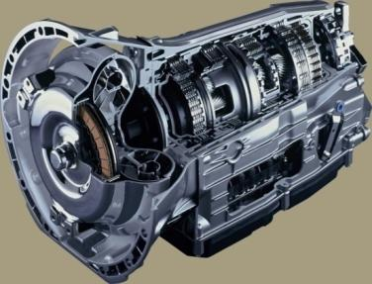
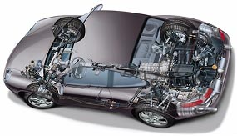
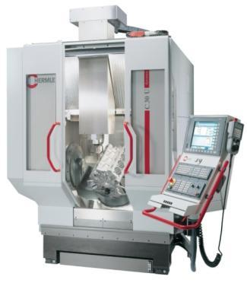
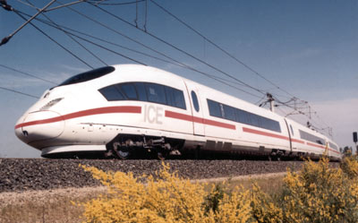

Modelling and Simulation Package REALIST*
Manyfold
Applications
Versatile Modeling Aspects
Numerous
Analysis Options
Production Process
Structure and States
Operations
Functions
R(t)
Modelling
Analysis
Reliability
REALIST
Modeling and
Simulation Package
Costs
C(t)
High Level
Petri Net
Monte Carlo
Simulation
Availability
A(t)
Costs
Reliability
Maintenance &
Logistics
Dependencies
Modeling and Analysis of complex technical systems “without” limitations!
*) REALIST = Reliability, Availability, Logistics and Inventory Simulation Tool

Slide 21
Modeling and Simulation Package REALIST
Creation of the system model as ESPN, ECSPN or CSM
Modularisation the presentation in pages
Management of simulation projects
Automated implementation of simulation projects
Analysis and processing of result data
Comfortable development and efficient analysis of a system model

Slide 22
Large and Complex Systems

Slide 23
Complexity of the Model
Measures to support modeling:
  Decomposition
  Application of sub-models
  Application of extended sub-models
  Conjoint modeling
  Generic model design (automatic generation)
Measures to reduce simulation time:
  Parallelization
  Focusing
Notes:
Degradation wird in diese zwei Gruppen unterteilt:
Bei der normale/natürliche Degradation werden Auswirkungen unter normalen Betriebsbedingungen untersucht.
Hingegen werden bei der beschleunigten Degradation die Belastungen erhöht. So kommt es zu einem verstärkten Degradationsprozess, wodurch der Ausfall früher erfolgt.

Slide 24
Application Examples

Slide 25
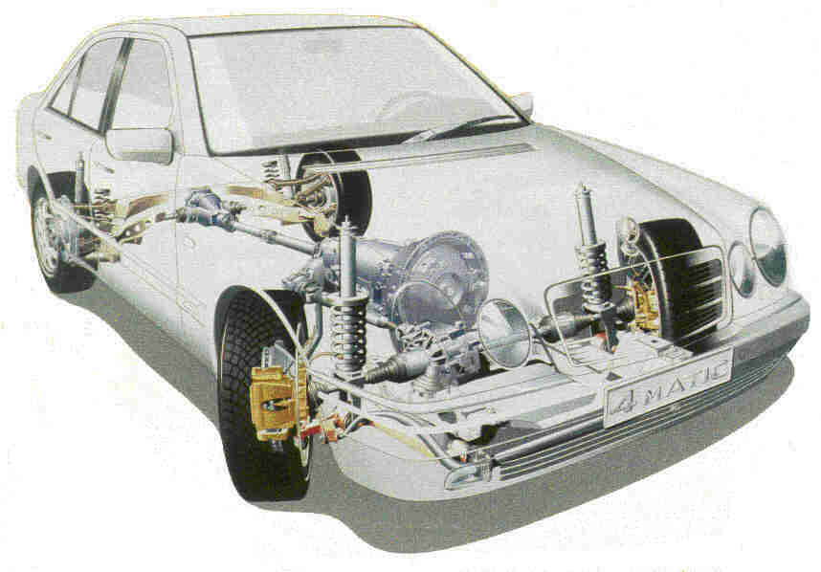
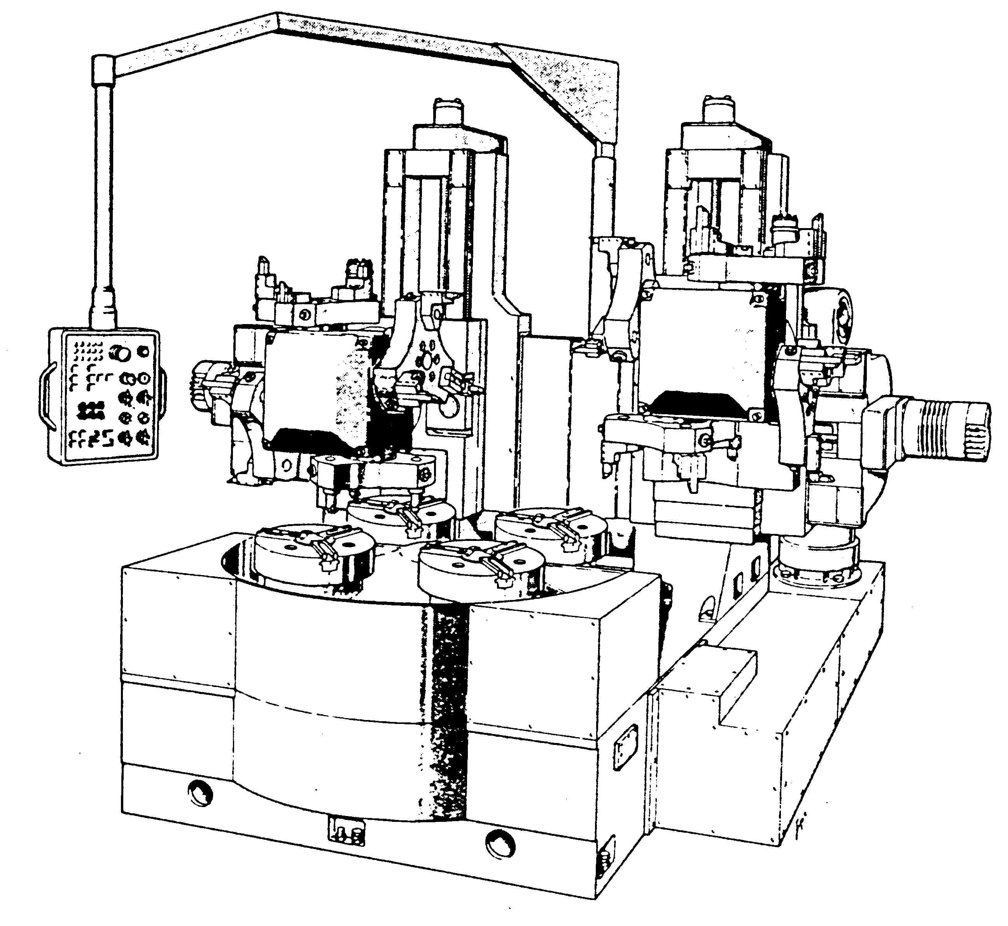

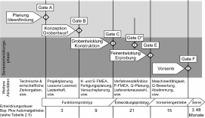

Range of Application
REALIST
Automotive and Mechanical Engineering
Machine Tool or Facility Engineering
Production processes
Logistics
Power Engineering
Aerospace Engineering
From single component up to comprehensive system

Slide 26
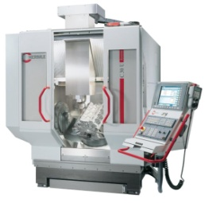
Application Example – Production system
Boundary conditions:
9 different product variants
Entire manufacturing process (15 process steps)
including quality control and rework
Reliability based on concurrent failure modes
Maintenance process including preventive
and corrective actions
Several cost drivers e.g. material, energy, personnel, …
Main analysis objectives:
Different maintenance strategies and costs
Probability of shortfall for the production unit target (based on availability)
Production system: band saw blade fabrication

Slide 27
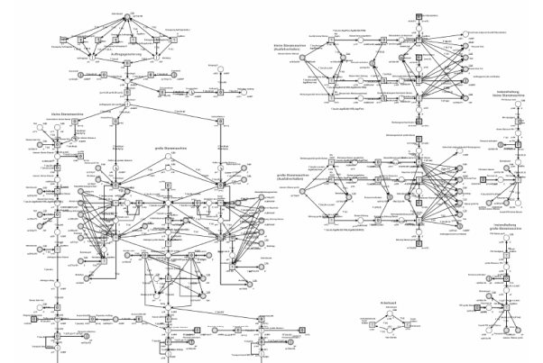
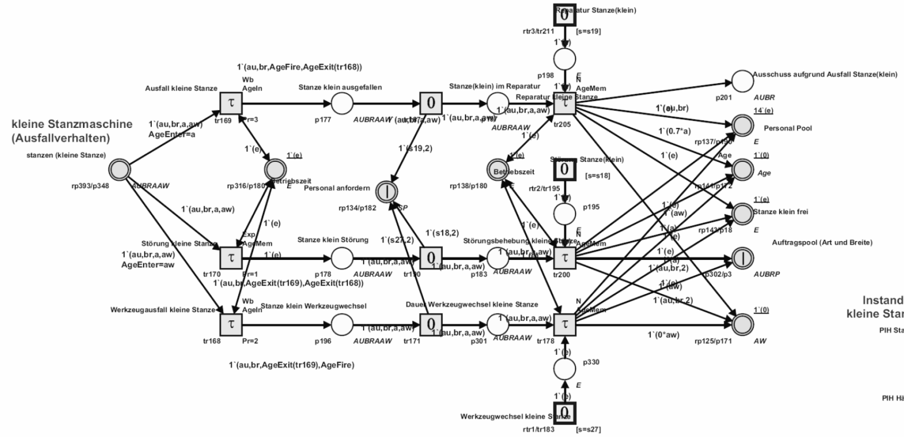
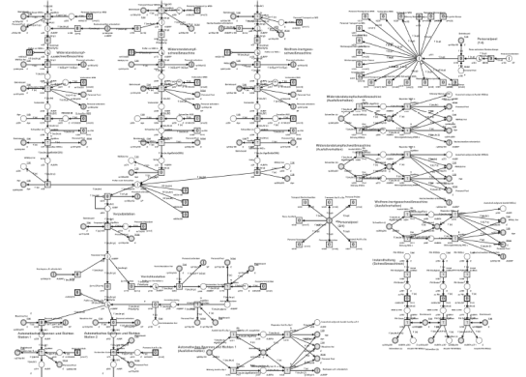
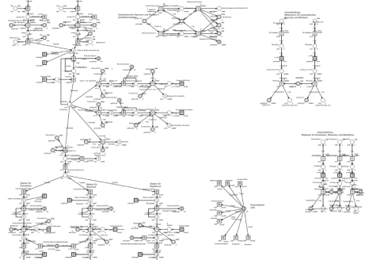
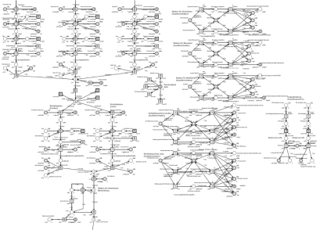
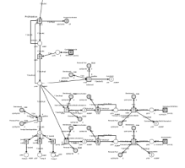
System Model – Production system
Entire model
Reliability model of machine A
3 concurrent failure modes
Initiation/administration of repair process

Slide 28
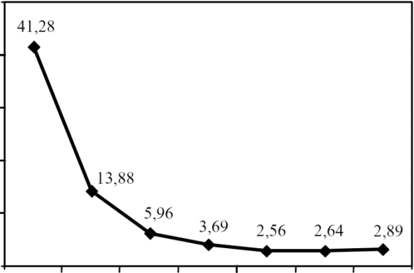
Results – Production system
Main analysis results:
Maintenance strategy
Probability of shortfall for the production unit target (based on availability)
Shortfall probability for contracted production volume of 7000 units/year
Production system: band saw blade fabrication
50
41.28
40
Number of experiments/year
Maintenance strategy and costs:
Strategy “24” PMs: 562,170 €/year
Strategy “36” PMs: 567,910 €/year
“Optimized Strategy”: 557,200 €/year
30
Shortfall Probabiliy [%]
20
13.88
10
Maximum
5.96
3.69
2.56
2.64
2.89
3
0
Budget constraints
0
9
12
18
24
36
optimized
Number of PM‘s per year
strategy

Slide 29
Summary & Conclusions

Slide 30
Summary & Conclusions
Presented powerful modeling methods are able to consider various modeling aspects
Conjoint system model based on Petri net yields the maximum modeling power and is able to consider manifold dependencies and reciprocal effects
Analyzed operational parameters are an integral base for the development of availability (predictions, comparisons, optimizations, …)
Large systems require support in modeling and analysis
Availability modeling and analysis based on Petri nets offers a great potential for CERN

Slide 31
Thank you for your attention!
peter.zeiler@ima.uni-stuttgart.de

