Slide 2
Outline
Introduction to LHC Power Converters
Failures in 2012
Extrapolating from 2012 to LS1-LS2
Controller for radiation tolerance
Future challenges
Conclusion

Slide 3
Introduction to LHC Power Converters (1/2)
Power & Control
After Todd, TWEPP’12
Control Part – FGC
Power Part – Voltage Source

Slide 4
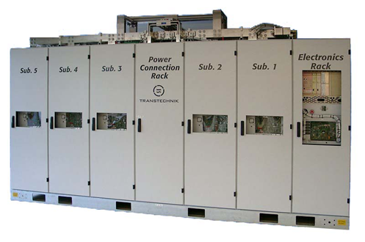
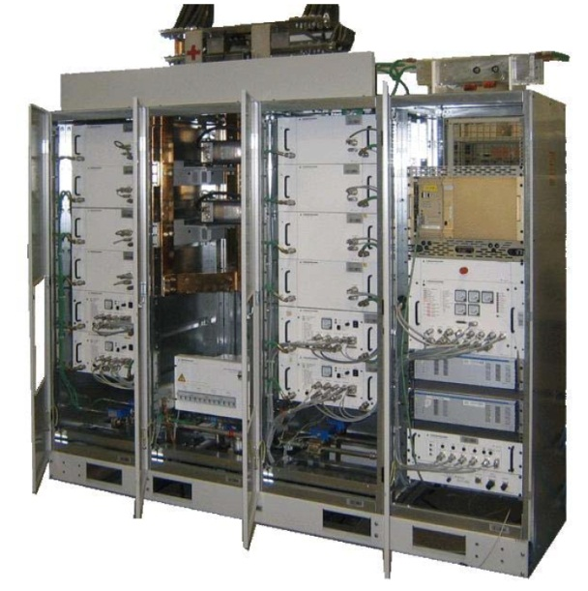
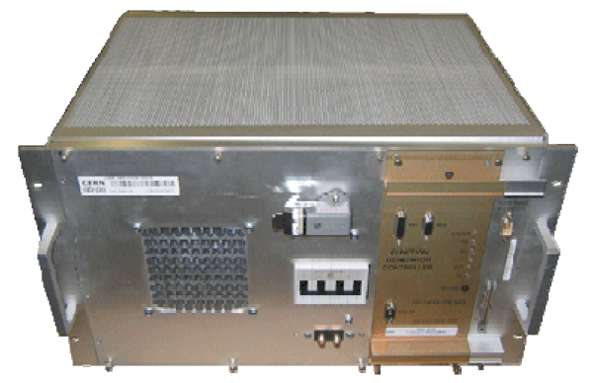
LHC Power Converters Introduction (2/2)
Types of Power Converters
G
C
Function Generator Controller
F
≈1050 in LHC radiation areas

Slide 5
Failures in 2012 (1/4)
Overview
Hardware failures leading to a beam dump
Data from Post Mortem analysis – Evian 2012
After Todd, Evian’12

Slide 6
Failures in 2012 (2/4)
Overview
Sources of information
Unknown origin (power or controls)
Non radiation related
Power Part
Control part
Total of 35 Beam Dumps from PM’s presented in Evian 2012
Number of hardware failures of the LHC Power Converters
Only physics runs with energy above 450 GeV
Discarded EOF, MD & MPS TEST

Slide 7
Failures in 2012 (2/4)
Overview
Sources of information
Number of hardware failures of the LHC Power Converters
As recorded by operations in eLogbook
Needs an expert input to analyze the root cause of failure

Slide 8
Failures in 2012 (2/4)
Overview
Sources of information
Number of hardware failures of the LHC Power Converters
As recorded by EPC Logbook comparing directly with eLogbook
Contains equipment expert analysis

Slide 9
Failures in 2012 (2/4)
Overview
Sources of information
Number of radiation-induced events in the LHC Power Converters
RadWG database that contains the equipment and radiation expert analysis

Slide 10
Failures in 2012 (2/4)
Overview
Sources of information
Worst case analysis
Combined information from:
EPC Logbook (electrical failures)
Radiation Working Group (radiation related failures)

Slide 11
Operation in 2012 (3/4)
Failures of VS
Electrical failures
…
Failures due to radiation
…
600A Power Converter (14/15 events)
Single Event Burnout of an AC-DC power supply
Detected in the R2E Project framework and fixed by TE-EPC-LPC

Slide 12
Operation in 2012 (4/4)
Failures of FGC
Electrical failures
Failures due to radiation

Slide 13
Extrapolating from 2012 to LS1-LS2
2012 data
Radiation Levels
LS1-LS2 – increased radiation levels, increased VS load
Røed,
CERN’12
?
Simulation tool
Thurel, CERN’12
Known unreliable parts fixed
New radiation tolerant
controller needed!
?
Does not account for the infant mortality of:
FGClite replacing FGC2
Voltage Source modifications

Slide 14
Radiation Tolerant Controller FGClite (1/4)
Technical Concept
Dedicated design methodology:
No µP/µC as computationally intensive tasks moved to the gateway
Extensive radiation testing to select/validate all electronic components
Highly available Gateway/FGClite communication required
Mitigation of radiation effects at the design level
Uznanski,
NSS’13

Slide 15
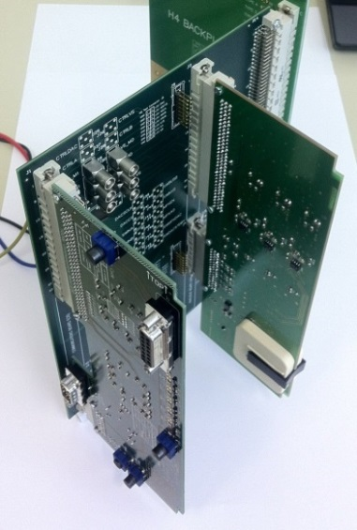
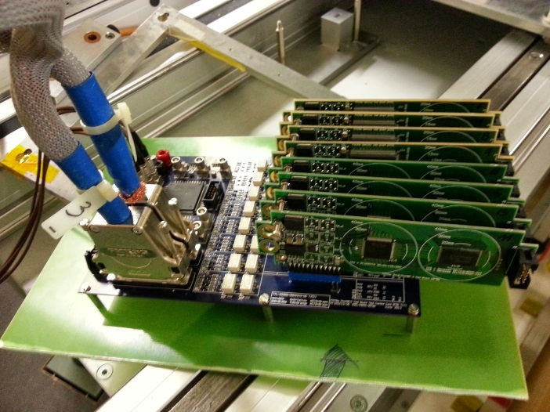
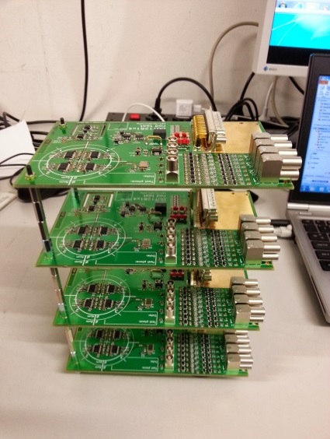
Radiation Tolerant Controller FGClite (2/4)
Project Timeline
  Equipment budget ≈ 3M CHF
  Prototype
  FPGA Type Tester
  ADC Type Tester
      2013 – hardware design & component type testing underway
      Q3/2014 – 10 fully validated FGClite proof-of-concept modules
      Q3/2014 – start of component batch testing using CHARM (PS East Area)
      Q2/2015 – Series production

Slide 16
Radiation Tolerant Controller FGClite (3/4)
Installation
  FGClite project planning
  2015
  2016
  2017
First Beam & Physics
Increasing failure rate
FGC2 not acceptable
  FGC2
OK
?
nOK
  FGClite
Production/Burn-in
?
OK
FGClite burn-in & installation
Infant mortality failures
FGClite operational
  FGC2
  ≈ 1700 units
  ≈1050 units
  Number of FGCs
  ≈650 units
  FGClite
  Time
FGC2 will be used after LS1 for the first months as its failure rate will be acceptable
FGC2 will start failing due to increasing radiation levels thus FGClite will be installed
FGClite infant mortality issues will have to be addressed in the first weeks of operation
FGClite operational will exhibit much lower failure rate than FGC2

Slide 17
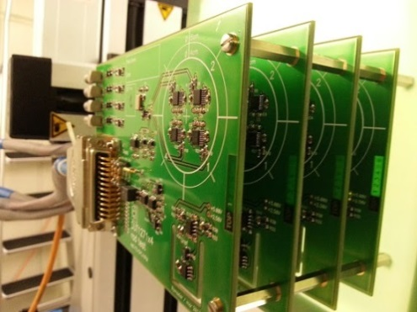
Radiation Tolerant Controller FGClite (4/4)
Challenges
Procurement of commercial components (COTS)
Batch origin (Silicon Date Code) information
Batch radiation qualification
  Importance of sample selection
  Assessment of component-to-component
  radiation response variability
Reliable communication infrastructure
Robust FGClite hardware (TE-EPC) and its communication module (BE-CO)
Robust Gateway software (TE-EPC) and its communication module (BE-CO)
Robust communication infrastructure: repeaters, cabling, etc… (BE-CO)

Slide 18
Conclusion
Concentrated on 2012 LHC Converters
Looking Back:
On the observed availability of Power Converters
  Radiation failure rates = new FGC needed
On the method used to track Power Converter availability
  Different information sources analyzed
  EPC Logbook (equipment) and RadWG databse (radiation) used
Looking Forward:
On the changes to Power converters during LS1
  Radiation failures addressed: FGClite replacing FGC2, modifications to 600A VS
  Predictions don’t account for the infant mortality of new/modified systems
  But overall an increased number of failures is possible
On future reliability studies
  In-depth analysis/predictions of radiation-induced failure rates (RHA program)
  Tracking and extrapolation of failure rates from operational data
On future data collection
  Integration of EPC logbook data in the MMP/OPIM solution when available

Slide 19
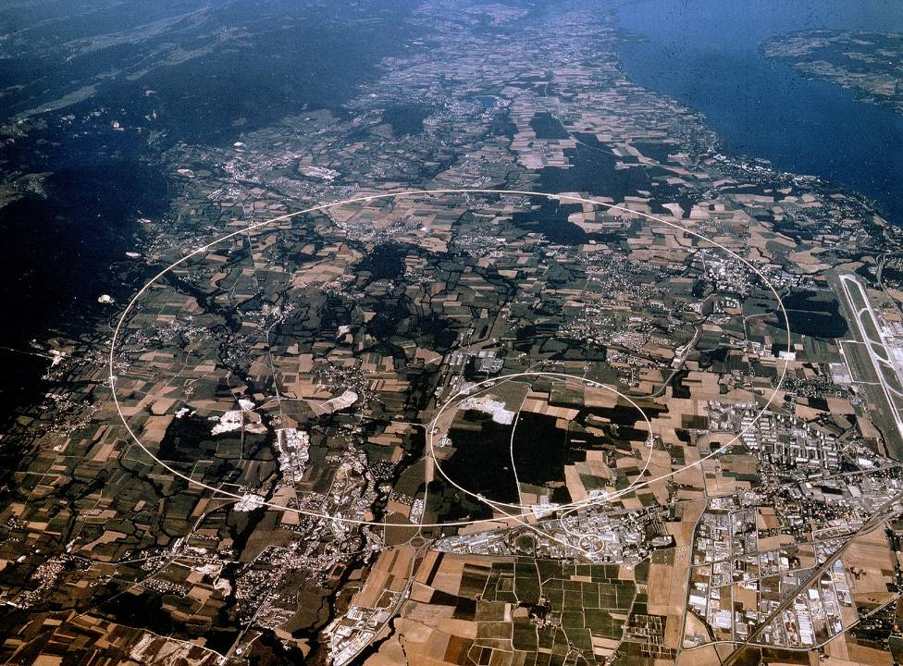
CERN
Thank you for attention!

