Slide 2
Outline
1. LHC Physics in Context of Availability
Key Performance Indicators
Availability vs Operation
2. Tracking Availability: 2010-2012
2012 experience, limitations
System survey results
3. Tracking Availability: post LS1
LHC System Availability Tracker (LSAT) Requirements
Implementation
4. The Cardiogram: August 2012
Reverse engineering
5. The future
Milestones and Timeline
Integration with Maintenance Management

Slide 3
Context of Availability

Slide 4
Context of Availability
integrated luminosity is a function of…
time colliding physics beams
turnaround between successive physics beams
time to clear faults
physics performance during colliding beams
availability!
machine understanding
& operator skill
These are not independent variables

Slide 5
Context of Availability
the Availability Working Group has been concentrating on understanding these relationships
Studied 2010-2012 availability
Studied protection system dependability
Analysed methods currently employed
Proposes a future direction
time colliding physics beams
turnaround between successive physics beams
time to clear faults
physics performance during colliding beams
availability!

Slide 6
Fault Tracking: 2010 - 2012

Slide 7
The Survey
Three key questions:
Q1: How systems find out that something is faulty?
Q2: How do systems keep track of what is faulty and needs repairing?
Q3: root cause / failure mode of every fault / event identified?

Slide 8
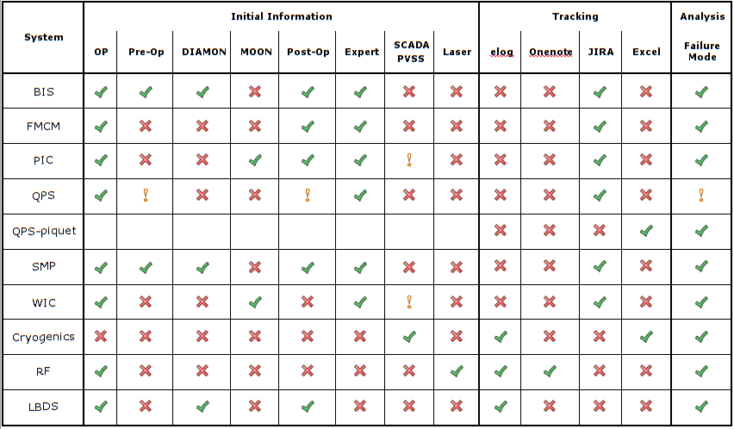
The Survey – Typical Results
… there are more rows

Slide 9
Fault / Event Information Flow
for each
equipment group

Slide 10
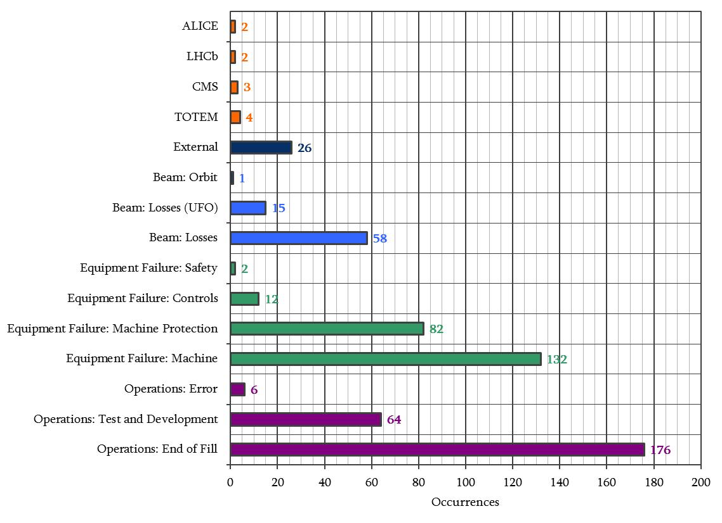
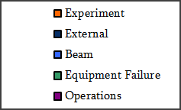
Dump Cause – 2012
11
26
74
228
246
585 dumps
[5]

Slide 11
Fault Tracking: post LS₁

Slide 12
Fault / Event Information Flow

Slide 13
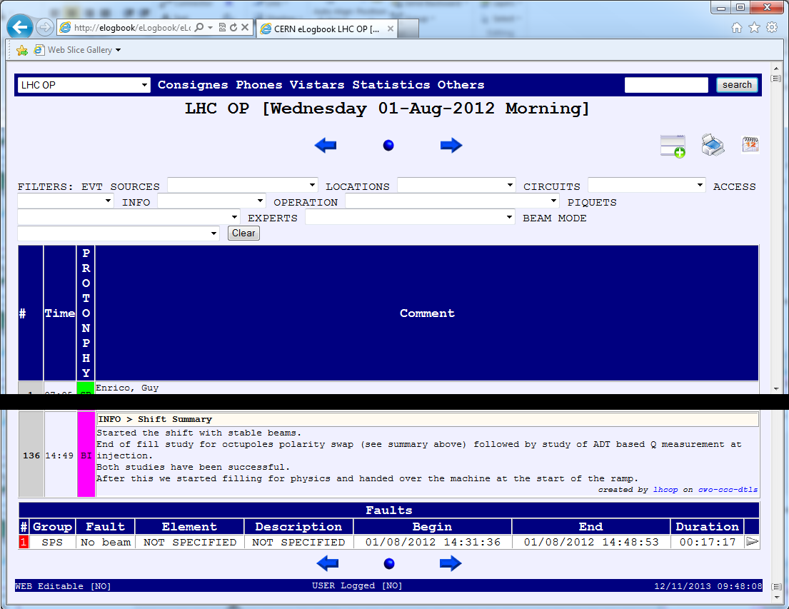
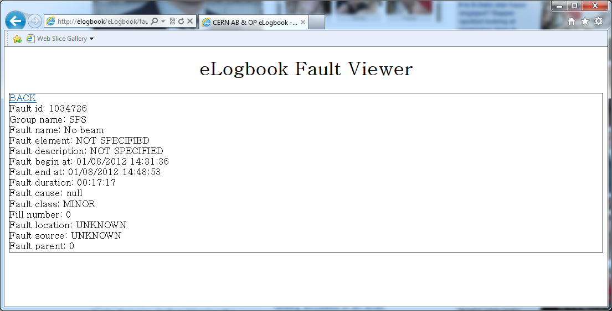
Fault / Event Information Flow

Slide 14
Fault / Event Information Flow

Slide 15
Fault / Event Information Flow
3. Viewing and Reporting
1. Common Data Format
2. Information Interpretation

Slide 16
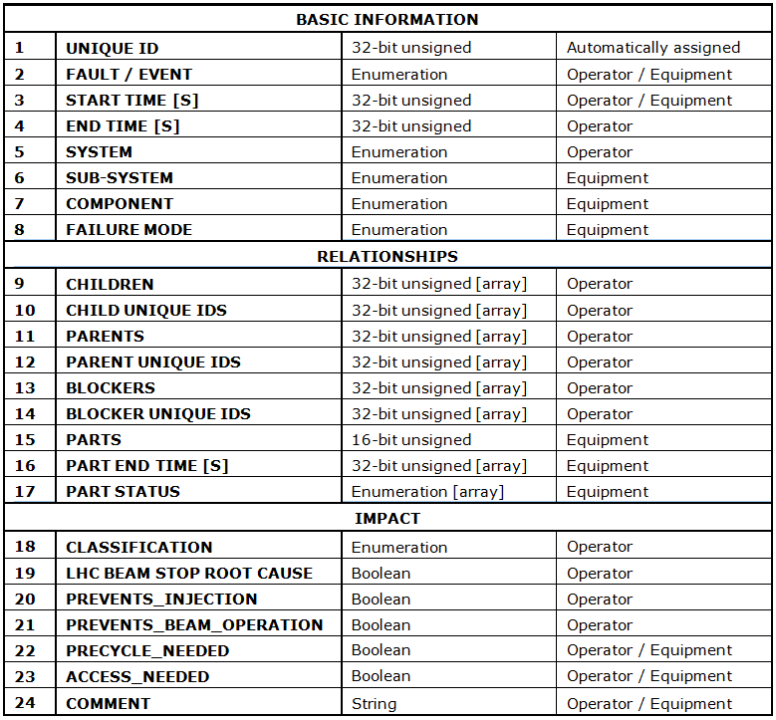
1. Common Data Format
a common set of fields to describe faults / events:

Slide 17
2. Information Interpretation
Interpreters to convert information from equipment logs to the common format
eLogbook – change is minimal
Small – moved by hand
Logged Variables– use them as a starting point
JIRA, Power Converter Logs
to be investigated…
see how we go…

Slide 18
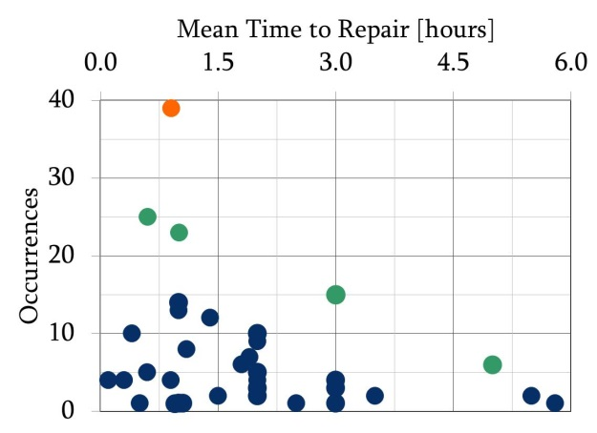
3. Viewing and Reporting
Outstanding Faults List
All faults which are active at a requested moment in time
Availability Tracking
system / sub-system availability shown across a defined time frame
Availability Matrices
For systems completing “failure-mode” the availability matrices drawn on the fly
Cardiogram
The most interesting view…

Slide 19
Cardiogram

Slide 20
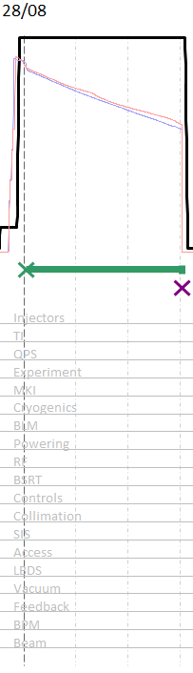
Cardiogram – August 2012
energy
beam-1 intensity
beam-2 intensity
stable beams = producing physics
post-mortem = beam dump
faults recorded

Slide 21
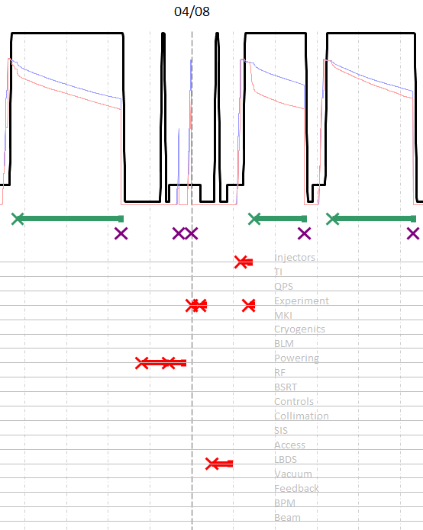
Cardiogram – August 2012
energy
beam-1 intensity
beam-2 intensity
stable beams = producing physics
post-mortem = beam dump
faults recorded

Slide 22
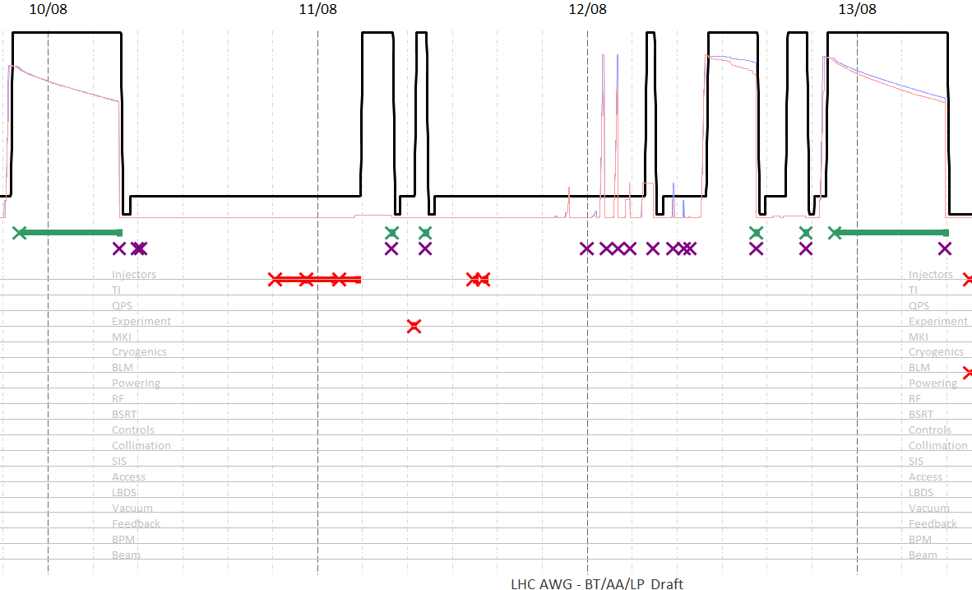
Cardiogram – August 2012
The whole raw cardiogram for August 2012 is in the indico folder with this presentation
A modified cardiogram showing some consolidated information is also found there

Slide 23
Information to be Displayed in the Fault Area:

Slide 24
Milestones and Timeline

Slide 25
Q. What will a “Maintenance Tracker” cover?
A. machine events that need maintenance / repair to continue operation…
585 dumps
≈50%

Slide 26
Q. What will a “Maintenance Tracker” miss?
A. machine events that do not need maintenance / repair to continue operation…
Operator = End of Fill
Feedback events
Beam Loss / UFO events
Pre-cycles
Transfer Line Steering
Waiting for handshakes
The maintenance / asset management tool alone will not provide the information needed.

Slide 27
Milestones and Timeline
2014:
eLogbook – additional fields
Interpreter feasibility and first implementation
Viewer – first implementation
Reverse engineering more data from 2012…
v1 Prototype ready for LHC restart
interaction with MMP to identify common areas

Slide 28
Milestones and Timeline
Every week – manual corroboration of data = operators + experts
Every Technical Stop – production of availability snapshot
…Evian 2015 – review of whole year’s data
2015:
Online tweaking of v1 prototype = v2… v3…
Determine “usefulness”

Slide 29
Milestones and Timeline
Longer term:
LHC System Availability Tracker
Regular interaction with MMP whilst we learn

Slide 30
Conclusions
AWG aims at providing a tool, gathering and generating required information for availability tracking. Information gathered will be used to generate reports and views to assess LHC availability in the post LS1 era.
AWG will collaborate with MMP on defining and exploiting tools and needs required for effective tracking of availability and measuring effects on physics performance of the LHC.
inverse femtobarn is a performance metric of LHC…
& machine understanding
… a function of time in physics, faults, beam performance and turnaround time
to optimise time in physics and faults we must track faults coherently
LHC System Availability Tracker based on the eLogbook… developed in 2014
prototype with manual interaction… used in 2015
If LSAT worthwhile integrate into other asset / maintenance tracker tools… 2015+

