Slide 1
CERN’s Maintenance Management Project
Available methods and tools to support LHC operation post LS1
Pierre Bonnal DG-DI
Christophe Delamare GS-ASE
Marine Gourber-Pace BE-CO
Damien Lafarge EN-HE
Christophe Mugnier TE-EPC
Goran Perinić TE-CRG
Régis Pilon TE-EPC
Ingo Ruehl EN-HE
Eric van Uytvinck EN-EL
David Widegren GS-ASE
Zornitsa Zaharieva BE-CO
Maintenance
Management
Project
Workshop on Machine availability and dependability for post LS1 LHC
28th November 2013
https://edms.cern.ch/document/1332829

Slide 2
Agenda
Introduction
Maintenance Management Project (MMP)
  Launch of the Maintenance Management Project
  Organizational structure of MMP/MFIO
  Basic concepts
  MMP/MFIO activities
  Issue management
  Equipment group side: MMP issue management
  CCC side : Operation issue management project (OPIM)
  Infor-EAM as Computerized Maintenance Management System
Conclusion
https://edms.cern.ch/document/1332829

Slide 3
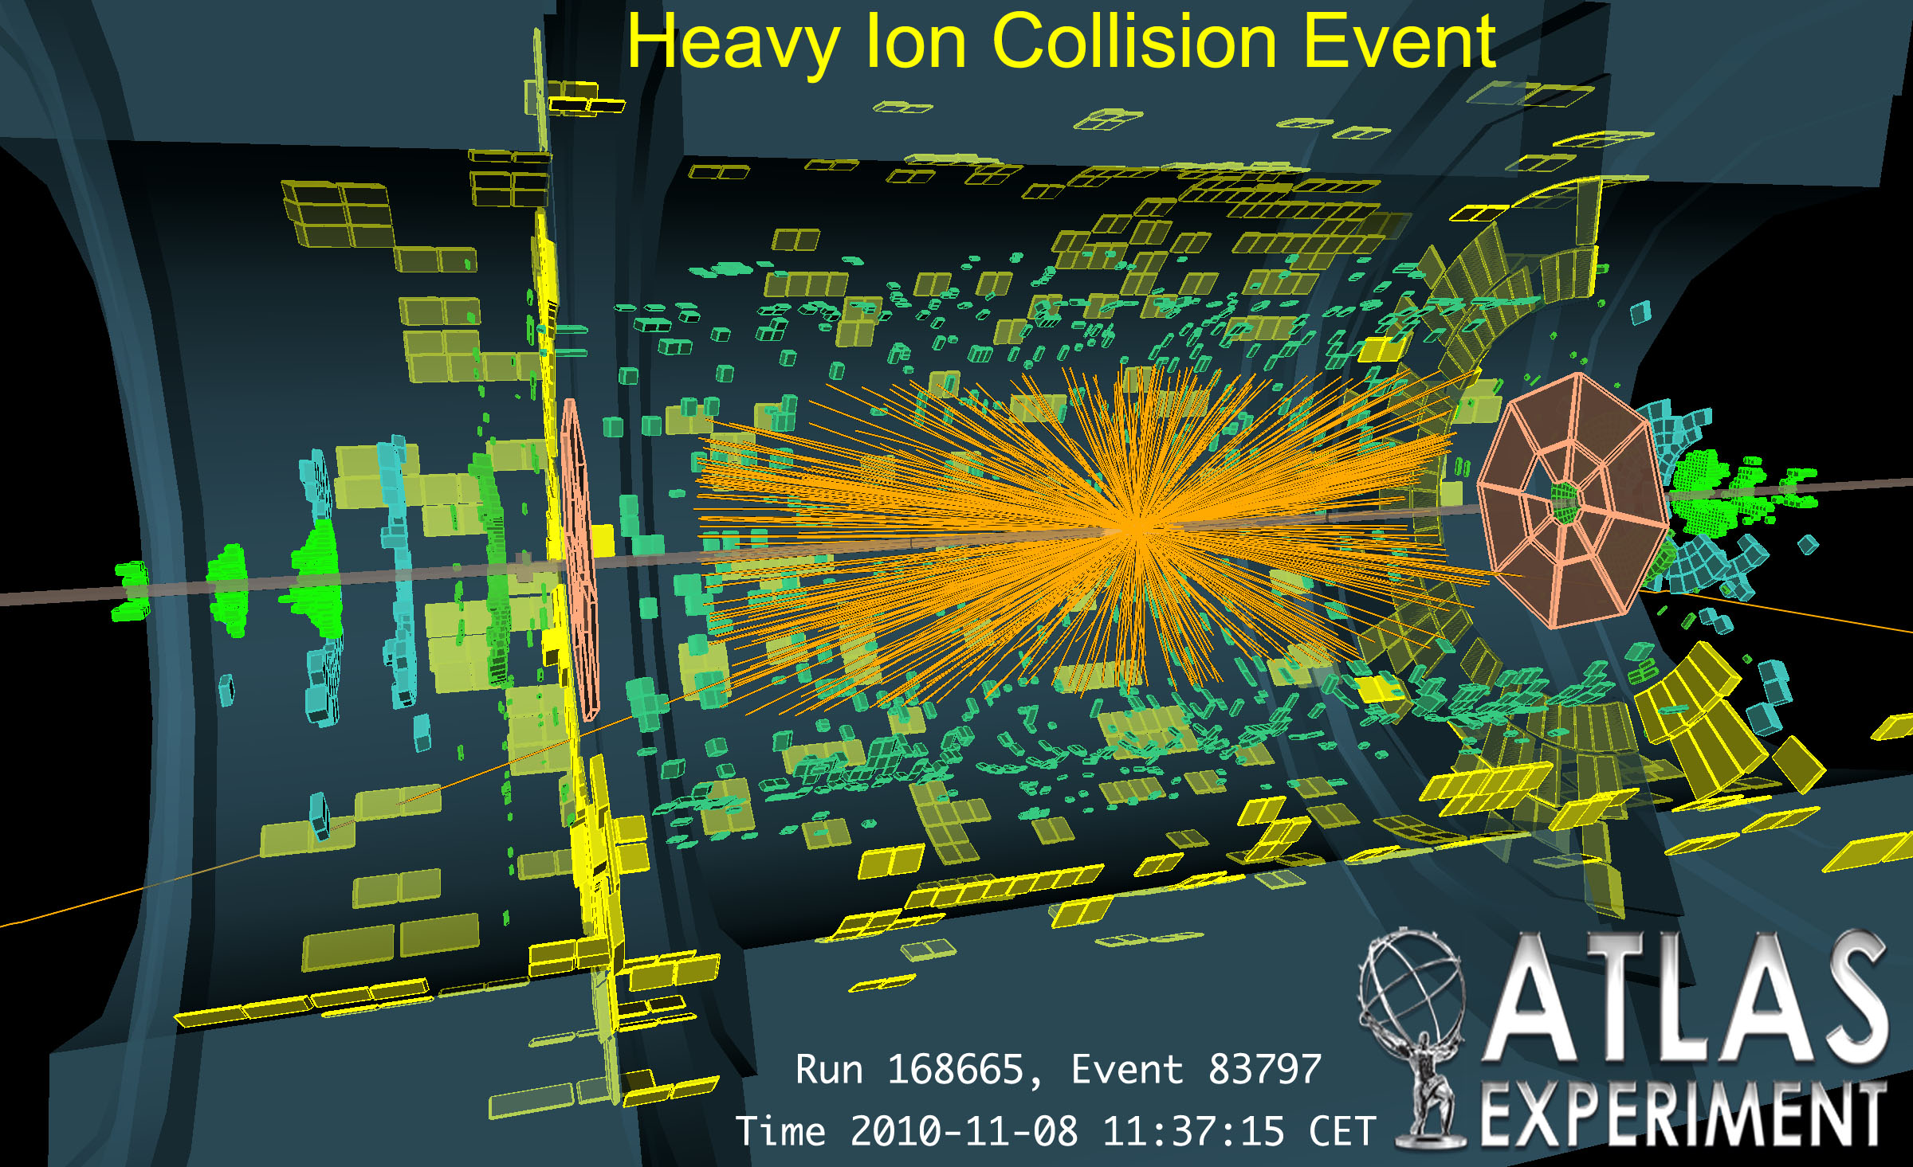
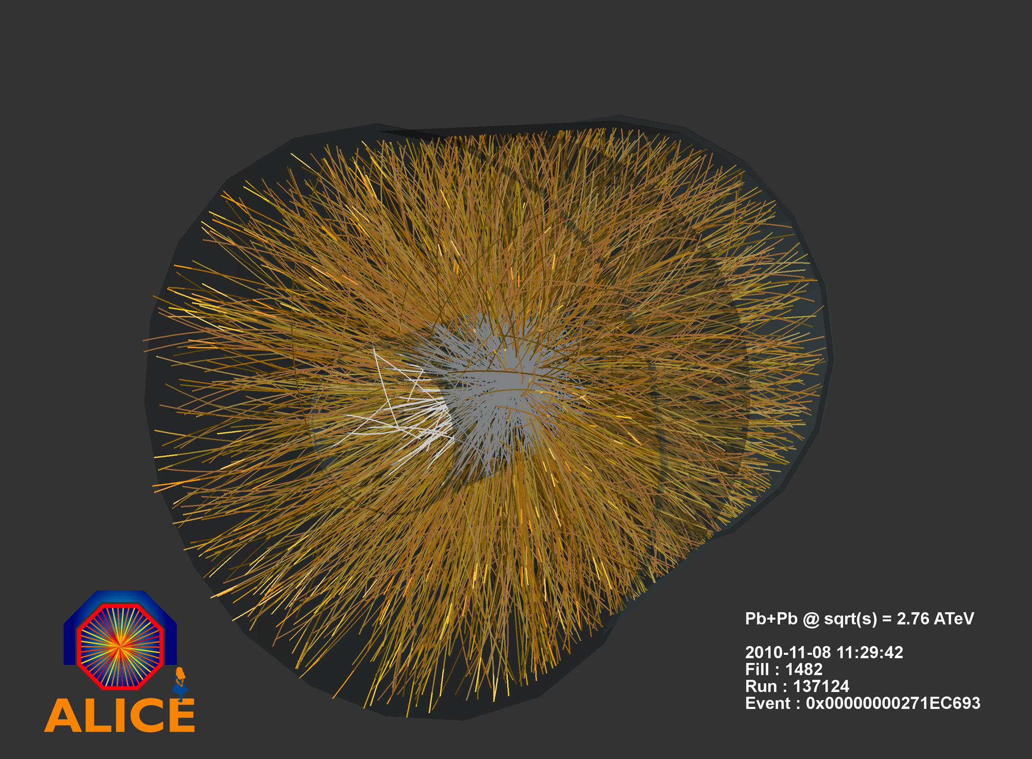
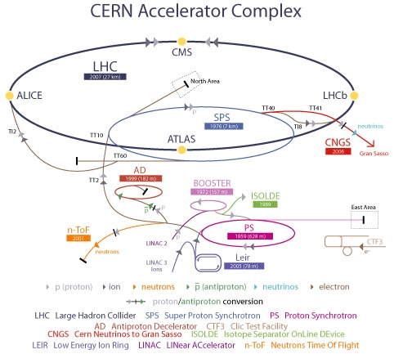

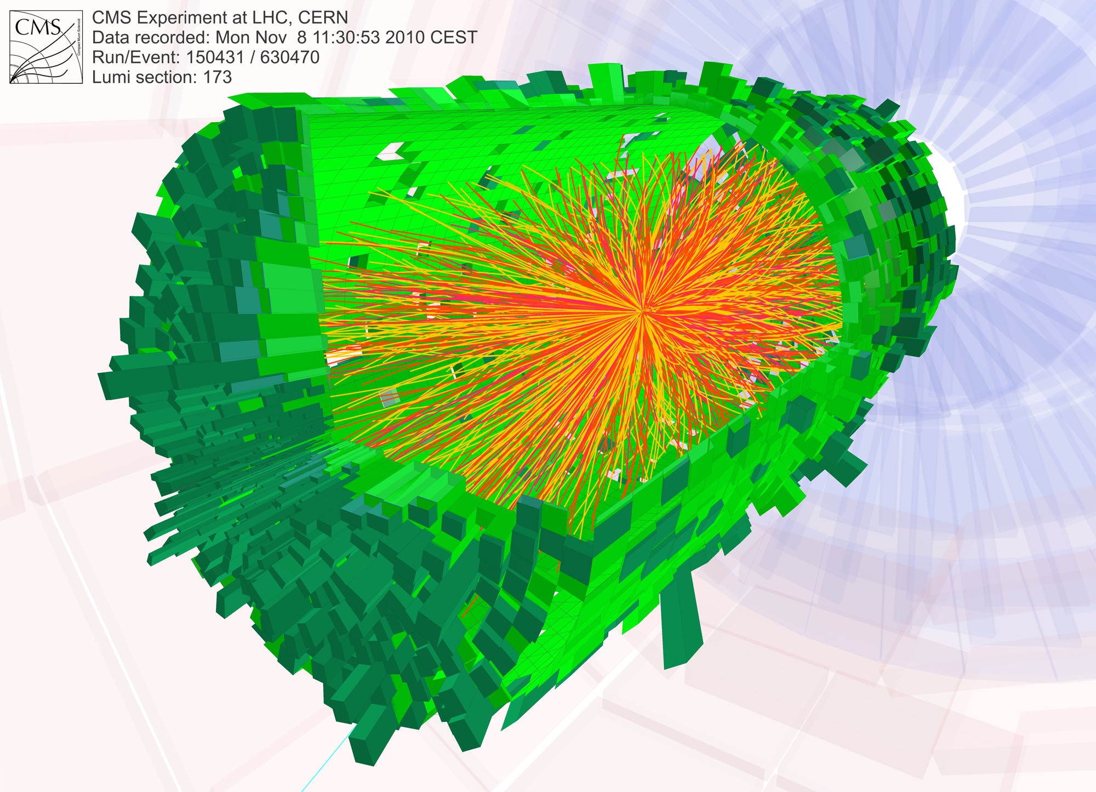
Introduction
With the first collisions in the LHC, CERN completed a long period of development and entered the operating phase in 2010.
ALICE detector
LHC's first lead-ion collisions
https://edms.cern.ch/document/1332829
Notes:
With the first collisions in the LHC, CERN completed a long period of development and entered the operating phase in 2010.
In this new phase, equipment groups gradually discover the behaviour, of the new accelerator and its injectors, across different operating modes. They correct the teething problems and organize maintenance activities.
It has rapidly turned out, that it is necessary to use a CMMS system to assist the management of maintenance activities.
This presentation will introduce the MMP project, and its Maintenance Framework Implementation Office (MFIO). It shall give an overview of the objectives, the organization, the developed concepts with a spotlight on the current developments in the area of documentation management and asset and spare part management.

Slide 4
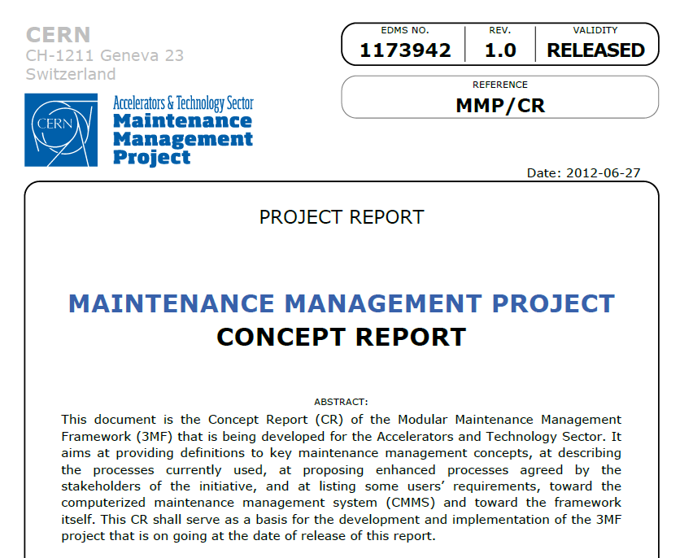
Launch of the Maintenance Management Project
At the end of 2011, the 3 Accelerator Sector departments have launched the MMP project with the target to :
  Develop a central data system to share technical information
  Define and formalize a global approach to manage the maintenance activities: Tools and Methods
  The Concept report defines the Modular Maintenance Management Framework.
3MF = Methods + Roles + IT tools
https://edms.cern.ch/document/1332829
Notes:
At the end of 2011, the 3 Accelerator Sector departments have launched the MMP project with the target to:
Develop a central data system to share technical information dedicated to maintenance activities
Define and formalize a global approach to manage the maintenance activities
A Concept report has been written and defines the 3MF (Modular Maintenance Management Framework) as a set composed of :
Maintenance management methods based on international standards and best practices
Harmonized maintenance roles and workflows for supporting the maintenance teams
IT systems and applications for simplifying maintenance management tasks

Slide 5
Purpose, Objectives and Impact of the Project
Modular Maintenance Management Framework (3MF)
  Develop a Modular MMF - time target end of LS1
Assets, critical assets, spare parts and documentation
  Manage 50% of assets, spare parts & their documentation through the 3MF
  Identify at least 95% of the critical assets
  Review maintenance requirements for the identified critical assets
Key performance indicators (KPIs)
  Provide through the 3MF KPIs for critical assets
Maintenance management organization
  Design, develop and deploy an organization for addressing the remaining assets
  as from the end of LS1, and for operating the MMF on the longer term
  16 groups of the 3 departments, are directly involved:
    4 groups already use the CMMS extensively and need new features
    12 groups have not or only partially implemented the CMMS
https://edms.cern.ch/document/1332829
Notes:
The detailed objectives of the project are:
The implementation of the modular 3MF until the end of 2014 (two thousand fourteen)
Deploying the 3MF for 95% of the critical assets and for 50% of all assets
Make available performance KPIs and
Propos a structure to operate the 3MF on the long term
The 3MF concerns at present 16 groups in 3 departments.
4 groups that use the CMMS already extensively and
12 groups that have various levels of maintenance management maturity.
Our principle has been to start with groups that are volunteering and that are ready to invest time and resources.
We ensure however, that all concerned groups are regularly informed about the advancements.

Slide 6
The MMP Project
Organizational Structure MMP/MFIO
Others CERN services
Steering Board
I. Rühl, G. Perinić
Project Coordination
Department Heads BE, EN, TE, GS
Task force members
Maintenance Management Project
P. Bonnal,
Z. Zaharieva
C. Delamare
Maintenance Management
Quality Assurance
CMMS Development
C. Mugnier
D. Lafarge
M. Gourber-Pace
TE Department
Maintenance Framework Implementation
EN Department
Maintenance Framework Implementation
BE Department
Maintenance Framework Implementation
https://edms.cern.ch/document/1332829
Notes:
The MMP project is sponsored by the four department heads who constitute the steering committee. The project is organized in five subprojects which are:
the maintenance management quality assurance,
the CMMS development,
the implementation of the framework in each of the three participating departments TE, BE and EN.

Slide 7
The MMP Project
Organizational Structure MMP/MFIO
Maintenance Management
Quality Assurance plan
Working groups
Asset management
Work management
Planning & Scheduling
Information management
Parts management
Analysis & Reporting
CMMS development team
MFI Office
(Maintenance Framework Implementation )
Management of requests
Centralizes and dispatches the requests
Elaborates specifications, BPMN of activities
Informs and supports users (Question => Answer)
Manages the website and the hotline
Framework deployment
Manages data collection and deployment tools:
  Plans, manages and monitors the collection,
  Analyses records and corrects where necessary
Develops interfaces and transitional databases
Centralizes and specifies requirements
TE
Maintenance Framework Implementation
EN
Maintenance Framework Implementation
BE
Maintenance Framework Implementation
https://edms.cern.ch/document/1332829
Notes:
Two structures have been created inside the Maintenance Management Project. Firstly, on the conceptual layer, a set of six working groups” who should analyse user needs in their respective field and identify and specify methods as well as tools that allow to perform a comprehensive management of maintenance activities.
The 6WG cover:
Asset management
Work management
Planning & Scheduling
Information management
Parts management
Analysis & Reporting
The second structure, on the executive level, is the Maintenance Framework Implementation Office which acts as interface between the users and the Maintenance Management Project. The MFIO is composed of 4 engineers and 4 technicians that ensure two main activities: The management of user requests and the deployment of the framework.

Slide 8

The MMP project
project management method
Data mngmt.
Parts,assts.
Audit of the operation of LHC and its injectors”
audit in 4 groups (BalticBerg)
internal TE audit (C. Mugnier)
Interv.workfl.
Methods office implementation July 2012
MMP Concept Report
May 2012
End of LS1
MMP Roadmap
Feb 2012
Today
(December 2013)
CMMWG
CMMSB
Aug 2010
Maintenance workshop Nov 2011
Three Main activities currently in progress:
Parts management
Documentation Management
Issue Management
https://edms.cern.ch/document/1332829
Notes:
The project monitoring is done by using the Hermes project management method.
Depending on the sub-project, we are today in the implementation or in the deployment phase.
At present the 3 main activities of MMP/MFIO are the developments in part management, documentation management as well as the Issue management
I will come back to these three activities.

Slide 9
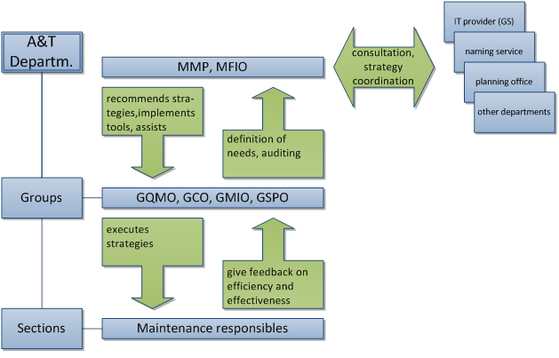
The roles concept for a modern maintenance organisation
A group quality/methods officer role (GQMO):
- promoting policy, procedures and standards
- implementing a QA system at group level
A group maintenance information officer role (GMIO):
- promoting good practices and guaranteeing coherent
management of information and documentation
A group coding officer role (GCO):
- link person with naming service
- promoting good practices and guaranteeing that coding is coherently implemented at group level
A group spare part officer role (GSPO):
- promoting good practices
- providing support for managing spare part processes
https://edms.cern.ch/document/1332829
Notes:
I would like to highlight basic concepts of the 3MF:
First!
We believe that all processes should be defined and established at the group level. We therefore promote the implementation of 4 transversal roles in each group:
Quality/methods officer role (GQMO)
Maintenance information officer role (GMIO):
Coding officer role (GCO)
Spare part officer role (GSPO)
These roles shall
- facilitate the communication between the equipment groups and the MFIO,
- actively participate in the implementation of the 3MF,
- promote best practices and recommendations and
- provide support to the maintenance teams
These roles shall in addition act as link persons with other concerned services, for example: the naming service and the layout service.

Slide 10
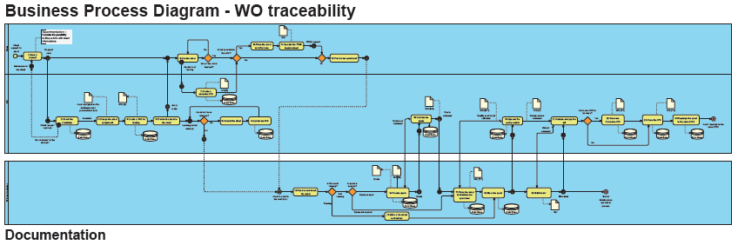
Basic concept for the definition of processes
Description of processes by BPMN:
  All processes are described/documented by « Business Process Diagrams »
Business Process Diagrams are:
  central part for the definition of the CMMS configuration
  integrated to the Quality Assurance Plan
https://edms.cern.ch/document/1332829
Notes:
Second basic concept
MMP promotes the systematic use of "Business Process Diagram Notation (BPMN)“. BPMN is a graphical means to describe the sequence of tasks and the associated roles that are required for the process.
BPMN diagrams are in fact the central part for the definition of the CMMS configuration.
The BPMN shown on this slide , describes the process for corrective maintenance.

Slide 11
  MMP/MFIO activities
AvailabilityWS2013- Ch.M
https://edms.cern.ch/document/1332829
11
Notes:
I will present now the 2 main activities of MMP/MFIO, on-going, that are Maintenance Documentation management and the part management

Slide 12


1) Documentation management: Strategy
Objective:
Constitute the maintenance documentation
Project
Documentation
A well defined perimeter
  Documentation mainly dedicated to maintenance activities
Archives
Specific treatment
    Documents and files are:
    Formatted, clearly identifiable
    Stored in EDMS with predefined keywords
Homogenization, formatting
Documentation for the maintenance and operational activities
Doc management
Documentation Management
    GMIO* is in charge of the management, he/she disposes of the required IT tools
    Documents and files are updated as required, easily accessible
Distribution of documents
External systems
users
*Group Maintenance Information Officer
https://edms.cern.ch/document/1332829
12
Notes:
The strategy for the management of the maintenance documentation is that all documents shall be stored in CERN`s document management system called EDMS.
In order to ensure homogeneous storage principles – some rules have been defined e.g.:
Maintenance related documents are separated and treated differently from other CERN documents
Ownership of documents is transferred to the Group Maintenance Information Officer
Document metadata have to fulfil specific rules and
Likewise document formats have to fulfil specific rules
This standardization allows finally the automation of certain documentation management tasks.

Slide 13
1) Documentation collection: Process
1st : treatment of documentation in DFS
  Establishing the functional breakdown of the equipment (assemblies, parts, assets)
  Collecting, sorting, cleaning, formatting of documents and files
  Classification, metadata filling and storage of documents uniformly in DFS
2nd : massive and automatic upload into EDMS
  Creation of empty EDMS documents
  Insertion of the EDMS number into the PDF file (stamp)
  Upload of metadata and files into the prepared EDMS documents
dfs
Support provided by MFIO
  A team of 2 experts to train and support the GMIO
  A set of specific IT tools to treat documents
  A set of methods and processes
EDMS
https://edms.cern.ch/document/1332829
13
Notes:
How are documents collected and handled?
The MFIO provides the following support:
A team of 2 experts to train and support the Group Maintenance Information Officer
A set of specific IT tools to treat documents
The required set of methods and processes
The treatment is done in two phases:
The documents are collected and treated in a file server structure called DFS
Once prepared, the documents are uploaded into EDMS batch wise

Slide 14
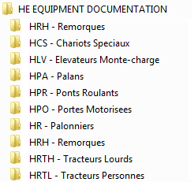
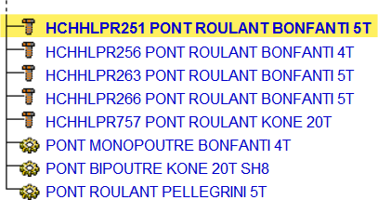
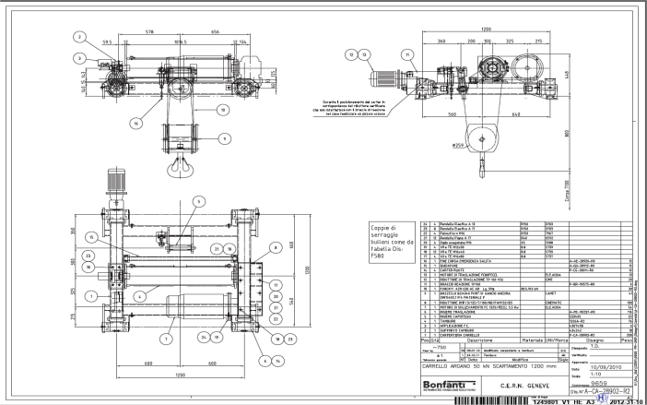
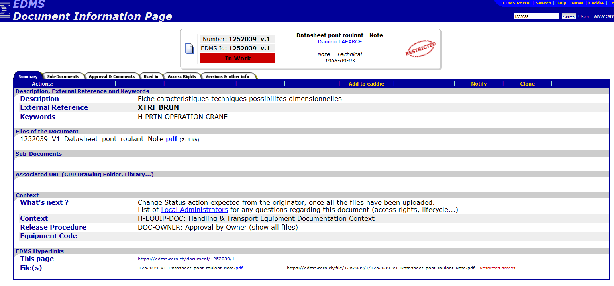
Documentation collection Process: e.g. EN-HE group
1) The functional breakdown is set-up in DFS
2) EDMS functional breakdown is automatically created from DFS
https://edms.cern.ch/document/1332829
14
Notes:
Here is an example of the documentation treatment process. On the left side the structured folder system on the file server that contains the documents that have been treated following the rules.
On the right hand side, is show the resulting EDMS structure after the upload. The documents are now fully linked to the associated parts or assets.
The drawing contains a barcode stamp that indicates the treatment of the document and its EDMS number.

Slide 15



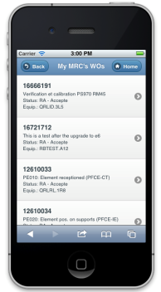
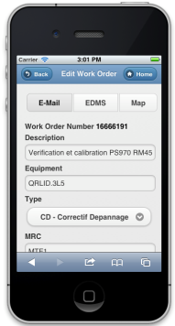
2) Parts management: Strategy
Objective:
Constitute a global catalogue of parts across departments
BE
EN
TE
Perimeter
  BE/TE/EN global rules and codification, to allow a global view across department and groups
Specific treatment of data
    Classes and customs fields are proposed by a panel of experts,
    Collection process is unified and well defined (BPMN)
    All records are validated (by automatic means or expert checking)
EAM
(Infor)
Part Management
  GCO* and GSPO* roles are essential to manage parts at group level
    EAM provides functionalities and specific user interfaces to manage stores and to guarantees the part traceability.
*Group Coding Officer
*Group Part Officer
https://edms.cern.ch/document/1332829
15
Notes:
The strategy for the management of parts is to ensure a transparent view across the departments and groups
Therefore we carry out a standardized treatment of the data
Standard classes and customs fields are proposed by a panel of experts,
Collection process is unified and well defined (BPMN)
Automated and expert validation processes are in place
For the part management
The roles of GCO* and GSPO* are essential at group level
EAM provides functionalities and specific user interfaces to manage stores and to guarantees the part traceability.

Slide 16
2) Parts collection: Process
1st : treatment of records in an external system
  Predefining and formatting classes and custom fields
2nd : in the field
  Collecting, sorting parts and record the characteristics and pictures in the external system
  Attribution of MFIO temporary codes for provisional labelling
dfs
3rd : setting up store management with EAM
  Formal code attribution by Naming Service
  Massive upload into EAM by the means of web services
  Implementation of an EAM integrated solution for store management, labelling and traceability
Support provided by MFIO
  A team of 2 people to support and train the Group Part Officer (GSPO)
  A set of specific IT tools to define classes and custom fields and to record parts
  Methods and processes well defined for part recording and store management
EAM
(Infor)
https://edms.cern.ch/document/1332829
16
Notes:
Like for the documentation collection process, the MFIO provides 2 experts to train and to support the GSPO and a set of specific tools for the collection process.
The first step is the definition of classes and custom fields.
Then the data is collected in the field and finally the part data is uploaded into the CMMS.

Slide 17
Issue Management
AvailabilityWS2013- Ch.M
https://edms.cern.ch/document/1332829
17

Slide 18



Issue Management: Objectives
1st line intervention
Maintenance action
Correction performed
→
Equipment is in operation
Equipment faulty →
Physic’s stopped
CCC
Objectives through the equipment groups:
  Define a common process for first line interventions
  Provide a shared computerized tools that allows to follow and trace the interventions
  Manage the exchange of information between CCC and equipment groups
  Provide a central repository of information concerning the interventions in order to enable feedbacks and allow the performing of analysis and decisions .
https://edms.cern.ch/document/1332829
Notes:
Objective No. 1 MMP project is to provide consistent methods
Here is an example of the different stages .....: When a failure takes place, CCC or field technicians can be called directly, the response and resources are organized according to procedures, documentation, maintenance plans, ect ... All this information is essential for optimal action on the ground.

Slide 19




Issue Management: Objectives
1st line intervention
Maintenance action
Correction performed
→
Equipment is in operation
Equipment faulty →
Physic’s stopped
CCC
Means - Resources -Tools
(Logistic aspects)
This example shows a first-line maintenance response process … and all the phases involved.
Databases
- Documentation
Spare Parts
(Information concerning equipments, context and environnement )
Key performance indicators (data analysis)
(What are the real facts ?)
Maintenance Methods
(Organisation & processes)
Feedback
(Loop analysis, advanced decision making)
https://edms.cern.ch/document/1332829
Notes:
Objective No. 1 MMP project is to provide consistent methods
Here is an example of the different stages .....: When a failure takes place, CCC or field technicians can be called directly, the response and resources are organized according to procedures, documentation, maintenance plans, ect ... All this information is essential for optimal action on the ground.

Slide 20
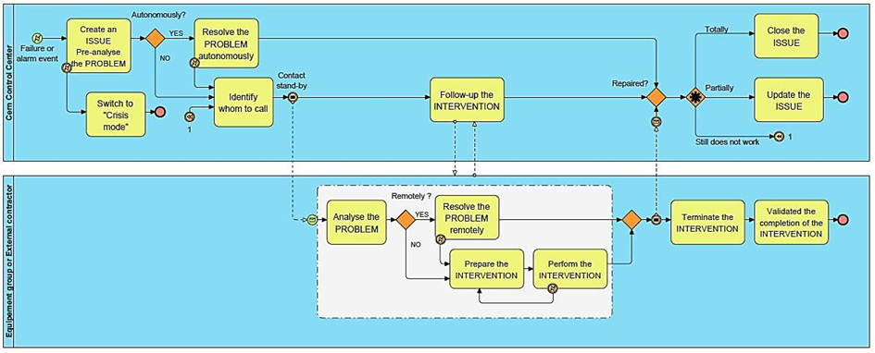
Common processes for first line intervention
Cern Control Center
Cern Control Center
Equipment groups or contractors
Equipment group or external contractor
A collaboration with CCC and equipment groups is important in order to achieve to define the various interactions between the both processes
https://edms.cern.ch/document/1332829

Slide 21
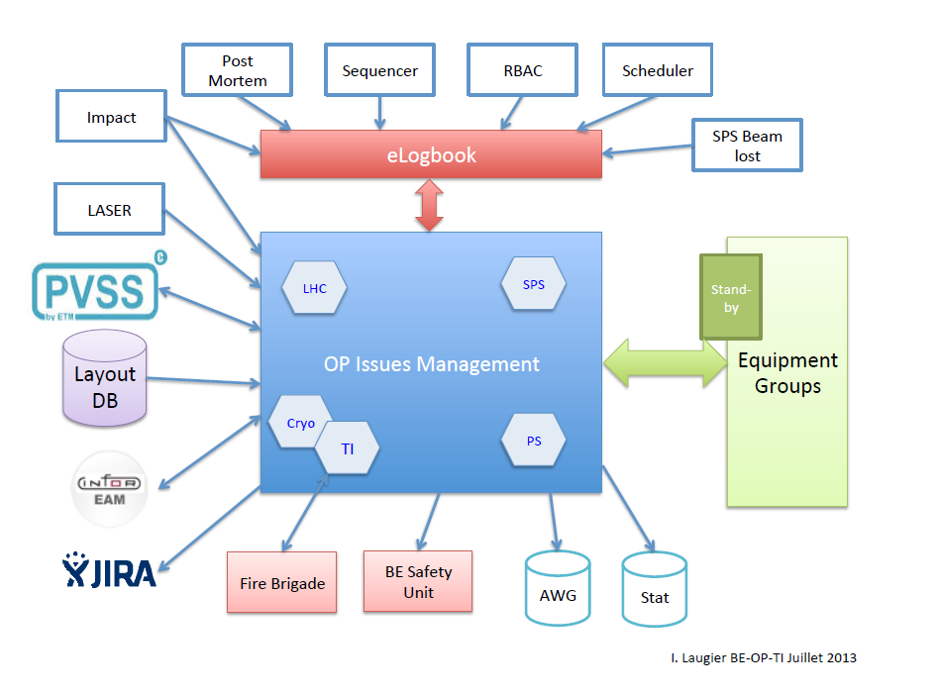
OP issues Management Project (OPIM)
AvailabilityWS2013- Ch.M
https://edms.cern.ch/document/1332829

Slide 22
Common processes for first line interventions: objectives
Optimization of first line interventions in terms of call and action.
Determine and provide to the CCC, means (tools, information) to:
  Perform the appropriate diagnostic,
  Call the relevant piquet/specialist when necessary,
  Prepare interventions (token, access, synchronization with other accelerators…),
  Undertake the 1st actions to postpone the intervention,
  Ensure the follow up and coordinate interventions in case of major event,
  Realize tests and restart of equipment
  Report the progress of the intervention,
  Analyze, gather feedbacks
Before
During
After
Afterwards
https://edms.cern.ch/document/1332829

Slide 23
Availability WG needs
Fault / Event Information Flow
AvailabilityWS2013- Ch.M
for each
equipment group
According B. Todd presentation
https://edms.cern.ch/document/1332829

Slide 24

AWG Needs: Fault / Event Information Flow
OP issues Management Project
Operation
EAM
AvailabilityWS2013- Ch.M
Equipment groups
Maintenance Management Project
    Requested in the framework of AW:
    General
    - Unique ID
    - Start time (s or ms)
    - End time ( s or ms)
    - System and/or equipment Group (from a list),
    - Sub-system and/or equipment Group (from a list),
    - Fault or Event
    Linked issues :
    - Children (ID or table)
    - Parents (ID or table)
    Serial issues :
    -Parts ID
    -Part end time ( s or ms)
    -Part status
https://edms.cern.ch/document/1332829

Slide 25
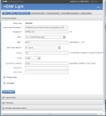


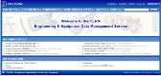

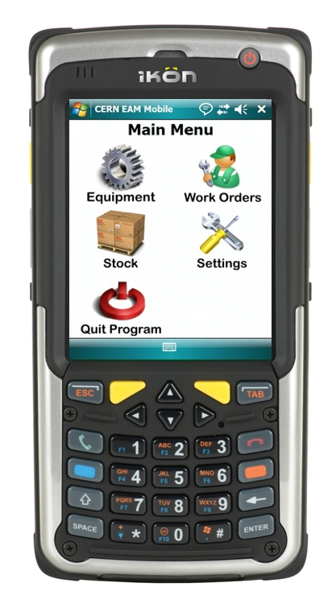
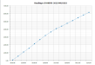
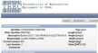
Infor EAM as CMMS
EAM Light
Control room (TI-OP Logbooks)
EDMS
Manufacturing & Tests
Accelerators Layout DB
EAM
IMPACT
CERN EAM Mobile
Reporting tools
TREC
GIS
GESMAR
ERP
(BAAN)
Slide provided by D.Widegren
https://edms.cern.ch/document/1332829
25
Notes:
This is the CMMS integration at CERN, where the commercial package Infor EAM is the center of the system. I have not talked about infor EAM until now because next presentations will talk more in deep about this subject.

Slide 26
Conclusion
  3MF is a specific set of methods, roles and tools for the management of maintenance activities. Its aim is to give means to share data and information, and to provide a global view of the operation of the accelerators.
  Currently, we (MMP/MFIO) are giving a support to Groups to:
    perform the functional breakdown of their facilities
    do inventory and codification of equipment/parts / assets of all installations
    constitute the dedicated documentation for the maintenance activities.
  We make the definition of specific workflows as “Issue management" that will be set up in the CMMS. As equipment groups, AWG is welcome to help us to identify their needs.
https://edms.cern.ch/document/1332829

Slide 27
Thank you for your attention
https://edms.cern.ch/document/1332829
27

Slide 28
AvailabilityWS2013- Ch.M
https://edms.cern.ch/document/1332829

