Slide 2
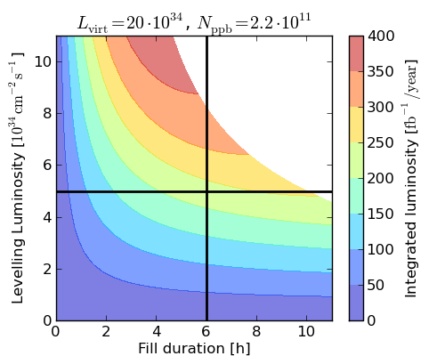
Dependability vs Operation
first LHC focus has been to safely commission and operate the LHC
Pre-LS1 machine performance steadily improved due to increased machine understanding and probing of various limits (bunch intensity/length, instabilities,…)
Post-LS1 (and even more so for HL-LHC) peak luminosity expected to exceed the acceptance of the experiments: focus shifts to providing stable and continuous operation = maximize the time in STABLE_BEAMS
Pushing performance (7TeV, 25ns, tighter protection thresholds,…) means Pre-LS1 availability will already be challenging Post-LS1
HL-LHC goal
Average fill length pre-LS1

Slide 3
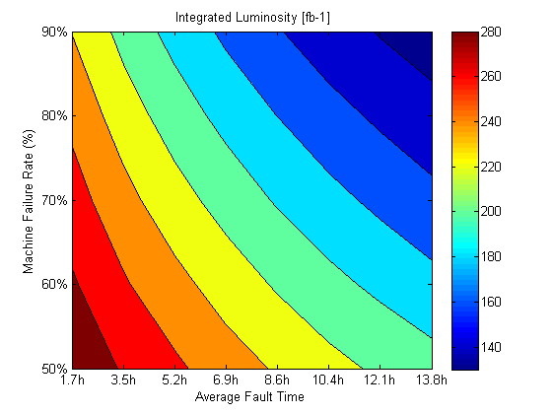
RLIUP & Hi-Lumi vs Dependability
  Main points from ECFA workshop:
    Request for a minimum goal of 3000 fb⁻¹ = average of ~270 fb⁻¹ / operational year
  Will go through beam performance increase throughout various machines (injectors, LHC)
  +
  Increase of machine availability, including
    Minimize equipment faults
    Minimize diagnostic, intervention + fault clearance times
    Minimize turnaround time
    Optimize protection strategy vs. availability (running at 90% of peak, realistic protection thresholds,..)
    …
  To determine the potential gains quantification of individual contributions is needed, i.e. detailed tracking of contribution to downtime
Achieved performance

Slide 4
There is a strong call to address this!
  O.Bruning – Report on outcome of RLIUP and ECFA - Hi-Lumi meeting in Daresbury
  “Machine reliability is critical for success of HL-LHC!”
  R.Garoby – RLIUP summary session at CERN
  “Main challenges besides e-cloud: effective leveling method and good reliability”
  S.Myers – RLIUP summary session at CERN
  “ Performance increase in following years through
      Pile-up and pile-up density (detectors and machine)
      25ns: e-cloud, scrubbing, short term mitigation, long term solution
      Machine availability: minimise down time, speed up turn around”
  F.Bordry – ‘The CERN programme for LHC operation and upgrade’ - Hi-Lumi meeting “HL-LHC : R&D => approved project with a lot of technical and operation challenges :
        Nb3Sn magnets (accelerator field quality) (HFM roadmap)
        Collimators
        Superconducting links
        Crab cavities
        Increased availability (machine protection,…)”

Slide 5
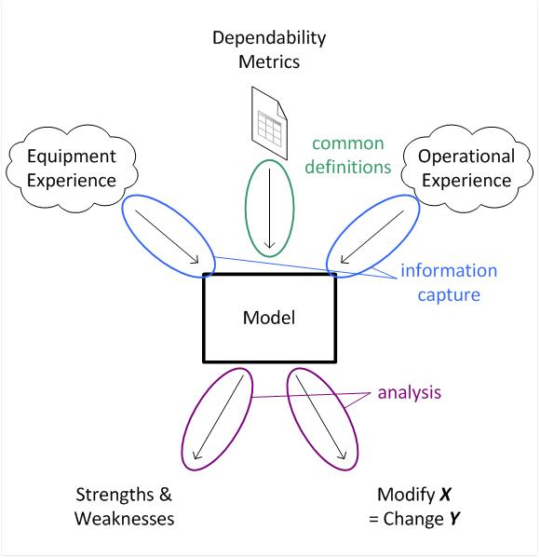
Workshop Goals
The Reliability Sub Working Group made a first study of the basic dependability of the core of the machine protection system. This proved useful, setting a solid forum for considering the performance. The AWG has continued in a similar manner to this. (see Jan)
1. Provide a forum for exchange and advertisement of work related to availability for CERN’s machines.

Slide 6
Workshop Goals
The Reliability Sub Working Group made a first study of the basic dependability of the core of the machine protection system. This proved useful, setting a solid forum for considering the performance. The AWG has continued in a similar manner to this. (see Jan)
1. Provide a forum for exchange and advertisement of work related to availability for CERN’s machines.
After LS1 new constraints mean that system availabilities will change, and physics production of the LHC could be affected.
2. Predict and quantify the impact of changes to key systems to the LHC physics performance.
The post LS1 and HL-LHC machines have very ambitious physics production targets. Coherent effort in understanding the role availability plays in meeting these targets is needed.
3. Propose tools and methodologies to understanding post-LS1 availability consistently.
All of this needs to be carried out in a robust and coherent way to provide the longer term road-map towards a high luminosity LHC.
4. Discuss and reinforce coherence between approaches. E.G. AWG and MMP

Slide 7
Messages
Looking Back:
1. On the observed availability of systems
If predictions made, how did they compare?
2010 – 2012: LHC physics…
What stood out?
2. On the method used to track system availabilities
What tools were used?
Looking Forward:
1. On the changes to systems during LS1
Post-LS1: LHC physics…
What will affect safety / availability?
What will be the sensitivity to operational conditions?
2. On future reliability studies
What studies are foreseen?
3. On future data collection
What tools will be used for data collection after LS1?

Slide 9
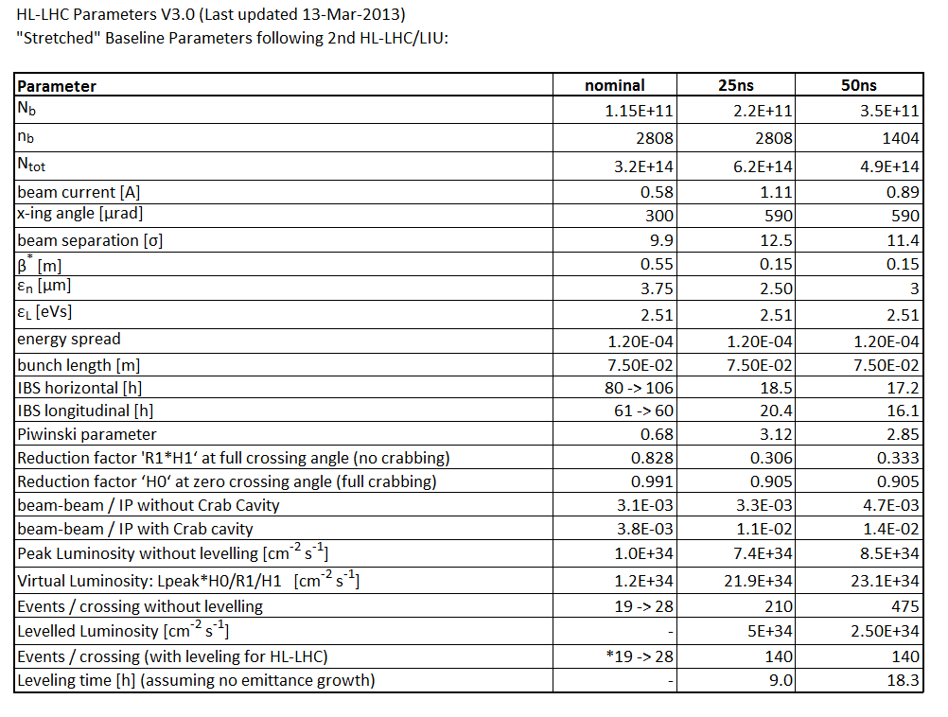
HL-LHC Baseline Parameter Set
Baseline

