Slide 1
LBDS overview on system analysis and design upgrades during LS1
Roberto Filippini, Etienne Carlier, Nicolas Magnin, Jan Uythoven
CERN Workshop Machine Availability for post LS1 LHC, 28th Nov 2013

Slide 2
LBDS overview on system analysis and design upgrades
Outline
  LBDS system analysis overview
  Insights on tools and methodologies
  System changes during LS1
  Conclusions and outlook

Slide 3
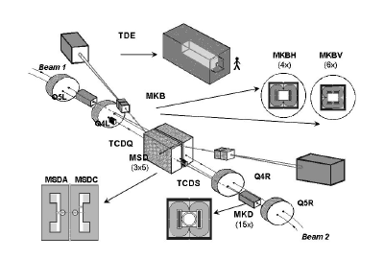

The LHC Beam Dumping System
The LBDS is the final element of the protection chain, it performs the extraction of the beams on demand (dump requests) either at the end of machine fills or because of safety reasons. Two LBDS exist, one per beam.
TDE
Internal ILK
Control
10 MKB
LBDS physical layout – point 6
External DR
15 MSD
Actuation
References
15 MKD
Interlocks and references
Control and supervision
Beam Line
350 MJ destructive power
Functional layout

Slide 4

System analysis overview
Theoretical reliability models 2003-2006
Failure Statistics 2010-2012
Updated failure models
Special reliability studies TCDQ - 2009
Triggering Synchronization and Distribution System - 2013
Estimates of availability and safety

Slide 5
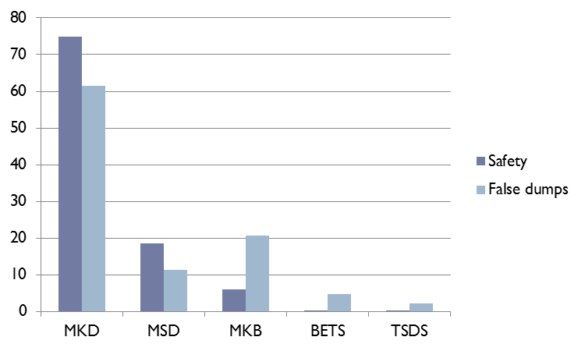
LBDS system analysis 2003-2006
The scope
  TSDS, the beam energy tracking BETS, the septa MSD, extraction kickers MKD and dilution kickers MKB. Passive protection elements not in the scope.
Assumptions
  Operation profile of 10 hours, 400 machine fills, 200 days of operation
  Post mortem diagnostics returns the system to an “as good as new” state
Results
  The LBDS is SIL 4
  False beam dumps 8 +/- 2 per year
  Asynchronous dumps 2 per year
  MKD most critical system (74%) and main cause of false beam dumps (61%)

Slide 6
Failure statistics 2010-2012
The scope
  MKD and MKB with control and supervision electronics and diagnostics
Analysis of 3 years of LHC operation 2010-2012
  Sources: LHC-OP logbook, and LHC-TE/ABT expert logbook
Results
  139 failure events of which 90 internal to LBDS
  Updated reliability prediction models
  New failure mechanisms discovered
  Availability and safety: comparison of predictions vs. statistics

Slide 7
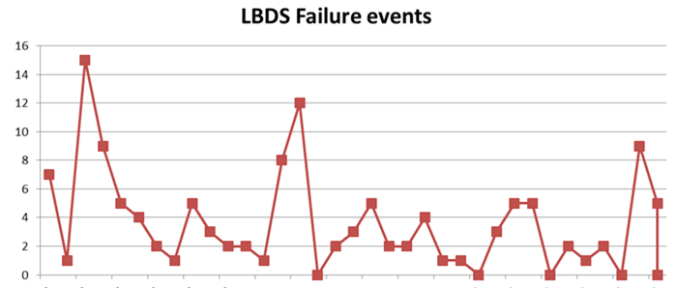
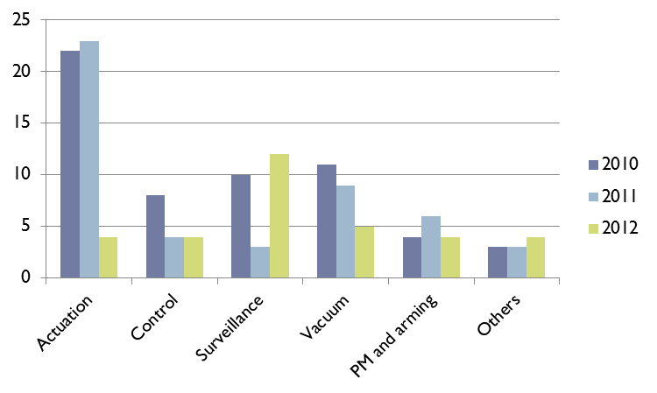
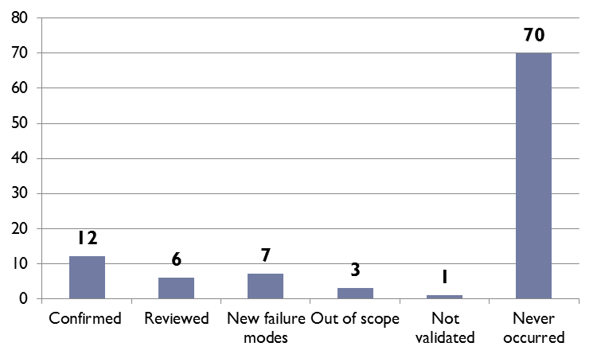
Results → from raw data to statistics
When→ Raw data series
139 failure events
Jan 2010
Dec 2012
How → Failures modes observed
18 occurred over 99 identified
7 new failure modes
Where → Failure distribution
90 within the LBDS
90
49

Slide 8
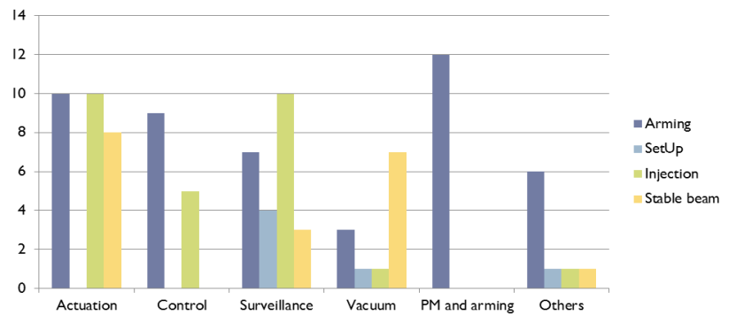
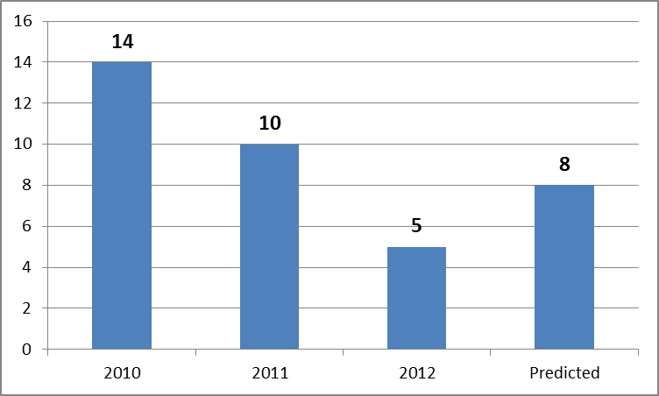
LBDS availability 2010-2012
The LBDS counted 29 false beam dumps, against 24 foreseen (8/year on average).
  Actuation (15) then surveillance (12) and controls (2)
1- False dumps
66 apportioned to LBDS in every phase
66
Observed Predicted
2 - Filtering
Only LBDS false beam dumps in the phases injection and stable beam
No repetition of the same internal dump request
Decreasing trend

Slide 9
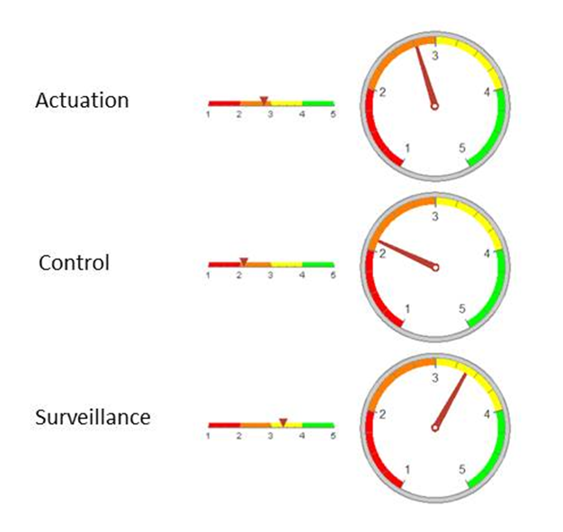
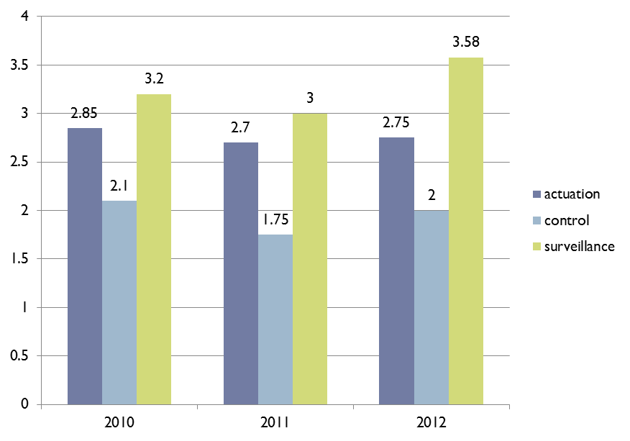
LBDS safety 2010-2012
Calculation of the safety margin at a dump request → loss of safety margins in 2011, and a recover in 2012, almost back to the initial levels of 2010
SIL3 at least is met (hypothesis test)
2.77
Safety margin
2.13
3.39
Remark → too much safety margin leads to an unnecessary reduction of availability
The safety gauge

Slide 10

Tools and Methodologies - insights
Failure statistics
Statistical framework and inference tools
Tracking availability
Safety trade-off
Availability figures
Tracking reliability
Advanced reliability prediction models

Slide 11
The statistical analysis framework
Raw data 2010-2012 IN
PHASE 1 – Censoring data
PHASE 2 – Statistics and validation
Predictions 2003-2006
Reliability models OUT

Slide 12
Failure modes and statistics – MKD system
Failure mode and identifier
# components
Time to Failure
Hypothesis test
Time to recovery
Validation
most conservative value is kept

Slide 13
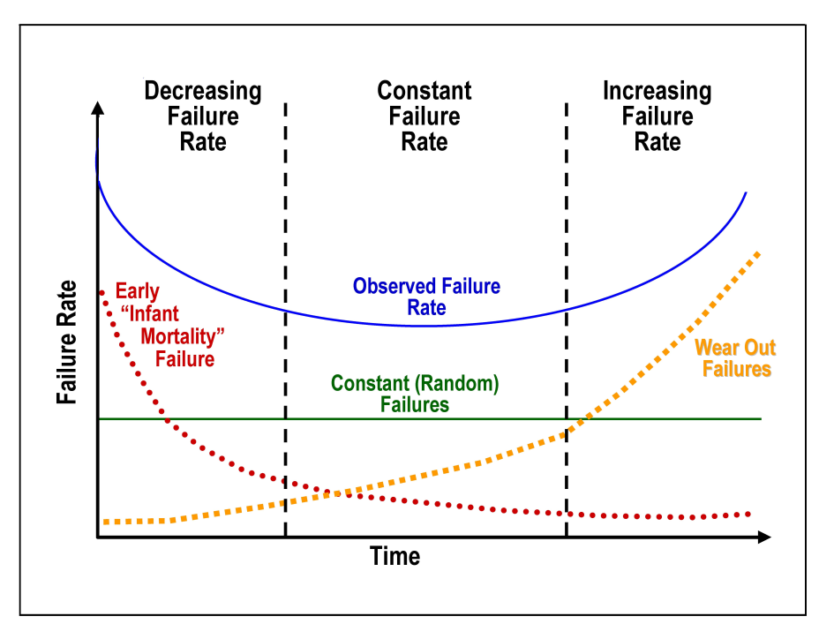
Advanced models for reliability prediction
Goal → How to capture anomalies from observations
  Reliability growth models
  Interaction-dependency models (CCF)
  Inaccurate diagnostics
  Stress models
  Failure on demand
1
2
3
4
Component Failure rates should always stay in the flat region
5
4
2
5
1
Failure on demand
Model apart
3

Slide 14
Tracking Availability
Narrow scope
  Faults that only manifest in operation → false beam dumps
Large scope
  Any fault that impacts (and retards) on the operation schedule
Systemic → balance safety and availability
  Is the system protected or overprotected?
  Safety margins and safety policies
  Trade-off and optimization

Slide 15
Safety margins
A state based approach → safety by design guarantees that failures do not develop further and let the system operate at sufficient safety margins
1 - Fault detection
2 - Failsafe mechanism
3 - Redundancy
UNSAFE
Degraded NON acceptable
Degraded acceptable
Degraded acceptable
Nominal state
2 safety margin
1 safety margin
Zero safety margin
near miss/single point of failure
Single point of failure

Slide 16
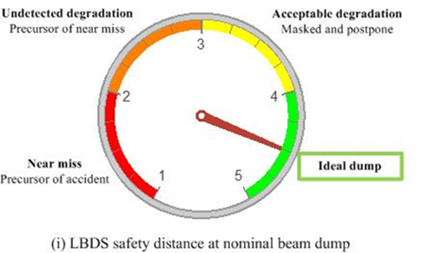
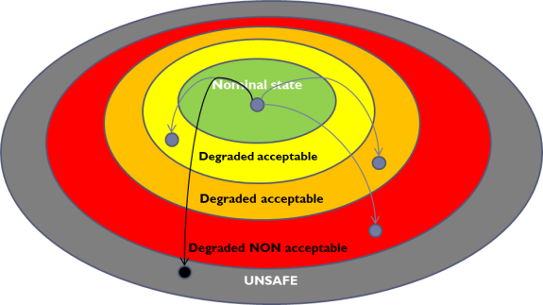

The safety gauge
Balance safety and availability
  Which ideal safety policy?
  Quantify the safety margins at every beam dump → black box model
Nominal beam dump
The system is fully available or in an acceptable degraded state
False beam dump
The internal dump must be justified → safety margin about to be eroded

Slide 17

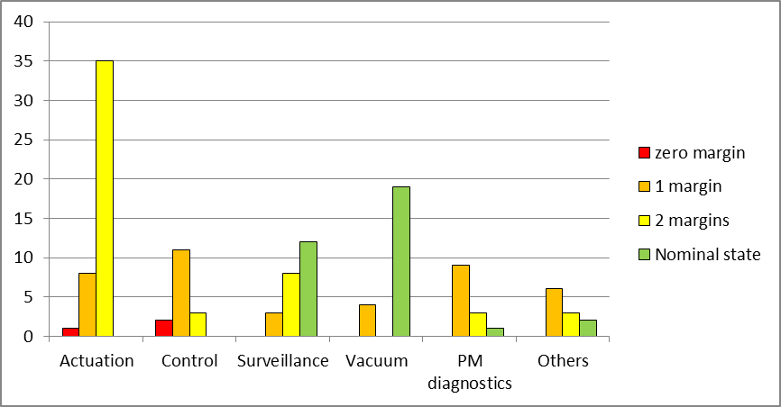
Example: Safety margins for the LBDS
Every system was calculated a safety margin at the beam dump
The average safety margin was calculated over 2010-2012
Surveillance function is unbalanced against availability (over-protection)
2.77
2.13
3.39
Control function (TSDS) is the closest to the safety margins
Average safety margins at an internal beam dump

Slide 18

Design upgrades during LS1
Additional re-trigger from BIS
Upgrade of TSU cards
Distribution TSU over three crates
Electronics
Magnets
Powering
Changes to HV generators
Upgrade of PTUs
UPS configuration
Add 2 MKB magnets per beam
Add shielding in MKD MKB cable ducts
MKB vacuum

Slide 19
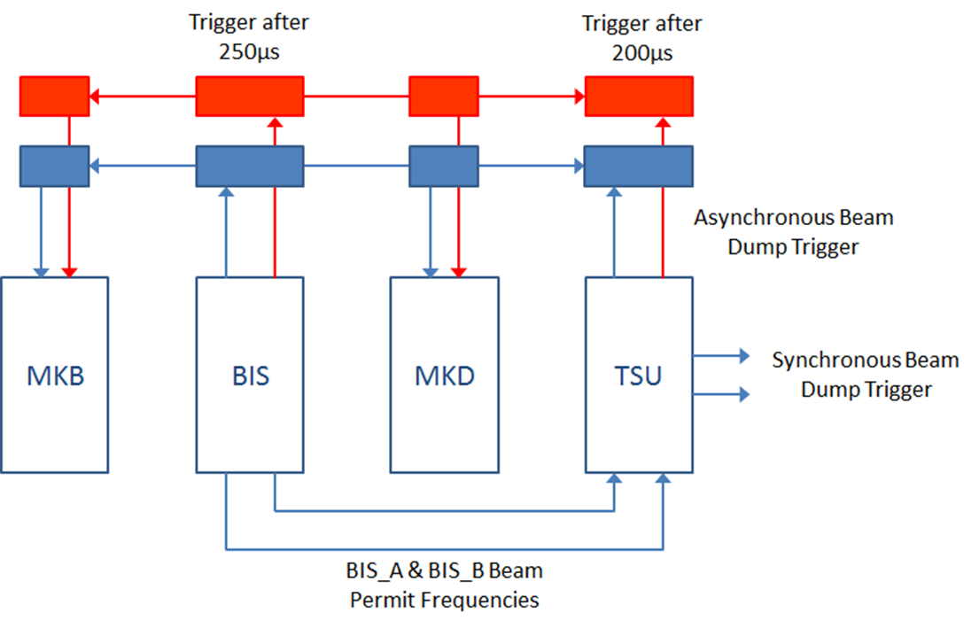
Design update during LS1:
Additional re-trigger from BIS
  What happens if TSU cards do not send the triggers ?
  => BIS sends retrigger pulses after 250 us.
Goal:
Increase SAFETY
Impact on availability:
=>Increase of async dump rate ?
Study done by V.Vatansever:
False Asynchronous beam dumps in 10 years:
  Specified: 2 / Calculated: 0.025
False Synchronous beam dumps per year:
  Specified: 2 / Calculated: 0.011

Slide 20
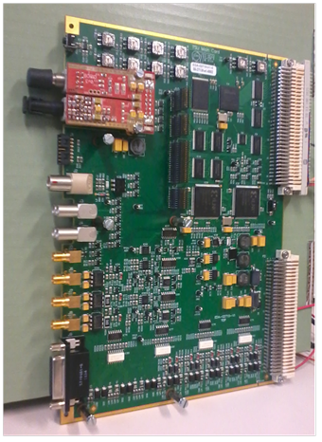
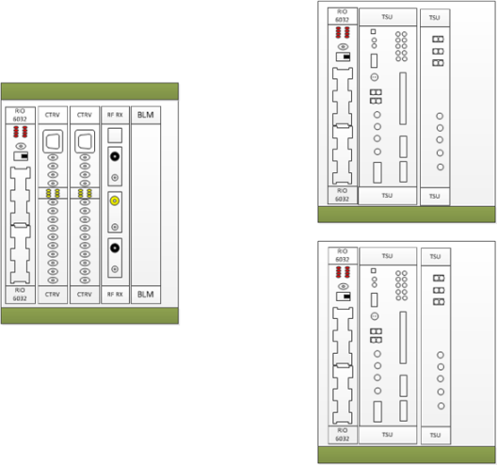
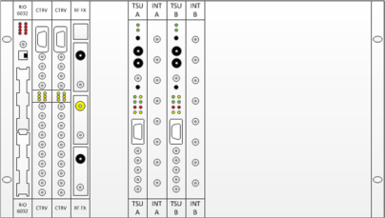
Design update during LS1:
Upgrade of TSU cards
Motivation:
External review of TSU v2 card (2010);
CIBU power filter problems (2011);
Internal review of LBDS Powering (2012);
+12V problem in TSU VME crate (2012);
Improvement of surveillance & diagnosis needed.
Implementation:
Design of a new TSU card (v3)
Deployment of the TSU cards over 3 separate crates
Goal:
Increase SAFETY
TSU A
TSDS
1 TSU crate
TSDS
Impact on availability:
More surveillance systems => lower availability
3 TSU crates
TSU B

Slide 21
Design update during LS1:
LBDS powering modifications
Add a separated connection to a second UPS (US65) for LBDS
Individual circuit breaker for each crate PSU (Distribution Box)
Software monitoring of all crate redundant PSU
Goal:
Increase SAFETY
Impact on availability:
More surveillance systems => lower availability

Slide 22
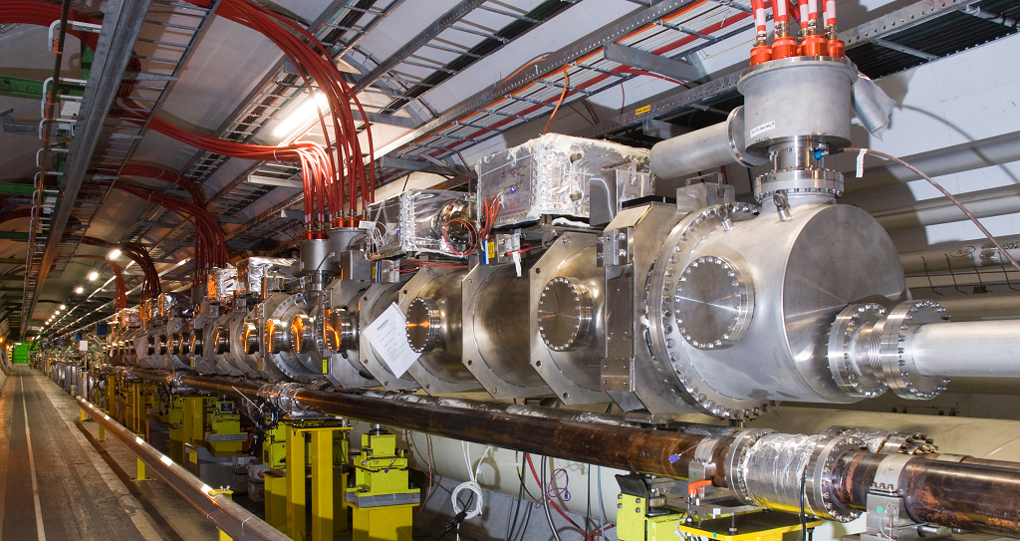
Design update during LS1:
Add 2 MKB magnets (1 tank) per beam
Goal:
Increase SAFETY
Impact on availability:
2 more MKBV (over 4 during LHC Run1):
Increased risk of erratic triggering
Increased risk of magnet flashover

Slide 23
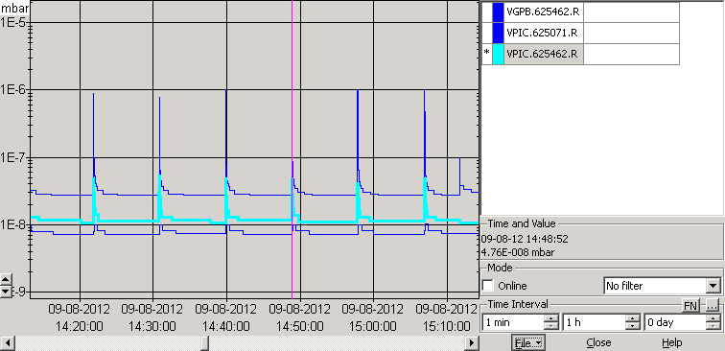
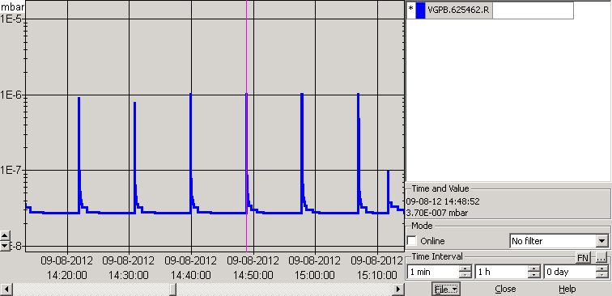
Design update during LS1:
MKB vacuum
Analogue signal very noisy
=> Masked since the beginning !
Digital signal experienced glitches/spikes
=> Many dumps due to this problem !
(13 during LHC Run 1)
4 noisy vacuum probes masked in XPOC since the beginning
Problems identified by TE/VSC:
Intervention is planned.
Goal:
Increase AVAILABILITY
Courtesy of Fabien ANTONIOTTI

Slide 24
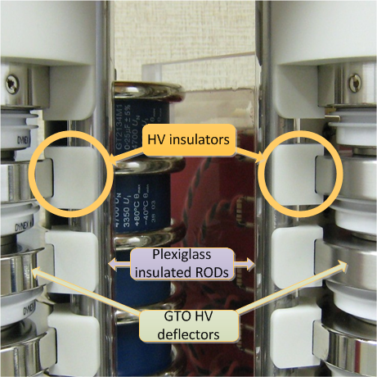
Design update during LS1:
Changes to HV generators
Sparking in the GTO stacks causing
self-triggers: (operation limited to 5 TeV)
=> HV insulators are added between:
Return current Plexiglas isolated rods;
GTO HV deflectors.
Goal:
Increase AVAILABILITY

Slide 25
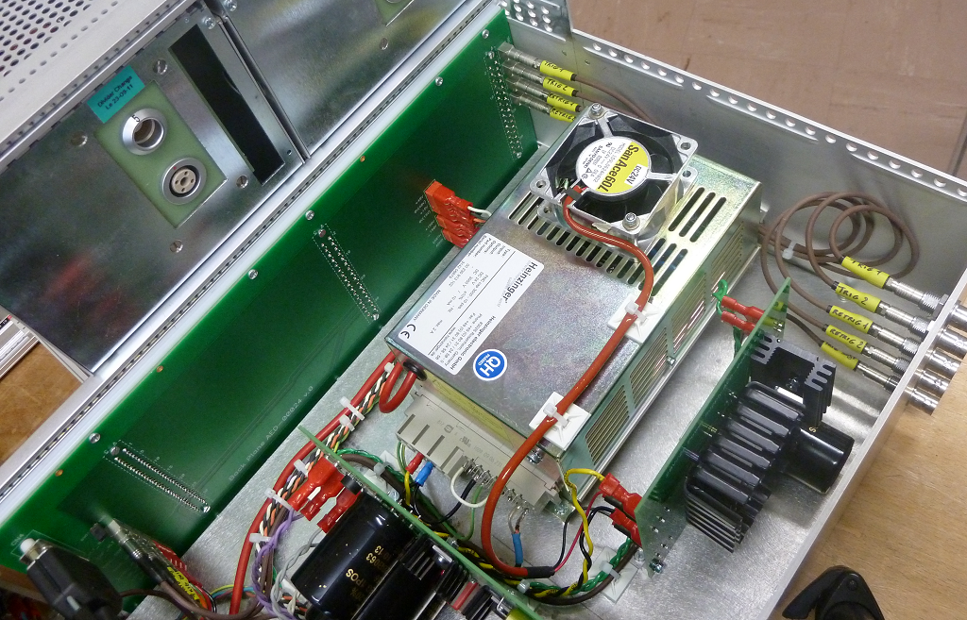
Design update during LS1:
Upgrade of PTUs
Increase PTU maximum voltage from 3 kV to 4 kV (replacement of HVPS)
Replace 1.2 kV IGBT with equivalent 1.7 kV type
=> better sensitivity to SEB
Operate PTU at ~3500 V constant voltage
=> Increased GTO gate current
=> less GTO wear out
Goal:
Increase AVAILABILITY

Slide 26
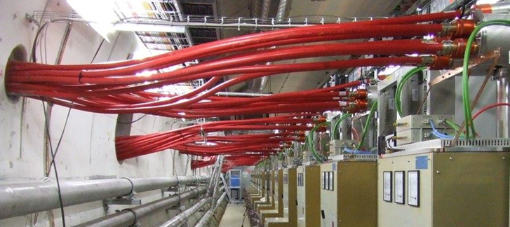
Design update during LS1:
Add shielding in MKD & MKB cable ducts
Add shielding in all MKD & MKB cable ducts between UA and RA:
=> less SEB problems
Goal:
Increase AVAILABILITY

Slide 27
System analysis and recommendations (1)
Safety by design → implementation issues
  Prevent the generation of erratic triggers (MKD)
  Loss of redundant chains and Common Cause of Failure (all)
  Overlap between control functions and safety functions (TSDS)
Safety by design → functional, systemic issues
  Analysis of rare events (e.g. “Swiss cheese” models)
  Safety measures as possible source of hazards
  Functional dependencies and domino effects
Tools
  Safety standards
  System analysis qualitative and probabilistic methods
  Fault tracking → monitor that every components stays in the flat region and identify anomalies (aging? dependencies? stress?)

Slide 28
System analysis and recommendations (2)
Scale up risks → operating at higher energies may demand tighter margins of safety and impact on availability
Review of the existing safety chains
  Review SIL in the light of possible increased risks
New hazards or existing hazards that become safety relevant
  New safety chains and interlocks after LS1 changes
  New failsafe mechanisms as sources of false beam dumps
Tools
  Risk analysis
  Real-time estimate of safety-availability balance → the safety gauge
  … export the safety gauge (safety margin) concept to every system that has a non trivial safety-availability trade-off - it returns a metric easy to understand and that can be shared throughout designers and operators

Slide 29
Conclusions
Analysis of LBDS over 2010-2012 returned overall satisfying statistics
  Availability and safety improved along the operational period.
  Anomalies sorted out.
  Theoretical models in line with observations
Experience in methodologies is encompassing
  Hazards → system analysis → safety by design
  Innovative methodologies → safety gauge
All design upgrades are safety-availability informed
  …

Slide 30
Conclusions (2): design upgrade during LS1
SAFETY is our main concern !
Most of important changes for SAFETY improvement…
…Perhaps reducing AVAILIBILITY !
Nonetheless, many changes are performed to improve AVAILIBILITY…
…where SAFETY is not impacted.

Slide 31
…question time
  Roberto Filippini
  email: rob.filippini@tiscali.it

Slide 32
Spare slides - recommendations

Slide 33
Sensitivity to unknowns
Some failure modes were not foreseen in the theoretical model (7 over 26 recorded)
Their impact is significant in the overall safety figures
  They reduced the safety margin or impacted on availability
R. Filippini, J. Uythoven Review of the LBDS safety and reliability analysis in the light of the operational experience 2010-2012, CERN-ATS-Note-2013-042 TECH. 2013

Slide 34
Recommendations (1)
Further investigations on failure mechanisms
  Common Cause Failure suspected in a few components such as the failure of three High Voltage power supplies in the MKD generators, two Triggering Units not responding, and the spurious firing of two Trigger Fan Out units. Further analysis on CCF and consequences on reliability is recommended.
Availability concerns
  7 false beam dumps are from the vacuum
  12 failures from post mortem and diagnostics => cause of delays in re-arming
  Diagnostics was not always accurate, faults fixed after several interventions
  Some functions might be over-protected, e.g. LBDS surveillance
Safety concerns
  SIL3 is largely met for LBDS, SIL4 possible but further analysis is recommended
  The control functions of the LBDS (TSDS) is estimated to have the smallest safety margin.
  HW changes during LS1 in TSDS (controls) and powering.

Slide 35
Recommendations (2)
Data quality
  Good and large quantity, but inconsistencies existed as well as non-homogeneities in the data reporting, time stamps, consequences from diagnostics and intervention
  Improvements during the years should be consolidated by the definition of standard procedures of data reporting and tools for the automatic information retrieval
Product assurance
  Several components did not meet the reliability specification because of design flaws, and were returned to the manufacturer (e.g. Asibus®, Power trigger power supply).
Other issues
  Maintenance, and diagnostics had a relevant impact on operation
  A number of faults/errors are procedural (human factor) and should be taken into account for a more detailed analysis

Slide 36
Spare – Failure models

Slide 37
Control and surveillance functions (spare)
Not validated

Slide 38
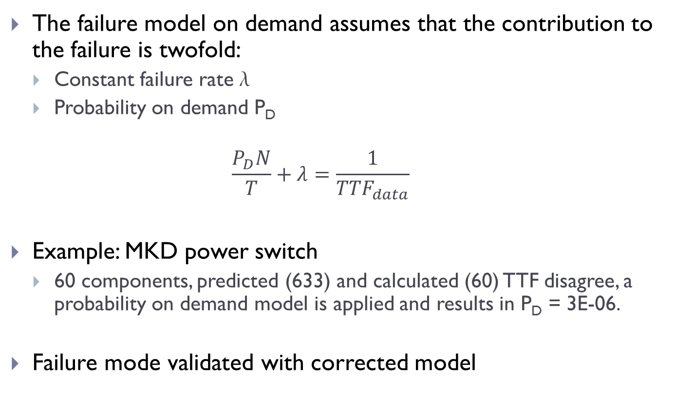
Failure on demand
The failure model on demand assumes that the contribution to the failure is twofold:
  Constant failure rate 
  Probability on demand P_{D}
  $$\frac{P_{D}N}{T}+λ=\frac{1}{{TTF}_{data}}$$
Example: MKD power switch
  60 components, predicted (633) and calculated (60) TTF disagree, a probability on demand model is applied and results in P_{D} = 3E-06.
Failure mode validated with corrected model
Average failure rate

Slide 39
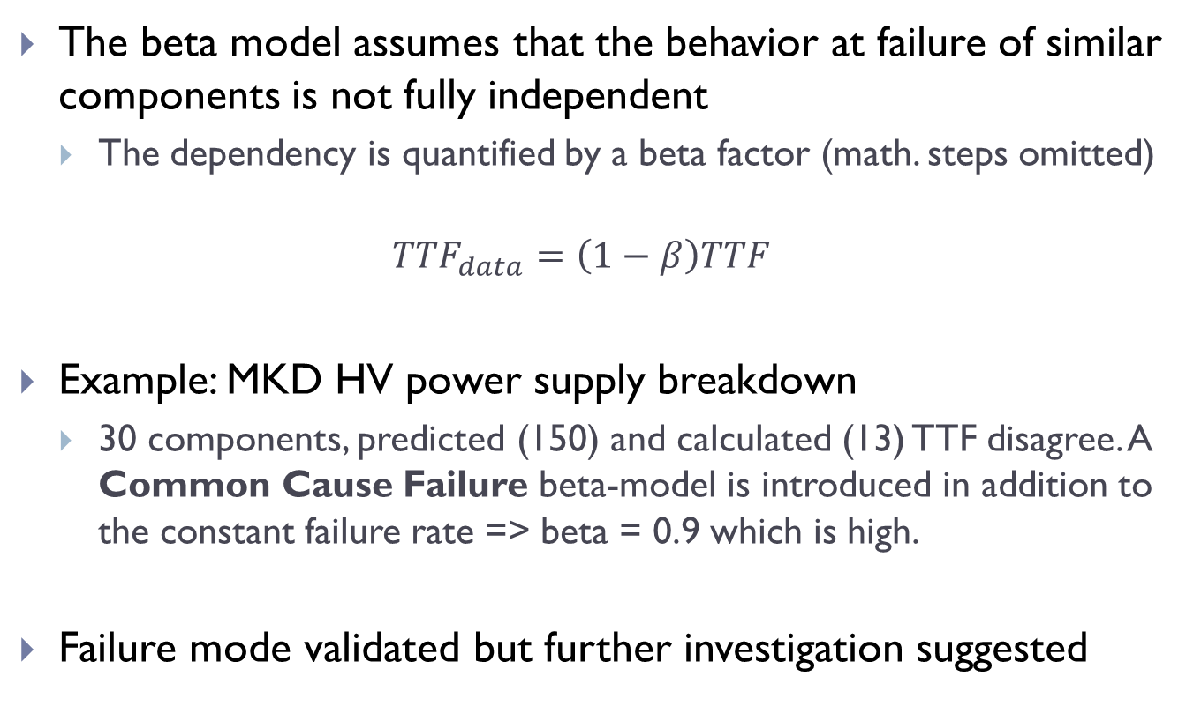
Failure Dependency
The beta model assumes that the behavior at failure of similar components is not fully independent
  The dependency is quantified by a beta factor (math. steps omitted)
  $${TTF}_{data}=\left(1−β\right)TTF$$
Example: MKD HV power supply breakdown
  30 components, predicted (150) and calculated (13) TTF disagree. A Common Cause Failure beta-model is introduced in addition to the constant failure rate => beta = 0.9 which is high.
Failure mode validated but further investigation suggested

Slide 40
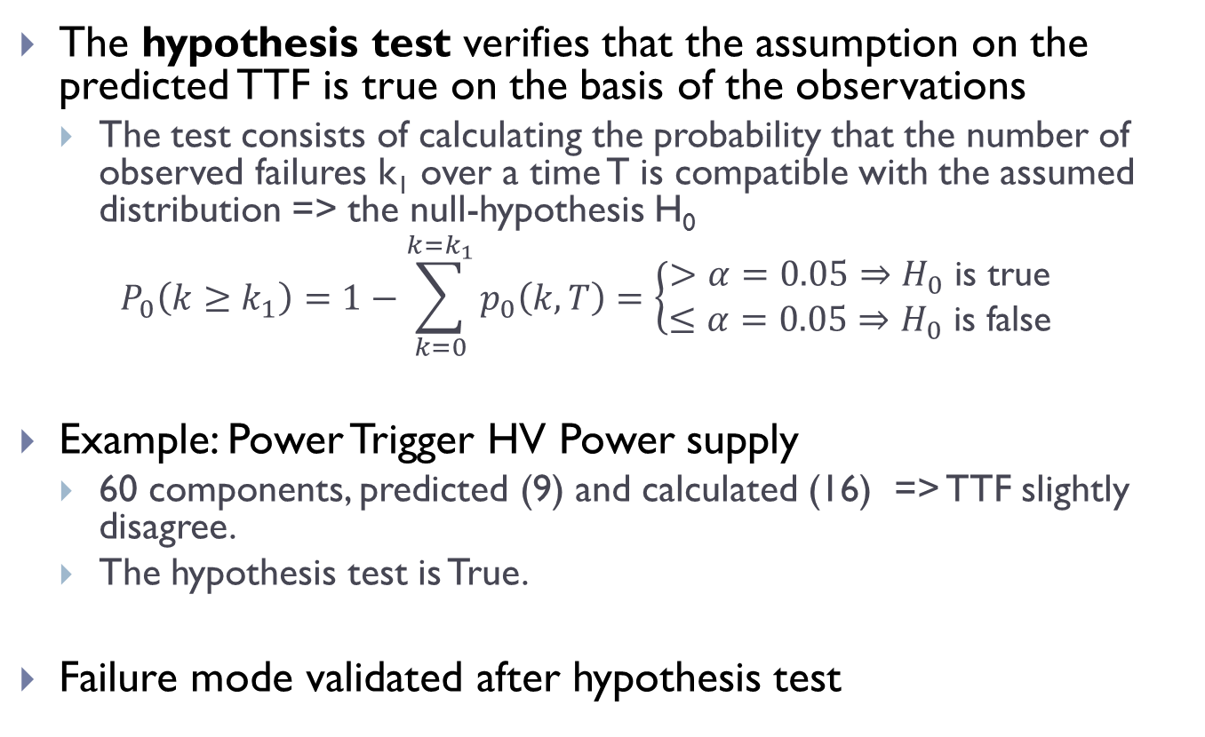
Hypothesis test
The hypothesis test verifies that the assumption on the predicted TTF is true on the basis of the observations
  The test consists of calculating the probability that the number of observed failures k₁ over a time T is compatible with the assumed distribution => the null-hypothesis H₀
  $$P_{0}\left(k≥k_{1}\right)=1−\sum_{k=0}^{k=k_{1}}{p_{0}\left(k,T\right)}=\left\{\begin{matrix}>α=0.05⇒H_{0} \text{is} \text{true} \\ ≤α=0.05⇒H_{0} \text{is} \text{false}\end{matrix}\right.$$
Example: Power Trigger HV Power supply
  60 components, predicted (9) and calculated (16) => TTF slightly disagree.
  The hypothesis test is True.
Failure mode validated after hypothesis test

Slide 41
Safety metrics
The problem
  The evidence that all beams were safely dumped at every beam dump request for LBDS is a necessary but not sufficient condition to state that the system is SIL3 at least
Rare events are hopefully not recordable but… their early development can be observed
  Look for near misses and close to near misses
  Identify the event driven failure dynamics
  Set a metric for safety → safety margin
  Estimate SIL on the calculated safety margin

Slide 42
Spare - Safety

Slide 43
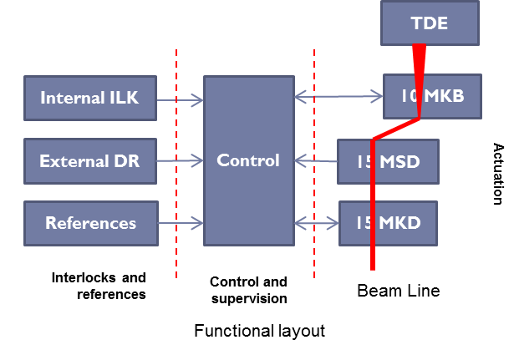
LBDS and safety by design
The behavior at failure of the LBDS is conceived in order to …
  Tolerate faults by redundancy => fault masking
  Prevent faults by surveillance => failsafe
TSDS (simplified)
Back-up a
Asynchronous re-trigger
RT-a
TSU-a
TFO-a
Primary
Synchronized trigger
Dump request
Beam dump
TSU-b
TFO-b
Back-up b
Asynchronous re-trigger
RT-b

Slide 44
Example: TSDS and safety distance
Simplified state transition diagram of the TSDS
  Some failure events may be detected and trigger a false dump
False dump
TSU-b fails
TSU-a fails
Initial state
TFO-a
TFO-b
RT-b
TSU-a fails
UNSAFE
False dump
False dump
False dump
False dump
3
2
1
Safety distance = number of failure events left

Slide 45
Actual safety (0)
Extreme outcomes and singularities
  failure events that moved the LBDS to a potentially unsafe state, or close to it (near miss) before this was discovered.
1 erratic trigger of 2 MKDs over three years, from 30 independent TFO outputs
  The maximum failure rate threshold in order to be SIL3 at least is 7.2 E-05/h which is met.
2 failure at zero safety margin (detected) in the actuation and control functions, in 3 years
  The maximum failure rate threshold for the control is 7.8 E-05. and the one for the actuation is 1.1 E-03, which are both SIL3 at least.
Notes:
TSDS is the failure of one TSU which properly triggered an synchronous dump – the actuation failed with 3 power supplies, detected

Slide 46
Actual safety (spare1)
Problem statement
  Given the average safety distance at failures for each LBDS function, over the period 2010-2012, the objective is to calculate the maximum component failure rate below which LBDS is SIL3, for 300 days per year (total = 21600 h) with an average machine fill of 10 hours
Data…
  P_{E} = probability of the initiating events (90/21600)
  N = 1674 number of components at failures in the LBDS
  s = safety distance
  d = detection rate; 0.73 for LBDS, 0.6 (actuation), 0.87 (control) 0.96(surveillance)
safety distance s
Unsafe
d
d
Initiating event P_{E}
Failsafe

Slide 47
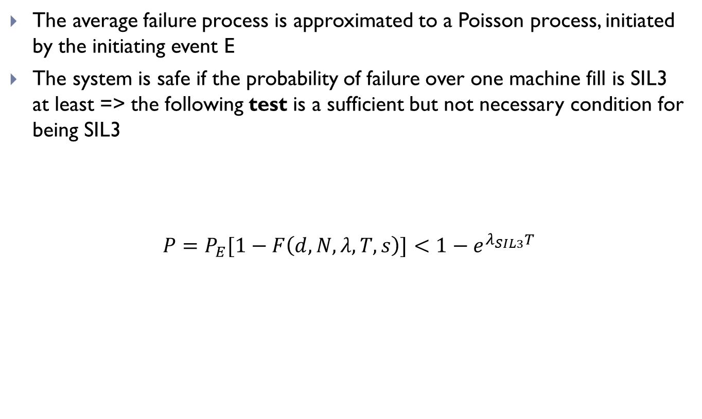
Actual safety (spare 2)
The average failure process is approximated to a Poisson process, initiated by the initiating event E
The system is safe if the probability of failure over one machine fill is SIL3 at least => the following test is a sufficient but not necessary condition for being SIL3
$$P=P_{E}[1−F\left(d,N,λ,T,s\right)]<1−e^{λ_{SIL3}T}$$
Continuous Poisson CDF
_{SIL3}= 1xE-07/h
residual safety margin
SIL3 bounds
Initiating event
Probability of exceeding the safety margin s
The failure rate threshold

Slide 48
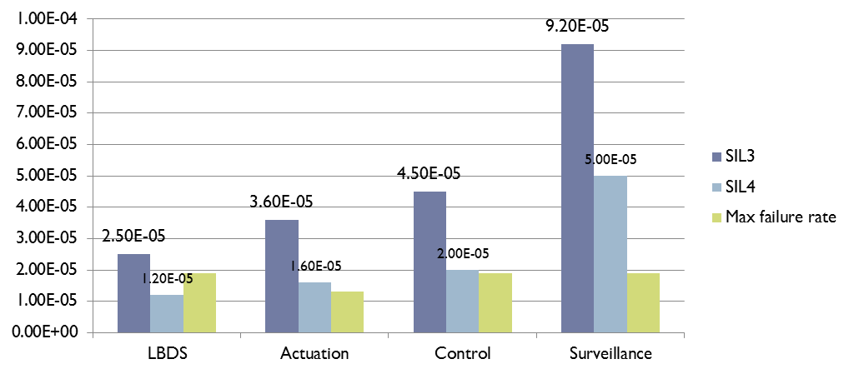
Actual safety (3)
Actuation, control, and surveillance functions meet the safety requirements individually and together as LBDS
  Example: LBDS SIL3 bound is 2.5 E-05/h - the highest rate is from the TSDS VME crate power supply failure =1.9 E-05/h with all other components being more reliable.
SIL3 bound
SIL4 bound
highest failure rate 1.9 E-05/h close to SIL4 bound

Slide 49
Safety: SIL3,SIL4 graphical tests
LBDS
actuation
control
surveillance
Probability T=10
SIL3 bound
SIL4 bound
Failure rate/h

Slide 50


LBDS safety gauge 2010-2012
Ideal behaviour
2.77
Ideal behaviour
2.13
Poor safety margins
3.39
Over-protected at detriment of availability

Slide 51
Spare – various statistics

Slide 52

Failure modes
2518 LBDS components exposed to failures during 2010-2012 resulted in 90 failure events, distributed in 29 different failure modes…
…but almost 70 failure modes never occurred
Hypothesis test always true with the exception of the PTM power supply that was expected to fail
The most conservative TTF was taken

Slide 53
Actual availability
Assumptions
  Only LBDS false beam dumps in the phases injection and stable beam are considered
  No repetition of the same internal dump request, i.e. occurrence of the same event (e.g. inaccurate diagnostics) after a short interval => 5 false dumps not considered.
Results
  The LBDS counted 29 false beam dumps, against the 24 (on average) foreseen.
  Actuation (15) then surveillance (12) and control (2)
False beam dumps
Decreasing trend

Slide 54

LBDS System analysis 2003-2006 (2)
The probability of being not able to dump the beam on demand is estimated to be1.8E-07 per year of operation = largely SIL4
The generated number of false beam dumps was 8 +/- 2
  MKD most critical system (74%)
  MKD 5 false beam dumps (61%)
%
Predictions from theoretical models!
Magnets

Slide 55
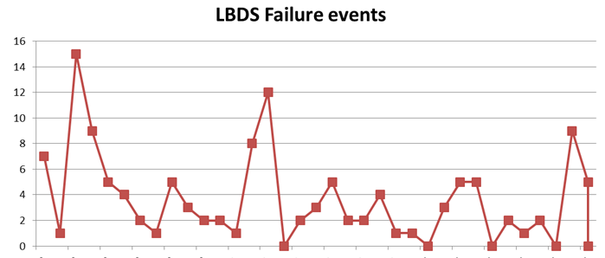
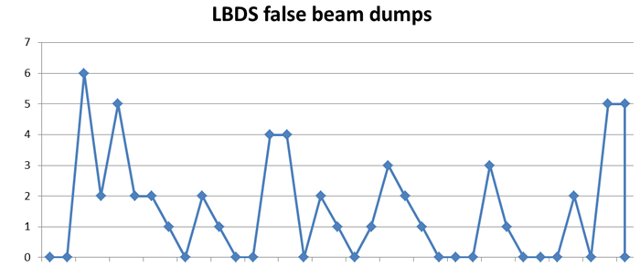
Raw data by time series 2010-2012
Put together 8, 9 and 10
Anomalies
1 Vacuum and BEM Anybus®
2 Vacuum and diagnostics
3 SCSS Asibus®
1
2
3
Jan 2010
Dec 2012
Statistics per month
Jan 2010
Dec 2012

Slide 56
Failure distribution vs. functions
139 failure events recorded of which 90 in the LBDS
  Actuation (MKD, MKB) is the largest contributor (60%)
49
90

Slide 57
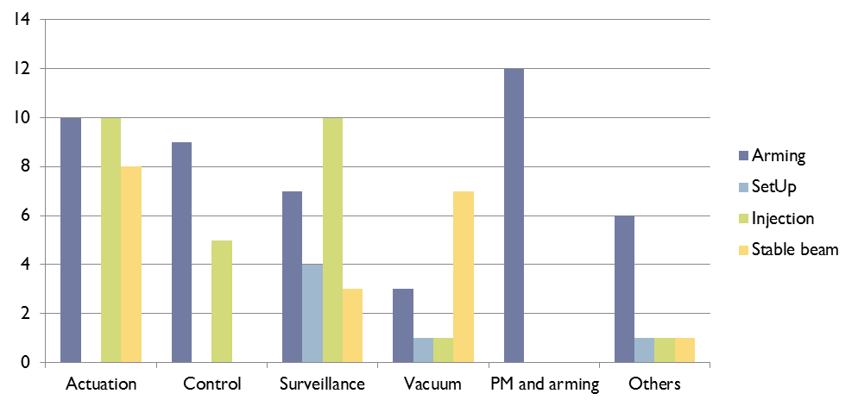
LBDS false dumps vs. machine phase
A total of 97 events during 2010-2012 triggered a false dump (with or without the beam) of which 66 from the LBDS, i.e. 73% of the total
  The most important contributor is the actuation (MKD, MKB)
66

Slide 58
Spare - MPS

Slide 59
Machine Protection and LBDS
The LHC machine protection system MPS allows operation with the beams only if the LHC is cleared from faults/errors, and it supervises its functioning in order to prevent that a failure may develop into a critical accident.
Is it reliable, safe?
LHC State
ILK
Beam
LBDS
Operation
Supervision
Safety logic
Actuation

Slide 60
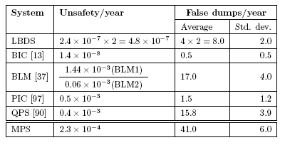
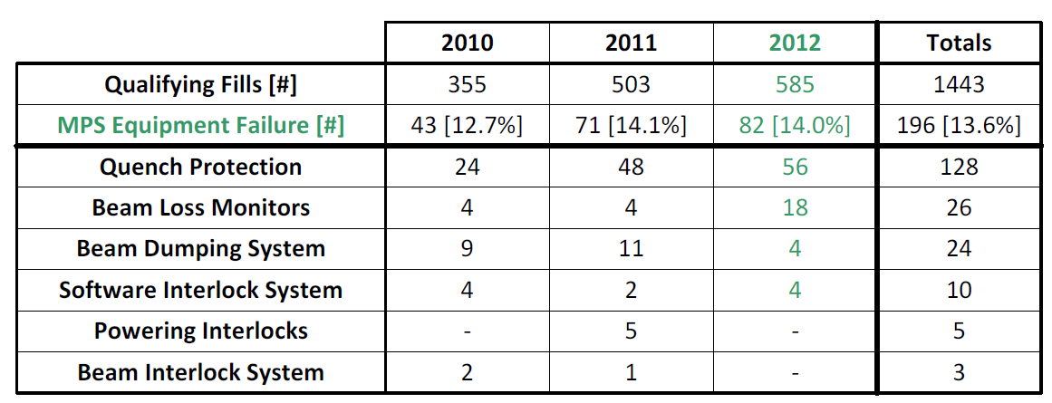
Machine Protection System 2003-2006
The reliability sub-working group of the machine protection system working group was charged to perform the analysis of safety and availability of the most critical systems of the MPS
The scope
  All active devices, supervision and interlocking elements including the Beam Loss Monitors, Quench Protection System, Beam Interlocking Systems, Power Interlock System, LBDS.
Reliability w.g. 2006
B. Todd, MP Workshop Annecy 2013
Most results confirmed, with a few exceptions

