Slide 1
SPS availability
K. Cornelis
Acknowledgments : A. Rey and J. Fleuret

Slide 2
Content
SPS statistics : how it is done?
Fixed Target and CNGS statistics.
CNGS faults evolution.
LHC availability versus FT and CNGS
Availability improvement.
Summary

Slide 3
Automatic beam absence in logbook for FT and CNGS
When beam intensity on FT or CNGS is below a fixed value, the BCT sends a “no beam” signal to the logbook.
A no beam comment is inserted in the logbook and an “event” is created in the ‘End of Shift Log’.
When beam comes back the “event” is closed and the beam back comment is inserted in the logbook.
The operator has to add pre-defined fault labels to every event in the ‘End of Shift Log’

Slide 4
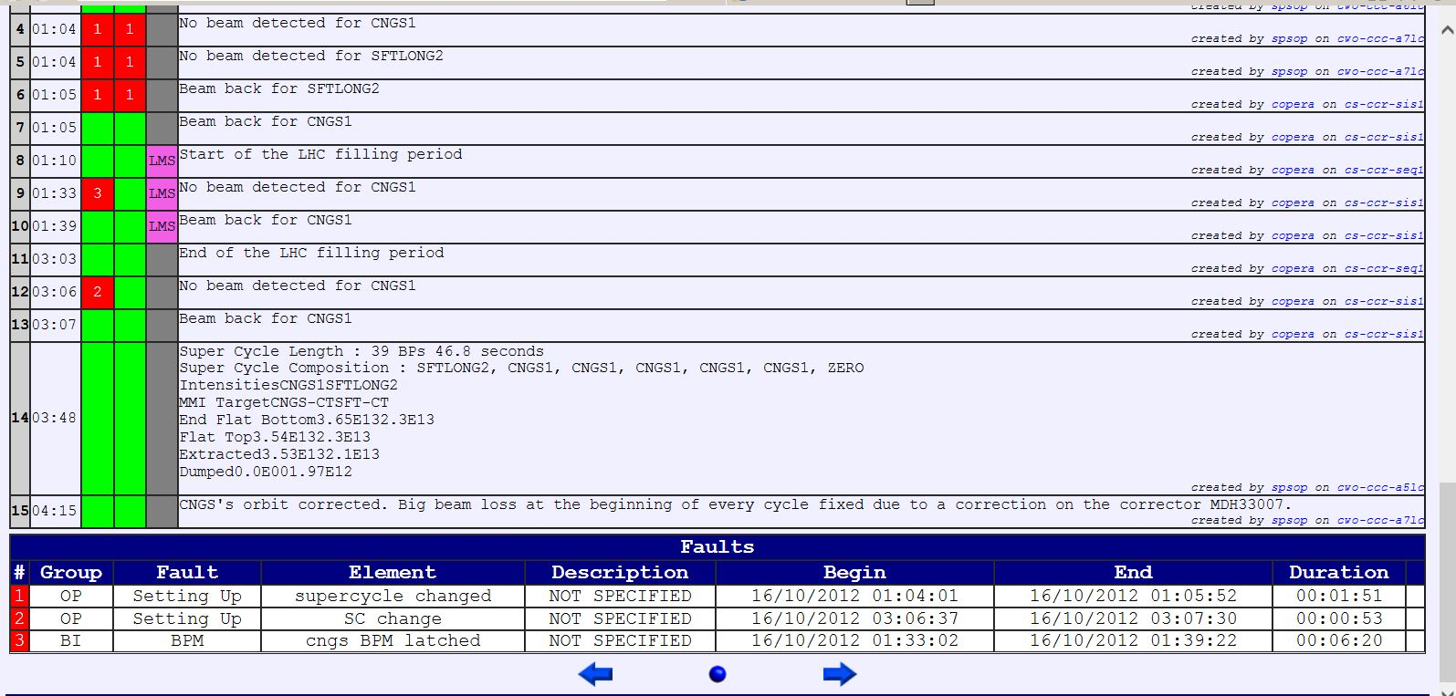
Fault insertion

Slide 5
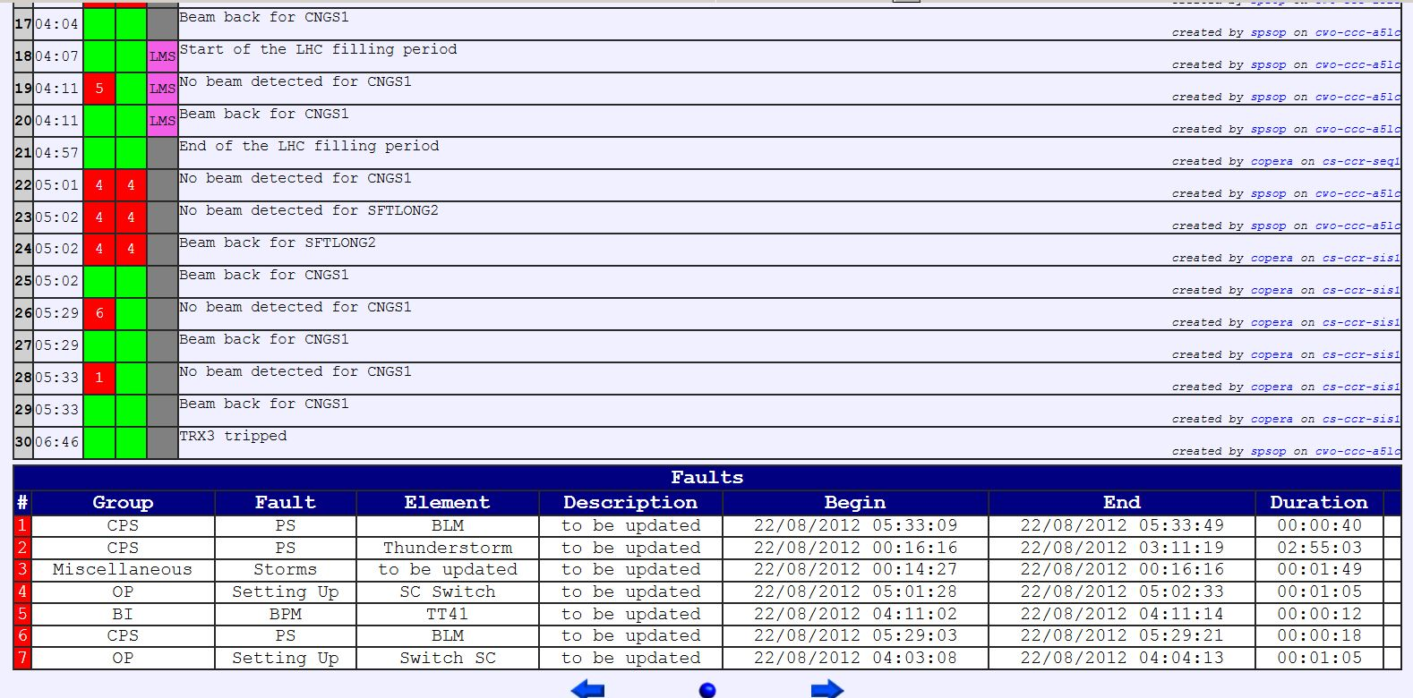
Fault Insertion

Slide 6
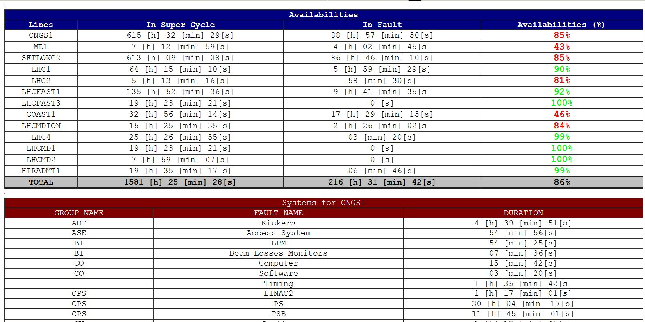
Fault statistics can be extracted for any interval shorter than 365 days.

Slide 7
Availability and Fault Statistics
Automatic insertion makes the availability calculations and fault statistics very reliable on FT and CNGS.
Automatic insertion for LHC beams is not straight forward. An LHC filling cycle without beam can be normal.
LHC-beam statistics are to be taken with a large error margin.

Slide 8
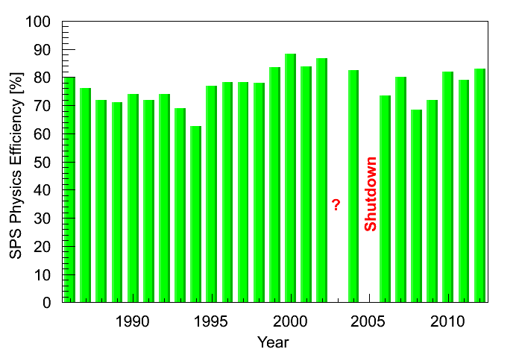
SPS availability for FT over long period
LEP effect
CNGS + LHC effect

Slide 9
Evolution of CNGS availability since 2007
Improved RF power maintenance

Slide 10
Fault statistics for CNGS 2009-2012

Slide 11
CNGS- fault statistics (injectors excluded)
Effect of LHC on other users : LHC access preparation , super-cycle changes
Reliability of RF power improves
Outgassing E-cloud.
Rise-time more critical

Slide 12
2012 for LHC, FT and CNGS
TT20 + RING
Interventions adapted to LHC filling
Ring
Target ventilation
LHC also suffers from power
cuts

Slide 13
SPS injector availabilities
The SPS injector chain counts for 40% to 60% of the total faults.

Slide 14
LHC beams in 2011 and 2012
Availability for LHC 2011 : 90 % 2012: 93.3%

Slide 15
Availability improvement
Magnets
  About 10 to 15 (suspected) magnets are changed every year as a preventive measure.
  Magnet refurbishment campaign in 2007-2009 to avoid water leaks and to make repairs in situ easier.
RF power : maintenance program and spare policy improved availability with high intensity beams.
18 kV cables renewed during LS1
Procedures and sequencers optimised to reduce down time due to operations (improvement since 2011).

Slide 16
Summary
SPS availability around 80% for CNGS and FT beams.
Availability for LHC beams > 90%.
Interventions can be scheduled when LHC does not need beam.
Since 2009 more beam time lost due to operations (especially on CNGS).
The SPS injector chain counts for 40% to 60% of the total faults.
Improvement visible for both SPS and its injectors since 2009.
Continued effort to improve availability of critical systems (RF, Kickers, Magnets, OP, …)

