Slide 1
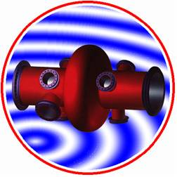
The past and future
RF performance in LHC
Pierre Maesen BE/RF
On behalf of the LHC RF team

Slide 2
Content
- LHC RF System
- RF performance up to 2012
  Tools used for faults tracking
LS1 ACS upgrades at PT4
LS1 ADT upgrades at PT4
- Prospects for RUN 2
  Tools that could help

Slide 3
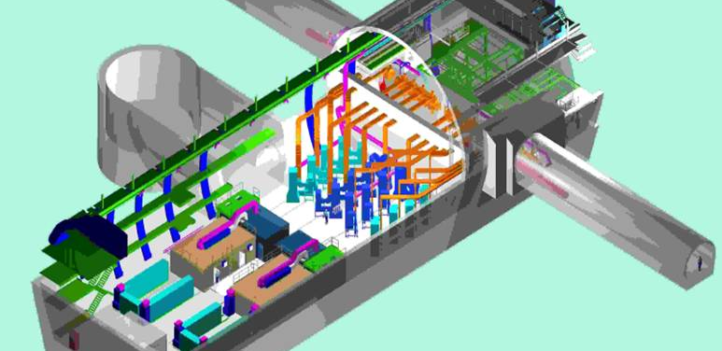
- LHC RF System
16 SC Cavities in 4 Modules
16 Klystrons
300 kW @ 400 MHz
1000 Interlocks
All connected to the beam dump
8 Transverse Dampers
32 Tetrodes

Slide 4
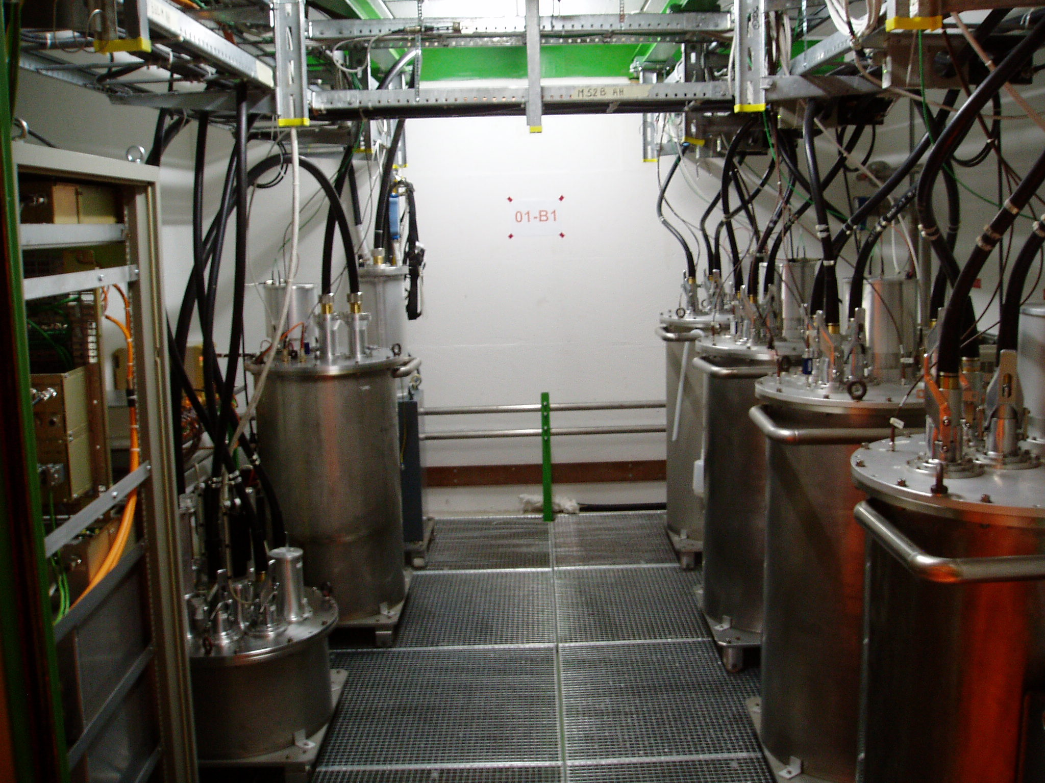
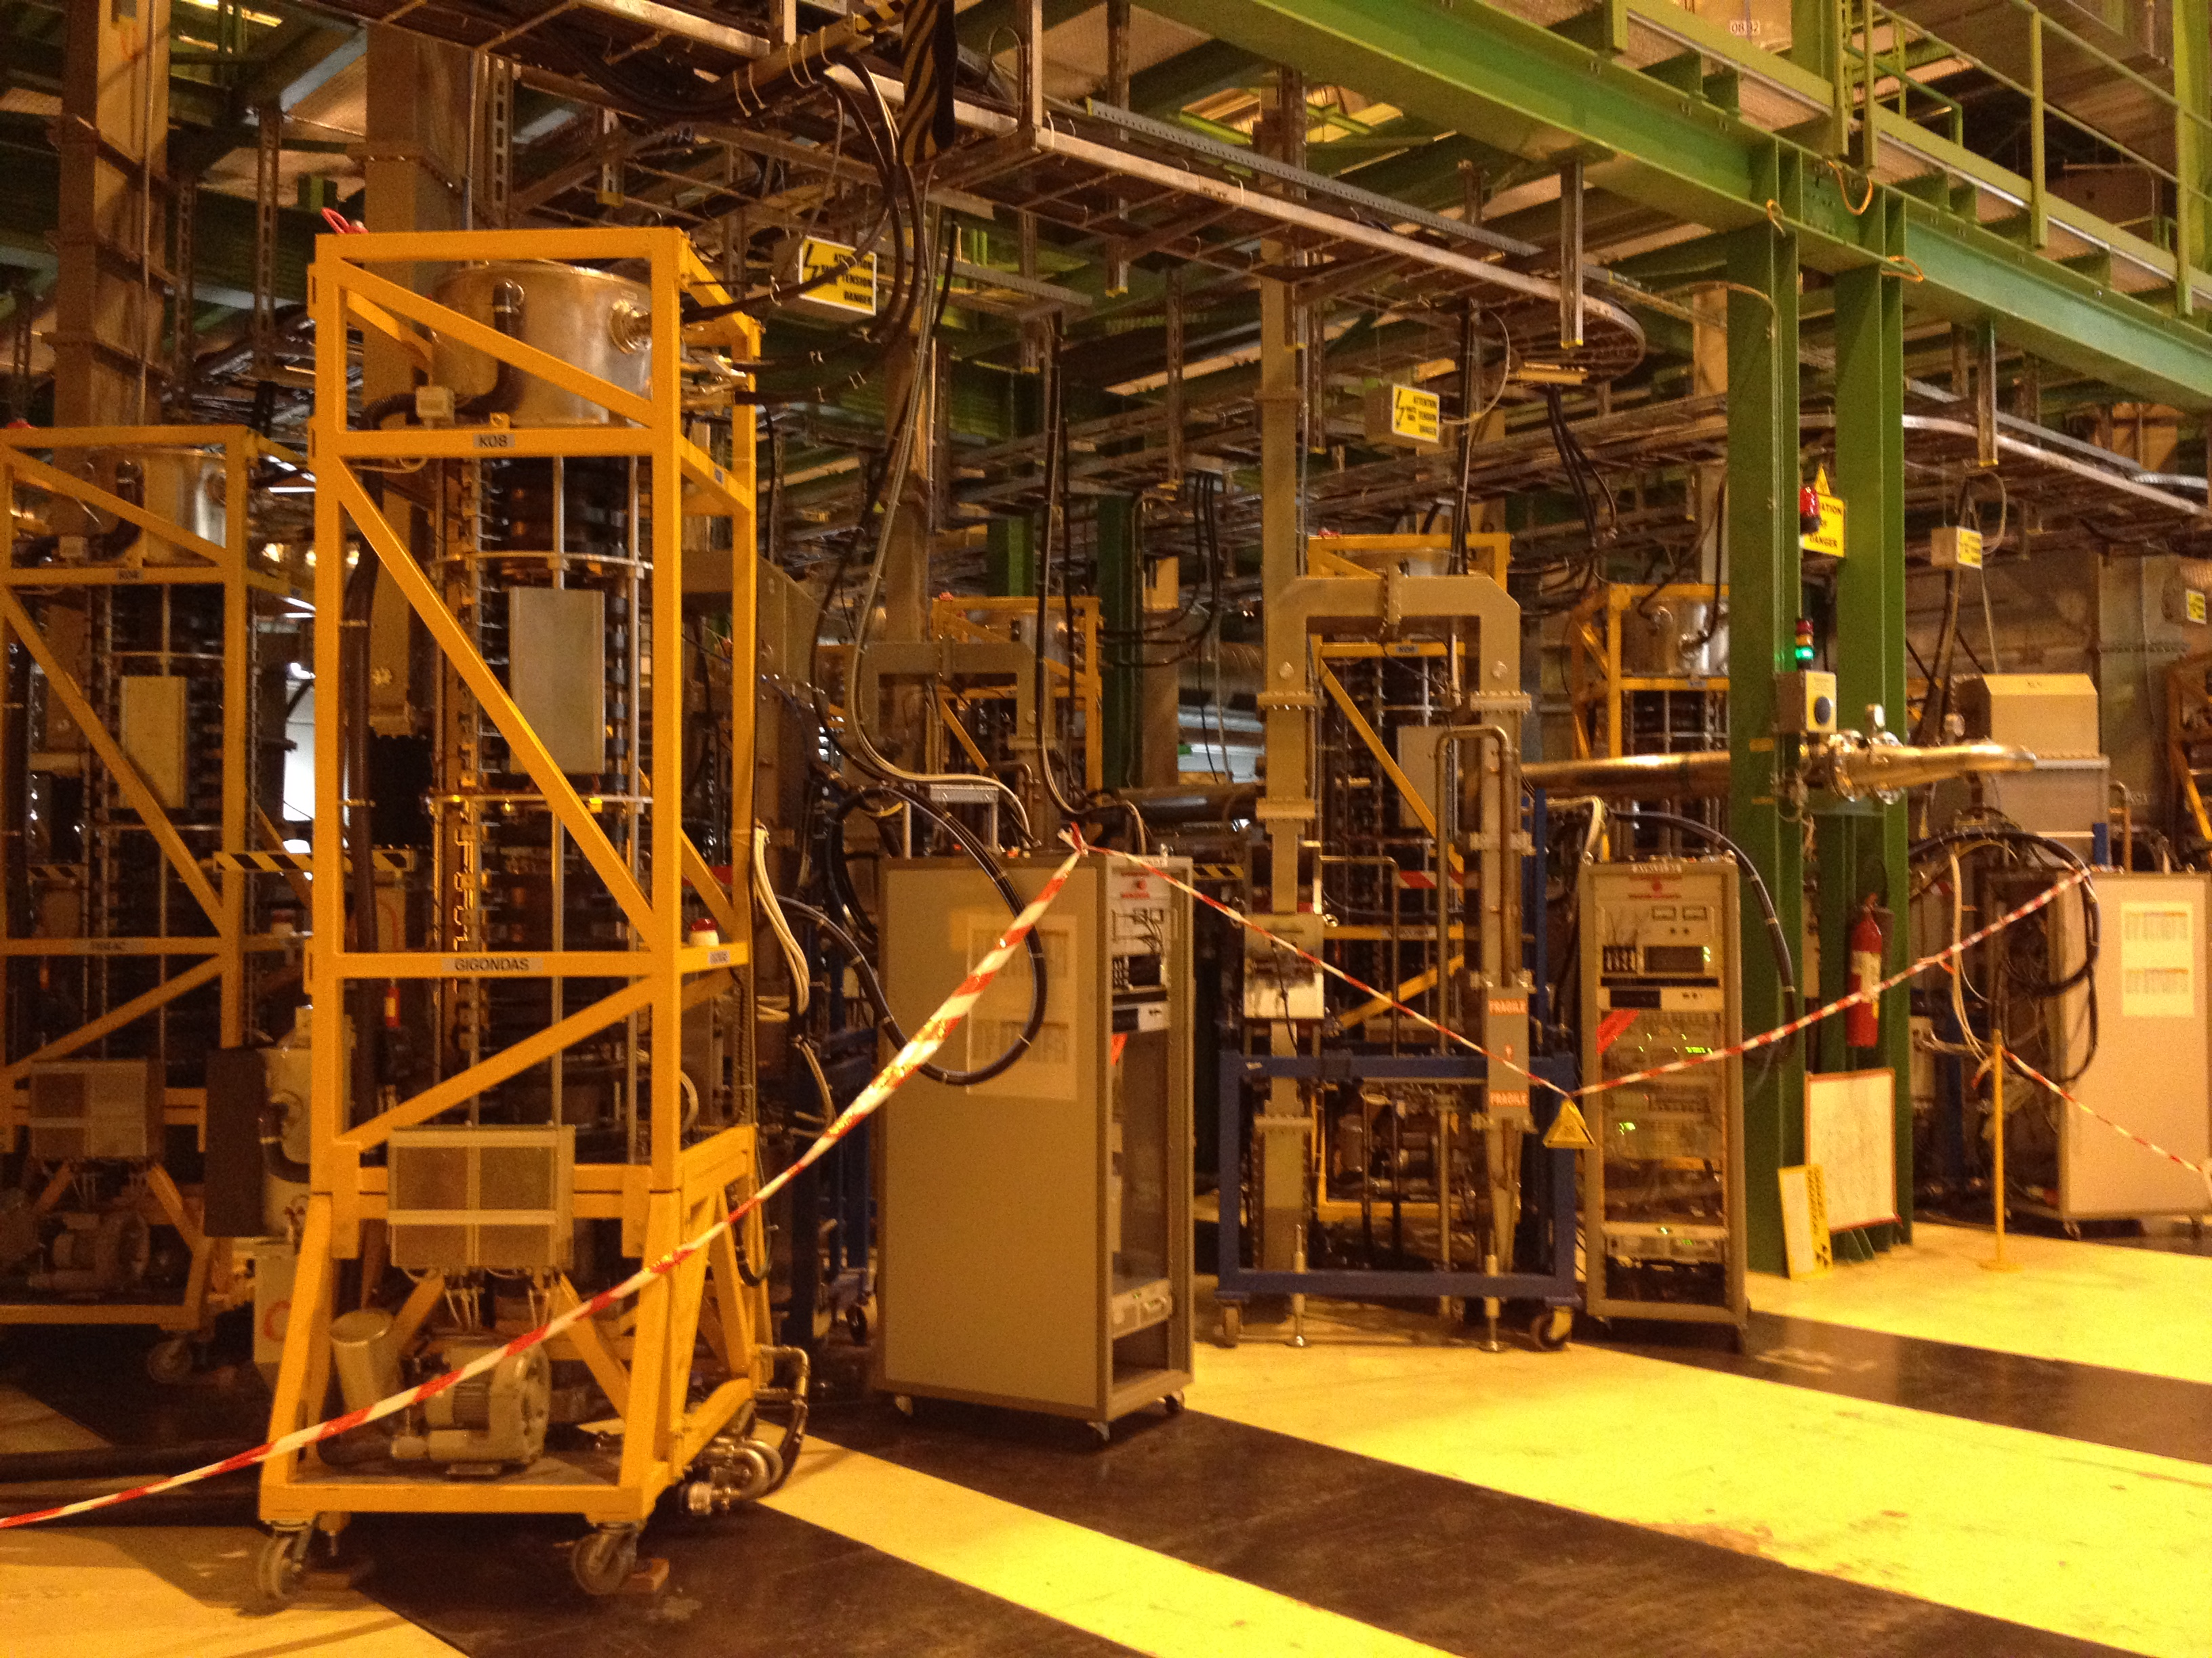
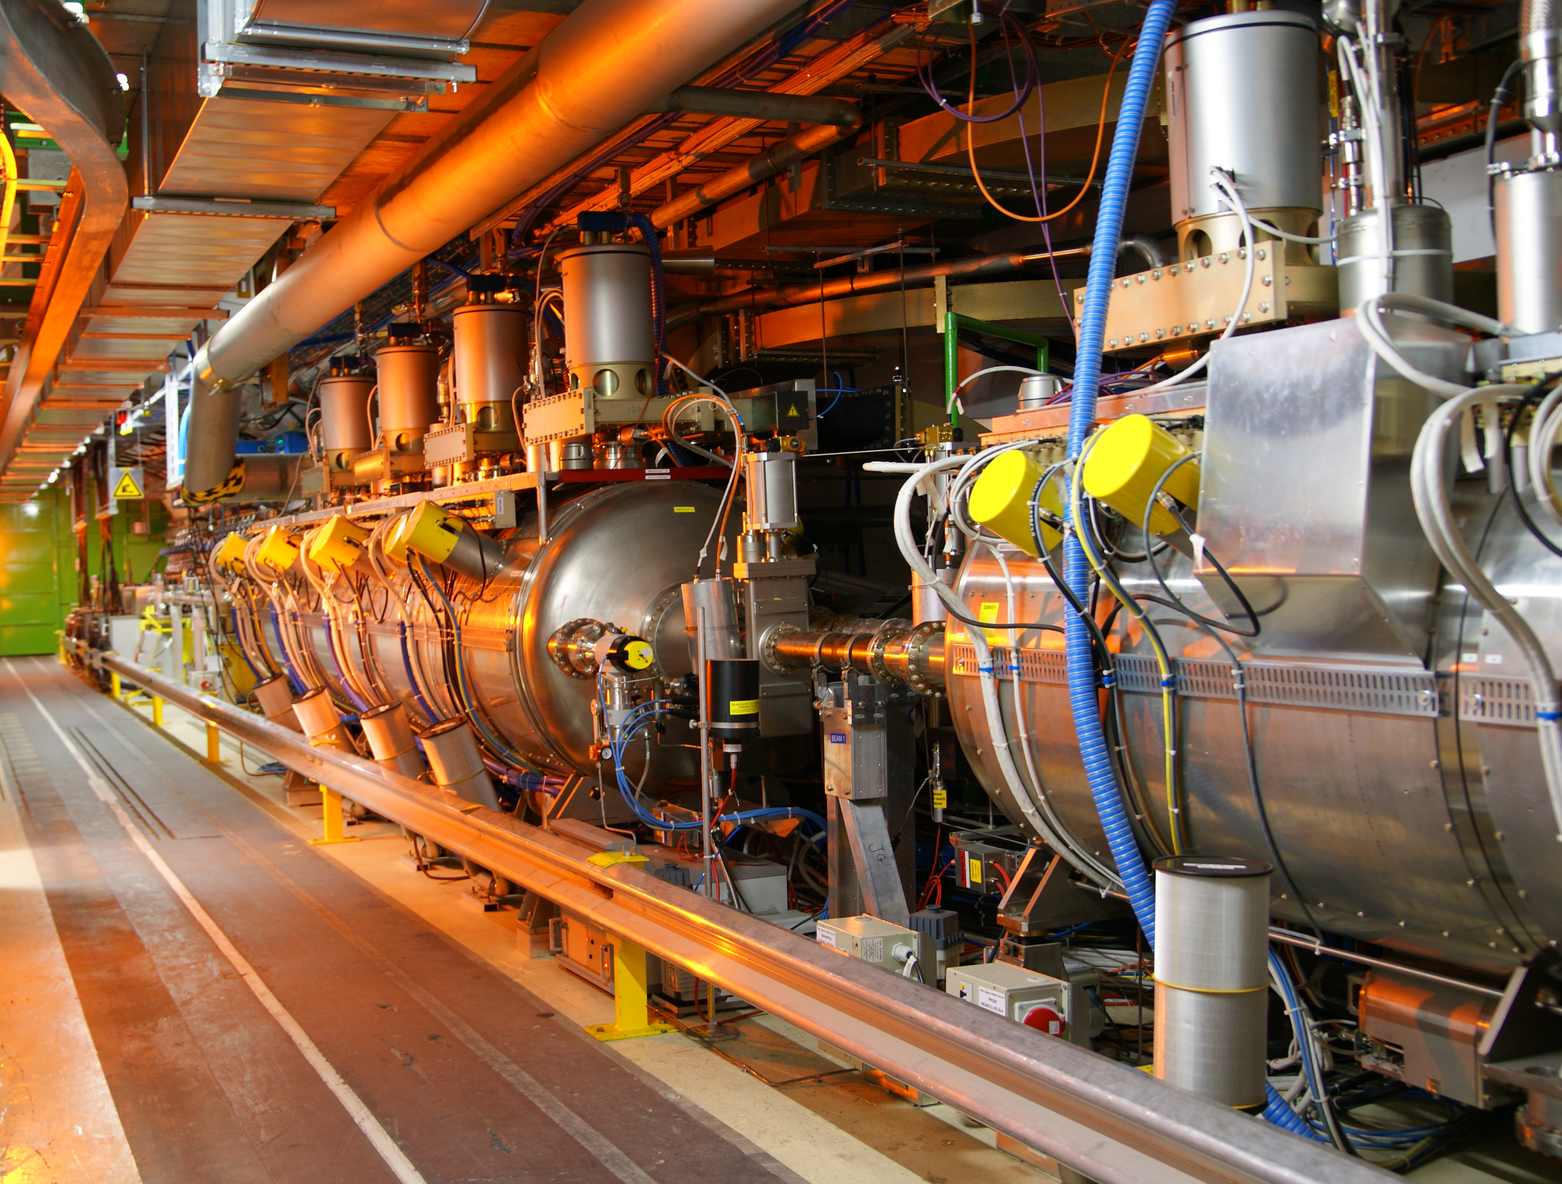
UX45 RA43-47
Notes:
Talk about modules = RF unit

Slide 5
RF power path & critical interlocks
Main Power Coupler
(ceramic window)
Wattcher HI (fast)
[SIS] (slow)
Wattcher LO
Arc
detector
Veto
MC Vacuum
HOM Power [SIS]
HOM coupler
RF Switch
HOM Temperature [SIS]
Circulator
Klystron
Beam
Generates RF Veto and
Beam Interlock since 2011
[SIS]: Software interlock
Cavity
Helium pressure (cavity quench)
Helium level (Cryo OK)
Load
Also connected to BIS:
RF frequency
Cavity vector sum (total voltage)
Faraday Cage UPS fail
A. Butterworth

Slide 6
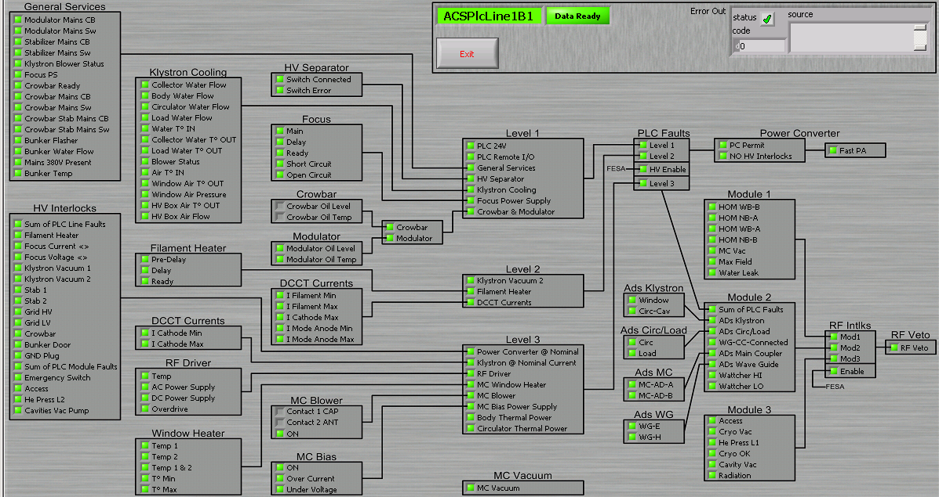
ACS RF & HV interlock chains
HV interlocks
Brings down complete module (4 Klystrons)
L. Arnaudon
RF interlocks (Trips 1 Klystron)

Slide 7
- RF performance up to 2012
2011:
78 faults in total
11% of all beam dumps
2 Faults per week during physics
2012: (Fault analysis: D. Glenat)
43 faults in total
x% of all beam dumps
1.3 Faults per week during physics
Some difficult weeks/periods:
  2 x Crowbars
  Defective HV cable
  RF driver
Fault statistics 2012
crowbar
RF driver
HV cable
crowbar
RF driver

Slide 8
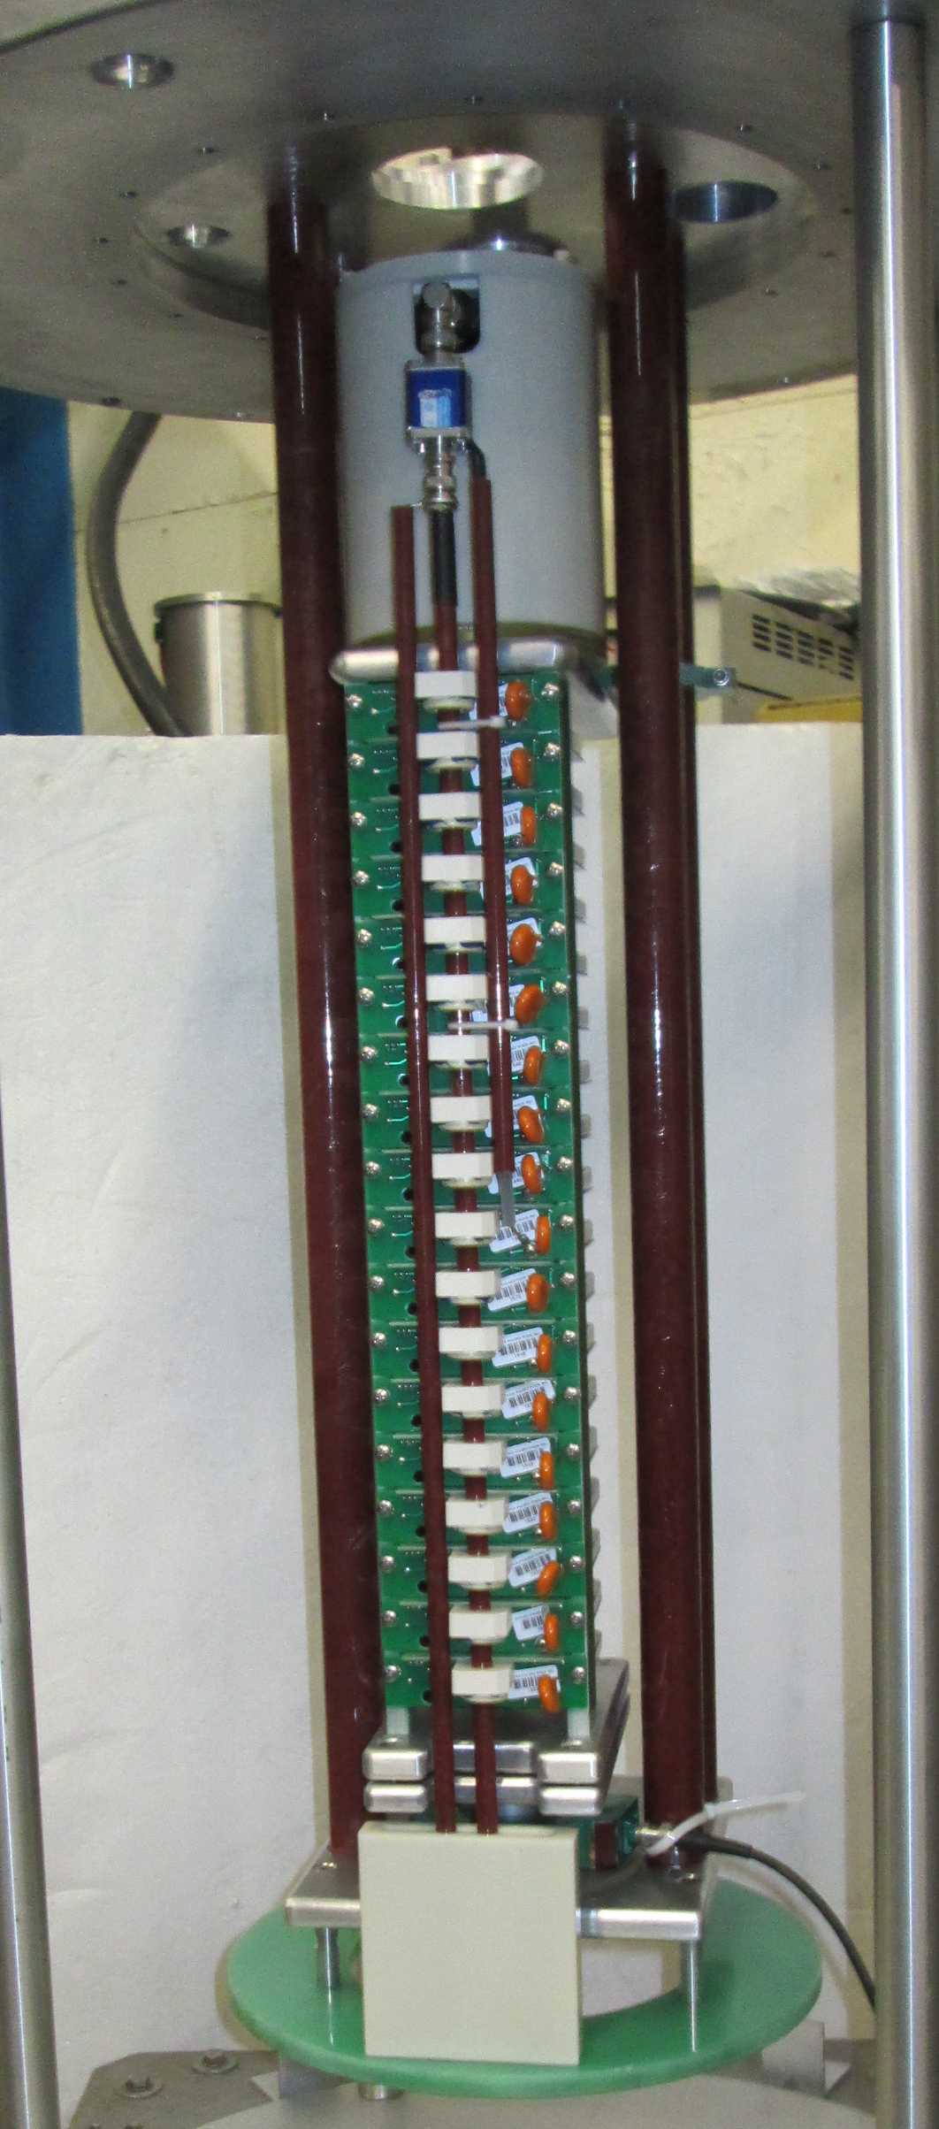

Thyratron replacement
Most critical equipment : the current Thyratron crowbar suffers from spurious trips
Solid-state replacement developed using Thyristor-Stack: very promising and showing comparable performance (See: Paper at IPAC12 by G. Ravida)
1 unit installed since September 2012
  No spurious trip observed
  Few trips due to klystron arcs
Notes:
Thyratron are sensitive to heater and reservoir current

Slide 9
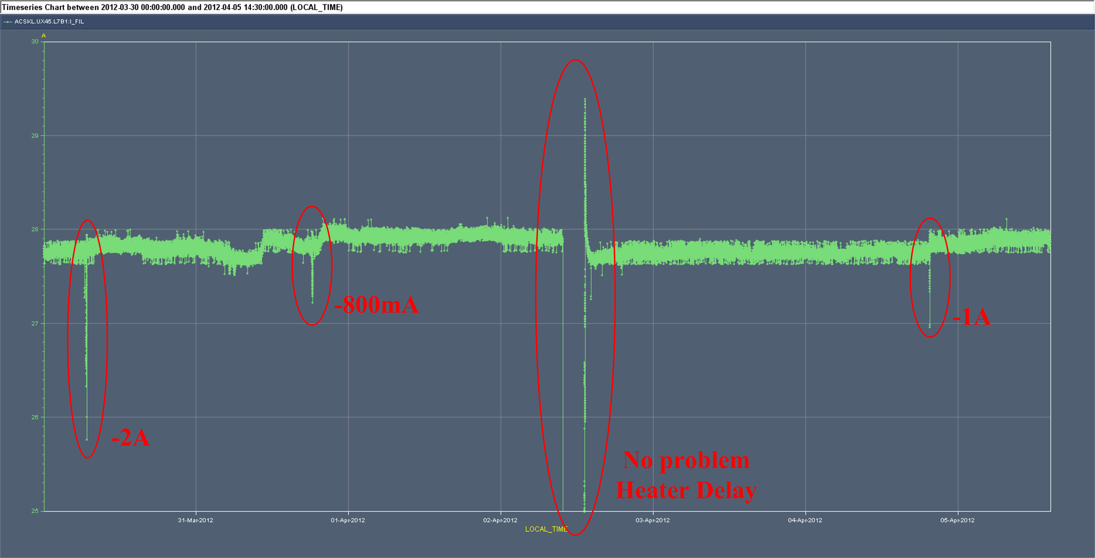
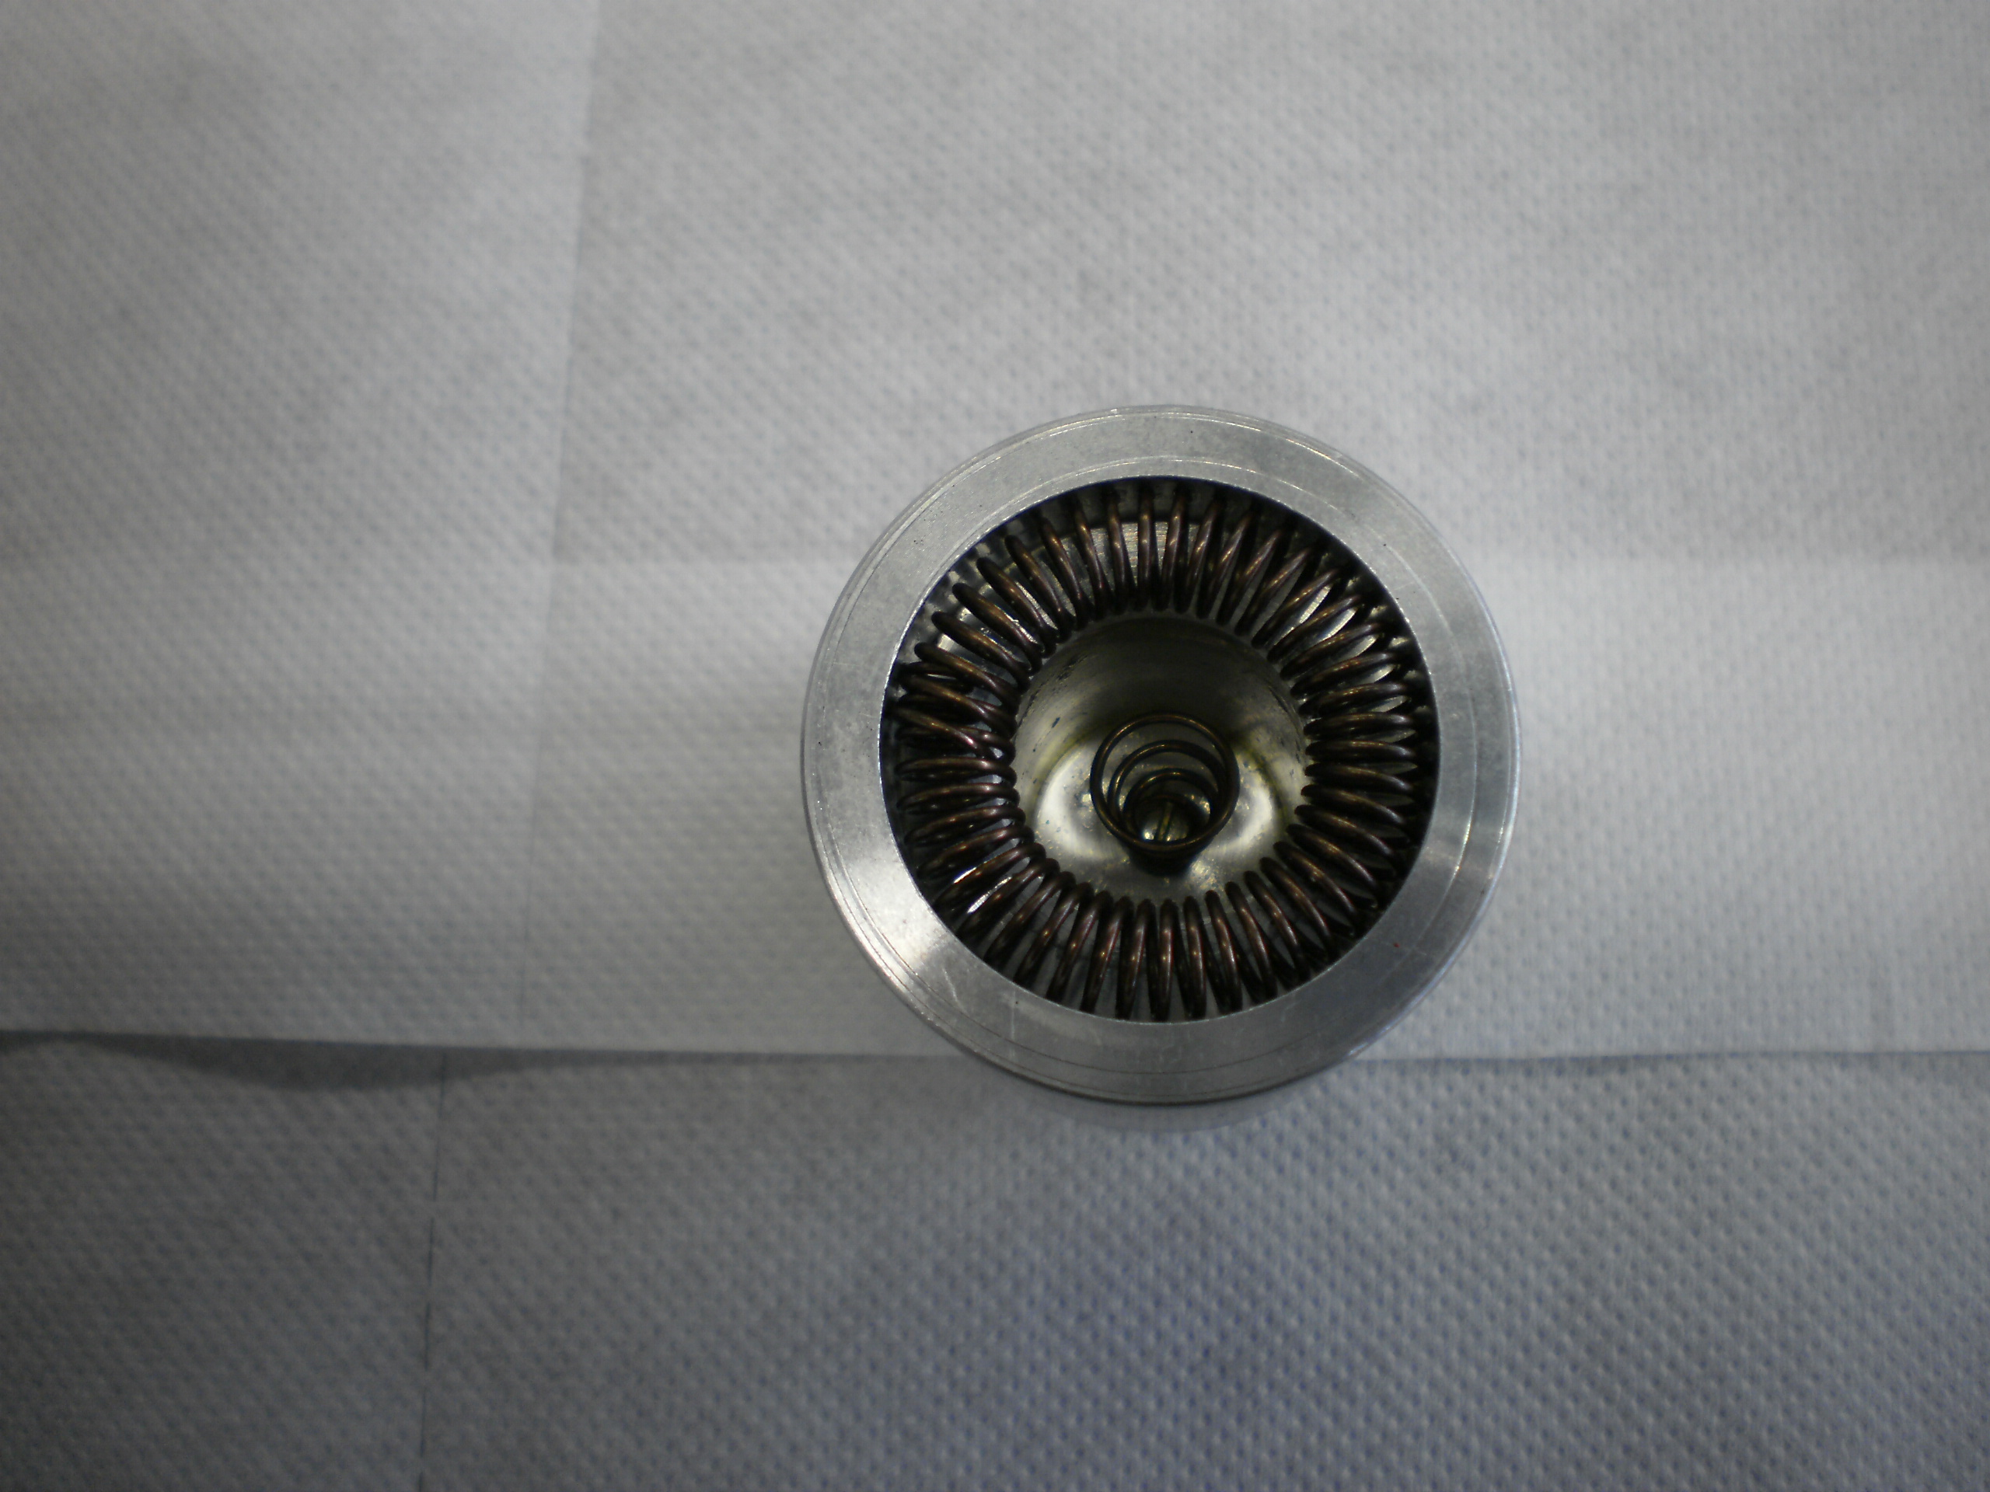
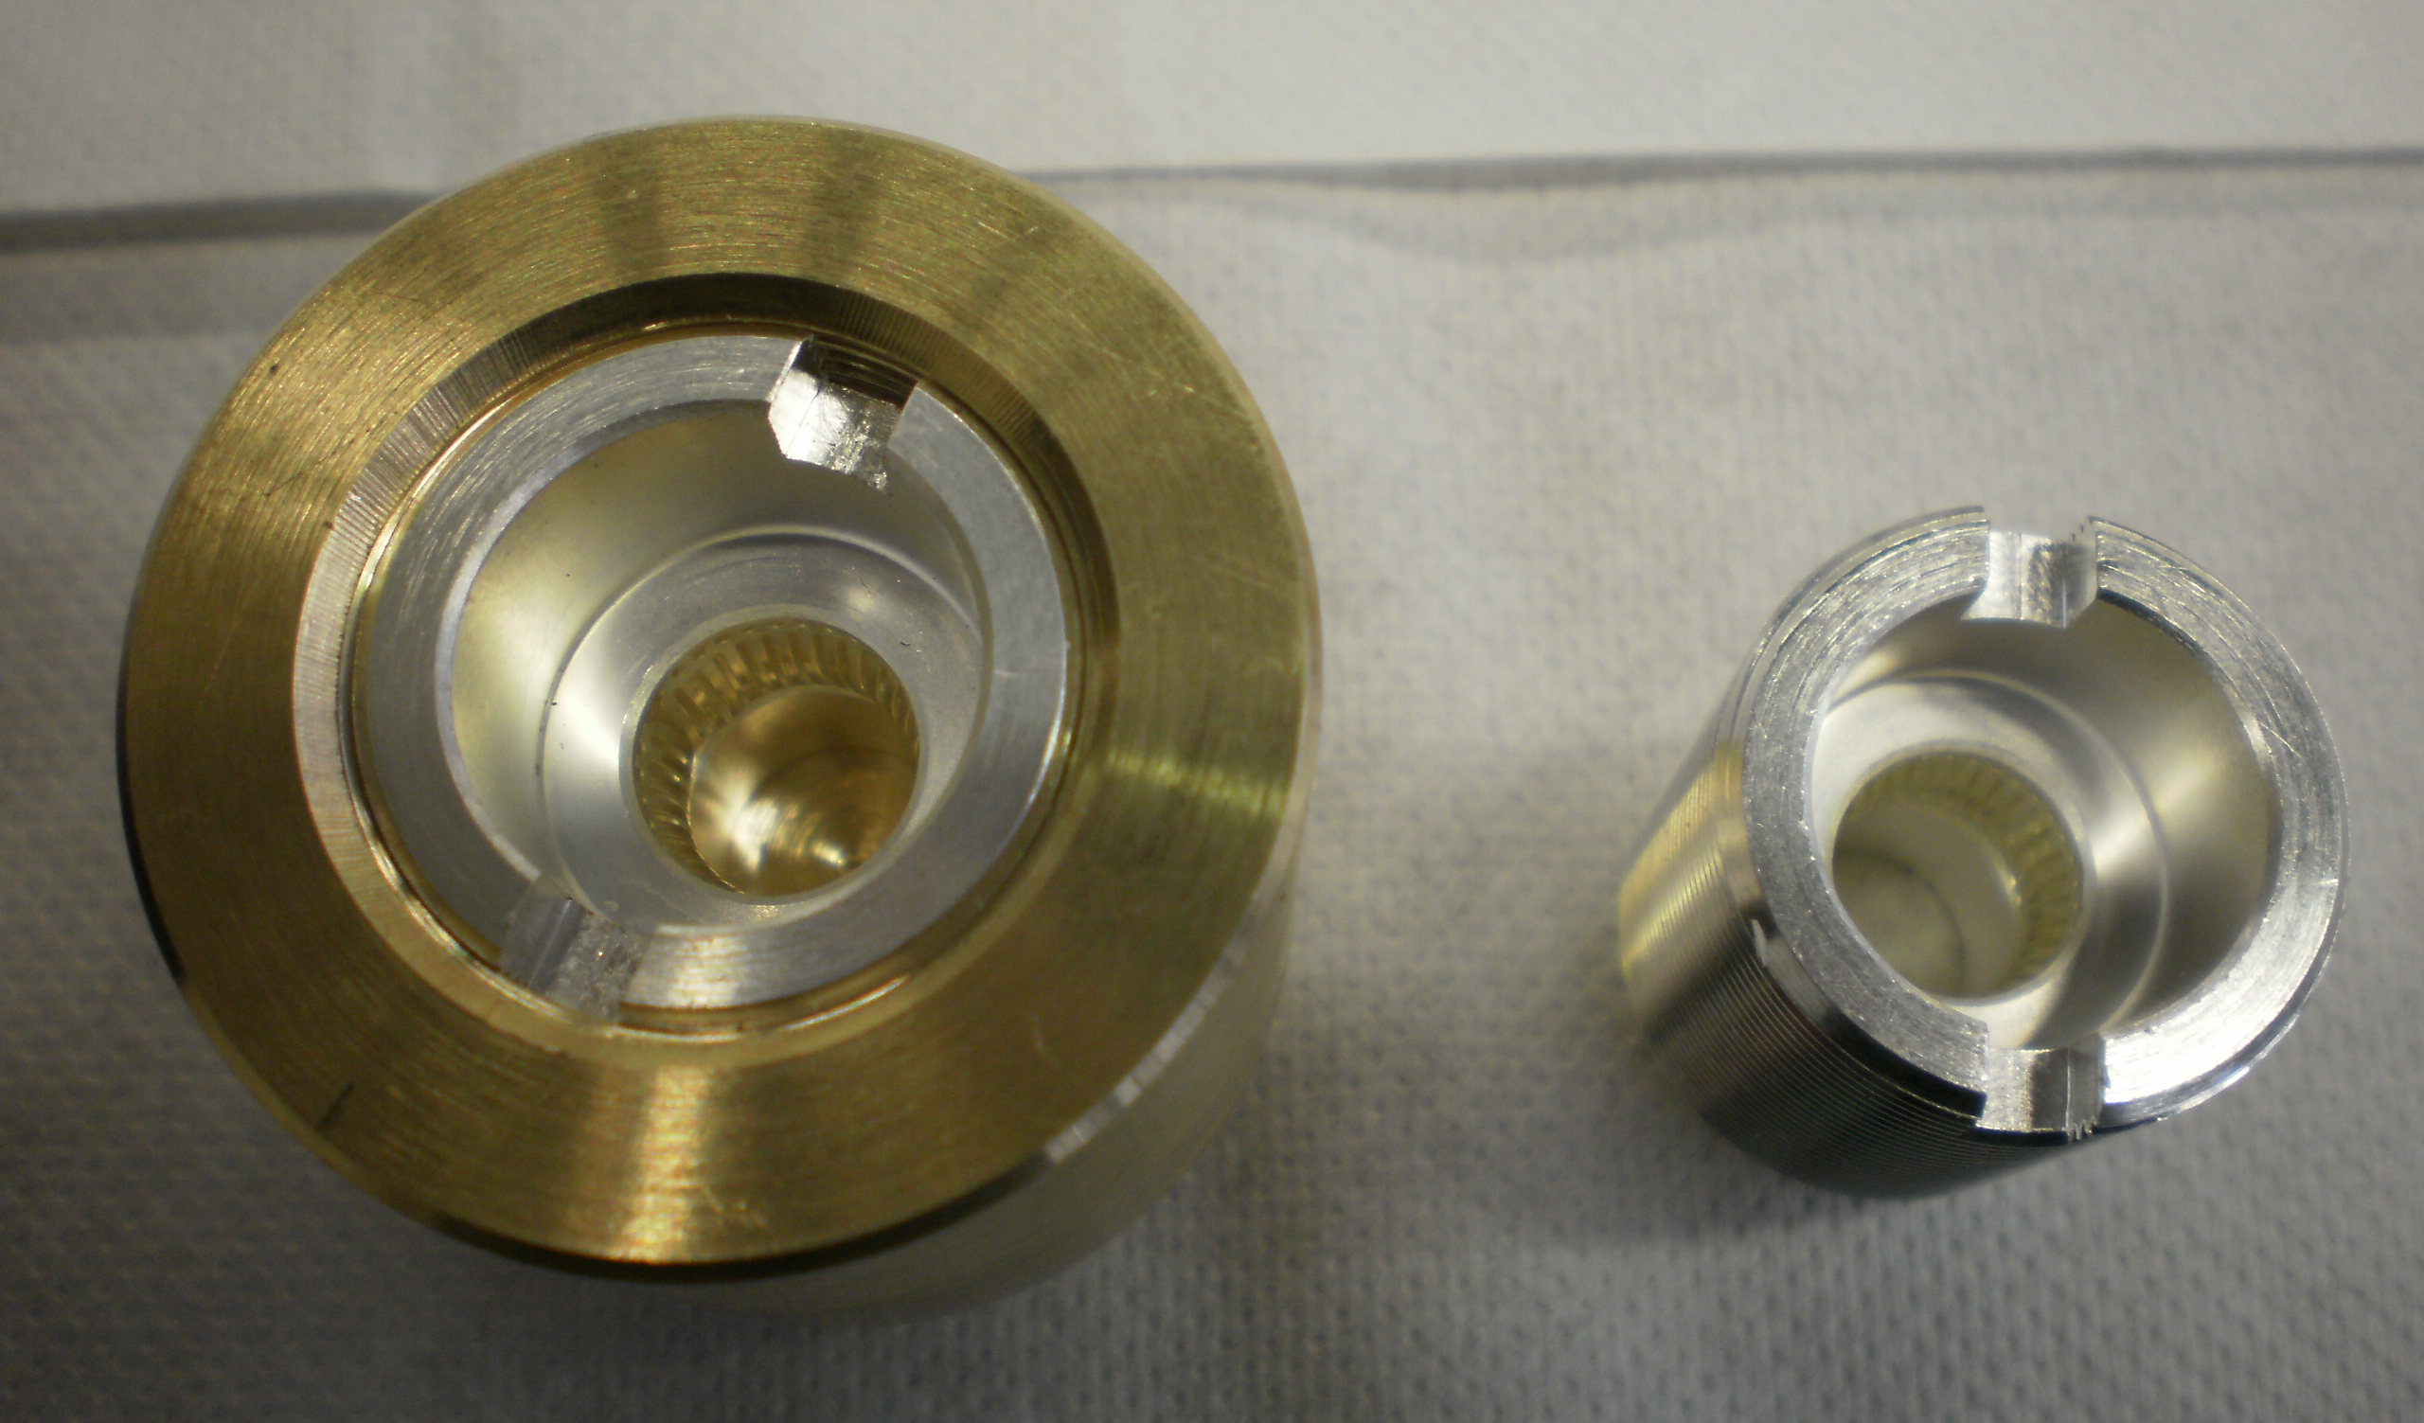
Klystron filament “I fil too low” faults
Second wondering
faulty : Filament
current interlocks
2 culprits identified:
  Several klystron HV connectors
    Spring contacts degraded (black deposit)
    Contacts needed to be cleaned repeatedly
    New connector design without springs,
    with special Multi-Contact installed
  Cable head defective welding…LS1

Slide 10
- Tools used for faults tracking
Equipment’s build with manual written logbook … scanned -> EDMS id 879141, 879146, 879150, 879151, 1082985
LHC commissioning with MS OneNote logbook
HMI Labview from FESA classes
LHC RUN 1 followed with OP and RF logbooks
  Rapid overview & general cmd on Delphine’s RF page
Faults tracking with LASER, post mortem TIMBER and RF specialist buffers in VME boards
PVSS for Cryo and Vacuum in monitor mode
Manual extraction and corrections for statistics

Slide 11
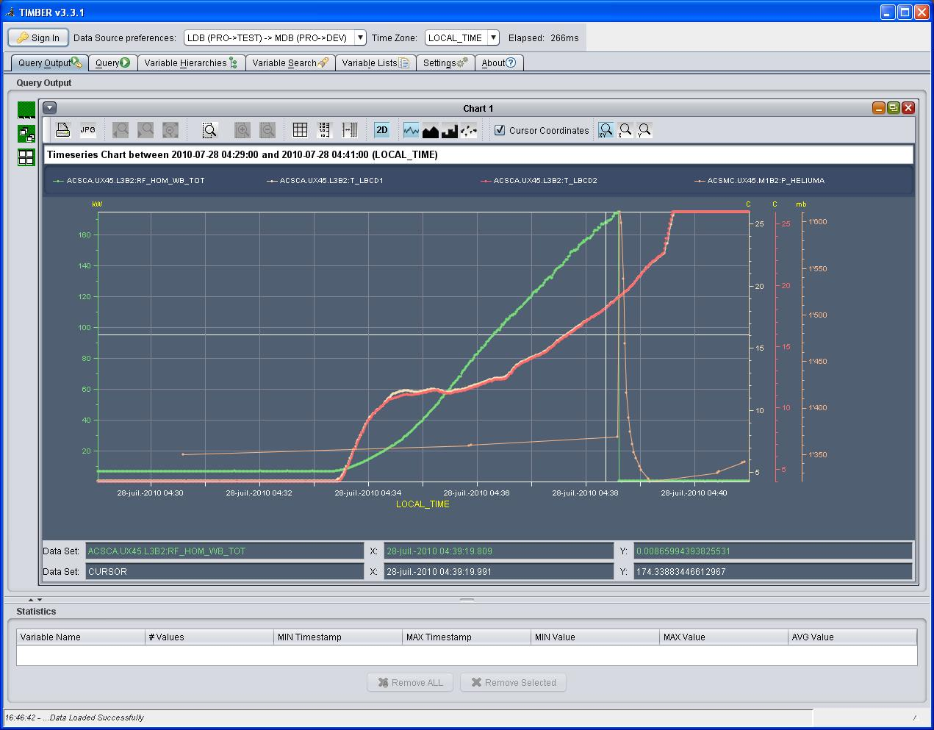
C3.B2 quench on HOM

Slide 12
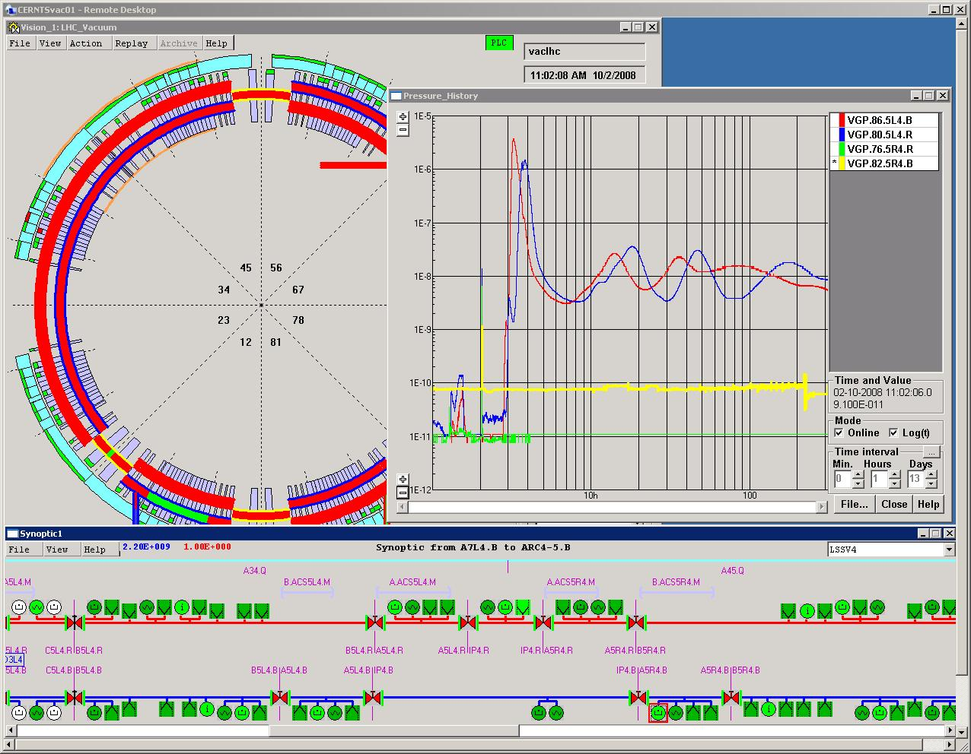
ACS modules Vacuum during 2008 incident

Slide 13
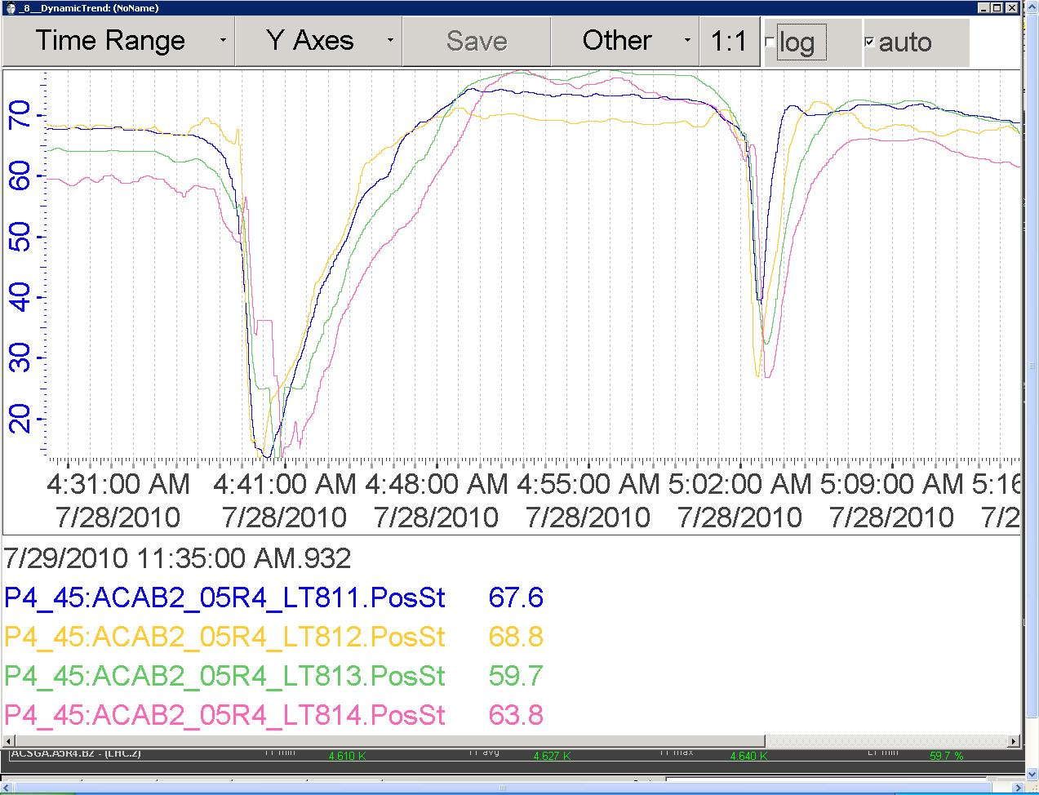
He liquid levels during C3.B2 quenches

Slide 14
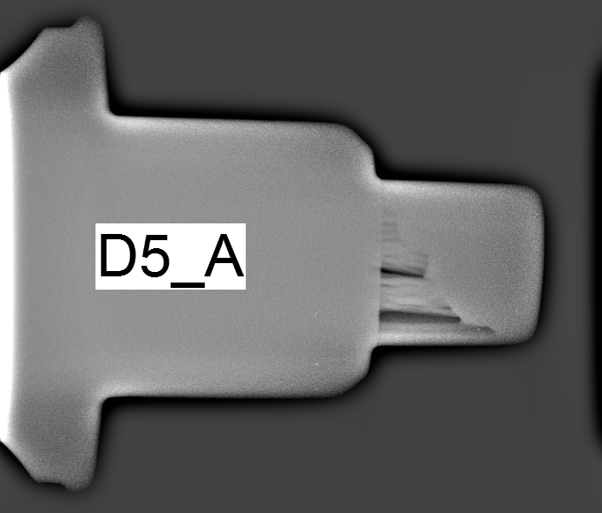
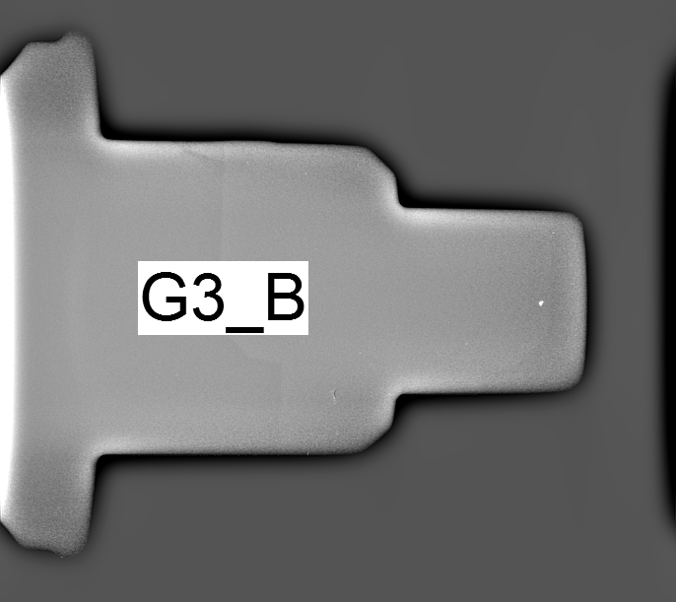
- LS1 ACS upgrades at PT4
New induction welding campaign on HV connectors
      Before After
8 last new klystrons/16 for nominal performance
  58 kV/9.5 A => 300 kW CW RF
4/4 new HV solid state crowbars
Maintenance campaign of ageing tetrode in modulator
New Air cooling of HV Bunkers
O. Brunner

Slide 15
- LS1 ACS upgrades at PT4 cont.
LHC ACS module M1.B2 to be replaced
  To overcome C3.B2 limitation at 1.3 MV acc. field
New version of PLC software UNITY V8
New version of FESA ?
Replacement of all Windows XP consoles
R2E
  ACS module Cryo control racks will be displaced
  UX451 PAD moved further away from tunnel
    Access with LHC-TNL, no LHC-RF list anymore

Slide 16
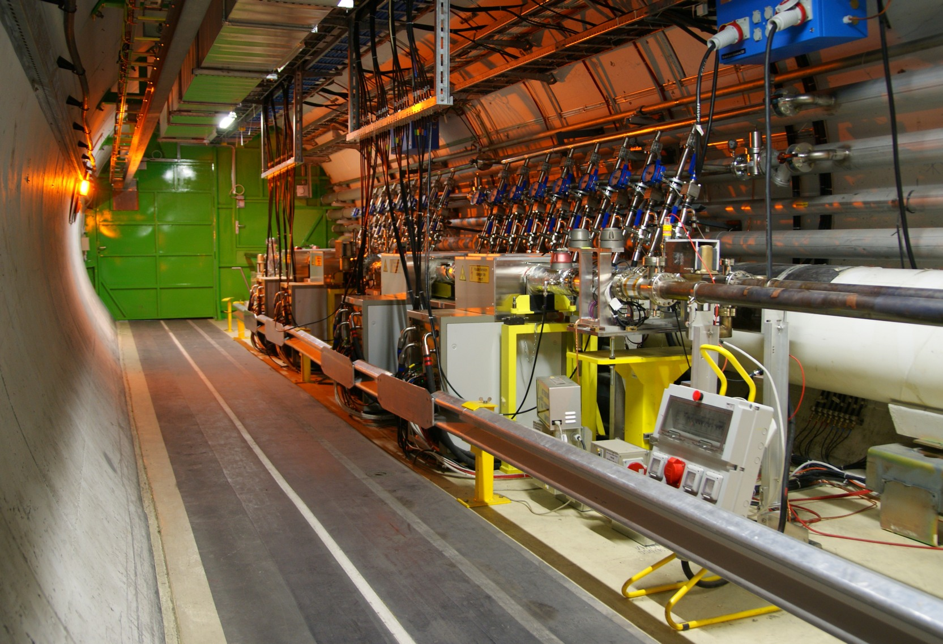
ADT vertical and horizontal kickers
Old Flow meters
Tetrode amplifiers

Slide 17
- LS1 ADT upgrades at PT4
New amplifier-kicker clamp
Improvement of the HVPS by adding HV switches allowing a remote off line of a faulty amplifier
New HVPS cables to avoid cable burning
Replacement of power attenuator with power load
New flow-meters in replacement to the old Eletta from LEP time
Adding redundancy to the problematic kicker vacuum interlock
E. Montesinos

Slide 18
- LS1 ADT Feedback upgrade
Large coax recabling campaign
Major upgrade of electronics to house all new features accumulated since 2009
Double the number of pickups, new upgraded beam position modules
Multiple output DACs:
  Independent treatment of different bunch groups (high/low gain, high/low bandwidth)
  Independent cleaning performance
D. Valuch

Slide 19
- Prospects for RUN 2
Restarting injectors & LHC … Delicate
  Safety for people and equipment
Scrubbing 25ns… No problem
  Scrubbing 5ns TBC see LBOC meetings
25 ns operation with nominal current…
  Promising, see presentations in Evian and Chamonix by P. Baudrenghien et al.
Klystrons at 58kV/9A instead of 50kV/8A
More flexibility in pickups and ADT functionality
Plenty of hope ☺

Slide 20
- Prospects for RUN 2
Equipment ageing ?
  Inspection during technical stops…
  ACS tuning cables inside insulation vacuum etc.
  New development to replace klystron modulator tetrode
  Dispersion of klystron age
Component obsolescence FPGA, DSP !
  So far enough VME spare boards…
Manpower for piquet’s ?
  Young students are friendly but CERN needs continuity and experienced staff !

Slide 21
- Tools that could help
FESA V? & TIMBER mandatory ready in time !
Remote monitoring from home very useful
  Remote control with piquet role ( gains time and avoids displacements )
  Down to expert PLC tools on TN via UNITY
More user friendly configuration of LASER ?
  Better “hierarchisation” of alarms, faults...
Automatic event logging in the RF logbook
  But editable for correction or addition of signals charts & comments => easier statistics
Replacement of Labview by Inspector BE/OP ?
  Parallel development during RUN 2

Slide 22
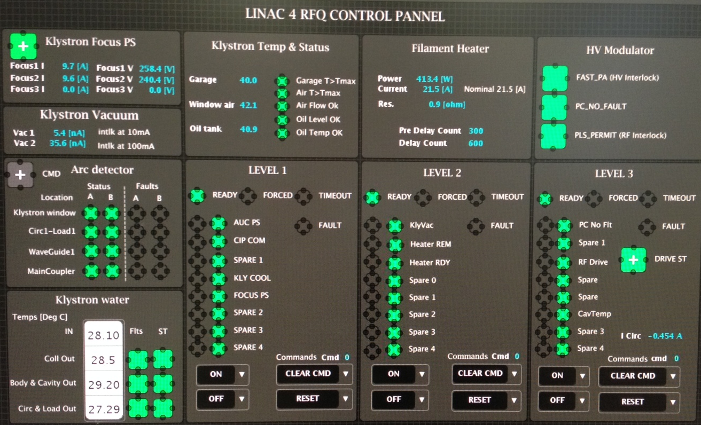
New Inspector display
Example for Linac 4

Slide 23
Thank you for your attention
Questions ?

Slide 24
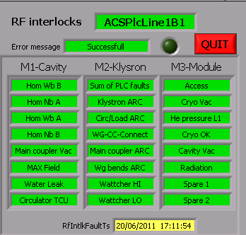
RF interlocks
Arc detectors
Higher order mode power
Access system
Cryo + Vacuum
Main coupler vacuum
Radiation
Reflected power

Slide 25
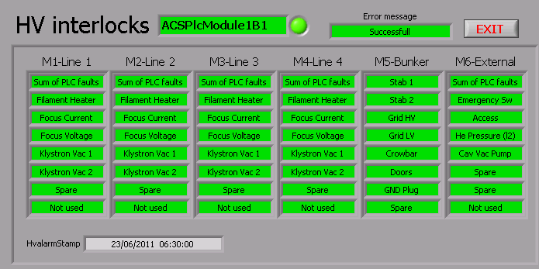
HV interlocks
Klystron faults
HV bunker faults
External faults

Slide 26
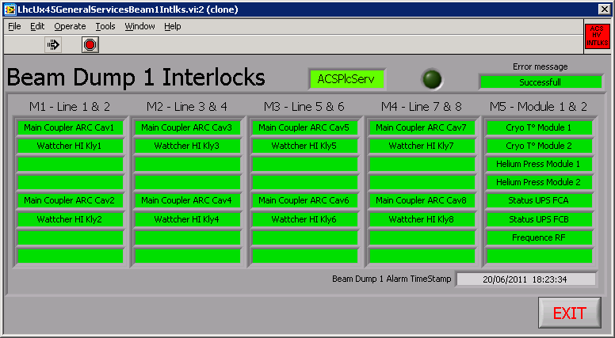
Interlocks connected to BIS (UX45)
Arc detector on Main Coupler
Sum of RF Veto interlocks
Fast Reflected Power (Wattcher HI)
He pressure (cavity quench)
RF Veto Module 1
RF Veto Module 2
Faraday cage power status
RF frequency interlock

Slide 27
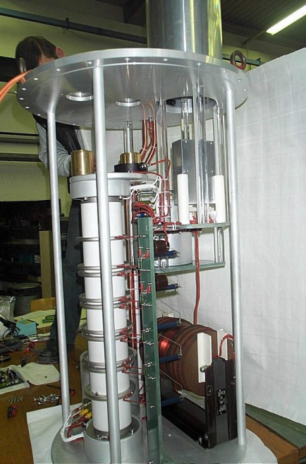

Solid state crowbars (“fast protection system”)
Gianfranco Ravida/S. Menoni
Sophisticate circuit
Water/oil Cooling
350 litters oil volume
Limited lifetime
Very simple circuit
No cooling (±10W)
90 litters oil volume
Solid State device has better performances than the thyratron
Validated during 2012 running period
In series production

Slide 28
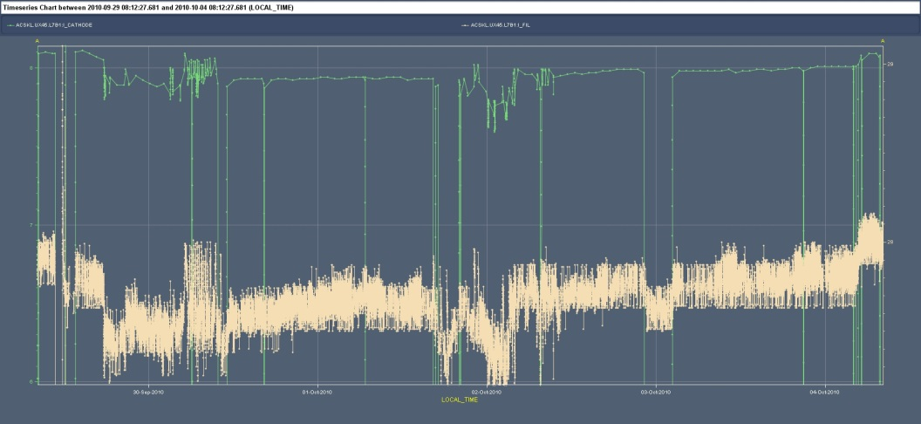
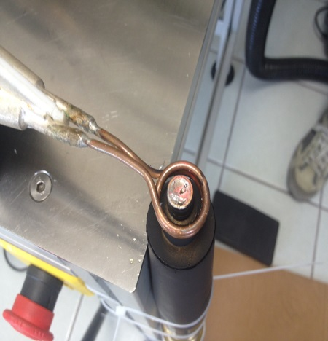
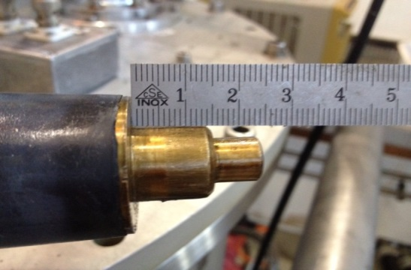
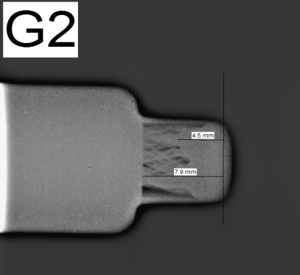

Repair of the high voltage connectors
P. Martinez-Yanez/G. Ravida
Zone with welding defect
Klystron filament glitches responsible for frequent RF trips during operation
Procedure validated to re-weld the connectors without damaging the insulation material
Campaign in LHC will soon be launched

Slide 29
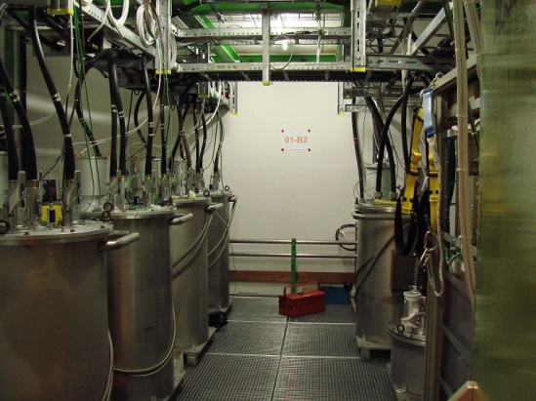
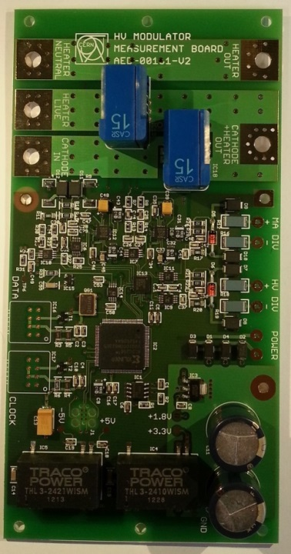
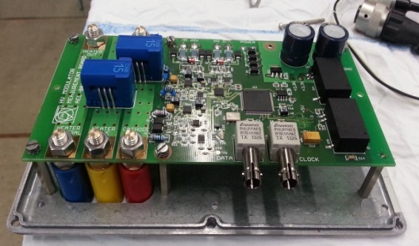
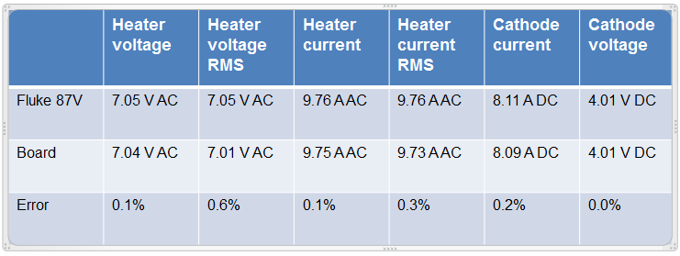
Digital measurement system for the klystron modulators
Anders Mikkelsen/D. Valuch/G. Ravida/S. Menoni
DCCT’s and tetrodes used in LHC are no longer produced by industry
Development of a FPGA based electronic located in HV modulator
  -> the crowbar survival challenge!
Prototype built: looks very promising
Evaluation tests for tetrode replacement
Zone with welding defect

