Slide 1
A. Herlert, CERN PH-IS
ISOLDE scientific coordinator’s report
INTC meeting, February 11, 2008
Impact of technical issues
Running statistics 2007
Report from GUI
Planning for 2008

Slide 2
Main problems affecting physics 2007
ISOLDE/CERN controls (not working properly since startup, also affecting target heating and separator magnets)
target HT (lots of tripping due to outgassing from target)
  60kV or 50kV operation not possible in some cases
REXTRAP (shortcut at trap electrodes and control software crash after WINDOWS/NICE update)
REX-LINAC scaling not working properly
  Difficult setup and probably lower yield
interventions for vacuum problems (especially during RFQ installation)
accidental change of beam focus

Slide 3
Main failures of physics program (I)
Broken target/ion source
      - CaO/MiniMono (#236) target/ion source failure
      stopped TISD run
      - ZrO/HP (#349) ion-source short cut
      IS442, IS450, and IS453 cancelled (7 shifts)
      - HfO/MiniMono (#363) overheating damaged ion source
      IS400, IS445, and test collections cancelled (13 shifts)
      - UC_{x}/q-n-RILIS(Cd) (#362) RILIS window "dirty"
      IS413 no Cd beam (8 shifts)
Target performance
      - UC_{x}/RILIS(Ag) (#322) large contamination with In, Cs, Ba
      IS413 hampered to reach neutron rich Ag isotopes (A>121) (8 shifts)
      - UC_{x}/RILIS(Pb) (#347) very low Pb yield (also due to p-beam-intensity limitation)
      not enough yield for IS413 and IS448 (8 shifts)
      - CaO/CP (#366) large ³⁵Cl contamination and REXTRAP cleaning not working
      IS433 hampered, no results (10 shifts)

Slide 4
Main failures of physics program (II)
REX performance
      - IS451 very low yield for ⁹⁶Sr¹⁹F (LINAC scaling?)
      IS411 reduced program, ¹⁴⁸Ba and ¹⁵⁰Ba not possible due to contaminations
      IS454 hampered due to lower ³⁰Mg yield
      IS452 stopped earlier due to crash of REX-TRAP control system
Limitation of p-beam intensity at GPS (max 1µA)
      - general issue for all GPS runs
      - IS417 very low ¹¹Li ion yield, managed to do physics due to higher efficiency of new detector system
      IS413 and IS448: Pb ion yield too low for physics
Vacuum problems
      - Leak at GHM prevented “parallel” collections
      - IS417 lost three shifts due to problems with vacuum system after intervention at merging switchyard (running in manual mode afterwards)
      - IS454 stopped for more than three shifts due to vacuum leak and intervention at merging switchyard

Slide 5
Requests for schedule 2007
Requested = 480 shifts
  Schedule allows up to 400 shifts
Maximum 10 new UC_{x} targets (+ developments)
  Requests ~ 260.5 shifts
RILIS operation
  Requests for 2007 amount to 249 experiment shifts
  More than 2000 hours on line (exp. + dev. + prep.)
REX-ISOLDE
  Beam requests = 205 shifts
Operations limited
Target development
ISCOOL installation and commissioning
Move of MINIBALL setup

Slide 6
ISOLDE schedule 2007
ISOLDE dates 2007:
protons started April 16
physics started April 20
protons stopped Nov. 12
29.5 weeks
for physics
30 experiments
(7 REX runs)
24 target units
(4 old units)
12 UC_{x} targets
(2 old units)

Slide 7
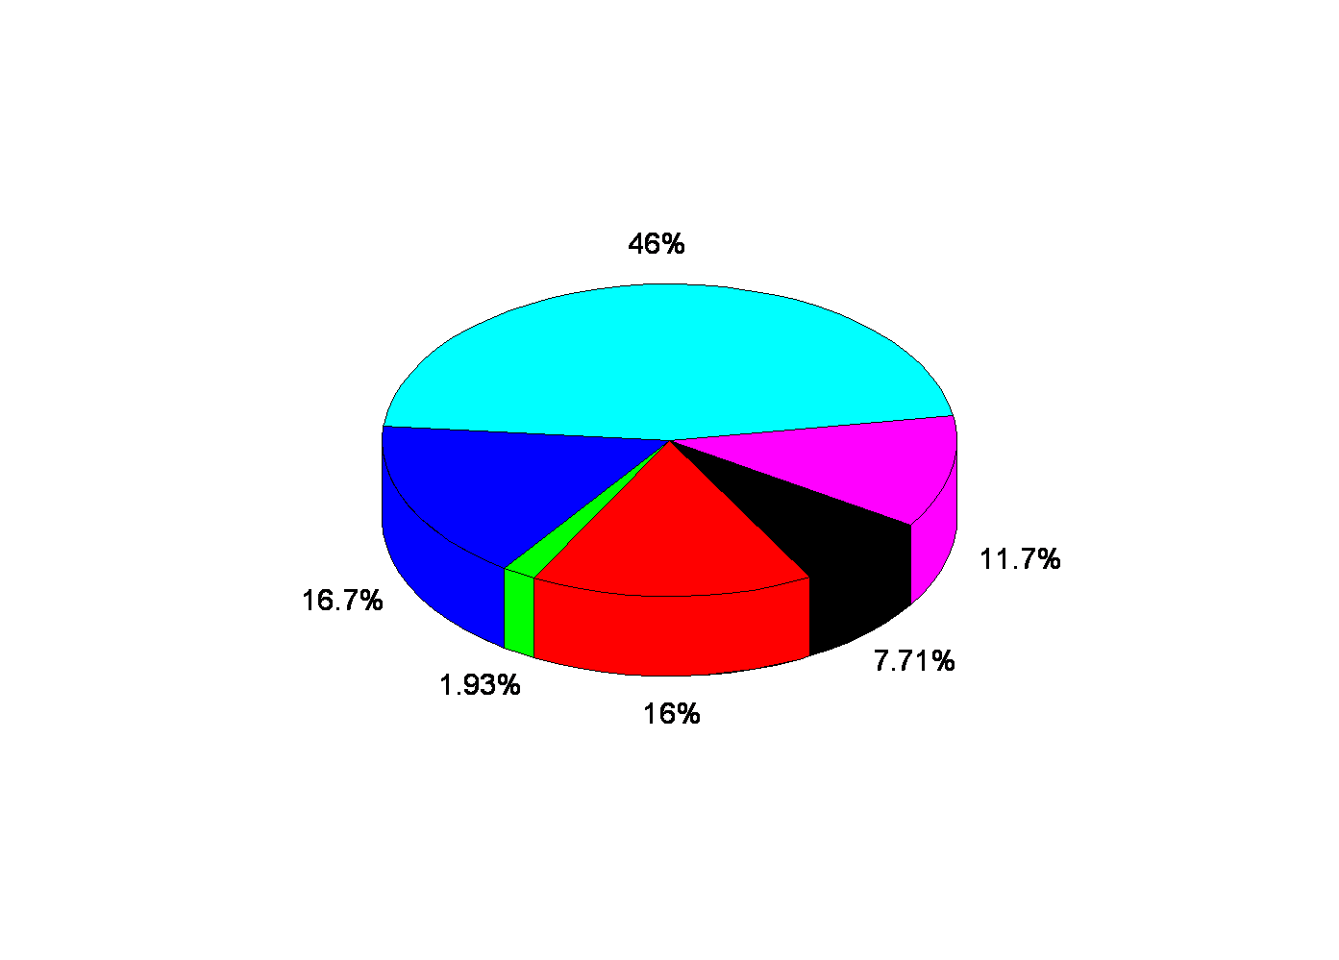
Allocated shifts in 2007
480 shifts requested in 2007
407 shifts scheduled for INTC experiments
(in total 467 shifts, including TISD, ISCOOL, etc.,
with 261 shifts on GPS and 206 on HRS)
Weak Interaction and
Nuclear physics
Solid state physics
REX MD, TISD
exp. developments
Particle and Astrophysics
Biophysics
Atomic physics
experiments

Slide 8
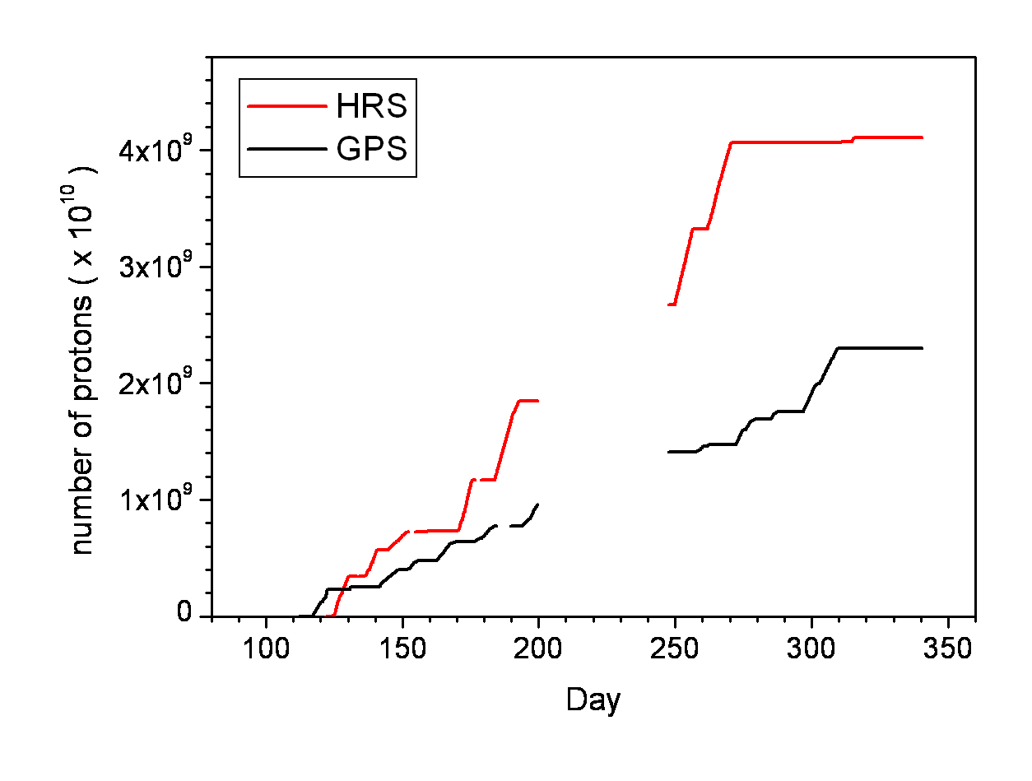
ISOLDE beam time summary 2007
ISOLDE delivered 377.5 RIB shifts
  292 (77.4%) for INTC experiments
  85.5 (22.6%) other
    Standard target check + TISD + REX-MD
    Coordinators reserve: debugging, recovery, LoIs
  30 research projects (“experiments”)
  Integrated # protons = 6.41E+19
    Below 2E+20 radioprotection
    average limit
    limitation of GPS proton beam
    intensity (activated air release)
  Installation of ISCOOL RFQ
  Running for 207 days
    One week no beam for ISCOOL
    installation

Slide 9
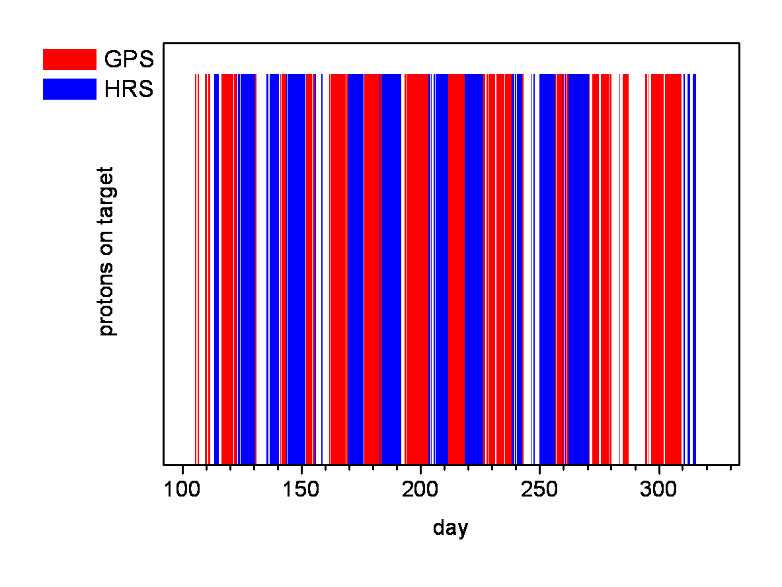
RIB overview GPS/HRS 2007
CaO
target failure
ZrO
target failure
REX
MD
HfO
target failure
Target change
(HRS off)
ISCOOL
(GPS + HRS off)
61% of possible
RIB shifts used
(1.82 shifts/day)
(55% in 2006)
207 days
of operation
on/off-time from
radiation monitors

Slide 10
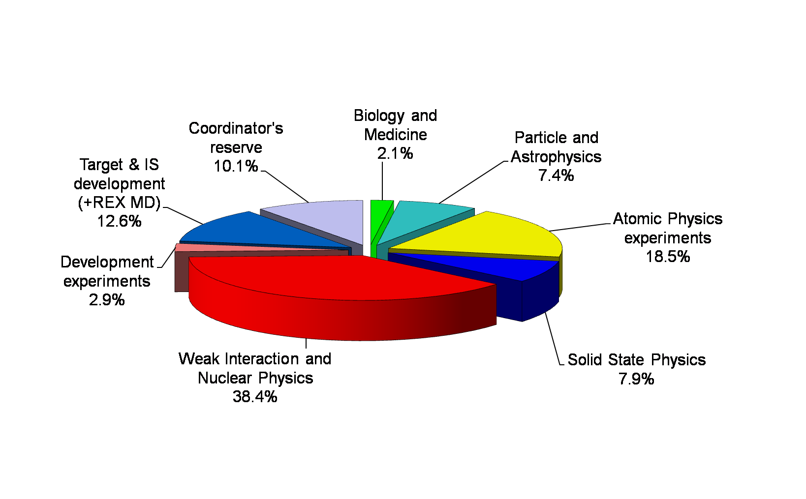
ISOLDE shift distribution 2007

Slide 11
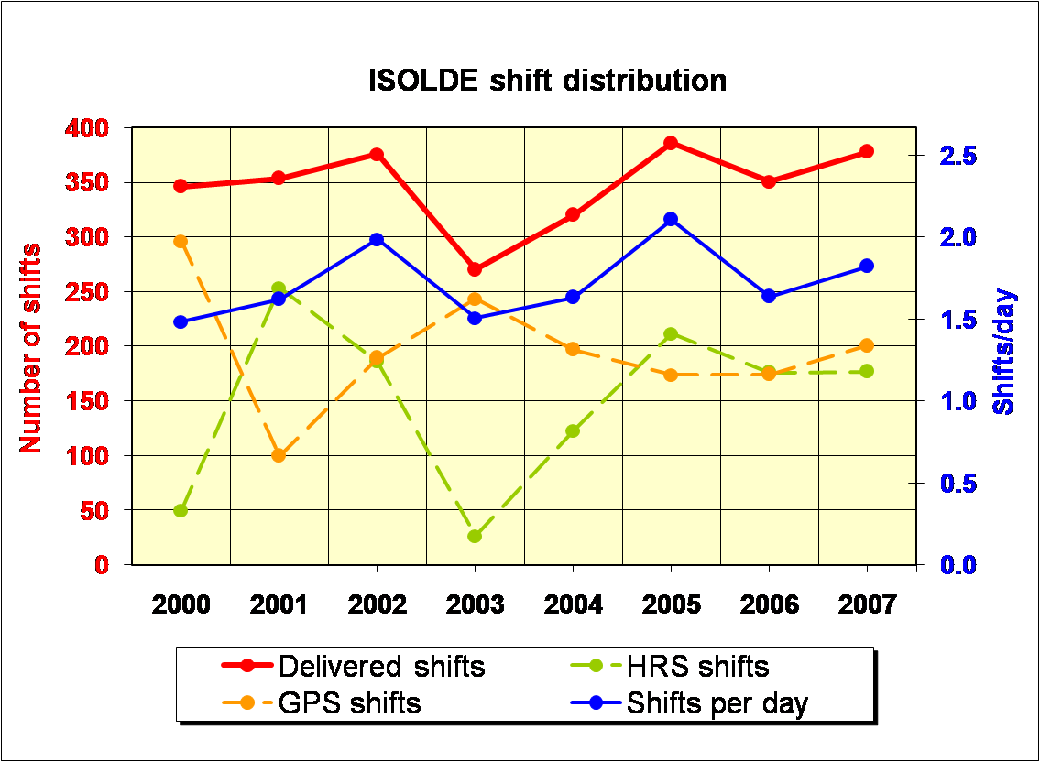
ISOLDE shift distribution 2000-2007

Slide 12
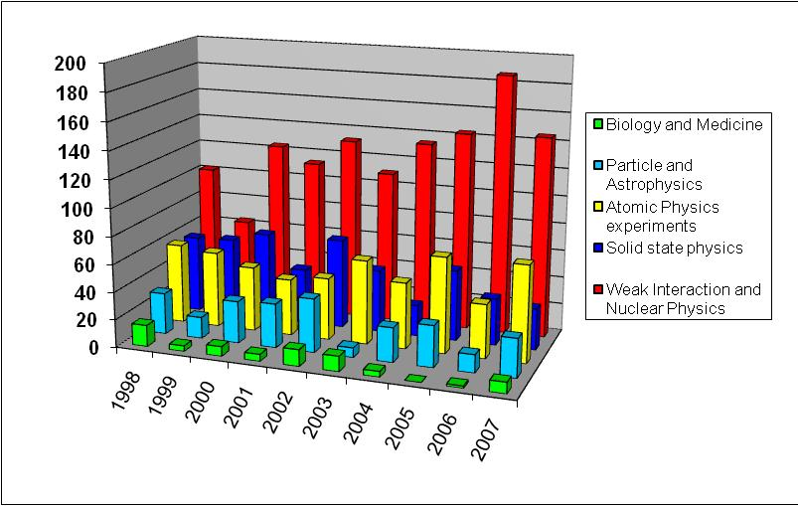
Shift distribution 1998-2007
Number of shifts

Slide 13
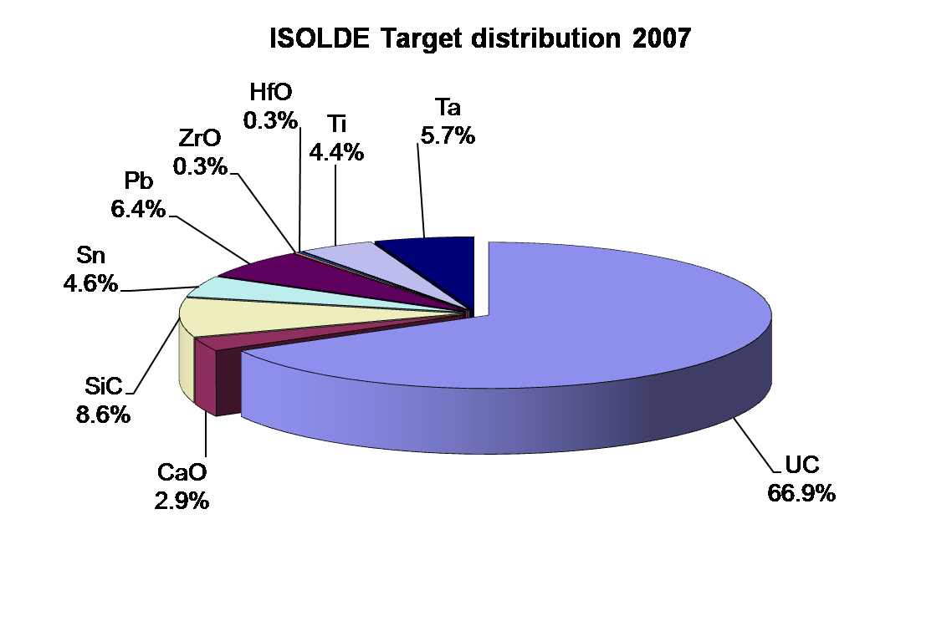
Key resources: targets
Actinide targets
  252.5 shifts (out of 377.5) [67%]
  10 new units (+ 2 old)
In total 24 targets
  20 new units

Slide 14
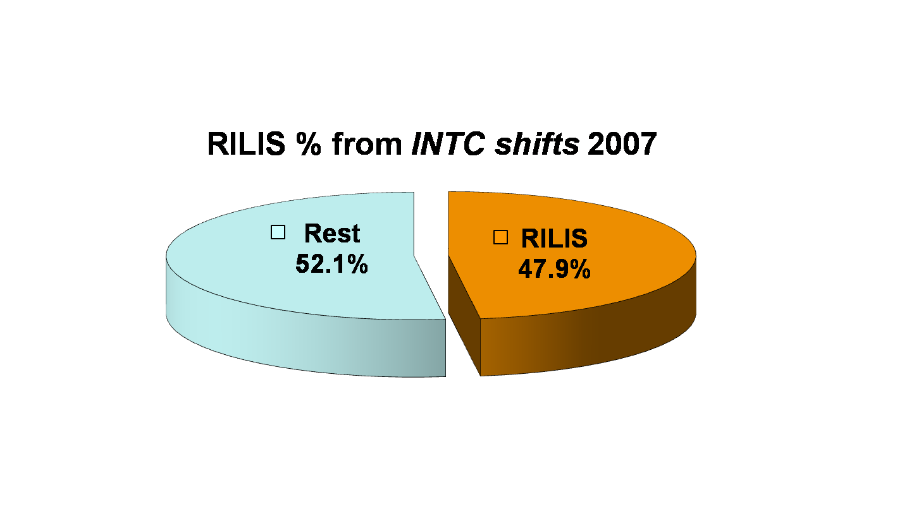
Key resources: RILIS
154.5 total RIB shifts
  146.5 shifts for INTC shifts
1763 hours for online work
  includes setup, yield checks, etc.
14 IS experiments
Beams: Ag, Mg, Pb, Mn,
Cu, Po, Cd

Slide 15
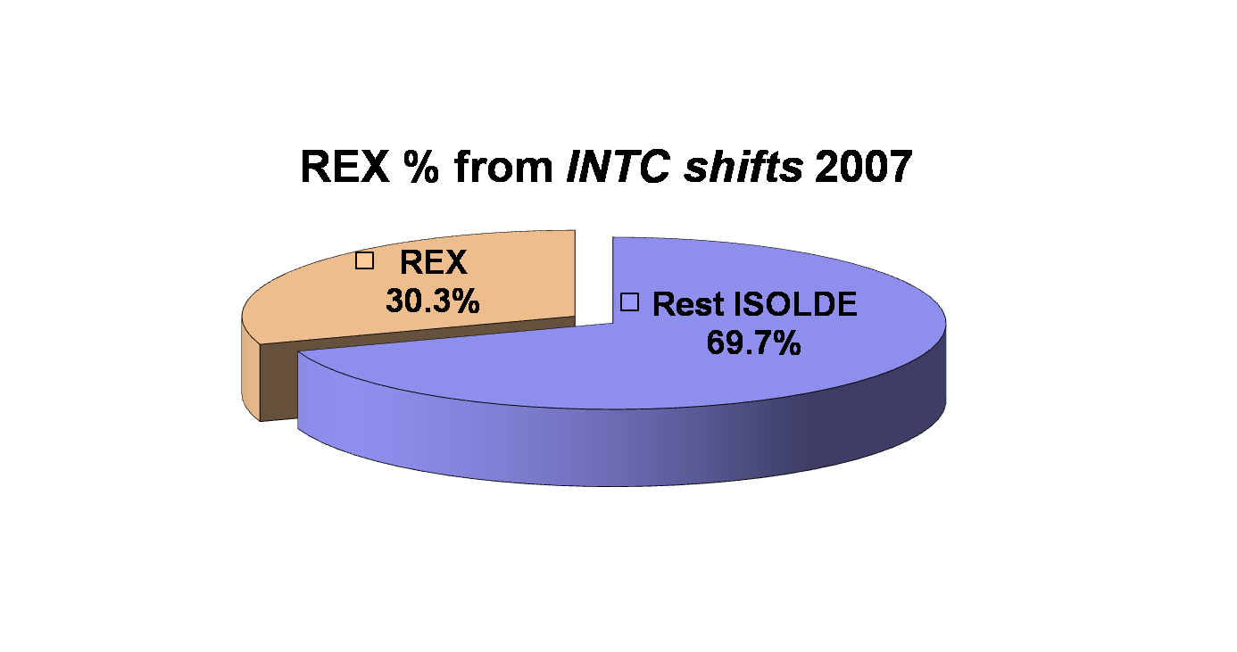
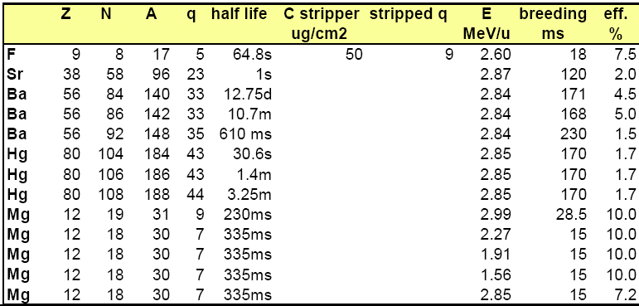
REX-ISOLDE 2007
88.5 RIB shifts delivered to experiments
  + 6 RIB shifts for development
  7 experiments
  REX-ISOLDE training
  for machine supervisors
E ≤ 3 MeV/u
  E=2.99 MeV/u (³¹Mg)
Efficiency
  Range 1.5% - 10%

Slide 16
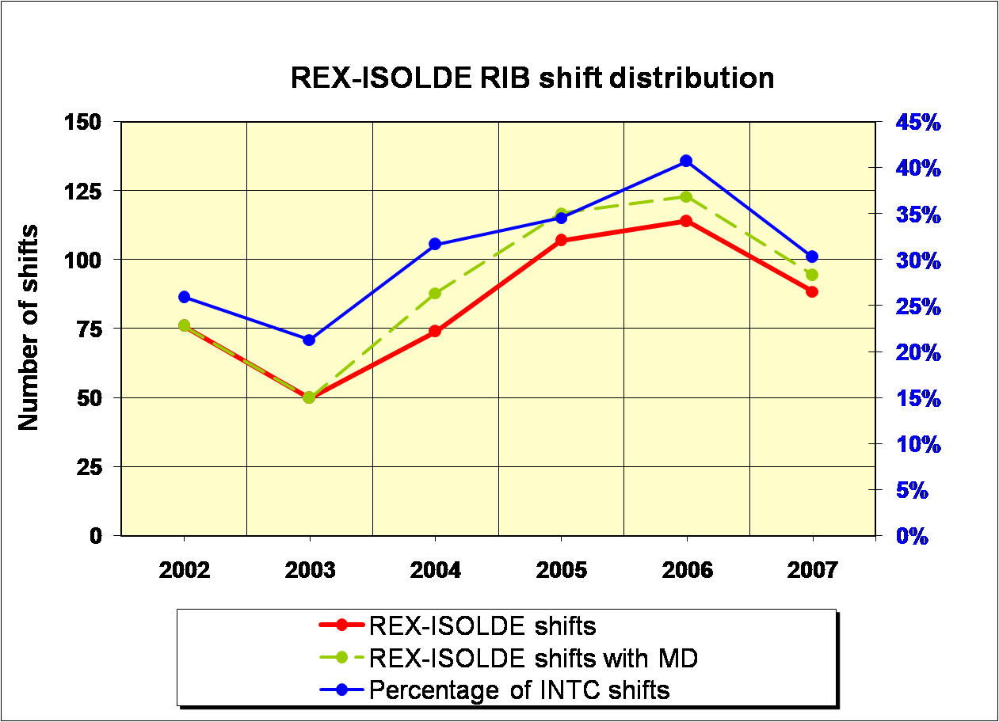
REX-ISOLDE 2002-2007

Slide 17
REX ISOLDE 2007 – new beams
New REX radioactive beams for Physics in 2007
  ⁹⁶Sr²⁷⁺
  ^{140,142,148}Ba^{33+,33+,35+}
  ^{184,186,188}Hg^{43+,43+,44+}
New record for heavy masses
  ²³⁸U⁵⁶⁺ accelerated (A/q = 4.25, T_{breed} = 500 ms)
  ^{184,186,188}Hg accelerated to 2.8 MeV/u
So far 53 radioactive isotopes of 20 elements
3 new elements and
7 new radioactive isotopes

Slide 18
Highlights 2007
See ISOLDE workshop December 2007
  IS414 first proof of shape coexistence at the borderline
  of the 'Island of Inversion‘ - second 0⁺ state in ³⁰Mg
  IS454 d(³⁰Mg,³¹Mg)p transfer reaction at REX/MINIBALL
  IS409/410 Coulex of ³¹Mg
  IS452 Coulex of ^{184,186,188}Hg
  IS456 Spectroscopy of neutron-deficient Po isotopes
  using the ISOLDE RILIS
  IS413 first direct mass measurement of ⁹⁹Cd
  IS439 ^{71,72}Cu Spin determination and magnetic and
  quadrupole moment
  first on-line emission channeling experiments
  first ISCOOL results – cooled ion bunches for spectroscopy
  …
and ISOLDE Newsletter (coming soon …)

Slide 19
Standing group for the upgrade of ISOLDE (GUI)
Target priorities
First priority: approved experiments
Second priority: letters of intent
Third priority: research and development
http://isolde-upgrade.web.cern.ch/isolde-upgrade

Slide 20
TISD runs in 2007
Four dedicated
TISD runs:
CaO / CP bivalve
CaO / MiniMono
HfO / MiniMono
UCx / q n W RILIS
+
yield measurements
throughout the year

Slide 21
Target and Ion Source R&D (last meeting)
Priority 1
IS451: SrF⁺ REX
IS452: Hg REX
IS413: (Add): ¹⁴O
P225: Ge/Se beams
P228: ⁷²Kr [not recommended, but INTC requests high priority]
P231: LIST - ⁶²Ga
P232: Fr suppression (Hg/Tl)
Priority 2
P230: Rare earth beams (fluorides) for mass measurements
I70: ⁴⁴Ti
Priority 3
Negative beams (³⁰S) combined with ISCOOL

Slide 22
Target and Ion Source R&D (last meeting)
Priority 1
IS451: SrF⁺ REX TESTED (NOT OK)
IS452: Hg REX DONE
IS413: (Add): ¹⁴O
IS458: Ge/Se/Sr molecular beams PARTLY TESTED (NOT OK)
P228: ⁷²Kr [not recommended, but INTC requests high priority]
IS462: LIST - ⁶²Ga
IS463: Fr suppression (Hg/Tl) TESTED (UCx quartz)
Priority 2
IS461: Rare earth beams (fluorides) for mass measurements
I70: ⁴⁴Ti UNDERWAY
Priority 3
I71: Negative beams (³⁰S) combined with ISCOOL

Slide 23
Target and Ion Source R&D (additions)
Priority 1
IS459/P227: Yield measurement for ^{105,107}Sn
IS433: purification of ³⁵Ar beam (observed large ³⁵Cl contamination during 2007 run with CaO / CP target)
IS435: reduction of ⁷⁵Ga background in ⁷⁵Cu beam
IS411: ¹⁴⁸Ba, reduction of contaminations
Priority 2
P226: Yield measurement for ¹²⁸Cd
I51: ²²Mg beam, cleaning of ²²Na (+ REX cleaning)
Priority 3
UC_{x} target development and temperature controlled transfer (trapping material screening, i.e. other elements to be frozen out)

Slide 24
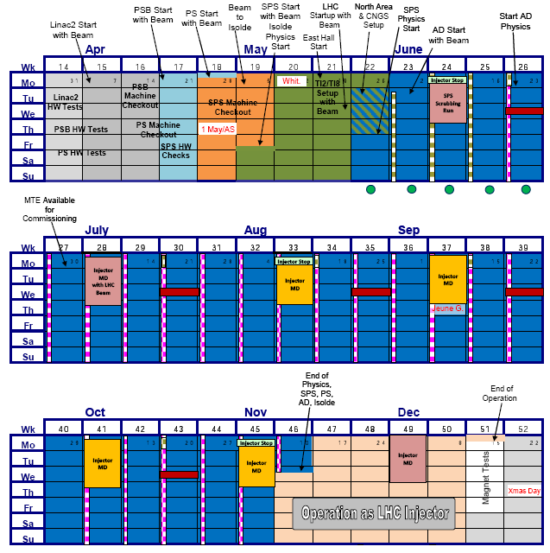
Accelerator schedule 2008
Approved by CERN Research
Board November 28, 2007
ISOLDE dates:
protons from PSB May 5
physics start ISOLDE May 7
protons stop November 12
(i.e. 27 weeks for physics)
Expected frequent changes
of supercycles (as 2007)
Several long periods of MD
without protons to ISOLDE

Slide 25
ISOLDE schedule/operation 2008
Limits in key resources
  RILIS (installation of new solid state lasers)
  UC_{x} targets
REX operation
  MINIBALL ready for Physics June 1
Schedule:
  470 RIB shifts left for approved experiments
  New proposals and addenda at February INTC meeting 2008
  ISCOOL operation (further tests, optimization for users, …)
  Long supercycles
  Several proton beam cuts due to MD periods at PS and SPS (each up to a duration of 3 days)
New Solid State Physics Lab
  In building 115, ready for operation in 2008

Slide 26
Safety at ISOLDE
New safety structure
    GLIMOS (Group Leader in Matters Of Safety)
    ISOLDE GLIMOS (ISOLDE Physics Coordinator)
    Deputy GLIMOS (ISOLDE Physics group leader)
    Nominating Installation Supervisors for larger experimental
    installations (ISOLTRAP, COLLAPS, NICOLE, ...)
Safety courses
    Basic safety course (mandatory)
    Laser safety course (will become mandatory ???)
    New Radioprotection course (Part I+II) to obtain dosimeter
    Special Radioprotection course (web-based course for ISOLDE)
    Cryogenics safety course (recommended)
    Bridge crane used restricted (new rules for access)

